Slide 1


An-Najah National University
Faculty of Eng. & IT
MIS Department
AL-QASEM OF SOLAR ENERGY
Submitted To
Dr. Najwan Al-Dalaq
Developing Team
1.Obaida Aziz
2.Majd al-haj Qasem
2021

Slide 2
The Historical Review:
Al-Qasem Company started its activity in the field of energy applications since 2011. Al-Qasem Solar Energy Company was established as a Palestinian company specialized in alternative energy systems in 2018 under the number 562305813, and we have been accredited by the Ministry of National Economy and the Tulkarm Chamber of Commerce and Industry and from several official departments.
Since our establishment, we have been seeking and aspiring to reach the best levels of solar energy uses and applications locally through our various and distinctive services. Thanks to God Almighty, we were able to achieve a prominent position at the local level in installing solar energy devices and equipment for domestic, industrial and agricultural applications.
As a result, the company expanded in the local market to build a strong base that enables it to practice its business and serve our community in most areas of Palestine through staff affiliated with the company and allied companies inside Palestine that install solar systems.

Slide 3
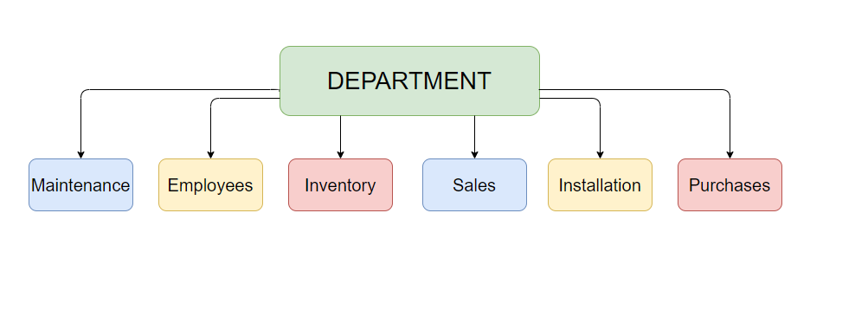
The Organizational Structure:
Maintenance
Employees
Inventory
Sales
Installation
Purchases

Slide 4
Tangible Objectives:
Inserting customer’s data accurately like the customers’ contact details (Name, ID, Number, location). Also to insert details about orders (Product type, Product number, Quantity, Orders’ due date) .
Enable Data Editing [Insert, Update, Select, Delete].
Printing all types of ad-hock reports such as Account and Contact Reports, Sales Reports, number of orders per day/week/month, Financial reports and so on.
Logging out of the system, as simple as this step is, but it’s a very critical.

Slide 5
Intangible Objectives:
Linking data of customers & orders (services) with each other.
Enable accurate planning for future.
Develop data integrity.
Save time and effort.

Slide 6
The Mechanism of the Current Manual System
The current system goes as this:
When a customer requests an order, they do it by phone then the order is registered manually on a notebook the Name, phone number and address.
Where the request is sent to the installation department and also it is to go to the site and take the necessary measurements for the installation space and the request is sent back to the engineer in order to perform some simple procedures.
After obtaining the approval from the engineer, the measurements are given to the plumber in order to create the bases for the solar cells. After that, the request is sent to the inventory department where all the devices are examined and prepared for installation and then communicate with the plumber to make sure that the bases are established.
If the goods are not available in the warehouse, the order is spoken and sent to the suppliers and upon arrival the equipment, cells and wires are prepared and sent to the location and start work.

Slide 7
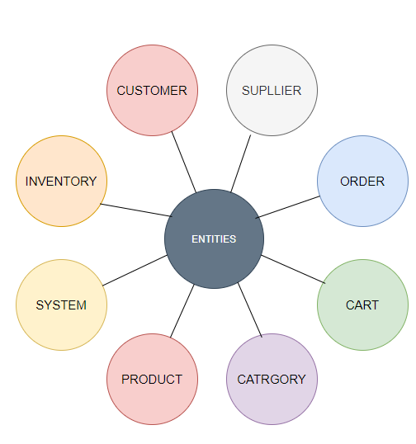
Entities of the system:
•Inventory
•Customers
•Suppliers
•Orders
•System
•Product
•Category
•Cart

Slide 8
Problems with the Current System:
Difficulty accessing files and wasting time and effort.
Files may easily be damaged or lost.
The problem of misunderstanding or mishearing the orders.
The problem of missing or forgetting the dates of delivering products to customers.
The difficulty of organizing and managing processes

Slide 9
Services We Will Provide to the System:
Design, supply, installation and operation of solar electric projects (photoelectric cells, inverters, and any other requirements).
Maintenance, follow-up and supervision of the installation.
Providing technical consultations and economic feasibility studies related to solar energy and its applications.
Supplying solar cells and inverter to the local market.
Use an automated solution (by using forms that customers can fill to place orders, that will immediately check the database of the available inventory etc…).
Monitor inventory consistently.
Saving employee time and effort.

