Slide 1
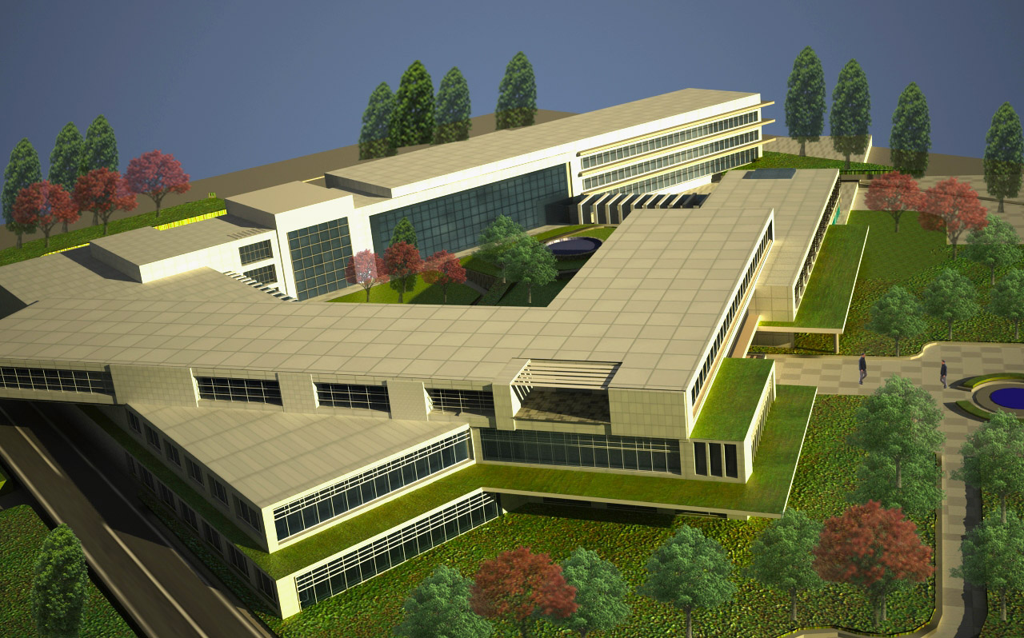
General hospital
Designed by: Tamara adnan khudareiah
Supervised by :Dr. Khaled qamheya Dr. Hasan al qadi arch Areej afifi

Slide 2
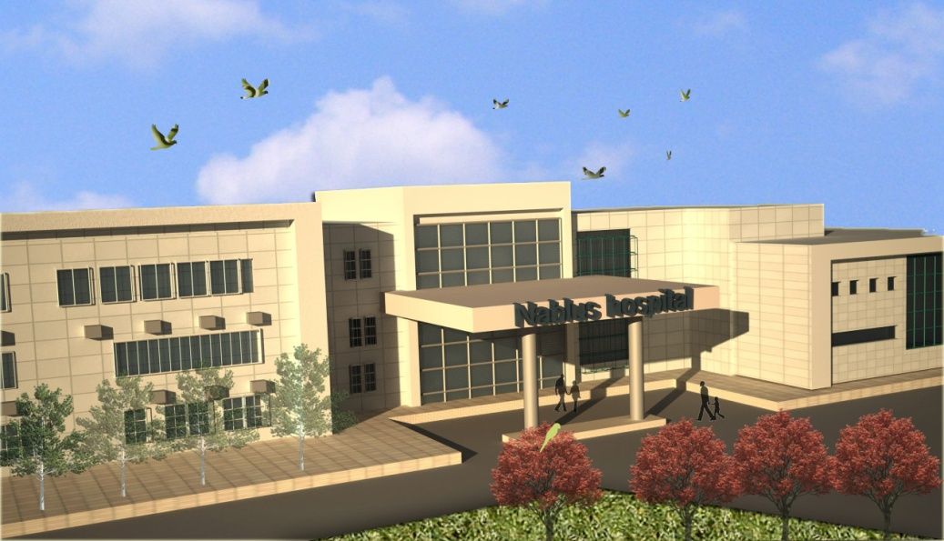
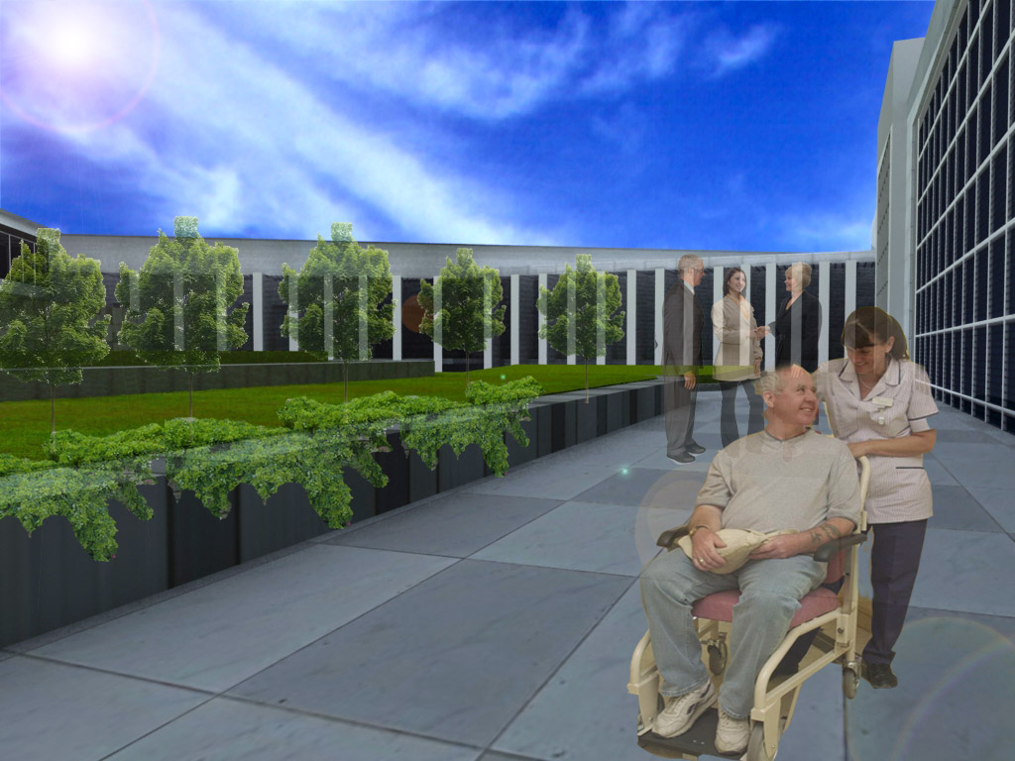
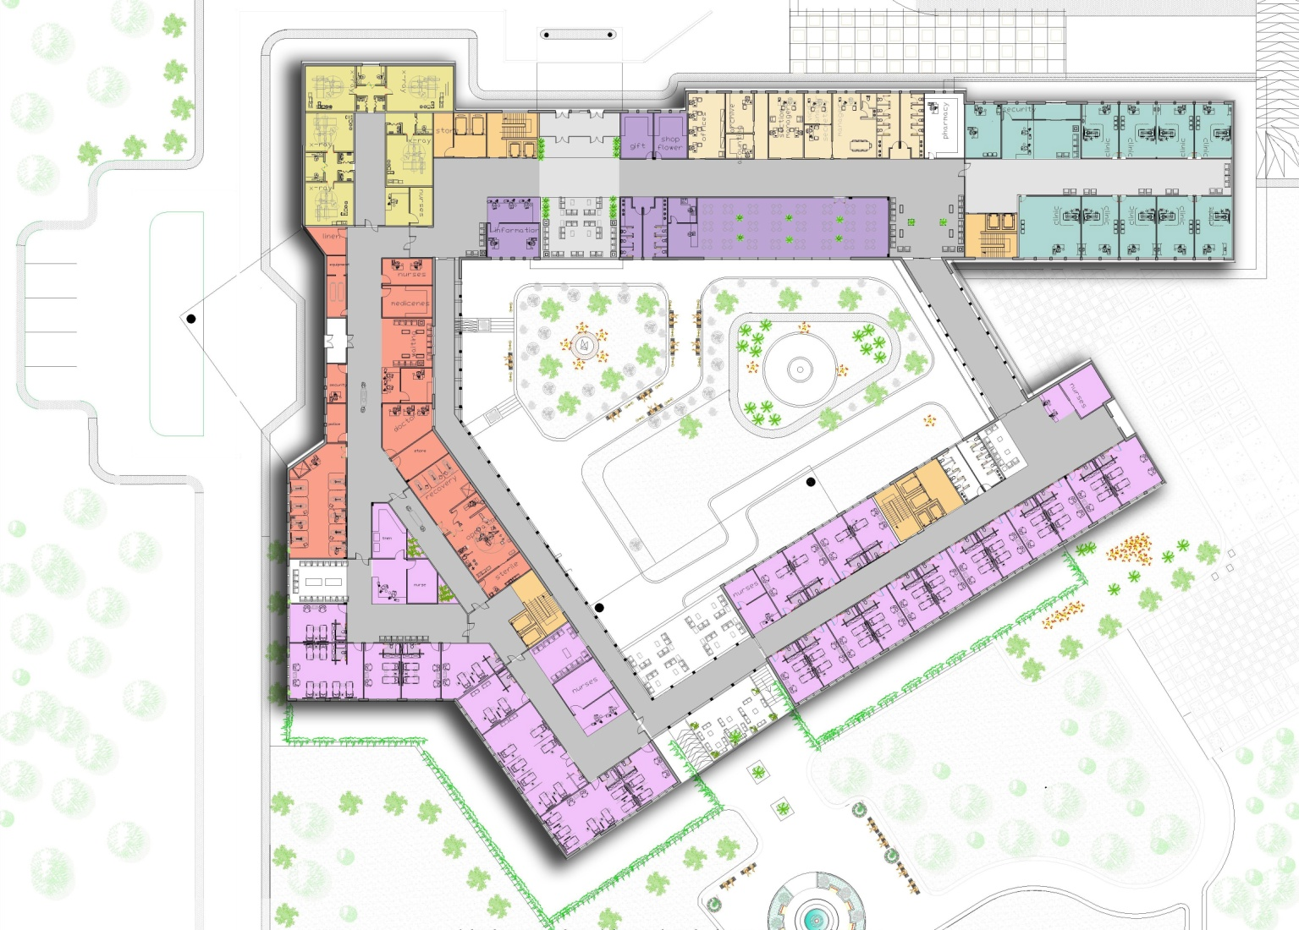
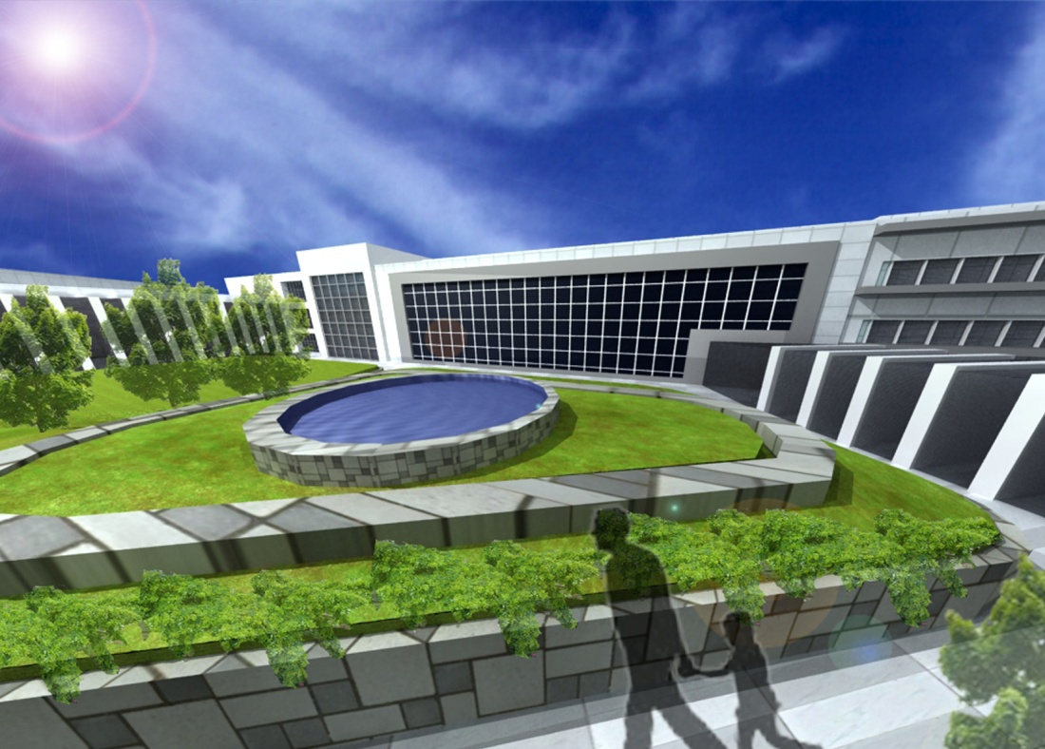

Slide 3
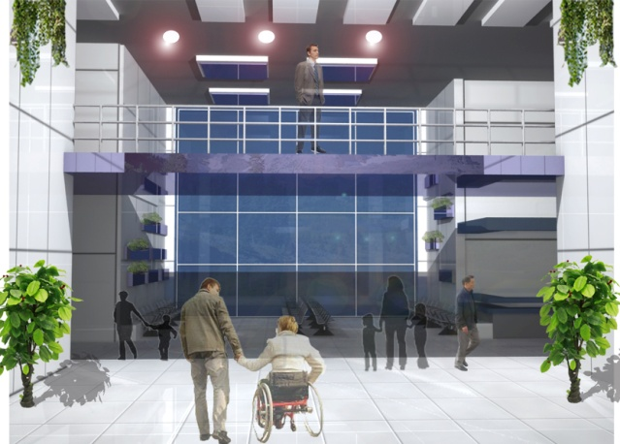
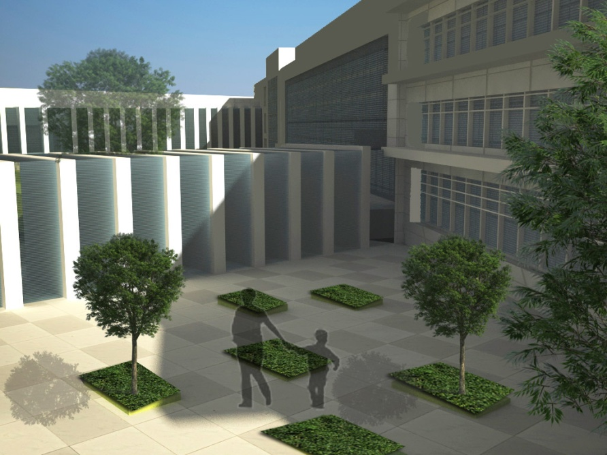
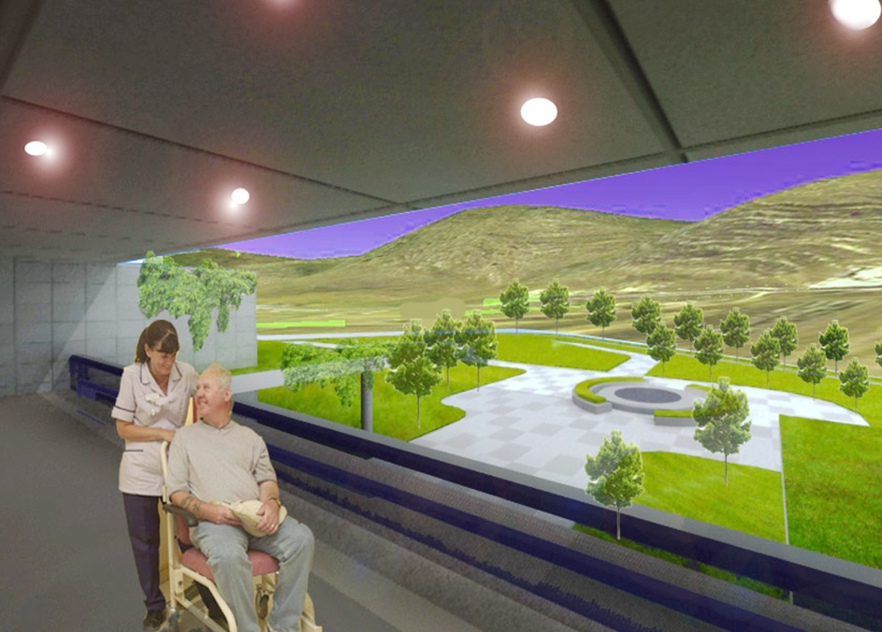
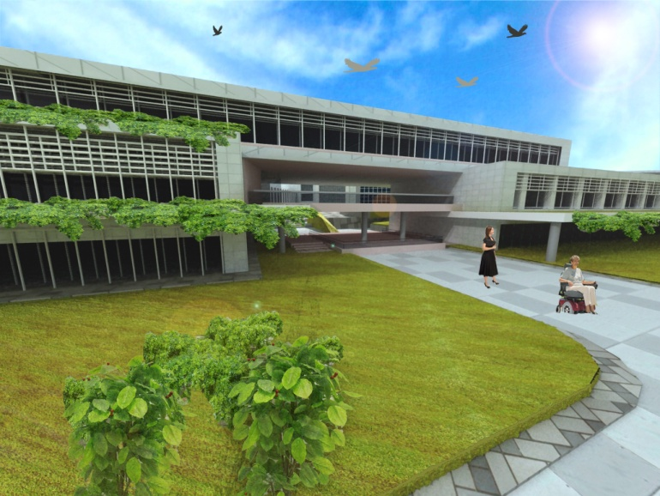

Slide 4
emergency
Out patient
Ground floor
visitors

Slide 5
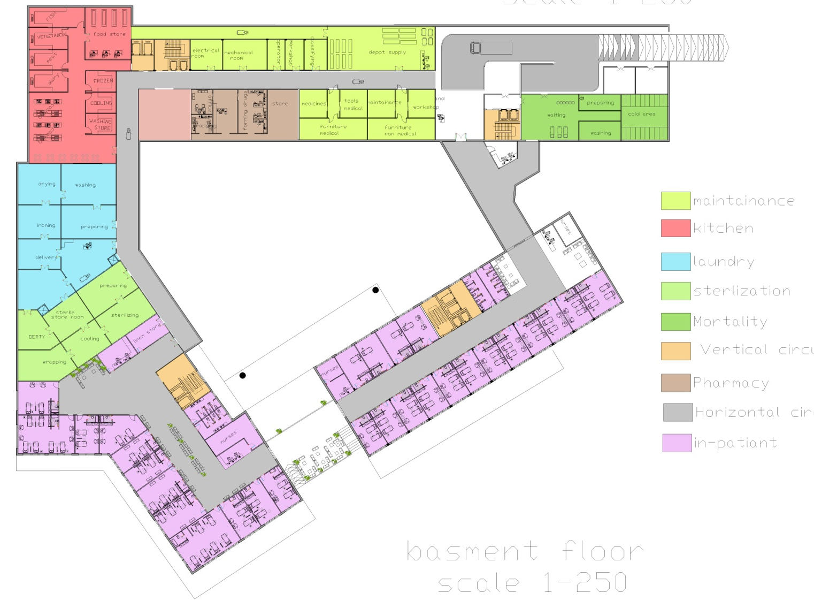
Basement floor
visitors
services
laundry
sterilization

Slide 6
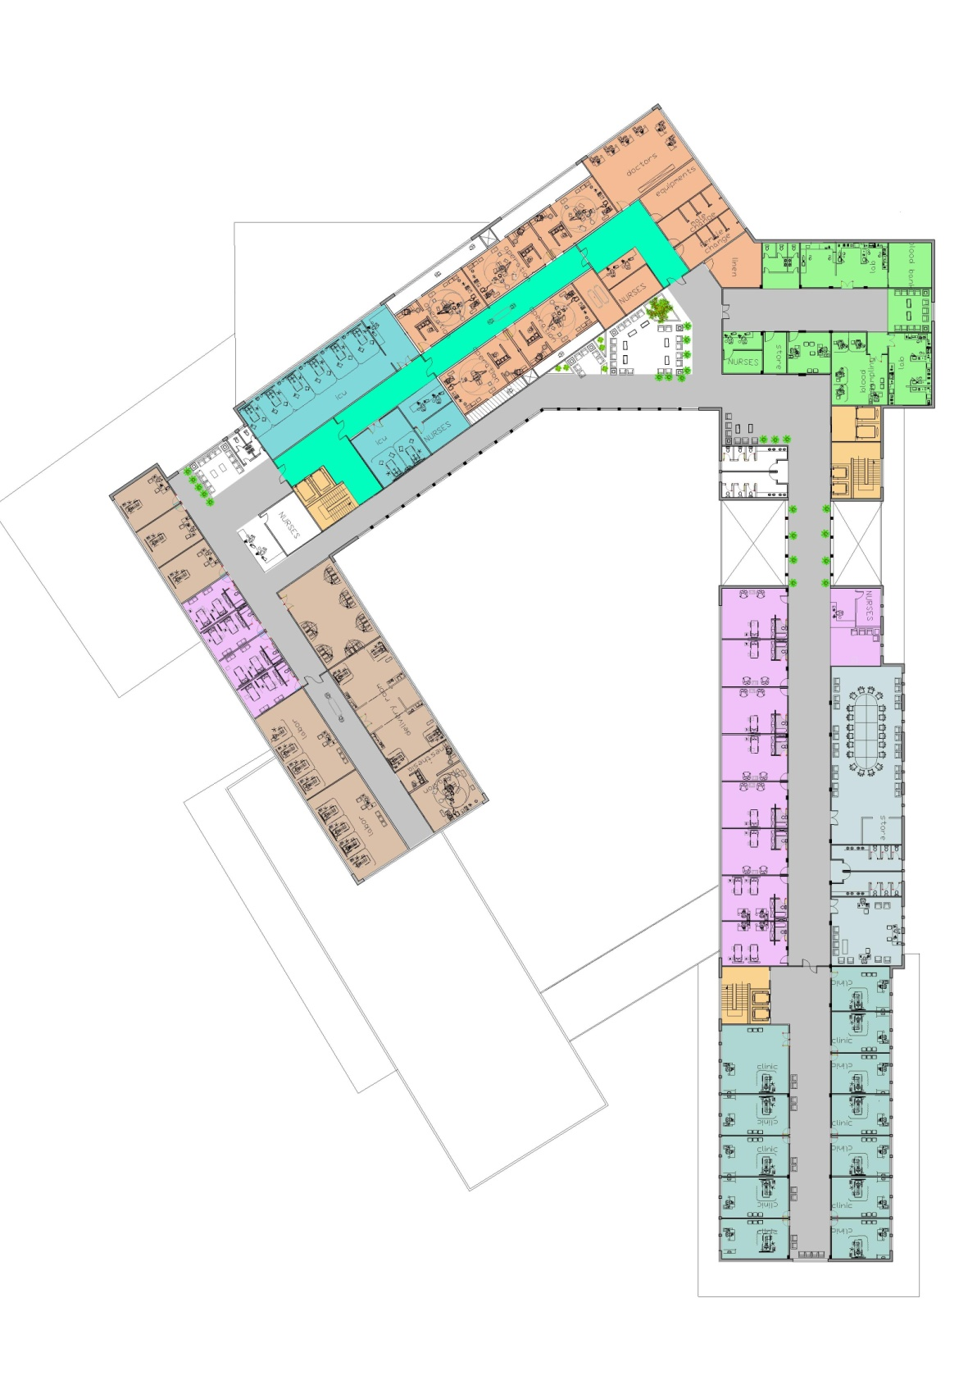
employers
First floor
emergency
births

Slide 7
Operation department
Patient
doctors
Pollutants

Slide 8
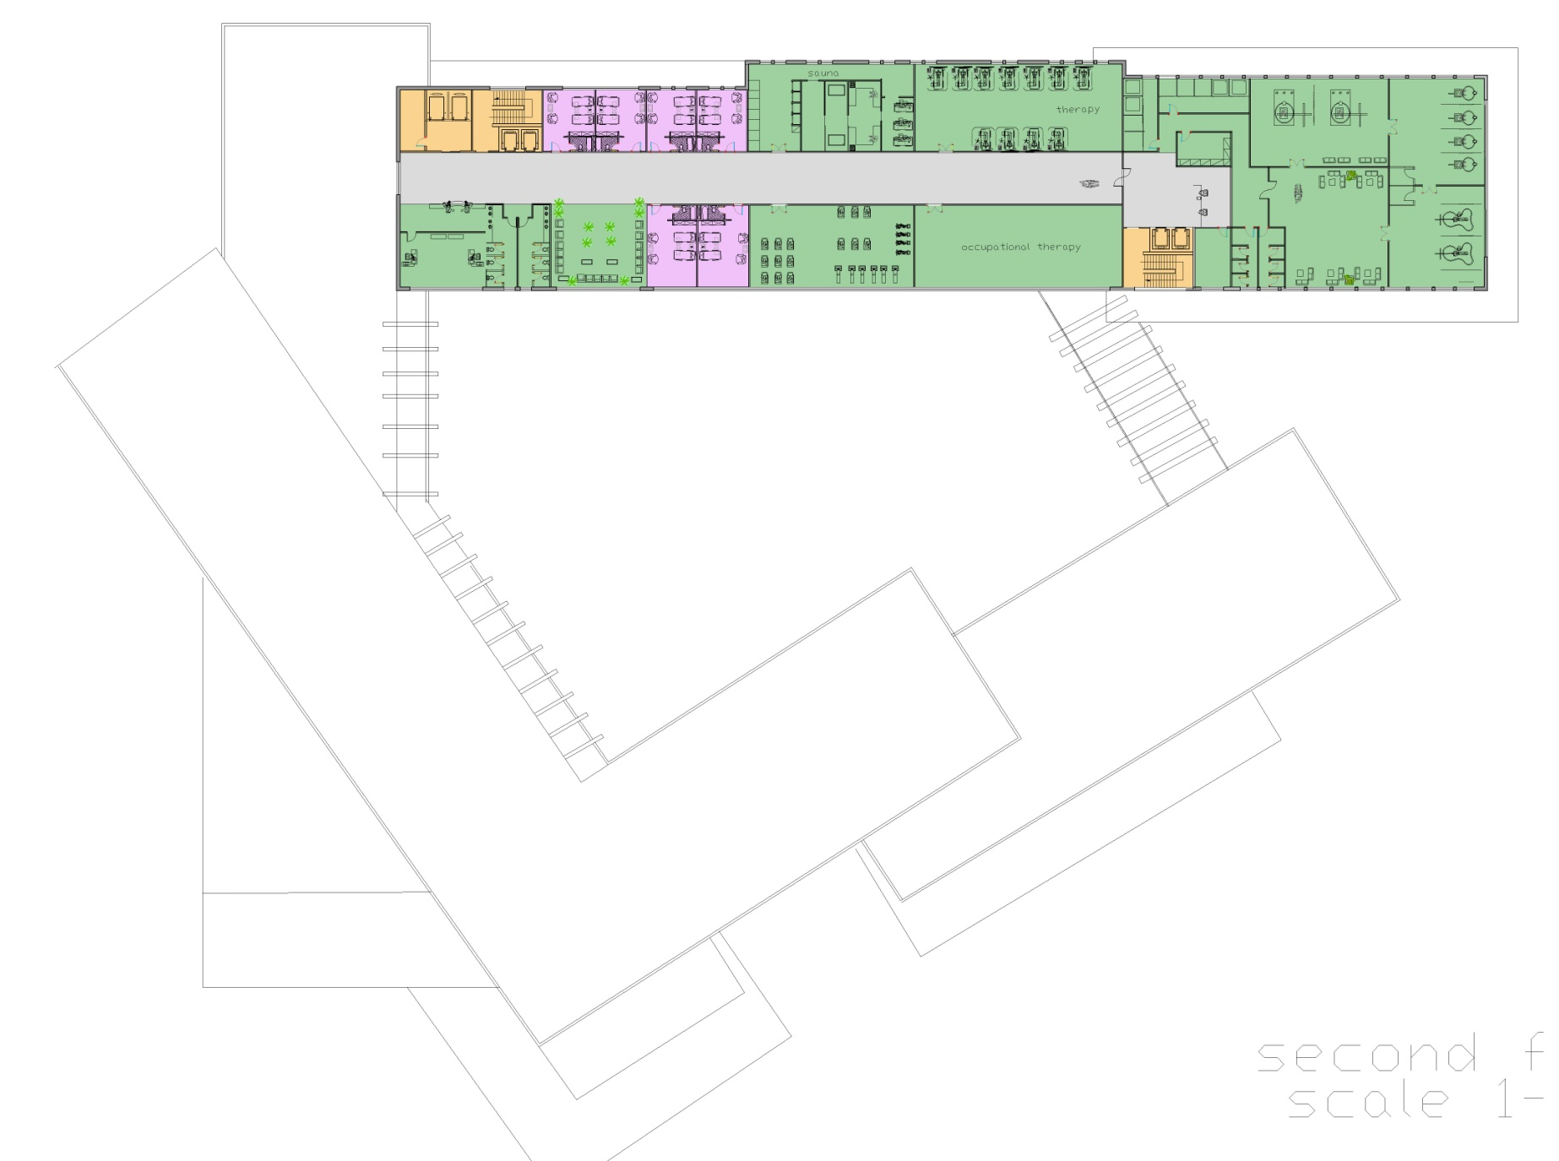
Out patient
second floor

Slide 9

Physiotherapy department
Dry treatment
Hydrotherapy

