Slide 1
WATER DESALINATION BY USING SOLAR ENERGY

Slide 2
Prepared by
Ahmad Al-Odeh
Ali Abbas
Mohammad Alyat
Mohammad Sulaiman
Supervisor
Dr. Bashir Nouri

Slide 3
INTRODUCTION
Why this project?
As the number of people increase as the problem of water sources appears, in addition to problems caused by the Israeli occupation .
The problems of black and gray water.
The development which has happened in the world makes decreasing in the fuel sources, and increasing its cost.
Pollution which has appeared because of development and toxic gases produced by using fossil fuel.
in Our country this project encourage the scientific researches about solar energy.
For the previous problems, water desalination system using solar energy has its importance.

Slide 4
TYPES OF WATER TREATMENT
A ) Unit operations
This type will remove the contaminants are achieved by physical forces such as gravity and screening
Unit operation can divided into three methods:
Boiling
Filtration
B ) Unit processes
Removal is achieved by chemical and biological reactions

Slide 5
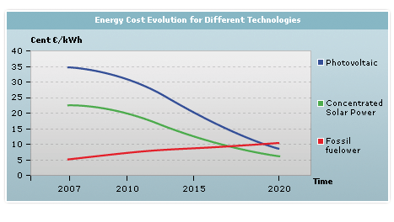
SOLAR ENERGY
Because of continuous decrease of fuel(oil and gas),the world needs anew sources (renewable energy).
Sun energy is the most available one and it has many advantages: available , the running coast is very small, and no pollution.
Soon, solar energy technologies will compete with fossil fuels

Slide 6
TYPES OF SOLAR TECHNOLOGIES
There are two main areas of solar technology depend on the method of concentrating sun rays
Concentrating Solar Power (CSP) Technology
Solar energy is concentrated and used to produce thermal energy. This thermal energy is then converted to electricity using conventional thermodynamic cycles.
The plant consist of two main parts:
one that collects solar energy and converts it to heat, and the other that converts heat energy to electricity
Photovoltaic (PV) Technology
Through the use of semiconductor materials and the photoelectric effect, electricity can be produced directly from solar radiation.

Slide 7
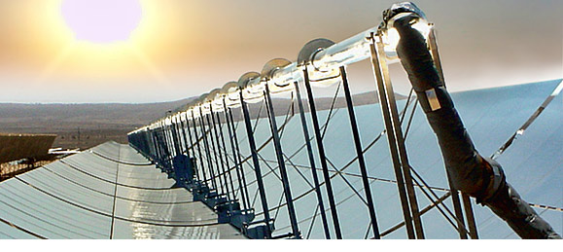
TYPES OF CONCENTRARED SOLAR POWER SYSTEM
Depends on how they collect solar energy
There are three kinds of concentrating solar power systems:
1-Trough systems

Slide 8
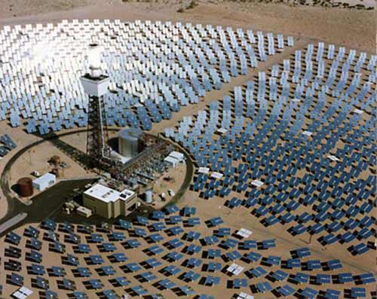
2-Power tower systems
Reflecting sunshine into clean electricity
Focusing sunlight on a receiver at the top of a tower
Steam generation, which, in turn ,
is used in a conventional turbine-generator to produce electricity

Slide 9
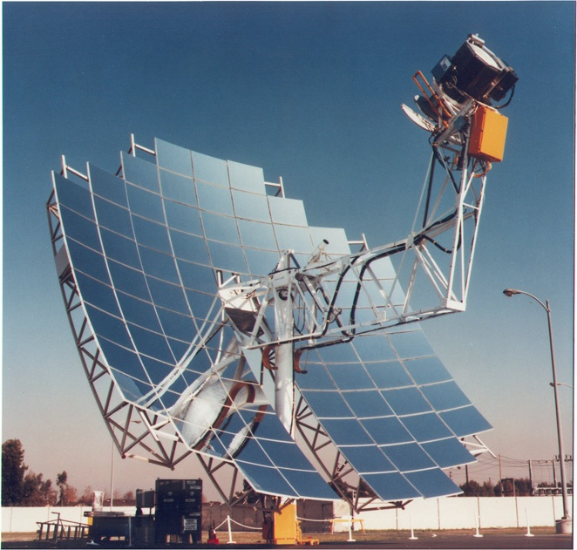
3-Dish / Engine systems
It is an electric generator that “burns” sunlight instead of gas or coal to produce electricity
It concentrates or focuses the sun light on a small area

Slide 10
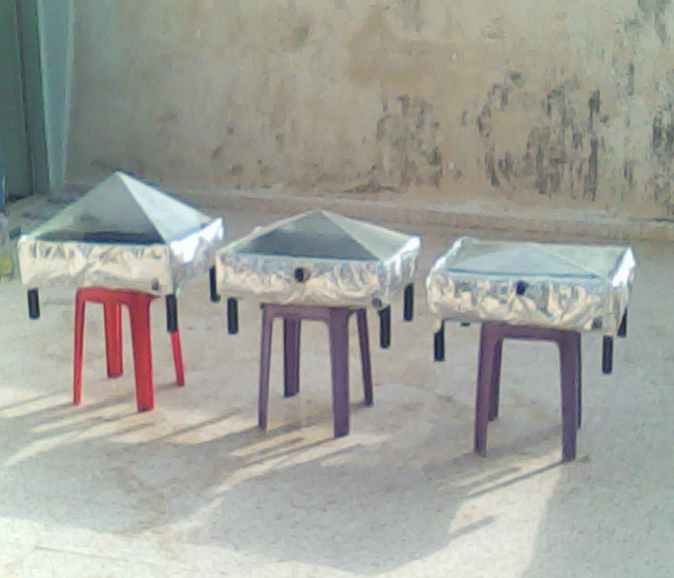
APPLICATIONS
the project had built on several experiments to achieve the best results
The work is divided into two parts:
Part one : find the best angle of the glass boxes
After designing the boxes and painting them by black color, the glass of the boxes has pyramid shape, and the only difference was in the angle of the glass.
The angles were:15,30,45 degrees

Slide 11
Results of part one

Slide 12
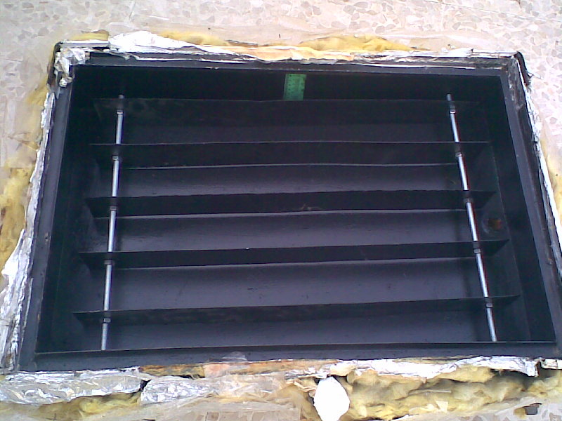
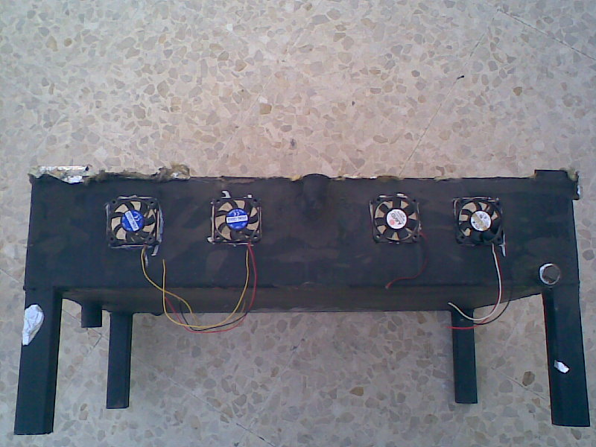
Part two: Adding additional component to the boxes
Adding fins
Adding fans
Using trough system
After modifying the glass boxes at angle 30, the fins is added to the first box and fans is added to the second box, the third box is left as reference for comparison.

Slide 13
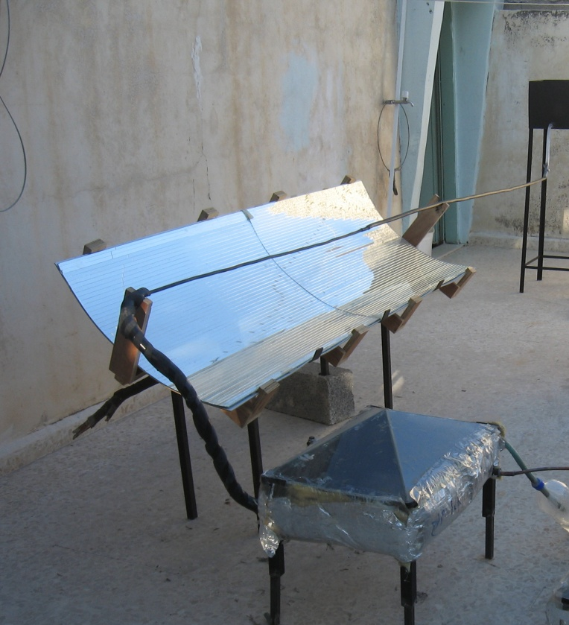
Adding the trough system
The mirorr is divided in to small parts in order to get the required shape.
Parts:
Storage tank .
Copper tube which is supposed
to concentrated solar power.
Mirror.
Heat exchanger.
Receiver tank.
Pump.

Slide 14
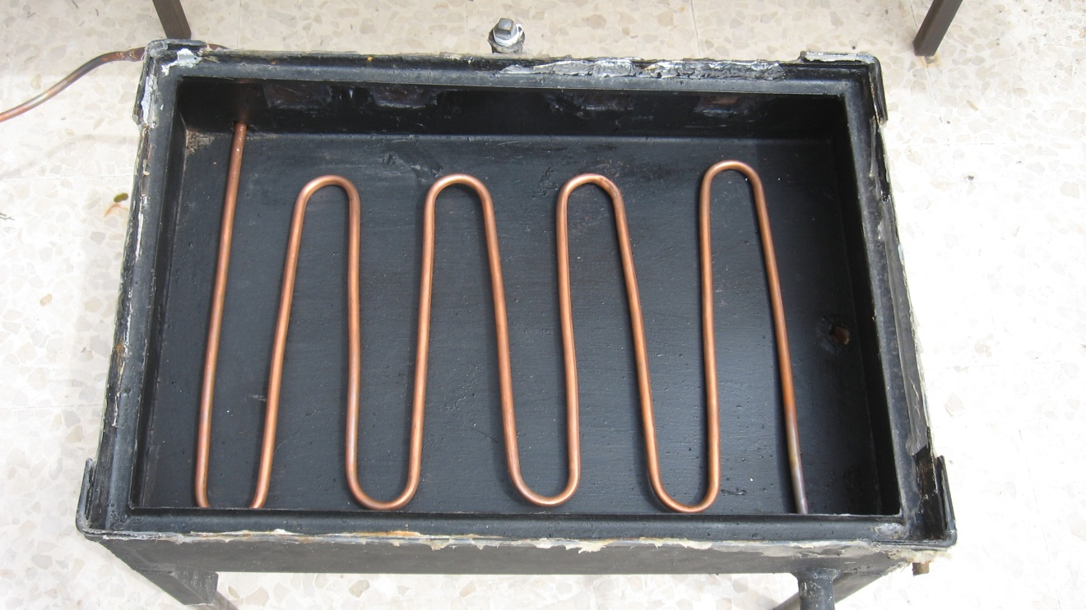
Heat Exchanger Function
Increasing the vaporization by transmitting the obtained energy from trough to the water to be desalinated.

Slide 15
Pump Function
Circulating the water in the closed cycle (from the copper tube to the heat exchanger through pump which return the water to the tank ,and so on).

Slide 17
CONCLUSION
Great results is achieved by applying the trough system in spite of high losses.
Gray water becomes a desalinated water ready to use.
Decrease the dependency on the fuel and gases, and create new field for a renewable energy.
The ability for developments in this system.

Slide 18

Finally ,We hope that this project (water desalination system using solar energy) has interested you.
Our designed web site (sun-boon.com)coming soon

Slide 19

Web site
www.sun-boon.com

Slide 20
Thank you

