Slide 1
Tarneeb Game

Slide 2
Outline
Introduction
LibgGdx
Network Module
Algorithms
Conclusion
Future work
Demo

Slide 3
Introduction
Tarneeb is one of the popular card game in the Middle East world.
Project was divided into 3 parts :
1- Build GUI by using LibGDx framework .
2- multiplayer mode on Local Network ( LAN ).
3- single player mode ( algorithms )

Slide 4
Libgdx
What is LibGdx :
JAVA library that support OpenGL.
LibGdx is a cross platform game library, offers the ability to run game on Android, IOS, and Windows.
Use Universal Tween Engine to make some smooth animation.

Slide 5
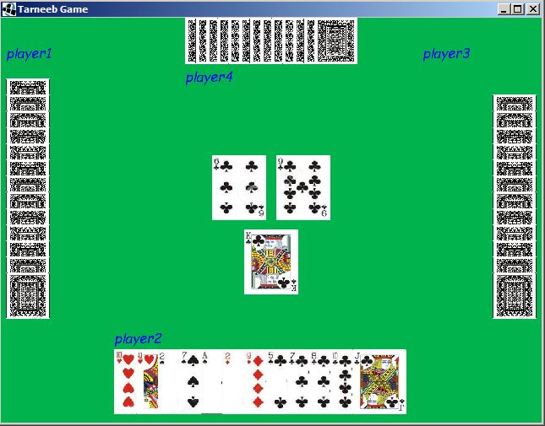
GUI

Slide 6
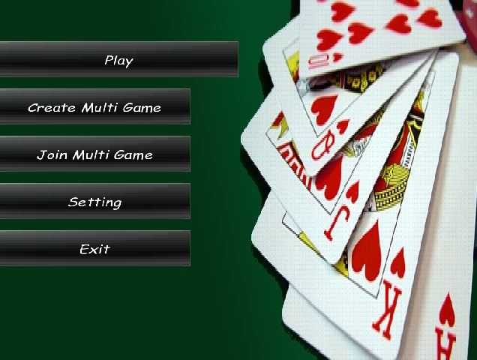
Tween Engine

Slide 7
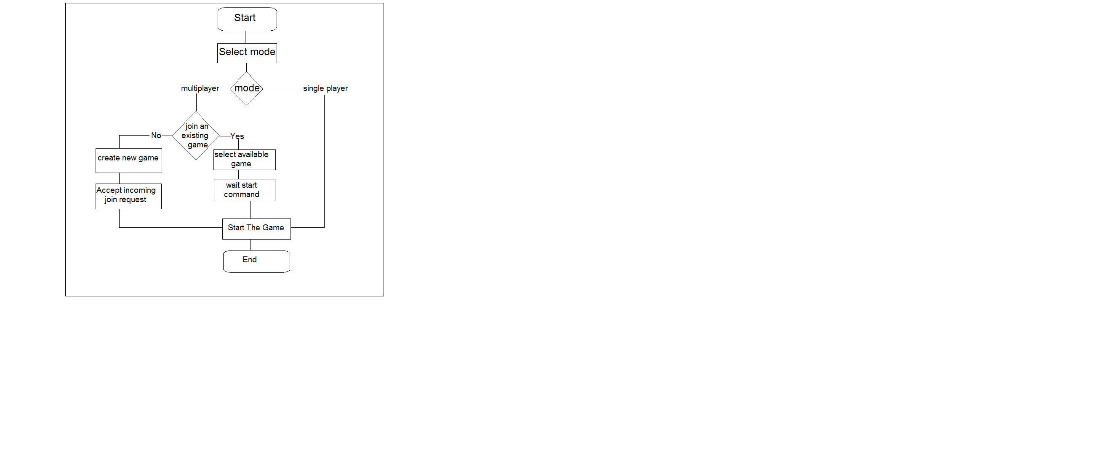
Game Flow

Slide 8
Outline
Introduction
LibgGdx
Network Module
Algorithms
Conclusion
Future work
Demo

Slide 9
Network Module
Multiplayer-Mode
LibGdx has own network library (only TCP)
unfortunately , TCP is not enough suitable for us.
Needs network (LAN)

Slide 10
Network Module cont.
Why not TCP :
1- TCP is an established connection protocol, which means they will be more overhead to establish and make connection reliable.
2- Our game needs broadcast packet to discover the available game on the network, and this option not available in the TCP.
For that, we decide to use UDP from java network library.

Slide 11
Network Module cont.
Network Stages : how network module works during multi-mode.

Slide 12
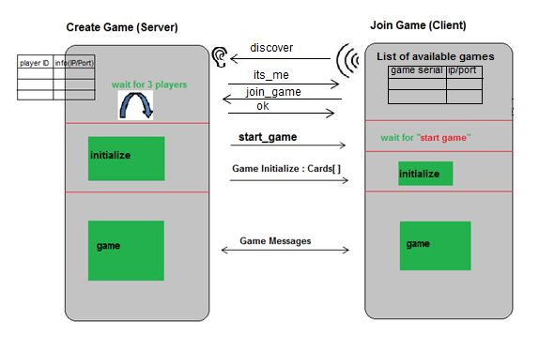
Network Stages

Slide 13
Network Module cont.
Network constrains:
1- All communications between players are just allowed through the creator of the game (the server).
2- In this game, Network module is build to work only in the case of exist four players. One creator/server & three client players.
Notes:
1- That means if a player wants to tell the other players what card he played recently, this must do through the creator/server device.
2- and no way in our module to continue the game without the fourth player.

Slide 14
Algorithms
Many algorithms are developed during this project.
Each has own specific task.
Some of them, are changed during developing to achieve needs.

Slide 15
Algorithms cont.
1- shuffle cards algorithm (Cards distribution )
2- Bidding algorithm.
3- Algorithm for winner-bidding team.
4- algorithm for unwinner-bidding team.

Slide 16
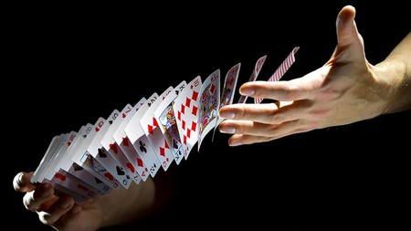
shuffle cards algorithm
This algorithm is response about distribute 13 cards for each player; it aims to give a fair chance for every player so that can apply a bidding (request).
Notes:
It will shuffle the cards first , then give each player 13 cards.

Slide 17
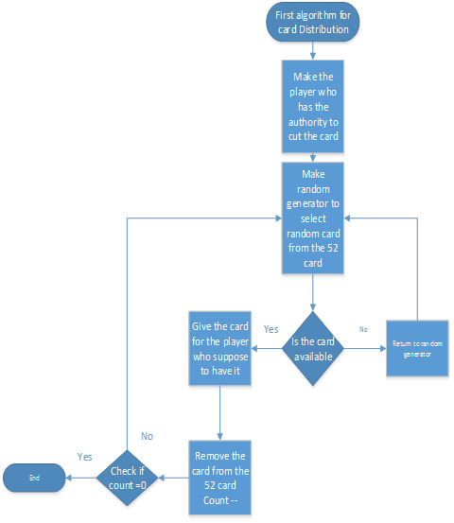
shuffle cards algorithm
Version1

Slide 18
shuffle cards algorithm cont.
Version1
face problems make us change algorithm later:
1- The cards dealing was too random that make the player with low chance of having good cards to make initial bidding.
2- The CPU was most of the time, call pass as initial bidding so we forced to enhance the algorithm.
Notes:
This algorithm swap every card on the deck , start from the zero index up to 51 index, in each loop , swap the current index with a random index. So, we end up with a new distribution of the cards. After that, every player will be given 13 cards, according to algorithm we used.

Slide 19
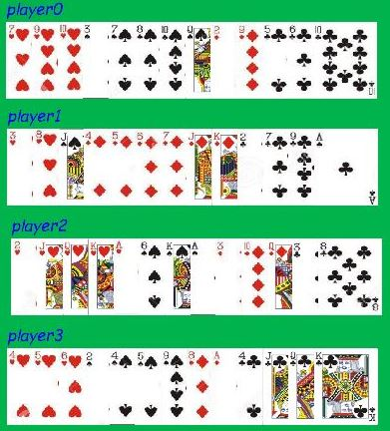
shuffle cards algorithm cont.
Version1 : Test case

Slide 20
shuffle cards algorithm cont.
Version2: this updated version of algorithm guarantee that the player who have cards has chance doing bidding most of the rounds.

Slide 21
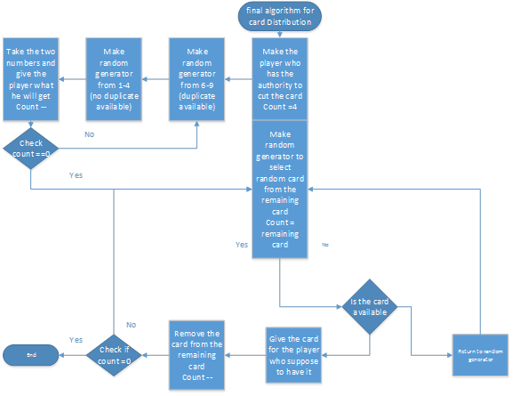
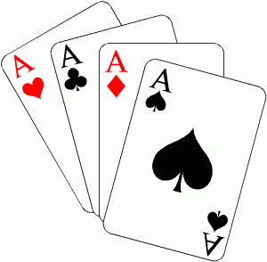
shuffle cards algorithm cont.
Version2

Slide 22
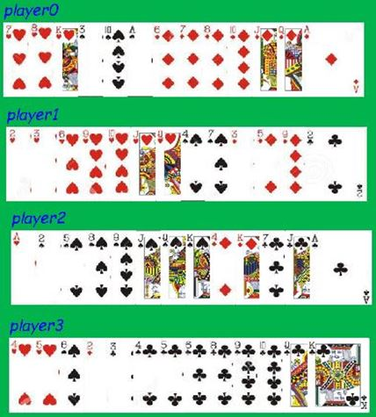
shuffle cards algorithm cont.
Version2 : Test case

Slide 23
algorithm
1- shuffle cards algorithm (Cards distribution )
2- Bidding algorithm.
3- Algorithm for winner-bidding team.
4- algorithm for unwinner-bidding team.

Slide 24
Biding algorithm
This algorithm allow CPU to have the best bidding as possible as can, due to its cards power.
what we mean by “Bidding“ ? .........................................
…………………………………….

Slide 25
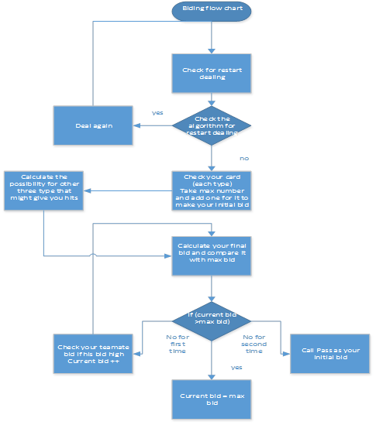
Biding algorithm cont.

Slide 26
Biding algorithm cont.
The following piece of code is applied during make a bidding :
tarneebValue = 0;
OtherCardValue = 0;
for i=0; i<13
do
if cards[i] is tarneeb
tarneebValue += cards[i].value
else
OtherCardValue += cards[i].value
End for

Slide 27
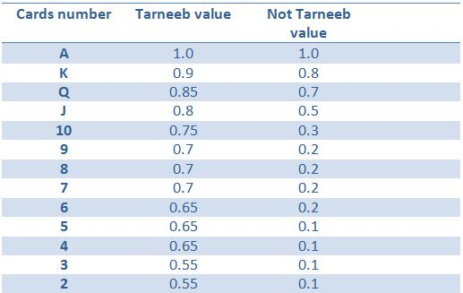
Biding algorithm cont.
Cards values applied in previous piece of code are shown in this table :

Slide 28
Algorithm for winner-bidding team
This algorithm is applied for the player who is in the team that make bidding in current round.

Slide 29
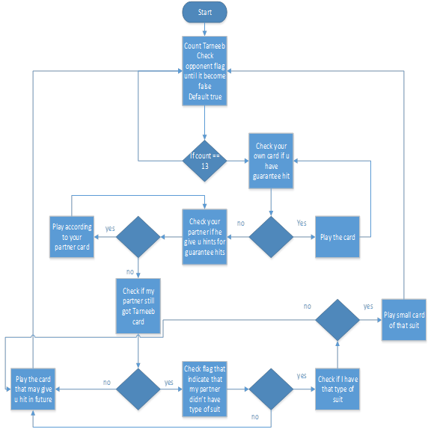
Algorithm for winner-bidding team

Slide 30
Algorithm for unwinner-bidding team
This algorithm is applied for the player who is in the team that is opposite to team who make bidding in current round.

Slide 31
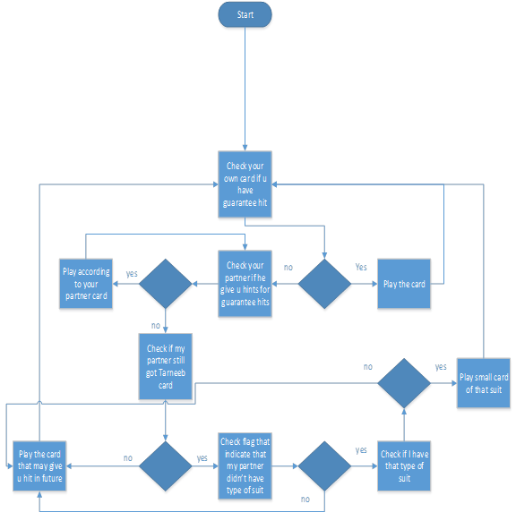
Algorithm for unwinner-bidding team

Slide 32
Conclusion
  User Friendly of the Game (GUI):
  1- try to make the UI of the game attractive and friendly as can as possible.
  2- not expert in the graphics & no enough budget
  use free tools (painter, hiero)
  3- Tween Engine was helpful, add smooth transitions on the graphics.

Slide 33
Conclusion cont.
  Game Network
1- the network module was centralized .
2- because of our network communication not so heavy, this choice wasn’t problem for us .

Slide 34
Future work
Enhance on the game can’t stop in specific point.
UI :
the choice is for enhance the design and make it smoother.
Network :
1- allow the CPU to play together with players on the network
2- we may make the game globally not just locally on the LAN

Slide 35
Future work cont.
Algorithms:
Make some algorithms more intelligent.
For Bidding algorithm, we might make the Machine train the cards values using NN.
For playing algorithm, we might add difficulty to make it more reality.

Slide 36
Demo time

Slide 37
Any question

