Slide 1
Graduation Project 2
An Experimental Comparison of Bifacial and Monofacial PV Modules in Palestine Climate.
Students: Supervisor:
Ahmad Tabash Dr. Adel Juaidi
Luay Shareef

Slide 2
Overview
Introduction
Methodology
Solar Module Insulation
Devices
Experimental Data Results
Conclusions

Slide 3
Introduction
The importance of energy.
Palestine is 100% dependent on neighboring countries for fuel, and 90% for electricity.
The percentage of renewable energy from the energy consumed in Palestine is 11.7% .

Slide 4



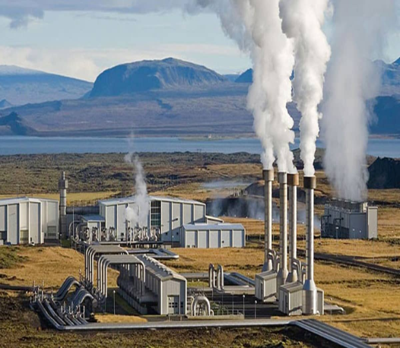
Energy Profile
Solar energy.
Wind energy.
Biomass energy.
Geothermal energy.

Slide 5
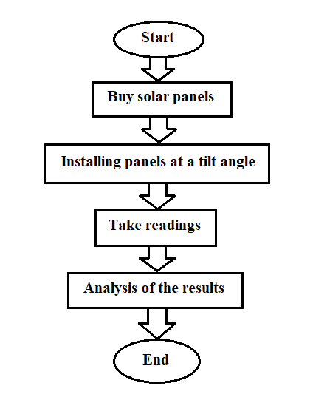
Methodology
The work plan

Slide 6
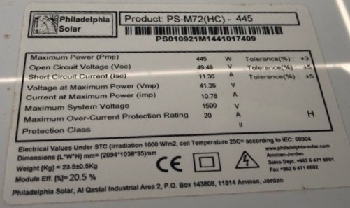
Data Sheet
ا
Technology | Model | V_{OC} (V) | I_{SC} (A) | P_{mp} (W) | η (%)
Bifacial | PS-B72-445 | 49.69 | 11.29 | 445 | 20.5
Monofacial | PS-M72(HC) | 49.49 | 11.30 | 445 | 20.5

Slide 7
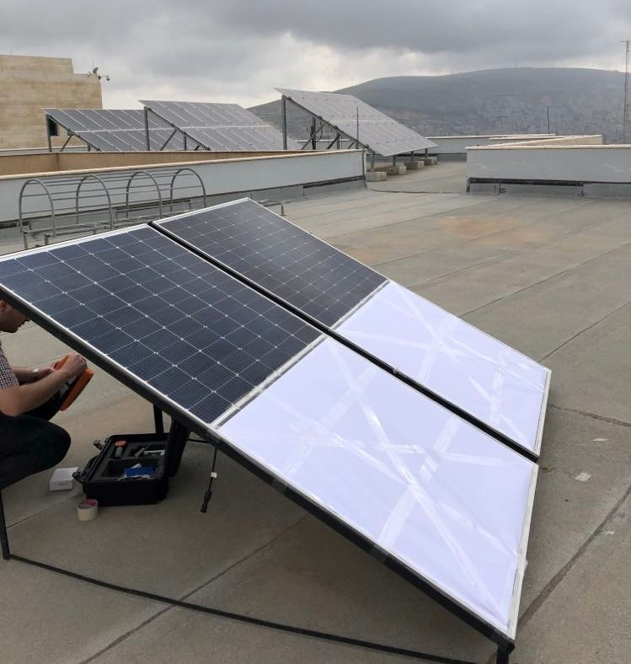
Challenges

Slide 8
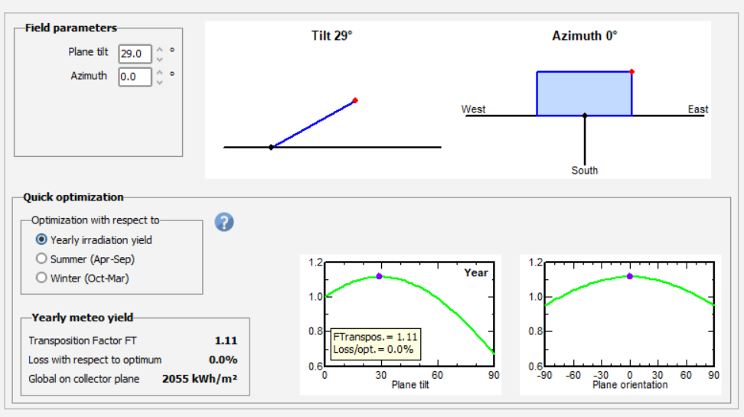
Solar Module Insulation

Slide 9
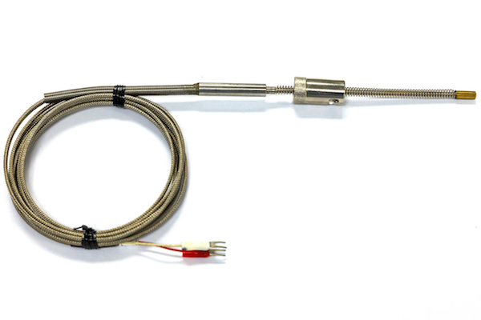
Devices
Temperature Measurement by Using Thermocouple Sensors.

Slide 10
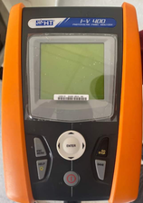
Devices
Irradiance & Power Measurements by Using IV-400.

Slide 11
Experimental Data
Date | Hour | T_{mono} (C°) | T_{bif} (C°) | Irr_{Mono} (Watt/m²) | Irr _{bif} (Watt/m²) | P_{mono} (Watt) | P_{bif} (Watt)
27.April | 9 | 38.2 | 39.1 | 352 | 422 | 115 | 131
 | 10 | 46.4 | 48.6 | 511 | 649 | 160 | 174
 | 11 | 47.5 | 51.4 | 759 | 772 | 186 | 199
 | 12 | 40.6 | 42.6 | 561 | 641 | 145 | 177
 | 1 | 57.4 | 56.2 | 976 | 993 | 236 | 249

Slide 12
Experimental Data
Date | Hour | V_{oc,mono (V)} | V_{oc,Bi (V)} | I_{sc,mono (A)} | I_{sc,Bi (A)} | FF_{mono} | FF_{Bi}
27.April | 9 | 45.7 | 45.3 | 3.12 | 3.78 | 0.81 | 0.78
 | 10 | 45.4 | 44.8 | 4.43 | 5.19 | 0.8 | 0.78
 | 11 | 45.1 | 44.8 | 5.21 | 6.05 | 0.79 | 0.77
 | 12 | 45.4 | 45.3 | 3.97 | 5.2 | 0.8 | 0.78
 | 1 | 44.7 | 44.5 | 6.69 | 7.41 | 0.79 | 0.77

Slide 13
Temperature Measurement Result

Slide 14
Temperature Measurement Result

Slide 15
Temperature Measurement Result

Slide 16
Irradiance Measurement Results

Slide 17
Irradiance Measurement Results

Slide 18
Irradiance Measurement Results

Slide 19
Power Measurement Results

Slide 20
Power Measurement Results

Slide 21
Power Measurement Results

Slide 22
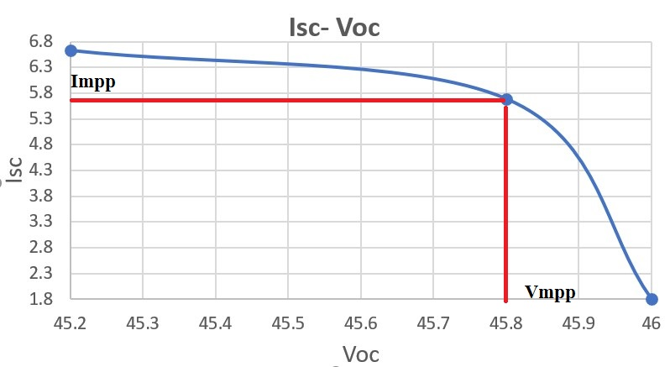

I-V Measurement Results
$$FF=\frac{I_{mpp}∗V_{mpp}}{I_{sc}∗V_{sc}}$$

Slide 23

Efficiency Measurement Results
$$η=\frac{P_{out}}{P_{in}}∗100\%$$

Slide 24
Conclusions
Monofacial VS Bifacial
Recommendations

Slide 25

Thank You

