Slide 1






كتابي وكتابك
تقديم :ندى عجعج
ابتهاج العاصي

Slide 2


what is “كتابي وكتابك”
  is an online platform for buying, reading, and exchanging books across various categories. It simplifies the book purchasing process via a user-friendly mobile app and website, offering services like audiobook and PDF subscriptions. The platform allows users to exchange books for free and resell purchased books with a commission for the platform.

Slide 3
Objective
  Developing an integrated electronic platform for buying and reading books.
  Providing a wide range of books in various categories.
  Facilitating the process of purchasing books via a mobile app and an easy-to-use web interface.
**Target Audience:
The platform targets users from various backgrounds, including book lovers and audiobook enthusiasts

Slide 4




Scope of Work
User
Admin

Slide 5

User features
sign up
Log in using email and paswword
Reset password
Browse the store and purchase books from various categories.
Receive exclusive store offers and discounts.
Subscribe to the audiobook library for unlimited access.
Subscribe to the PDF book collection for convenient reading.
Exchange books with other users or pick from available exchange listings.
Resell purchased books through the store with a small commission fee.

Slide 6
Admin features
Add and delete categories.
Add books to specific categories,
edit prices and quantities, or remove books.
View a table displaying all books added to each category.
Add, edit, and delete PDF books.
Add, edit, and delete audiobooks, as well as add, modify, and remove chapters.

Slide 7
Admin features
View all registered users.
View all user orders and update order statuses.
Send notifications or motivational messages to users.
Apply discounts on specific books, categories, or all books in the store.
View used books listed for sale.
View books listed for exchange along with the owner's information.
Track monthly sales and identify the best-selling books.

Slide 8








Tools

Slide 9

Programming language
Backend
Frontend
Node js
Dart
Flutter framework

Slide 10

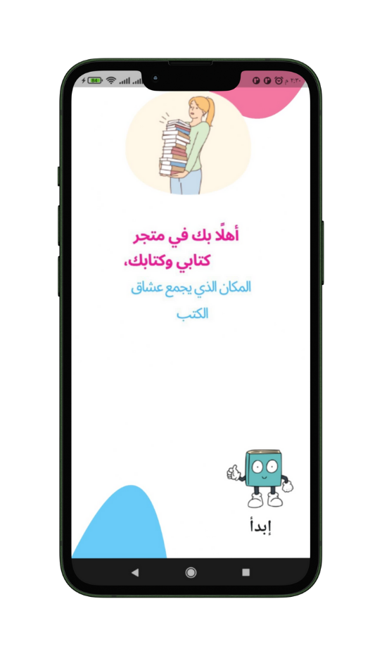
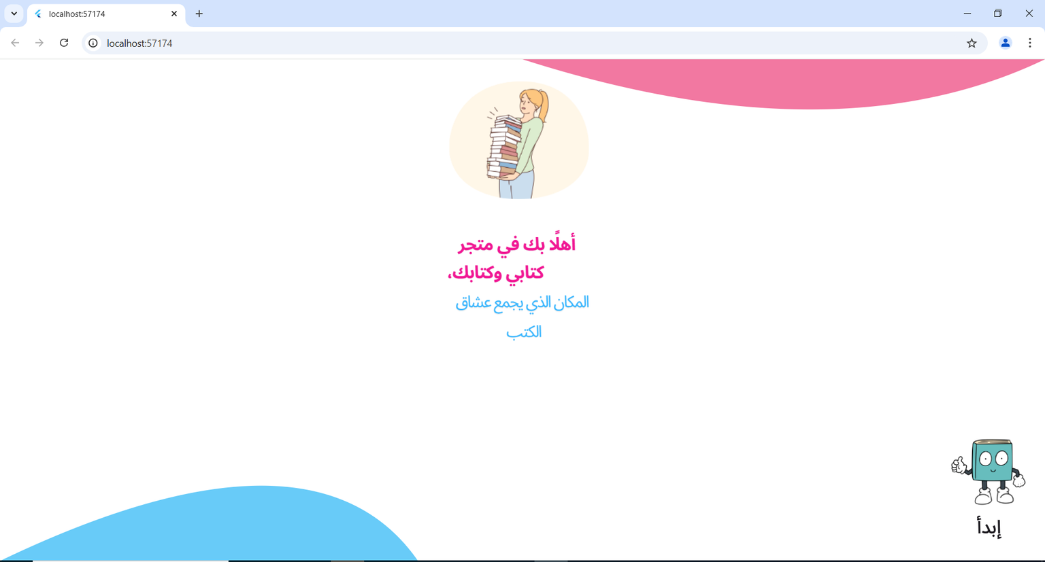

Start page
The user clicks on the word "إبدأ" to navigate to the login page.

Slide 11
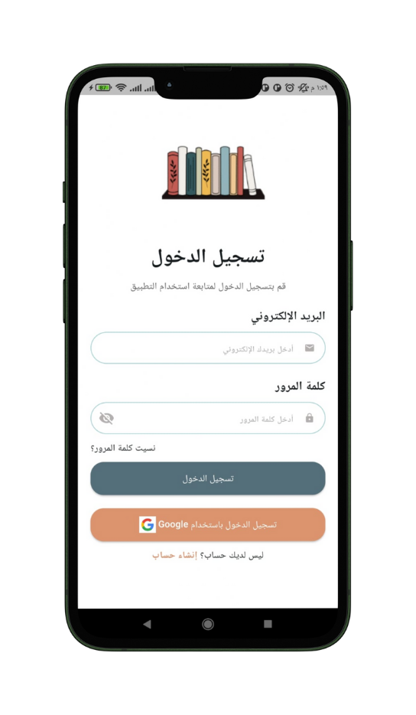
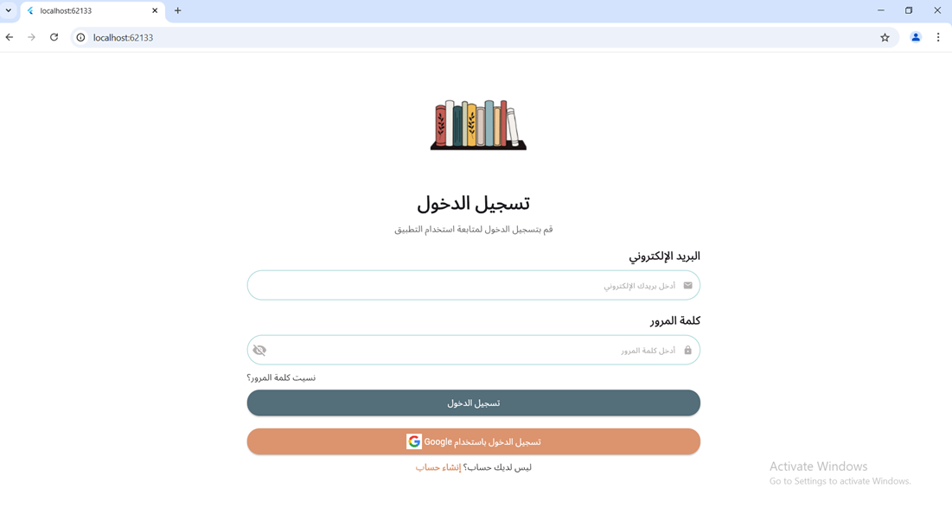
Login page
The user enters their email and password to log in to the store.

Slide 12
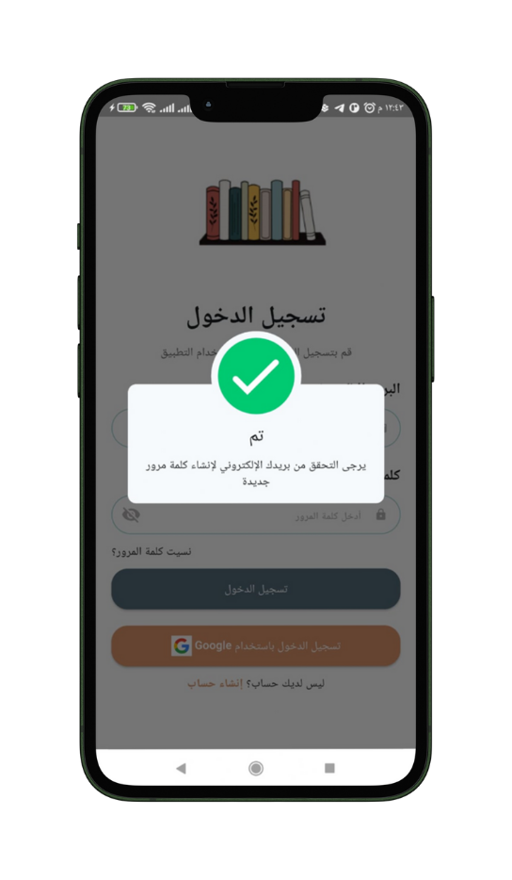
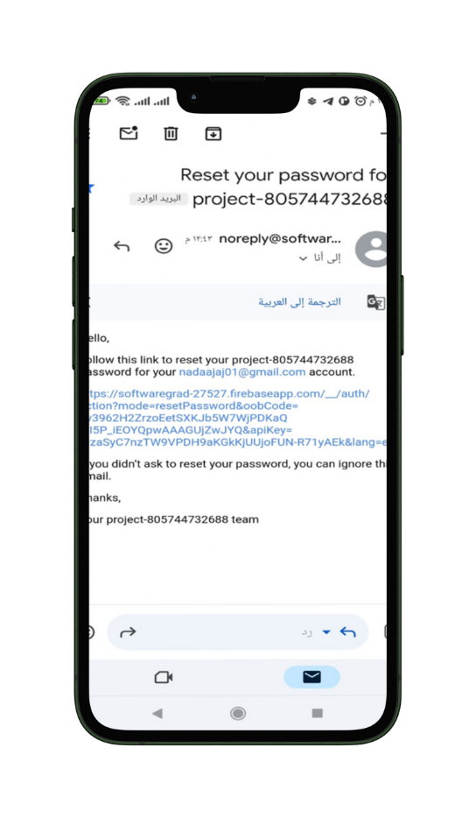
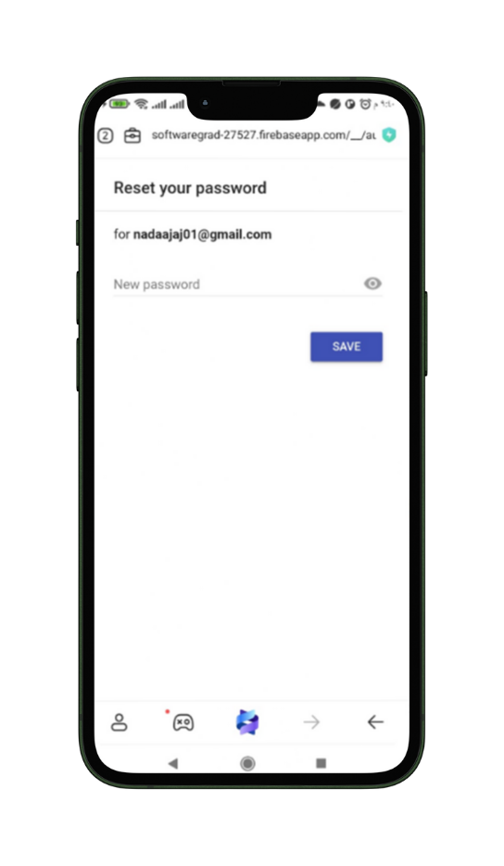
Resete Password
*If the user forgete the password or want to change it he can press on “هل نسيت كلمة المرور” in login page.

Slide 13
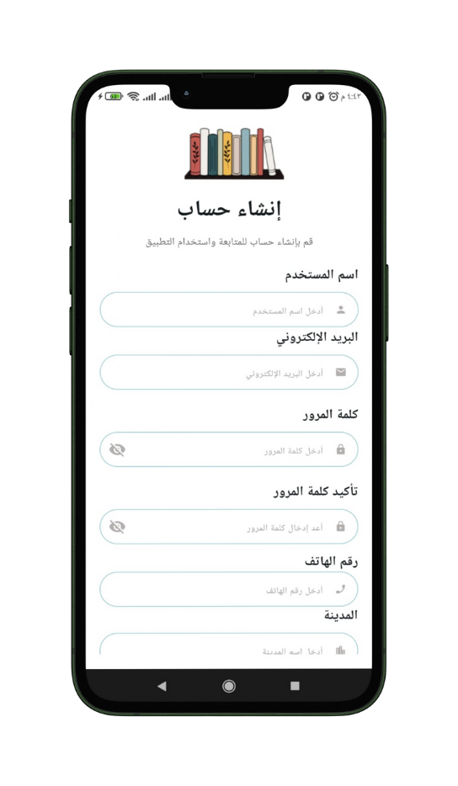
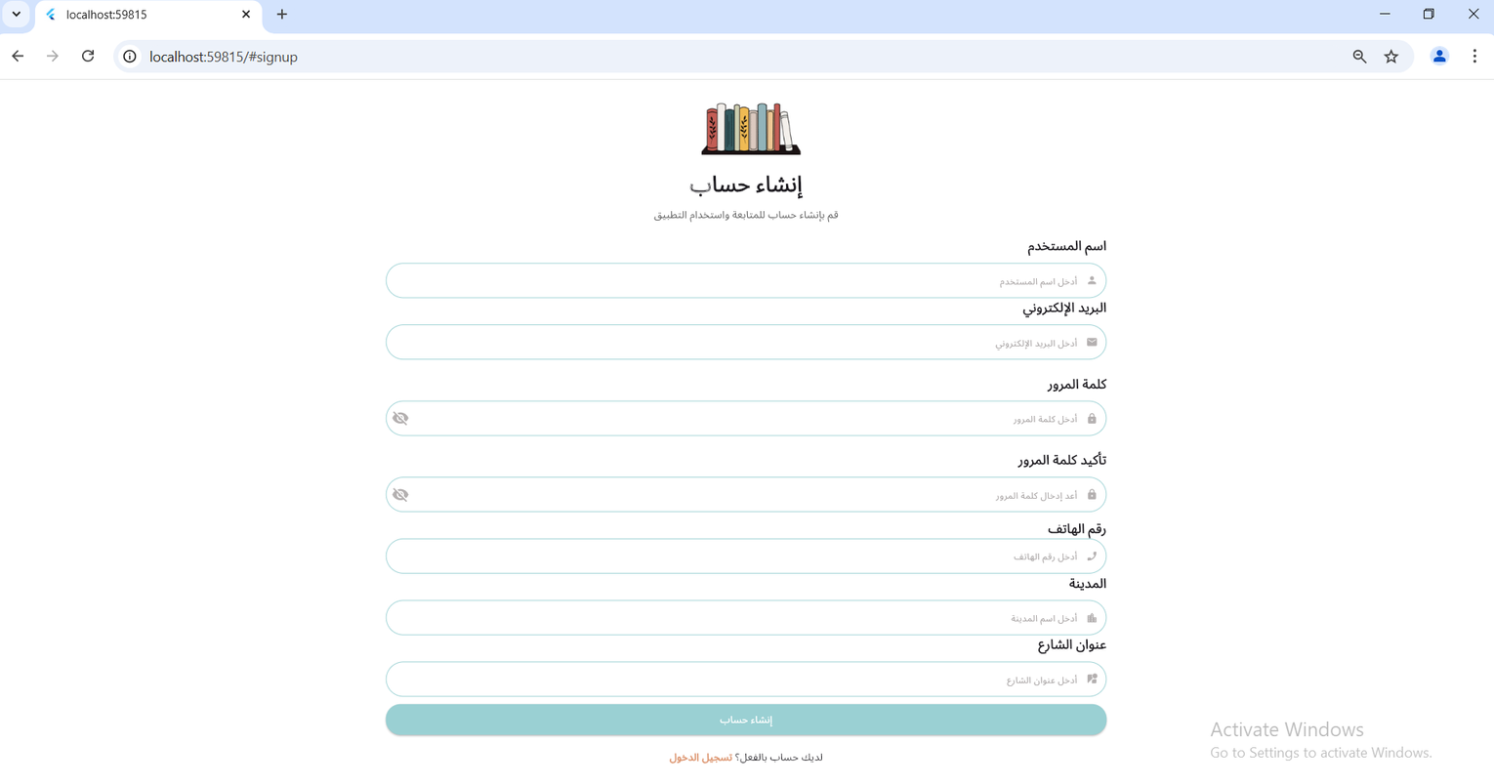
Sign Up page
*If the user does not have an account, they click on "Create Account" to register a new account.

Slide 14
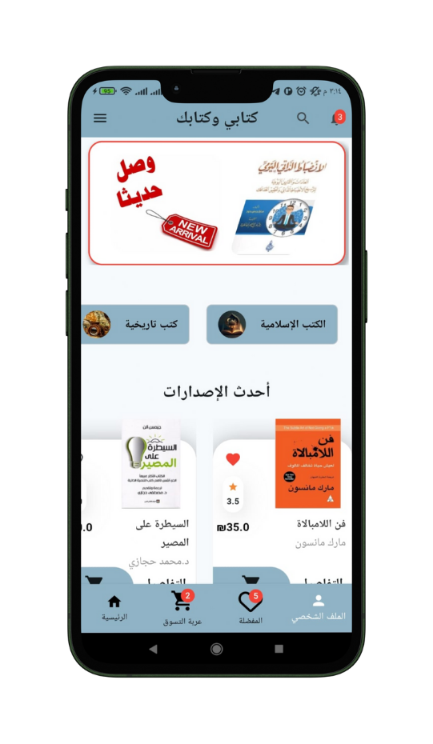
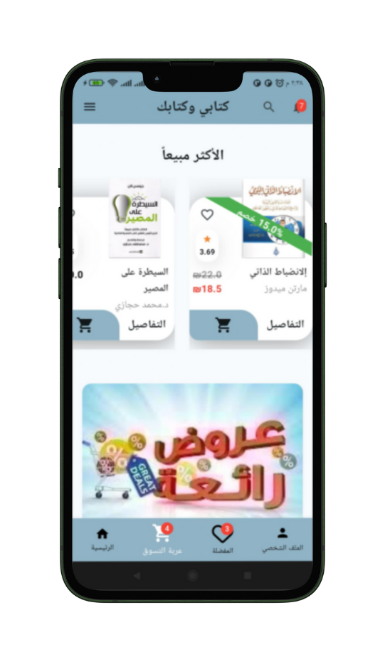
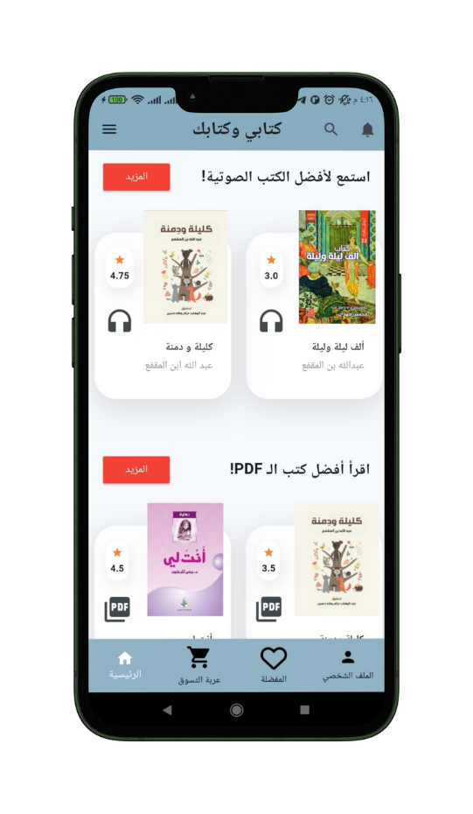
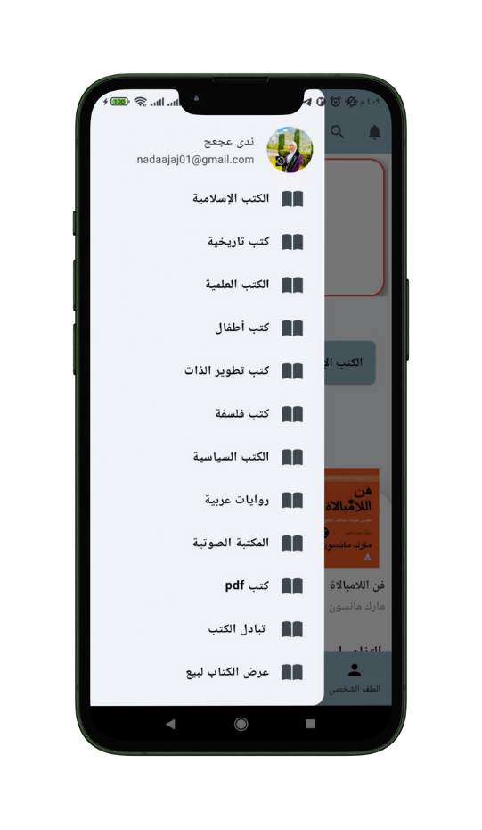
Home Screen

Slide 15
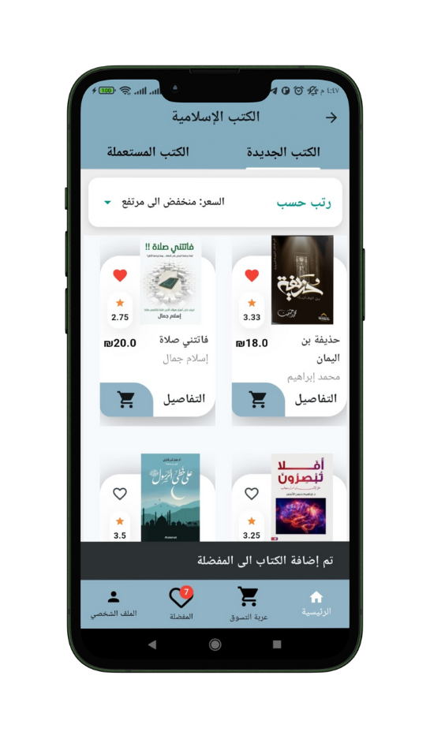
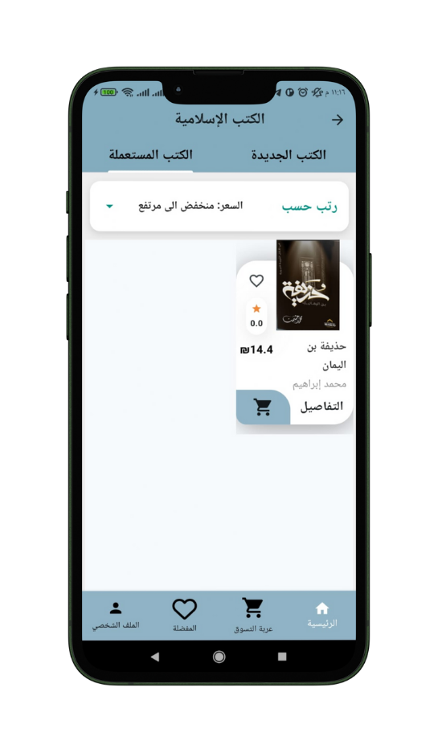
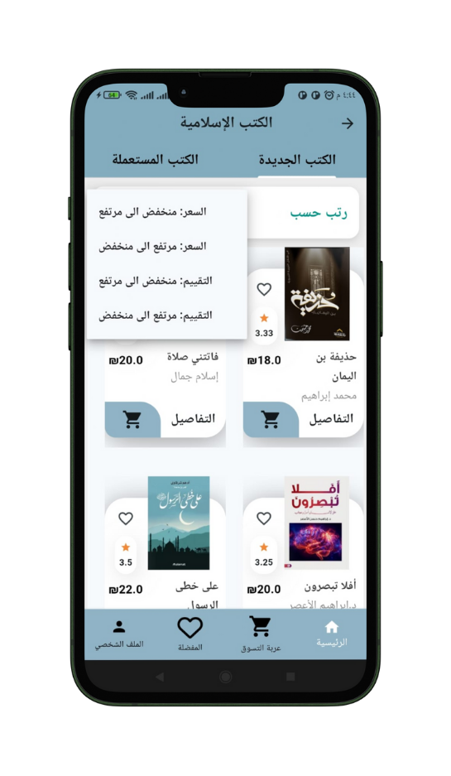
Category page
NEW BOOK
USED BOOK
ORDER BOOK

Slide 16
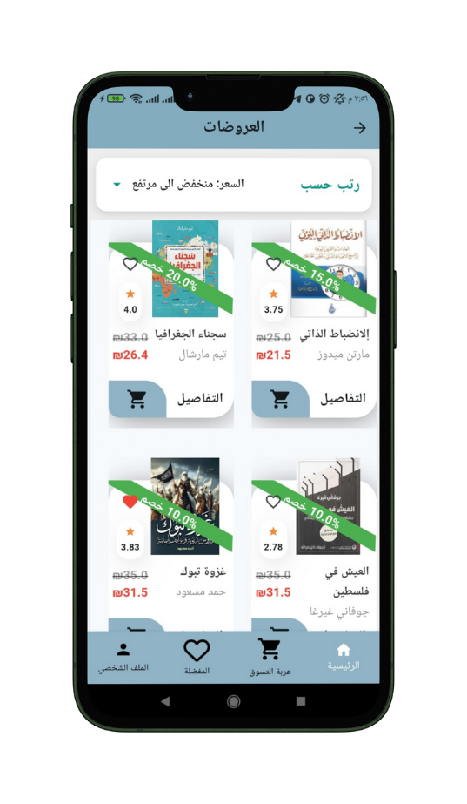

Dicount page
The user can see all books with a discount on the offers page.

Slide 17
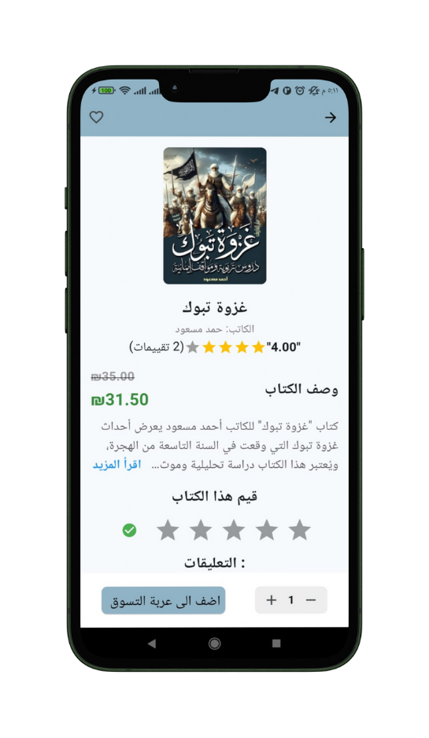
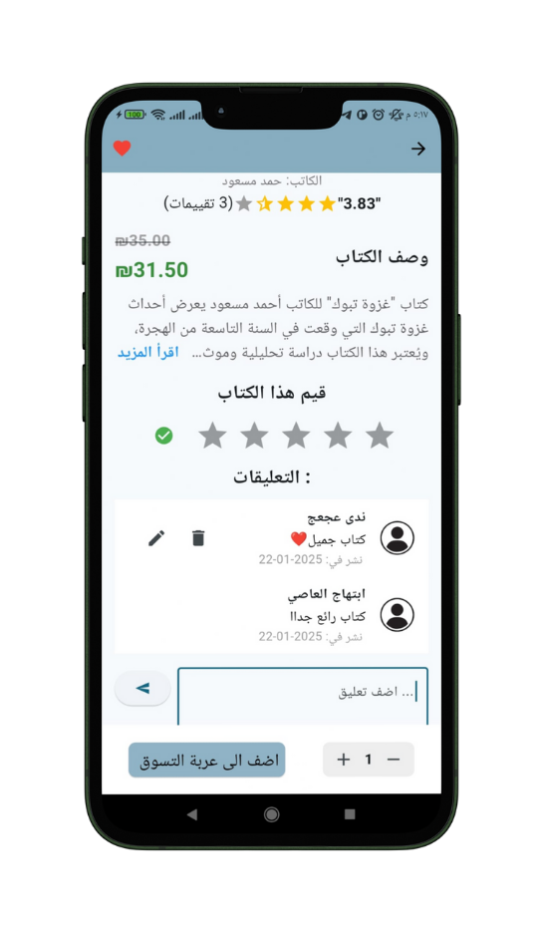
Book Details Page
When clicking on
" التفاصيل" while displaying the book, a new page opens to show all the book's details, including the book's rating and user comments.

Slide 18
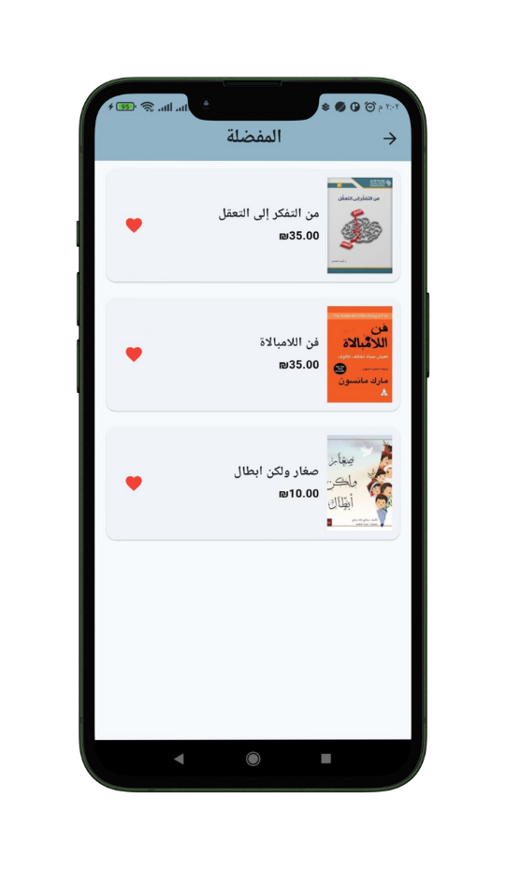
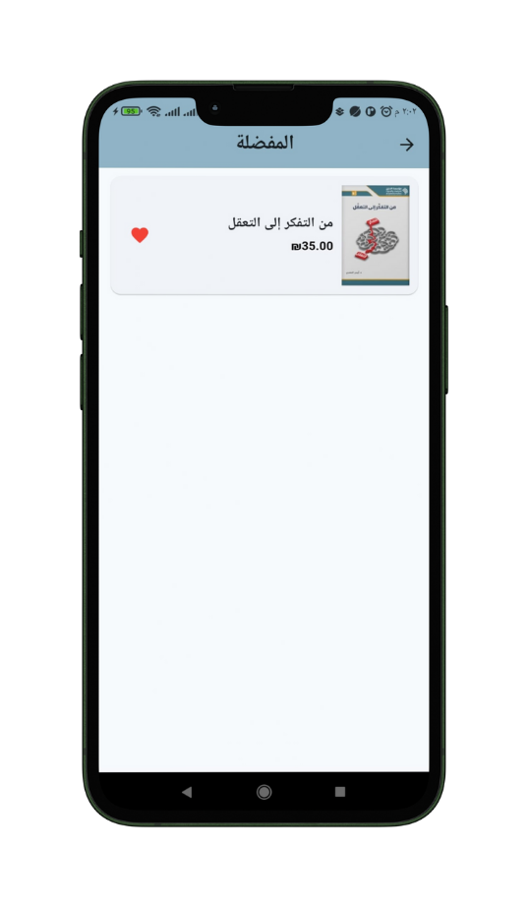

Wishlist Page
On this page, all the books that the user has added to their favorites will be displayed.
Delete from Wishlist

Slide 19
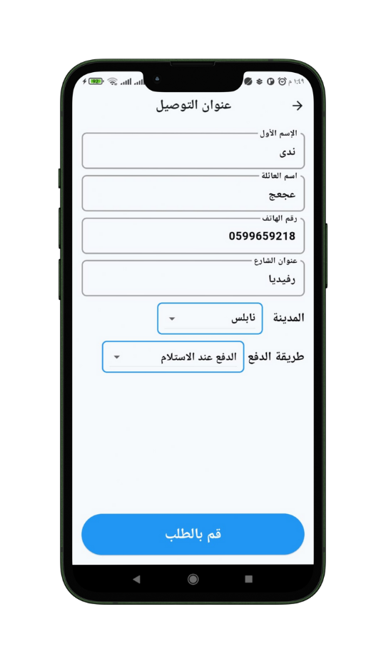
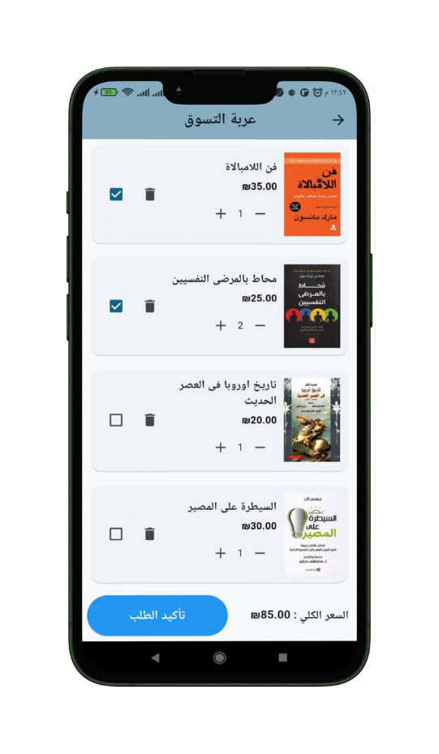
Cart Page
This page displays all the books the user has added to the cart with their quantities. The user can select the books they want to confirm for purchase and then enter their details to finalize the order.
Make Order

Slide 20

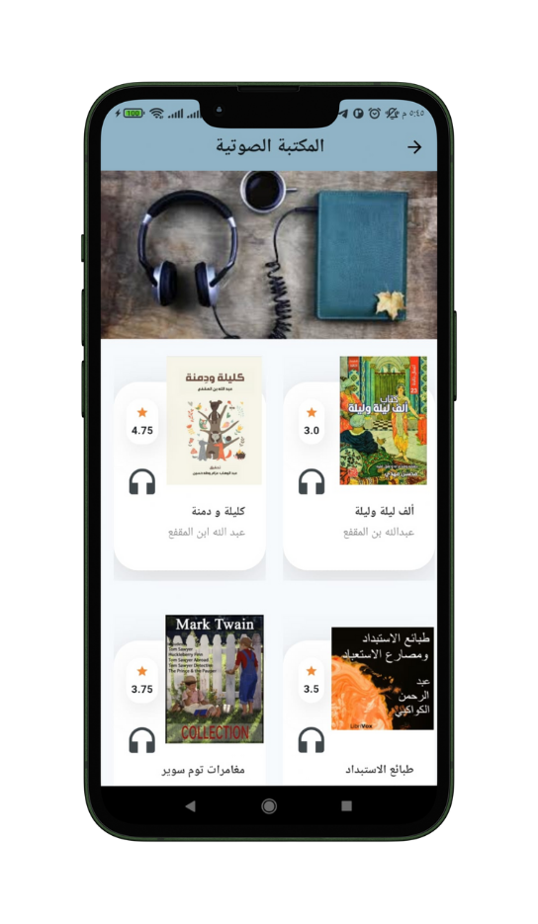
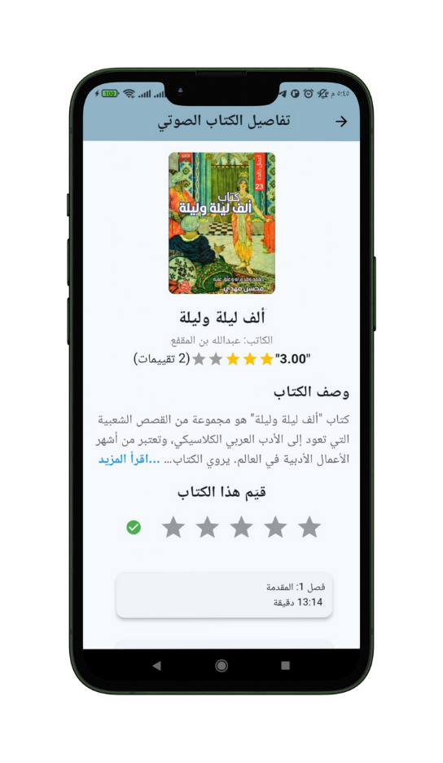
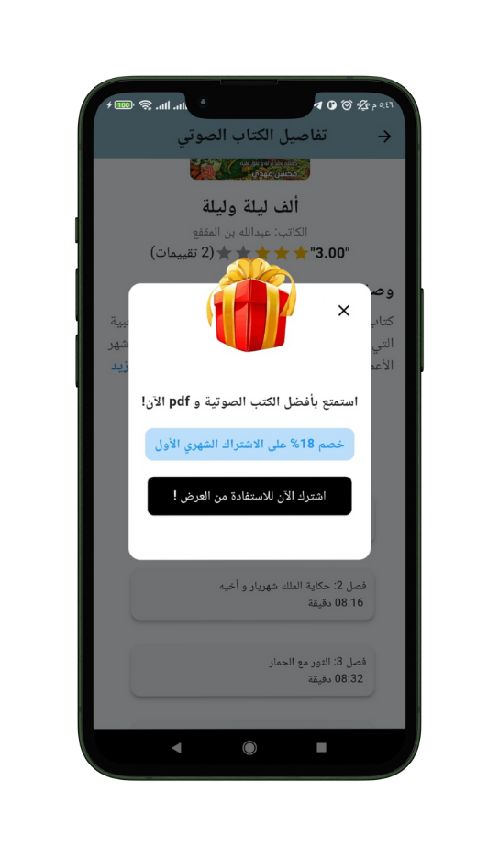
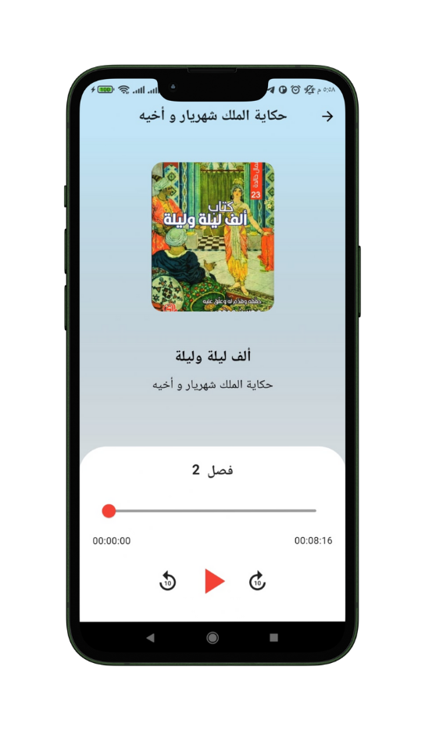

Audio Library Page

Slide 21
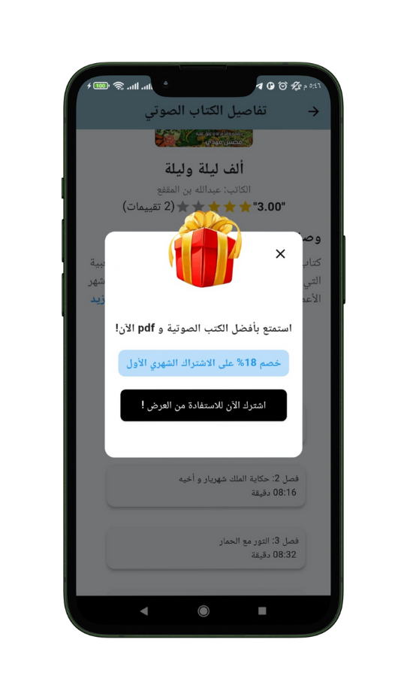
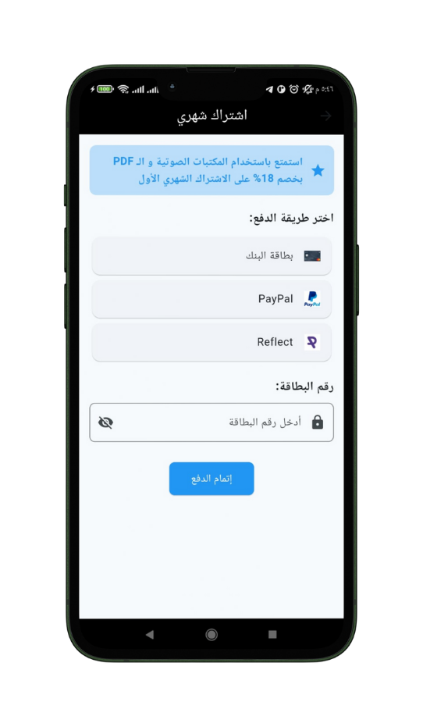

Subsicription Page

Slide 22
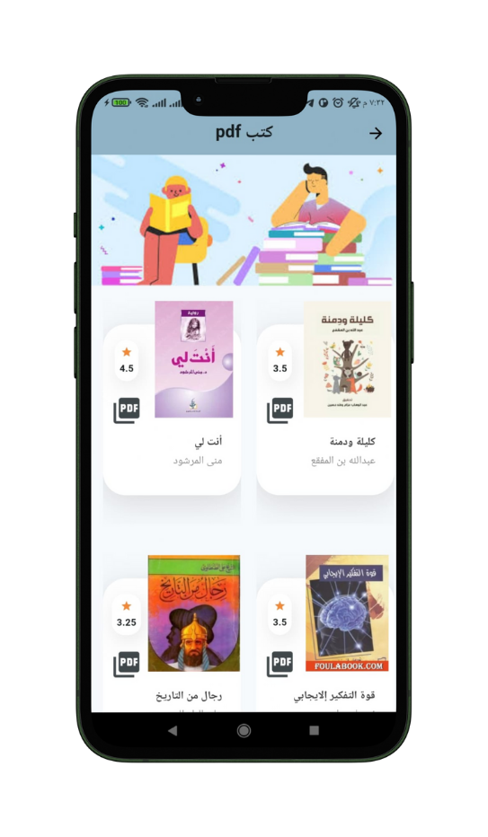
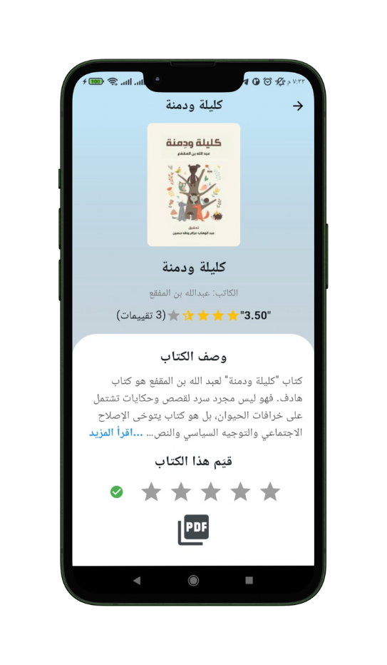
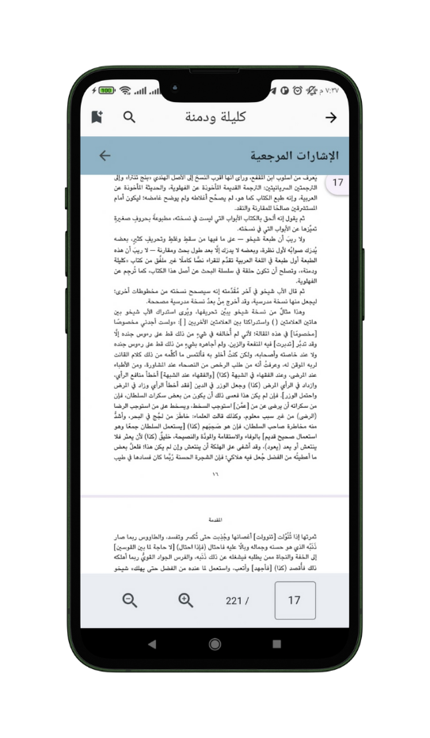
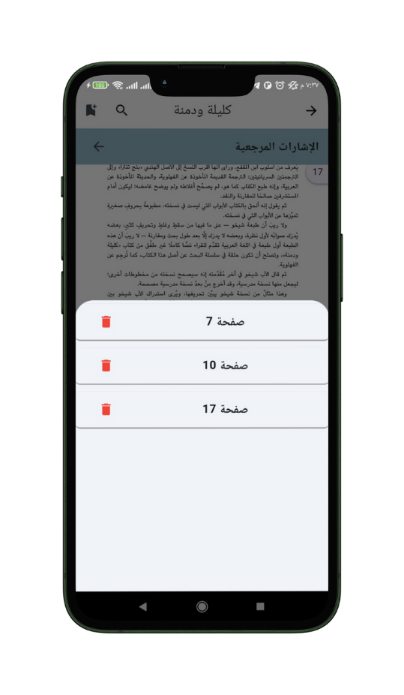
Pdf Book Page

Slide 23
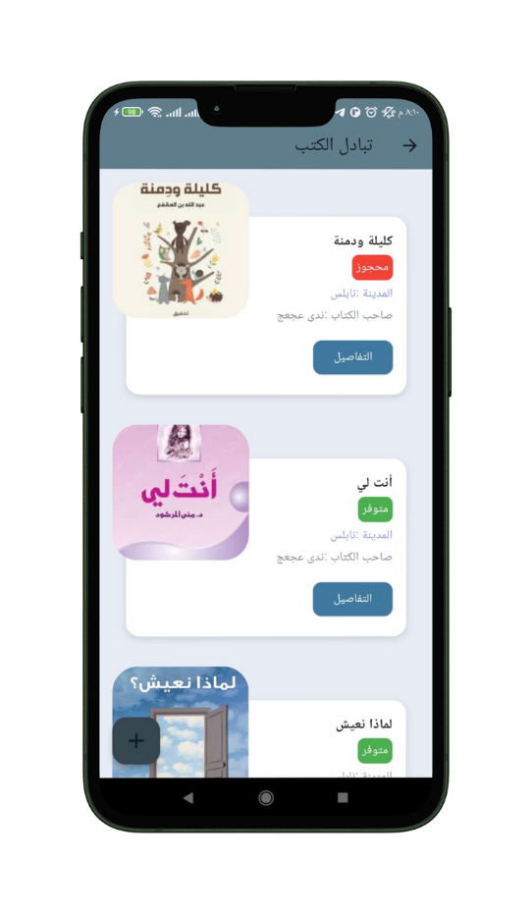
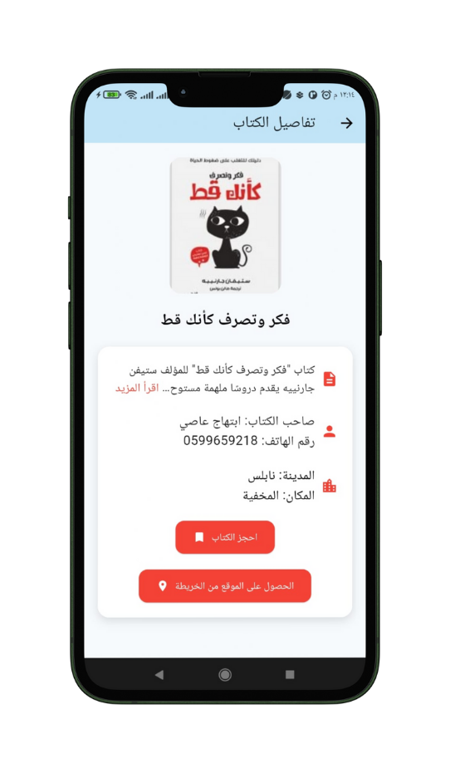
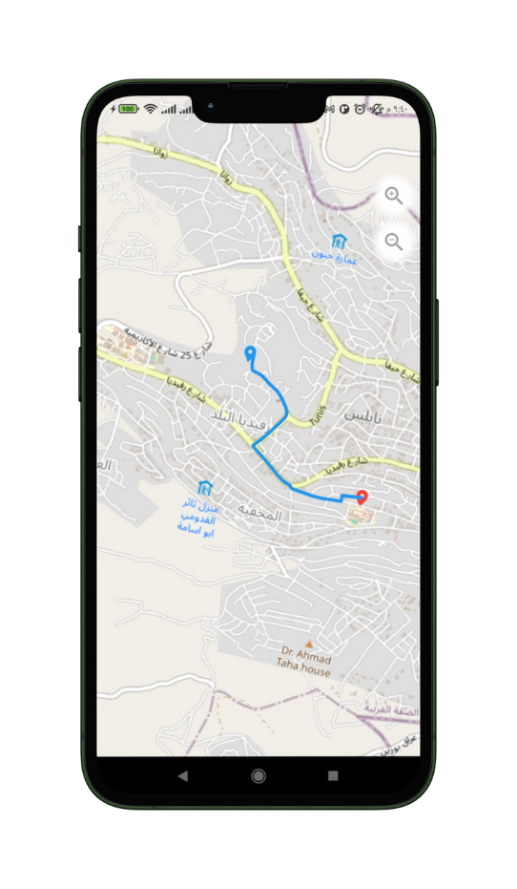
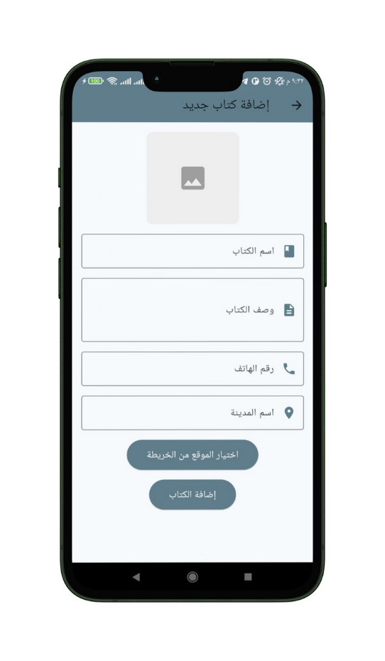
Exchange Book Page

Slide 24
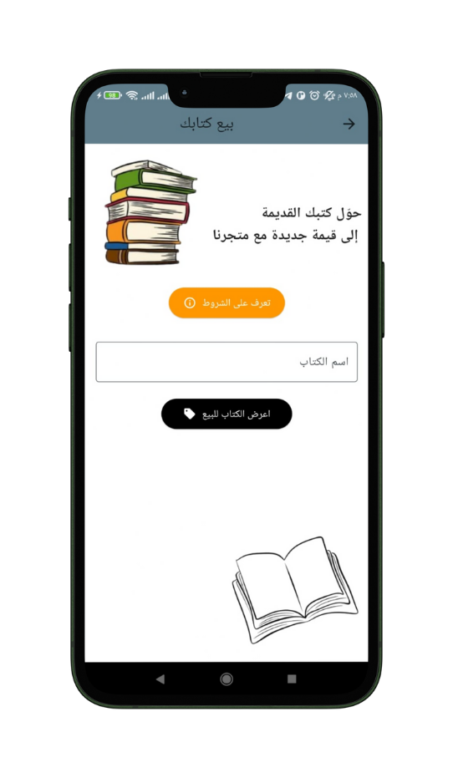
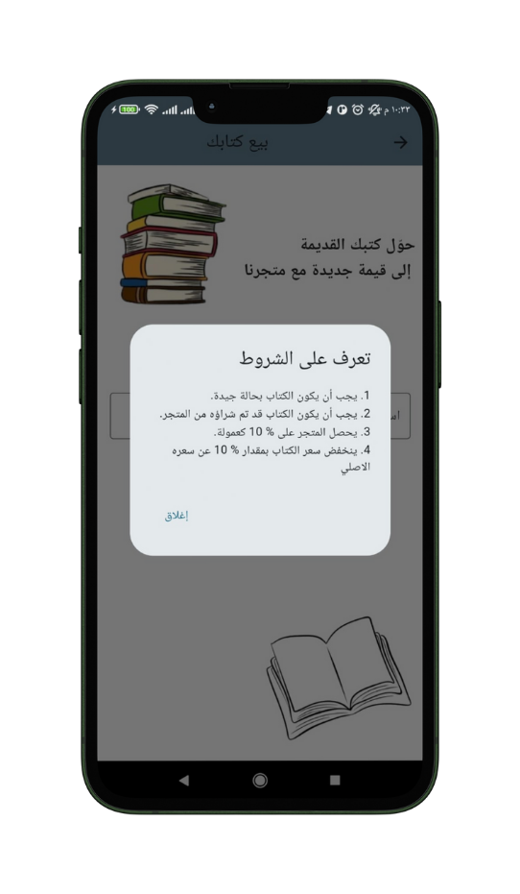
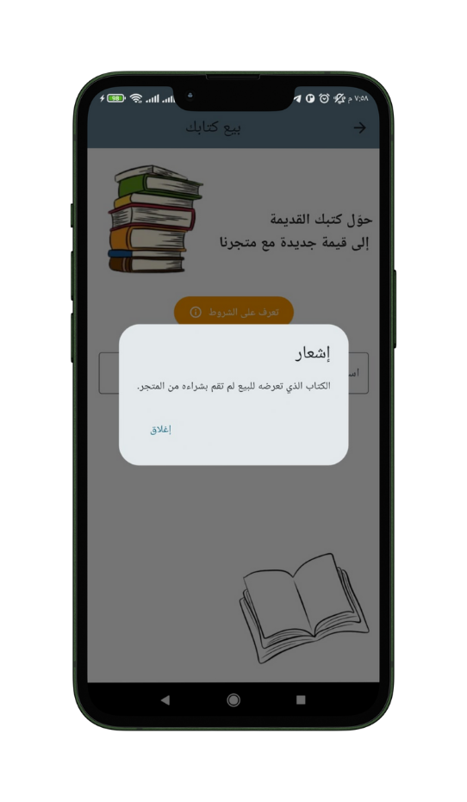

Used Books Selling Page

Slide 25
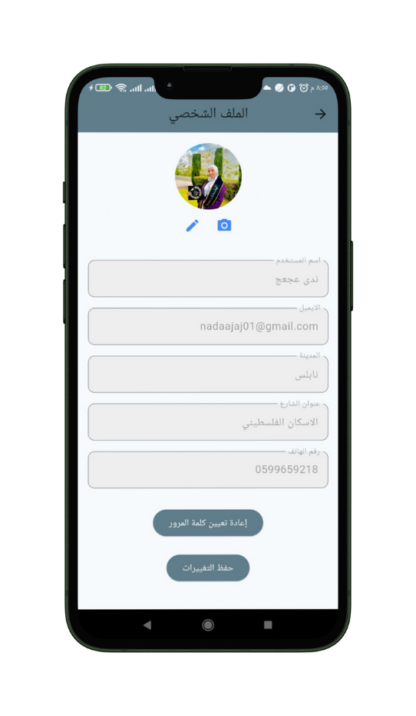
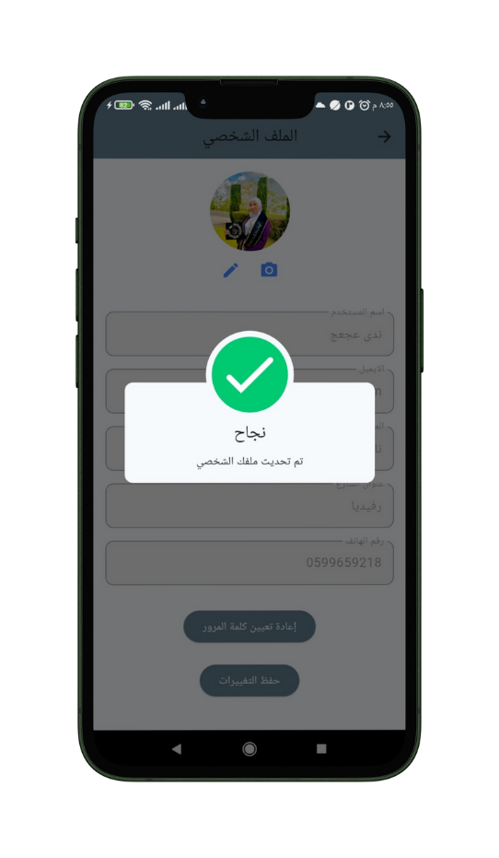
Profile Page
The user can edit their personal information or profile picture through this page.

Slide 26
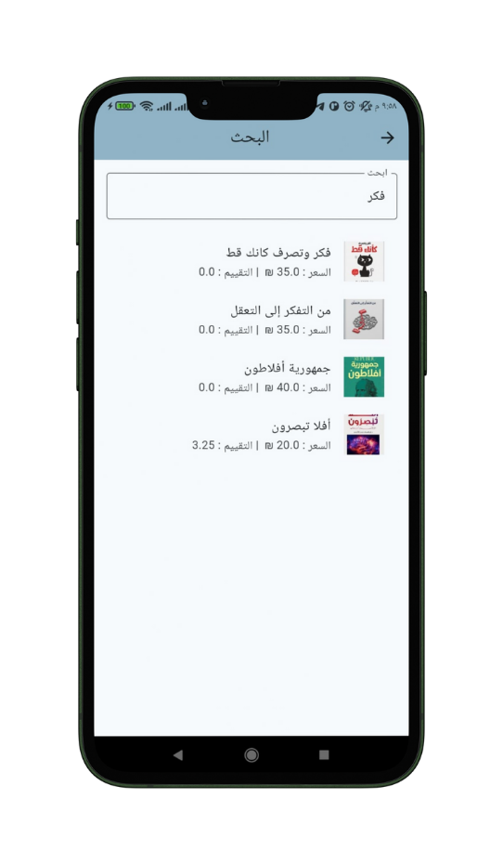
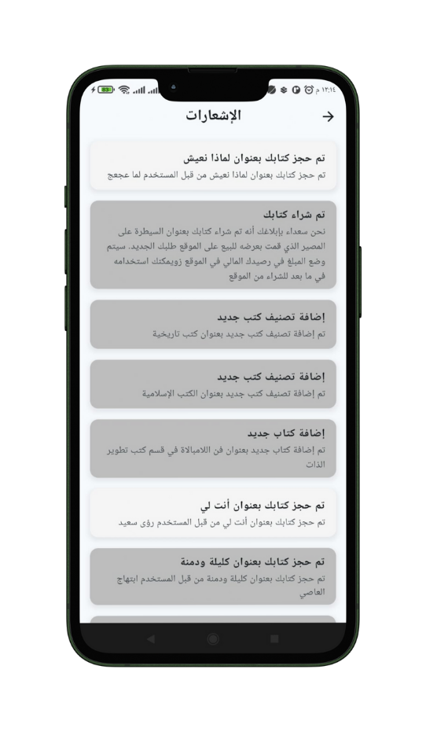
Search Page
Notification Page

Slide 27
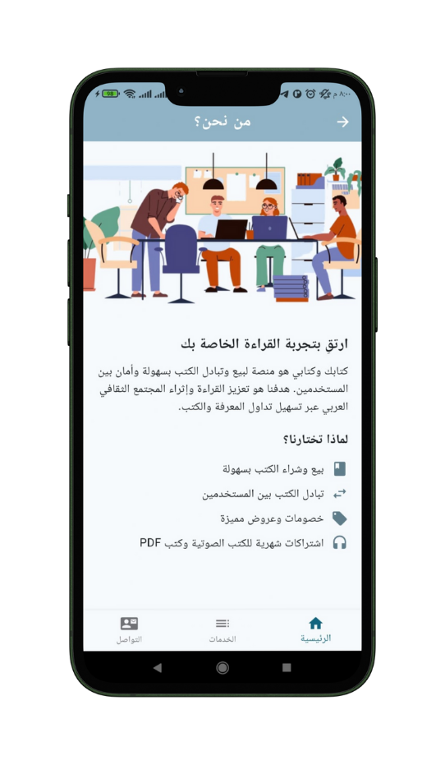
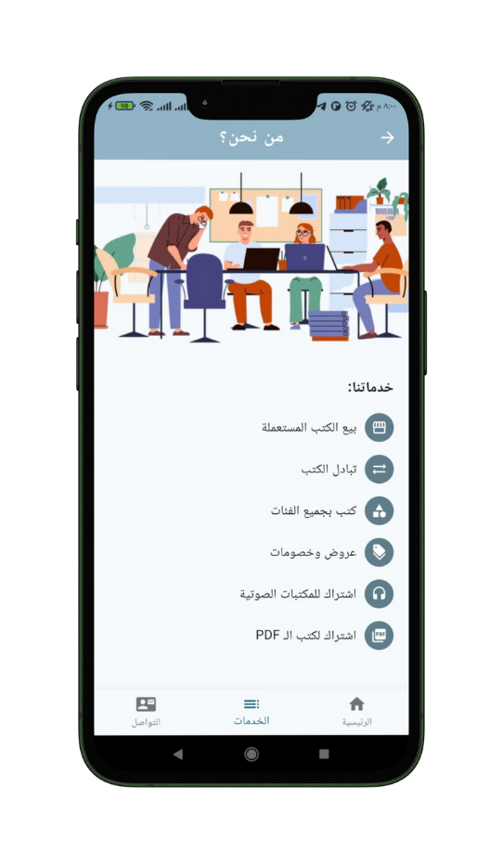
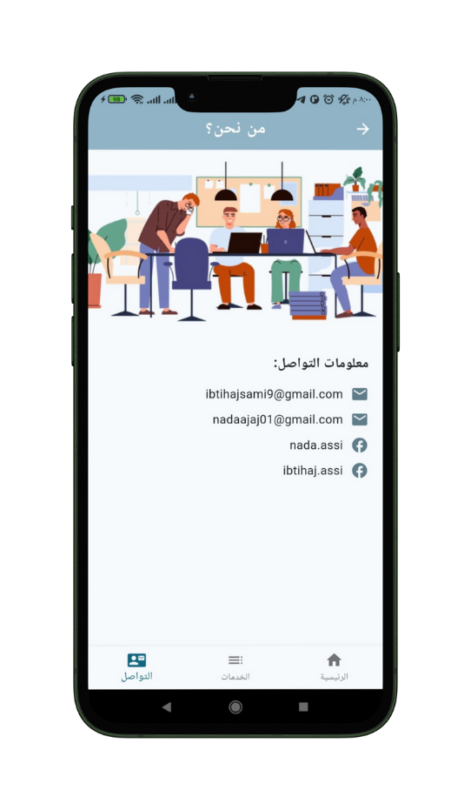
Aboute Us Page

Slide 28
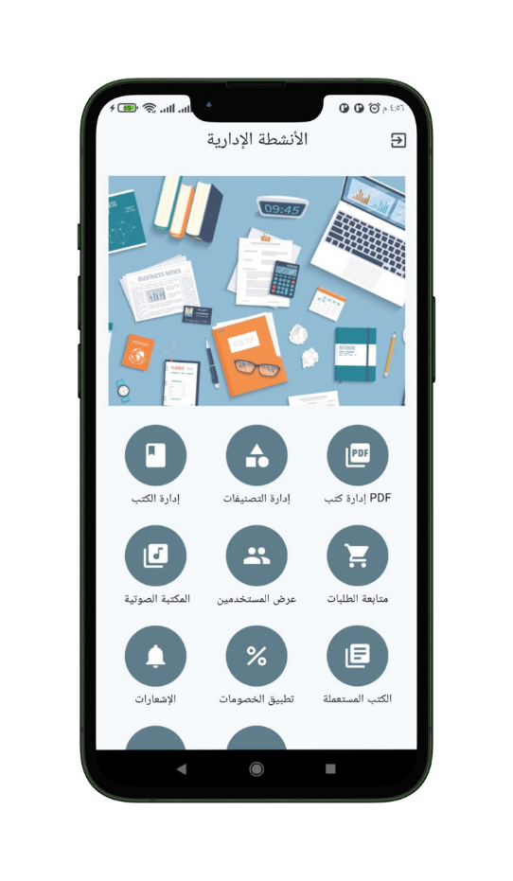
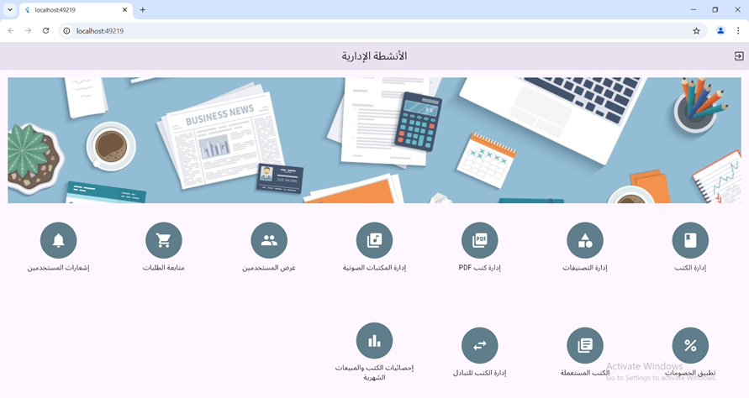
Admin Features

Slide 29
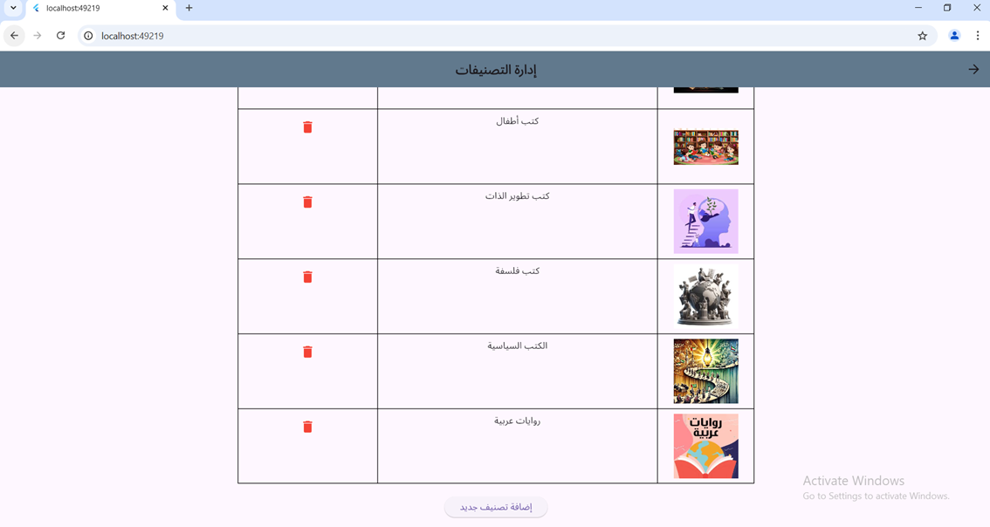
Category Manegement
All categories are displayed, and the admin can add or delete categories as needed.

Slide 30


Book Manegement
All categories are displayed on this page
The admin can select the category they want to add or edit a book in, after viewing all the books available in that category.

Slide 31

Pdf Book Manegement
All books are displayed, and the admin can add, delete, edit, or view the PDF book.

Slide 32


Audio Book Manegement
Chapters page

Slide 33

View User
The admin can view the users who have registered in the store.

Slide 34


View Order
  The admin can modify the order status.

Slide 35

Used Books Mangement
The admin can view the books listed for sale and know the email of the user who posted the book for sale.
4o mini

Slide 36


Exchange Book manegement
The admin can view the books available for exchange, and upon clicking on them, the details of the book owner are displayed.

Slide 37

Notification
The admin can send notifications or
motivational messages to users

Slide 38

Discount
The admin can apply discounts to a specific book, a particular category, or all the books available in the store.

Slide 39

Sales Statistics
The admin can know the best-selling books.
The admin can track the monthly sales, with a color-coded indicator: red means low sales, orange means average sales, and green means high sales.

Slide 40




Future Work
01
02
Adding English language support in the application
Create a special section for delivery

Slide 41

Thank's For Watching

