Slide 1
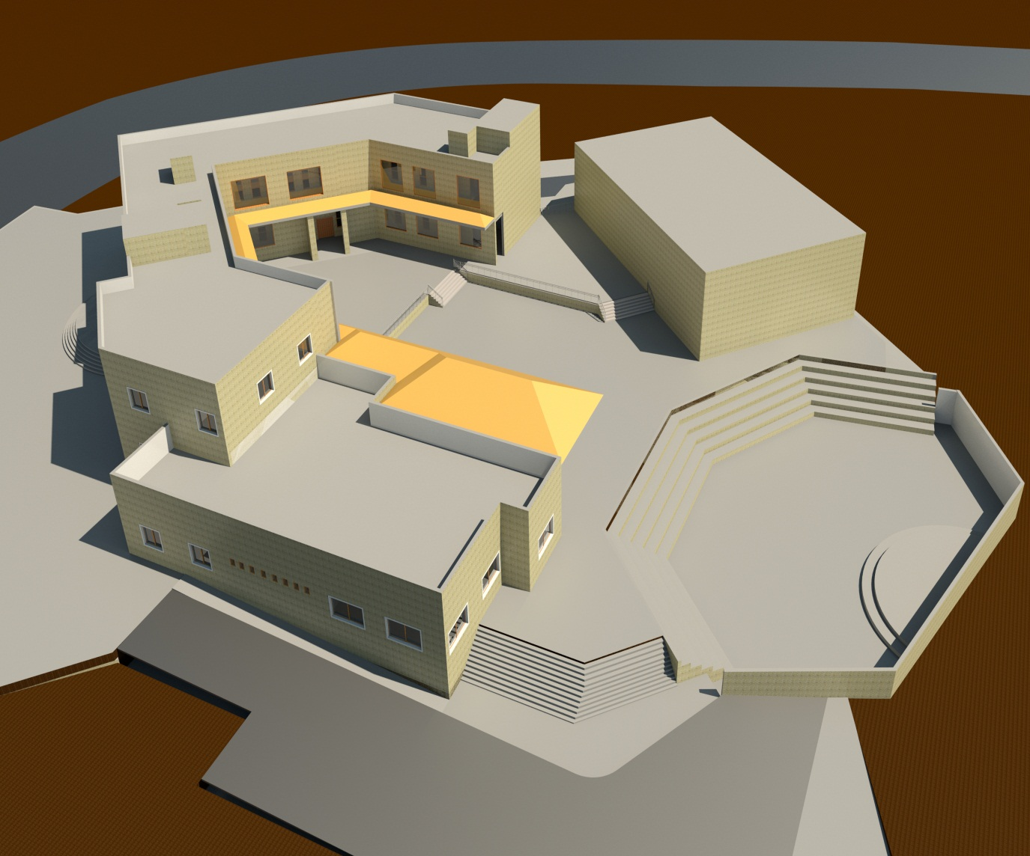

Cultural
Center
Prepared By
Ahmad Atatri Shadi Hanon
Ahmad Ahmad Ayoub azmi
Supervisor
Dr. Alaa’ Shahen

Slide 2
Outline
Introduction and Site location
Architectural Design
Environmental Design
Structural Design
Mechanical Design
Electrical Design
Safety Design
BOQ

Slide 3
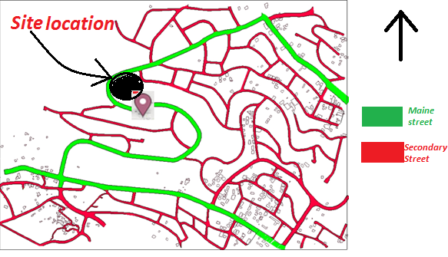

Slide 4
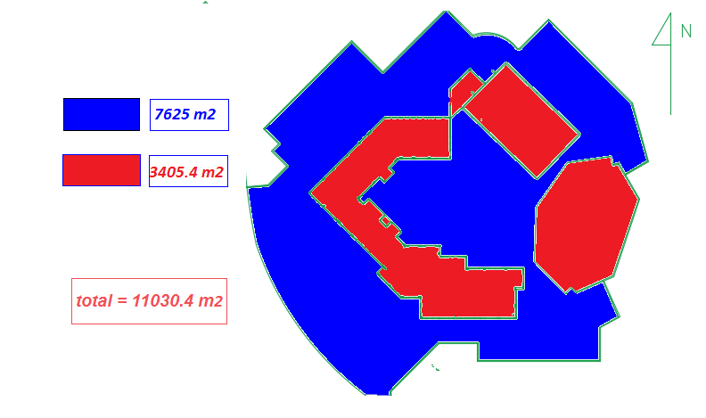

Slide 5
Outline
Site location
Site plan
Architectural Design
Circulation and entrances
Environmental Design
Parking
Structural Design
Plans
Mechanical Design
Safety Design
Elevations
Electrical Design
BOQ

Slide 6
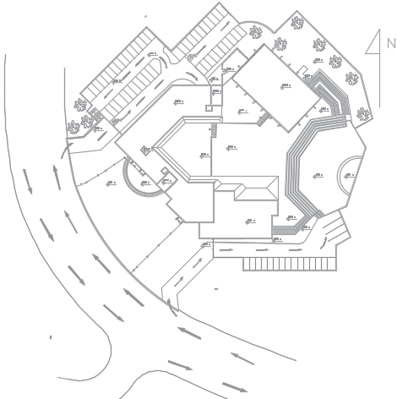
Site plan

Slide 7
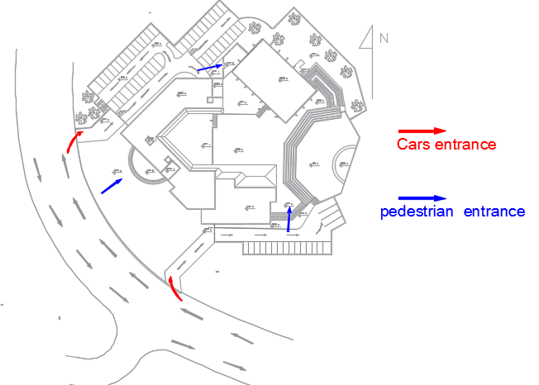
Circulation and Entrances
Notes:
pedestrian

Slide 8
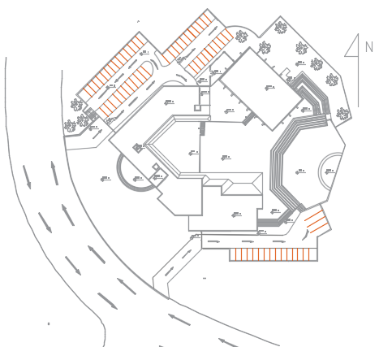
Parking
Area = 2150 m2
No. car parking | zone
62 cars 4 busses | Theaters and library
10 cars 17 cars | Employee Gallery

Slide 9
Outline
Site location
Site plan
Architectural Design
Circulation and entrances
Environmental Design
Parking
Structural Design
Plans
Mechanical Design
Safety Design
Elevations
Electrical Design
BOQ

Slide 10
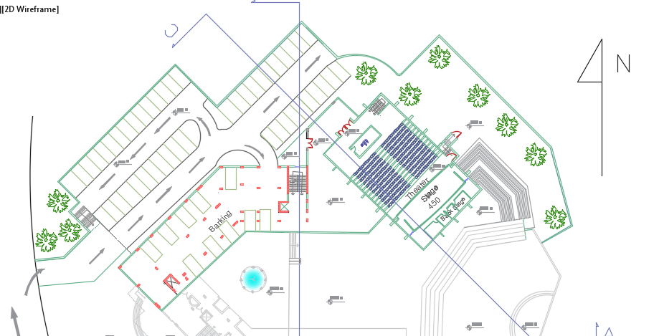
Basement Floor
Total Area = 1780 m²

Slide 11
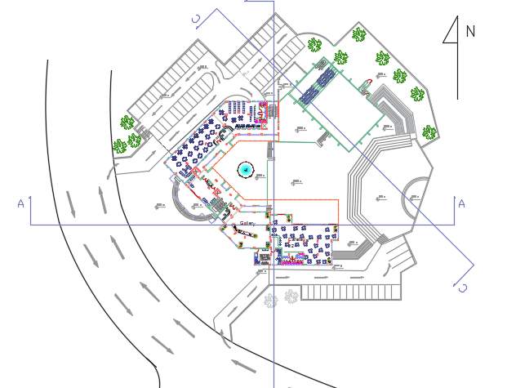
Ground Floor
Total Area = 1624 m²

Slide 12
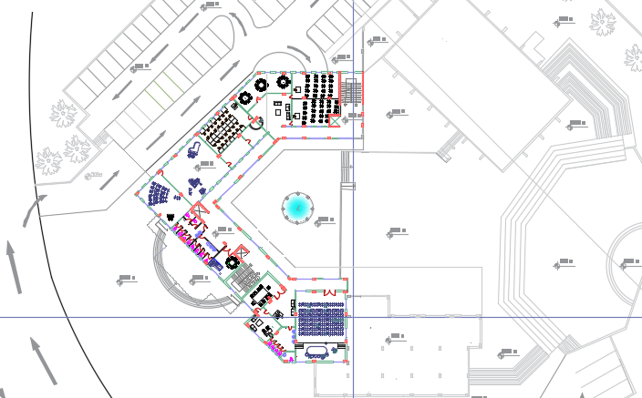
First Floor
Total Area = 1108 m²

Slide 13
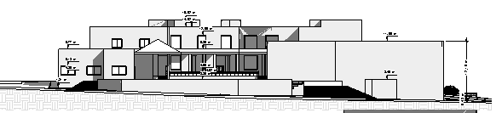
East Elevation

Slide 14
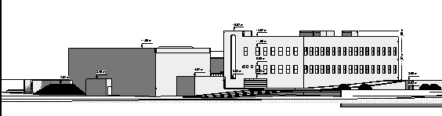
North Elevation

Slide 15
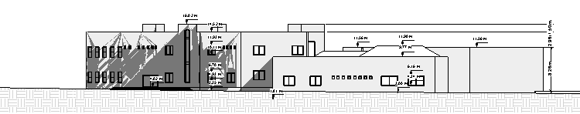
South Elevation

Slide 16
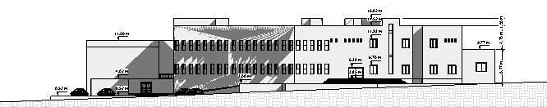
West Elevation

Slide 17
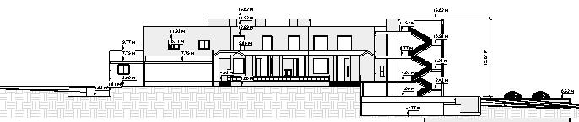
Section B-B

Slide 18
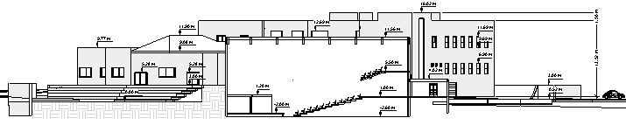
Section C-C

Slide 19
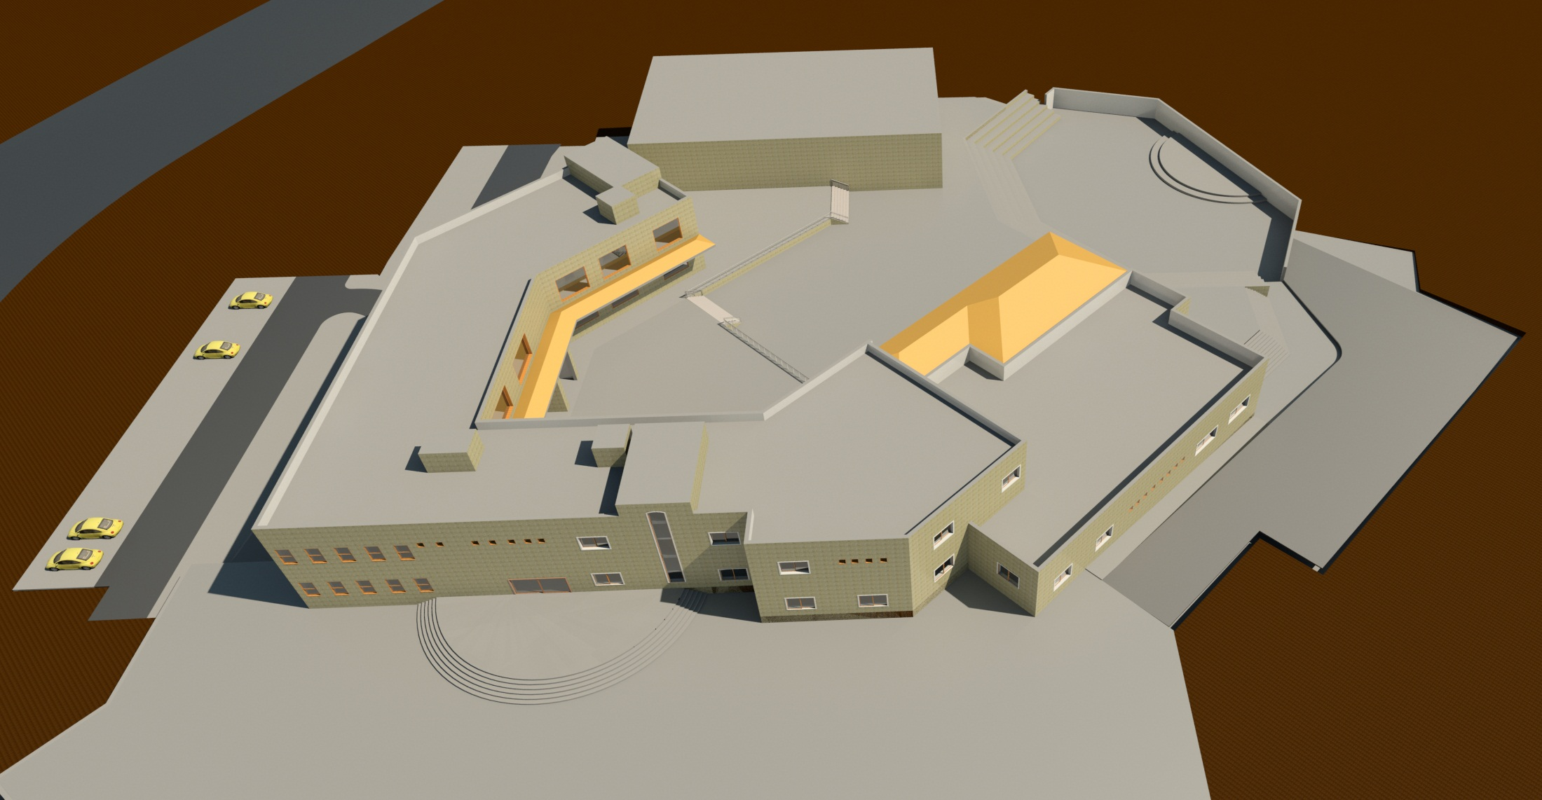

Slide 20
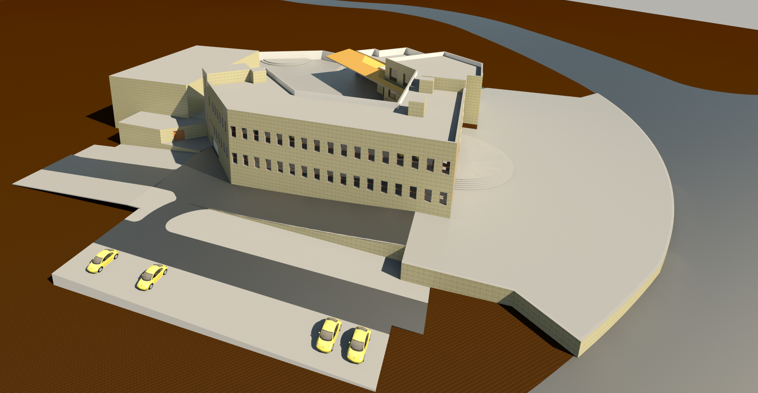

Slide 21
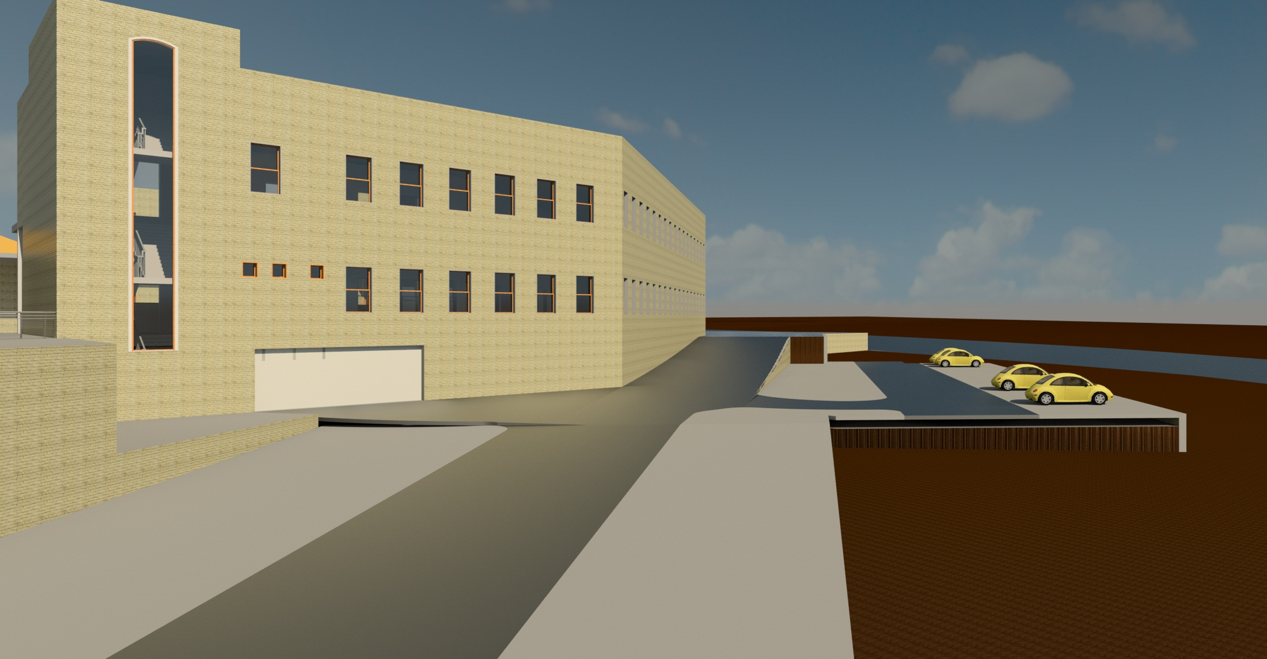

Slide 22
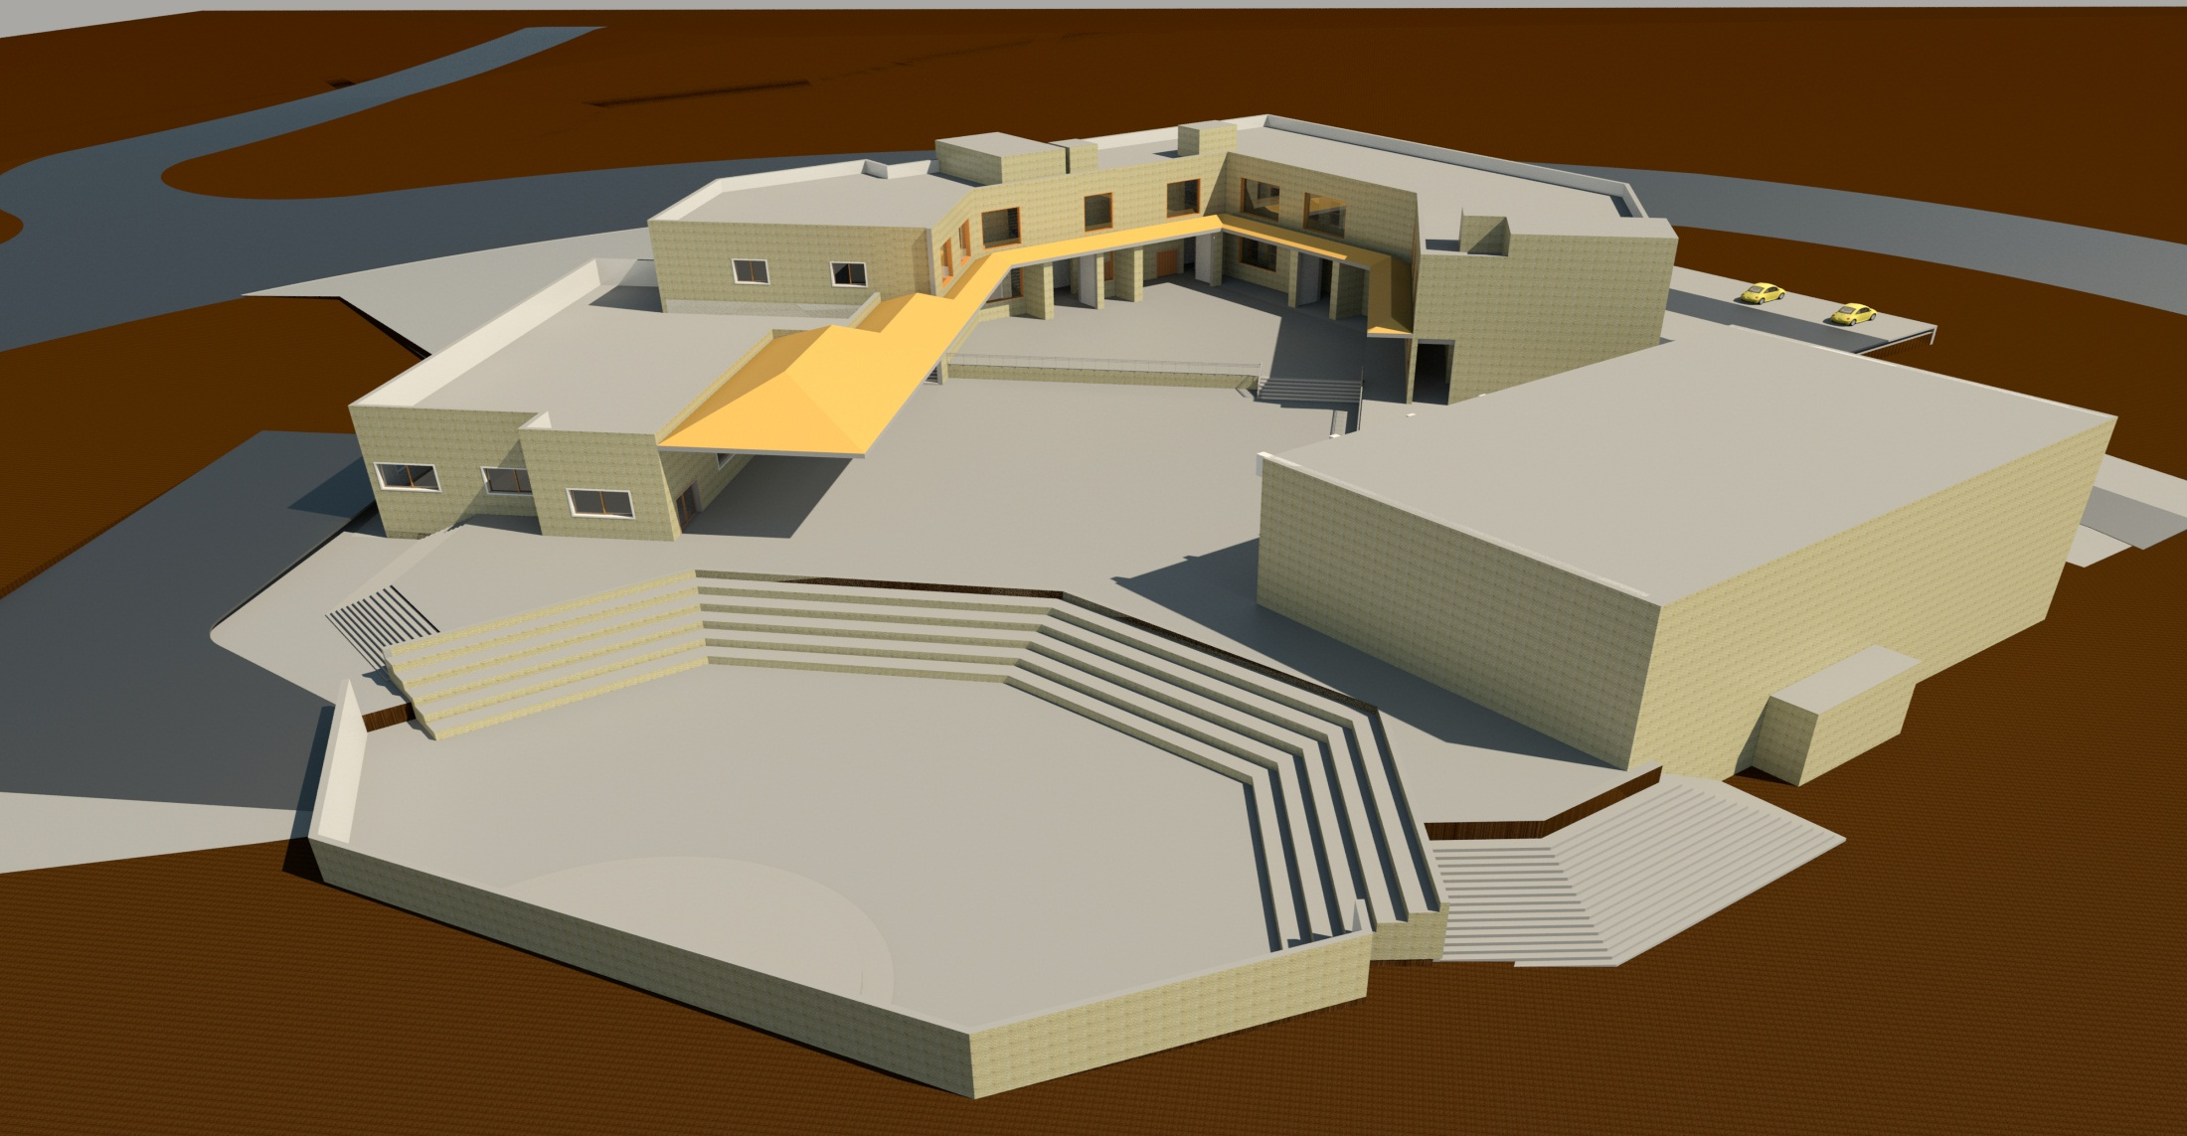

Slide 23
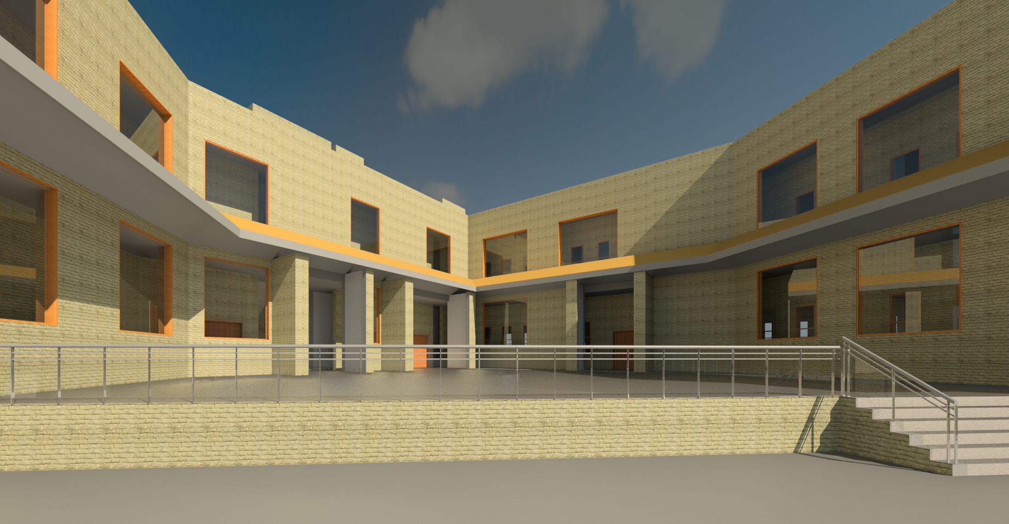

Slide 24
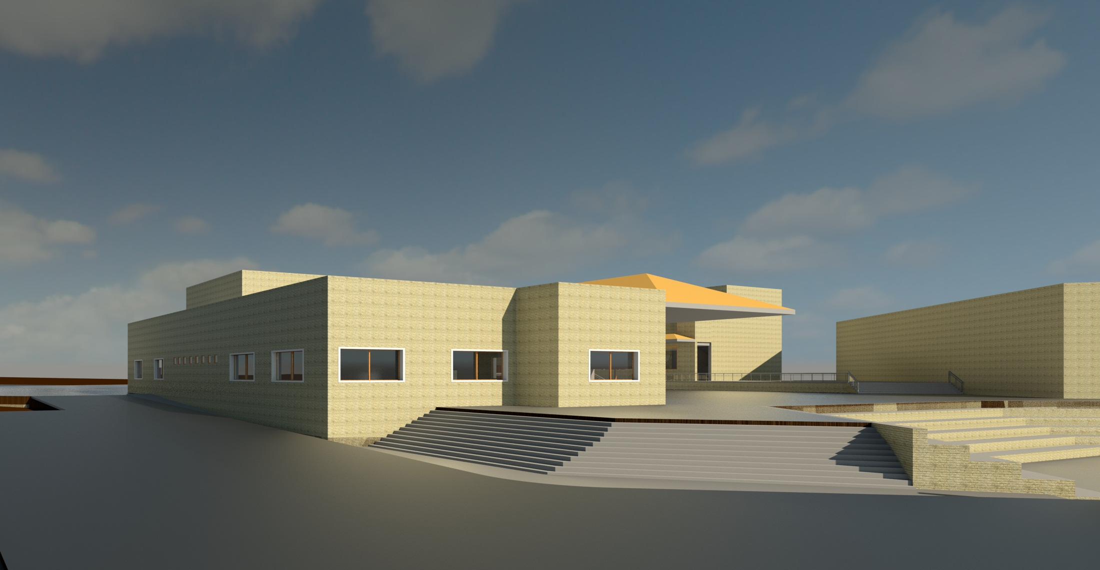

Slide 25
Outline
Site location
Daylight factor
Architectural Design
Environmental Design
Thermal analysis and materials
Structural Design
Mechanical Design
Acoustical design
Electrical Design
Safety Design
BOQ

Slide 26
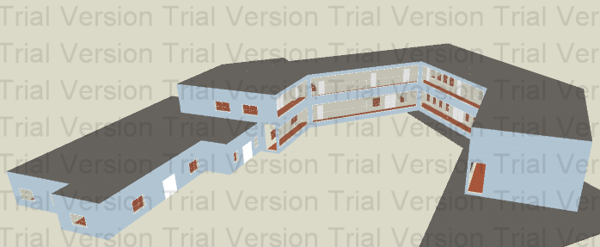
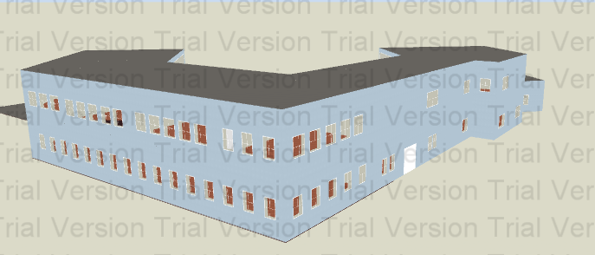
Building in Design Builder

Slide 27
Daylight Factor
4.45 % | In F.F
3.77 % | In G.F

Slide 28
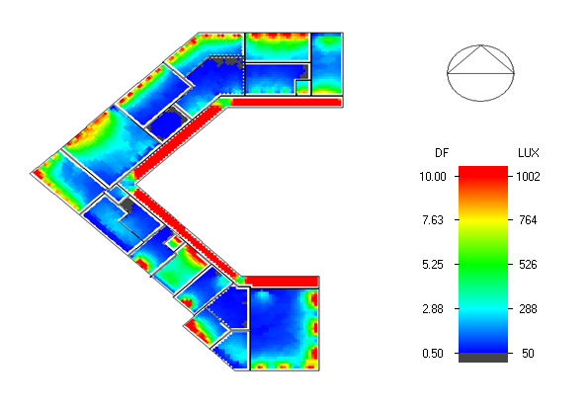
Daylight factor in F.F

Slide 29
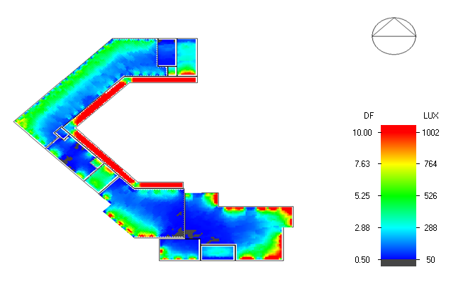
Daylight factor in G.F

Slide 30
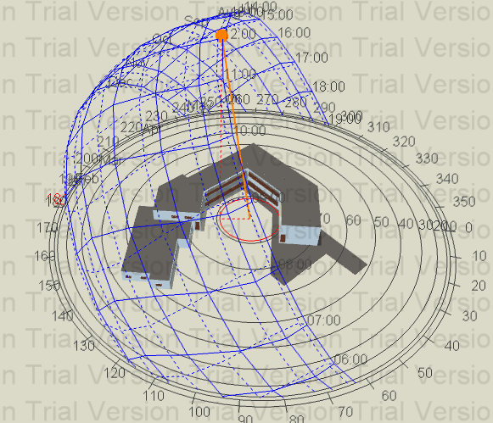
Sun path and shadow on building in summer at 12.00pm

Slide 31
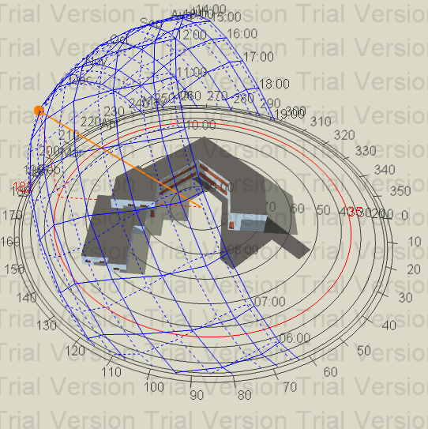
Sun path and shadow on building in winter at 12.00pm

Slide 32
Thermal Analysis
Total cooling load (KW) = 209 KW In 21/7
Total Heating load (KW) = 123 KW In 21/12

Slide 33
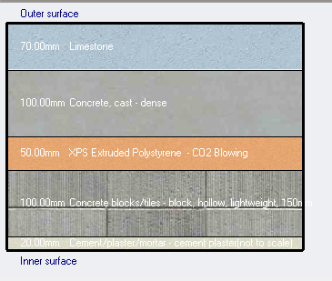
Materials :
External wall of U = 0.5041 W/m2.K

Slide 34
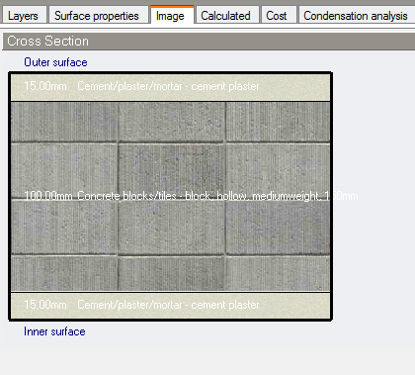
Internal wall of U = 2.16 W/m2.K

Slide 35
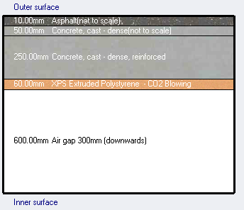
Roof of U = 0.422 W/m2.K

Slide 36
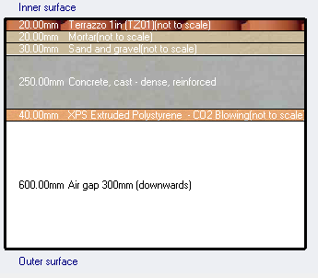
Internal Floor of U = 0.539 W/m2.K

Slide 37
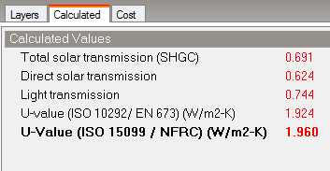
Glass material :
The windows consist of two layers (double glazing) with air gap =6mm
U = 1.96 W/m2.K

Slide 38
Outline
Site location
Architectural Design
Daylight factor
Environmental Design
Thermal analysis and materials
Structural Design
Mechanical Design
Acoustical design
Electrical Design
Safety Design
BOQ

Slide 39
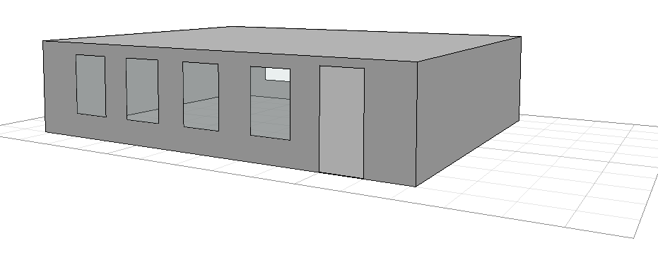
Model in Ecotect

Slide 40

Reverberation Time RT60
The optimum reverberation time for Music room is 2-2.5 ,
We Use board gypsum in ceiling and use plaster gypsum in walls

Slide 41


RT₆₀ before any improvement
RT₆₀ after applying the improvements

Slide 42
Outline
Site location
Design cods
Architectural Design
Design Data
Environmental Design
Structural Design
Structural Elements
Mechanical Design
Etabs Result
Electrical Design
Detailing
Safety Design
BOQ

Slide 43
Design Codes
The American Concrete Institute code (ACI 318-11).
The seismic design according to UBC-97.
The analysis and design were done using ETABS 2015 programs.

Slide 44
Design Data
1. Concrete compressive strength
f’c =24 MPa for slabs and beams.
f’c = 32 MPa for shear walls, columns and footings.
2.Yielding strength of steel
The yield strength of steel Fy= 420MPa
3. Bearing capacity of soil
the bearing capacity of soil = 250 KN/m2

Slide 45
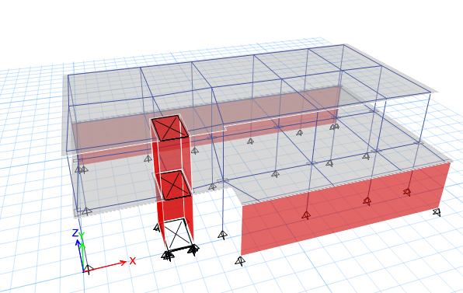
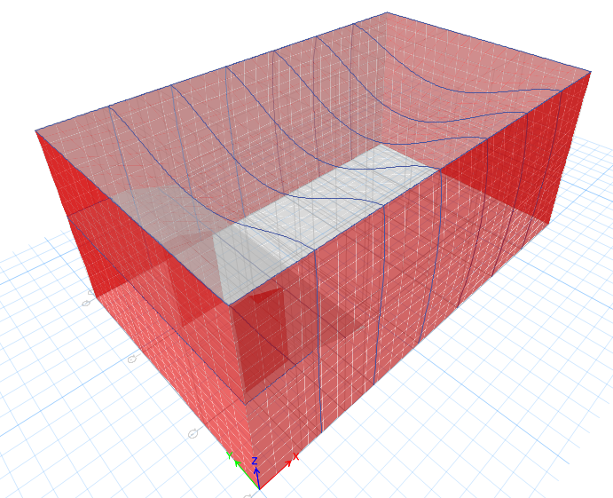
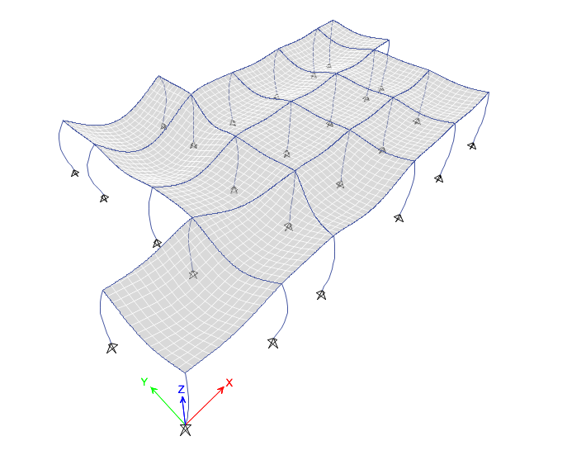
Designed block
Library
Cafeteria
Theater

Slide 46
Structural Systems
Tow way solid slab
Thickness :
Library = 17cm
Cafeteria = 20cm
One way solid slab
Theater = 20 cm

Slide 47
Cheeks
1-Compatiblity check
2-deflection cheek .
3-Equlibriume check
4-Stres strain check

Slide 48
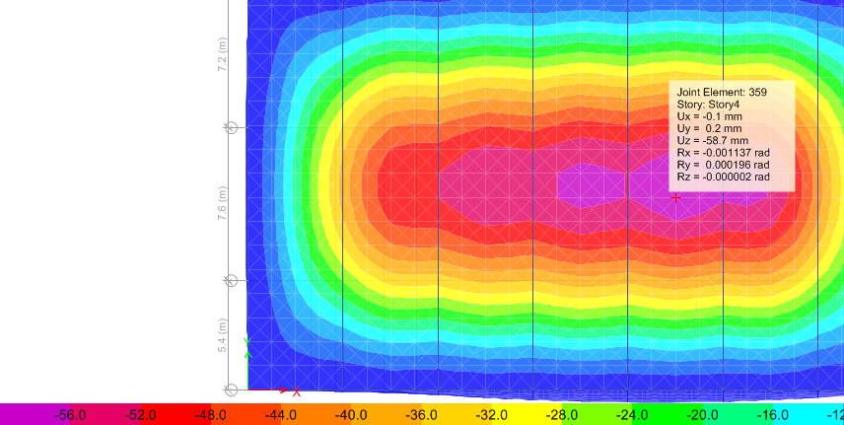
Checks
ETABS 2015
deflection cheek :Compatibility cheek
Allwable = 20.1/240=83.7mm
max deflection on slab = 58.7

Slide 49
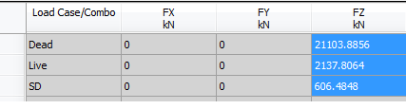
Checks
ETABS 2015
Equilibrium Check
E-tabs result hand result
Live load = = 2182.86 KN
dead+ SD load == 21849.25 KN
% of deference
Dead *SD load = 0.6 % , live load = 2 %.

Slide 50
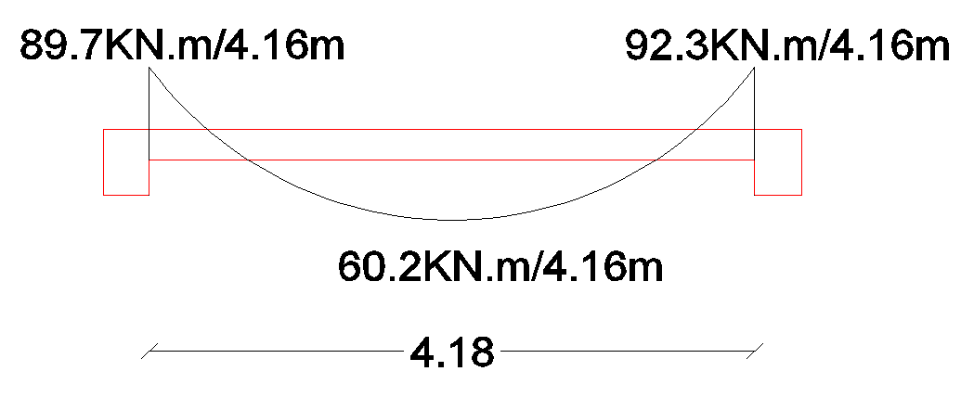

Checks
ETABS 2015
E-tabs result Stress strain check
Hand calculation
Wu (span) = 4.7*((1.6*3.0) + (1.2*0.2*25)) = 50.7KN
Mu (span) = Wu*Ln/8= 50.7*(4.7/8= 140.0KN.
Mu (ETABs)= +60.2= 147.4KN.M

Slide 51
Seismic Design
Response Spectrum
library blocks frame system
period from hand calculation,1.3*Thand =0.379s
UBC-97
I = 1
Z= 0.2
R= 5.5
Ca= 0.24
Cv= 0.32
T = 0.29 sec
W=14620.96KN, Include D.L+S.D+0.25LL

Slide 52

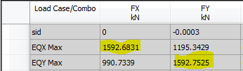

Seismic Design
Response Spectrum
Base shear check : base reaction from E-tabs

Slide 53

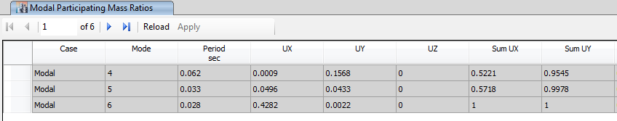
Story drift
show model participation ratio result

Slide 54
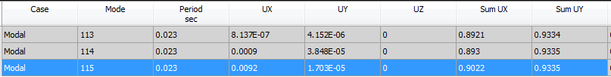
Seismic Design
Response Spectrum
Theater shear wall system
period from hand calculation,1.3*Thand =0.42s
T(E-tabs) = .322 s
required modal = 115
UBC-97
I = 1
Z= 0.2
R= 5.5
Ca= 0.24
Cv= 0.32
T = 0.32 sec
W= 22244.81KN, Include D.L+S.D+0.25LL

Slide 55

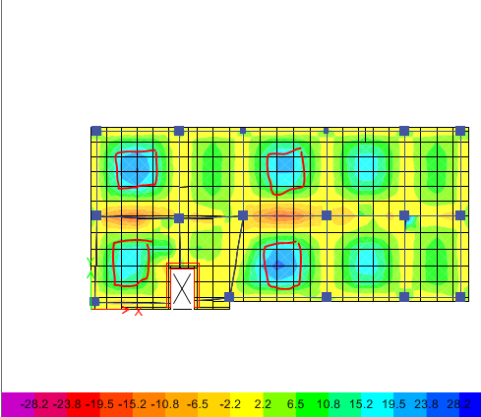
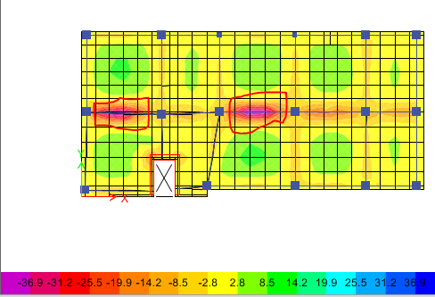
Slab design
AS_{min} = ρmin*b*d As._{min} = 0.0033*1000*130= 390mm2 use 3Ø14
Ømn = ØAS_{min} *FY*(D- ) =19.16 KN.M

Slide 56
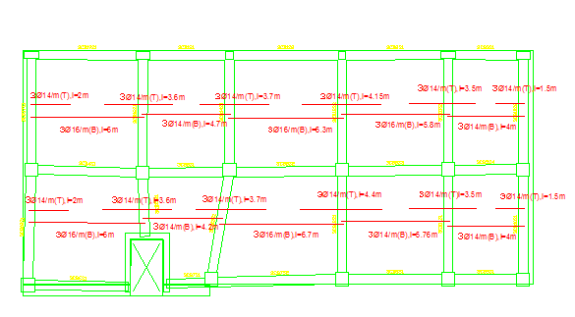
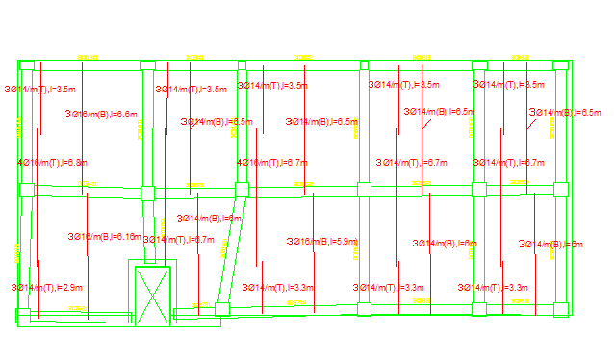
Slab Reinforcement

Slide 57
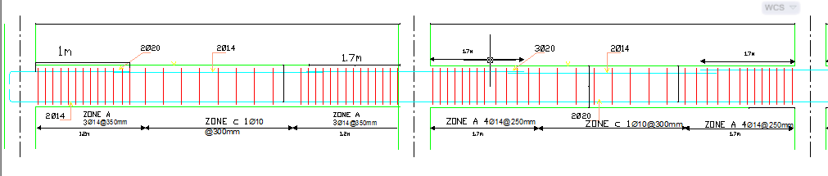
Beams Reinforcement

Slide 58
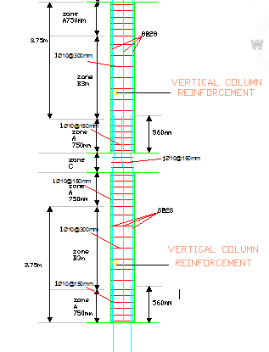
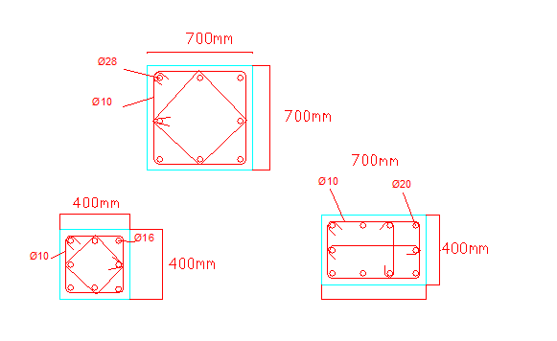
Columns Reinforcement

Slide 59
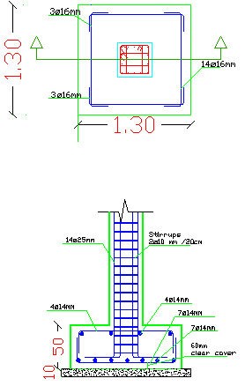
Footing Reinforcement

Slide 60

Spiral Stairs Reinforcement

Slide 61
Shear wall design
Thickness = 40 cm h = 33m
Moment = 12218KN.m , V= 1460 KN
fc_all= (0.3-0.4) * 350 =140 Kg/cm2
N= max (𝐴 * (𝐷+0.25𝐿) * 𝐴𝐷)
N= 2556.4 KN , A= 16.1 m2, y= L/2= 33/2= 4m 𝐼= I= 1197.9 m4
𝑓= −(𝑁 / 𝐴) ∓ (𝑀 / 𝐼) 𝑦
fmin = 25.3 KN/m2 = 0.25 Kg/cm2 (compression) <fc_allok
fmax = 362 KN/m2= 3.62 Kg/cm2 (compression)<fc_all, ok
For boundary
The boundary width= 0.1*L= 0.1*33 = 3.3 m
ρ= 1%
As= ρ b d = 0.01*0.4 * 1 = 4000mm²16Ø18 mm
Stirrups 1Ø10/15cm

Slide 62
Shear wall design
For horizontal steel:
ρ= 0.25%
As= ρ b d= 0.0025*0.4*1= 1000mm²→10Ø12mm²/m
For vertical steel:
ρ= 0.3%
As= ρ b d= 0.003*0.4*1= 1200 →10Ø12mm/m

Slide 63


Shear wall design

Slide 64
Outline
Site location
Architectural Design
Environmental Design
HVAC
Structural Design
Mechanical Design
Water supply system
Safety Design
Drainage system
Electrical Design
BOQ

Slide 65
Vrv system
LOW OPERATING COSTS.
2.PRECISE ZONE CONTROL.
3.PERSONAL COMFORT.
.

Slide 66



Vrv system
Out door unit
Indoor unit
Remote control

Slide 67
Vrv system
Cooling load (kw) | Heating load (kw) | Zone
8.43 | 8.43 | Bath rooms
36.9 | 17.4 | Library
19.75 | 12.8 | Corridor (gf)
4.21 | 3.73 | Entrance
12.73 | 9.23 | Gallery
24.81 | 18.3 | Cafeteria
7.34 | 2.01 | Kitchen (gf)
7.58 | 5.65 | Management
8.51 | 2.61 | Class room
4.49 | 3.36 | Tecing room
21.51 | 11.57 | Corridor (f.f)
4.56 | 2.01 | Kitchen (f.f)
22.15 | 11.55 | Music room
7 | 3.66 | Computer lab
7.97 | 7.78 | Multi-purpose room
76.42 | 60 | Theater
267.85 | 186.66 | Total

Slide 68

Vrv system
Required pipe diameter for cafteria

Slide 69

Vrv system
Required pipe diameter for theater

Slide 70

Vrv system
In door unit distribution in cafteria

Slide 71


Vrv system
In door unit distribution in theater

Slide 72
Outline
Site location
Architectural Design
Environmental Design
Structural Design
HVAC System
Mechanical Design
Water supply system
Safety Design
Electrical Design
Drainage system
BOQ

Slide 73

Water consumption
Total water demand = 6450 Gallon/day

Slide 74

Water isolation

Slide 75

Water supply :
For collector 1 :
meter : 2"
vertical : 2"
horizontal : 1.5"
branch: 1”

Slide 76
Water supply system :
Tank Design:
The size of the tank will be computed over four days.
6450 * 4 = 25800 gallon
= 117.3 cubic meter

Slide 77
Outline
Site location
Architectural Design
Environmental Design
Structural Design
Water supply system
Mechanical Design
Drainage system
Electrical Design
HVAC
Safety Design
BOQ

Slide 78


Drainage system for Library and offices
Stack diameter = 4"
Slope for pipe (horizontal pipe) 4" = 1%
Slope for pipe (horizontal pipe) 2" = 1%

Slide 79
Outline
Site location
Architectural Design
Environmental Design
Structural Design
Mechanical Design
Socket distribution
Electrical Design
Lighting distribution
Safety Design
Dialux
BOQ

Slide 80


Distribution of Sockets

Slide 81

Distribution of Lighting

Slide 82

Artificial Lighting
Dialux Program

Slide 83


Artificial Lighting
Dialux Program

Slide 84
Outline
Site location
Architectural Design
Environmental Design
Structural Design
Mechanical Design
Emergency signs
Electrical Design
Sprinklers distribution
Safety Design
Evacuation maps
BOQ

Slide 85



Emergency Signs

Slide 86

Fire Sprinklers Distribution

Slide 87

Fire Sprinklers Distribution
In Cafeteria – Ground Floor

Slide 88
Outline
Site location
Architectural Design
Environmental Design
Structural Design
Mechanical Design
Safety Design
Electrical Design
BOQ

Slide 89
Quantity Survey
Total cost of Cultural center per meter square = 1,821 NIS
Total Cost of the Cultural center
= 4,886,250.70 NIS

Slide 90
Thank you

