Slide 1
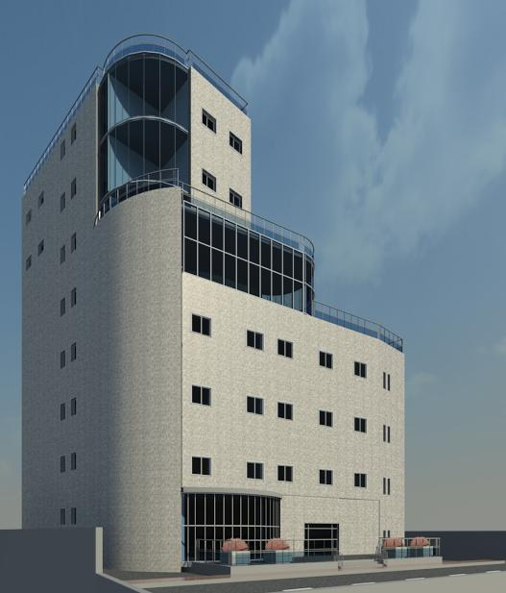
Nablus Municipality Redesign
Presented by:
Nour Aldin Tubeileh

Slide 2
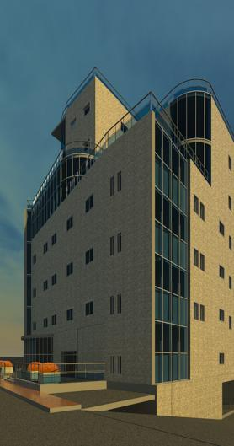
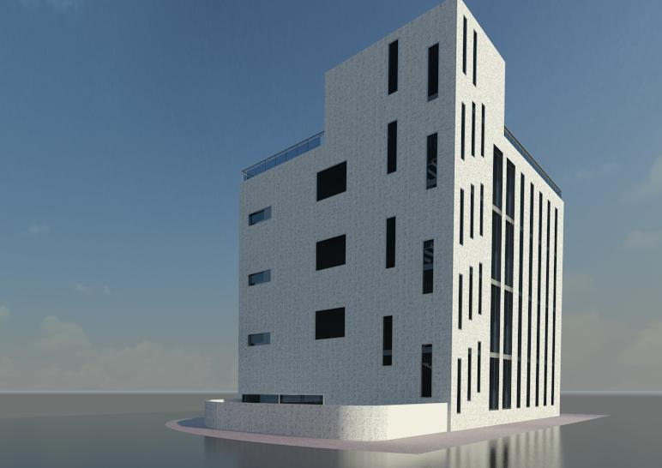
Architectural design:
Main building
Extinction building

Slide 3
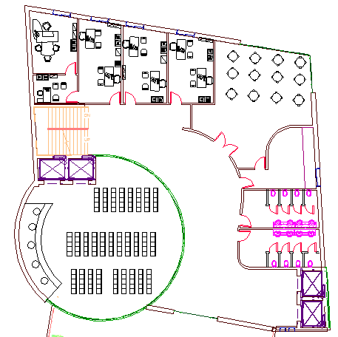

Architectural design:
Main Building Plans :
Ground floor:

Slide 4
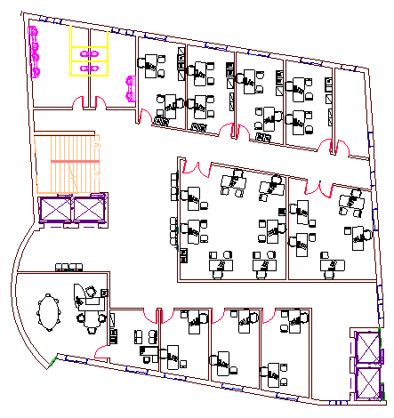
Architectural design:
Main Building Plans :
F1+F2+F3 floors:

Slide 5
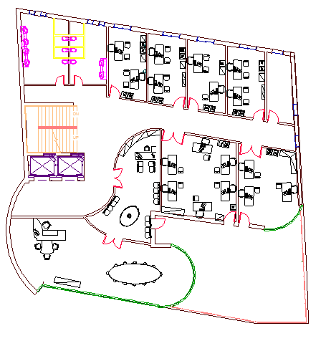
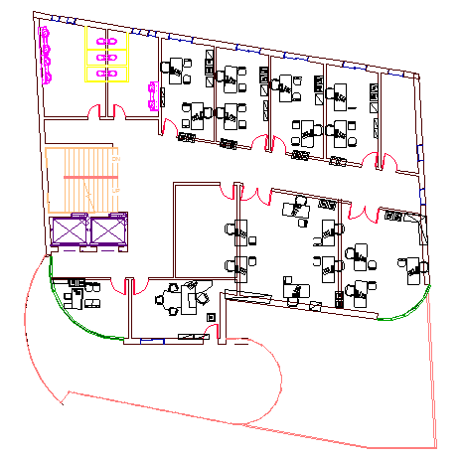
Architectural design:
Main Building Plans :
4th Floor
5th Floor

Slide 6
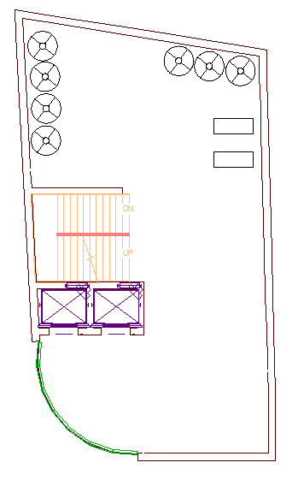
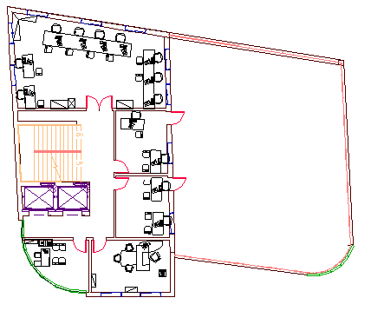
Architectural design:
Main Building Plans :

Slide 7
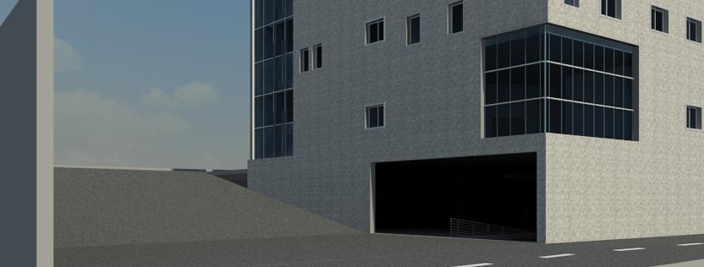
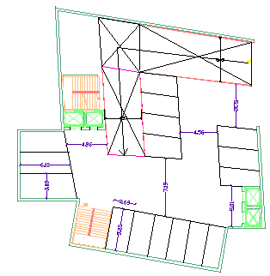
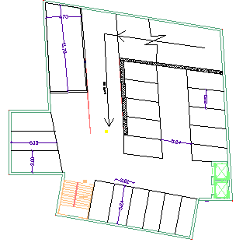
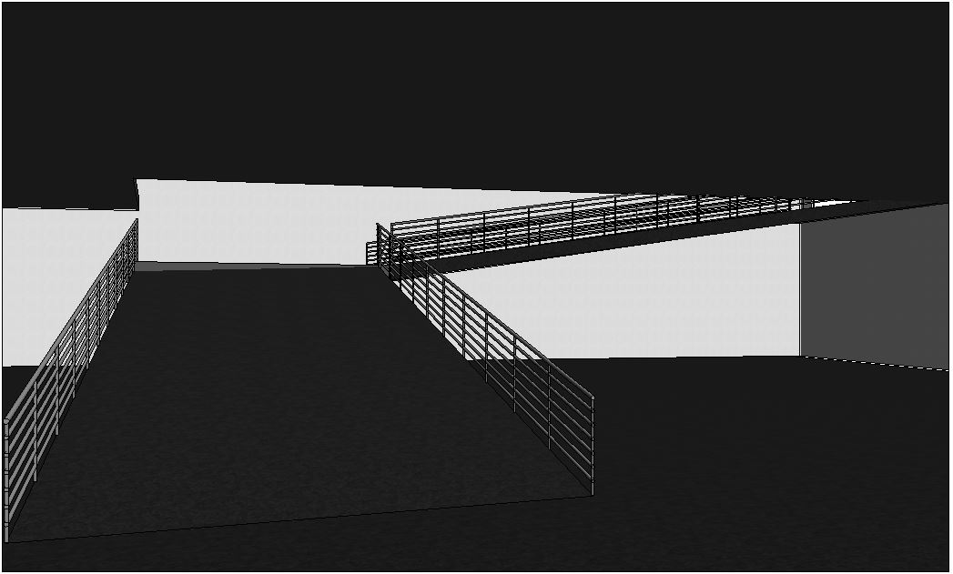
Architectural design:
Parking:
B1
B2

Slide 8
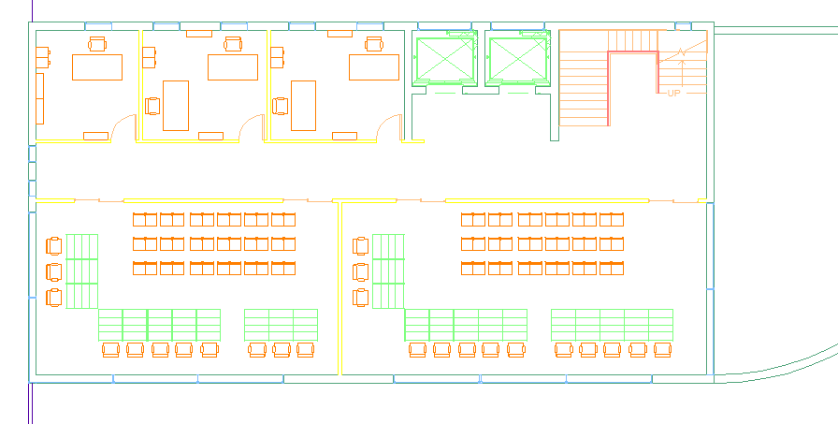
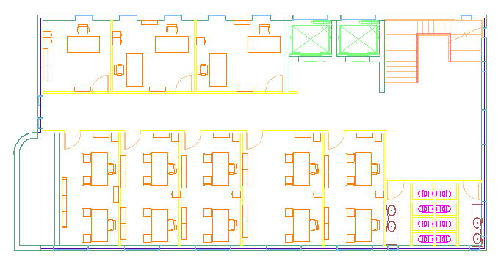
Architectural design:
Extinction Building plans:
Ground Floor
F1+F2+F3

Slide 9
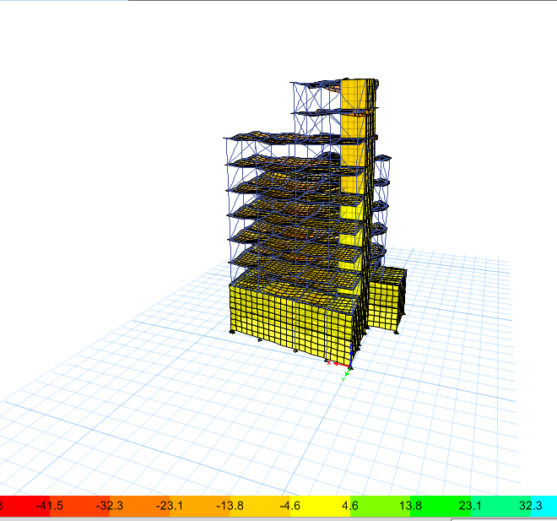
Structural design:
Model
ETABs was used for structural modeling.
External Walls presented as bracing beams .
ACI-318 and UBC97 was used as references.

Slide 10
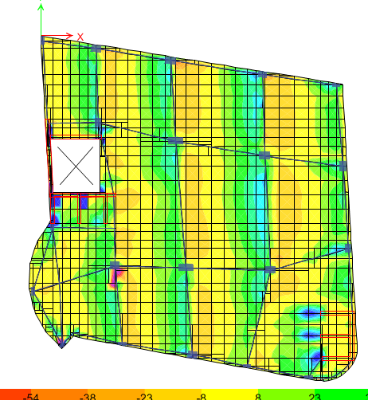
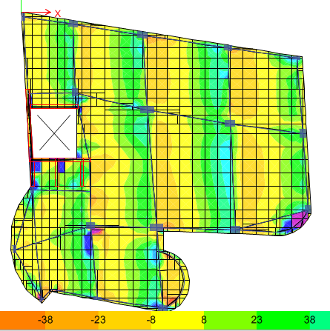
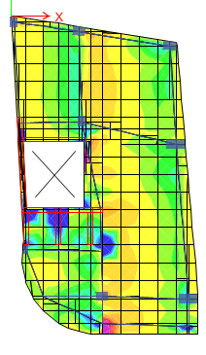
Structural design :
Slap design :
Wu = 26 kN/m2.
One-Way ribbed slap 30 cm thickness with drop beams.
the figures bellow shows shear stress diagram with
limit of Vu =100 kN/m2

Slide 11
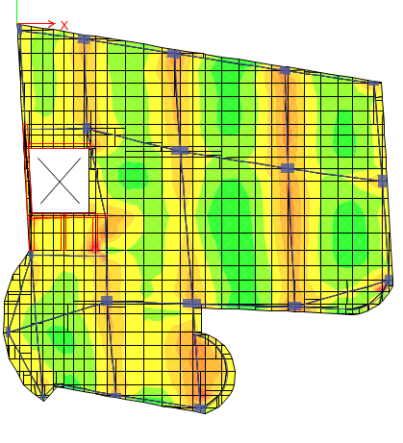
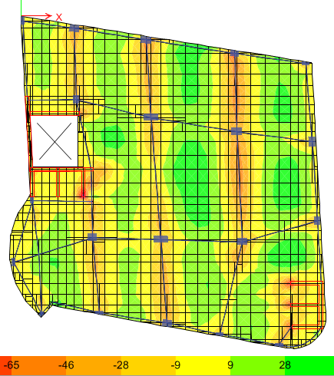
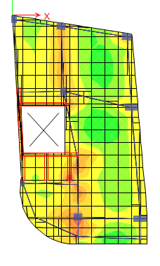
Structural design :
Slap design:
The figures bellow shows Moment distribution diagram with limit of Mu =120 kN.m
So the areas that show as dark red and dark blue are the areas the needs more than As min.
All slaps will use As min= 4 ∅14

Slide 12
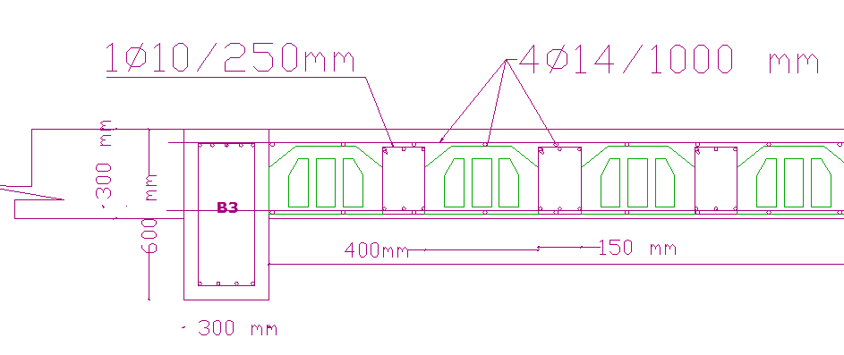
Structural design :
Slap design:
The following figure shows a section in the slap .

Slide 13
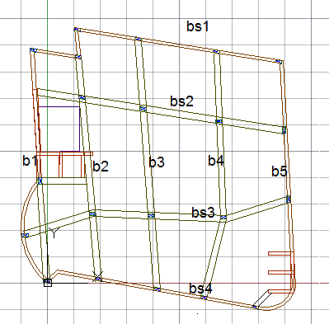
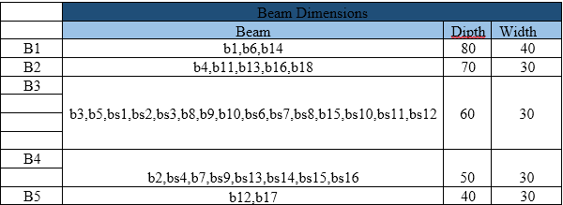
Structural design :
Beam design:
First beam dimension (D1) was calculated from ACI 318 deflection table.
Dimension to check calculated as : D=D1*1.3 , And approximate to united depth for similar beams.
The table bellow shows the first dimension investigation and then checked on ETABs, where b(n) is main beam and bs(n) secondary beam.

Slide 14
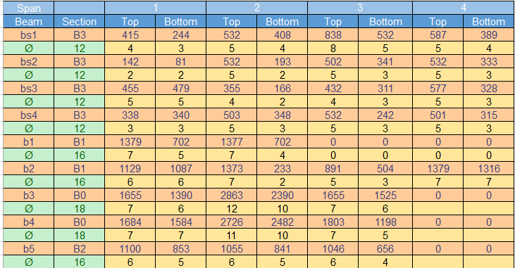
Structural design :
Beam design:
The figure bellow shows the beam steel reinforcement result for each span in each beam from ETABs after modifying dimensions.

Slide 15

Structural design :
Beam design:
The figure bellow shows the final dimension and reinforcement after grouping to near values

Slide 16
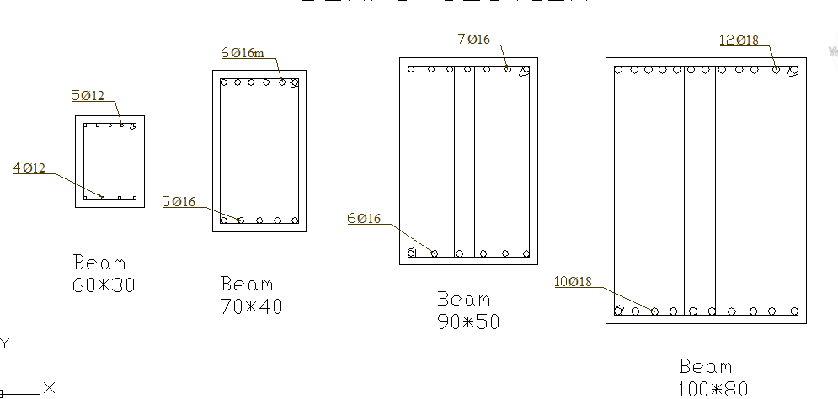
Structural design :
Beam design:
The figure bellow shows the final dimension and reinforcement after grouping to near values

Slide 17
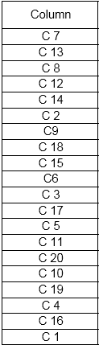
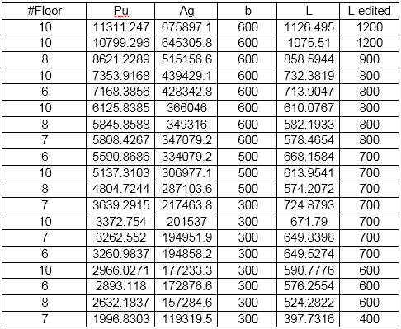
Structural design :
Column design:
First ,column dimensions was calculated manually , and then it entered to ETABs to be checked, the initial dimensions are:

Slide 18
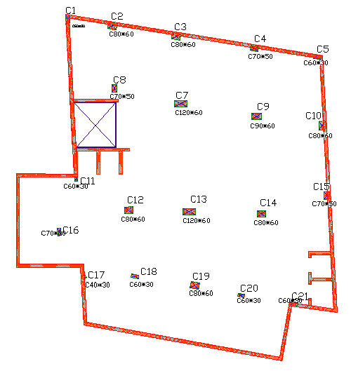
Structural design :
Column design:
The following figure shows the column distribution:

Slide 19
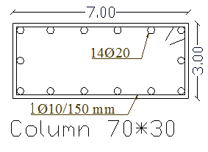
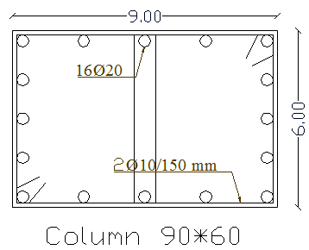
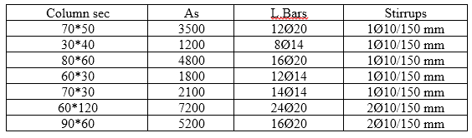
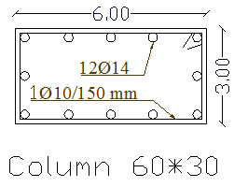
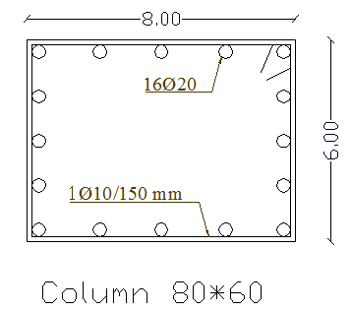
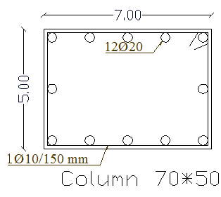
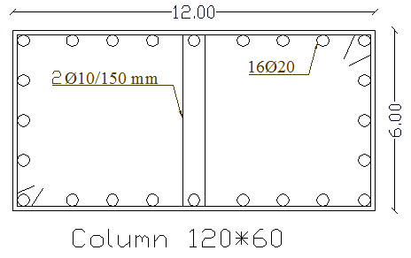
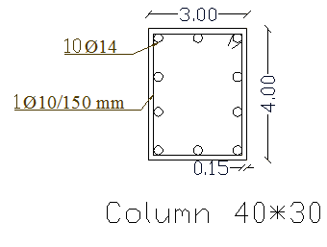
Structural design :
Column design:
The final column dimensions and reinforcement after checks on ETABs are:

Slide 20
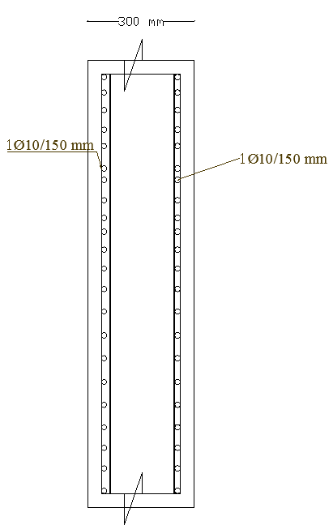
Structural design :
Shear wall design:
The following figure shows the shear wall reinforcements:

Slide 21
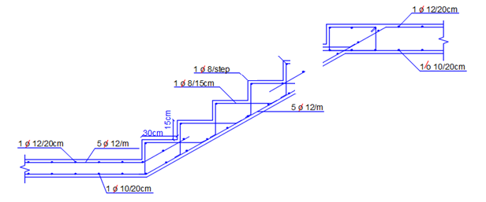
Structural design :
Stair reinforcement:
The following figure shows the Stairs reinforcements:
The hook between the mid slap and the shear wall is = 200 mm

Slide 22
Structural design :
Footing design:
After manual calculating of footing area , depending on total loads from column and considered as single footing , they crossed each other , and the total area of column and wall footing was more than 70% of total base area , so It had been designed as mat foundation
Depth of foundation is 80 cm
Upper net = 1 Ø18/200 mm in two direction.
Lower net = 1 Ø16/200 mm in tow direction.

Slide 23
Acoustical design:
Three rooms had been used for calculations checks based on similarity of spaces
Acoustical design elements :
Background Noise (BN)
Sound transition class (STC).
Impact Insolation Class (IIC).
Reverberation Time.

Slide 24
Acoustical design:
Background Noise (BN) : Depend on (Architectural Acoustic) , BN for working places is 40-45 dB.
STC: The figure bellow shows STC value for each element in the building at 500 Hz:
STC value (dB) | Element
58 | Partitions
46 | External wall
37 | Glazing (Curtin wall)
55 | Doors
Sound transition and noise reduction : it have to be around 60 dB to avoid noise and it is equal to 42 dB in the critical area
IIC: for floors was calculated using INSUL 8.0 to be 42dB

Slide 25
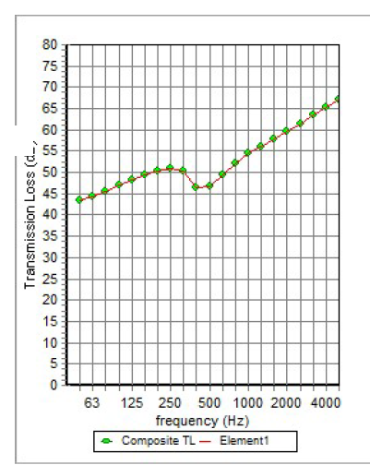
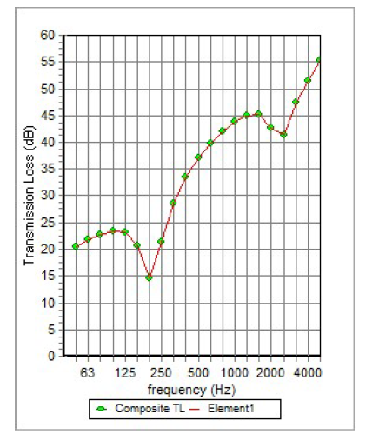
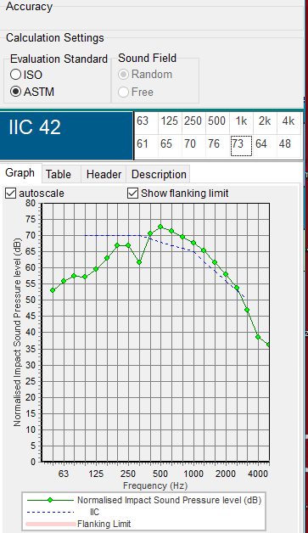
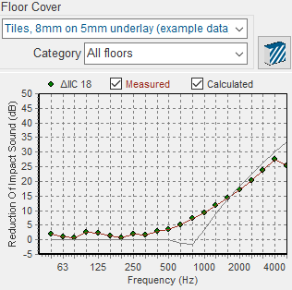
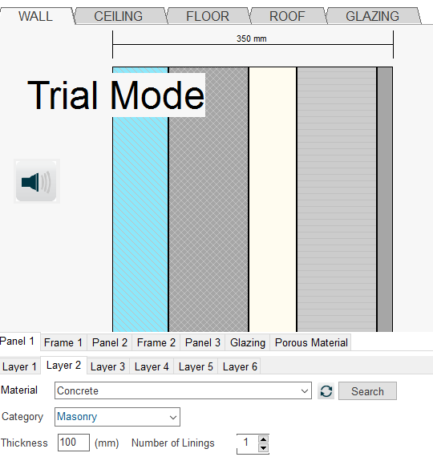
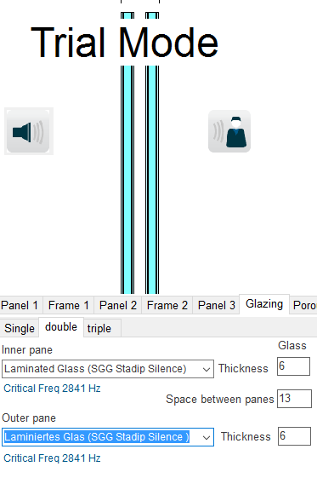
Acoustical design:
STC for External wall
IIC of floor
STC for Glazing wall

Slide 26
Acoustical design:
Reverberation Time (RT60) : Based on (Architectural Acoustics) , RT60 is recommended to be more than 0.6 seconds in work places , the table bellow shows the calculated value from Ecotect program for 3 rooms chosen basing on similarity at 500 Hz , based in MIL-SE :
RT60 (s) | Room
0.63 | 1
0.78 | 2
0.69 | 3

Slide 27
HVAC Design:
VRF system had been used in HVAC design.
Design builder program was used for calculating heating and cooling load in the building.
Copper pipes was used from the outdoor unit to fans coil , and ducts from fan coil to diffusers.
Each fan coil is feeding one zone , and zones was divided based on volumetric flow rate of the fan coil can carry.
Outdoor unit was chosen based on the total cooling and heating load that can carry.

Slide 28
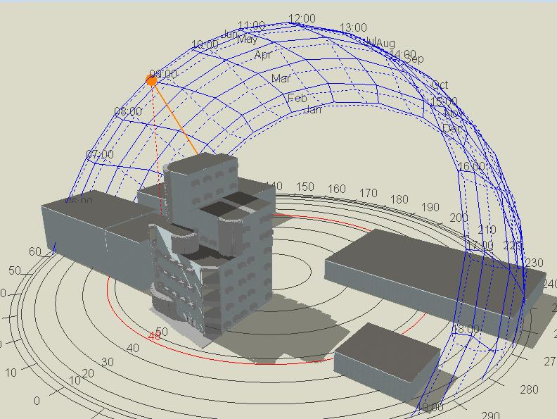
HVAC Design:
The following figure shows the building layout , shadow and the surrounding buildings in design builder:

Slide 29
HVAC Design:
The Total cooling load of the building is 193 kW.
The total Heating load of the building is 110 kW.
Fan coil that selected is from DAIKIN Company, with mass flow rate of 1746 m3\h (0.49 m3/s), 7.2 kW cooling capacity and 8.8 heating capacity.
Out door unit that selected is Tow of 36HP had been chosen with 101 cooling capacity and 113 heating capacity.

Slide 30
Lighting Design:
DIALux EVO program was used to design lighting in the building
The table bellow shows the recommended Lux values:
Glare value is recommended to be less than 22.
Lux | Room Function
500 | Public service room
100 | WC
100 | Stairs
300 | Office
300 | Cafeteria
100 | Corridors

Slide 31
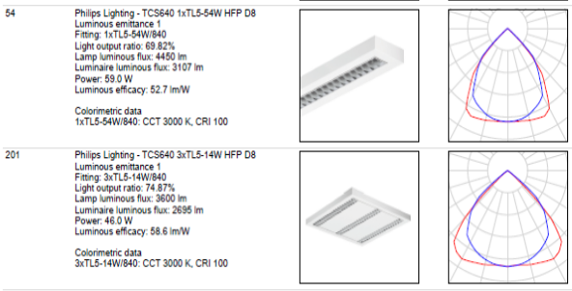
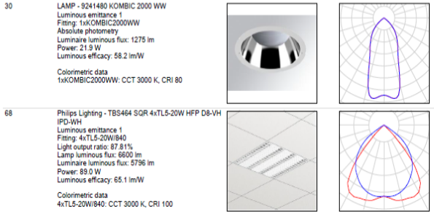
Lighting Design:
The table bellow shows the luminaires and lamps that had been used :

Slide 32
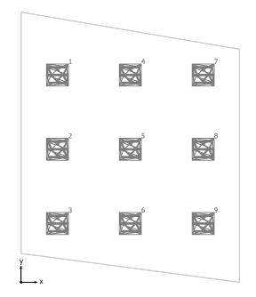

Lighting Design:
The following figure (1) shows the lighting distribution in one of the offices that will be a sample for design:
Figure (2) shows the uniformity in the room:
Eavg=407 lux
UGR= 15.6
Figure (2)
Figure (1)

Slide 33

Lighting Design:
The following figure displays the luminaries distribution in the ground floor:

Slide 34


Electrical Elements:
The following Figure shows Sockets distribution in GF and F1 as an example:

Slide 35

Fire safety:
Wet pipe sprinklers system was used as the main way to suppression fire.
Heat detectors with alarm system was used to detect fires.
A box located in several spaces in the building contains an extinguisher and a Hose, the figure bellow is an example for the system plan:
A separate water tanks located at the final story to feed hoses and sprinklers, with
net volume of 8 m3.

Slide 36
Drainage System:
Size of pipe from sinks to stack: 2 inch with slope 1%.
Size of pipe from WC to stack: 4 inch with slope 1%.
Size of manholes: (0.7*0.7) m.
Size of pipe from stack to manhole: 4 inch with slope 1%.
Size of pipe between manholes: 6 inch with slope 1%.
The figure bellow shows the manhole pipe line , and a WC piping:

Slide 37


Drainage System:
The figure bellow shows the Manhole pipe lines out side building :

Slide 38
The End
Thank you

