Slide 1

Organic waste from a health and environmental burden to organic fertilizer
Graduation Project
Prepared by:
Lama Azzam
Under supervision of:
Dr. Abdelhaleem Khader

Slide 2
Outline of the project :
Introduction
Literature review
Methodology
Modeling, Analysis and design
results and data analysis
Conclusions and Recommendations

Slide 3
1. Introduction
In a world where the volume of waste is increasing dramatically, the waste problem has become an urgent environmental issue, as a result of population increase on the one hand and increased consumption rates on the other hand.. The waste problem in Palestine is one of the most important environmental issues. However, the number of studies and solutions on this problem is few. Therefore, it is necessary to find effective solutions and mechanisms for the problem of waste and address its risks to human health, soil and groundwater, and the most important of these mechanisms is the recycling of organic waste into organic. Compost (compost). It was found that more than 50% of the solid waste components are organic materials (Palestinian Statistics Authority and Environmental Quality Authority, 2018) and that 59.8% of households in Palestine are waste, and food is the most important component of household solid waste (The Palestinian Central Bureau of Statistics, 2015). The accumulation of these wastes is considered one of the most dangerous types of waste because of their negative effects on human health and the environment. It is a paradise for insects, birds and various animals that carry diseases, a source of unpleasant odors, and also lead to pollution of soil and ground water as a result of sap and other dangerous effects, so I must think about managing this type of waste. Therefore, in our project, we will discuss the importance and how to convert food waste into organic fertilizer (compost).

Slide 4
1.2 solid waste
Definition of solid waste:
Residues or wastes in general are any excess and unwanted materials resulting from all industrial, agricultural or household activities practiced by humans, and they differ greatly in their content and quality. In our research, we will deal with one of the most important of these residues or wastes, which is "organic waste“.
classification of solid waste:
1. Organic waste.
2. Waste from mining and industrial operations.
3. Waste resulting from construction and various constructions.
4. Medical waste.
1.3 Organic waste
Definition of organic waste:
It is the waste or excess and undesirable organic composition “lignocellulose” “resulting from all agricultural activities, agricultural manufacturing processes, animal husbandry, or food waste from homes and restaurants that are free from any foreign materials such as metals, plastic, glass or chemical compounds.” The percentage of these wastes is more than (60%) of the total general waste.(Garatli.2016)

Slide 5
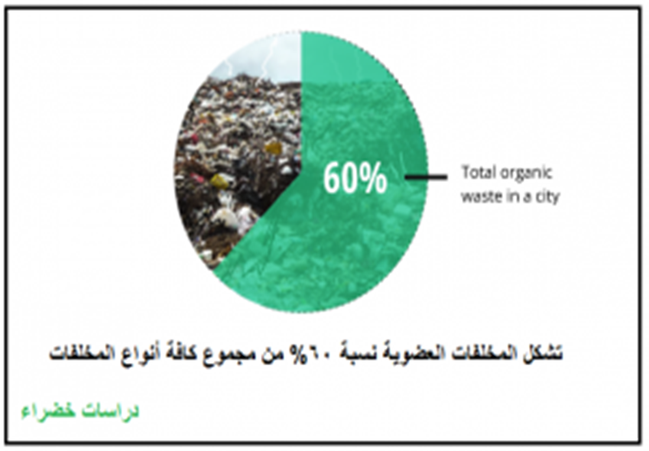
Figure ‎1.1 Percentage of organic waste
Types of organic waste:
Waste or organic residues can be divided into three main types according to their source, namely:

Slide 6
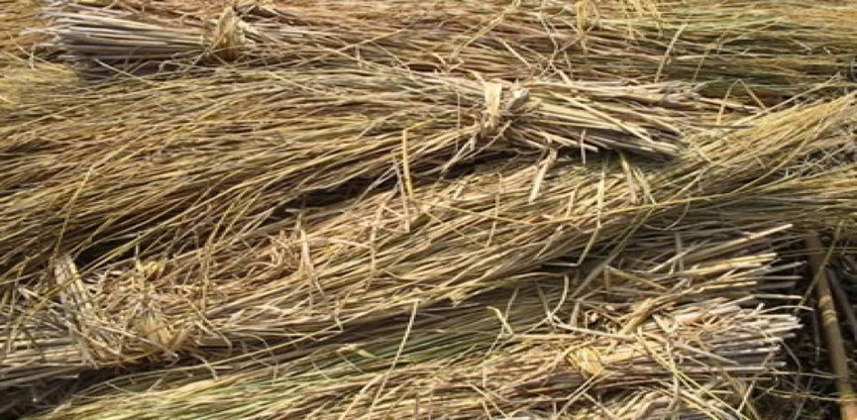
Agricultural waste:
There are many types of agricultural waste that began to be manufactured as raw materials in the production and recycling processes from all organic files that started from production and farms or from new agricultural production and are divided into two main types:
a) Remnants of crops:
It includes all organic agricultural waste that is produced after harvest operations (for field crops such as grains and legumes) or produced after harvesting field crops (fruit crops) or during their preparation for those crops for marketing, and most of these wastes are produced at the level of fields and farms, and this type of waste represents the largest amount From agricultural waste.
Figure ‎1.2 Remnants of Corps

Slide 7
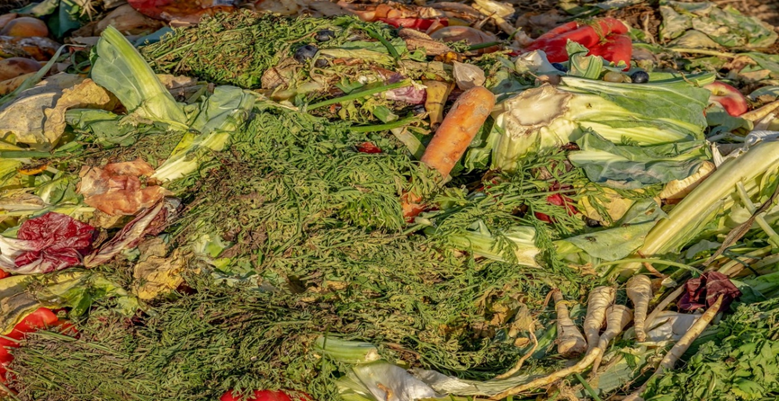
b) agro-industrial Waste:
It is all that is produced by accident or secondary during the preservation or industrialization of agricultural crops. These wastes include many types, including the remnants of plant-based agricultural processing, such as “waste oil mills, waste mills and grain silos, waste rackets and remnants of sugar, starch and glucose industries.
Figure ‎1.3 Agro-Industrial waste

Slide 8
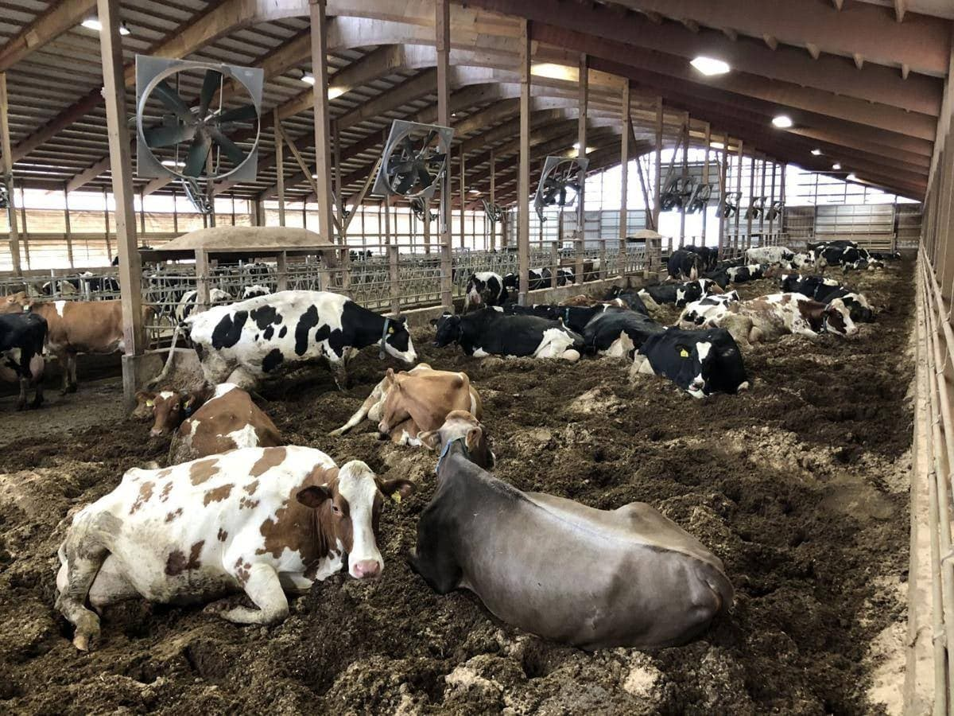
2. Animal waste:
It is the organic waste resulting from the activities and projects of raising animals, fish and birds. It includes many wastes, including “animal and poultry droppings during raising them in farms, incinerators, poultry, or production stations. They include animal waste from animal dung, poultry droppings and brushes, in addition to processing wastes resulting from animals, birds or fish, which include remnants of slaughterhouses and slaughterhouses and waste from dairy factories and food industries” Those that depend on animal products as well as residues of fish breeding projects and fish preservation and processing laboratories .
Figure ‎1.4 Animal waste

Slide 9
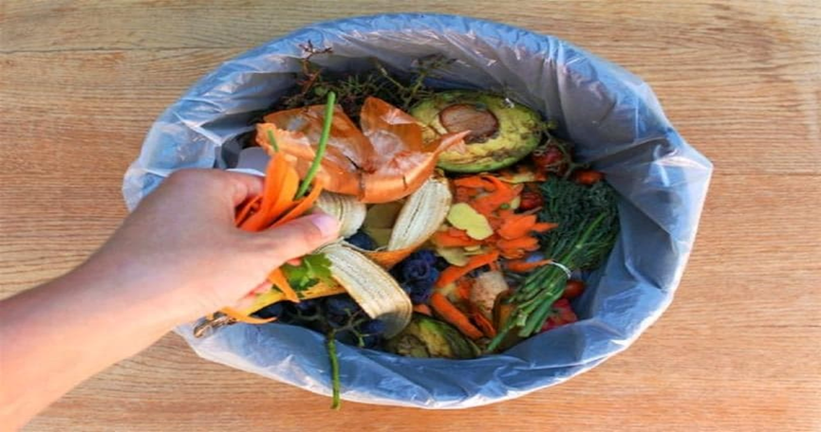
3. Household organic waste from food and restaurants:
It includes kitchen and restaurant waste.
Figure ‎1.5 Organic waste from food leftovers

Slide 10
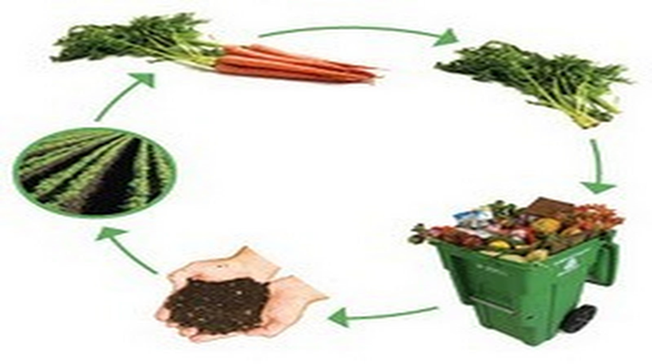
1.4 Compost
The concept of compost:
It is a process of aerobic fermentation of organic materials (food residues) in which microorganisms’ decomposition these organic materials and convert them into organic fertilizer. This process is carried out through two main products, which are nitrogen-rich materials (food residues, especially vegetables and eggshells) and carbon-rich materials (paper, wood, cardboard). , Leaves and dry herbs), where the presence of nitrogen and carbon are important to achieve the growth of microorganisms.
The main elements of the compost process:
1. Organic matter.
2. Humidity.
3. Oxygen.
4. Bacteria.

Slide 11
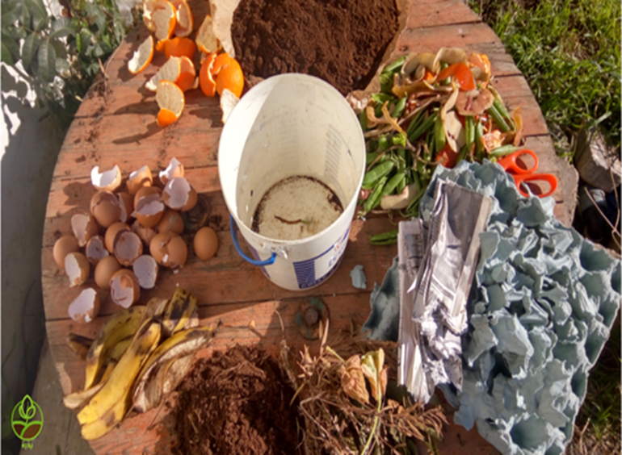
1.5 The Strategy Followed
The First Track
Increasing people's awareness of the importance of the policy of separating waste in the home, and to achieve this, we must draw people's attention that through this waste, valuable and useful products can be produced. As a result of this, we will discuss in Graduation Project 1 how to convert food leftovers into organic fertilizer (compost) through simple tools available in any home.
Figure ‎1.7 Making Compost at home

Slide 12
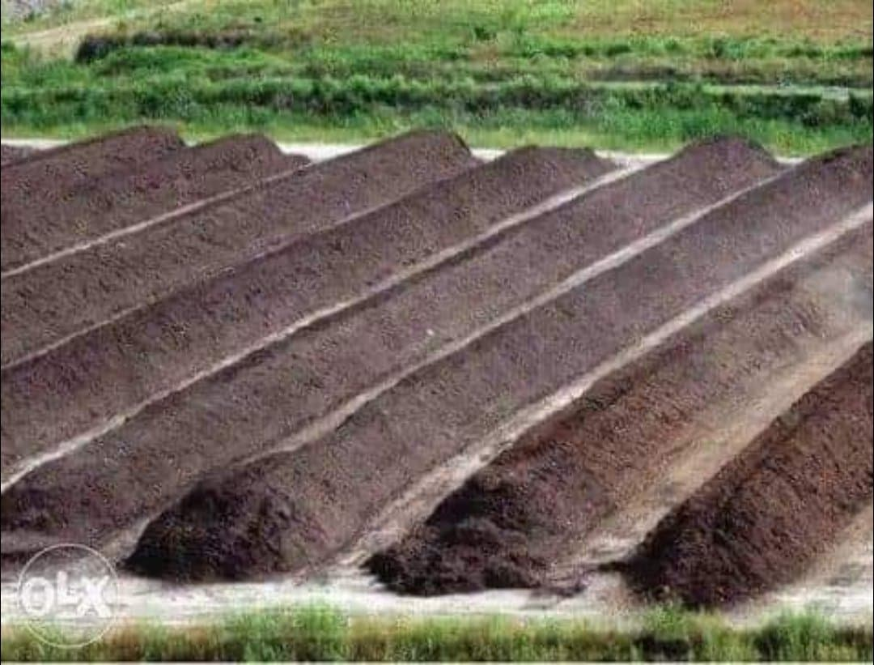
The Second Track
We will try to draw the attention of municipalities and institutions supporting projects and the Ministry of Environmental Development to the importance of building compost stations from a cultural, economic and environmental point of view. This will be discussed in Graduation Project 1 and Graduation Project 2 We will discuss the design of a compost plant specialized in converting food residues into organic fertilizer, and we will show the most appropriate designs for the work of a compost plant in developing countries.
Figure ‎1.8 Compost Station

Slide 13
1.6 Significance of the work
Benefits of using and manufacturing compost:
Reducing environmental pollution, resulting from accumulation of waste, and from waste disposal by burial or incineration.
Reducing landfill waste, as most landfills fill up quickly; Many of them have been closed with the knowledge that a third of the waste in landfills consists of materials suitable for the manufacture of compost.
Organic fertilizer improves soil quality, which helps greatly in increasing production and improving its quality, because organic fertilizer provides most of the essential nutrients (nitrogen and carbon ..) for healthy plant growth, as it is rich in nutrients. It also helps the soil gain a healthy and fertile structure as well as improving the soil's ventilation system.
Producing organic fertilizer and selling it at an affordable price to farmers reduces the use of expensive chemical fertilizers, pesticides and medicines, so that industrial --fertilizers do not improve the quality of the soil but directly nourish the plants and over time can destroy the beneficial microorganisms for healthy soil, as well as when large quantities of them are used. Frequently, its chemical products will accumulate in the soil and over time will be harmful to plants, , in addition to causing pollution of groundwater.

Slide 14
Contribute to building an independent national economic structure towards the recycling policy in order to achieve economic development and overcome the economic blockade.
6. Building an industrial model that depends on its available internal resources to achieve economic development.
The economic return because of the provision of job opportunities.
Organic compost keeps water in the soil, which reduces water addition and saves money.
9. Organic compost provides good benefits for the environment, natural alternatives to chemical fertilizers and obtaining environmentally friendly agricultural production and public health.

Slide 15
1.7 Objectives
Highlighting the issue of non-utilization of waste when it is wasted, which results in environmental pollution and economic waste, and the increase in the need for import, which represents an economic burden.
Increase the community’s awareness of the importance of the waste separation policy, especially the separation of food waste from waste.
Building an industrial model that depends on its available internal resources to achieve economic development.
The scarcity of economic studies on recycling policy in Palestine.
Draw attention to the intermediate return from recycling waste, so that we will reduce the total waste percentage by 30-40%.
The economic return as it provides job opportunities when implementing the project on a large scale, and the production of competitive organic fertilizer.

Slide 16
2. LITERATURE REVIEW
The possibilities of food waste source as organic fertilizer have been evaluated by studying its effective management. Much of the food waste generated from unused consumable food products, household food waste, and waste products from the food manufacturing and processing industries end up in landfills. Fertilizing is a sustainable technique that converts these organic and biodegradable food waste into a stable form of organic matter and fertilizers that can be used for agriculture as soil amendments (Wolka & Melaku,2015).
The applications of organic-based agricultural fertilizer are very promising as it has the potential to convert biodegradable waste into valuable fertilizer products and should be considered as an effective management of compostable wastes. Razza et al has conducted experiments showed that the conversion of food and municipal solid waste to fertilizers helps improving crop productivity and soil fertility and contributed to reduction of the carbon footprint (Razza et al.,2018) Further, the recycling of olive mill waste as an organic fertilizer can enhance soil fertility as well as reduce the CO2 emissions as results of a recent study were shown by Altieri and Esposito(Altieri & Esposito, 2010). Moreover, Chiang et al have used liquid fertilizer obtained through food composting to remediate contaminated soils. These liquid fertilizers have large amounts of organic matter content and are favored for the preparation of dissolved organic carbon (DOC) solutions compared to wine-processing waste. DOC solutions are very useful in the adsorption of heavy metals such as Zn, Cu, and Pb in soils (Chiang et al., 2016)

Slide 17
To investigate the long-term application of food waste fertilizers. A study by Diacono and Montemurro (2011) was also conducted to determine the effects of organic amendments to soil when applied for a long period. A study on the nitrogen availability after seven years of food waste compost application exhibited an increase in soil organic matter, results are shown in (Mazzon et al., 2018). Furthermore, the long-lasting application of organic amendments also improved soil aggregate stability, enzymes activities, reduce soil bulk density, enhance soil organic nitrogen, and gave a positive effect in climate change mitigation by soil carbon sequestration.
Many processes of production of organic fertilizer from food waste were suggested. Jiang et al, provided a dynamic high-temperature aerobic fermentation (DHAF) process that has been developed for the rapid production of organic fertilizer from food waste (Romano et al.,2014) The DHAF technique successfully converted food waste into mature organic fertilizer within 96 hours and this is attributed to the strong oxygen transfer and buffering capacity, as well as the high reaction surface area. Other techniques were proposed, such as adding the biochar to the fertilizer which in turn produces positive results in continuous watermelon monocropping system as concluded by (Cao et al., 2017).The combination of biochar with compost showed better watermelon yield due to the potentially reduced nutrients leaching and increased nutrient holding capacity of the soil .
Nevertheless, there are several challenges in the fertilizing process were explained by Li et al: (1) The process is lengthy and could take up to three to four months for a small-scale operation; (2) there may be acidification of soil and odor emissions during composting; (3) there are possibilities of heavy metals contamination; (4) the economic prospects of a composting facility are uncertain (Li et al., 2019). Hence, more effective, and efficient methods of composting need to be developed to make the management of food waste through composting a promising direction for sustainability.

Slide 18
3. METHODOLOGY
3.1 Data collection
Average daily household production of household waste: According to a study carried out by the Palestinian Central Bureau of Statistics(2015), the average daily household production of household waste in Palestine for the year 2015 was about 5.2 kg, and this average varied between the West Bank and Gaza Strip, as the average was 1.5 kg in the West Bank. In comparison to 5.4 kg in the Gaza Strip, the estimated amount of domestic waste produced in Palestine was about 2,551.0 tons, with an amount of 1,835.0 tons in the West Bank and 716.0 tons in the Gaza Strip.
Food waste is the most important component of household solid waste: The results of the Palestinian Central Bureau of Statistics ( 2015) indicated that 59.8% of households in Palestine consider food waste to be the most important component of household solid waste.
The following table shows the most important factors that must be adhered to, along with the ratio of each factor, in order to produce good fertilizer.( Badawi,2020)

Slide 19
Table ‎3.1 The most important factors that must be adhered to with the proportion of each worker in order to produce a good fertilizer
Parameter | Value
Oxygen Concentration | 5%-10%
C/N Ratio | 1:25-1:35
Particle size and porosity | <1cm and 45%-60%
Moisture content | 45%-60%
Temperature | Warm-up phase: 20-50°C then 50-70°C Cooling stage: 20–50°C Maturity stage: 5.5-9°C
pH | 5.5-9

Slide 20
3.2 Organic waste management
At the beginning of each project, it will depend on organic waste. It must know many scientific and precise details of the process, including knowledge of the following information:
1. Study the quality of organic waste (its origin, content analysis, physical and biological situation).
So at the beginning we determined the type and source of organic materials that we will use in our project and it was food leftovers, and we followed two paths, the first path was to increase people's awareness of separating food leftovers from household waste with the aim of reducing the amount of waste and contributing to alleviating the waste problem and the second goal was to benefit from food leftovers by converting them Composting and increasing people's awareness of the importance of organic fertilizer and its preference for industrial compost that is somewhat destructive to the environment. The second path was to build compost plants to mitigate the environmental and health negative effects of food waste waste, and to build an integrated financial project that covers at least the costs of waste collection And processing it, and in order to prepare large quantities of compost, it will benefit from the collection of vegetable residues from the vegetable markets and benefit from the leftovers of the harvest and the remains of the vegetables from the farmers.
2. Study the quantities of organic waste (quantities of monthly supply and the continuity of obtaining them ...).
This is what will be studied in Graduation Project 2, we will calculate the amount of waste generated from each restaurant, after that we will be able to estimate and calculate the amount of final waste that will be collected, and accordingly we will determine the time required to collect this waste and the final amount resulting from the collection as well. We will be able to calculate and estimate the amount of organic fertilizer that will be produced and the time required for the production and maturity of the compost

Slide 21
3. Study the utilization of organic waste (the final product of that waste is determined and composition..).
These wastes will be converted into organic fertilizer, we will take into account that food waste does not contain meat and milk, it is reduced to the remains of vegetables and fruits to obtain a good compost that contains nitrogen and carbon, which are the two most important components of the soil, so compost is one of the most important and best types of fertilizer.
4. Study the steps of the automated manufacturing processes, "the complete automatic line".
First, we must study the track of the project, after that we study and develop strategies for the production process inside the station, so that the project path is based on placing containers for restaurant owners in order to collect food leftovers, and every specific period of time a special car collects these leftovers from containers, vegetable market owners and farmers to the station. As for the mechanism followed in the station, there are four mechanisms suitable for low and middle income countries. We will present them in a graduation project 1(Windrow composting, passively aerated windrows, forced aerated windrows and in-vessel composting) and in a graduation project 2 After doing a feasibility study, we will choose the most appropriate mechanism within special studied criteria.

Slide 22
3.3 How to apply each track
The First Track
A person can produce organic fertilizer for his plants and garden, and at the same time contribute to preserving the environment by reducing household waste, by converting food waste into organic fertilizer, so that the use of chemical fertilizers negatively affects the environment and human health. The percentage of food waste from household waste constitutes the largest percentage, so we aspire to increase people's awareness of the importance of the waste sorting policy and benefit from it by converting it into organic fertilizer in simple and environmentally friendly ways. Therefore, we will show people simple experiences of making compost at home with simple tools and easy steps.
How to produce compost at home:
The following kitchen and garden waste are to be collected: Fruit and vegetable peels, remaining parts of vegetables, eggshells, carton in which eggs are placed, leaves, leaves and dry stems. All this waste should be collected and placed in a container in layers so that holes must be made in the container for ventilation. The best way to fill a container is to divide its content into layers stacked on top of one another. At the bottom of the container we place a layer of twigs and leaves, followed by a layer of nitrogen called green materials (vegetables, food scraps, seeds, egg shells), followed by a carbon layer called brown materials (leaves, straw, plain paper, small pieces of wood, mulch) Wood ...) and a thin layer of soil to speed up the decomposition process due to the presence of microorganisms in the soil, and the waste is relatively stirred (pellet stirring).

Slide 23
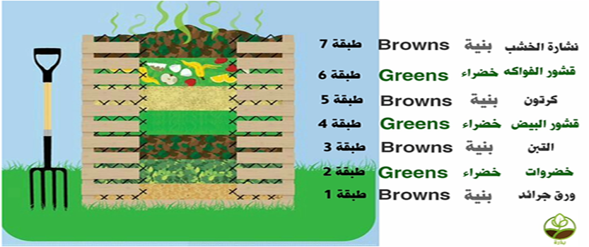
(The flipping process once every two days in the summer and once a week in the winter), which speeds up the process of decomposition as it enters air and oxygen in the mixture, which helps microorganisms to grow and finish their work faster, and the air also helps bacteria and fungi for air respiration. Thus, there is no unpleasant odor, but if the air is clogged, it will produce an unpleasant odor. Video link containing our experience making compost at home (https://drive.google.com/file/d/1FLKgI89FTl2Zft26T-7Tzx2LBNgqiHmN/view?usp=drivesdk).
Figure ‎3.1 How to make compost at home

Slide 24
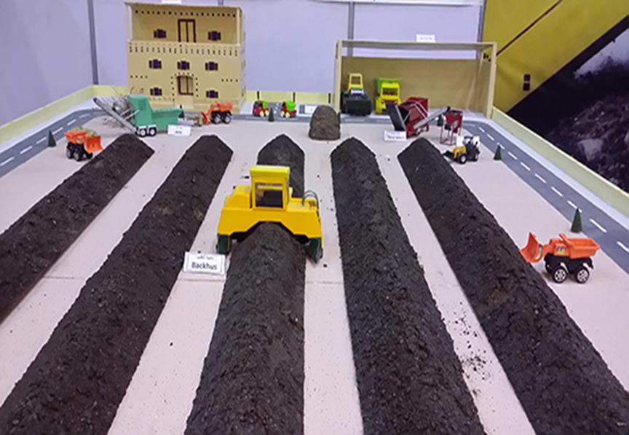
The Second Track
It will be agreed with the supporter to provide special containers for restaurants to collect food leftovers in them in exchange for exempting them from paying waste collection fees to the municipality, and there are also many vegetable markets from which the remains of vegetables and fruits will be collected.
Then workers are assigned to collect waste from these containers and transport it to the station every certain period of time within a deliberate strategy.
Figure ‎3.2 Compost Plant

Slide 25
3.4 Design alternatives
3.4.1 Design alternatives for track
For The First Track
It is possible to use any equipment available in the home, but openings must be made for this container. It is possible to use, for example, a bucket or a plastic box, and it is also possible to make a hole in the garden of the house. This method is the most appropriate and best because it neglects costs, but it needs to collect food leftovers and you need to have a suitable open place to put the container in. In our experience, as mentioned previously, we used a plastic box.
2. The second suggestion for this path is to use the compost device. The advantages of this method are that the device can be placed anywhere and also we do not need to collect food residues to make compost, the available food remains are placed directly in the device. But it's expensive so we didn't follow it. We will attach a video link to explain how the compost machine works (https://youtu.be/0d503XHAt1A)
For The Second Track
Establishing special containers for food waste in all sectors, but this design is expensive and difficult to implement, especially with the weak community policy to separate waste.
2. Putting special containers for leftovers for restaurants and vegetable and fruit market owners, and encouraging them to abide by exempting them from paying municipal waste collection fees (the chosen design).

Slide 26
3.4.2 Design alternatives for compost station
In this section, we will have a look at the different composting technologies which are commonly used in low- and middle-income countries. These are:
1. Windrow composting,
2. Passively aerated windrows,
3. Forced aerated windrows,
In-Vessel composting,
3.5 Limitations
Huge percentage of people are unaware of the waste separation policy and its benefit to the environment and economy.
2. To apply compost at home, we need to collect a quantity of food leftovers, and we need to have a home garden or an open place suitable for placing the container containing the compost.
3. Preference to use raw materials over retrieved materials.
4. The lack of sufficient awareness about the importance of solid waste statistics for the community.
5. There are no Palestinian specifications and standards for making compost.

Slide 27
4. MODELING, ANALYSIS AND DESIGN
4.1 Operational information that needs to be considered
Composting is not always satisfactory, an unpleasant odor can emanate from the process, time consuming, attract pests and even contaminate surface water when not managed properly. Many operational parameters must be taken into account in order to avoid these problems, and since graduation project 1 is an introduction to graduation project 2 in which we will design a compost plant in Nablus, we will now discuss these operational parameters and in graduation project 2 we will discuss how to make checks for these parameters. The main ones are:
1. Oxygen concentration and flipping
2. Carbon-nitrogen ratio.
3. Practical size and porosity.
4. Moisture content,
5. Temperature.
6. P.H

Slide 28
Conducting the turning once a week (or according to the temperature and the internal humidity of the matrix so that the temperature does not exceed 70 degrees Celsius and the humidity does not exceed 65%) and the flipping is done by the appropriate method for the batch quantity, so that the oxygen concentration in the stack is not less than 5%.
The ratio of carbon to nitrogen (C / N) in the tailings should range between 1:25 to 1:35 to provide a good life for the rapid activity of microorganisms as carbon is a source of energy and nitrogen is important for building protein cells of microorganisms ... After composting and during decomposition, this ratio decreases. From the start of the composting process to reach 1:12 in the ripe compost. When the percentage of cron rises to 35 parts, the temperature decreases, so the compost ripening stage is delayed. If the ratio falls below 20 parts, the excess nitrogen is lost in the air in the form of ammonia and causes unpleasant odors and the PH rises, which may become toxic to some beneficial microorganisms.
The size of the initial parts should not exceed 5 cm in length and 1 cm in diameter. Therefore, the waste must be chopped, which leads to an increase in its surfaces exposed to microbial degradation, and thus an increase in the speed of decomposition. Porosity is a very important factor because it will affect the airflow inside the heap, which affects the level of oxygen which is key to microbial activity. The pile size is usually reduced by compression and volume reduction, which reduces the pore size and thus the airport porosity. This will restrict the airflow inside the mound and thus the oxygen level. Therefore, it is recommended to have an initial aerodrome porosity of 45 to 60 and keep it above 35% especially during the active phase when oxygen is required. The porosity can be increased by adding so-called "building materials" such as branches, hard fruits, etc.

Slide 29
The humidity level in the compartment should range between 45% to 60%, as the lack of humidity less than 45% reduces the activity of living organisms, and increasing it to more than 60% reduces the availability of oxygen in the heap. Therefore, it should be taken into account to moisten the repellent with water when needed to accelerate moisture loss during the decomposition process. The optimum humidity can be identified by taking an amount of compost in the palm of the hand and pressing it. If some drops of water fall between the fingers, this means that there is sufficient moisture, but if the back of the palm does not get wet after pressing the compost, this means that the materials are dry and the moisture is not sufficient. The moisture content of more than 60% means that the porous voids in the compost pile will fill with water instead of air resulting in anaerobic conditions, and under anaerobic conditions, oxygen is depleted, thus the anaerobic bacteria begin to decompose the raw materials resulting in the formation of bad orders. It produces methane, which is a greenhouse gas. The pile should always contain at least 5-10% oxygen in the cavities.
Acidity, less than 7, or alkalinity, PH higher than 7, of organic matter affects the growth of microorganisms, bacteria analyzers prefer a PH range between 6 and 7.5. While fungal analyzers prefer the pH range from 5.5 to 8. The pH number is preferable to range from 6.5 to 8, but in general, the residual decomposing microorganisms can operate in a wide range from 5.5 to 9. If the pH is lower than 5.5, it is preferable to add calcium carbonate. The pH is higher than 9, so it is preferred to add sulfur and agricultural gypsum to the compost.

Slide 30
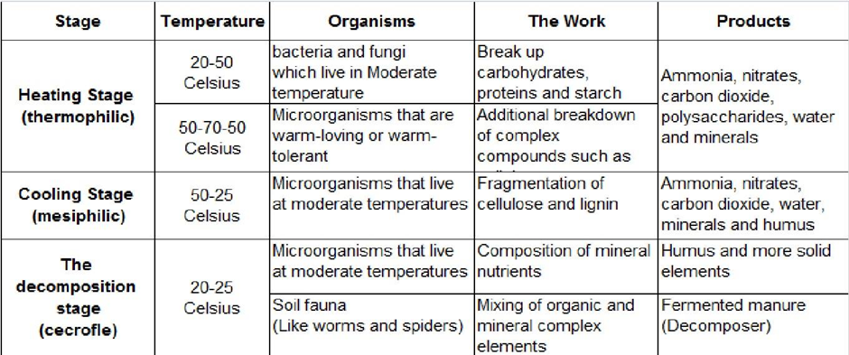
Ambient temperature affects the growth and activity of spores in the compost pile and thus the rate of decomposition of raw materials. In temperature climates, fertilization is faster in the spring, summer and fall months and is likely to stop in the winter months. However, a trick on how to preserve the micro in colder seasons is to increase the size of the mound, or cover it with mature compost. The appropriate temperature during the compression process ranges between 55 - 70 m 0 for a period of about 5 - 10 days, which leads to the activity of high heat-loving bacteria and elimination of pathogens. It can be obtained by turning the compressor every 4 days during the compression process and providing the appropriate carbon to nitrogen ratio. Each of the stages in which the compost is formed has a specific temperature, and there are 3 stages that the compost goes through, as shown in the table.
Table ‎4.1 Temperatures and products for each stage of compost manufacturing

Slide 31
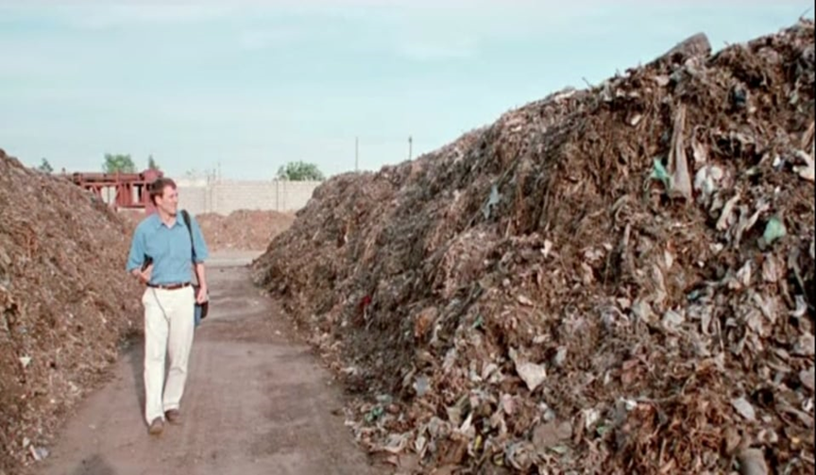

4.2 Explain and illustrate the design alternatives for a compost plant
1. Windrow composting: Windrow is the general term for an elongated pile of stacked raw materials, This method is suited to treat large volumes of bio-waste and produce large volumes of compost. Aeration of the material is crucial. Oxygen needs to be replenished as it is consumed. Otherwise, the piles go anaerobic in the center, following a different decomposition process and producing foul odors. Making sure that the material is porous enough for air to pass through is always advisable. This is achieved by mixing fine dusty, wet, or soft materials together with structure-giving materials such as small branches, cardboard, or hard vegetables. In any case, the piles are normally turned which can be done mechanically or manually. This way, the porosity is reestablished and air, and therefore oxygen, get into the pile. Besides, the materials which are at the exterior of the pile are now in the interior so that they can be decomposed by micro-organisms. This technology requires low initial investment and maintenance. However, it needs a lot of space because the windrows have sloped sides and cannot be put too close together. It ranks medium when it comes to the time needed for the composting process and it is labor intensive.

Slide 32
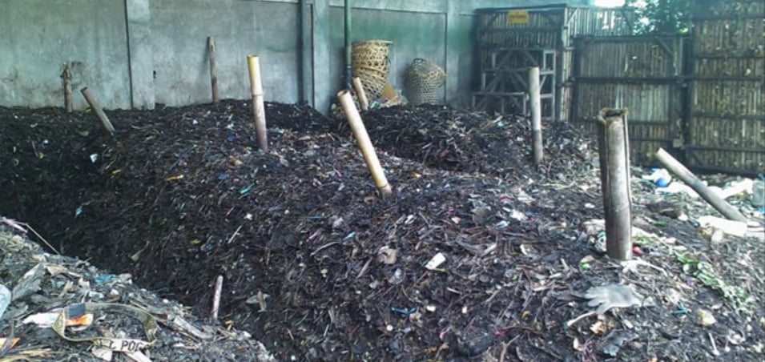
2. Passively aerated windrows: This technology consists of perforated pipes located within the bio-waste pile which promotes convected airflow throughout the material. The pipes can be located in different dispositions as shown in the picture. The air that gets into the pile brings the oxygen required by the microorganisms. These piles are normally not turned during the process. Therefore, it is important to premix the feed stock thoroughly before placing it on the perforated pipes. It is advisable to insulate these piles with finished compost to ensure thermophilic temperatures reach the outer layer of the pile as well. This technology requires slightly higher initial investment and maintenance than non-aerated windrows, as it involves a passive aeration system. It has similar space requirements. The composting process might take as long or slightly shorter than with non-aerated windrows and it also requires less labor as the piles do not need to be turned.
Figure ‎4.2 Passive aerated windrows

Slide 33
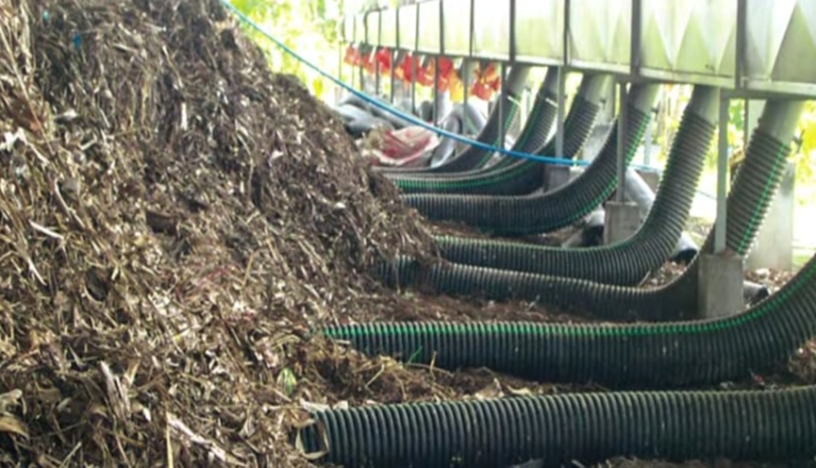
3. forced aerated windrows: They might look very similar to the previous ones. The difference is that blowers are installed at the end of perforated pipes or air ducts. These blowers inject air into the piles, preferably during the active phase, when the compost reaches high temperature. Airflow can be adjusted by changing the frequency and duration of the blower. These piles do not need to be turned, and as in the previous ones, insulation with finished compost ensures that thermophilic temperatures are reached in the outer layers. This technology requires even higher initial investment, given the need for a blower and aeration channels. Maintenance is also higher than the previous two. It has similar or slightly less space requirements since the composting process is even shorter and it requires less labor, as the piles do not need to be turned.
Figure ‎4.3 Forced aerated windrows

Slide 34
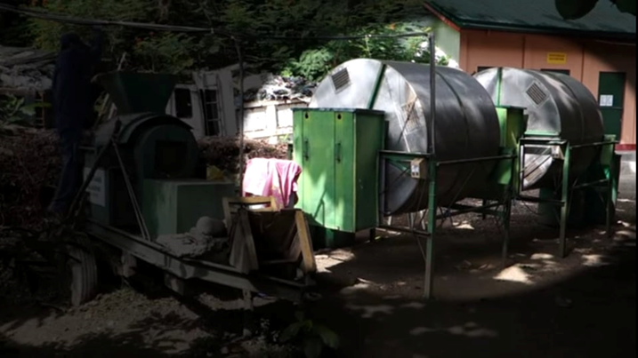
4. In-Vessel composting: This describes a group of methods that confine the composting materials within a container or vessel. Installations vary from very high-tech options where parameters are monitored, acting more as a bio-reactor, to very low tech alternatives. In all configurations airflow and temperature can be more easily controlled than with other composting techniques. Turning or stirring takes place manually or mechanically. This technology is more capital intensive and requires more maintenance than the ones mentioned before. It requires less surface area than with the previous technologies since the composting process is shorter. Besides, little labor is required as the material is mixed within the vessel.
Figure ‎4.4 In-Vessel composting

Slide 35
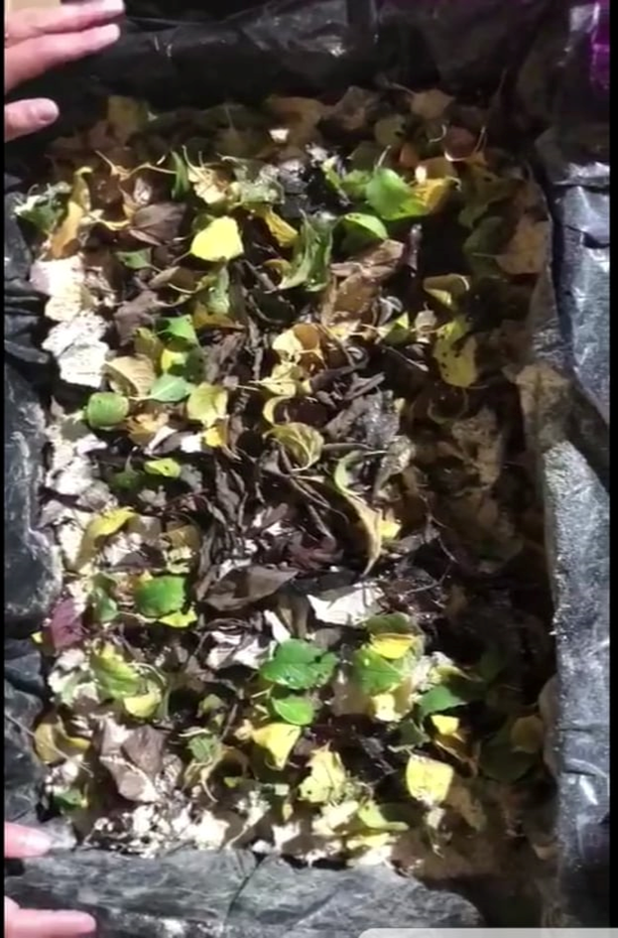
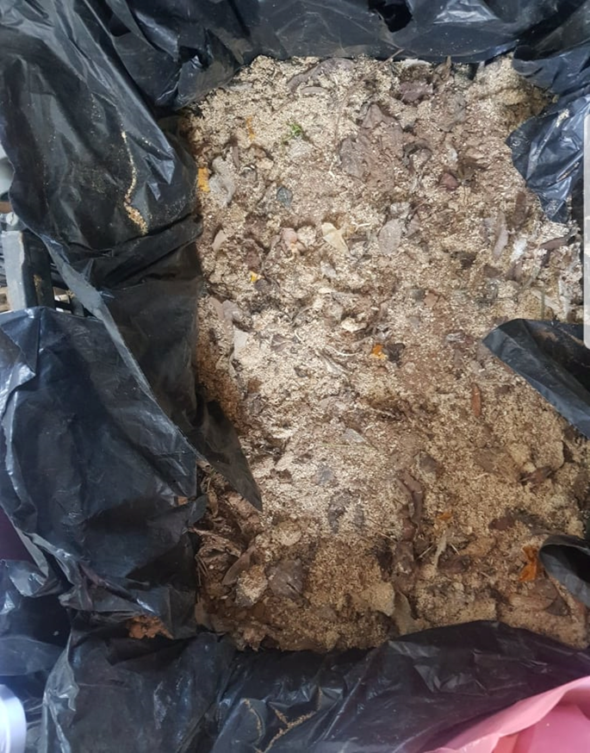
5. RESULTS AND DISCUSSION
5.1 Results
Figure ‎5.1 Compost after one day of preparing
Figure ‎5.2 Compost after 60 days of preparing

Slide 36
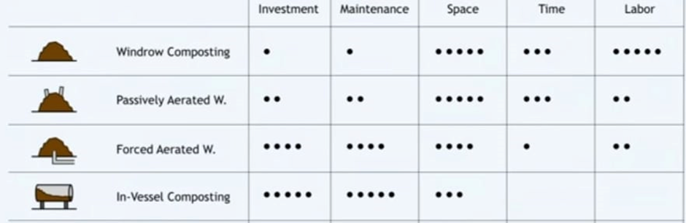
Table ‎5.1 Comparison of alternative compost plant design applied in middle- and low- income countries

Slide 37
5.2 Discussion
In our experience of making compost at home, after about two months had passed, we noticed that the color of the compost began to change and the volume of compost began to decrease and a smell appeared similar to the smell of wet dirt and most of the ingredients had melted and mixed together so that it was difficult to distinguish between them. These signs indicate that the compost is about to ripen, as the compost needs to ripen from two to three months, and there are several factors that affect the speed of decomposition of the compost and its ripening. Now we will mention the most important instructions that we followed to increase the speed of decomposition and obtain a successful and good fertilizer:
1- Cooked food, meat, fish, or chicken should not be added to this mixture so as not to attract unwanted organisms.
2- Flipping the waste periodically so that the air permeates it, usually in the summer season every 2-3 days, and in the winter it is every 7-10 days.
3- Add dry brown foliage and newspapers.
4- Do not immerse the wastes in water. However, the water content must be sufficient to remain wet, and in order to make sure of the level of humidity we press the compost, if the humidity level is good, we feel our hands are damp.

Slide 38
5- Bury any green plant remains under a layer of soil or cover with dry leaves and newspaper. This helps prevent insects and flies.
6- At the bottom of the container, place a layer of branches and tree leaves. It is best if this layer is durable so that it does not break when we start filling the container, and the purpose of this layer is to ventilate the center of the container.
7- The moisture must be checked every period, and if the mixture is dry, we add some water to it. But you should not overdo it with adding water so that the compost does not spoil.
8- Chop the leftovers in small pieces to increase the speed of decomposition.
9-This step is optional. When we fill the container, we turn it upside down every time without dropping the material inside, this helps speed up the process of fermentation of the materials and their composting.
10- Try to put a bowl in the kitchen to collect leftovers (vegetables, egg shells, coffee ...). Do not cover the container as the materials inside will ferment and become stinky.
11-The brown layers (carbon) are larger than the green layers (nitrogen), because the organic matter contains an adequate amount of nitrogen, and the bacteria and fungi responsible for the decomposition of the organic matter that depletes this nitrogen in the representation of carbon (into energy production and building their bodies) in a ratio (1: 25) -1: 35 N: C for food residue analysis.
12- We used dirt and it was placed with the mixture in the form of layers because the soil contains microorganisms that help in decomposition, and thus we increase the speed of decomposition.

Slide 39
As for the design that will be applied in the compost station, we will choose it in the graduation project 2 after making a feasibility study and knowing the amount of waste produced and the area of land on which the station will be designed, and also after knowing the size of the financial support for the project, after this information is available we will be able to determine The most appropriate and best design.
CONCLUSIONS AND RECOMMENDATIONS
6.1 Common signs of ripening compost:
1. The appearance of the smell of dust splashed with water.
2. The compost turned dark brown.
3. Spongy texture.
4. Not to contaminate hands when holding a fist.
5. The size decreases to a third.
6. Not to distinguish between the components of compost in a final way.

Slide 40
6.2 Tips to speed up the compost process
The time period for the compost to ripen varies greatly according to many factors such as:
1- The amount of air that enters the compost (increasing it greatly speeds up the dissolution), so we must stir the mixture well and continuously.
2- Speed up the decomposition process as much as possible by chopping the waste into small pieces, which speeds up the decomposition process very drastically, as it exposes more surface area to the microorganisms to carry out the decomposition process.
3- Using a layer of soil to accelerate the decomposition process because the dirt contains micro-organisms that aid in the decomposition process.
4- The mixture is moist to provide the appropriate environment for the microbes to interact to carry out the decomposition process.
6.3 Recommendations
It is recommended to add 5-10% ready-made compost so that it contains necessary microorganisms that help in the process of decomposition and increase it and also contribute to help in improving humidity and ventilation and also use an insulating material so that the compost protects from insects and germs.

Slide 41


