Slide 1
Design of a Solar Air Conditioning System Using Adsorption
Prepared By:
Saleh Atieh
Majd Hussain
Supervisor:
Eng.Luqman herzallah

Slide 2
Contents
Objectives
Introduction
Solar Energy in Air Conditioning
Closed Solar Cooling Sorption Cycle
Project Design
Final Design
Adsorption Materials
Results
Recommendations
Conclusion

Slide 3
Objectives
1- Study and investigate the using of solar energy.
2- Study the adsorption process.
3- Using the adsorption phenomenon in cooling system.
4- Design a usable cooling system using adsorption and solar energy in the system.

Slide 4
Introduction
HVAC systems
Solar energy
History of solar energy
Using solar energy in cooling system

Slide 5
Solar Energy in air conditioning
Photovoltaic (PV) solar cooling
Open Sorption Cycle Solar Cooling
Closed Solar Cooling Sorption Cycle

Slide 6
Closed Solar Cooling Sorption Cycle

Slide 7
Solar Cooling Absorption systems

Slide 8
The basic principle of the absorption system.

Slide 9
Adsorption cooling

Slide 10
Adsorption system process

Slide 11
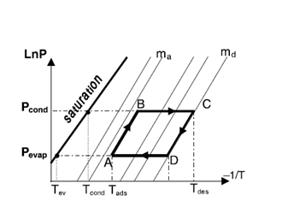
Adsorption cycle

Slide 12
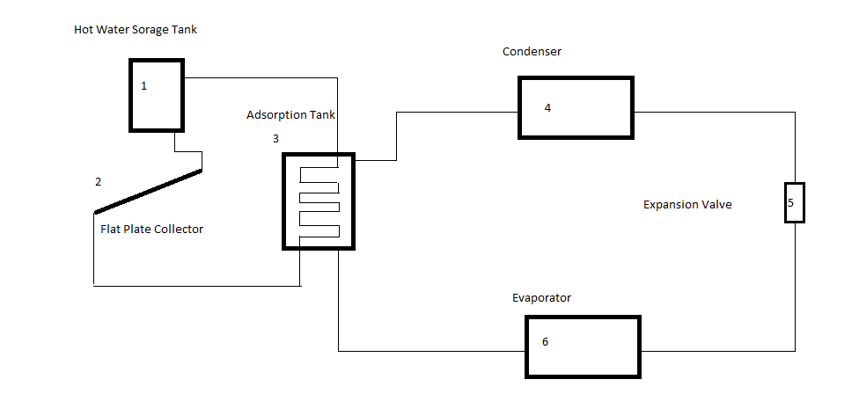
Project design

Slide 13
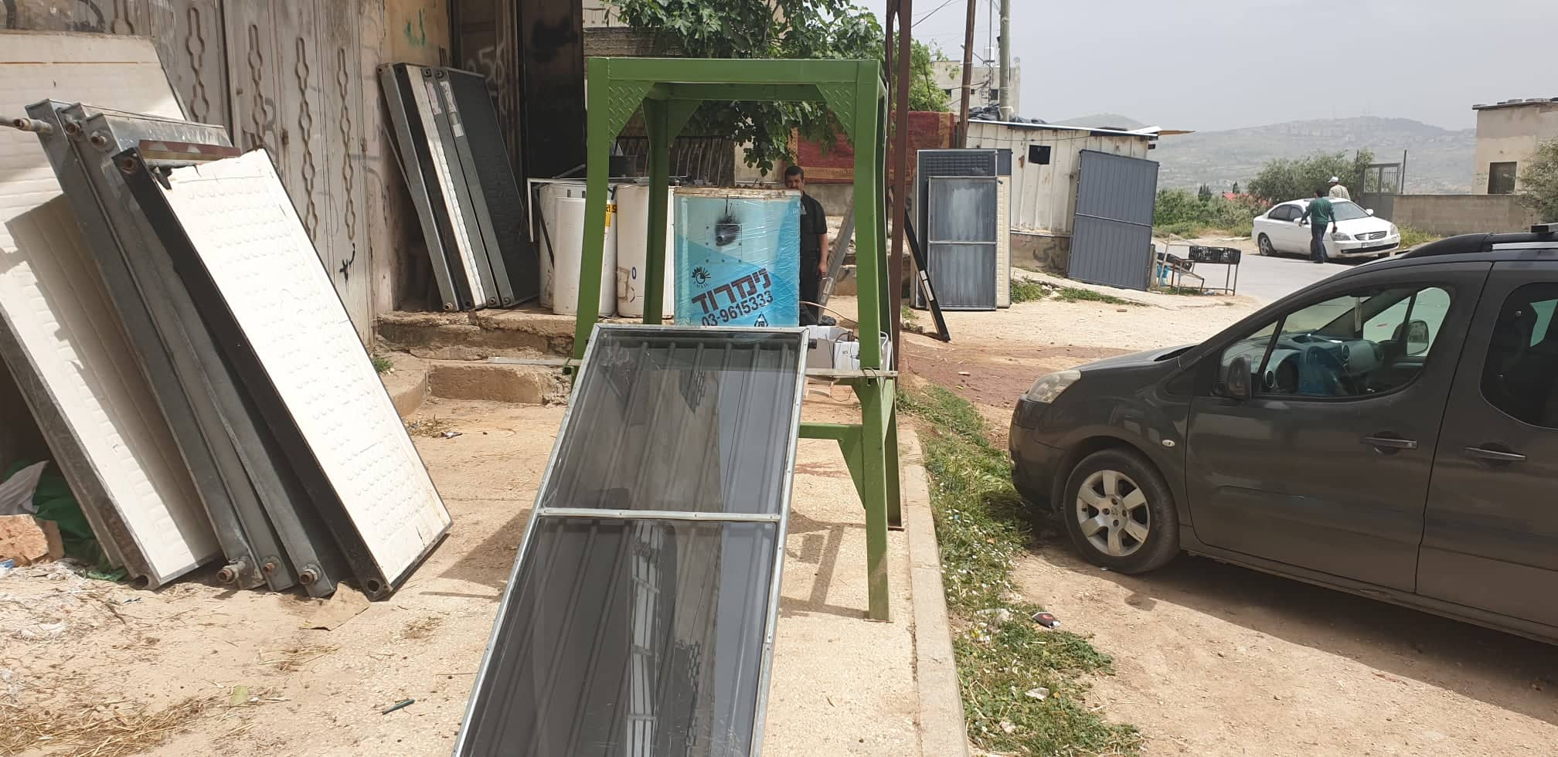
Final Design

Slide 14
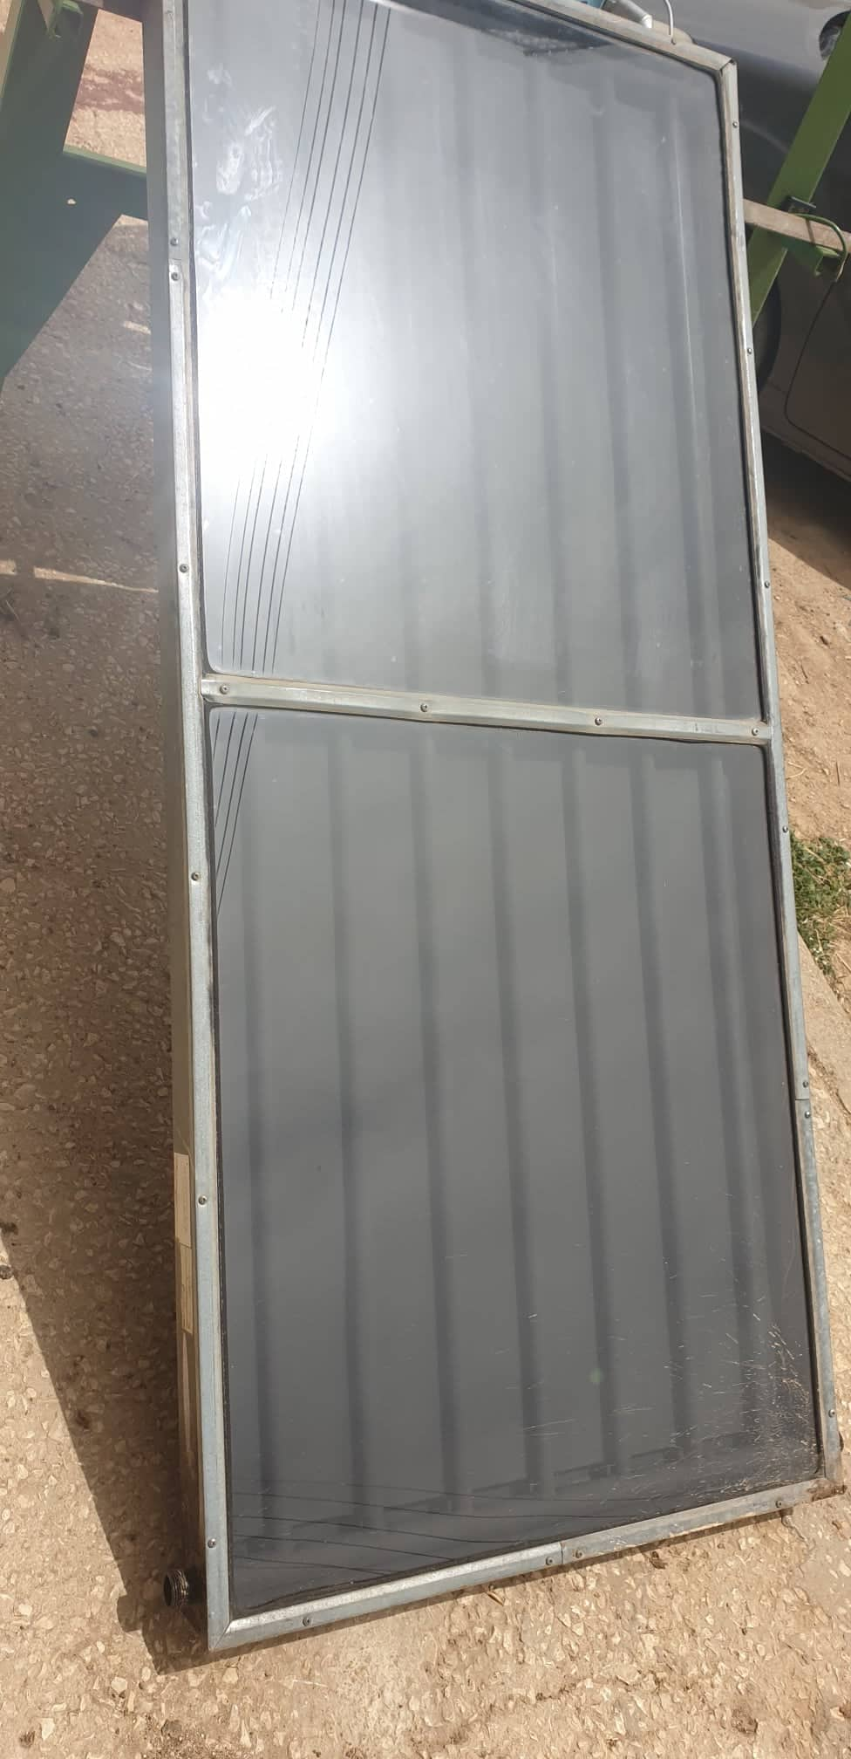
Flat Plate Collector

Slide 15
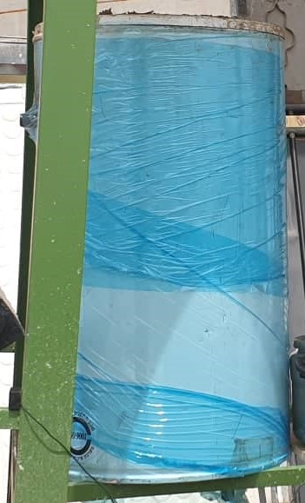
Hot Water Tank

Slide 16
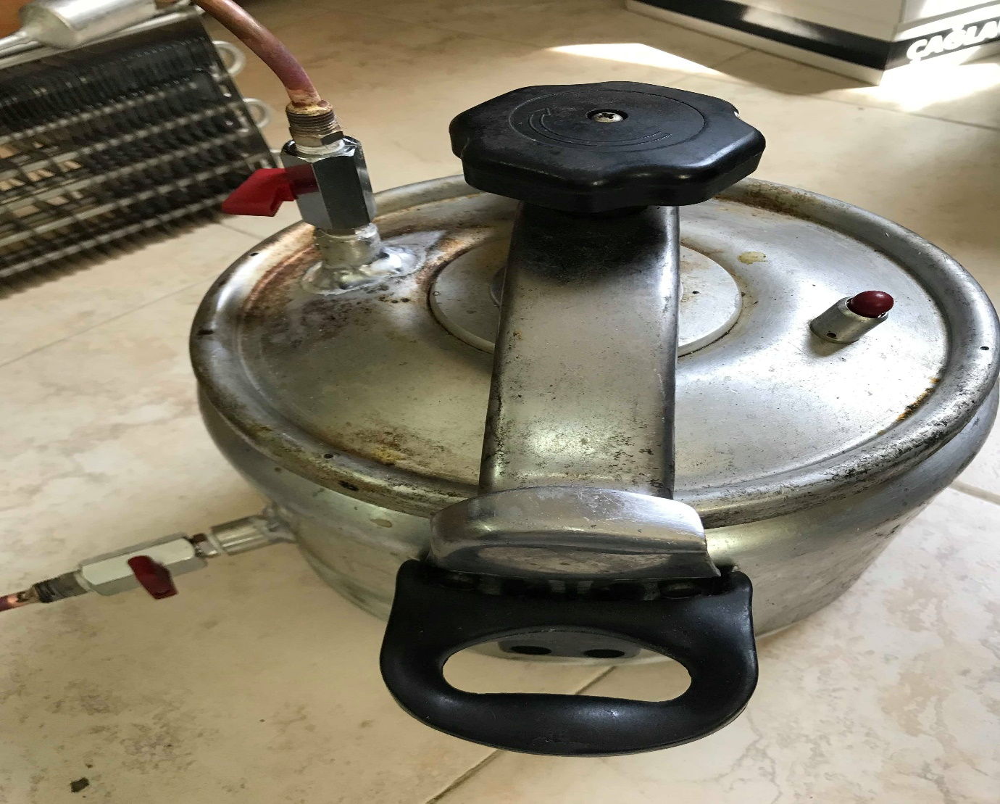
Adsorption Tank

Slide 17
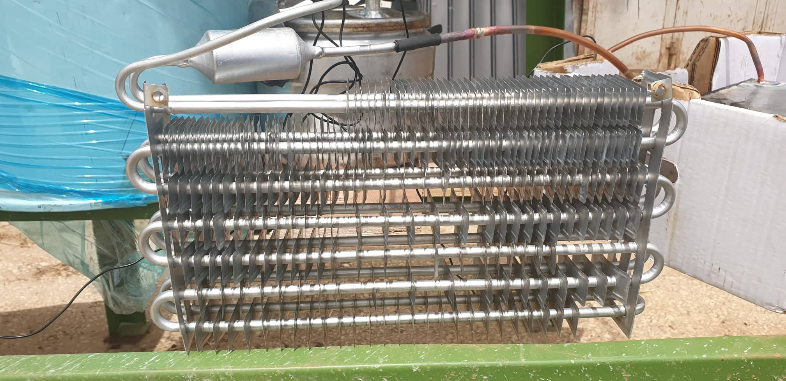
Condenser

Slide 18
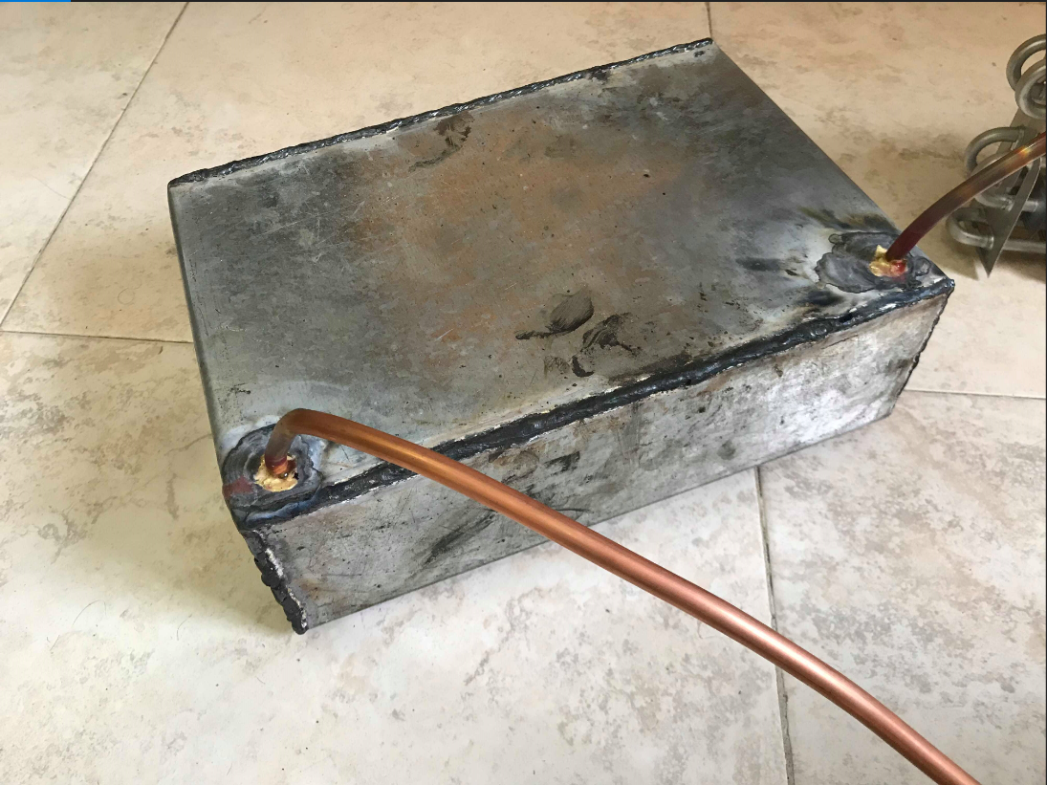
Evaporator

Slide 19
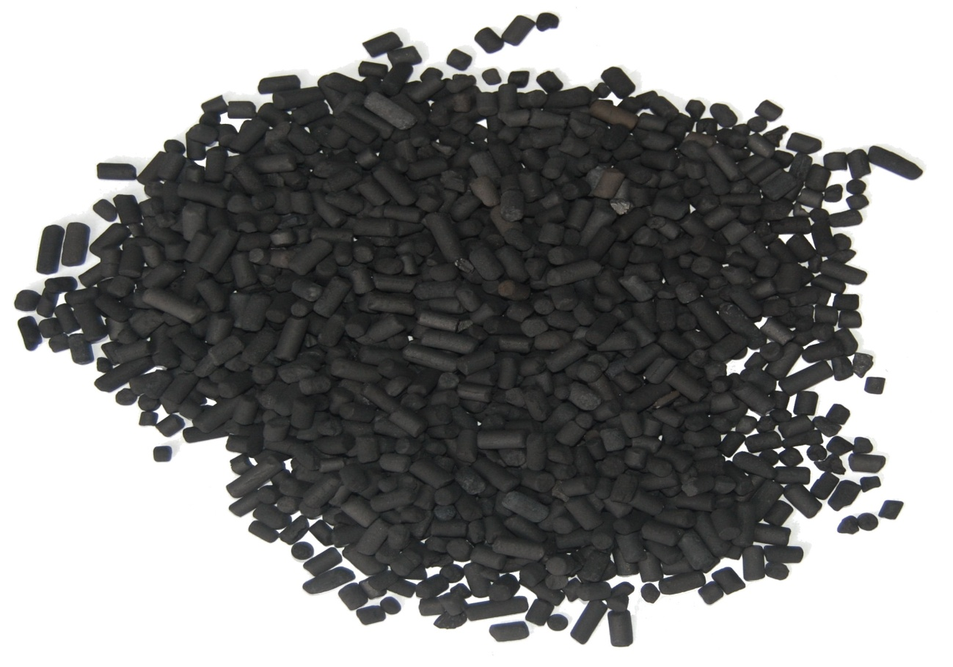
Adsorption Materials
Activated Carbon

Slide 20
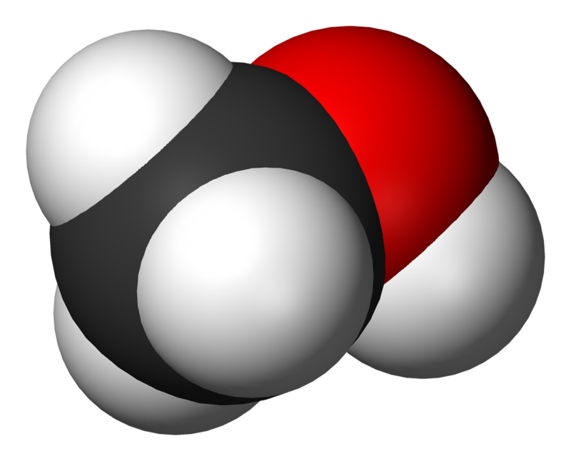
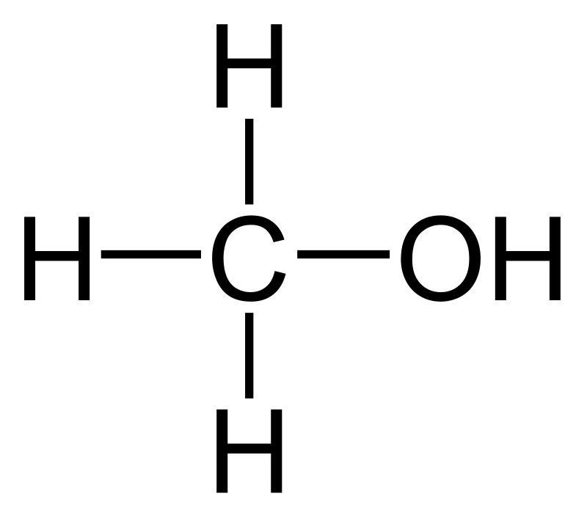
Methanol

Slide 21
Results
Flat Plate Collector Heating Power
Month | W/m² | kWh/m²
1 (January) | 106.79 | 2.56
2 (February) | 132.25 | 3.17
3 (March) | 176.07 | 4.225
4 (April) | 253.7 | 6.09
5 (May) | 255.9 | 6.14
6 (Jun) | 288.13 | 6.91
7 (July) | 276.6 | 4.64
8 (August) | 256.02 | 6.14
9 (September) | 217.49 | 5.2
10 (November) | 153.46 | 3.68
11 (October) | 91.78 | 2.2
12 (December) | 67.7 | 1.6

Slide 22
The annual daily average of solar radiation in Palestine is 5.4 kWh/m². But, the efficiency of every flat plate solar collector is about 51%-61%. And have a full area of concentration of 0.16 m². Therefore, the heat collected by the tube of the collector is:
0.56*5.4*0.16*1000/10 = 48.384 watt
where: 10 is the daily sun shine hours.

Slide 23
Results of Two Hours Heating
Temp. of water (°C) | Temp. of evaporator (°C) | Temp. of adsorption tank(°C) | Time (minutes)
23 | 23 | 24 | 0
29.6 | 26.2 | 40.6 | 30
30.5 | 28 | 67.4 | 60
30.7 | 28.9 | 88.2 | 90
31.6 | 29.4 | 94.3 | 120

Slide 24
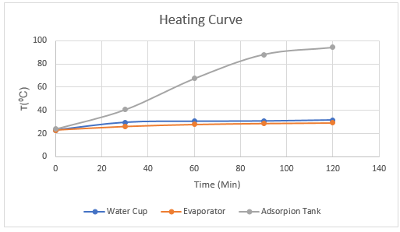

Slide 25
Results of Cooling
Temp. of water (°C) | Temp. of evaporator (°C) | Temp. of adsorption tank (°C) | Time (minutes)
31.6 | 29.4 | 94.3 | 0
33 | 33.7 | 84.2 | 30
27.4 | 38.4 | 76.8 | 60
25.9 | 37.2 | 70.6 | 90
23.6 | 34.5 | 64.7 | 120
21.3 | 31.6 | 58.3 | 150
20.7 | 27.7 | 47.8 | 180
19.6 | 25.3 | 43.2 | 210
17.8 | 22.8 | 39.5 | 240
16.6 | 21.6 | 35.3 | 270
15.8 | 20.1 | 31.1 | 300
15.2 | 19.4 | 27.3 | 330
14.6 | 15.3 | 26.2 | 360

Slide 26
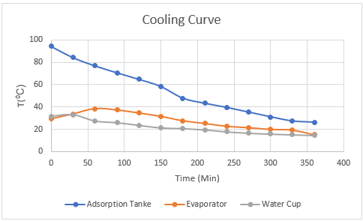

Slide 27
Calculating the Coefficient of Performance
Q = C*m*ΔT
Where:
Q: heat loss from water (in joule).
c: specific heat of water = 4.18 kJ/kg.K
m: mass of water = 1 kg ( as tested).
ΔT: temperature difference of water from the beginning of adsorption to the end of adsorption (in K).
Qwater = 4.18*1*[(31.6 – 14.6) + 273] = 1212.2 kJ
Qheaters = 1000*2*3600/1000 = 7200 kJ
COP= Qwater/Qheaters
COP= 1212.2 / 7200 = 0.1684 approximately to 0.2.

Slide 28
conclusion
We discovered the usage of solar energy in air conditioning.
We discovered the types of solar collectors and the efficiency of each type.
We investigate the adsorption process .

Slide 29
Recommendations
Using better equipment’s and parts to decrease the losses from the system.
Replace the flat plate collector with more efficient solar collectors like evacuated tube collector.
Increase the insulation of the evaporator to decrease the losses.
Using condenser with bigger size that used in this project to increase the heat exchanging area.
Replace this type of the evaporator with more efficient one.
Add some sensors and control systems to the project to decrease the error and losses.

Slide 30
Thank you for listening. any questions?

Slide 31
Efficiency of Flat Plate and Evacuated Tube Collectors
ή = Qc/((A*Ic))
Where:
Qc: Useful heat output of flat plate collector (Watt).
A: Collector surface area (m^2).
Ic: Intensity of solar radiation incident on the collector surface (w/m^2 ).
To calculate the useful heat output (Qc) by the relation:
Qc = A [Ic* (τα)e – Uc (Tin – Ta)] (2.2) [19]
Where:
(τα)e: Effective product of transmissivity of the transparent cover and
absorptivity of the absorber.
Uc: Overall heat transfer coefficient of collector (w/(m^2.k))
Tin: Collector fluid inlet temperature (⁰C).
Tout: Ambient air temperature (⁰C).

Slide 32
Dubinin–Radushkevich (D-R) equation
x = xₒ exp [-k (T/Ts - 1)ⁿ] (4.1)
Where:
x: refrigerant concentration (kg refrigerant /kg adsorbent).
xₒ : refrigerant concentration at saturation conditions (kg refrigerant /kg adsorbent).
Ts: is the Saturated temperature of refrigerant (K)
k and n are specific coefficients for different adsorbent and refrigerants.

Slide 33
Performance Estimation
QT = QAB ‏ + QBD (4.2)
QAB = (mA.T CpAT+ Cpr mrA)( TB – TA ) (4.3)
QBD =[ mA.TCpA.T +Cpm{(mrA +mrD) / 2}](TD – TB)+(mrA-mrD) H (4.4)
Where:
mA.T : mass of adsorbent (kg).
CpA.T : specific heat of adsorbent (kJ/kg).
mr , Cpr : mass and specific heat of adsorbate respectively (kg) and (kJ/kg).
H: heat of desorption, (kJ/kg).
The gross heat released during the cooling period Qe1 will be the energy of vaporization of adsorbate.
Qel = ( mrA – mrD ) L (4.5)
Where:
L: the Latent heat of evaporation of adsorbate (kJ/kg).

Slide 34
But the net energy actually used to cool evaporator space Qe will be:
Qe = Qe1 – Qe2 (4.6)
Where:
Qe2: the energy necessary for cooling the liquid adsorbate from the temperature at which it is condensed to the temperature at which it evaporates.
Qe2 = ( mrA – mrD )Cpr( Tc – Te ) (4.7)
In the evaporator space:
Qload is the energy required to cool the space from T1 to T2 .
Q = U*A*(T1-T2) (4.8)
Where: U is the overall heat transfer coefficient of the space walls and A is the area of the space

Slide 35
The performance estimates of the closed type adsorption refrigeration system could be expressed in terms of the net solar: [19]
COP= Qload / QI
The cycle:
COP = Qe1/QT
The evaporator efficiency:
η₁ ₌ Q_{load/} Q_{e}
The collector efficiency:
η₂ ₌ QT/QI
Where QI is the total solar energy input to the system during the day.

Slide 36
