Slide 1

Presenter:
Mohammad Soqy
Mohammad Ateeq
Noor AL Deen Omar
Supervisor:
Dr. Issam Jardaneh

Slide 2

Analysis and design of foundation of Al Eyman building-Jenin

Slide 3
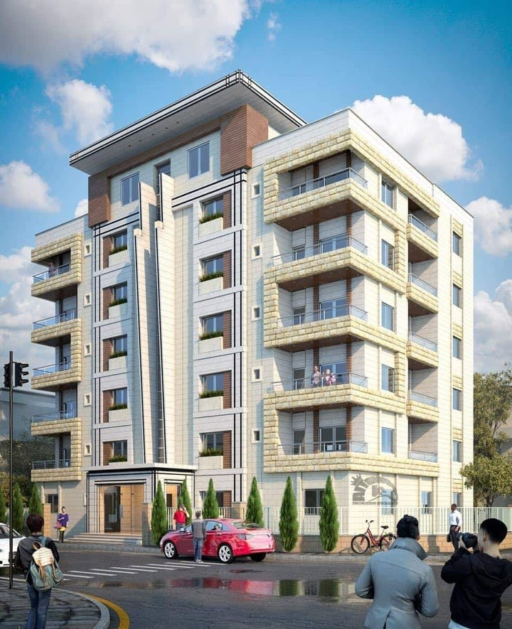
  glance of the project:
  The project is located in Jenin city – Nazareth street.
  The project is a residential building consists of seven stories each storey has a two apartments.
  The area of each story is 342 meter square.
  The building does not have any commercial areas.

Slide 4







Foundation types

Slide 5
Recommendation of Site investigation:
  Site investigation:
In this project, the soil is improving by at least 1.2m (0.8 m of compacted rockfill and 0.4m of compacted basecourse according to standards) in this case the allowable bearing capacity is (2 Kg/cm²).

Slide 6
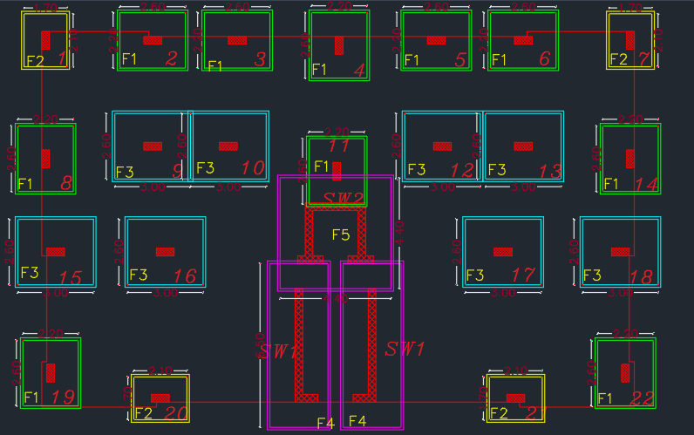
  Foundation System:
  Single Footing System:
service load (KN) | type of footing | Dimension | THICKNESS
from 1200 to 1500 | F3 | 2.6 * 2.2 | 65
from 800 to 1150 | F1 | 2.1 * 1.7 | 65
from 600 to 750 | `F2 | 3.0 * 2.6 | 65
  8 of these single footing are overlapped
  The over all percentage of footing to the hole building is 56%.
  Due to the overlaps and 56% percentage this system is not recommended.
  single footing distribution

Slide 7
  Foundation System:
  Mat foundation System:
  Because the single footing method fails to fulfil the design process Mat foundation will be used.
  The way to choose the correct thickness is by trial and error.
  After several tries 60 cm thickness succeeded to pass the tests.

Slide 8
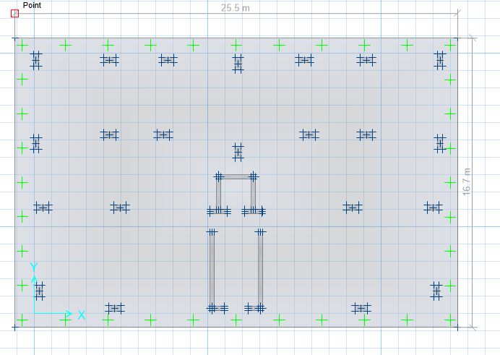
  The concrete is B300 F’C = 24 Mpa
  Safe Design:
  The steel yielding strength 420
  Mat thickness = 600 mm
  Stiff thickness under column = 600 mm
  Soil capacity = 2 kgm/cm2
  Mat concrete cover = 60 mm
  Dead load pattern = 1 (to calculate mat self weight
Model from safe to our project

Slide 9
In order to continue the design and steel calculation process four checks must be done:
  Checks:
Compatibility check
Deflection check
Pressure under footing from service load
Punching shear check

Slide 10
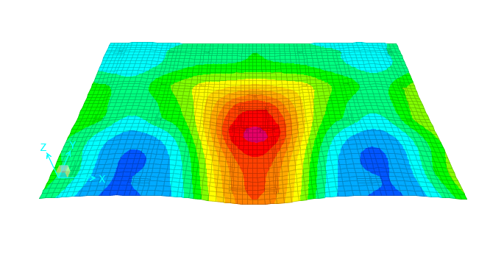
After the animation of the model started, all elements moved together as one body, which means that the model is compatible.
  Compatibility Check:
Compatibility Check

Slide 11
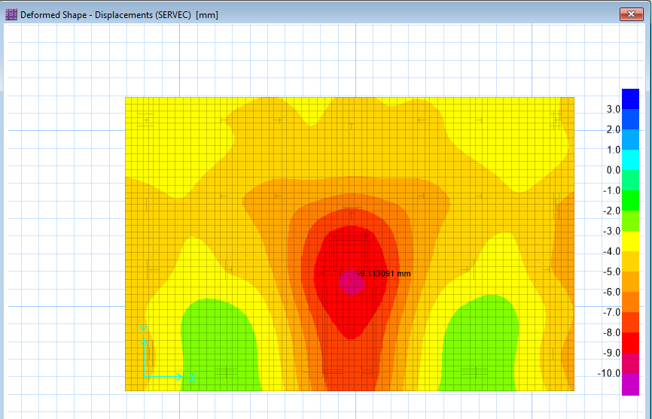
The allowable deflection is 10 mm
  Deflection Check:
The max deflection in the project =9.11 mm
The deflection check passes
Service load deflection shape

Slide 12
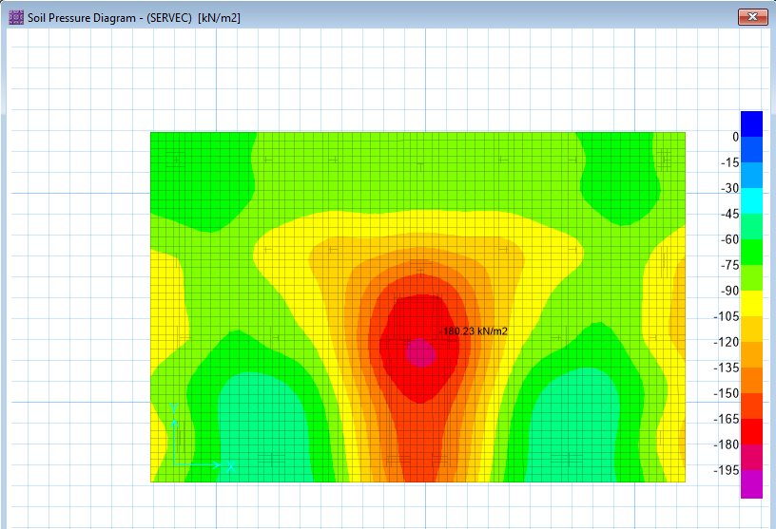
The allowable pressure under footing is 200 kN/m2
  Pressure under footing from service load Check:
The max pressure in the project = 180 kN/m2
The Pressure under footing from service load check passes
Pressure under footing from service load

Slide 13
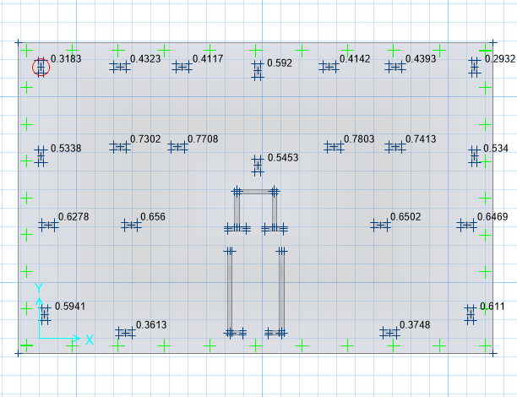

All value less than 1 →$\frac{Vu}{φVc}$ <1
  Punching shear Check:
$\frac{Vu}{φVc}$ < 1 → Vu < $φVc$
The Punching shear check passes
Punching shear Check

Slide 14
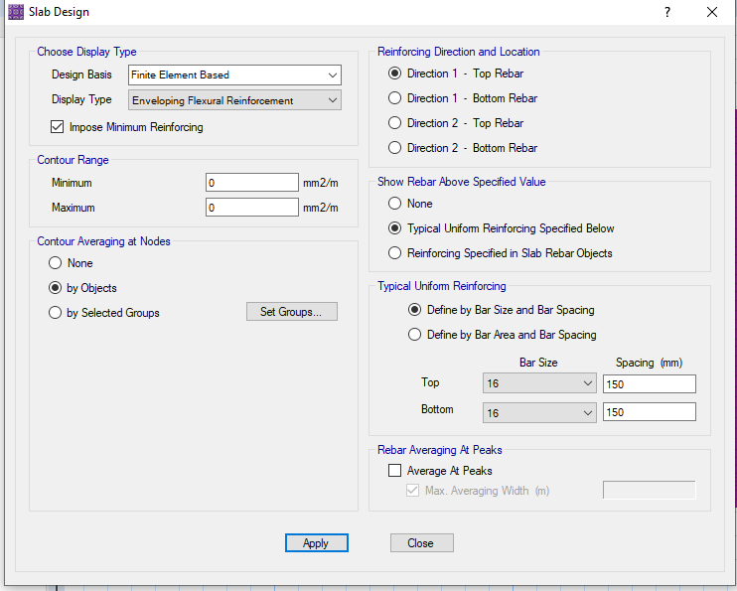
Steel reinforcement from safe

Slide 15
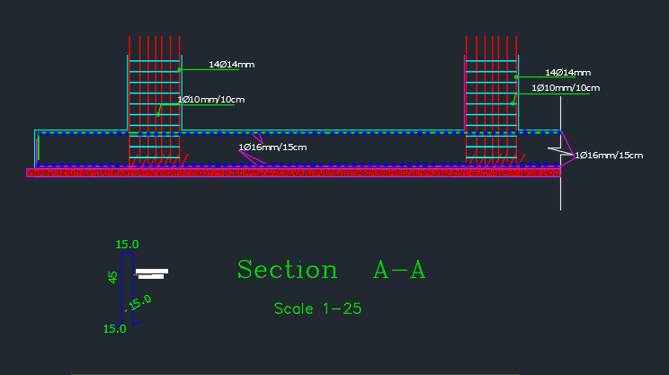
As min = 0.0018 * 1000 * 600 = 1080 mm2 → 6ᴓ16/m
The bar distribution: 1080/201 = 6ᴓ16/m
Moment M11 max (top steel in X-direction and Y-direction)
Moment M22 min (bottom steel in X-direction and Y-direction) the steel distribution is 1ϕ16/ 15 cm overlap equal 960mm
  Foundation Reinforcement:

Slide 16
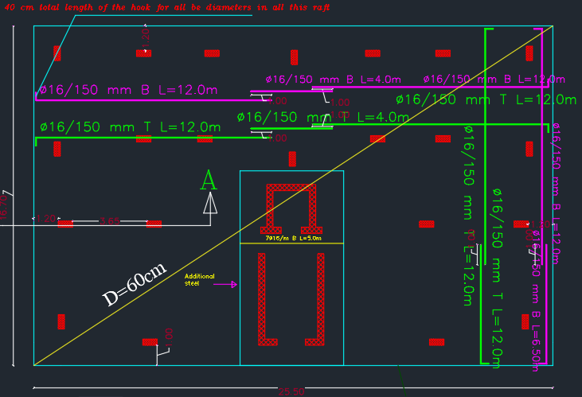
Steel bars distribution

Slide 17
The square meter costs approximately = 490 NIS
  Bell of quantity (BOQ):
cost (NIS) | unit price (NIS) | unit | quantity | term | no
4510 | 11 | m3 | 410 | excavation | 1
3300 | 12 | m3 | 275 | rockfill | 2
6235 | 43 | m3 | 145 | landfill | 3
62100 | 300 | m3 | 207 | concrete | 4
70950 | 4.3 | kg | 16500 | steel | 5
20520 | 60 | m2 | 342 | labor | 6
167615 | total cost

Slide 18




Thanks for listening

