Slide 1

Foundation Design of Law and Media College
GP2-22/12/2016
Prepared By :
Aya Waleed Odeh
Under Supervision of :
Dr. Isam Jaradaneh

Slide 2
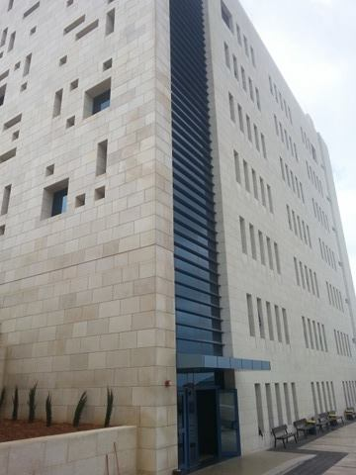
GP2-22/12/2016
College of Media Law and

Slide 3
GP2-22/12/2016
Table of Contents
The Structural System of the College
Site Investigation of Soil
Design of Foundation in three systems:-
Single footing with tie beams
Hollow mat foundation
Solid mat foundation

Slide 4
GP2-22/12/2016
The Structural System of the College

Slide 5
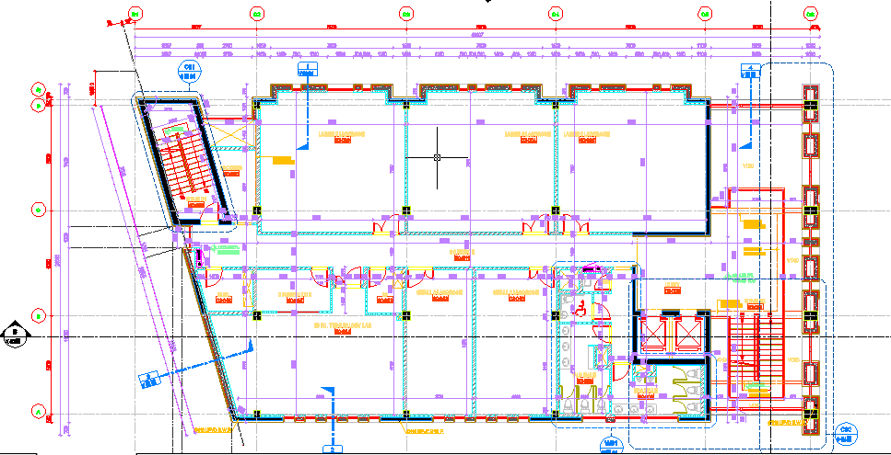
GP2-22/12/2016
The Plan of the Project

Slide 6
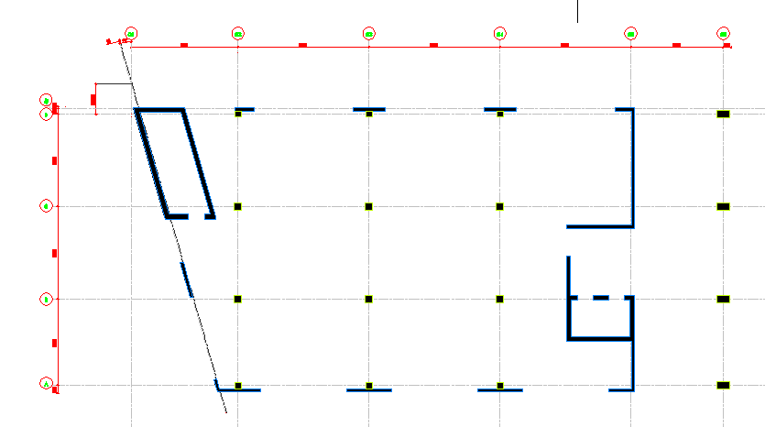
GP2-22/12/2016
Centerlines of Columns

Slide 7
GP2-22/12/2016
Loads on Columns
Column | Dead Load | Live Load | Service Load | Ultimate Load
C2A | 300 | 200 | 500 | 680
C2B | 1560 | 1000 | 2560 | 3472
C2C | 870 | 530 | 1400 | 1892
C2D | 360 | 225 | 585 | 792
C3A | 480 | 300 | 780 | 1056
C3B | 2900 | 2000 | 4900 | 6680
C3C | 3000 | 2000 | 5000 | 6800
C3D | 600 | 380 | 980 | 1328
C4A | 380 | 240 | 620 | 840
C4B | 1800 | 1200 | 3000 | 4080
C4C | 2300 | 1500 | 3800 | 5160
C4D | 570 | 360 | 930 | 1260
C6A | 550 | 320 | 870 | 1172
C6B | 950 | 530 | 1480 | 1988
C6C | 950 | 530 | 1480 | 1988
C6D | 550 | 320 | 870 | 1172

Slide 8
GP2-22/12/2016
Site Investigation of Soil

Slide 9
GP2-22/12/2016
Purpose of the report
Describe soil strata of the site
Selection of the most suitable and practical foundation type and depth to be constructed at the site.
Evaluate bearing capacity of soil.
Estimation of the probable settlement of structure.
Ground water level.
Check if the site soil need improvement.

Slide 10
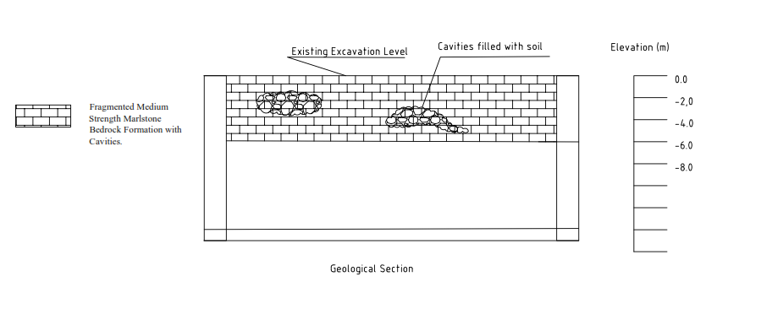
GP2-22/12/2016
Site Description
The site from geotechnical point of view can be described as medium strength Marlstone bedrock formation with cavities. Some of these cavities are filled with soil and stone. The site is excavated to the foundation level and prepared for construction of foundation

Slide 11
GP2-22/12/2016
Type of Foundation
Shallow foundation especially mat or strip foundation systems are recommended to be used in this site. This is due to existing of cavities. In case of isolated footings are to be constructed, then strong tie beams should connect the footings.
Bearing Capacity of the Soil
Recommend bearing capacity of medium strength marlstone bedrock formation with cavities is 3.0 kg/cm2 → (300 kN/m2)

Slide 12
GP2-22/12/2016
Design of Foundation

Slide 13
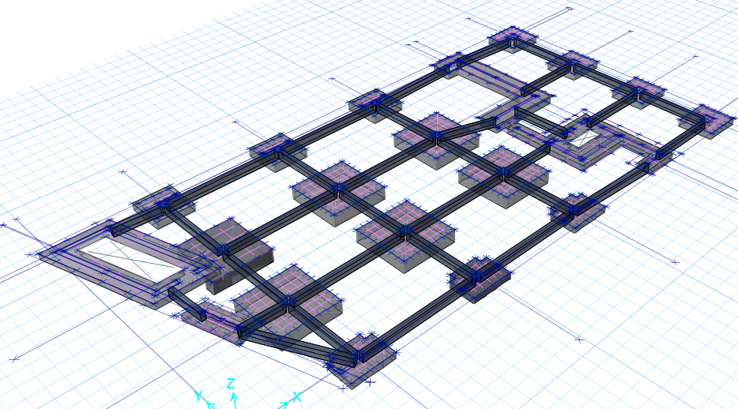
GP2-22/12/2016
Single Footing With Tie Beams

Slide 14
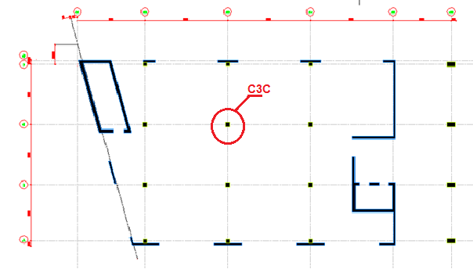
GP2-22/12/2016
Sample of Hand Calculations
for column C3C (0.6*0.6 m)
Design Steps:
Calculate Footing area→ Af = Pa/q allow
→16.667 then B*L = 4*4 m
Calculate footing depth depending on wide beam shear
Pu = 1.2D+1.6L =1.2(3000) + 1.6(2000) = 6800 KN
Qu= Pu/Af= 425 kN/m2
Vu =722.5-425 d
ɸVc = 661.44 d
Let Vu = ɸVc

Slide 15
GP2-22/12/2016
D= 0.67m
h= 0.75 m
Design for flexure
Mu = quL^2/ 2 = 614.125 kN/m2
Ƿ= 0.00246
As = 2021.978 mm2/m
As min= Ƿbh =1620 <As → o.k
Check punching shear
Vu p = Pu – A1 qu → Vu = 6114.5
ɸVc,p = 4475.5 < Vu ,p → Not good
Take h = 0.9
d= 0.82
Vu ,p = 5943.03
ɸVc,p = 6099.8
Vu.p < ɸVc,p → o.k

Slide 16
GP2-22/12/2016
Design using SAFE program
Column # | Column dimension (m) | Footing # | Footing Dimension(m) | Footing thickness (m)
C2B,C2C,C3B,C3C, C4B,C4C | 0.6*0.6 | F1 | 4*4 | 0.9
C6A,C6B,C6C,C6D | 0.5*0.8 | F2 | 2.5*2.8 | 0.5
C2A,C2D,C3A,C3D, C4A,C4D | 0.4*0.4 | F3,F4 | 2*2 | 0.5

Slide 17
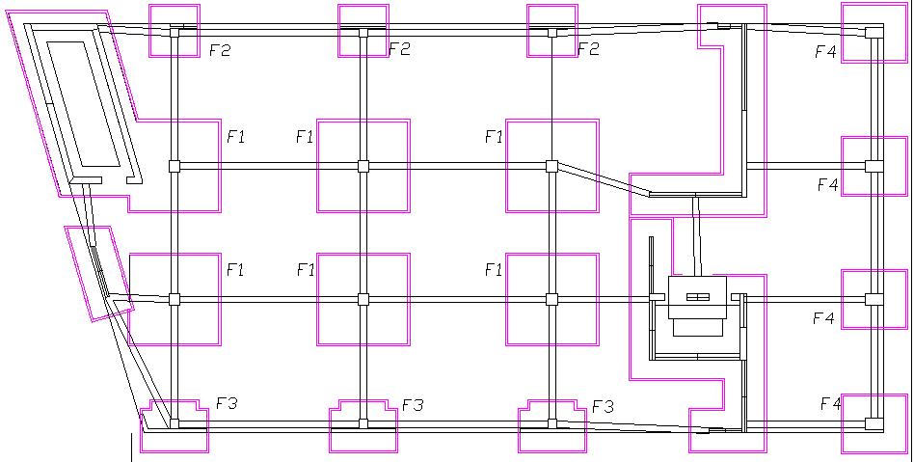
GP2-22/12/2016
Then we design strip footing for shear wall and dimensions were 0.4m thickness and 1.8 m width. As we have shear wall next to the columns, the final dimension for F3 is (2.9*2.2)m and F4 is (2.1*2.2) m with thickness 0.5 m.

Slide 18
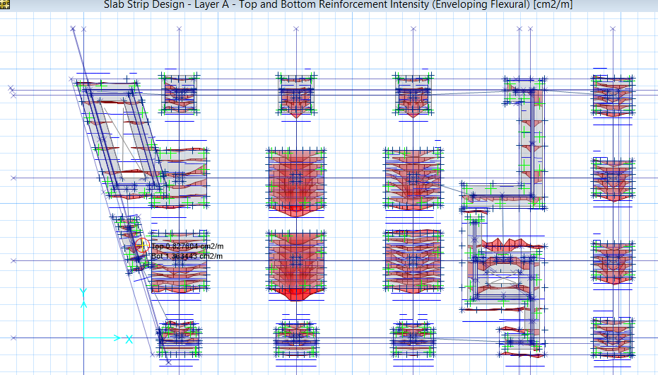
GP2-22/12/2016
Footing Reinforcement
Distribution of top and bottom steel in footings in x-direction

Slide 19
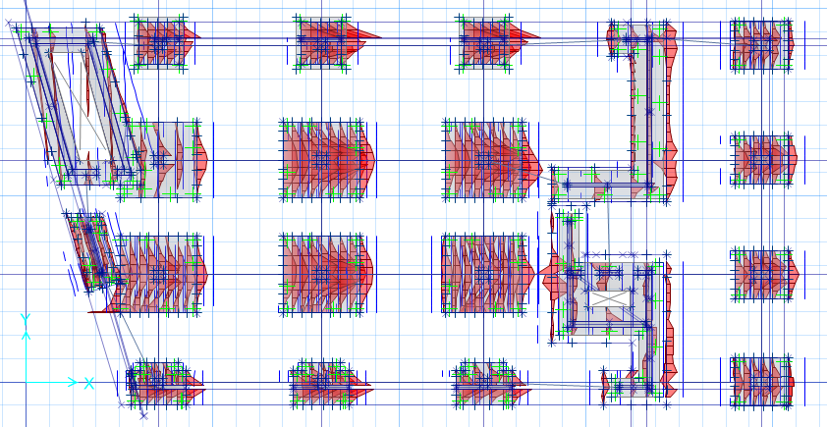
GP2-22/12/2016
Footing Reinforcement
Distribution of top and bottom steel in footings in y-direction

Slide 20
GP2-22/12/2016
Footing Reinforcement
Footing # | Reinforcement in long direction | Reinforcement in short direction
F1 | ɸ18/15 cm | ɸ18/15 cm
F2 | ɸ14/15 cm | ɸ18/15 cm
F3 | ɸ14/15 cm | ɸ18/15 cm
F4 | ɸ14/10 cm | ɸ16/15 cm
We need intensification for steel in 1 meter under column for footing #1 so we will use 5ɸ18/ m, and the same for footing #1 and #2 so we will use 5ɸ16 in 1 meter under column.
Strip Footing Reinforcement
We will use ɸ14/15 cm in long direction and ɸ16/15 cm in short direction.

Slide 21
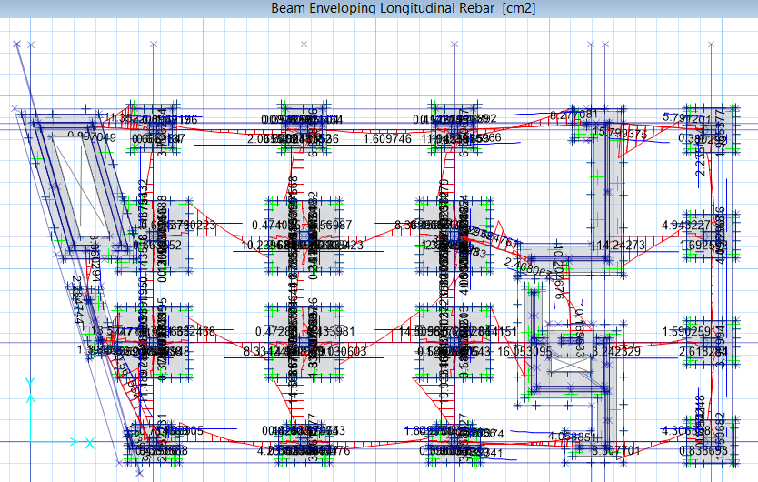
GP2-22/12/2016
Longitudinal rebar in tie beams

Slide 22
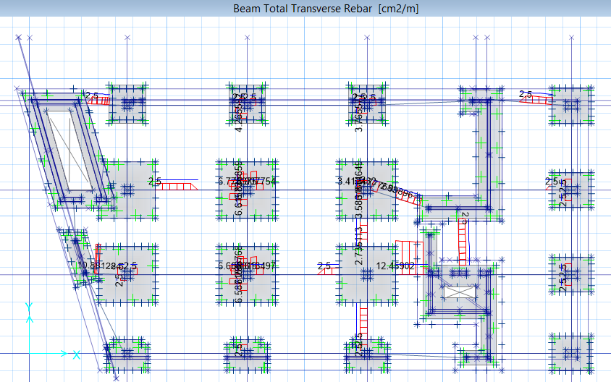
GP2-22/12/2016
Transverse rebar in tie beams
Tie Beams Reinforcement
Tie beams are 0.3 width and 0.6 depth.
We will use 4ɸ22 for top and bottom steel and ɸ8/15 cm in the transverse rebar.

Slide 23
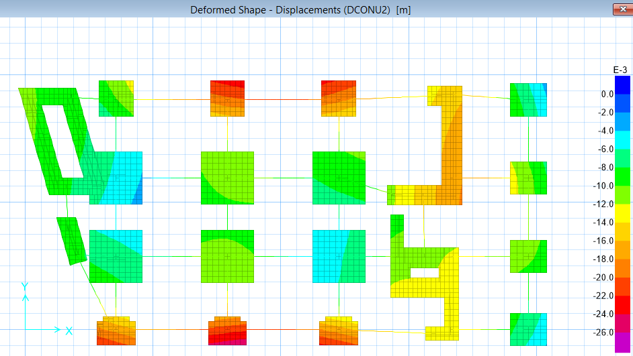
Check Deformed Shape
GP2-22/12/2016
From Safe program we found that the largest value of settlement = 0.002m which is less than 25 mm → o.k

Slide 24
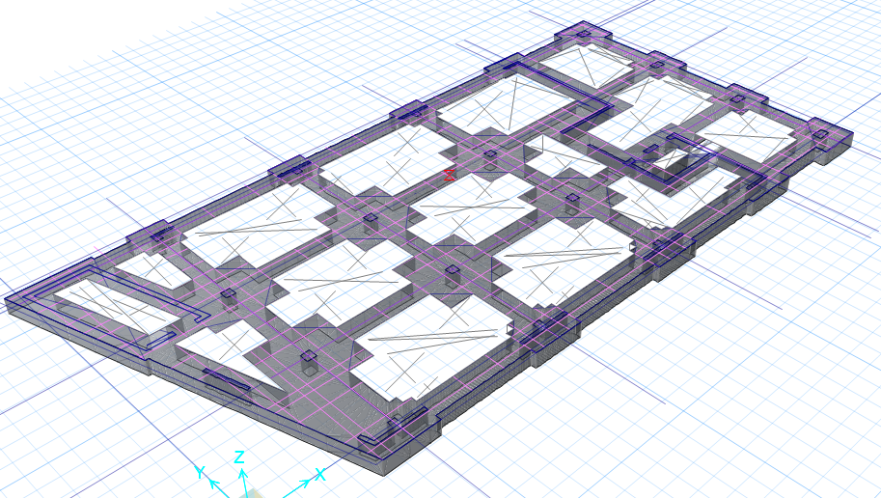
GP2-22/12/2016
Design of Hollow Mat Foundation

Slide 25
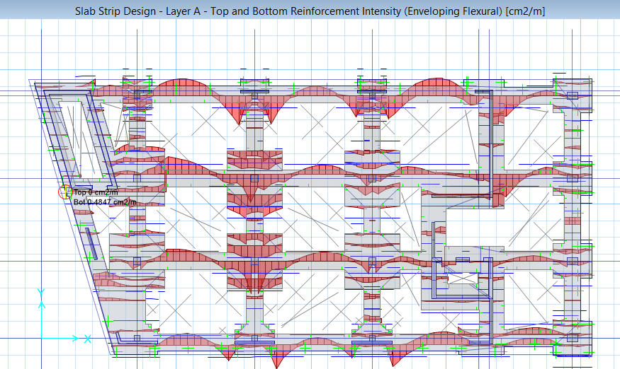
GP2-22/12/2016
we will design a hollow mat foundation with thickness = largest thickness of single footing = 0.9 m depending on punching shear, the strips between footing are 1.2 m width and the area of footing will be the same as single footing system. The blanked areas will be filled with base coarse and finally the floor will be casted as one unit.

Slide 26
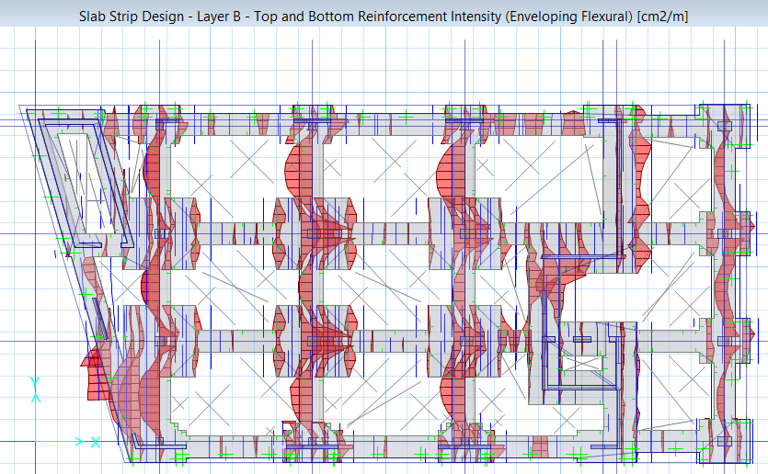
Reinforcement
In long direction
For footing: we will use 8ɸ16/m
For strips: we will use 8ɸ20 in top and bottom steel
In short direction:
For footing: we will use 8ɸ16/m
For strips: we will use 5ɸ12/m top and bottom steel (as stirrups )

Slide 27
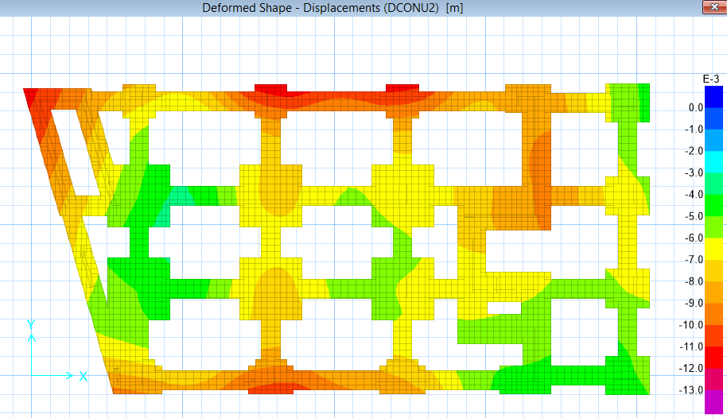
GP2-22/12/2016
Check Deformed Shape
The largest value =0.01m which is very small → o.k

Slide 28
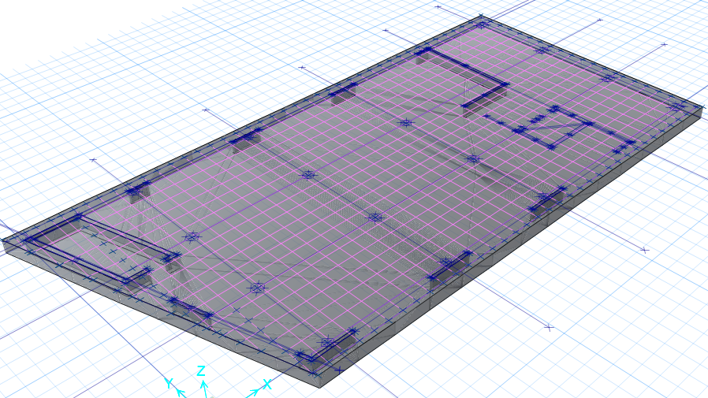
GP2-22/12/2016
Design of Mat Foundation

Slide 29
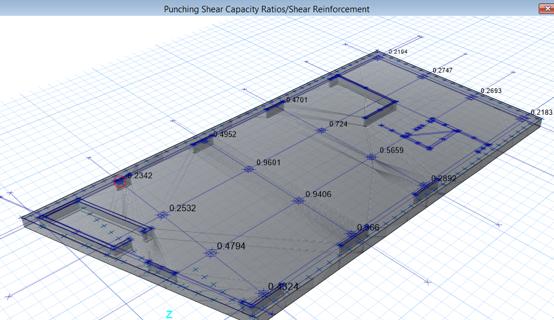
GP2-22/12/2016
Check of punching shear

Slide 30
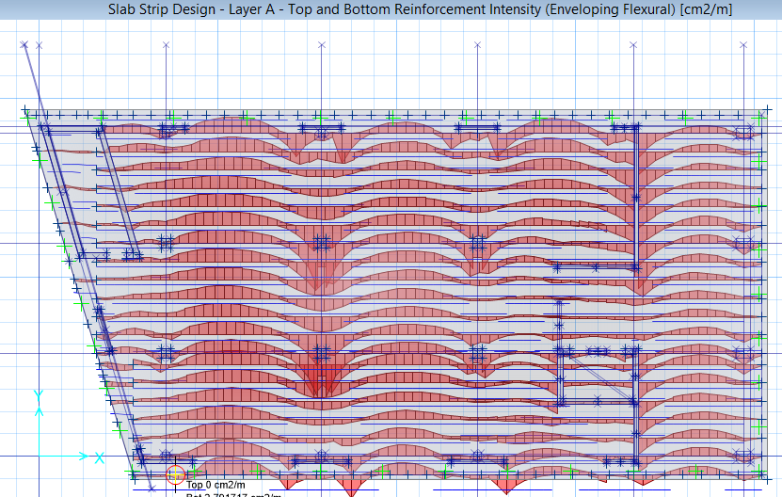
GP2-22/12/2016
Depending on punching shear we will design a mat foundation with thickness= the largest thickness in isolated footing = 0.9 m
Reinforcement
We will use ɸ16/20 cm in the top and ɸ16/15 cm in the bottom in the long direction.

Slide 31
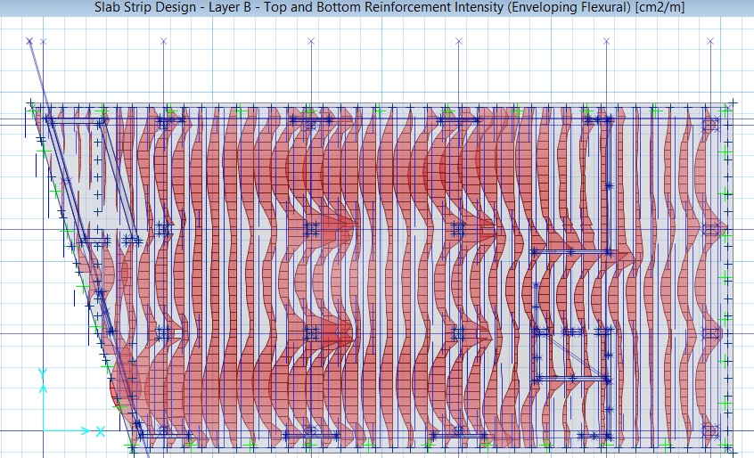
GP2-22/12/2016
We will use ɸ16/20 cm in the top and ɸ16/15 cm in the bottom in the short direction.

Slide 32
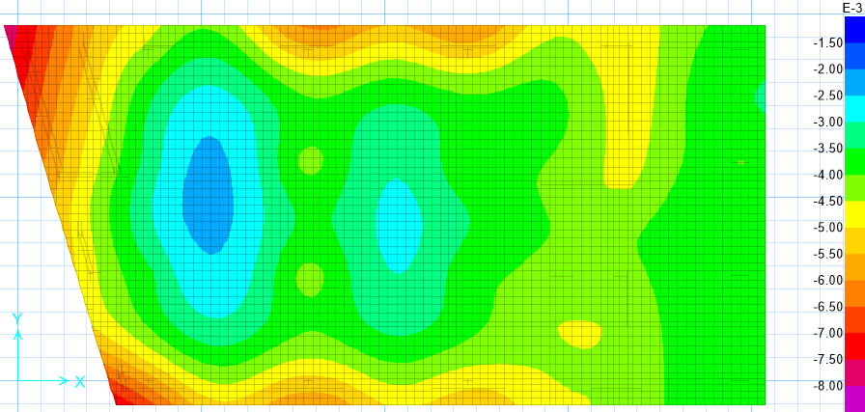
GP2-22/12/2016
Check Deformed Shape
From Safe program we found that the largest value of settlement = 0.008m which is less than 50 mm → o.k

Slide 33
GP2-22/12/2016
Conclusion
Three foundation systems were designed for the proposed building of this project which Law and Media Building. The first type of foundation is single footings with tie beam, the second type is hollow mat foundation and the last type is solid mat foundation. The type of soil at foundation level of the proposed site is medium strength Marlstone and Limestone formation with cavities and buckets within this foundation.
Due to existing of cavities within the bedrock formation below the level of foundation, it is highly recommended to have rigidly connected foundation. This is to over bridge the cavity if it encountered directly below any specific foundation. In this case the best type of foundation is continuous foundation or mat foundation.
Therefore, mat foundation or hollow mat foundation which replacement to continuous foundation is the most appropriate types of foundation for this site. However, the cost of hollow mat foundation is less expensive than solid mat foundation.
→ hollow mat foundation is recommended to be used for this project

Slide 34


