Slide 1
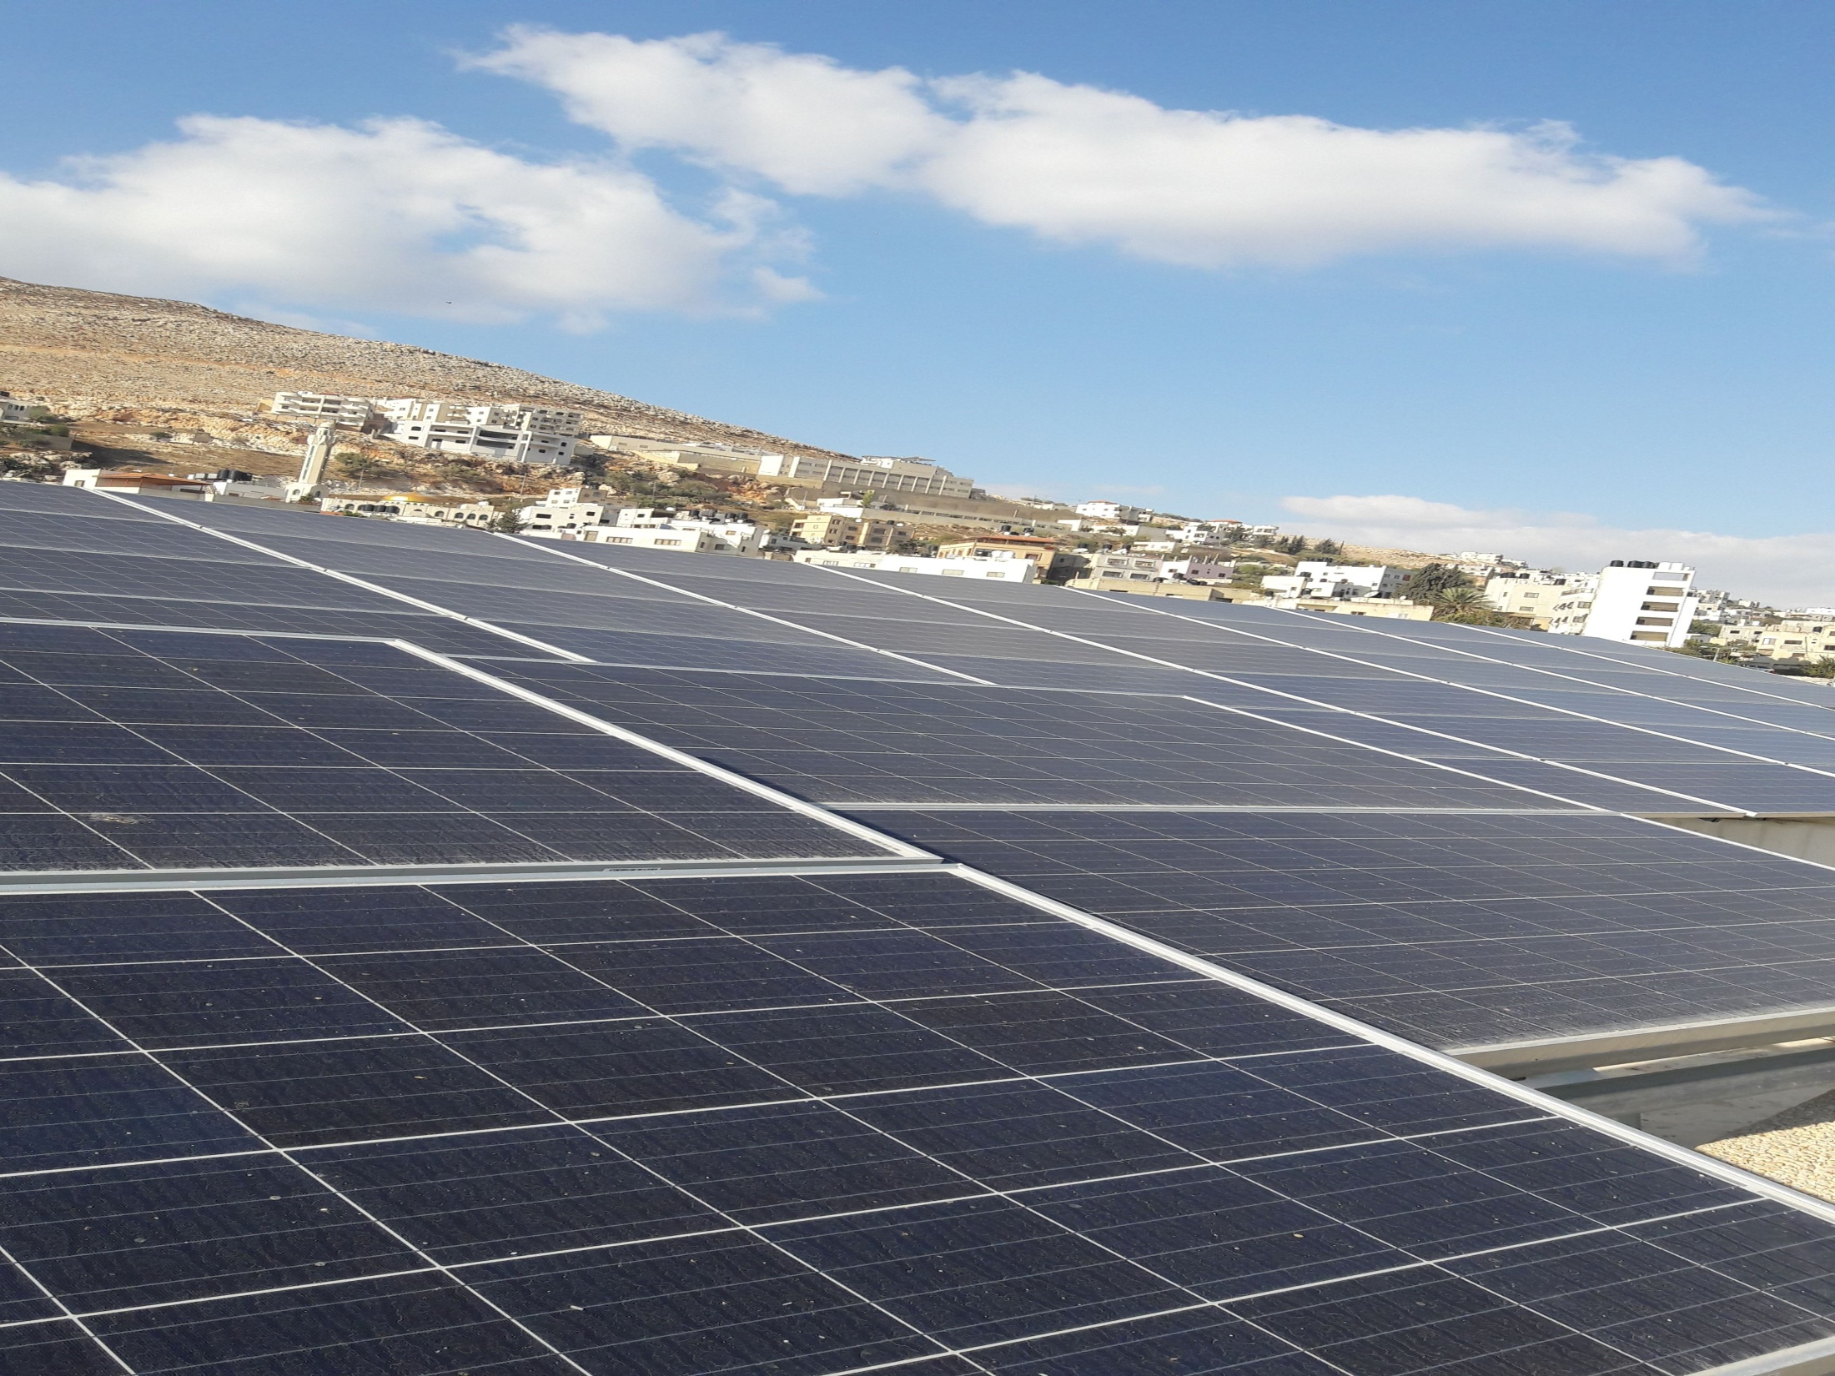

33KWp PV System
Instructor:
Jamal Kharosheh
Students:
Anas yousef saleh
Karam ibraheem
Yousef alawneh
Osaid mare

Slide 2
Abstract
In this project there is a study in details of the 33(kwp)PV system which is installed in Alrrajeh factory. First of all this project starts with the importance of PV system in Palestine, the equipment are installed , best angle in Palestine, assessing (evaluate) of the system .

Slide 3
Contents :
Why the solar energy very important specially in Palestine
Installation angles and instrument.
Type of connection to the network.
Assessing and evaluating the system
Net metering .

Slide 4
Why the solar energy very important especially in Palestine:
The energy sector situation in Palestine is highly different compared to their countries in the Middle East due to many reasons:-
Non-availability of natural sources, unstable political conditions, financial crisis and high density population
For Palestine, the average solar resource ranges from5.4kWh/m2/day to6kWh/m2/day
This energy is very promising if it is compared to other places in the world like Spain-Madrid (4.88kWh/m2/day), USA-Denver (4.95 kWh/m2/day), Australia-Sidney (4.64kWh/m2/day), Mexico-Gulf of Mexico (4.78kWh/m2/day).

Slide 5
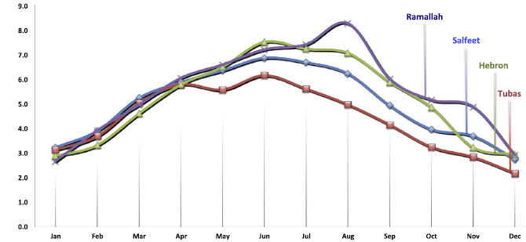
Ramallah in the middle part of the West Bank and Hebron in south part of the West Bank in year 2010.The highest solar radiation average for year 2010 in Salfeet is 5.65kWh/m2/day, then Ramallah is 5.5 kWh/m2/day, Hebron is 5.14kWh/m2/day.
Fig. 3. Monthly averages of solar radiation in different cities in West Bank in year 2010

Slide 6
* High fuel cost in Palestine makes PV more feasible than diesel powered electric generators in supplying power to different applications in rural areas.
* High average of solar radiation intensity and sun shine hours of about 3000h per year.
* Availability of a large number of rural villages, settlement sand public utilities isolated from the electric grid that will not be connected to it in the near future.

Slide 7
The solar angles very important in the solar system because the efficncy is depend on the angle .

Slide 8
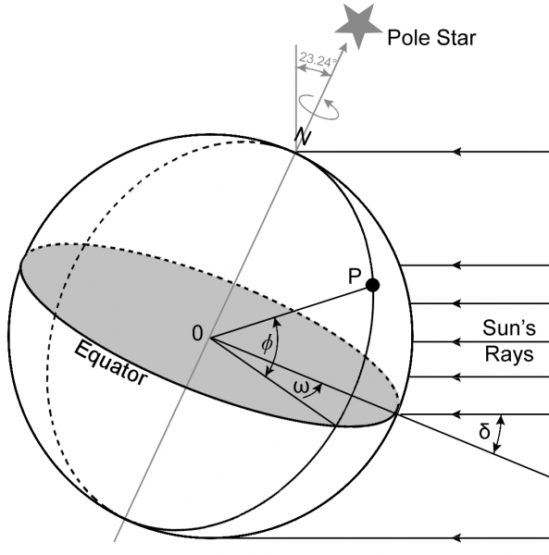
First: the declination angle (delta) it is the angle between the sun line ray and the Earth's equator.

Slide 9
The declination angle is change every day:
so Every year the solar declination goes from -23.44 degrees to +23.44 degrees in line with the Earth's seasons.

Slide 10
The declinantion angle calculated by :
Delta =23.5(sin (360*(n+284)/365))
N=number of day
At 21/December delta =-23.5 the winter solstice
At21/ June delta=+23.5 the summer solstice
At 21/ March delta=0 autumn equinox
At 21/ September delta=0 vernal equinox

Slide 11
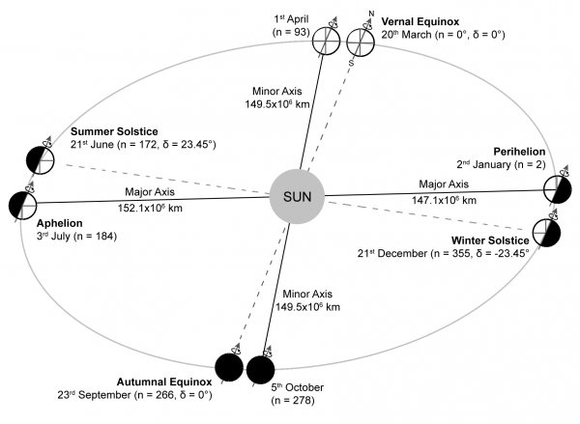

Slide 12
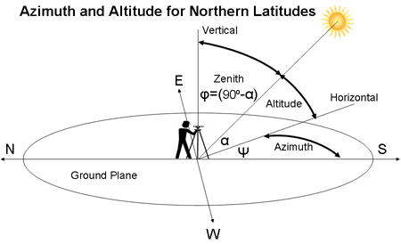
Second angle the altitude and the zenith angle :
the altitude angle is the height of the sun in the sky measured from the horizontal.
The solar zenith angle is the angle between the zenith and the centre of the Sun's disc.

Slide 13
The hour angle
: it is the hour angle: it’s the angle is the earth should be rotate in order to bring the local meridian of the local point direction under sun with means the solar noon.

Slide 14
It calculated by :
Hs=15(ts-12)
But:
TS: solar time.
Ts=LMT+EOT+4(LTZ-LOD)
Where:
LMT: local mean time.
EOT: equation of time.
LTZ =local standard meridian.
LOD: longitude of the local point.

Slide 15
Latitude and longitude angles
latitude is a geographic coordinate that specifies the north–south position of a point on the Earth's surface. Latitude is an angle (defined below) which ranges from 0° at the Equator to 90° (North or South) at the poles.
The latitude angle for nabluse =32.
The longitude angle is a geographic coordinate that specifies the east-west position of a point on the Earth's surface. It is an angular measurement, usually expressed in degrees.
The longitude for Nablus =35.

Slide 16
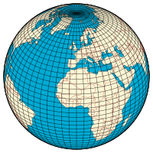

Slide 17
We can find the altitude angle by the following :
sin (alpha)=sin(delta)sin(latitude)+cos(delta)cos(latitude)hs
=cos (latitude-delta)

Slide 18
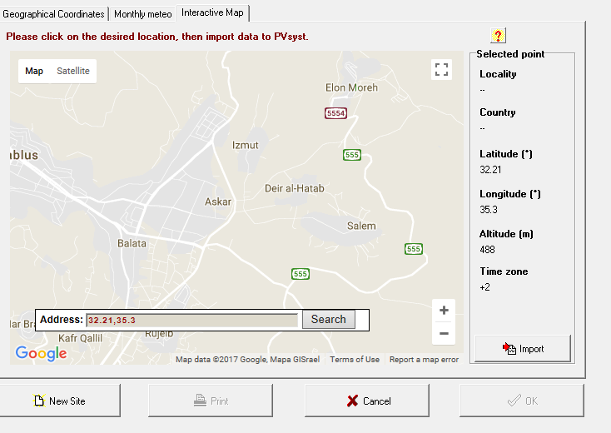
The following angle is by using solar sys program:

Slide 19
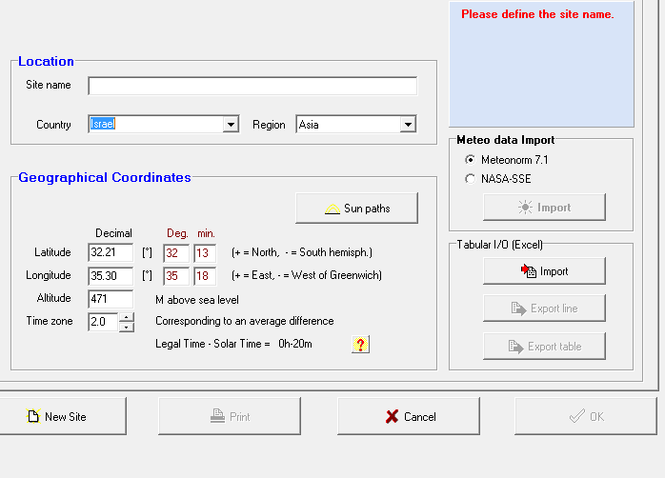

Slide 20
The tilt angle that is the angle between the horizontal and the panel
B=90-(alfa) but: alfa=90-latitude +delta.
The month | Delta | Altitude angle (alpha)=90-latitude +delta, at solar noon | Tilt angle(at solar noon) =90-(alpha)
January | -17.82 | 39.98 | 50.02
February | -8.68 | 49.12 | 40.88
March | 3.62 | 61.42 | 28.58
April | 14.68 | 72.48 | 17.52
May | 21.79 | 79.59 | 10.41
June | 23.29 | 81.09 | 8.91
July | 18.4 | 76.2 | 13.8
Augusts | 8.876 | 66.67 | 23.33
September | -3.42 | 54.38 | 35.62
October | -14.4 | 43.4 | 46.6
November | -21.72 | 36.08 | 53.92
December | -23.26 | 34.54 | 55.46
Avg | No need | No need | 32.08

Slide 21
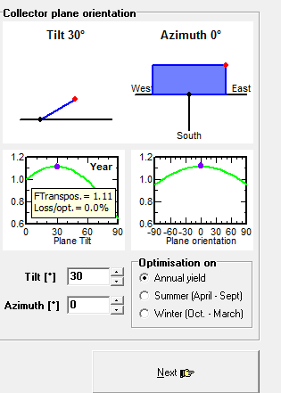
Azimuth angle for the collector it the angle of btween the collector and the south angle .
as =sin^-1(-(sin(hs)*cos(delta))/(cos(altitude)))
By the programe

Slide 22
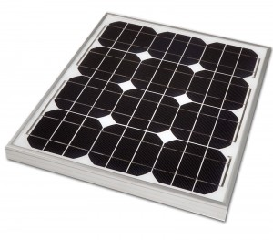
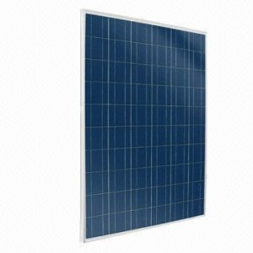
Types Of Solar Panel :
*Monocrysatalline Silicon Solar PV:
This type of panels had higher peak efficiency than another types, ,but as a result of that the price is higher "relatively" than another types.
*Polycrystalline (or Multicrystalline ) Silicon Solar PV:
Due to manufacturing issues "methods" , the crystal which PV made of has impurities. As a result of impurities this type is less efficient when compared with monocrystalline. But in the other hand polycrystalline has significant cost advantage over monocrystalline.

Slide 23
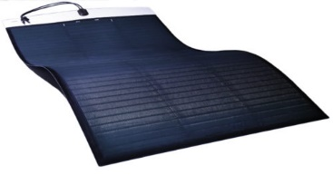
*Thin-Film Solar PV :
It is the second generation of PV comes after crystal silicon PV generation. It is distinguish by lightweight and portability .

Slide 24
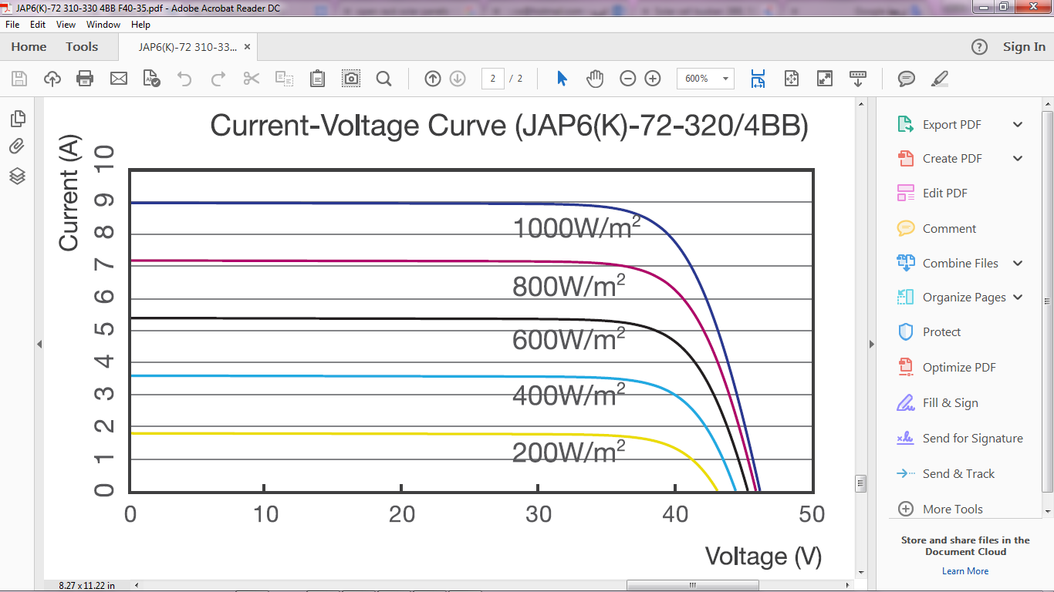
Type of PV used in the project:
Characteristic of JAP6(K):
4BB design :
In 4BB design the number of busbars used in each solar cell is four. Which resulted in reducing the internal resistance which leads to more reliable and efficient module.
IV curve “different solar insolation “

Slide 25
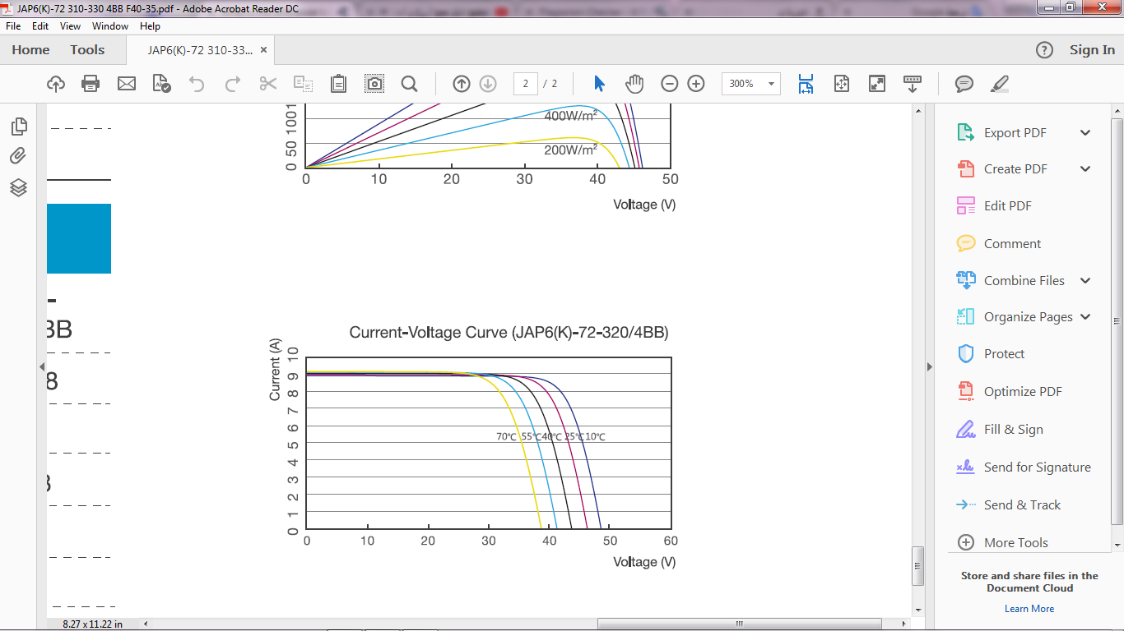
IV curve "different temperatures“

Slide 26
Types of Inverters:
String inverter
Generally solar panels are installed in strings
Central inverters
They can support more than one sting, where strings are connected together
In parallel.
Micro Inverter
In this type each panel connected with its own inverter.

Slide 27
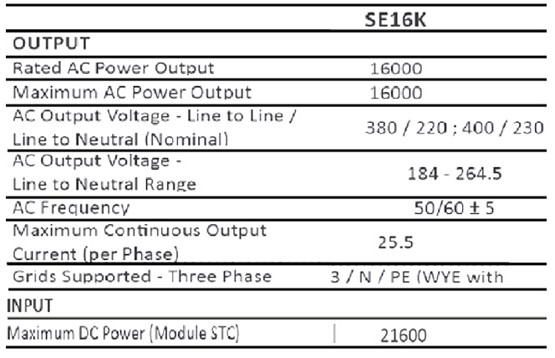
Type of inverter used in the project:
The inverter used in the project is solar edge.

Slide 28
Off-Grid systems
Definition: These systems designed without grid ;allow you to store the solar power in battaries ;to use when the solar panels are not producing enough energy
Components:
PV Modules - convert sunlight instantly into DC electric power.
Batteries: Batteries are an important element in any standalone PV ; used to store the extra solar-produced electricity. Depending upon the solar array configuration, battery banks can be of 12V, 24V or 48V ; There are basically two types of batteries used for solar energy storage: deep cycle lead acid batteries and shallow cycle batteries.
Charge Controller: A charge controller regulates and controls the output from the solar array to prevent the batteries from being over charged (or over discharged) by dissipating the excess power into a load resistance. connected in between the solar panels and the batteries

Slide 29
Fuses and Isolation Switches: These allow PV installations to be protected from accidental shorting of wires allowing power from the PV modules and system to be turned “OFF”.
Inverter: Inverters are used to convert the 12V, 24V or 48 Volts direct current (DC) power from the solar array and batteries into an alternating current (AC) electricity and power of either or 220 VAC .

Slide 30
On-Grid Solar
Definition: On-Grid Systems are solar PV systems that only generate power when the utility power grid is available. They must connect to the grid to function. They can send excess power generated back to the grid when you are overproducing so you credit it for later use.
Benefits: These are simplest systems and the most cost effective to install.
Components:
PV Modules - convert sunlight instantly into DC electric power.
Grid-Tie Inverter (GTI)
They regulate the voltage and current received from your solar panels. Direct current (DC) from your solar panels is converted into alternating current (AC), which is the type of current that is utilized by the majority of electrical appliances.

Slide 31
grid-tie inverters, also known as grid-interactive or synchronous inverters, synchronize the phase and frequency of the current to fit the utility grid (nominally 50Hz).
Surely we will simulate and explaine in details the components of this system in project 2 .
Note :In our project in alrajeh company we connect the system on the grid

Slide 32
Net metering system
Net metering system allows consumers who generate some or all of their own electricity to use that electricity anytime, instead of when it is generated.
Net metering system calculate the power consume by the customer and the power produced by the solar system, if the customer consume above the energy that the solar system is produced he will pay to the electricity company the price of the different of energy between the energy that he is consumed from the network and the energy that the solar system produced it.
Net metering policies can vary significantly by country and by state or province: if net metering is available, in Palestine the net metering system available with some policy that from the electrical company put it, like The north electrical company and the Village Council, in this research we will talk about agreement of north electricity company that alrajeh company agreed with north electricity company.

Slide 33
The different in energy = the energy consumed – the energy produced by the solar system.
If the different of the energy positive the customer pay the price of the different at the end of every month ,
If the different of the energy is negative the balanced of energy will add to customer as following :
The increment of the energy balanced =
(The different of energy in this month)* 75%+ the last energy balanced in last month if exist.

Slide 34
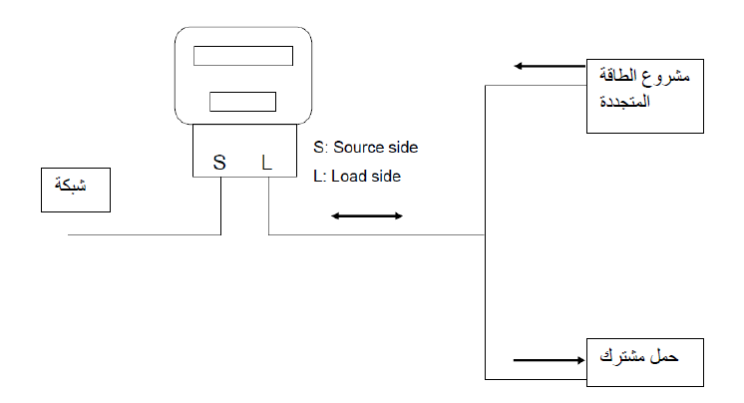
The subscriber meter is replaced by Bidirectional meter to measure the power Consumable distributor, exporting energy from project to network distributor.

Slide 35
In the morning hours, the solar energy system usually produces more energy than domestic consumption, so the excess energy goes to the grid and the direction of the measurement clock rotation from right to left.
In the evening the production of solar power stops and the home consumption of energy from the network so, the clock rotation direction is from left to right.

Slide 36

Assessing The project
Apply Key performance indicators “KPI”
Performance ratio (Quality Factor):
Performance ratio is one of the most important factor to assess the implemented solar system "or any other system". By using performance ratio there are many of mistakes and faults can be discovered, these faults can occur during the installation of the solar system or after the it is installed.
PR(QF)=
The actual production is obtained from the factory data base for September and October, and in the following PR of the system in these months September and October.

Slide 37


September "9th":
The actual production of the system at September is equal to➔5427479 (Wh)
Can be written as➔5.427479(MWh)
The theoretical production (from the previous table) ➔6.56MWh
Thus the PR is
Performance Ratio = =82.736%
October "10th":
The actual production of the system at October is equal to➔4574181(Wh)
Can be written as➔4.574181(MWh)
The theoretical production (from the previous table) ➔4.9MWh
Thus the PR is
Performance Ratio = =93.35%

Slide 38


Yield factor:
It gives us how much the (Wp) produce (Wh) and it is can be calculated as follow:
YF=
Coverage ratio:
it gives us an indicator to how much consumption covered from PV system.
CR=

Slide 39
Theoretical monthly energy production of the PV system (Mwh)
Calculated by using the following formula:
E_{pv system} = Solar radiation * Area of panel *Number of panel *Efficiency of panel *Efficiency of other equipment *Number of days

Slide 40
Month | Solar radiation Kw/m² per day | Power consumption | PV production (theoretical) | Coverage (%) | Saving in NIS | Yield factor (YF)
January | 2.46 | 11MWh | 2.74MWh | 24.9 | 1680.7 | 83.95
February | 3.388 | 11MWh | 3.413MWh | 31.03 | 2093.5 | 104.56
March | 5.15 | 11MWh | 5.74MWh | 52.18 | 3520.9 | 175.86
April | 6.18 | 11MWh | 6.67MWh | 60.6 | 4091.4 | 204.35
May | 7.03 | 11MWh | 7.84MWh | 71.27 | 4809.1 | 240.2
June | 7.65 | 11MWh | 8.26MWh | 75.1 | 5066.7 | 253.1
July | 7.75 | 11MWh | 8.64MWh | 78.5 | 5299.8 | 264.7
August | 6.9 | 11MWh | 7.7MWh | 62.73 | 4723.2 | 235.9
September | 5.88 | 11MWh | 6.56MWh | 59.64 | 4023.9 | 200.98
October | 4.42 | 11MWh | 4.9MWh | 44.54 | 3005.7 | 150.1
November | 2.78 | 11MWh | 3MWh | 27.27 | 1840.2 | 91.9
December | 2.52 | 11MWh | 2.81MWh | 25.54 | 1723.6 | 86.1

