Slide 1
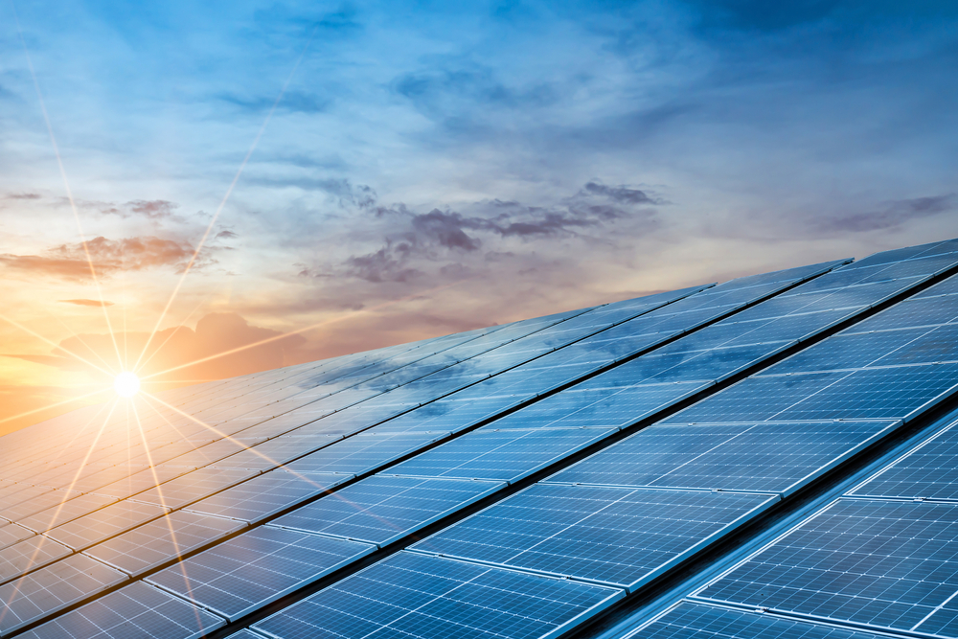
DUAL AXIS SOLAR TRACKER:
By:
Eng. Ali Bsharat.
Eng. Lana Saed .
Eng. Malak Azzam .
Project Supervisor:
Dr. Raed Jaber

Slide 2
Contents :
Introduction .
What is a Solar Tracker & How Does it Work ?
Solar Tracker :
Types of Solar Tracker Bases .
What is a Dual Axis Solar Tracker?
Solar Angles .
Block diagram of solar tracker .
Hardware System .
software System .
Applications of Dual Axis Solar Trackers .
summary of the economic feasibility study
CONCLUSION :

Slide 3
Introduction :
We have worked hard to design a high performance solar panel system that increases power output and increases efficiency .
Our system uses a dual-axis tracking base to track the sun's path throughout the day, ensuring optimal power output.
In this presentation, we will explain the types of solar tracking and the difference between them, as well as explain the components of the design and its purpose in terms of efficiency, etc., circuit planning, cost analysis of our system, and other things.

Slide 4
What is a Solar Tracker & How Does it Work ?
Solar Trackers
Devices that orient solar panels to face the sun as it moves throughout the day. This improves power output by maximizing the amount of sunlight absorbed by the panels.
How it Works
Solar trackers use sensors to detect the location of the sun, and then adjust the angle of the panels to constantly point towards it.
Types of Sensors
Some trackers use light sensors called LDRs, while others use GPS sensors to track the location of the sun.
Benefits of Solar Trackers
They can increase a solar panel system's efficiency by up to 40%, leading to significant savings over time.

Slide 5
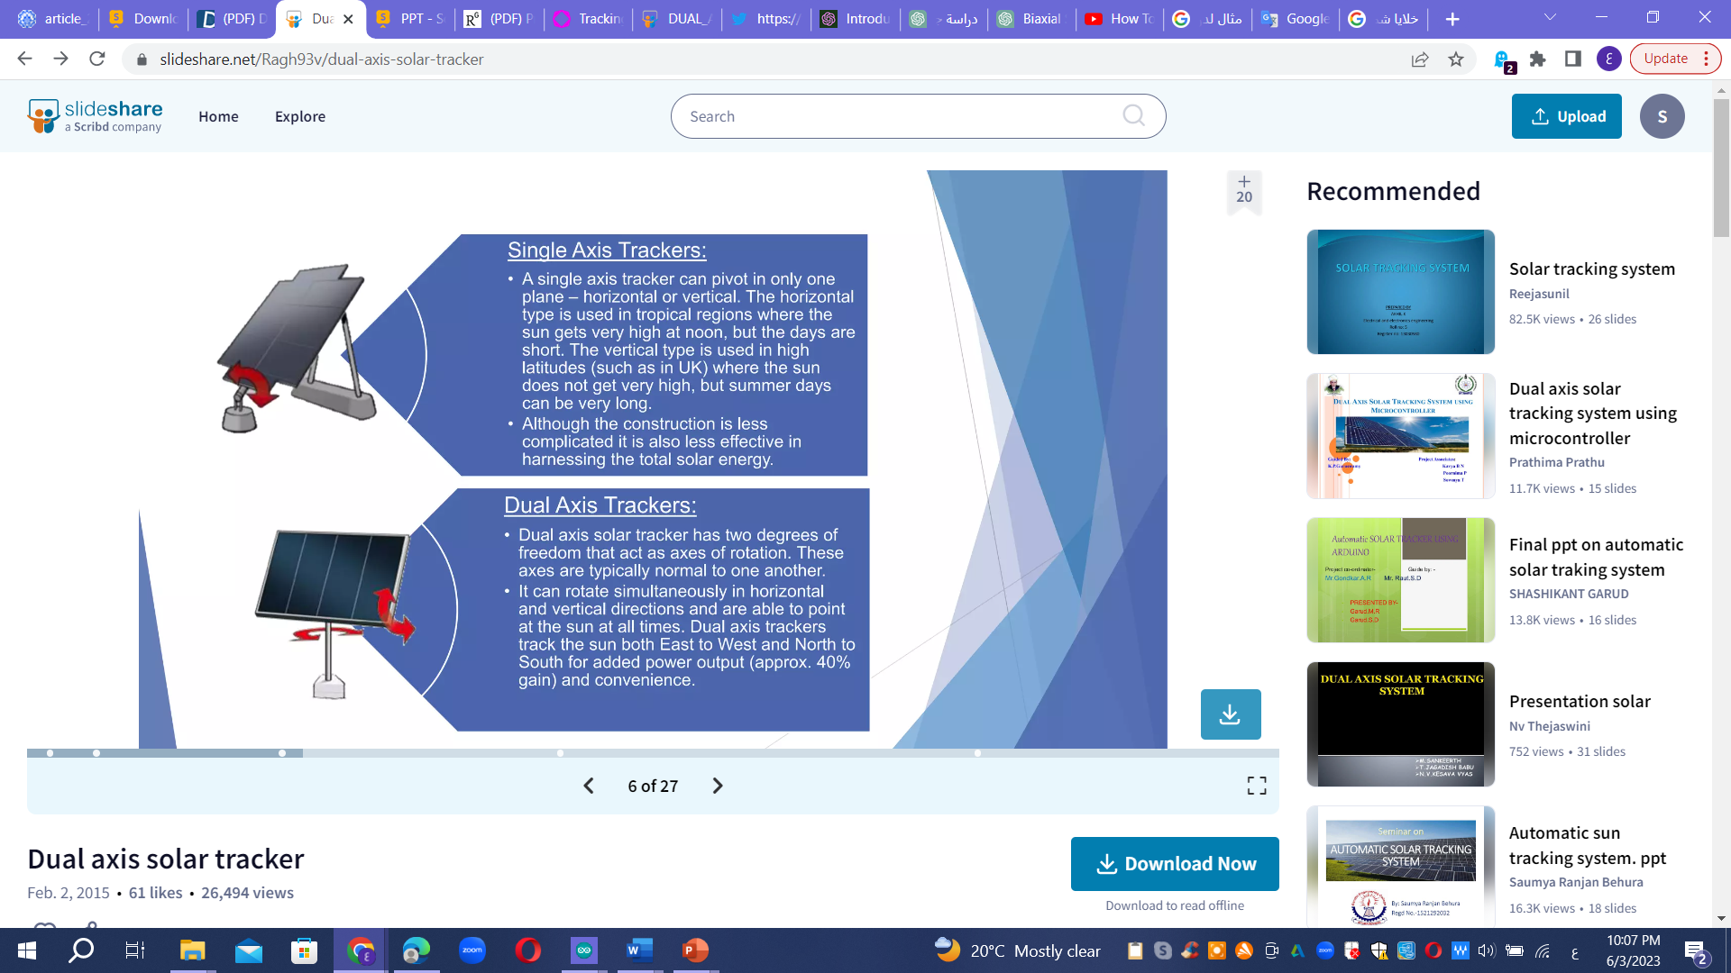
Types of Solar Tracker Bases
Single Axis Trackers:
• A single axis tracker can pivot in
only one plane - horizontal or vertical. The horizontal type is used in tropical regions where the sun gets very high at noon, but the days are short. The vertical type is used in high latitudes (such as in UK) where the sun does not get very high, but summer days can be very long. • Although the construction is less complicated it is also less effective in harnessing the total solar energy.
Dual Axis Trackers:
• Dual axis solar tracker has two degrees
of freedom that act as axes of rotation. These axes are typically normal to one another. • It can rotate simultaneously in horizontal and vertical directions and are able to point at the sun at all times. Dual axis trackers track the sun both East to West and North to South for added power output (approx. 40% gain) and convenience.

Slide 6
What is a Dual Axis Solar Tracker?
Definition :
A type of solar tracker that tracks the sun's position in both the horizontal and vertical planes. This allows for the most precise alignment of the panels with the sun, increasing efficiency.
How it Works :
Dual axis trackers use two separate motors to move the panels in two dimensions, following the sun's movement throughout the day.
Benefits :
Can improve energy generation by up to 60% compared to fixed solar panels.

Slide 7
Solar Angles
Altitude Angle
The angle from the horizon to the sun's position. This angle changes with the time of day and location on the earth.
2
1
3
Azimuth Angle
The angle between due south and the position of the sun
Panel Angle
The angle at which the solar panel is tilted from horizontal on a solar tracker. This angle changes throughout the day as the sun moves through the sky.

Slide 8
Block diagram of solar tracker
Charge controller
battery
inverter
Servo Motor
Solar Panel
Servo Motor
LDRs
Ac load
ARDUINO
Power supply

Slide 9
Hardware System
Servo Motors
The motors control the movement of the solar panels in two dimensions. They are connected to an Arduino board equipped with light sensors that detect the sun's position.
LDR Sensors :
Light sensors called Light Dependent Resistors (LDRs) are attached to a servo motor to detect the sun's position.
Arduino Board :
The Arduino board controls the servo motors based on input from LDR sensors, keeping the panels optimally oriented towards the sun.
Solar Panels :
Solar panels are mounted on the servo motors and move in response to the inputs from the light sensors and motors.
Charge Controller:
This is basically a voltage regulating circuit which is placed between a solar panel and battery to be charged or any load connected to the panel.
power inverter :
is a piece of power electronics equipment or circuitry that transforms direct current (DC) into alternating current (AC).

Slide 10
software System
LDRs are used as the main light sensors. Two servo motors are installed on the chassis that holds the solar panel. The Arduino program is uploaded to the microcontroller. The project worked as follows.
LDRs sense the amount of sunlight falling on them. Four LDRs divided into top, bottom, left and right.
For east-west tracking, the analog values from two upper LDRs and two lower LDRs are compared, and if the upper set of LDRs receives more light, the vertical servo will move in the upper direction.
If the lower LDRs receive more light, the servo moves in the lower direction.
For the angular deviation of the solar panel, the analog values from two left and two right LDRs are compared. If the left group of LDRs receives more light than the right group, the horizontal servo will move in the left direction, and if the LDRs receive more light from the right than the left, the horizontal servo will move in the right direction.
The battery (DC) will also be charged from the solar panel by the solar controller, then the charge will be transferred from the battery to the inverter and the AC Load will be supplied with electric power.

Slide 11
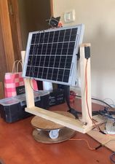
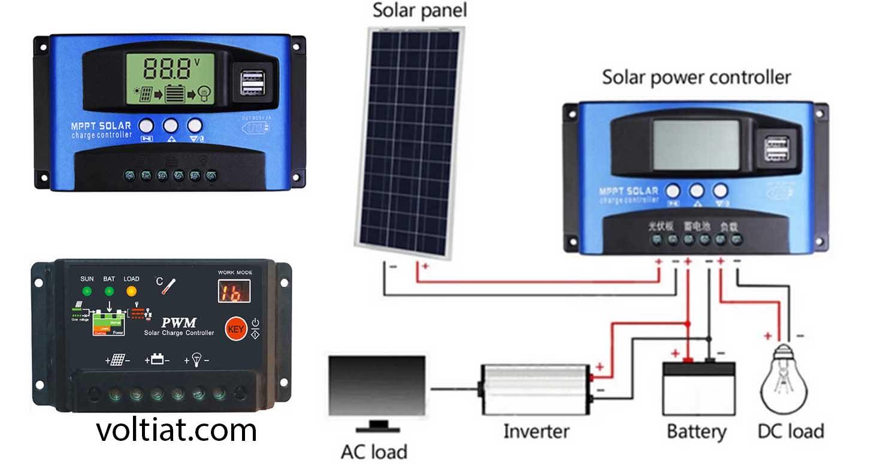
software System
LDR sensors
Solar panel
Servo motor
(Up and down)
Arduino
Servo motor (right and left )

Slide 12
Applications of Dual Axis Solar Trackers
Solar Farms :
Large scale installations of solar panels in open spaces, where solar trackers can improve energy generation significantly.
Residential Rooftop Systems :
Dual axis trackers can improve the output of residential solar panel installations and help homes generate their own electricity.
Off-Grid Power Systems :
Dual axis solar trackers can help power off-grid homes and installations, such as remote cabins or water pumps.
Greenhouses :
Solar trackers can be used to power greenhouses, providing renewable energy for growing crops while reducing greenhouse gas emissions.

Slide 13
we also is a summary of the economic feasibility study which we have done for the dual-axis solar panel project at the Turkish Government Hospital in Tubas:
The project aims to install a dual-axis solar panel system on the roof of the Turkish Government
Hospital in Tubas.
The system consists of 100 dual-axis solar panels for electricity generation.
The hospital's electricity consumption is approximately 200 kilowatt-hours per month, with an expected
annual growth rate of 5%.
The installation cost of the project is around $150,000, with annual maintenance costs of $3,000.
The generated electricity is sold at a rate of $0.15 per kilowatt-hour.
It is estimated that approximately 120,000 kilowatt-hours will be produced annually.

Slide 14
The projected payback period for the initial investment is around 4 years.
Net Present Value (NPV) and Internal Rate of Return (IRR) analysis are used to evaluate the project's feasibility.
The project contributes to a reduction of approximately 90 tons of carbon dioxide emissions annually and improves environmental sustainability in the area.
The project provides cost savings for the hospital's energy expenses and promotes reliance on renewable energy sources.
The project requires government support and financial facilitation to enhance its attractiveness and achieve the desired financial return.
Based on the feasibility study analysis, investing in the dual-axis solar panel project at the Turkish Government Hospital in Tubas is economically and environmentally sustainable, enabling investors to make informed investment decisions.

Slide 15
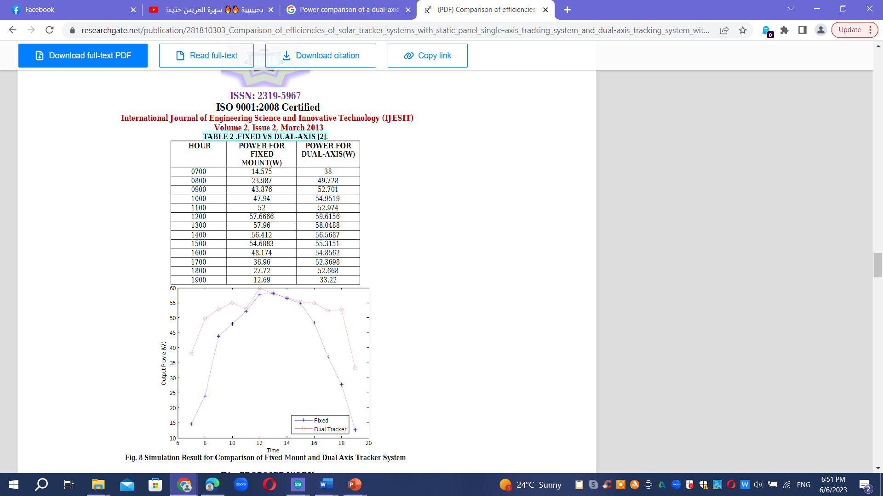
Power comparison of a dual-axis PV panel with a fixed panel :

Slide 16
Future Enhancements :
❖ Updating the database feature could be added in the software.
❖ Construction of real structure from the prototype
❖ Addition of capability to track the sun up to 90° zenith axis
❖ Elimination of database by using Dynamic Data Generation
❖ Dual Axis tracking could be achieved by single motor using complex mechanical structure.
❖ The solar radiation measuring instrument and PV panel could be installed in it and use it for dual benefit

Slide 17
CONCLUSION
This project has presented a mean of controlling a sun tracking panel with an embedded microprocessor system. Specifically, it demonstrates working solution for maximizing solar cell output by positioning a solar panel at the point of maximum light intensity.
The proposed solution for a solar tracking system offers several advantages concerning the dual axis movement of the solar panel: the high system stability; the control microprocessor used has no searching phase; it calculates the position of the sun and moves the motors towards that sun immediately.
Dual Axis Solar Trackers are a reliable, cost-effective way to generate renewable solar energy. They improve energy production by up to 60% compared to fixed solar panels, increasing efficiency and reducing costs over time.

Slide 18
