Slide 1

An-Najah National University
Engineering Collage
Civil Engineering Department
Graduation project:
Structrural Design Of Palestine Islamic Bank
Supervised by: Eng. Ibrahim Mohamed

Slide 2
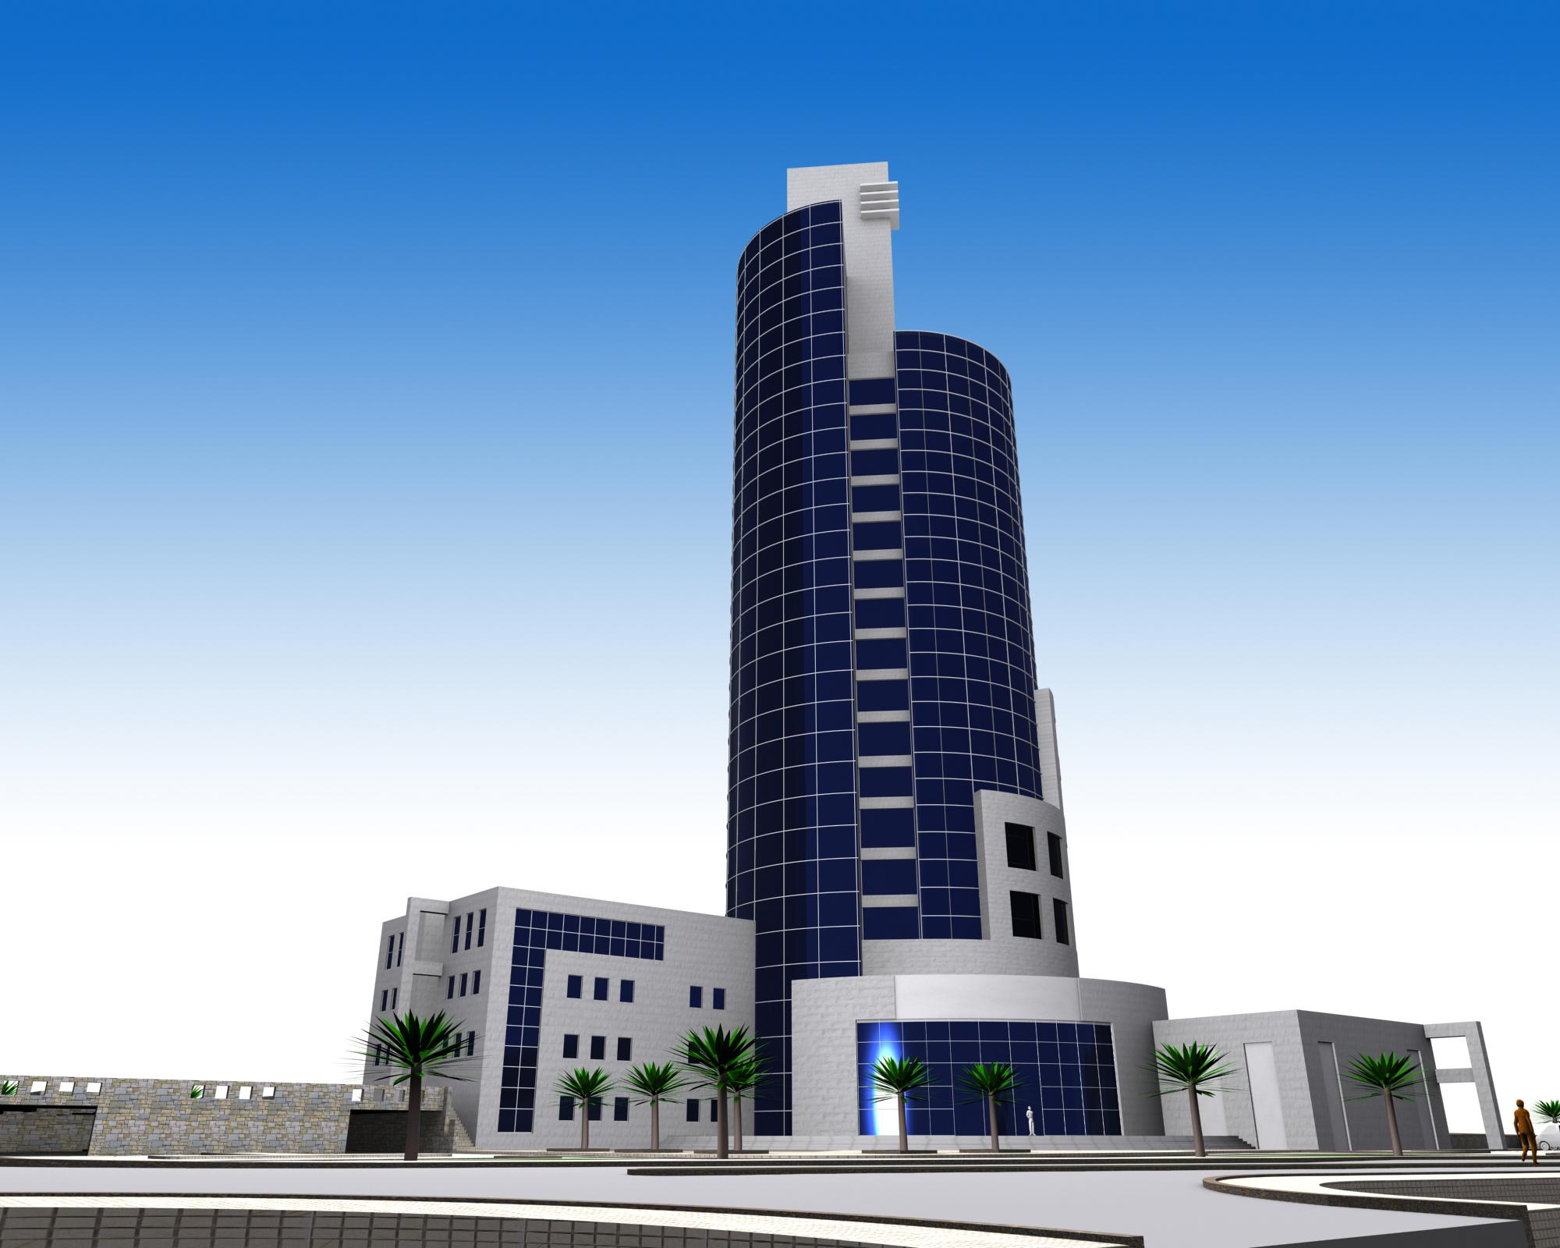

Slide 3
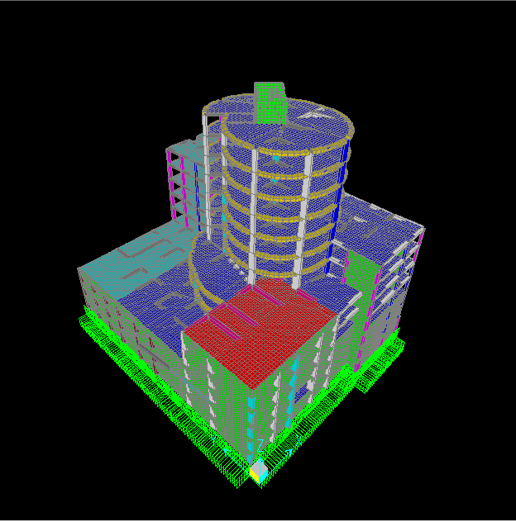

Slide 4

Chapter One: Introduction

Slide 5
Preface
OBJECTIVES :
* The essence of the graduation project and practical life is to face such problem and transform architectural plans for structural design.
* Simulating the structure and all applied loads by computer software and using principles of structural design to obtain the perfect design.

Slide 6
What we accomplished in this part of graduation project
* We collect all of the necessary data that related to the project: materials, loads and load combinations, site investigation and seismic factors.
* Make a new distribution of the columns centers in the floors, and modified the architectural plans based on this distribution.
* Choosing the proper structural system.
* draw the structure on sap 2000

Slide 7
* Dynamic design for all structure members ( columns, beams, slabs, footings and basement wall).
Draw samples for structural detailing.
Some checks on sap results for design of beams

Slide 8
Abstract :
* One of the most important feature of this project is that it was designed architecturally in the academic year 2007/2008 according to modern international standards by the student Sufyan Sa'abneh and was supervised by professors of architecture department in An-Najah National University.
* This project deals with the analysis and design of reinforced concrete central bank which will be designed as an islamic bank.
* The interest in the luxury and attractive architectural design become one of this era requirements, which prompts us to keep up with these things by modern, safe and economical structural systems that achieve structural and architectural purposes.

Slide 9
Project description
“Palestine Islamic Bank" building is to be constructed in Nablus-Rafedya
on a 40000 m² area. It consists of 12 stories, each
FloorArea (m2)
Basement 3,2 and 1 3550
Ground floor and first floor 2470
Second and third floors 1710
Fourth floor 1310
Fifth, sixth, seventh and eighth floor 650

Slide 10
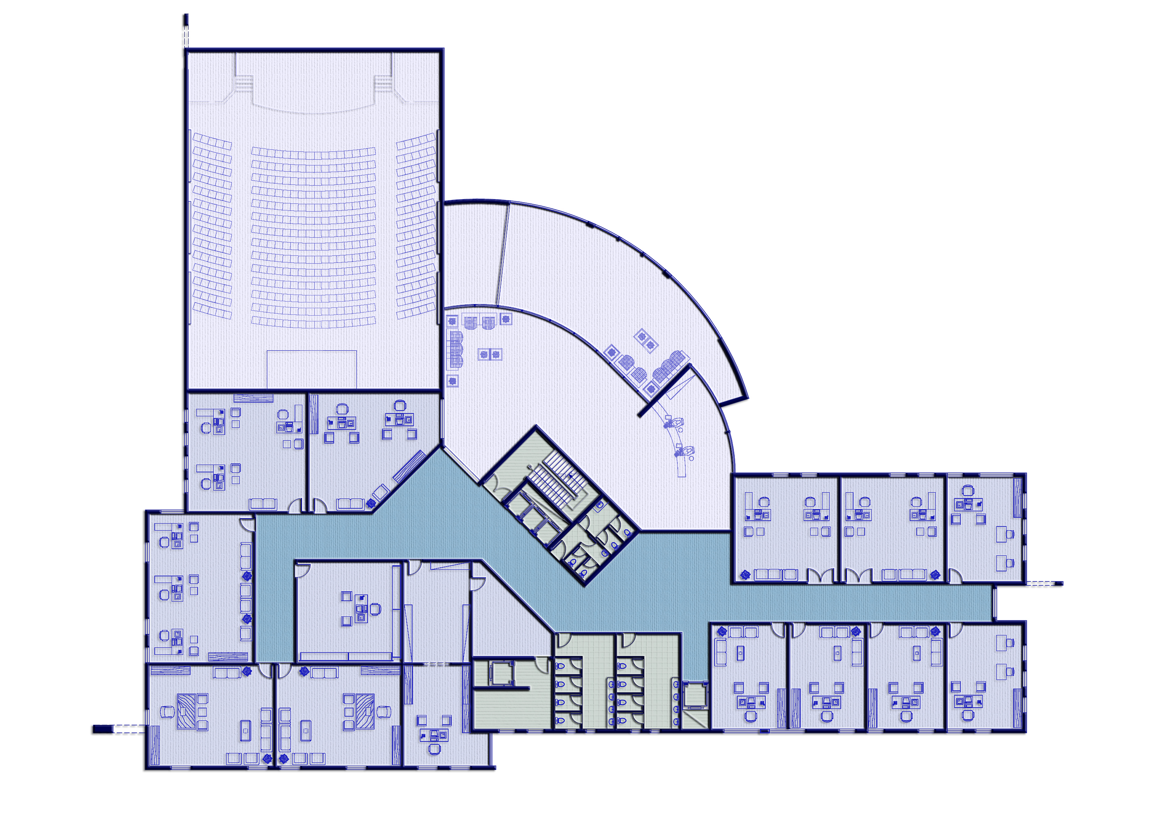

Slide 11
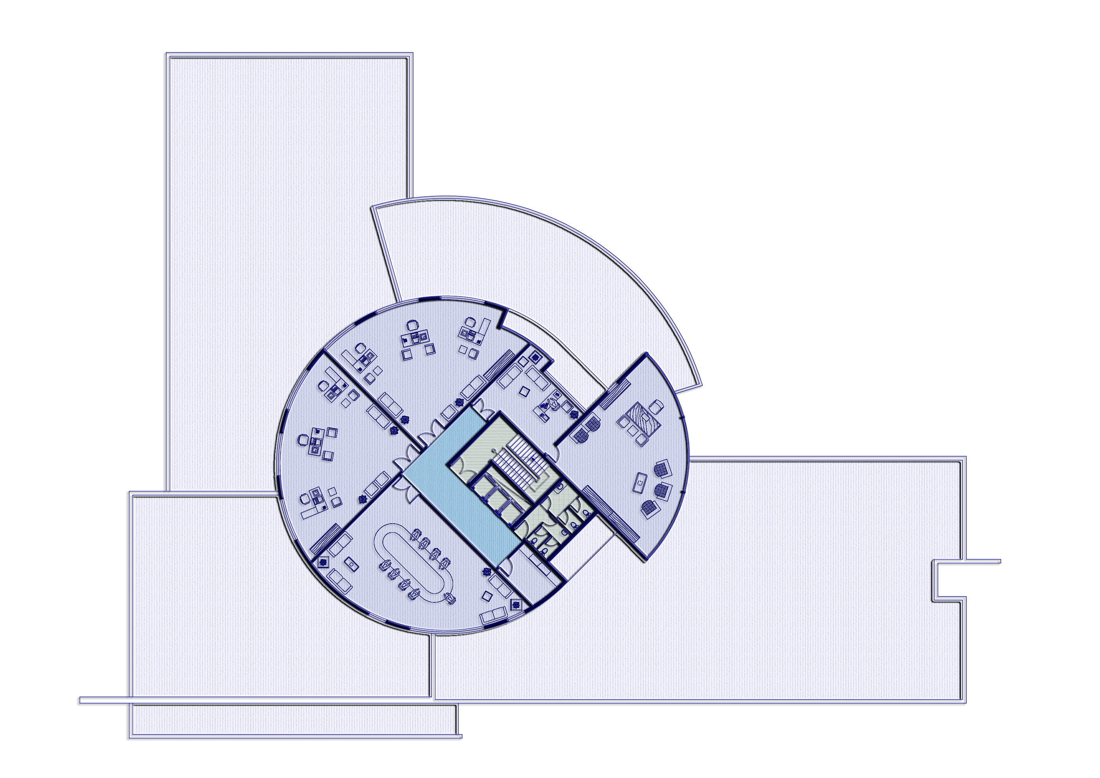

Slide 12
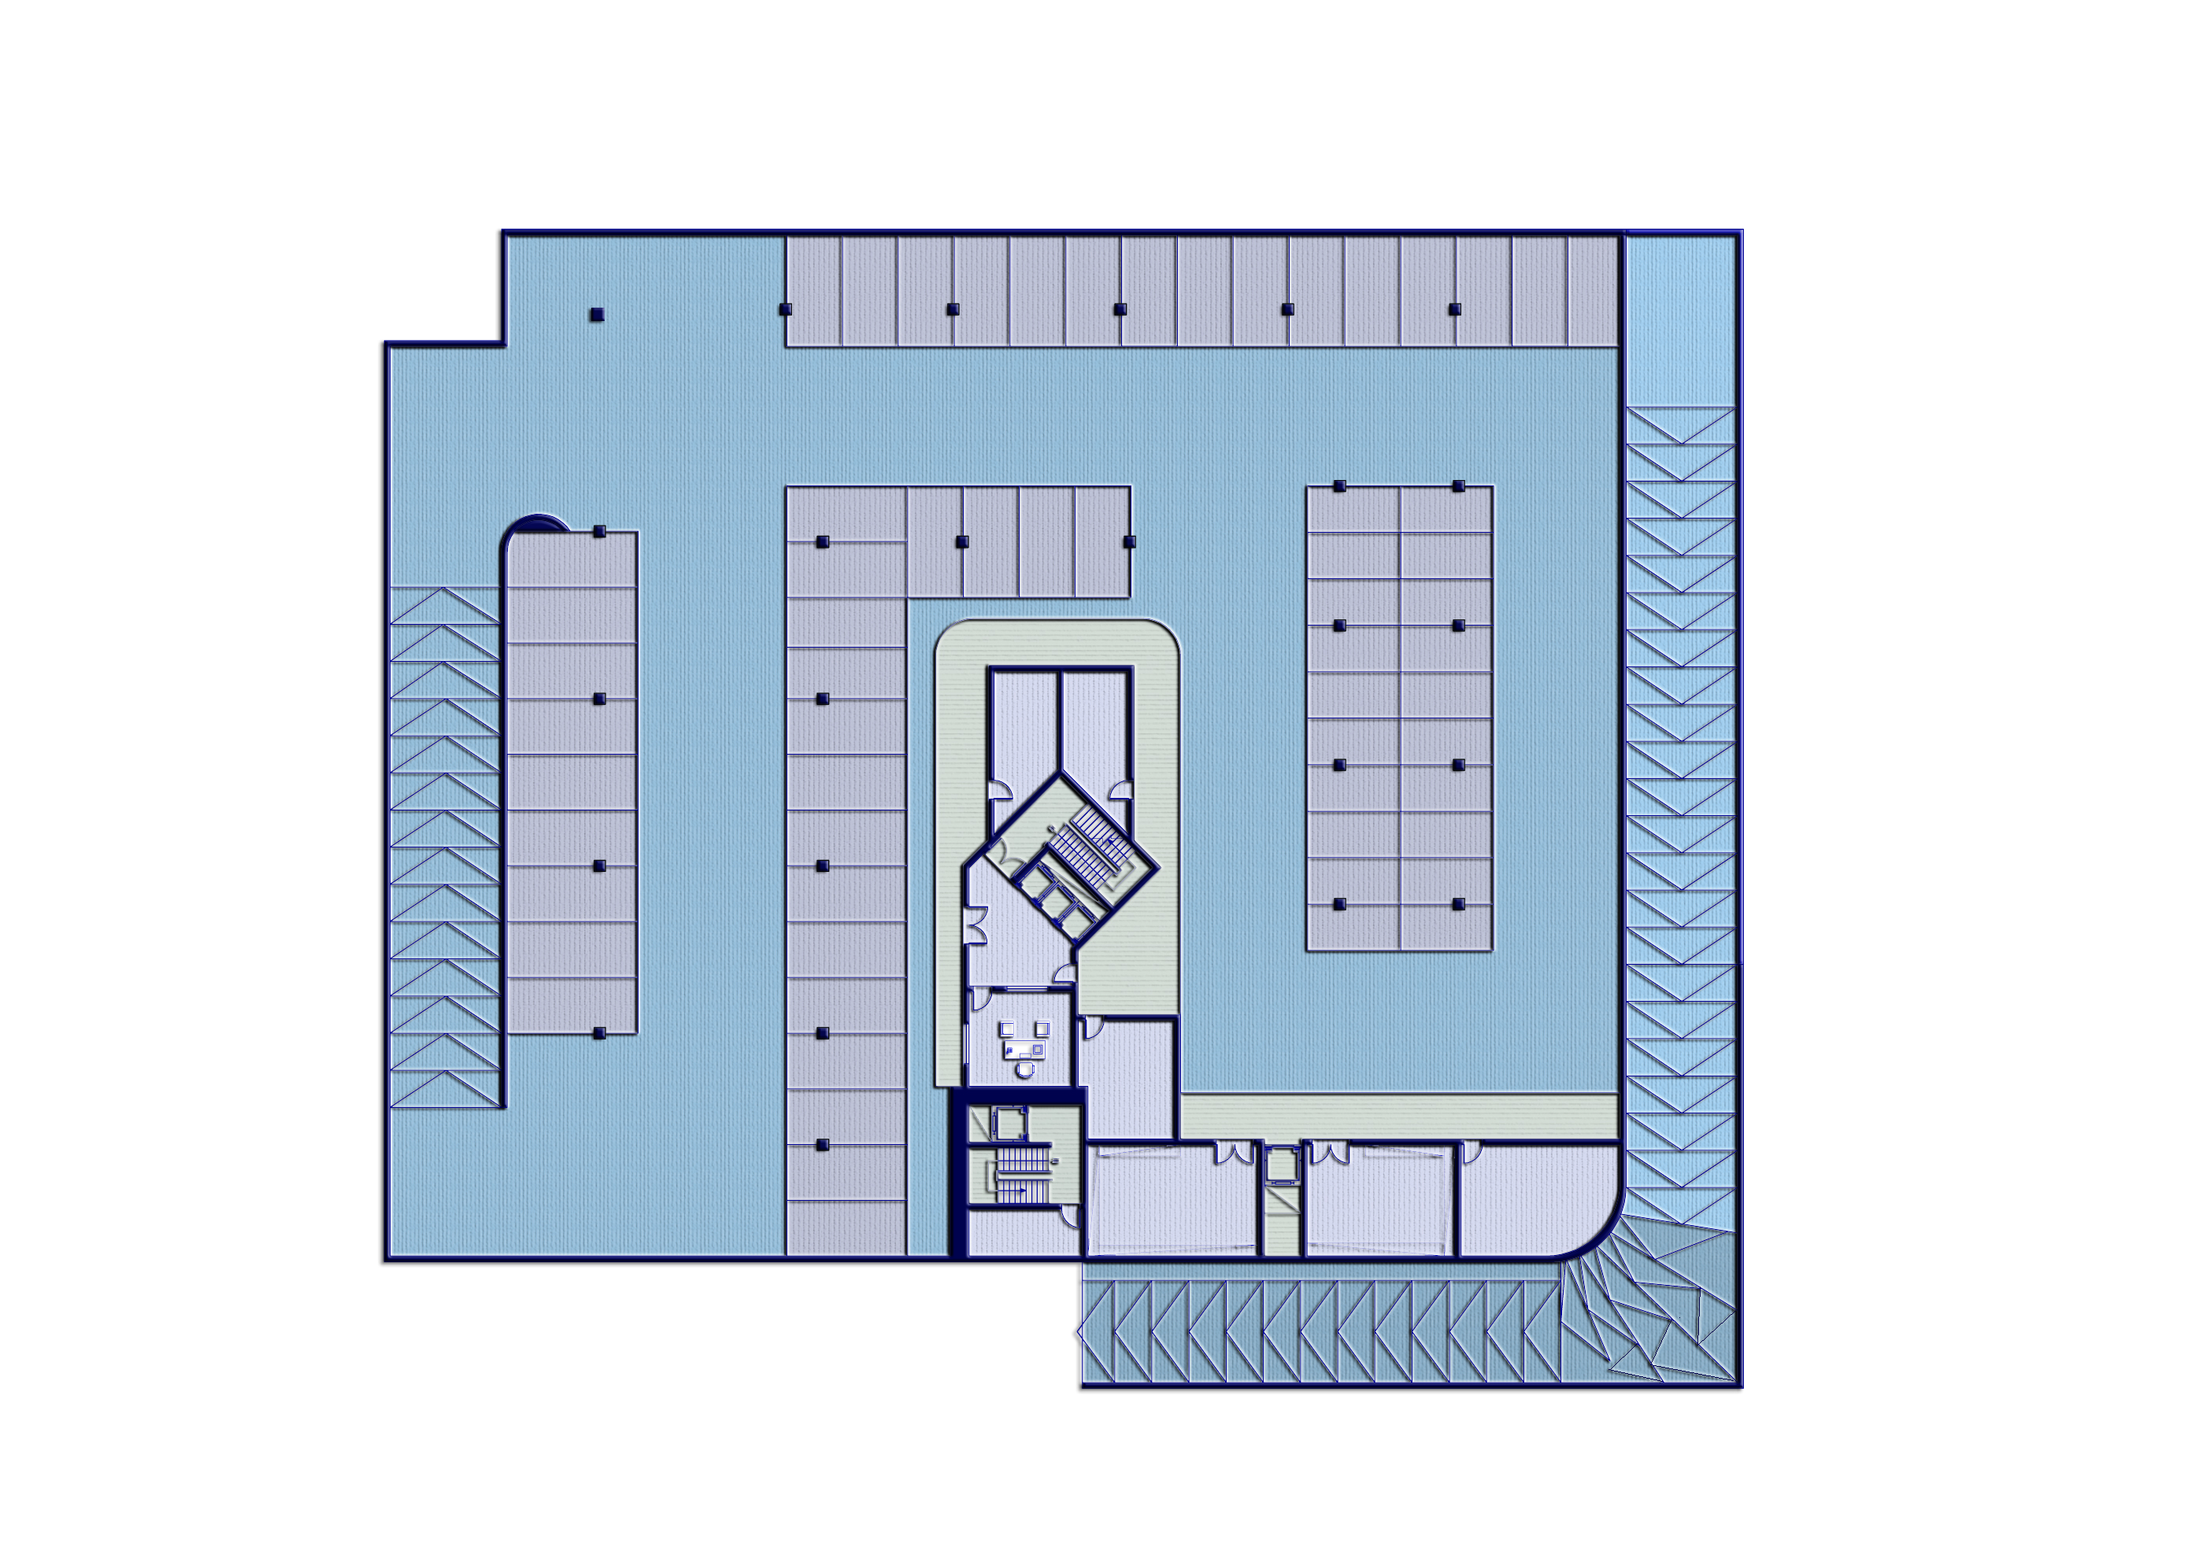

Slide 13
From a structural point of view the structural
elements, footings, columns, beams, and slabs will be
designed statically firstly by hand and using SAP for
dynamic design.

Slide 14
Design Determinants
Materials:
Concrete: For beams and slabs:
F’c = 32 Mpa, ρ= 2500 Kg/m³
For Columns: F’c = 40 Mpa
Reinforcing Steel:
Fy =4200 Kg/cm²
Soil : Bearing capacity = 3.5 Kg/cm²

Slide 15
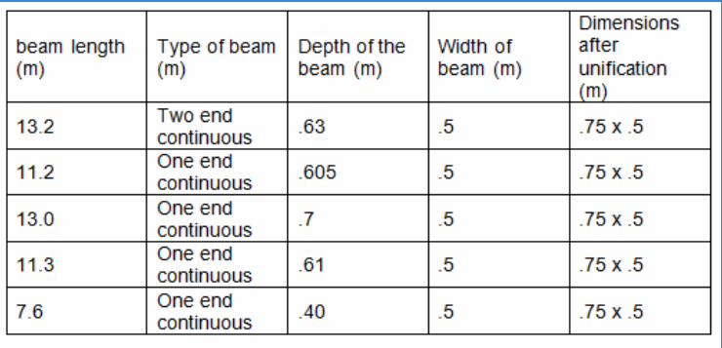
Preliminary design
1- Beams
Dimensions : 75 cm*50 cm drop beams

Slide 16
Preliminary design
2-Column :
Dimension : 80cm*80cm
The first step was to detrmine the tributary area for each column in each floor by using Auto-CAD 2012.
Then all of columns were be divided into catagories to make them groups to be able to compute the diemension and the reinfocment.

Slide 17
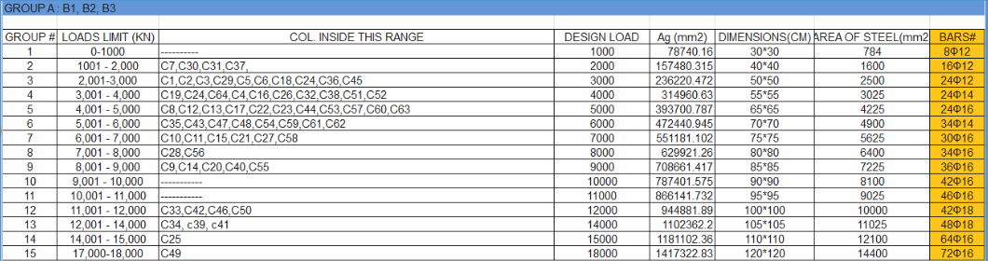

Slide 18
Preliminary design
    3.Slab
    According to ACI code the equation that will govern the thickness of two way slab is :
    h=(ln(0.8+fy/1400))/(36+9β)
    If αm≥2
    where :
    - αm is the average of all α for each panel
    α =(stiffness of beam )/(stiffness of slab ) = Ibeam/Islab

Slide 19
Based on the length of spans that we have there are two categories :
1- h= .25 m
and the second zone where h = .3 m

Slide 20

Chapter Three:3D
MODELING & CHECKS
(for the building)

Slide 21
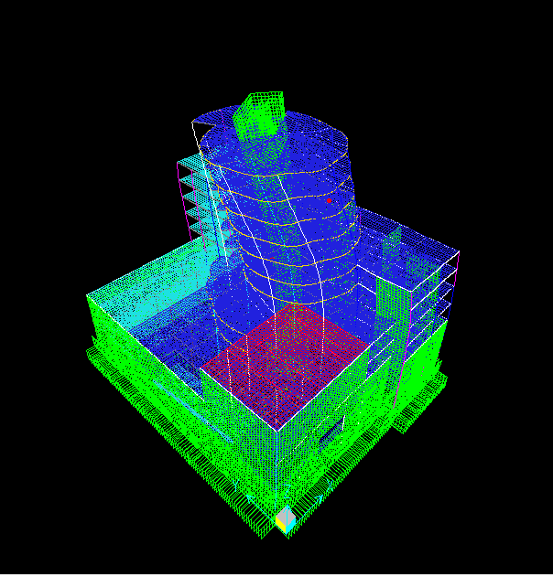
Checks
Compatibility

Slide 22
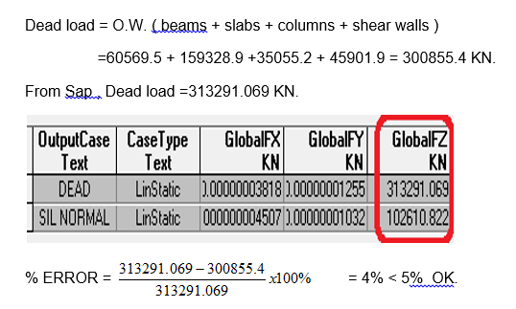
Checks
Equilibrium

Slide 23
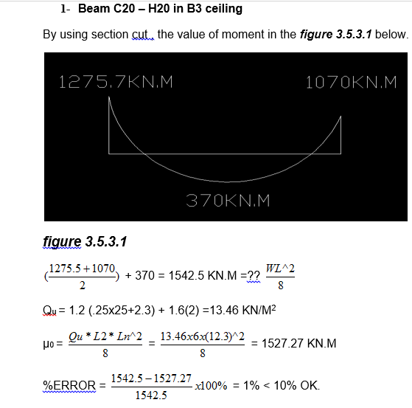
Stress strain relationship

Slide 24

Dynamic Design

Slide 25
content
Calculation of modal period by using static equivalent method and to compare this period with SAP results.
design using response spectra.

Slide 26
Calculation of periods
SAP results & hand results:
Period (T) by static equivalent method = 1.45
Period (T) by sap =.98
Still there is a difference because of static equivalent does not applicable on this type of building.

Slide 27
Design using response spectra
Location characteristics : from the following figures
For Ramallah site
Ss=1.25 z, S1=2.5z
Ss: mapped spectral acceleration for short periods (0.2 second).
S₁: mapped spectral acceleration for 1.0 sec. periods
SDS and SD1 are calculated automatically by SAP.
Soil Bering capacity = 3.5kg/cm² =7168psf ➔
Site class from international building code = C (Very dense soil and soft rock (

Slide 28
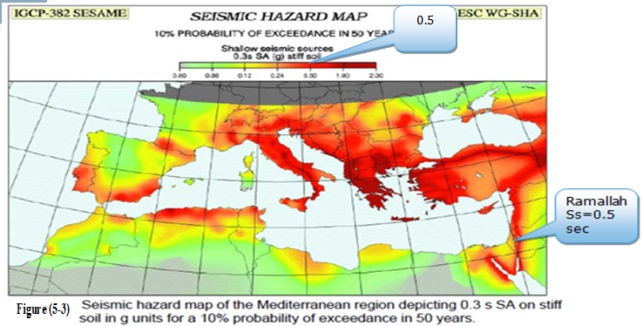
Ss

Slide 29
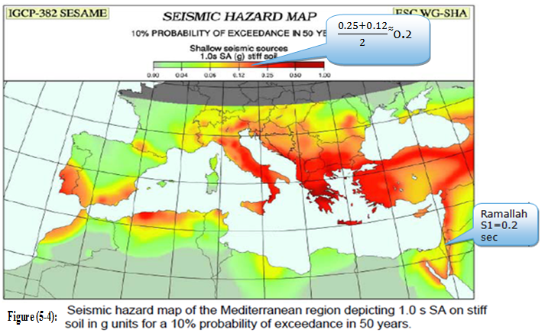
S1

Slide 30
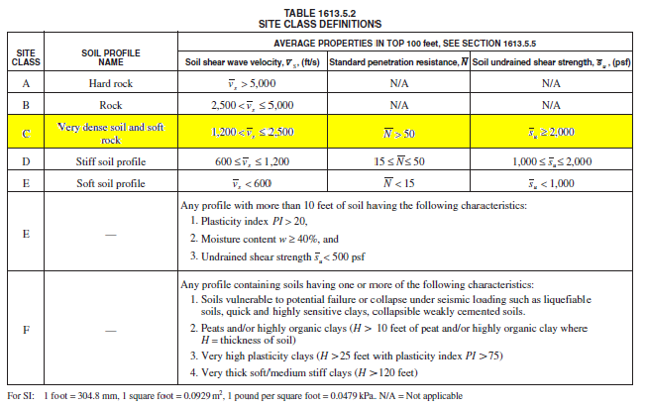
Site Class Definition

Slide 31
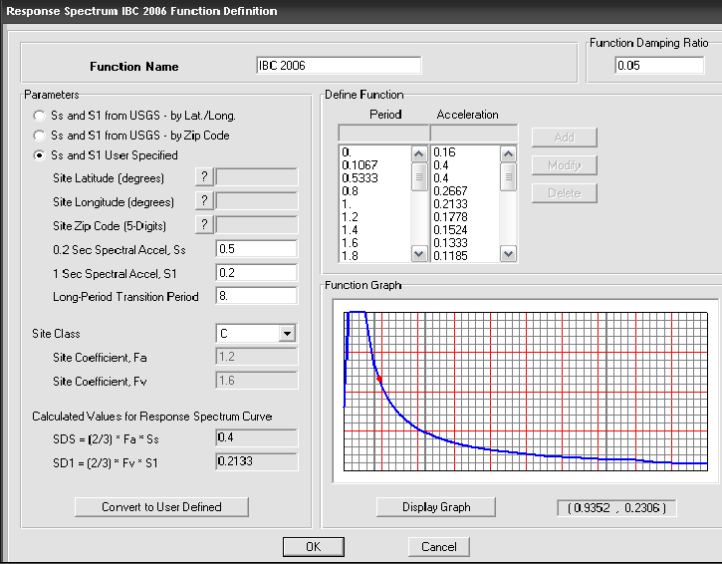
Function definition

Slide 32
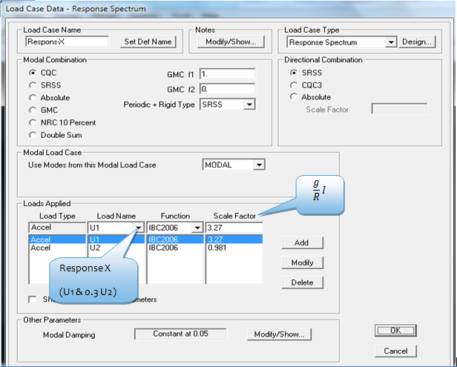
Load Cases
Load case 1 :
Response X: U1

Slide 33
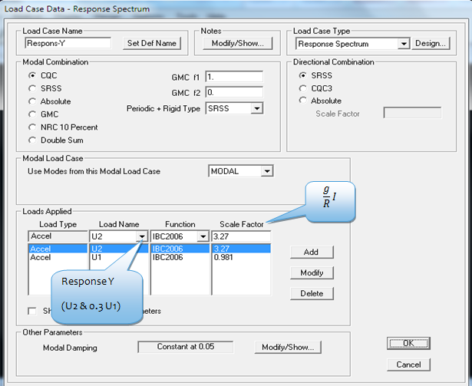
Load case 2
Response Y: U2
Importance factor I =1.0 (category II)
R=3 (ordinary reinforced concrete moment frames

Slide 34
Slab Design
From SAP and by using envelope combination, the differences in moment from one slab to another can be neglected.
Design using maximum value in each floor

Slide 35
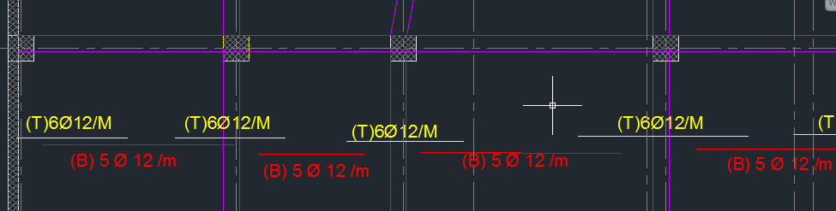

Slide 36
Beam Design(dynamic combination)
Here we did more than reading the results from sap also we made a sheet of excel to be sure that code requirement was satisfied.

Slide 37
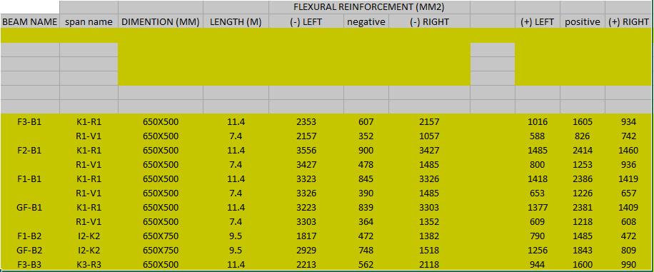
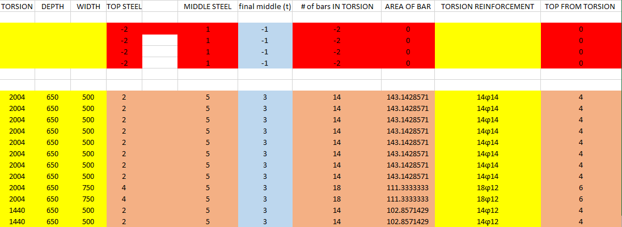

Slide 38
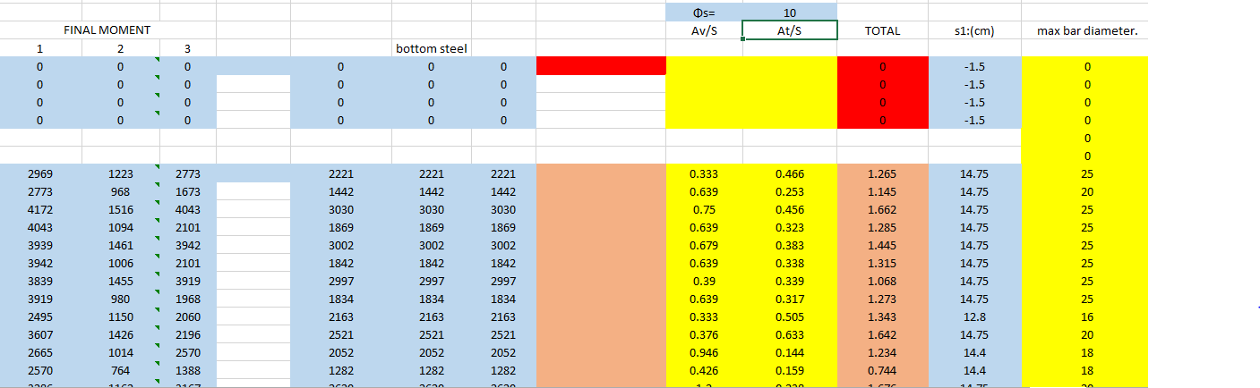
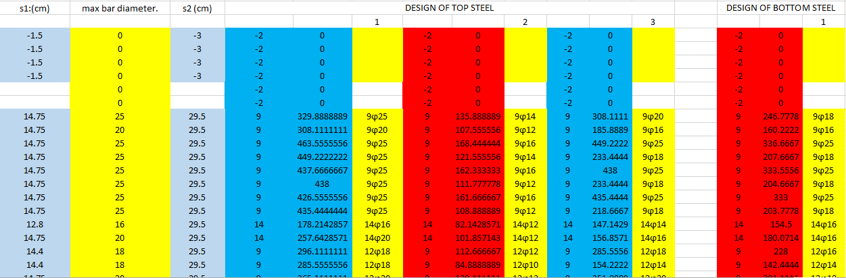

Slide 39
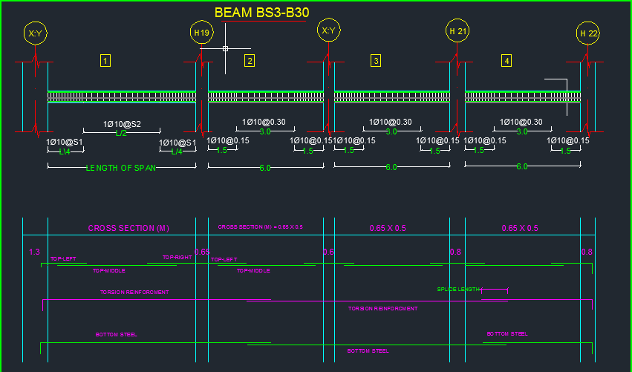

Slide 40
Columns design:
We depend in the preliminary design on the equation that deals with only axial force with minimum eccentricity but when we install the earthquake that add a large moment that that affect the preliminary design so much and modify it.

Slide 41
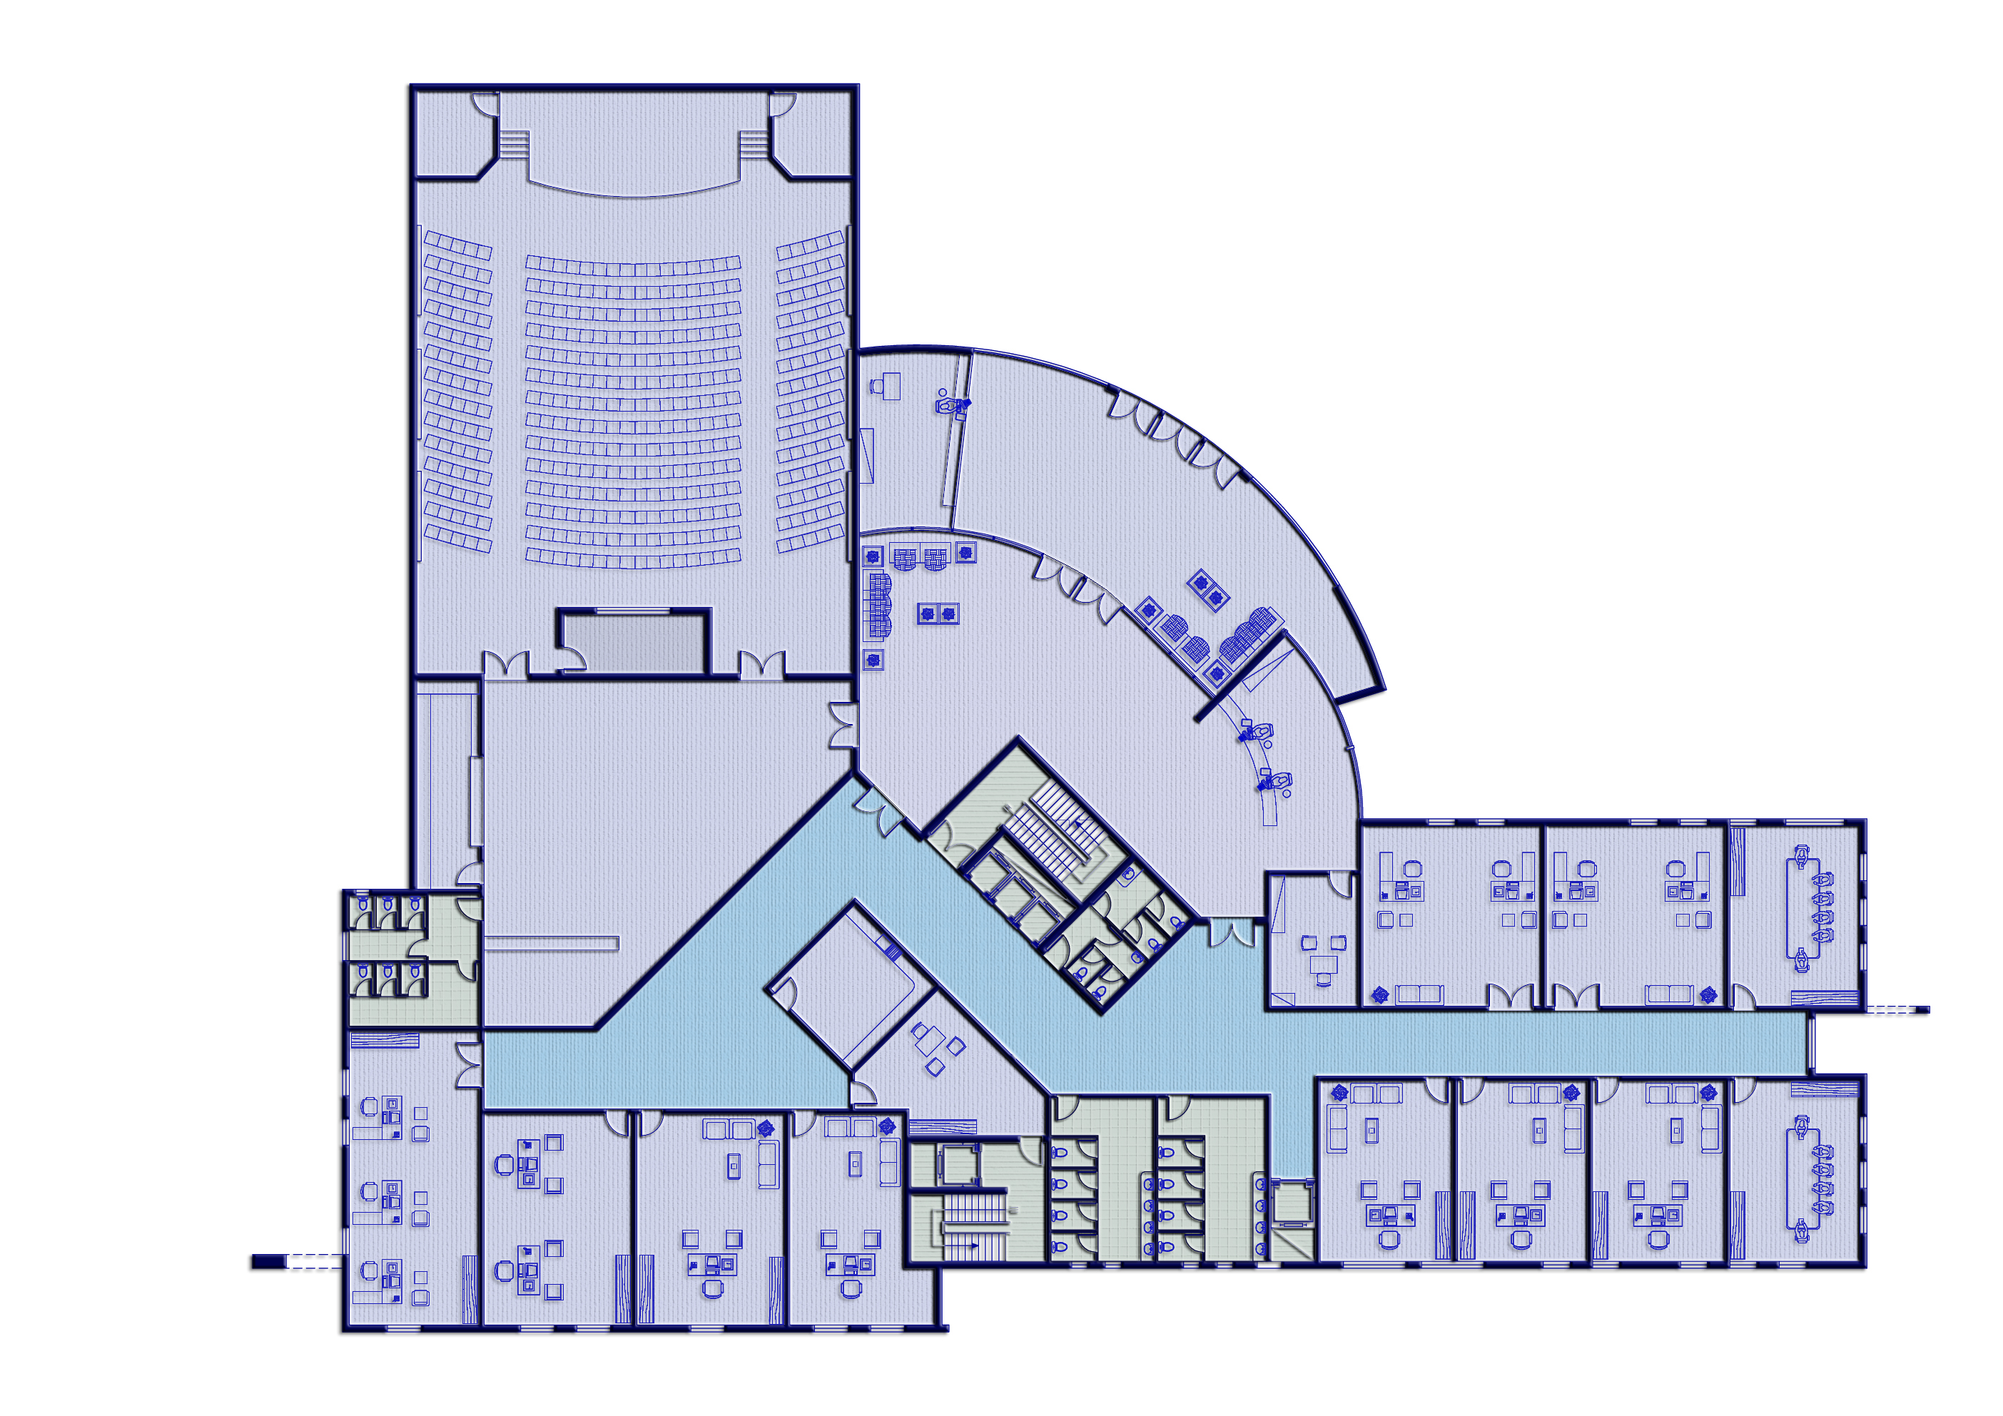
The differences between static design ( preliminary design ) and dynamic design that we enlarge most of columns and make some of them to extend in the direction of x or in y to create a good frame that can resist the earthquake

Slide 42
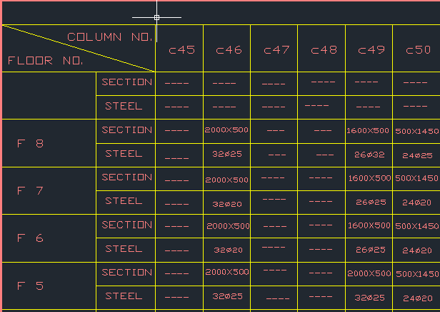

Slide 43
Design of mat foundation
INTRODUCTION:
A foundation is the lower part of a structure which transmits loads to the underlying soil without causing a shear failure of soil or excessive settlement.
The raft foundation is continuous footing that covers the entire area beneath a structure and supports all the walls and columns. The term mat is also used for foundation of this type. It is used generally on soil of low bearing capacity and where the area covered by spread footings is more than half the area covered by the structure.
.

Slide 44
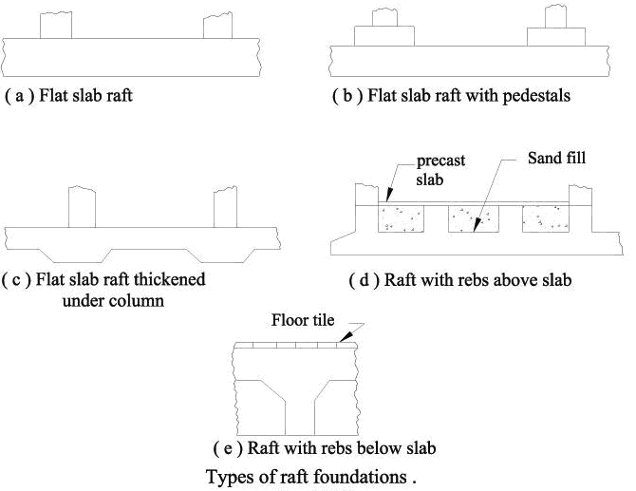
There are many types of raft foundations:

Slide 45
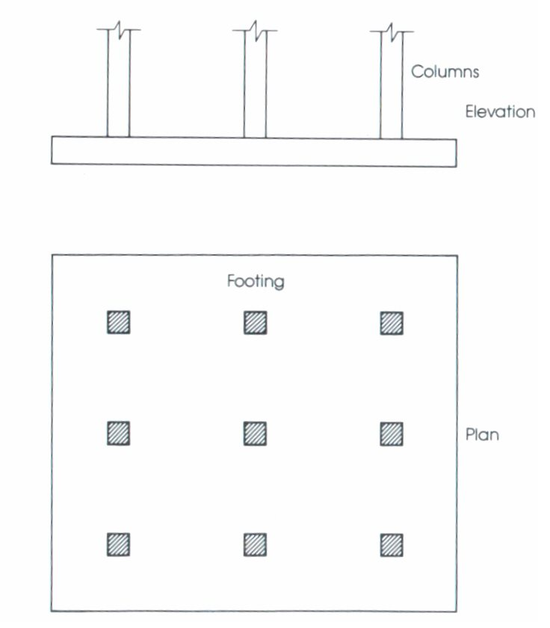
Steps for designing mat foundation:
In our project the mat was designed
as flat plate with the following Structural material
The compressive strengths of concrete are :
f’_{c} = 40 Mpa for mat foundation ,
Columns and basement walls .
Yield strength of Steel :
f_{y} = 420 Mpa .
q_{all} =300kn/m²
Thickness can be determined by
check column with high load and
minimum area.

Slide 46
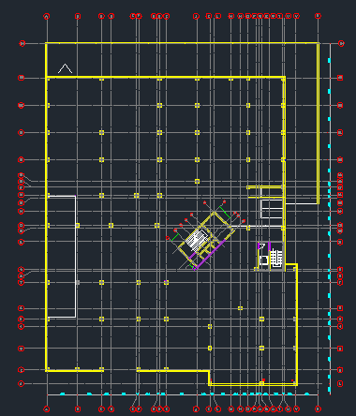

Slide 47
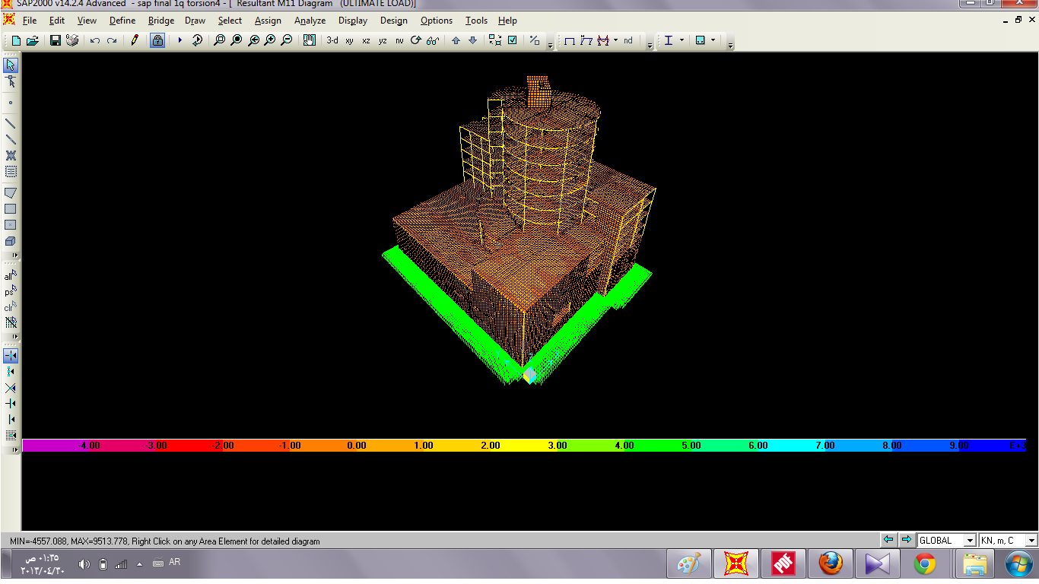

Slide 48
Using SAP2000, Bending moment values determined, there for the amount of required steel is also determined.
The mat divided into strips in order to put the required amount of steel in the required place instead of providing maximum steel to the whole area. (column strip and middle strip)
Ultimate load =17500kn
Use q_{u} = q_{all} =300kn/m²
Vu=17500 – (300*1.3) =17110kn
Φ*Vc = Φ (0.33)√f'_{c}*b_{o}*d
=0.75(0.33) )√40*9200*1300/1000=18721KN
Use d=140cm
h=150cm
Cover = 10cm

Slide 49
Determine the thickness of the mat:
Check column 39:
Ultimate load =10200kn
Assume d=100cm
Use q_{u} = q_{all} =300kn/ m²
Vu=10200 – (300*0.8) =9900 kn
Φ*Vc = Φ (0.33)√40*7200*1000/1000 =1159KN (OK)
Check Column 41 :
d=100cm
Ultimate load =16700 kn
Vu= 16700-(300*1)=1600kn
Φ*Vc = Φ (0.33)√40*7200*1000/1000 =11270 KN (not ok)
Increase d
D= 130cm
Vu=16700-(300*1.3)=16310kn
Φ*Vc = Φ (0.33)√40*9200*1300/1000 =18721 KN (ok)
Coloumn 42
Ultimate load =17500kn
Use q_{u} = q_{all} =300kn/m²
Vu=17500 – (300*1.3) =17110kn
Φ*Vc = Φ (0.33)√f'_{c}*b_{o}*d
=0.75(0.33) )√40*9200*1300/1000=18721KN=
Use d=140cm
h=150cm
Cover = 10cm

Slide 50
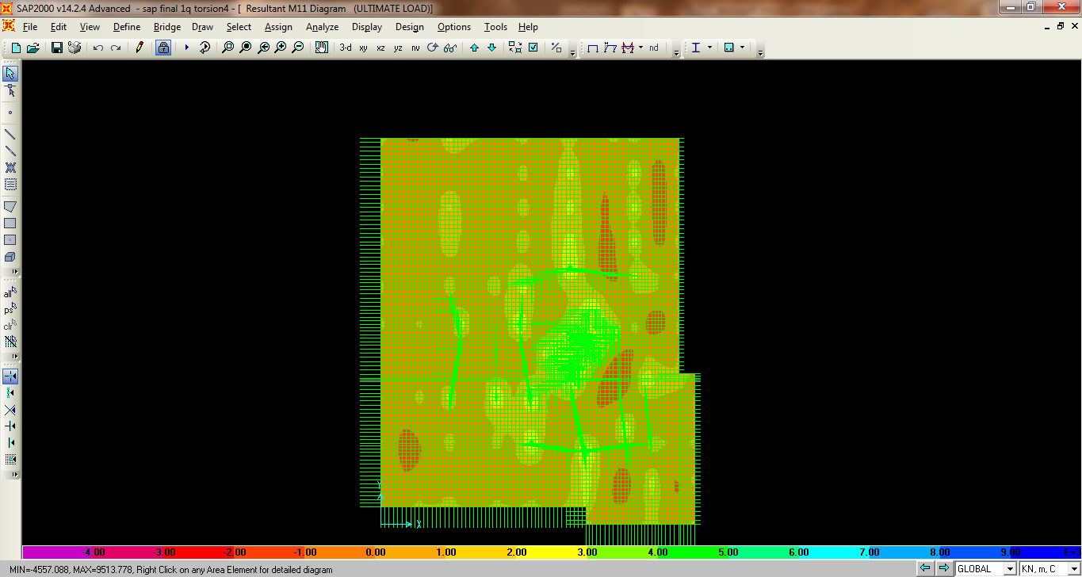
X-direction:
The area in the x-direction will be divided into column strip and middle strip
Figure below show bending moment in x-direction using SAP2000:

Slide 51
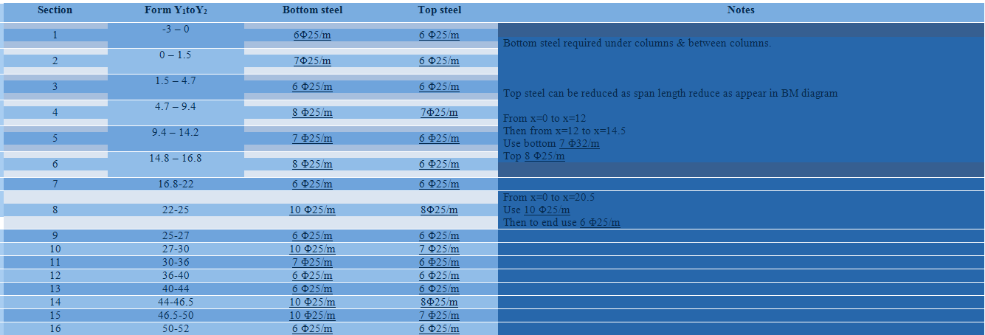
Summary of reinforcement in x-direction shown in the following table:

Slide 52
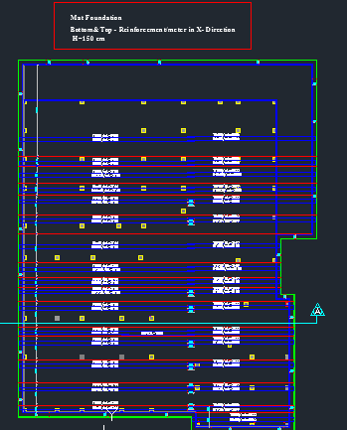

Slide 53
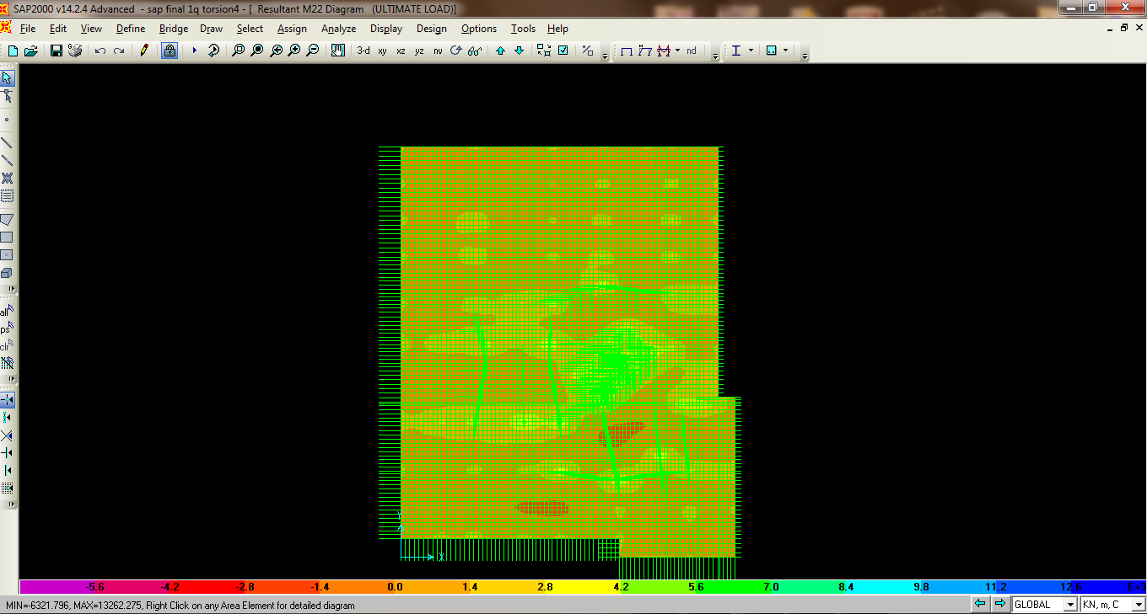
Reinforcement in Y-direction:
The area in the y-direction will be divided into column strip and middle strip.
Figure show bending moment in y-direction using SAP2000:

Slide 54
BM_{+ve} =1200kn.m
=1200 kn.m
ρ= 0.85 *40 ( 1- (√(1-(2.61*1200*10⁶) ) ) =1.631*10-3
420 40*1000*1400²
Therefore, A_{st} =1.631*10-3 (1000) (1400) =2800cm²
Use 6Φ25/m (Bottom steel)
Max BM_{-ve} =1200 kn.m
ρ= 0.85 *40 ( 1- (√(1-(2.61*1200*10⁶) ) ) =1.631*10-3
420 40*1000*1400²
Therefore, A_{st} =1.631*10-3 (1000) (1400) =2800cm²
Use 6Φ25/m (Top steel)
Max BM_{+ve} =3850kn.m
ρ= 0.85 *40 (1- (√(1-(2.61*3850*10⁶) ) ) =5.3*10-3
420 40*1000*1400²
Therefore, A_{st} =5.331*10-3 (1000) (1400) =7410cm²
Use 10Φ25/m (bottom steel)

Slide 55
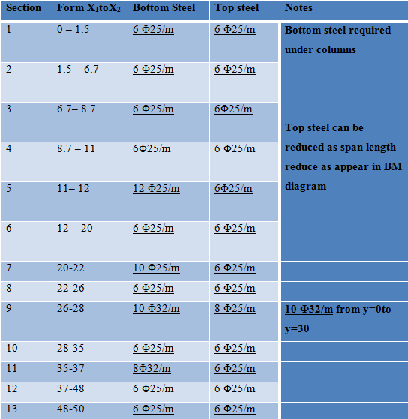
Summary of reinforcement in Y-direction shown in the following table:

Slide 56
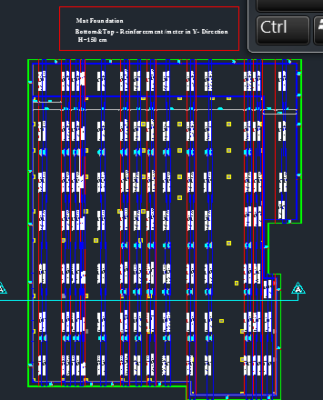

Slide 57
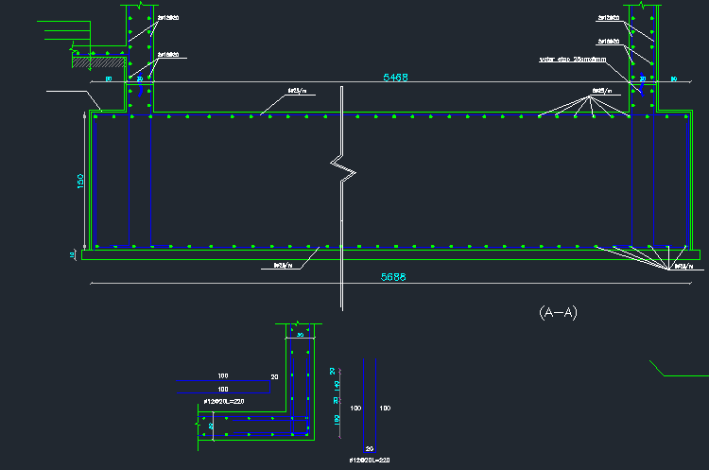

Slide 58
SETTLEMENT
The allowable settlement in mat footing
is 50mm and the allowable differential settlement is 19 mm
The settlement calculations for mat are less than the allowable , the design is ok

Slide 59
Basement wall design:
  All basement walls in the building are modeled using (sap2000 14.2.4) and the values
  Of moments and the axial forces due to live loads, dead load & soil pressure are taken from this model, and the reinforcement is determined manually, We use three
  basement walls with the following dimensions:
  (b3=600mm, b2=450, b1=300mm)

Slide 60
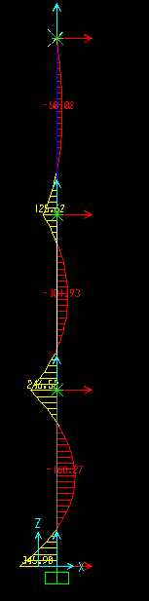
Notes:
(Moment diagram from sap)

Slide 61
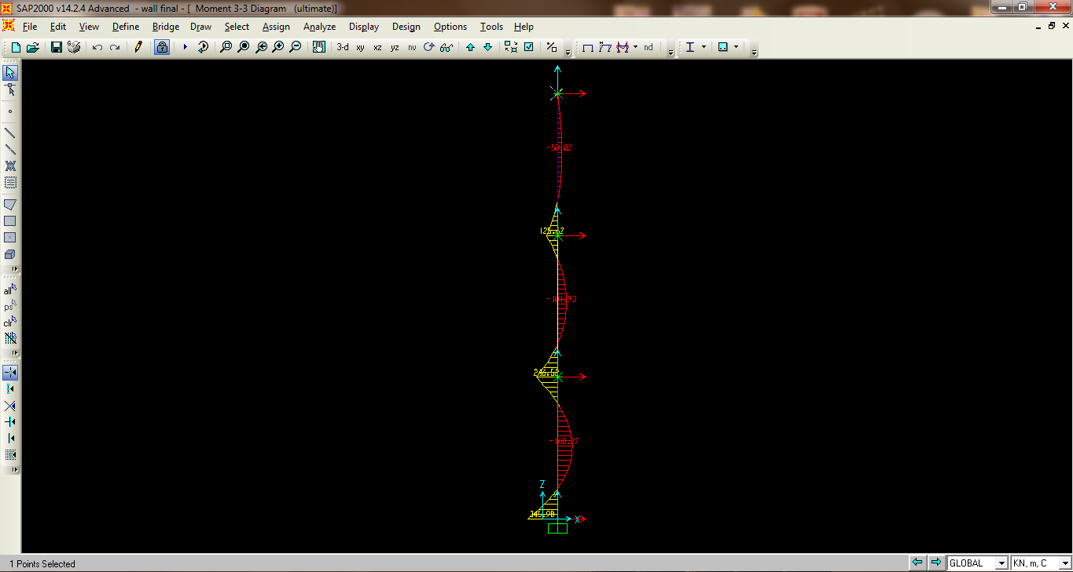
(Moment diagram from sap)

Slide 62
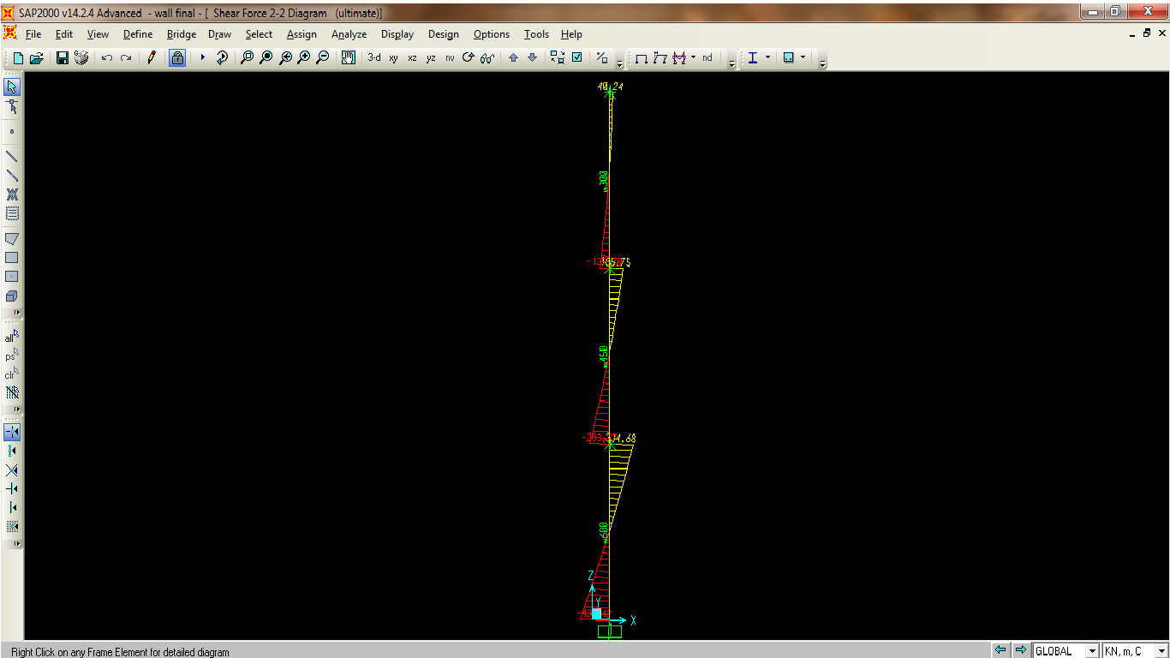
(shear diagram from sap)

Slide 63
Design for basement three (600 mm wall)
Checks shear capacity for b3
= *0.17* * d* b
Where,
= 0.75 d: depth (mm)
fc = 40mpa b: width (mm)
= *0.17* * d* b
=.75*.17**1000*540/1000=
Vu (from sap) =420 ok
Vertical reinforcement:
From sap:
M +ve max=346kn.m
M –ve max=159kn.m
For +ve moment
ρ = 0.85fc/fy (1 - √1 – (2.61*10^5 * Mu / bd^2 *fc))
ρ = 0.85*40/420(1 - √1 – (2.61*10^6 * 346 / 1000*540^2 *40))= 3.17*10-3
As= ρ*b*d
=3.17*10-3*1000*540=1727 mm2
Use 8φ18
For –ve moments= M –ve max=159kn.m
ρ = 0.85fc/fy (1 - √1 – (2.61*10^5 * Mu / bd^2 *fc))
ρ = 0.85*40/420(1 - √1 – (2.61*10^6*159 /1000*540^2 *40))=1.453*10-3
As= ρ*b*d
=1.453*10-3*1000*540=785mm
Use 5φ14
As min= ρmin*b*d
As min=.0033*1000*540=1620mm
Use 7φ18
Horizontal reinforcement:
As= ρ*b*h
As min=.003*1000*600=1800mm
Use 8φ18
Use 4φ18 in each direction

Slide 64
Reinforcement for basement two (450mm wall)
Check shears capacity for b2:
= *0.17* * d* b
Where,
= 0.75 d: depth (mm)
fc = 40mpa b: width (mm)
= *0.17* * d* b
=.75*.17**1000*390/1000=308.3kn
Vu (from sap)=384kn ok
Vertical reinforcement:
From sap:
M +ve max=247kn.m
M –ve max=102kn.m
For +ve moment
ρ = 0.85fc/fy (1 - √1 – (2.61*10^5 * Mu / bd^2 *fc))
ρ = 0.85*40/420(1 - √1 – (2.61*10^6 * 247/ 1000*390^2 *40))= 4.41*10-3
As= ρ*b*d
=3.17*10-3*1000*390=1720 mm2
Use 7φ18
For –ve moments= M –ve max=102kn.m
ρ = 0.85fc/fy (1 - √1 – (2.61*10^6* Mu / bd^2 *fc))
ρ = 0.85*40/420(1 - √1 – (2.61*10^6*159 /1000*540^2 *40))=1.8*10-3
As= ρ*b*d
=1.453*10-3*1000*390=698.5mm
As min= ρmin*b*d
As min=.0033*1000*390=1620mm
Use 7φ18
Horizontal reinforcement:
As= ρ*b*h
As min=.003*1000*450=1350mm
Use 6φ16
Use 3φ16 in each direction

Slide 65
Checks shear capacity for basement one (300mm wall):
= *0.17* * d* b
Where,
= 0.75 d: depth (mm)
fc =40mpa b: width (mm)
= *0.17* * d* b
=.75*.17**1000*240/1000=189.75
Vu (from sap)=140 ok
From sap:
M +ve max=126kn.m
M –ve max=51kn.m
For +ve moment
ρ = 0.85fc/fy (1 - √1 – (2.61*10^6 * Mu / bd^2 *fc))
ρ = 0.85*40/420(1 - √1 – (2.61*10^6 * 126 / 1000*240^2 *40))= 5.99*10-3
As= ρ*b*d
=5.99*10-3*1000*240=1440mm2
Use 6φ18
For –ve moments= M –ve max=51kn.m
ρ = 0.85fc/fy (1 - √1 – (2.61*10^5 * Mu / bd^2 *fc))
ρ = 0.85*40/420(1 - √1 – (2.61*10^6*51 /1000*240^2 *40))=2.373*10-3
As= ρ*b*d
=1.453*10-3*1000*240=570mm
Use 5φ14
As min= ρmin*b*d
As min=.0033*1000*340=720mm
Use 5φ14
Horizontal reinforcement:
As= ρ*b*h
As min=.003*1000*300=900mm
Use 6φ14
(Use 3φ14 in each direction)

Slide 66
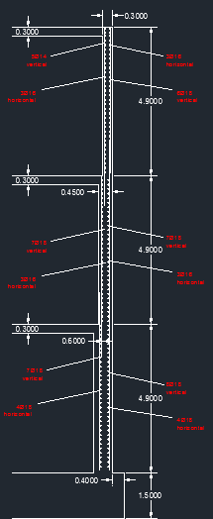

Slide 67


