Slide 1

An-Najah National University
Faculty of Engineering & Information Technology.
Building Engineering Department.
Graduation project (2)
Integrated redesign of the Children’s Hospital of Palestine in Ramallah city.
Prepared By:
1. Ameer Ihmedan.
2. Anees Ihmedan.
3. Rawan Amireh.
Supervisor: Eng. Haitham Sawalha.
1

Slide 2
01
02
03
04
05
06
TABLE OF CONTENTS
Introduction
Architectural Aspects
Environmental Aspects
Structural Aspects
Eloctro-Mechanical Aspects
Quantity Surveying and Cost Estimation
2

Slide 3
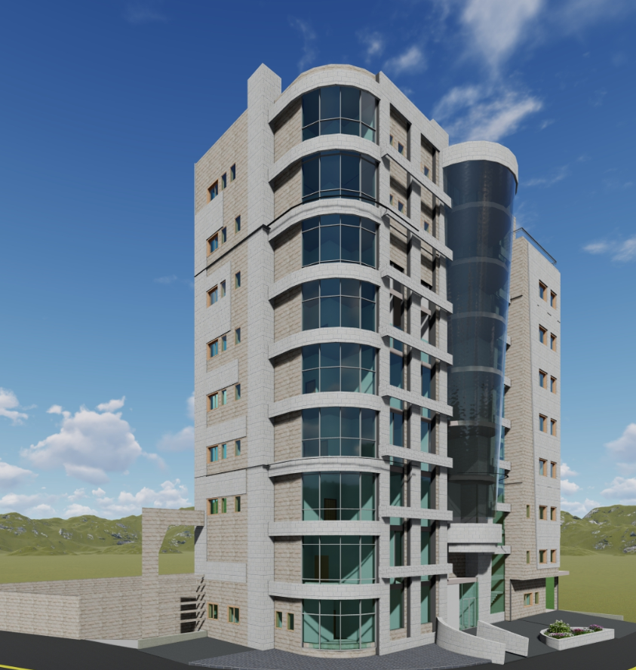
01
Introduction
Project Description & location
Methodology
3

Slide 4
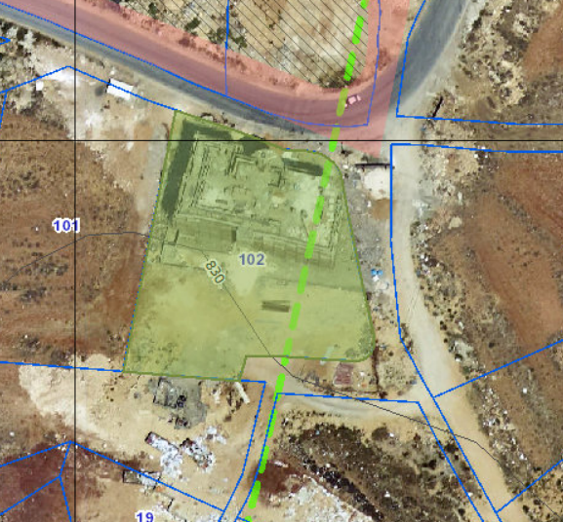
  Project Description
This project is a specialized hospital for children located in Ramallah in Al-Bireh Khallat Al-Salamia, Block No. 102, Basin 8. with total area 7551 and number of floors 12
4

Slide 5
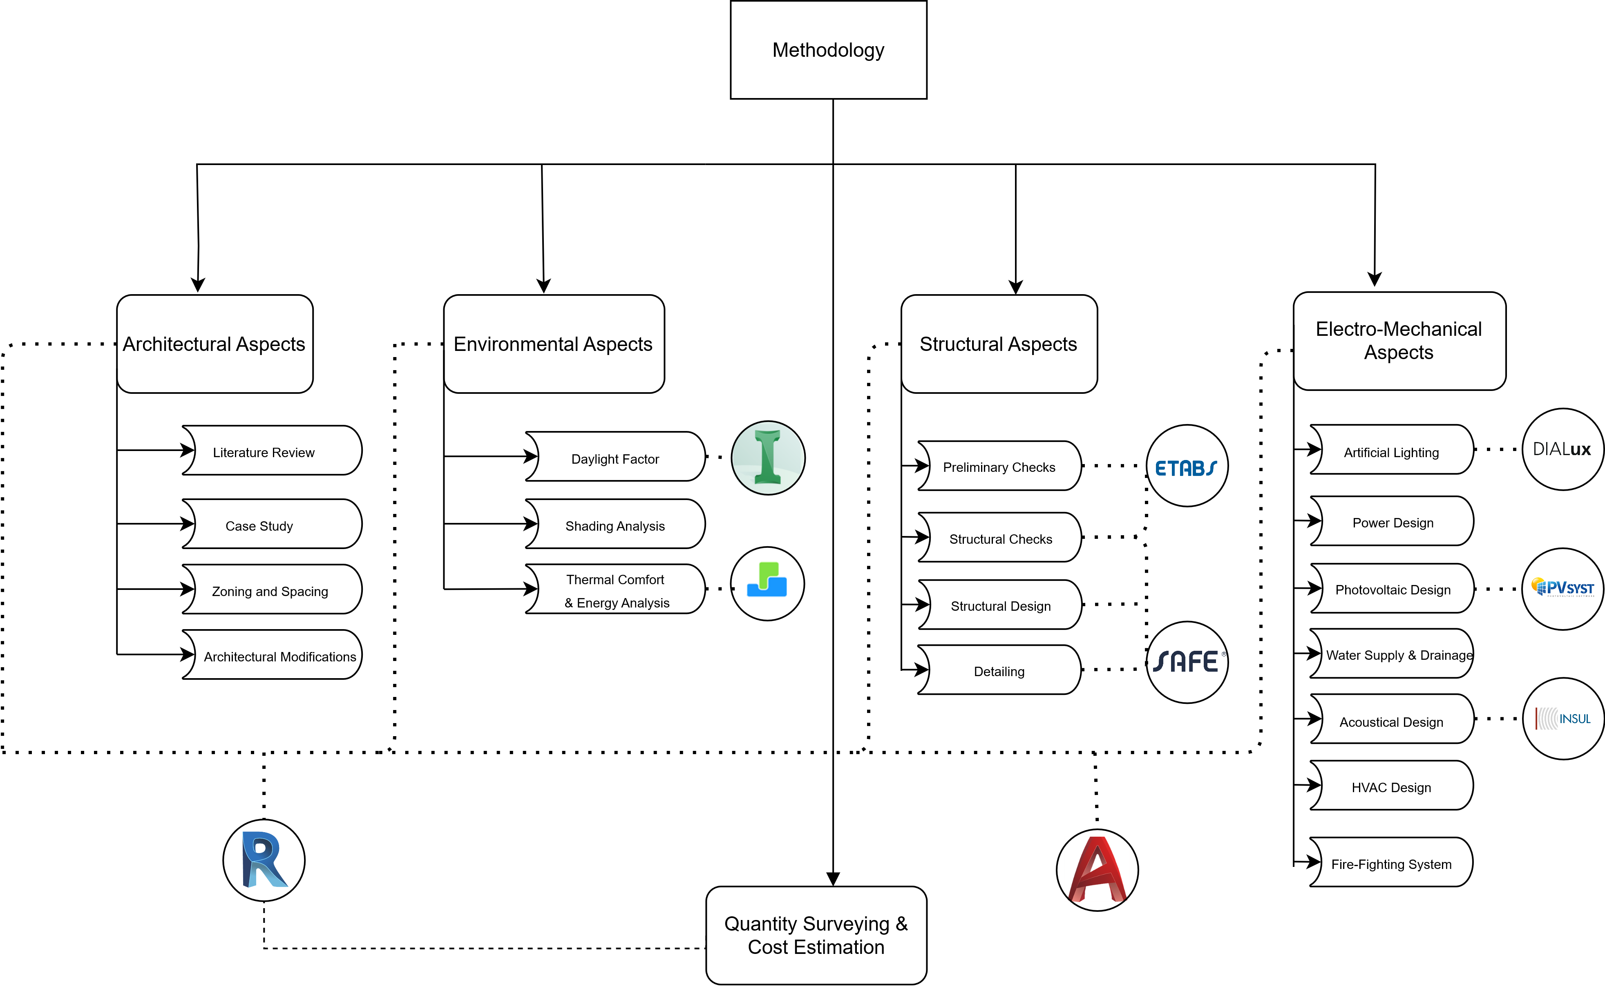
Methodology
5

Slide 6
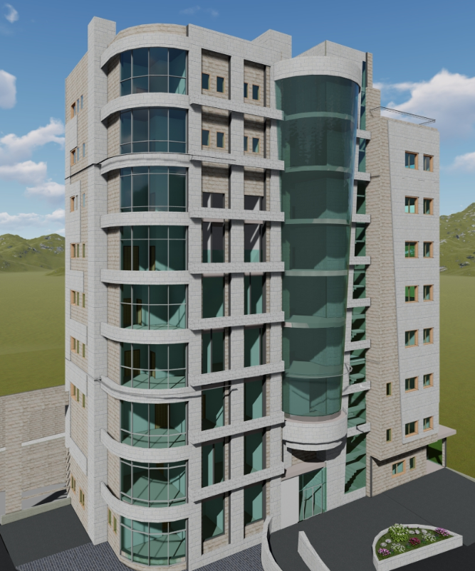
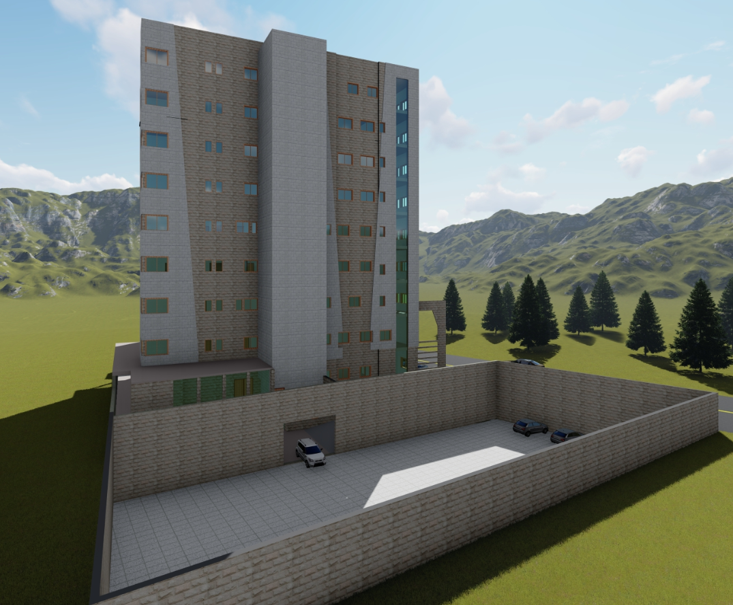
02
Architectural Aspects
Adding an ambulance bridge
Adding a parking floor
plans before and after modification
3D View
Site analysis
6

Slide 7
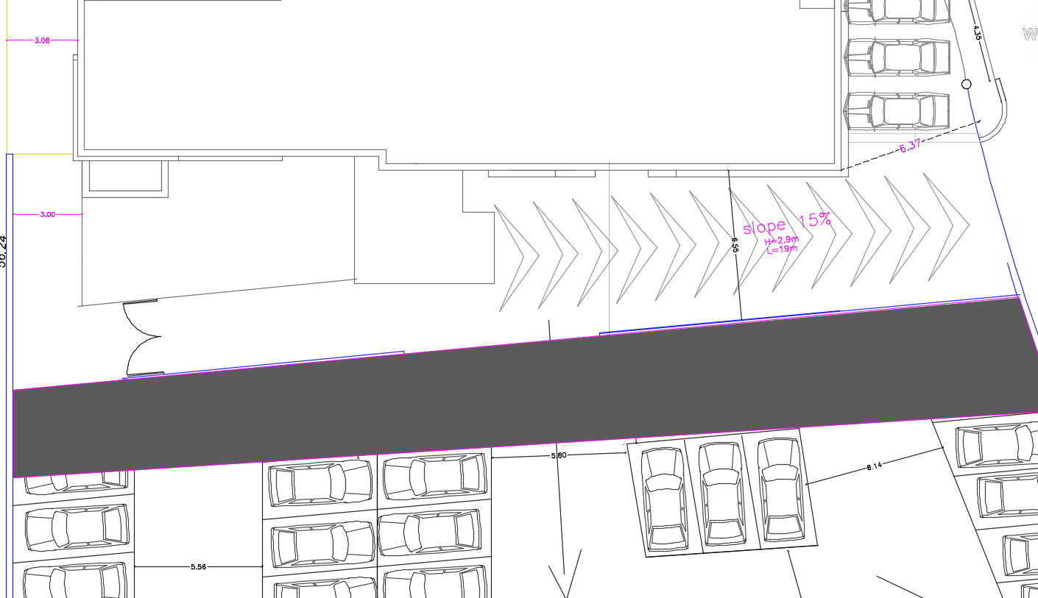
Adding a
ambulance bridge
7

Slide 8
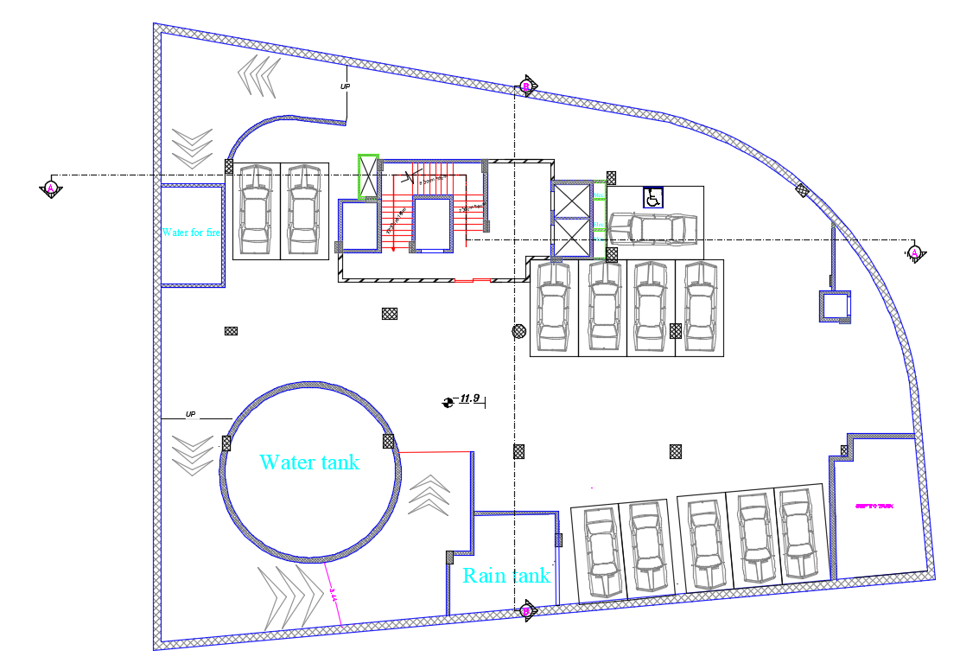
Adding a Parking floor
Added basement floor 3
8

Slide 9
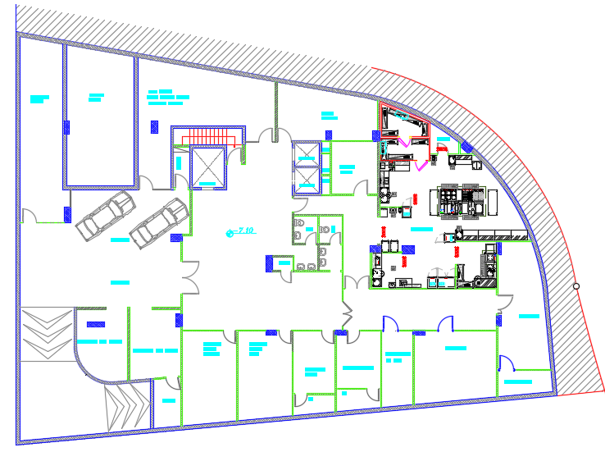
Basement floor2 before modification
Plan before modification
9

Slide 10
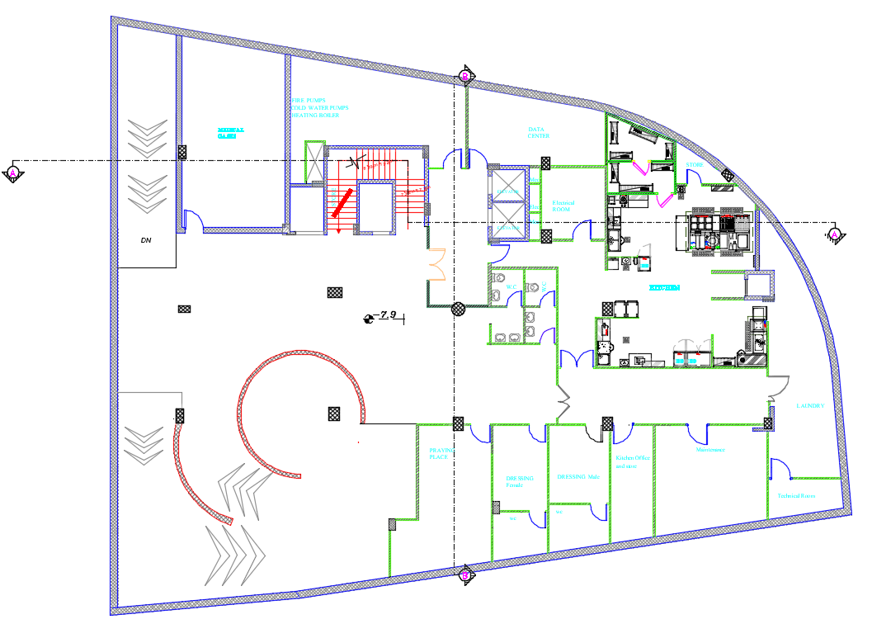
Basement floor2 after modification
Plan after modification
Added two ramp for parking
10

Slide 11
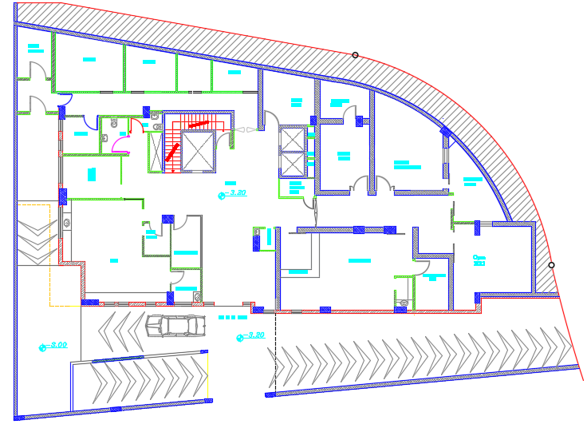
Plan before modification
Basement floor1 before modification
11

Slide 12
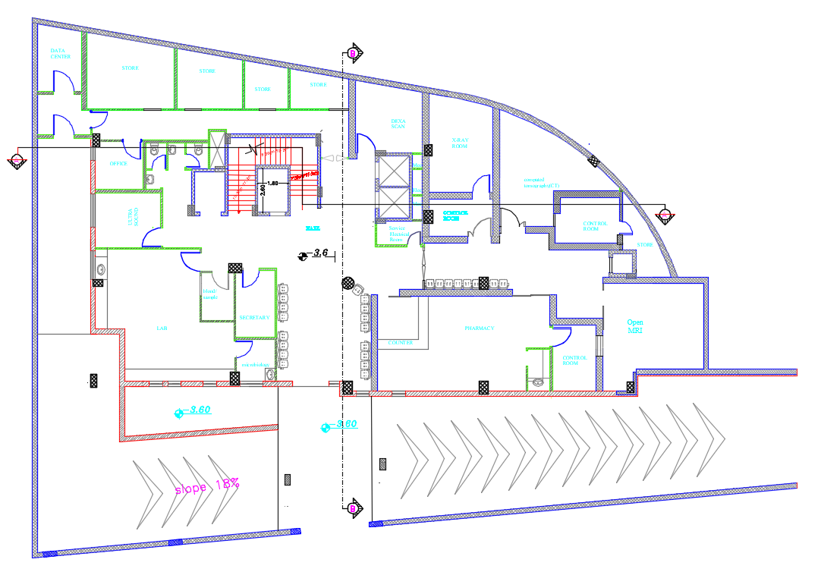
Plan after modification
1.Waiting area
2.Change in control room location
Basement floor1 after modification
12

Slide 13
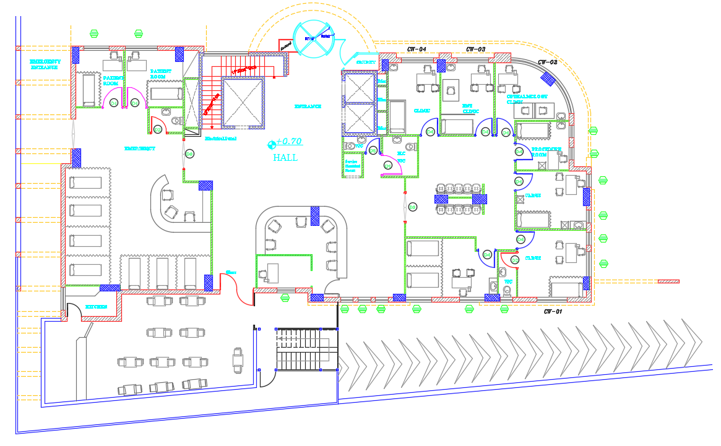
Plan before modification
Ground floor before modification
13

Slide 14
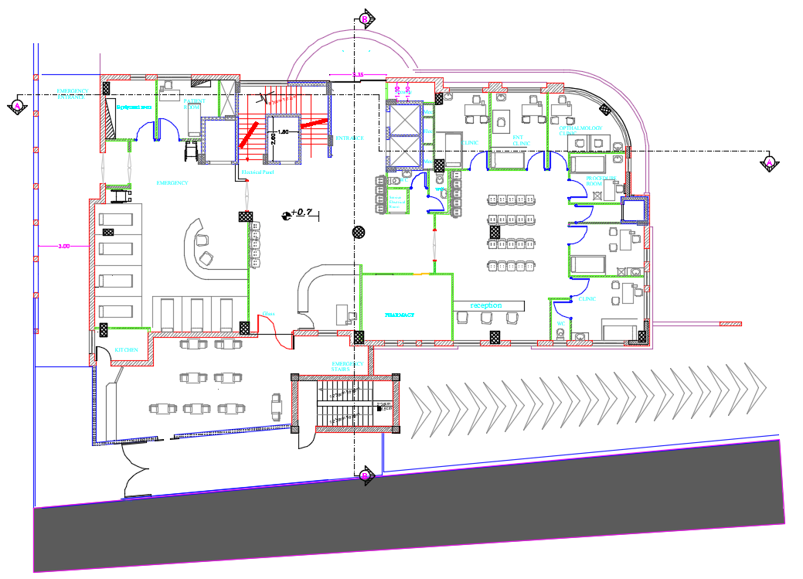
Plan after modification
1. Pharmacy
2. Reception
3. Elevator in emergency room and medical staff
Ground floor after modification
14

Slide 15
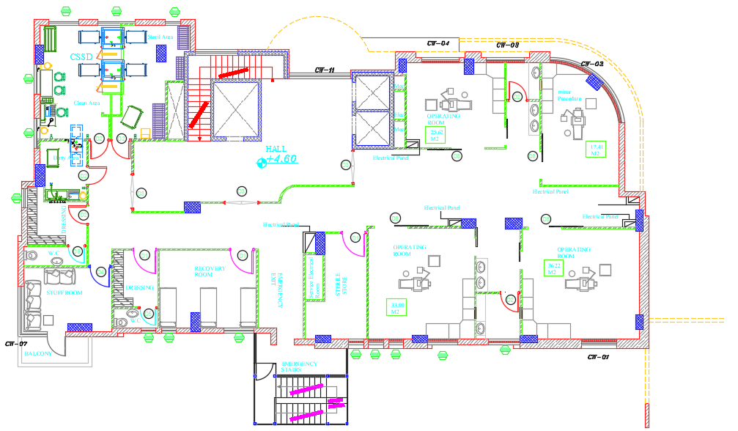
Plan before modification
First floor before modification
15

Slide 16
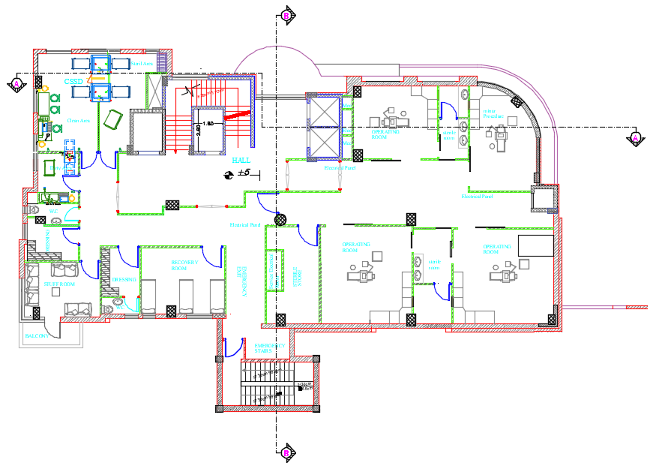
Plan after modification
1. Door in operation area
2. Stairs and Escape stairs
First floor after modification
16

Slide 17
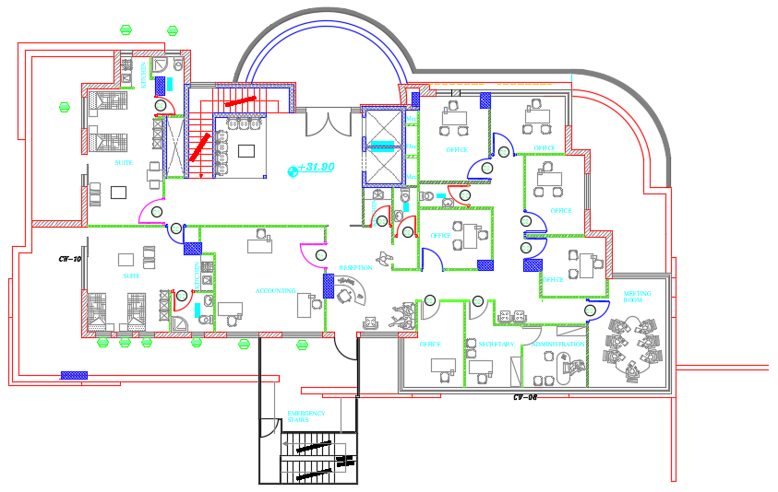
Plan before modification
Roof before modification
17

Slide 18
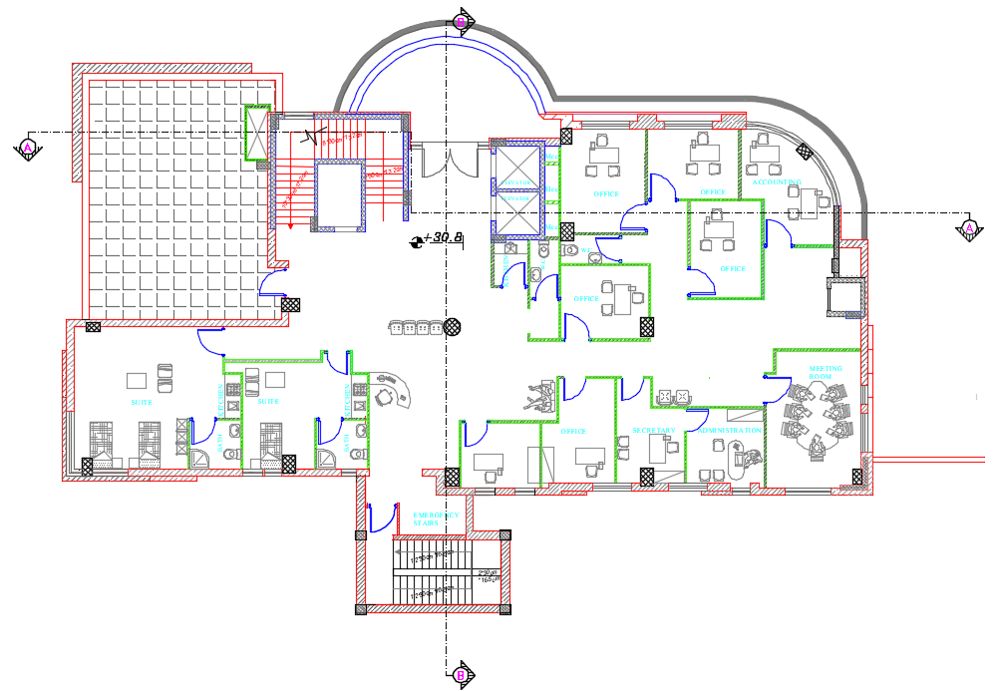
Plan after modification
Roof after modification
18

Slide 19
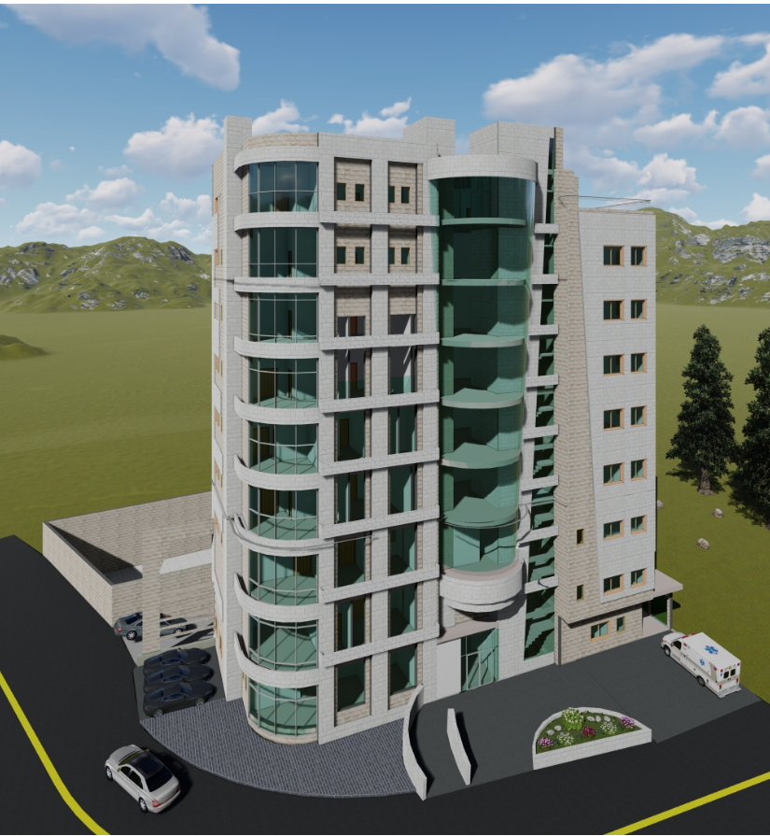
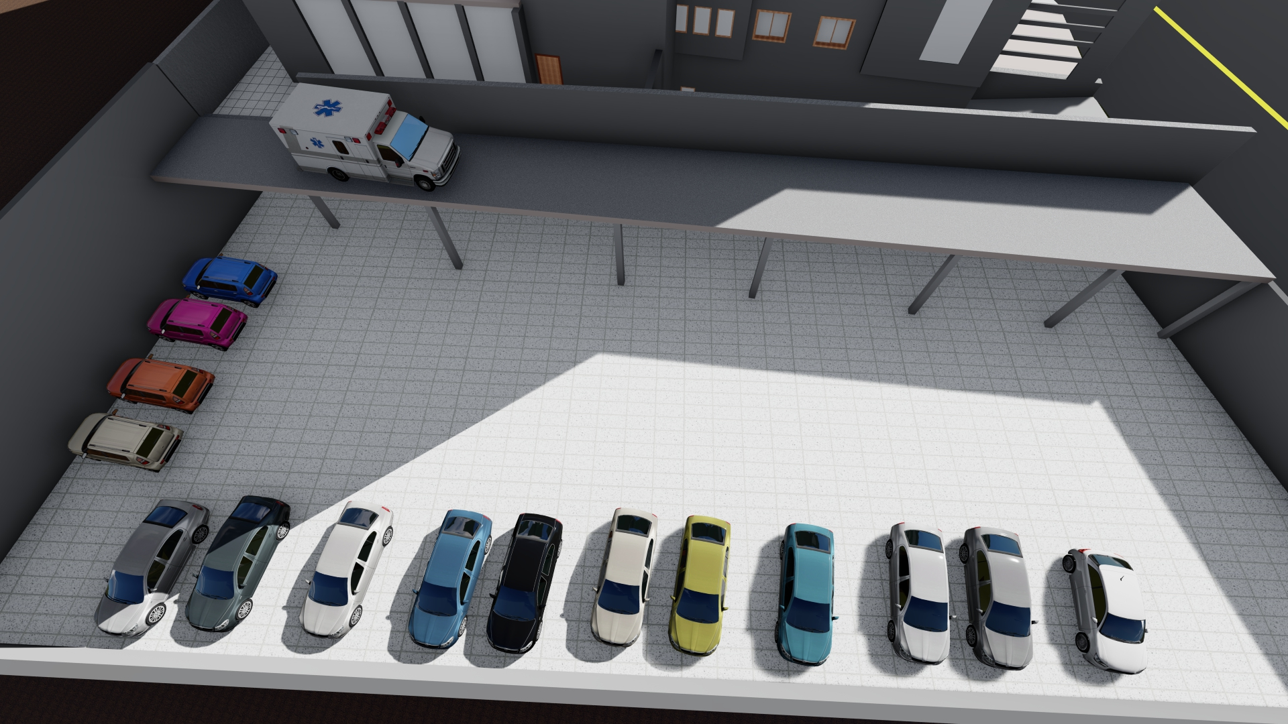
3D view
19

Slide 20
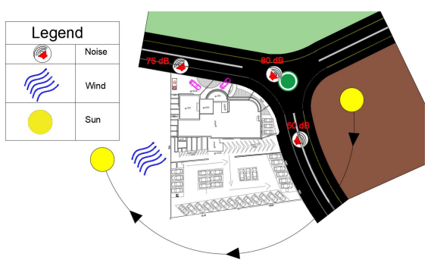
Site Analysis
20

Slide 21
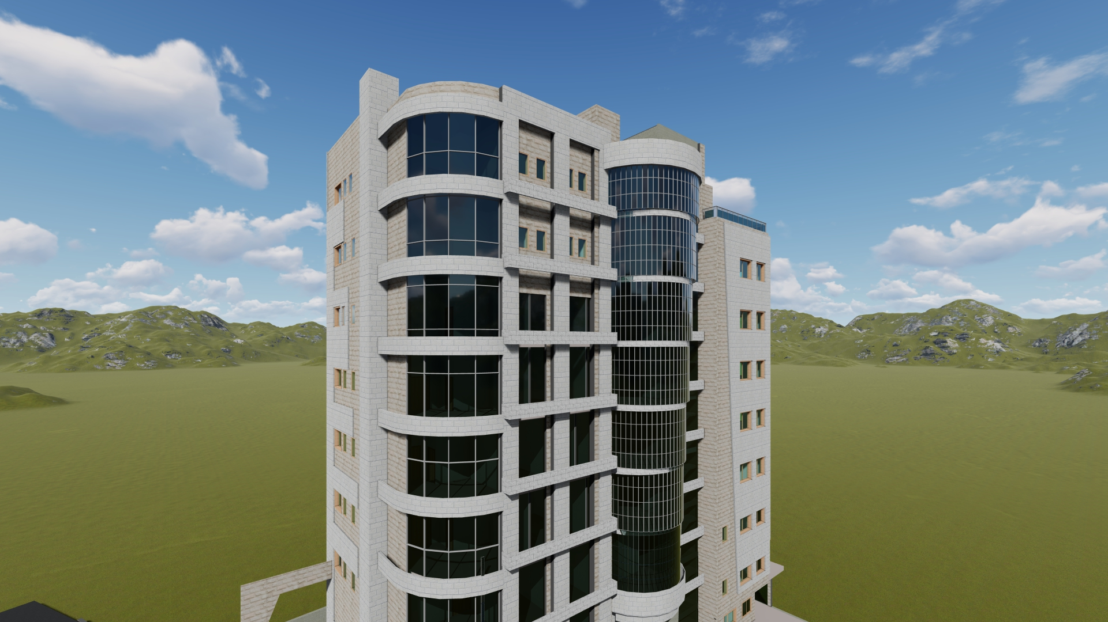
03
Enviromental Aspects
Simulation Analysis
CFD Analysis
Daylight Factor Analysis
Shading Analysis
21

Slide 22
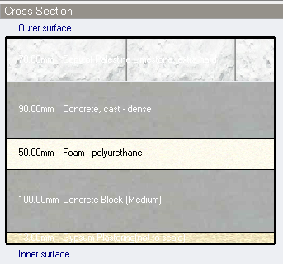
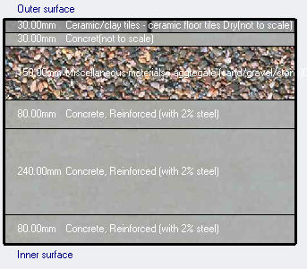
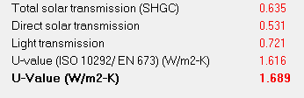


Design Builder Simulation Analysis
Wall Section
Roof Section
Glass U-Value
Wall U-Value
Roof U-Value

Slide 23
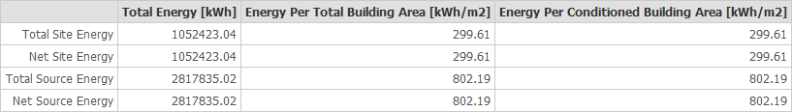
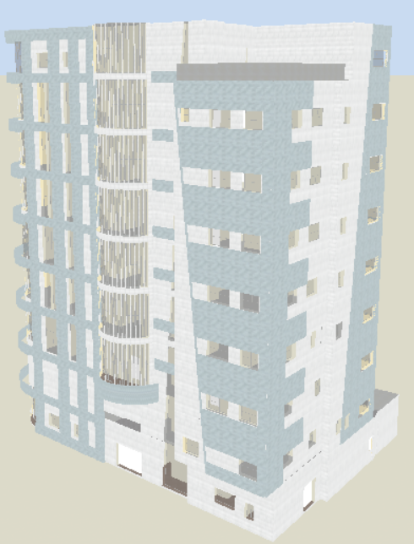
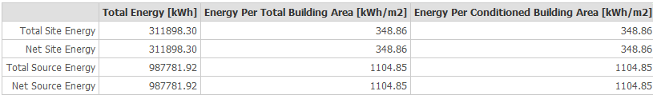


Design Builder Simulation Result

Slide 24
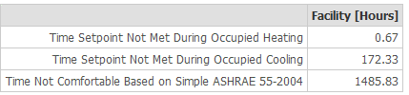
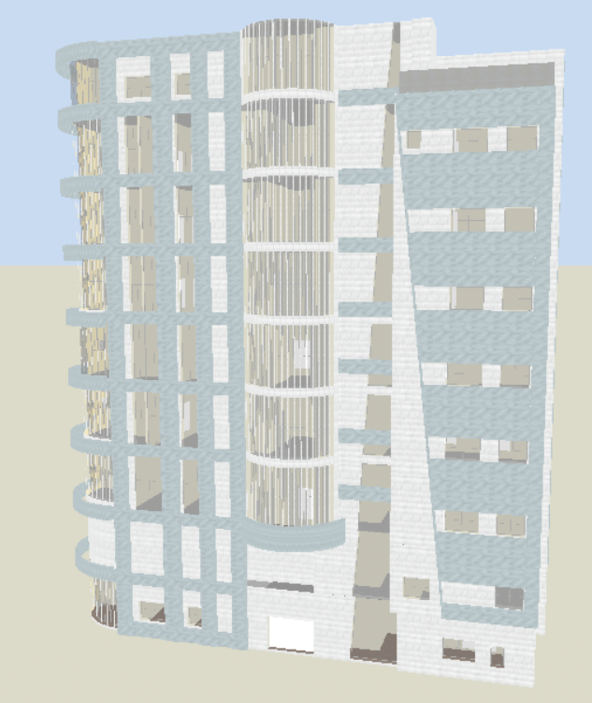

Design Builder Simulation Result

Slide 25
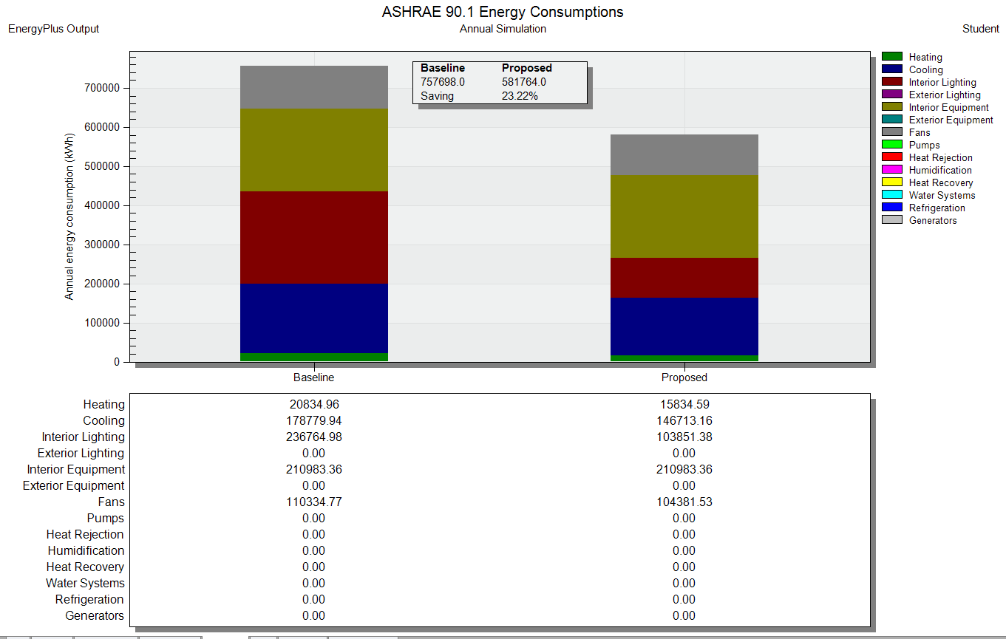
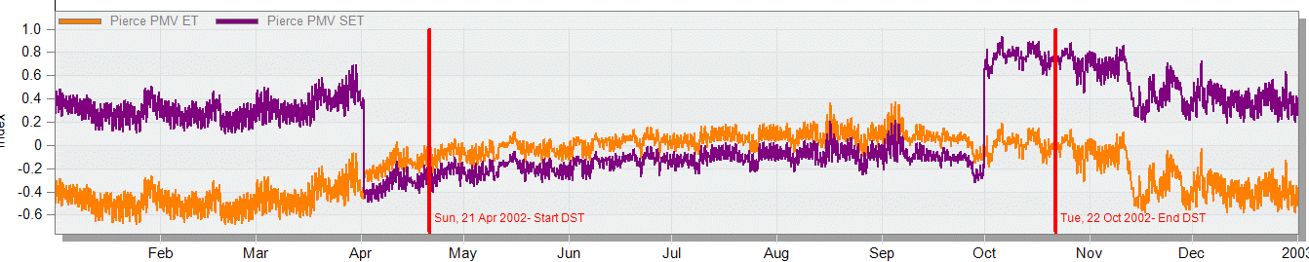
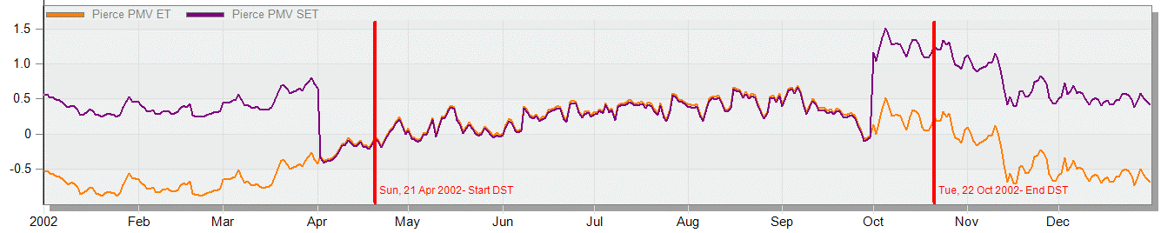
Design Builder Simulation Result
Predicted Mean Vote
Energy Baseline Comparison

Slide 26
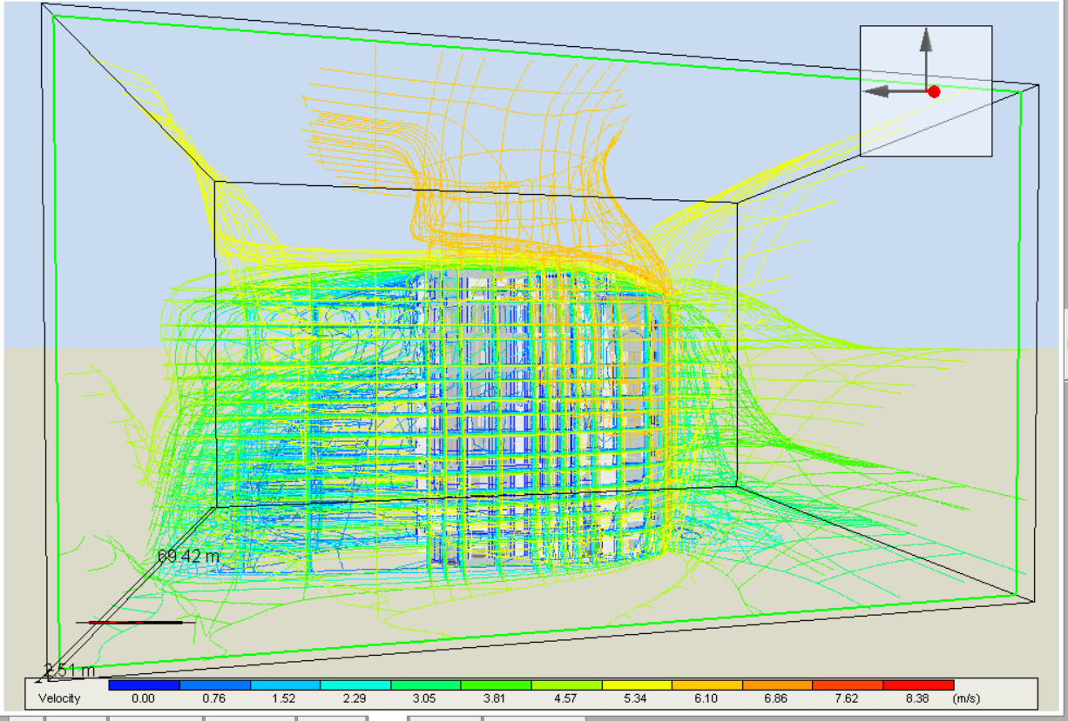
Design Builder CFD

Slide 27
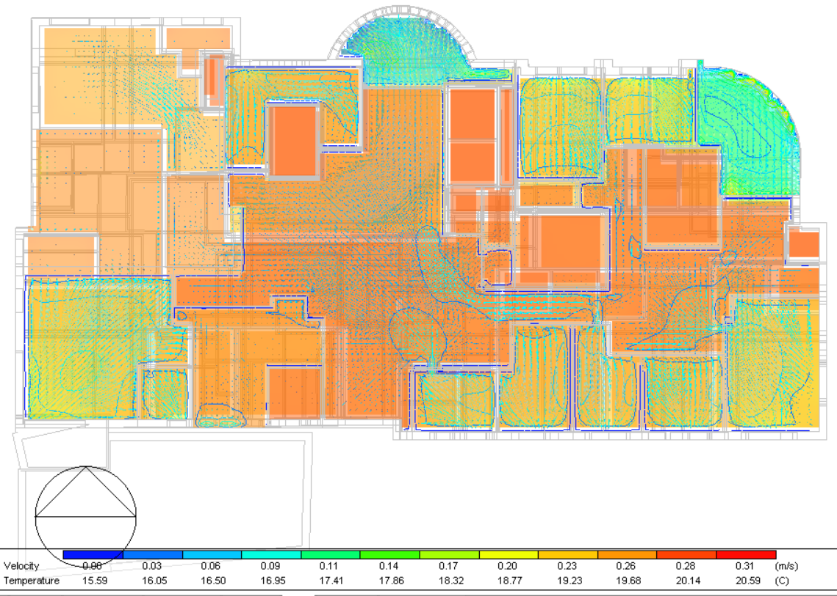
Design Builder CFD

Slide 28
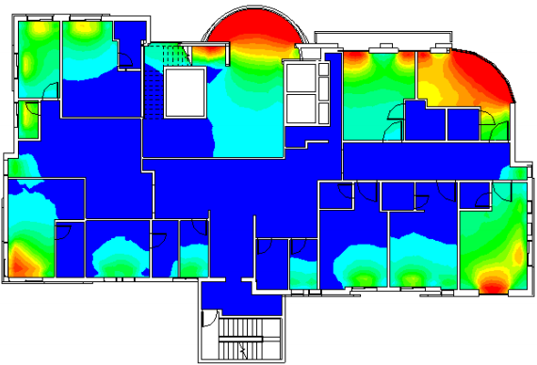
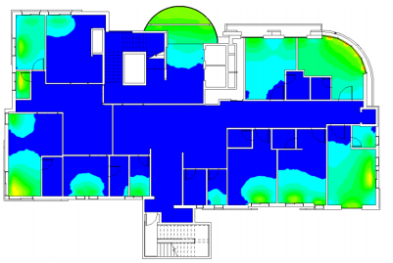
Daylight Factor Analysis
Third Floor Before Modifications
Third Floor After Modifications

Slide 29
Floor | Space name | Lighting daylight Factor Before modification % | Lighting daylight Factor after modification %
Ground floor | Clinic | 8-34 | 2-6
 | Clinic | 4-14 | 1-6
 | Clinic | 4-14 | 1-6
 | Entrance | 4-20 | 2-6
 | Clinic | 8-24 | 2-5
 | Dining area | 4-30 | 2-7
First floor | sterile room | 2-20 | 2-6
 | STUFF room | 7-22 | 2-10
Second floor | ICU room | 5-22 | 2-10
 | Machine room | 4-14 | 3-11
 | ICU room | 10-34 | 3-7
 | ICU room | 5-22 | 2-6
 | CCU room | 1-20 | 1-7
 | ICU room | 5-28 | 2-6
 | wating area | 30-34 | 3-8
Third floor | wating area | 2-32 | 1-7
 | Patients room | 12-32 | 2-7
 | LABOUR | 1-22 | 1-9
 | Patients room | 2-22 | 1-5
 | Patients room | 2-22 | 1-7
Fourth floor | Hall | 2-33 | 2-7
 | W.C | 2-16 | 2-5
 | W.C | 4-18 | 1-5
 | Patients room | 2-20 | 2-10
 | Patients room | 2-20 | 2-6
 | Patients room | 4-33 | 2-10
 | Baby room | 2-18 | 1-9
Floor | Space name | Lighting daylight Factor Before modification % | Lighting daylight Factor after modification %
Fourth floor | Hall | 2-33 | 2-7
 | W.C | 2-16 | 2-5
 | W.C | 4-18 | 1-5
 | Patients room | 2-20 | 2-10
 | Patients room | 2-20 | 2-6
 | Patients room | 4-33 | 2-10
 | Baby room | 2-18 | 1-9
Fifth Floor | Patients room | 8-33 | 2-7
 | Patients room | 2-22 | 2-6
 | Patients room | 2-18 | 1-6
 | Patients room | 3-22 | 1-6
 | Patients room | 1-14 | 1-8
 | Hall | 6-33 | 2-6
Sixth floor | Patients room | 8-33 | 2-7
 | Patients room | 2-22 | 2-6
 | Patients room | 2-18 | 1-6
 | Patients room | 3-22 | 1-6
 | Patients room | 1-14 | 1-8
 | Hall | 6-33 | 2-6
Roof | Meeting room | 40-60 | 2-7
 | Admnistration | 6-30 | 1-4
 | HAll | 40-60 | 2-6

Slide 30
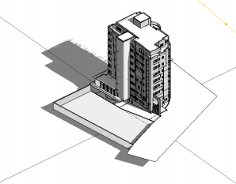
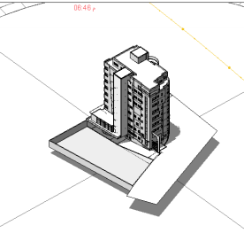
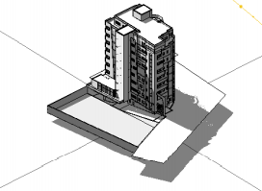
Shading Analysis
South east Elevation in Summer
8:00 AM
12:00 PM
2:00 PM

Slide 31
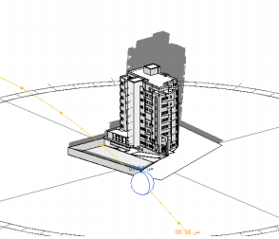
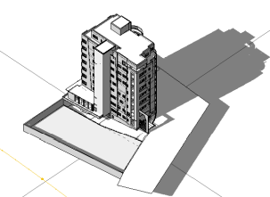
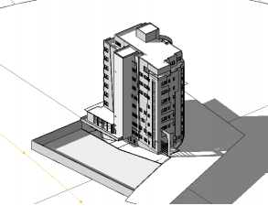
Shading Analysis
South east Elevation in Winter
8:00 AM
12:00 PM
2:00 PM

Slide 32
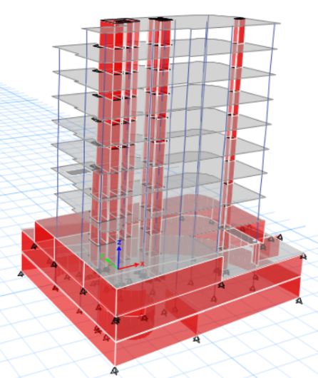
03
Structural Aspects
Structural System
Structural Checks
Seismic Design
Seismic Checks
Design & Details
32

Slide 33
Structural System
The following codes were used in the structural design:
ACI-318R-11 for reinforced concrete structural design
ASCE 7 2010 for load combinations
IBC – 2016 for seismic design.
Load effect :
Dead load (From ETABS)
SID= 4 KN/m² , 7 KN/m² and 12 KN/m²
Live Loads = 4 KN/m² and 7 KN/m²
Lateral Loads

Slide 34
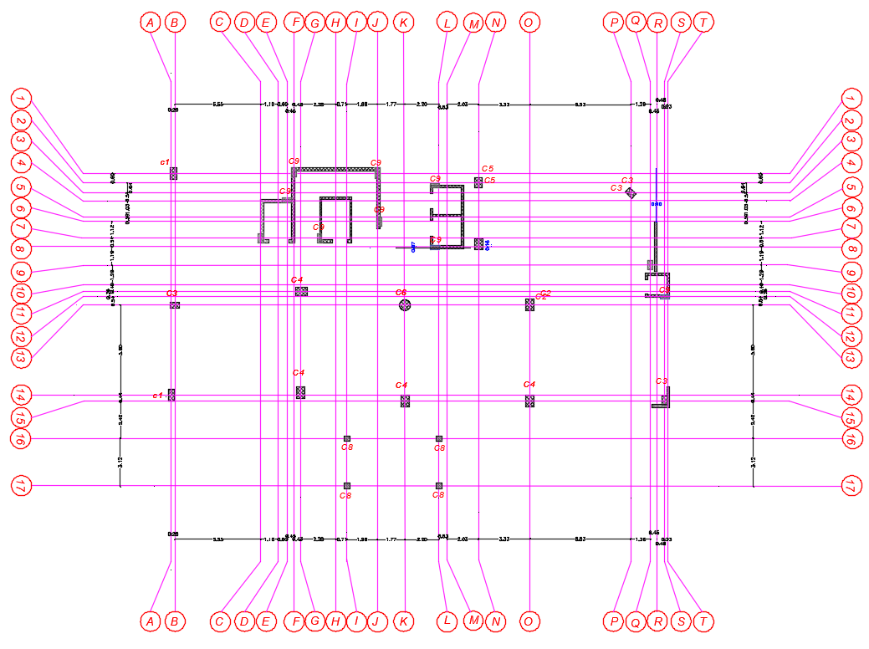
Structural System
Ground floor Column Distribution

Slide 35
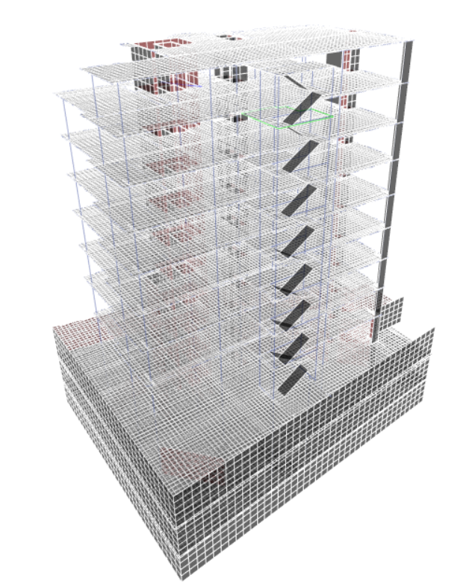
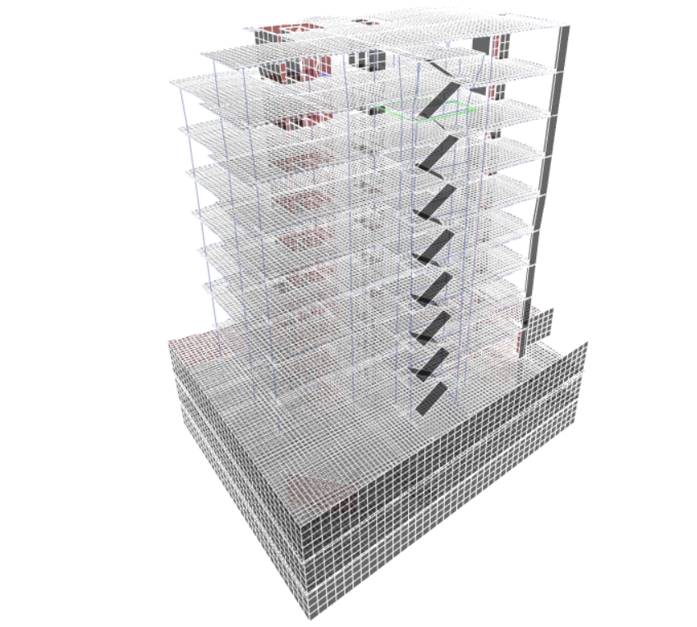
Structural Checks
Compatibility Check

Slide 36
Structural Checks
Equilibrium Check
 | Etabs | Manual | Error | < 5 %
Dead | 73301 | 70647.49 | 3.62 | OK
Live | 27876 | 27785 | 0.33 | OK
SID | 37628 | 38218 | 1.57 | OK

Slide 37
Structural Checks
Stress-Strain Check – Columns
 | Etabs | Manual | Error | < 10 %
interior column | 10590 | 10203.71 | 3.65 | OK
Edge column | 8751 | 8513.92 | 2.705 | OK
corner column | 2204 | 3193.6 | 44.91 | Not OK
Stress-Strain Check – Slab
Moment A-B | Etabs | Manual | Error | < 10 %
Moment(+ve) | 122.3 | 117.6 | 3.84 | OK
Moment(-ve) | 139.5 | 136.2 | 2.37 | OK
Moment(-ve) | 552 | 540 | 2.17 | OK

Slide 38
Seismic Design
Seismic Design
City of Structure | Ramallah
Soil Capacity | 520 KN/m2
Site Class | B
Seismic Design Category | C
Seismic Importance Factor | I=1.5
Structural Design Type | DUAL SYSTEMS WITH INTERMEDIATE MOMENT FRAMES CAPABLE OF RESISTING AT LEAST 25% OF PRESCRIBED SEISMIC FORCES-ORDINARY REINFORCED CONCRETE SHEAR WALLS
Response Modification factor ( R) | R=5.5

Slide 39
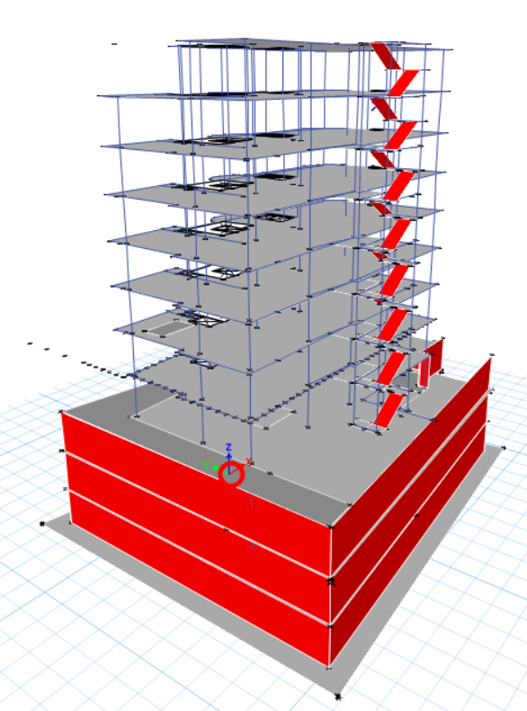
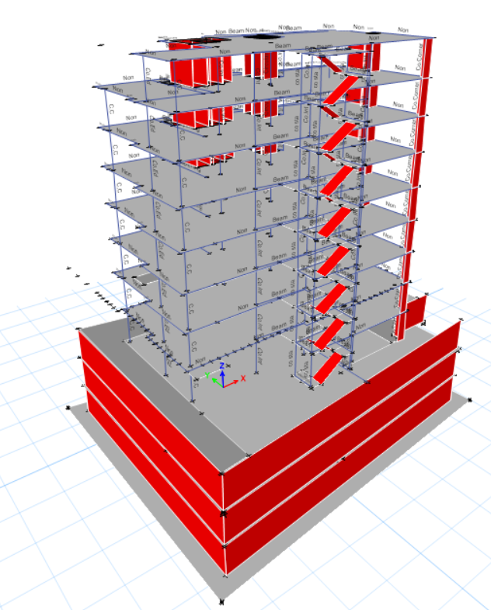
Seismic Design
DUAL SYSTEMS
Building with 25%seismic load
Building with 100%seismic load

Slide 40
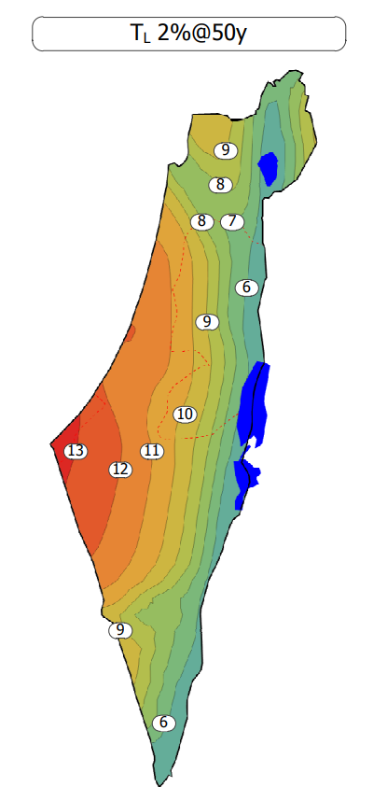
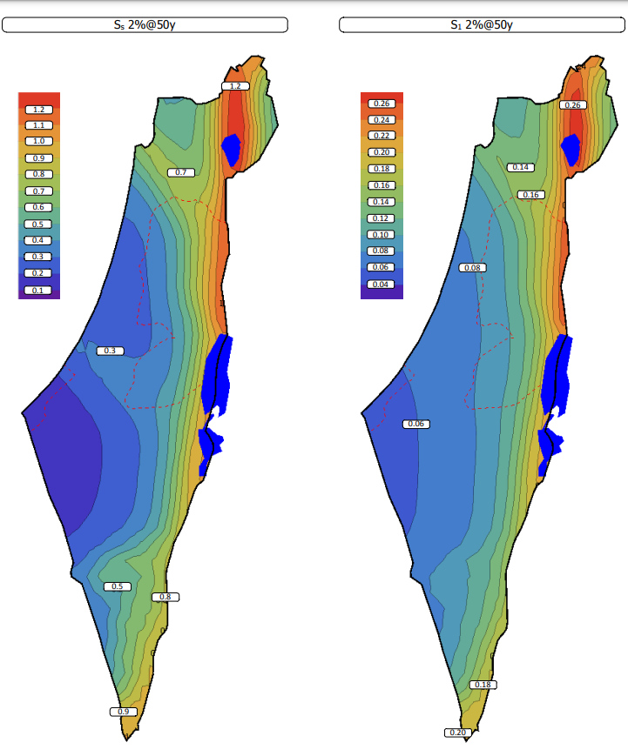
Seismic Design
From maps:
TL= 9
Ss= 0.4
S1= 0.1

Slide 41
Seismic Check
      Base Shear Check (V)
Axis | T | T(limit) | Tfinal | Cs1 | Cs2 | Cs3 | Csfinal | V | V(Etabs) | Error
X | 1.247 | 2.924 | 1.247 | 0.0727 | 0.0146 | 0.0176 | 0.01760 | 2338.437 | 2331.6 | 0.292
Y | 1.726 | 2.924 | 1.726 | 0.0727 | 0.0105 | 0.0176 | 0.01760 | 2338.437 | 2318.219 | 0.865
Error percentage is less than 5%.

Slide 42
Seismic Check
      Drift Check
Number of story | Axis | drift (m) | factor | Check
Story11 | X | 0.00524 | 0.004716 | ok
Story11 | Y | 0.006845 | 0.006161 | ok
Story11 | X | 0.004799 | 0.004319 | ok
Story11 | Y | 0.006786 | 0.006107 | ok
Story10 | X | 0.001752 | 0.001577 | ok
Story10 | Y | 0.001409 | 0.001268 | ok
Story10 | X | 0.002015 | 0.001814 | ok
Story10 | Y | 0.001447 | 0.001302 | ok
Story9 | X | 0.001849 | 0.001664 | ok
Story9 | Y | 0.001458 | 0.001312 | ok
Story9 | X | 0.002226 | 0.002003 | ok
Story9 | Y | 0.001617 | 0.001455 | ok
Story8 | X | 0.002003 | 0.001803 | ok
Story8 | Y | 0.001459 | 0.001313 | ok
Story8 | X | 0.002303 | 0.002073 | ok
Story8 | Y | 0.001549 | 0.001394 | ok
Story7 | X | 0.002095 | 0.001886 | ok
Story7 | Y | 0.001397 | 0.001257 | ok
Story7 | X | 0.002262 | 0.002036 | ok
Story7 | Y | 0.001427 | 0.001284 | ok
Story6 | X | 0.00211 | 0.001899 | ok
Story6 | Y | 0.001316 | 0.001184 | ok
Story6 | X | 0.002069 | 0.001862 | ok
Story6 | Y | 0.001309 | 0.001178 | ok
Story5 | X | 0.002051 | 0.001846 | ok
Story5 | Y | 0.001332 | 0.001199 | ok
Story5 | X | 0.001721 | 0.001549 | ok
Story5 | Y | 0.001119 | 0.001007 | ok
Number of story | Axis | drift (m) | factor | Check
Story4 | X | 0.002025 | 0.001823 | ok
Story4 | Y | 0.00191 | 0.001719 | ok
Story4 | X | 0.001262 | 0.001136 | ok
Story4 | Y | 0.000883 | 0.000795 | ok
Story3 | X | 0.001038 | 0.000934 | ok
Story3 | Y | 0.001458 | 0.001312 | ok
Story3 | X | 0.000304 | 0.000274 | ok
Story3 | Y | 0.000372 | 0.000335 | ok
Story2 | X | 0.00011 | 0.000099 | ok
Story2 | Y | 0.000057 | 5.13E-05 | ok
Story2 | X | 0.000122 | 0.00011 | ok
Story2 | Y | 0.000041 | 3.69E-05 | ok
Story1 | X | 0.000031 | 2.79E-05 | ok
Story1 | Y | 0.000039 | 3.51E-05 | ok
Story1 | X | 0.00003 | 0.000027 | ok
Story1 | Y | 0.000025 | 2.25E-05 | ok

Slide 43
Seismic Check
      Stiffness Check
Story 2
Axis | P (KN) | S (KN) | H (m) | Stability coefficient | Check
X | 155275.9 | 2532384 | 4.3 | 0.01426 | ok
Y | 155275.9 | 2144707 | 4.3 | 0.016837 | ok
Story 5
Axis | P (KN) | S (KN) | H (m) | Stability coefficient | Check
X | 98972.73 | 355599.5 | 4.3 | 0.064727 | ok
Y | 98972.73 | 451490 | 4.3 | 0.05098 | ok
Story 4
Axis | P (KN) | S (KN) | H (m) | Stability coefficient | Check
X | 112827.4 | 457838.1 | 4.3 | 0.057311 | ok
Y | 112827.4 | 703862.4 | 4.3 | 0.037278 | ok
Story 8
Axis | P (KN) | S (KN) | H (m) | Stability coefficient | Check
X | 55266.1 | 204338.8 | 4.3 | 0.062898 | ok
Y | 55266.1 | 273102 | 4.3 | 0.047061 | ok

Slide 44

Design & Details
First floor U-Boot plan
Slab Design

Slide 45


Design & Detailing
Slab Design
First floor Reinforcement
First floor Reinforcement

Slide 46


Design & Detailing
slab detailing
Section in slab
Shrinkage reinforcement

Slide 47



Design & Detailing
Column design & detailing

Slide 48



Design & Detailing
Column design & detailing

Slide 49



Design & Detailing
Column design & detailing

Slide 50

Design & Detailing
Column 3D

Slide 51




Design & Detailing
Beam design & detailing

Slide 52



Design & Detailing
Beam design & detailing

Slide 53

Design & Detailing
Stairs design & detailing

Slide 54


Design & Detailing
Stairs Beam and Detailing

Slide 55


Design & Detailing
Stairs Beam and Detailing

Slide 56

Design & Detailing
Mat Foundation design & detailing

Slide 57


Design & Detailing
Check Punching shear
Building with load 100%seismic
Building with load 25%seismic

Slide 58




Design & Detailing
Isolated footing Design and tie beam for bridge

Slide 59


Design & Detailing
Water Tank Design

Slide 60


Design & Detailing
    Basement wall and Shear wall Design

Slide 61





04
Electro-Mechanical Aspects
HAVC System
Water Supply system
Artificial Lighting system
Drainage system
Fire fighting system
Power Design and photovoltaic system Acoustical Design
61

Slide 62

HAVC System
VRF System has been considered.
HVAC System Used Components:
Air handling Unit
Ducts
Diffusers
Split unit

Slide 63

HAVC System
Design Capacity = 188 kW
Total Design Flowrate = 10000 L/sec.
Air Handling Unit Catalogue

Slide 64

HAVC System
Ground Floor

Slide 65



HAVC System
NACH
HEPA
Fan Coil Catalogue

Slide 66

HAVC System
diffuser design with check

Slide 67

HAVC System
Split unit design

Slide 68

Water Supply system
Fixture unit

Slide 69


Water Supply system

Slide 70




Water Supply system
Water loss and limiter used

Slide 71

Water Supply system
Water for fifth plan

Slide 72

Water Supply system
Water Tank

Slide 73


Water Supply system
Solar boiler

Slide 74




Artificial Lighting
DIALux has been used for Space Analysis and Design.
CSDD
Operation Room
Recovery Room
Reception Room Operation Room CSDD
Clinic Room
Patient Room
Emergency
Pharmacy
RECOVERY STERILE AREA

Slide 75




Artificial Lighting
Reception Room

Slide 76



Artificial Lighting
Patient Room

Slide 77


Artificial Lighting
Lighting Plans
Five Floor
Second Floor

Slide 78
Drainage
Used Diameters
W.C Horizontal Pipe = 4″ at slope of 1%
Lavatory Horizontal Pipe = 2″ at slope of 2%
Main Manhole’s Pipe = 6″ at slope of 1%

Slide 79

Drainage
Drainage System Sample Plans

Slide 80


Drainage
Drainage System Sample Plans

Slide 81


Drainage
Rainwater System

Slide 82





Fire Fighting System
Used Fire-fighting System
Sprinkler System
Fire Hose Stations
Fire alarm System
Dry Stand Pipe
Fire-fighting Signs
FM200
Dry chemical fire extinguisher
Manual ABC fire extinguisher

Slide 83


Fire Fighting System
Fire-fighting Symbols
Six Floor Fire-Fighting Plan

Slide 84

Fire Fighting System

Slide 85


Power Design
Socket and Distribution Boards Plans

Slide 86



Power Design
Distribution Boards Plans
Circuit breaker for fifth plan

Slide 87


Power Design
Low voltage Design
Designed the low voltage circuits such as internet or TV line.

Slide 88


photovoltaic system design
Module Specifications

Slide 89

photovoltaic system design
Module Distribution Cases

Slide 90


photovoltaic system design
Result of Photovoltaic system

Slide 91



Acoustical Design
Insul has been used to designed layer of wall
Standard of STC (Sound transmission class) for space and roof.
Ease has been used for RT60 analysis

Slide 92


Acoustical Design
IIC For Slab

Slide 93


Acoustical Design
STC For external Wall
STC For internal Wall

Slide 94


Acoustical Design

Slide 95



Acoustical Design
Ceiling loud speaker

Slide 96
05
Quantity Surveying & Cost Estimations
Cost Estimation of the Hospital has been conducted based on the Calculate in details for all work and activities
96

Slide 97
Cost Estimation
Unit cost =1600 NIS/m
Cost (NIS)
5000000 | Structure Work
4500000 | Finishing Work
900000 | Electrical Works
1600000.00 | Mechanical Work
12000000.00 | Total Cost

Slide 98
Thanks!
Does anyone have any questions?

