Slide 1
Master Plan For Tubas Governorate
Prepared By:
Abeer Akleek
Reham Hassoun
Supervised By:
Dr. Anan Jayyosi

Slide 2
Main points
Introduction
Objectives
Methodology
Clustering Communities
Bridging Water Gap
Recommendations

Slide 3
Many Palestinians have no choice but to purchase water.
additional supplies from mobile water tankers which deliver water at a much higher price and of often dubious quality.
With higher rates of urbanization, increasing demand for drinking water will put stress on existing water sources.

Slide 4
Water Resources Management
aims to optimize the available natural water flows, including surface water and groundwater, to satisfy competing needs.
highlight the importance of water in any development and growth agenda.
The ability of developing to make more water available for domestic, agricultural, industrial and environmental uses will depend on better management of water resources.

Slide 5
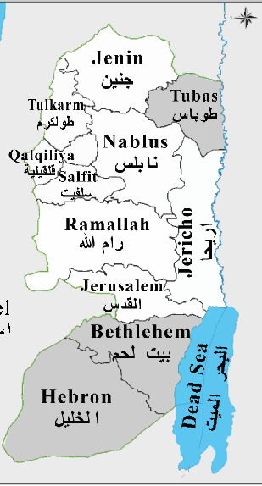
Notes:
TUBAS Governorate is located in the northeastern part of the West Bank. It is
bordered by Jenin Nablus and Jericho Governorates and Jordan valley
The highest elevation reaches up to 495 m above the Sea level at Aqqaba and the lowest
elevation reaches to 166 m below the Sea level. The average annual temperature in Tubas Governorate is 21 °C, and the average annual humidity is 56 %
Tubas governorate comprises of 19 localities, of which 3 localities are managed by
municipality councils, 6 localities by village councils and the rest are managed
by project committees in addition to one refugee.

Slide 6
objectives
To define the supply and demand situation for the Tubas Governorate up to the planning period of 2030 taking into consideration all relevant elements present and future population, present and future supply sources, present and future supplied infrastructure.
To prepare the necessary reports, maps, and drawings for the Master Plan.
To identify technical measures and equipment required to provide the present and future water demand for domestic, commercial, industrial, livestock and public uses.

Slide 7
Methodology
Analyze the water resources system for Tubas Governorate.
Evaluate the water supply and demand conditions which will include studying the existing wells, surface water and water needs both for agriculture and municipal uses.
After that the future water demand will be studied, that means estimating future population, future demand and future consumption rate.
Notes:
This will include collecting data about Tubas such as; location, population, climate, topography, land use such as built up areas, forests, agricultural land.

Slide 8
To bridge the gap between existing supply and future demand, the project will propose new sources such as water harvesting, rehabilitation of existing water network and digging of new groundwater wells.
Based on the proposed new sources, an investment plan will be developed to include the needed infrastructure to provide the additional water quantities to the different communities.

Slide 9
Existing Water Situation
The number of communities in the Governorate is 19, including 12 communities that do not have water networks.
There are only 2 wells in Tubas Governorate that supply it with drinking water which are Tubas and Tammoun wells.
The main and urgent objective of this project is to improve and increase the average supply of drinking water in all Palestinian communities in Tubas Governorate by rehabilitating existing internal water networks to reduce the percentage of loss,
building water reservoirs and installing booster pumps and main lines to convey water to both the served and currently un-served communities.
Notes:
1-These 12 communities depend mainly on tankers for transporting water from nearby wells and springs.
2-there is the old well of Tubas municipality with a capacity declining to less than 15 cubic meters per hour, in addition to the deterioration in the quality of its water. There is also the Tammoun well that was recently drilled by the Palestinian Water Authority.

Slide 10
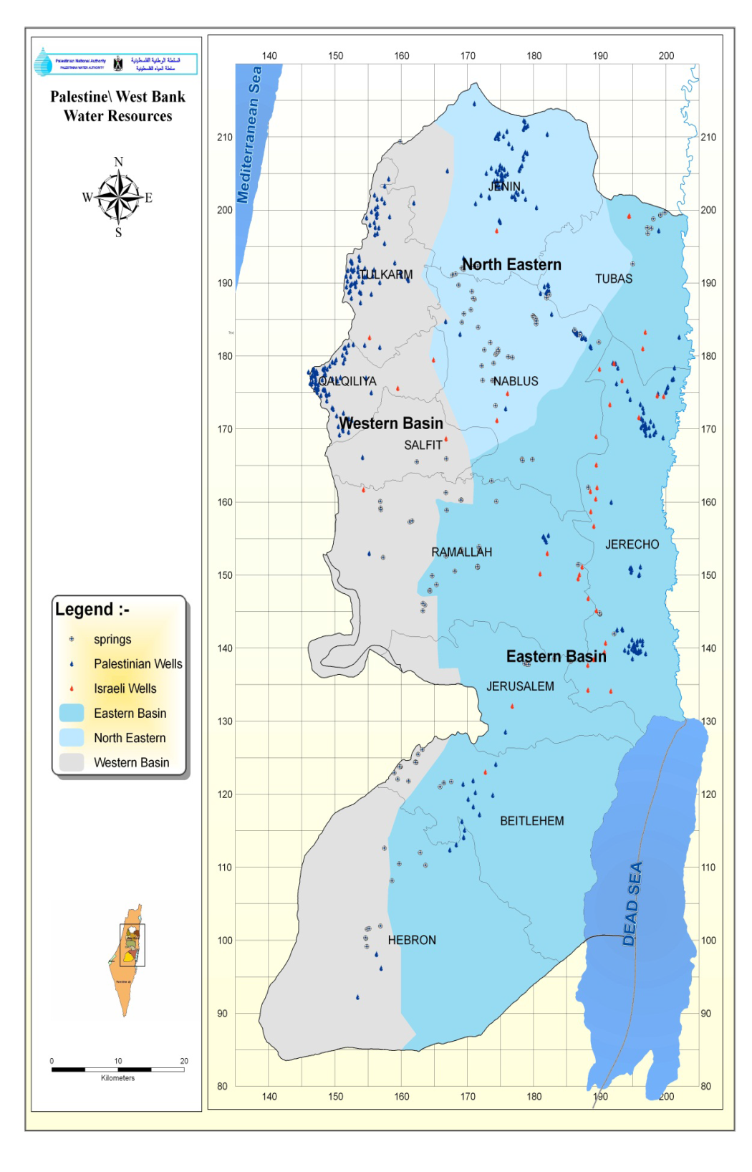
Basins
Basin Tubas Governorate Portion(MCM)
Eastern Basin Production 2.7
Western Basin Production 0
North-Eastern Basin Production 7
Total 9.7

Slide 11
Wells & springs
Tubas has about 21 wells used mainly for agricultural purposes and one well used for domestic purposes, which is tubas water project. Yielding (MCM) 0.7
Governorate Discharge of Springs(MCM) 0.627
There are no water from Mekerot for 2010.

Slide 12
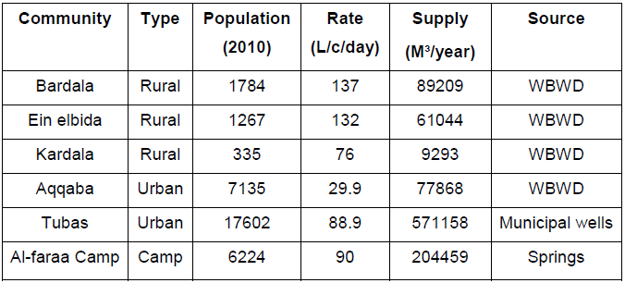
Water sectors
Water consumption in Tubas Governorates localities depends on many factors such as population and the economic and social status, it also depends whether the locality is served by network or not.
For piped communities the rate of consumption ranges from 30 to 137
For un-piped localities a 35L/c/day is assumed to be consumed

Slide 13
Water sectors
Water consumption in Palestine can be divided into many sectors which are:
Domestic
Industrial
Commercial
public
Livestock sectors

Slide 14
Future Water Needs
In This Project The Following Assumption Is Made:
Domestic sector:
for urban areas, an increment of nearly 1 % is assumed to be achieved in each of the assumed periods.
For rural areas also 1% increment will be considered as a result of expected expansion in those areas.
Public Sector:
For urban areas the increment is nearly 0.5%.
in rural areas the percentage decrease by nearly 0.5%.
Commercial Sector:
for urban areas, it's assumed that this percentage will increase by 2%.
rural areas this percentage will decrease.

Slide 15
Industrial Sector:
this percentage will decrease in both urban and rural areas.
Livestock Sector:
For rural area the percentage will increase. urban areas percentage from total will decrease.

Slide 16
losses
In piped areas Water loss is refers to the unaccounted for water which include:
Physical losses represented by source and conveyance lines leakage.
Illegal connection; black losses.
Meter losses.

Slide 17
Losses in urban & rural areas
Losses in rural areas
For un-piped rural areas the percentage of loss for 2010 is assumed to be zero because the network already doesn’t exist.
Remains 15% 2015, 2020, 2030.
Losses in urban areas:
In 2010 losses is assumed to be 35%
for 2015 the value become 25%.
In 2020 the value become 20%,.
Finally, in 2030 the percentage becomes 15%.

Slide 18
Future Water Demand
Future water needs are mainly based on the number of population that is expected to be reached in a certain year.
This project assumed a growth rate equals to 3% until 2020 and in 2030 with a growth rate of 2.5%.

Slide 19
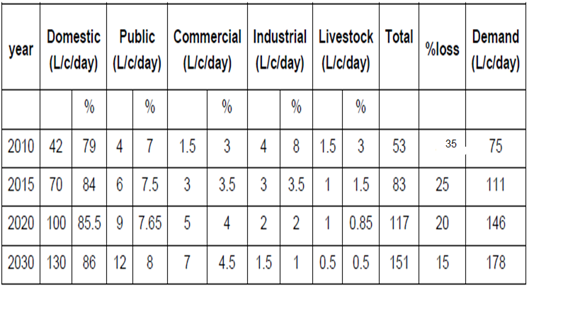
Urban areas

Slide 20
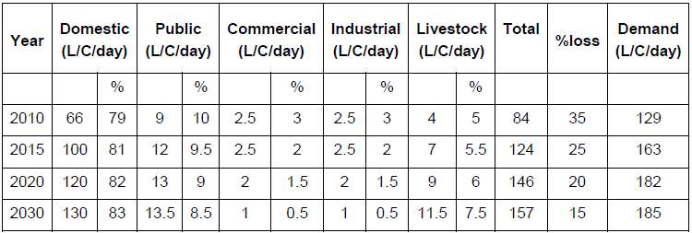
Rural piped areas

Slide 21
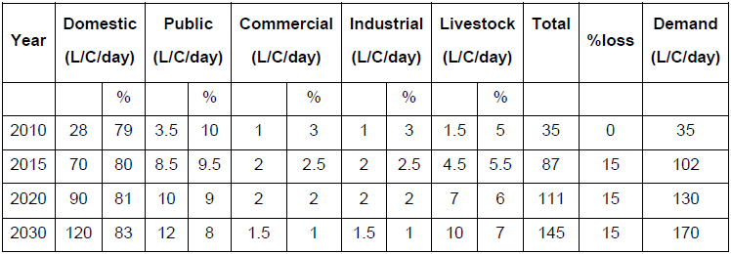
Rural un-piped areas

Slide 22
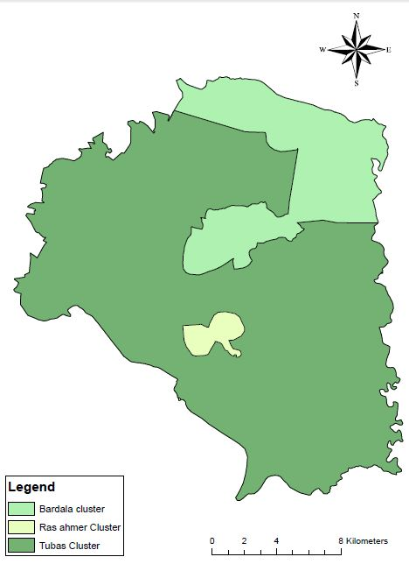
Clustering communities
The objective of clustering is to:
find a group of common conditions and factors affecting such situation and try to propose practical analysis with feasible solutions.

Slide 23
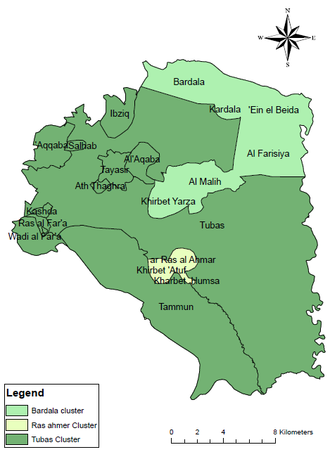
Geographical Location

Slide 24
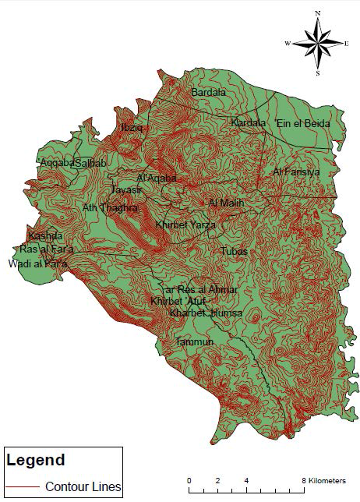
Topography

Slide 25
Source of water
serviceability

Slide 26
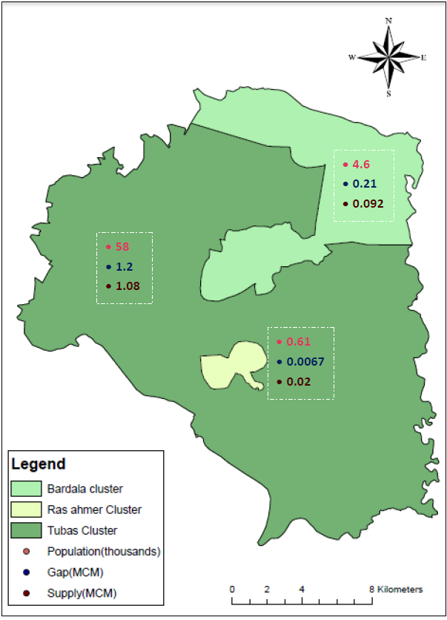
Future Water Gap, Supply and Population of 2015

Slide 27

Future Water Gap, Supply and Population of 2020

Slide 28

Future Water Gap, Supply and Population of 2030

Slide 29
Bridging the Gap
in order to bridge the gap three alternatives is to be considered, those are:
1. Rehabilitation of the existing network.
2. Rainwater harvesting.
3. New ground water wells.

Slide 30
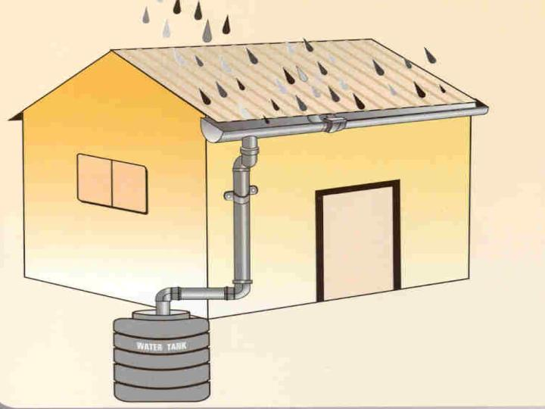
Water Harvesting
Rainwater harvesting is the accumulating and storing of rainwater for reuse before it reaches the aquifer.

Slide 31
Water Harvesting
Harvested rainwater amount=
No. of buildings ×Avg. area of buildings ×Avg. annual rainfall ×Efficiency
Year | Cluster Name | Amount of water (m³)
2015 | Tubas | 43288
 | Ein El-Beda | 2205
 | Kherbet El-Ras El-Ahmar | 256
2020 | Tubas | 93489
 | Ein El-Beda | 4580
 | Kherbet El-Ras El-Ahmar | 558
2030 | Tubas | 173603
 | Ein El-Beda | 8349
 | Kherbet El-Ras El-Ahmar | 1033

Slide 32
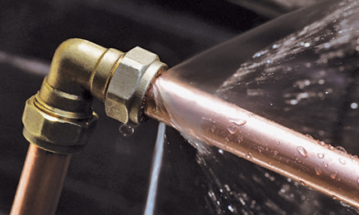
Rehabilitation
process of returning a water network to a state of utility, through repair or alternation, which aims to decrease physical water losses.

Slide 33
Rehabilitation
Water amount from rehabilitation=
Existing supply (2010) ×(loss₂₀₁₀ % - loss _{i} %)
Year | Cluster Name | Amount of water (m³)
2015 | Tubas | 0
 | Ein El-Beda | 0
 | Kherbet El-Ras El-Ahmar | 0
2020 | Tubas | 42674
 | Ein El-Beda | 7977
 | Kherbet El-Ras El-Ahmar | 0
2030 | Tubas | 85348
 | Ein El-Beda | 15954
 | Kherbet El-Ras El-Ahmar | 0

Slide 34
Remaining Gap
Year | Cluster Name | Remaining Gap(MCM)
2015 | Tubas | 1.04
 | Ein El-Beda | 0.09
 | Kherbet El-Ras El-Ahmar | 0.02
2020 | Tubas | 2.1
 | Ein El-Beda | 0.2
 | Kherbet El-Ras El-Ahmar | 0.03
2030 | Tubas | 3.8
 | Ein El-Beda | 0.24
 | Kherbet El-Ras El-Ahmar | 0.05

Slide 35
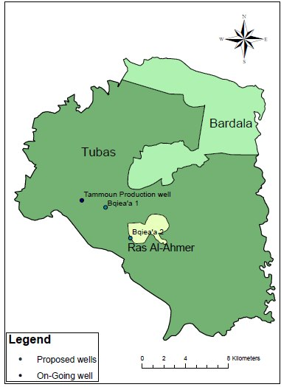
Groundwater Wells
Tubas Governorate has one “on going” well which is Tammoun Well and two proposed wells “Bqiea’a1,Bqiea’a 2

Slide 36
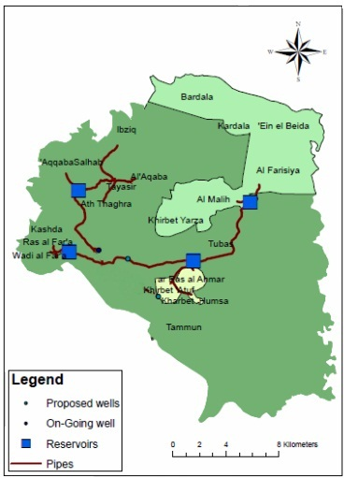
Water Distribution Plan
First time stage, 2015

Slide 37
Water Distribution Plan
Second time stage, 2020

Slide 38
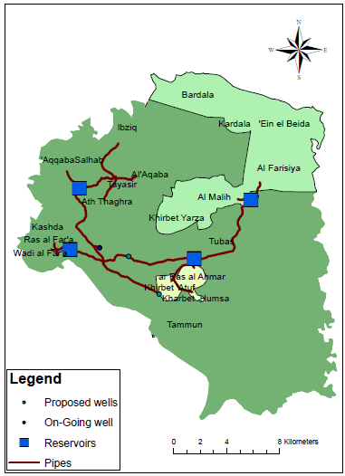
Water Distribution Plan
Third time stage, 2030

Slide 39
Project Components Design
a system consists of wells, pumps, pipes and reservoirs is needed to convey water from groundwater to communities .

Slide 40

wells

Slide 41
Pumps
There are pumping stations for the bulk transfer of water from sources to storage reservoirs which will normally operate under fairly constant hydraulic conditions.

Slide 42
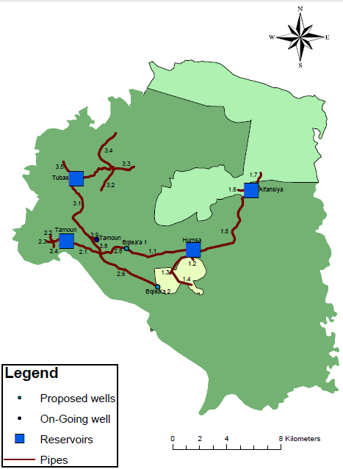
Pipes, Wells and Reservoirs Names

Slide 43
Pumps
Pumps were selected using the WILO Software
By enter the flow and total head values
Pump Location | Q (m³/hr) | Type | Efficiency | Note
Tammoun Well | 200 | TWI 6.60-06-B | 74 | 4 Pumps in parallel
Bqiea’a 1 Well | 150 | TWI 6.50-19 BSD-R | 76 | 3 Pumps in parallel
Bqiea’a 2 Well | 110 | TWI 660-16-BSD-R | 73 | 2 Pumps in parallel
Pipe 2.6 end | 46 | MVI 5209/PN 25 3~ | 70 | 1 Pump
Pipe 2.6 end | 64 | MVI 7004/1 PN 16 3~ | 74 | 1 Pump

Slide 44
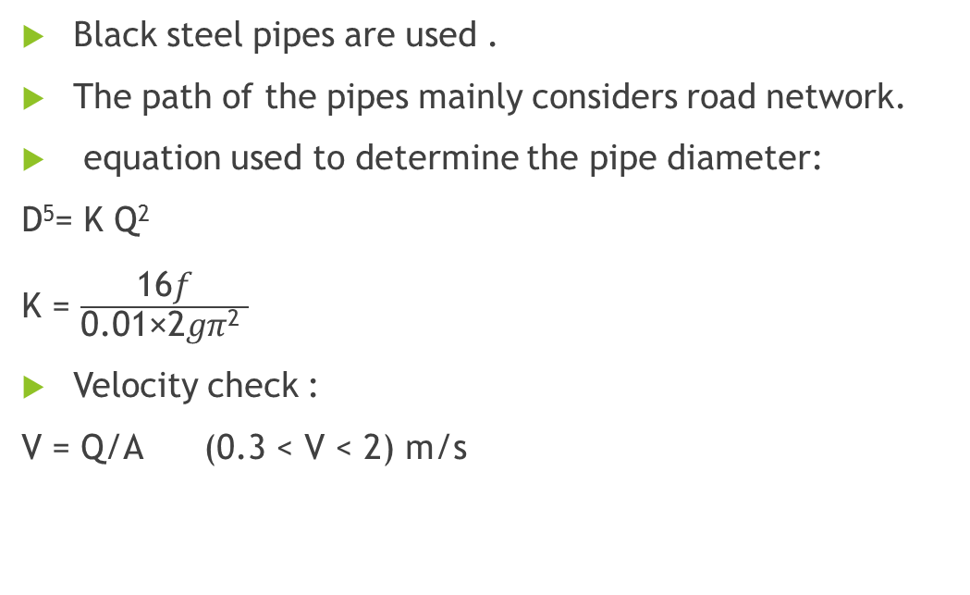
Pipes
Black steel pipes are used .
The path of the pipes mainly considers road network.
equation used to determine the pipe diameter:
D⁵= K Q²
K = $\frac{\text{16}\text{f}}{\text{0.01}\text{×}\text{2}\text{g}\text{π}\text{2} }$
Velocity check :
V = Q/A (0.3 < V < 2) m/s

Slide 45
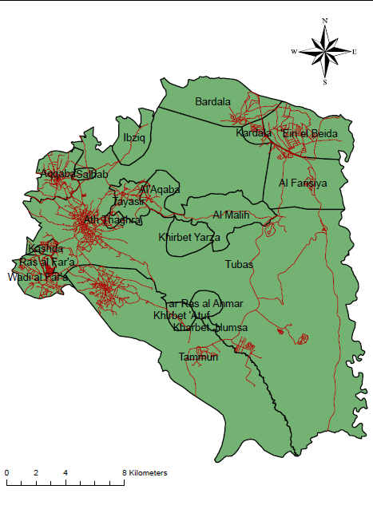
Road Network of Tubas Governorate

Slide 46
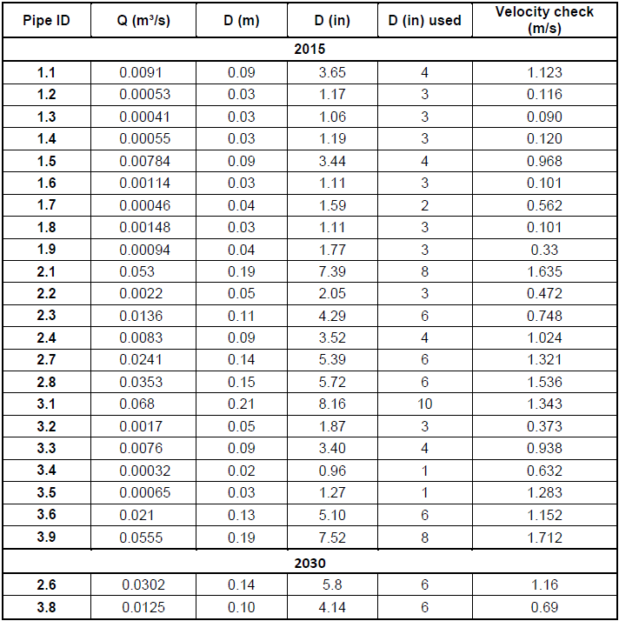

Slide 47
Reservoirs
Reservoir’s capacity is designed to cover a one day supply for the served communities.
The reservoir’s locations are selected considering relative high points.
Reservoir Name | Ground Elevation(m) | Capacity (m³)
Tamoun | 300 | 4450
Tubas | 475 | 5580
Humsa | 300 | 780
Alfarisiya | 0 | 650

Slide 48
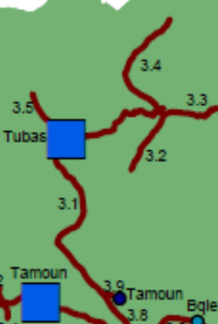
North West Tubas Localities (2014)
Tammoun well
6.4 km,(8,10)inches pipelines
173 HP pump and 5850 m3 reservoir
9.1 km,(3,6)inches pipelines to localities
Rehabilitation of existing network
2.1 million $
Notes:
Piped water supplies to 14494 people until 2020 in Thaghra, Tayaseer, Al-Aqaba, Aqqaba, and Ebzeeq and to 28843 people in Tubas until 2030.

Slide 49
Kherbet Ar-Ras Al-Ahmar Cluster (2018)
1 million $
well (Bqiea' 1) 1.4 MCM& 406m depth.
5.2 Km, 4 inch pipelines.
10 HP pump
780 m³,Reservoir
5 km, 3inch pipelines into localities
Notes:
Piped water supplies to 861 people in kherbet Al ras alahmar, kherbet Atoof and kherbet Homseh.

Slide 50
Bardala Cluster(2018)
0.52 million $
well (Baqe'a 1) 1.4 MCM&406 m depth.
7.65 Km, 4 inch pipelines.
650 m³ Reservoir.
2.83 Km, (2-3 inch) pipelines into localities.
Rehabilitation of existing network.

Slide 51
West localities (2018)
1 million $
1 well (Baqe'a 1) 1.4 MCM&406 m depth
4.9 Km, 8 inch pipelines
32 HP Pump
4550 m³ Reservoir.
2.2 Km,(3&4&6 inch) pipelines into localities
Rehabilitation of existing network.
Notes:
Piped water supplies to 20838 people in Tammoun, Wadi Al-Far'aa and Ras Al-Far'aa until 2020, and to 10198 people in Al-Far'aa Camp until 2030.

Slide 52
Bqie'a 2 well project (2028)
1 million $
1 well (Baqe'a 2) 1.4 MCM&406 m depth.
6.62 Km, 6 inch pipelines.
2 Pumps in parallel (55 m3/hr)
1Pump MVI 5209/PN 25 3~ (46 m3/hr)
1 Pump MVI 7004/1 PN 16 3~ (66.3 m3/hr)
Notes:
Piped water supplies to 7749 people in Thaghra, Tayaseer, Al-Aqaba, Aqqaba, Ebzeeq
Tammoun, Wadi Al-Far'aa and Ras Al-Far'aa.

Slide 53
Recommendation
The remaining water in the Bqiea’a 2 well may be used to fill any gap could occur in the future or used to fill any unexpected future needs.
If there is any shortage of water, it is possible to transform agricultural wells to domestic consumption, and to compensate farmers by treated wastewater from Nablus Station provided that cost less than the current cost.

Slide 54
Recommendation
The governorate should pay more attention for the un-served localities and offer them a network as possible as soon.
Continuous rehabilitation should be made to the network.
Make a workshop to educate people about harvesting system.

Slide 55
Thank You
For your attention

