Slide 1
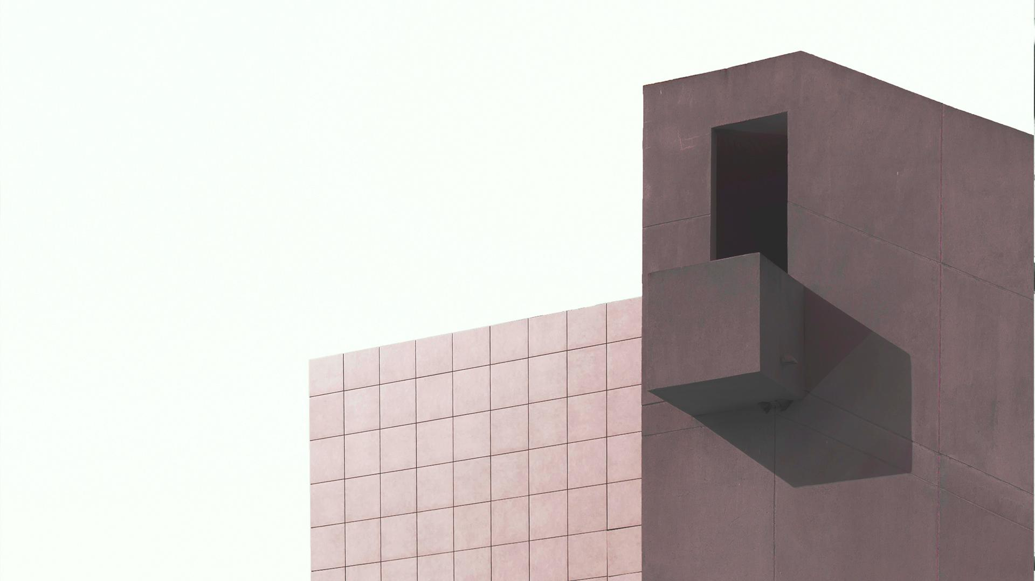

Analysis and redesign Mofeed Al-Shami building
Case Study in Nablus, Palestine
An- Najah National University
Civil Engineering Department
Graduation Project І
Supervised by:
Dr. Mohammad Ghazal

Slide 2
01
About the Project
02
Project Goals
TABLE OF CONTENTS
03
Assumptions
04
Calculations
05
Results
06
Conclusoins
`

Slide 3
ABOUT THE PROJECT
ABOUT THE PROJECT
In Graduation 1 project, we will do a soil analysis for the building of Mofeed Al-Shami, located in Tunis Street / Nablus, where the building was built 6 years ago and was subjected to many collapses, whether in walls, columns, or others, as these collapses reached the eighth floor. The necessary examinations to verify the cause of the collapse and compare the results with other results, whether engineering or laboratory drawings.

Slide 4
Project Goals
PROJECT GOALS
Find out the walls and floors causes about cracked
Getting to know whether the foundation of the building is designed on are appropriate or not.
Determine the appropriate foundations according to specific standards and calculations
2
3
1

Slide 5
ASSUMPTIONS
Assumptions
1
Number of floor = 12
2
Bearing Capacity =2.5 kg / cm2
3
Live Load = 3 km / m2
SD=2km/m2

Slide 6
Claculations
CALCULATIONS
Step 1
Determine the values of live load, SD and the Dead Load from the engineering plans.
Step 2
Detrmine the dimenssions of panels and columns
Step 3
Step 4
Fint the Ultimate load .
Find the area of footings accoding to the value of bearing capacity .
Step 5
Find the dimenssion of the footing

Slide 7
Calculations
According to the tables that we attached to our project , the value of Live Load = 3 km / m2 ,SD=2km/m2 and the Dead Load =
ultimate loads according code = 0٫78 *1٫2*10+2*1٫2+3 *1٫6 = 16٫56 kn/m^2

Slide 8
Calculations
Footing Design
Footing 1
Dimensions of panel
B0 = 6m B1 = 7m
total ultimate load (Wu) = 16.56 KN/m^2
Dimensions of all columns = 25.60 cm
Number of floors = 12
Ultimate loads in panel : Wu = # of floors * B0*B1*Wu = 8.346*10^3 KN
Weight of columns : Wc = 1.2*3*.25*.6*30*# of floors = 194.4 KN
Total load on footing : Wt = Wu + Wc =8.541*10^3
Bearing Capacity : Bc = 250 KN/ m^2
Area = Wt / Bc = 34.163 m^2 , if x=5m then we can find y ,
So y = Area / 5 =6.833 m

Slide 9
Calculations
Footing 2 :
Dimensions of panel
B0 = 9m B1 = 3.5 m
total ultimate load (Wu) = 16.56 KN/m^2
Dimensions of all columns = 25.60 cm
Number of floors = 12
Ultimate loads in panel : Wu = # of floors * B0*B1*Wu = 6.26*10^3 KN
Weight of columns : Wc = 1.2*3*.25*.6*30*# of floors = 194.4 KN
Total load on footing : Wt = Wu + Wc =6.454 *10^3
Bearing Capacity : Bc = 250 KN/ m^2
Area = Wt / Bc = 25.816 m^2 , if x=5m then we can find y ,
So y = Area / 5 =5.163 m

Slide 10
Calculations
Footing 3 :
Dimensions of panel
B0 = 7.33m B1 = 3.6m
total ultimate load (Wu) = 16.56 KN/m^2
Dimensions of all columns = 25.60 cm
Number of floors = 6
Ultimate loads in panel : Wu = # of floors * B0*B1*Wu = 2.622*10^3 KN
Weight of columns : Wc = 1.2*3*.25*.6*30*# of floors = 97.2 KN
Total load on footing : Wt = Wu + Wc =2.719*10^3
Bearing Capacity : Bc = 250 KN/ m^2
Area = Wt / Bc = 10.876 m^2 , if x=2m then we can find y ,
So y = Area / 2 =5.438 m .

Slide 11
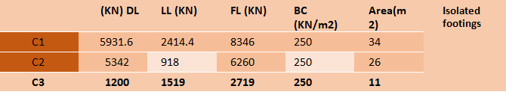
RESULTS
Results
Based on the previous manual calculations, it became clear that there is a defect in all bases located in the building , as there is a shortage in the base area required for the design, and as a result the terminal bases have become not resistant to the weight of the self-origin and the momentum of the outward duplication and this resulted in cracks in the edges of the building and the edges. The roof is from the inside, and the origin is not seismically designed, which poses a threat to the families residing in it .
And what was mentioned previously in terms of calculations and results can be summarized through the following table :

Slide 12
CONCLUSION
Conclusion
A comparison was made between the calculation method that was adopted by the engineering office, where we quoted part of the calculations and the second part was completed using the code, where it was noticed that the engineering office did not take into account the value of the SD and that it did not add a certain number of floors as a kind of safety In the calculation method, he adopted the bearing strength of the soil = 4 kg / cm2, as the bearing strength of the soil in reality is approximately equal to 2.5 kg / cm2 in addition to that he may not take into account the weight of the self-columns and may not have been calculated for the largest critical panel in the building, for those reasons that were made It was mentioned earlier that cracks have appeared in the building.
Therefore, in the next semester , the design will be re-designed and the use of the raft foundation for the building with an examination of the proportionality of the design of the foundations with the values of the loads on the building.

Slide 13
Thank You For Listening

