Slide 1

Development of Smart University Campus Based on IoT using An-Najah National University as a Case Study
Group Member
Lana Khairallah
Mohammad Shtewi
Rawan Jarrad
Duha Hara
Shahd Khaled
Supervisor name
Dr. Muawia Ramadan

Slide 2
Table of Contents
01
Introduction
02
03
Objective
Problem Statement
04
Smart Campus
05
06
RFID System
Program Language
07
08
09
Artificial Intelligence
Transformation
Digital Transformation
10
11
12
Analysis &
Result
Case Study Attendance
Research Limits
13
14
Conclusion
Recommendation

Slide 3
Introduction
We will talk about the traditional university systems and the problems facing the university from the administrative and academic sides, and how to transform these systems into an intelligent system using several modern methods and Internet of Things technology.
Back
Activities
Next

Slide 4
Problem Statment
Development that the world.
Mention the problems (activities that can develop them) the following: first, time, crisis management, archiving, information preservation, logistical operations that take place inside the University.
as they lack the presence of central heating and air conditioners, as well as the lack of a smartboard.
Problem of attendance and absence and the cumbersome and time-consuming paper processes
1000
50٪
7 min
500
Back
Next

Slide 5
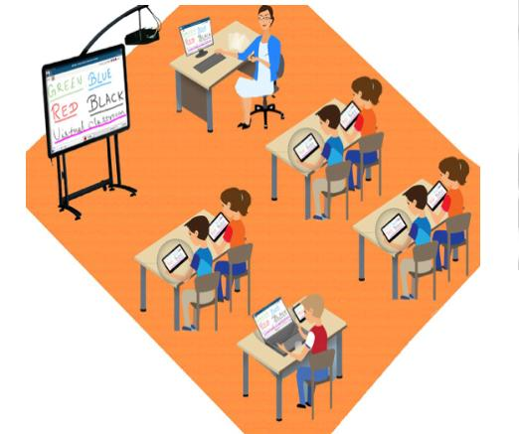

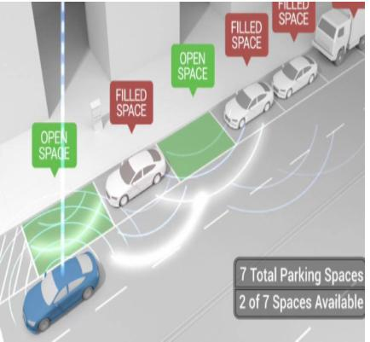
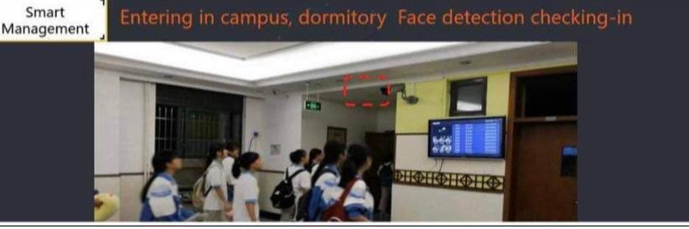
Objective
Improving the effective use of campus spaces.
Improving building services.
Support and improve campus management decisions.
Back
Next

Slide 6
Smart Campus
It can be defined as an extensive application of new technologies such as the Internet of Things, big data, and artificial intelligence; constructing an intelligent cognition environment, constructing a new learning classroom space, intelligently identifying learning, action scenes, and individual characteristics of teachers and student groups; promoting the process of improvement and intelligently rebuilding the system of teaching, learning, management, life, and culture Improving the quality of education staff training as well as the degree of decision-making in educational administration
Back
Next

Slide 7

Program Language
are...
Back
Next

Slide 8
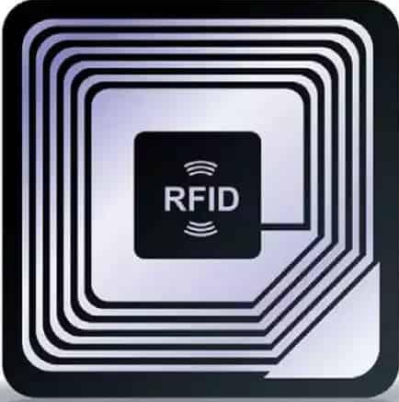
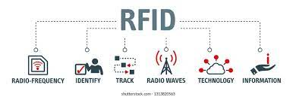
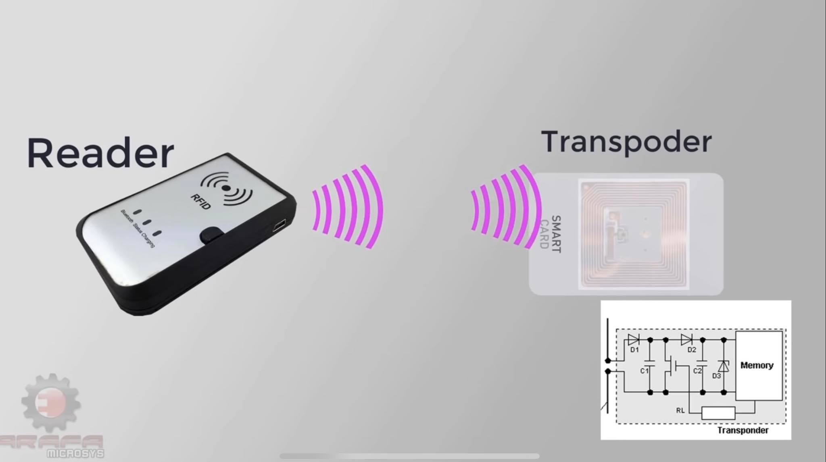
RFID System
Radio frequency identification system (RFID) is an automatic technology and aids machines or computers to identify objects, record metadata or control individual target through radio waves.
Back
Next

Slide 9
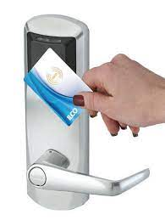
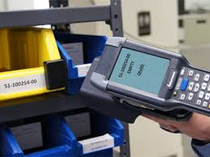
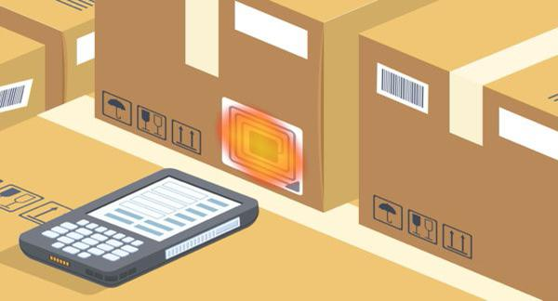
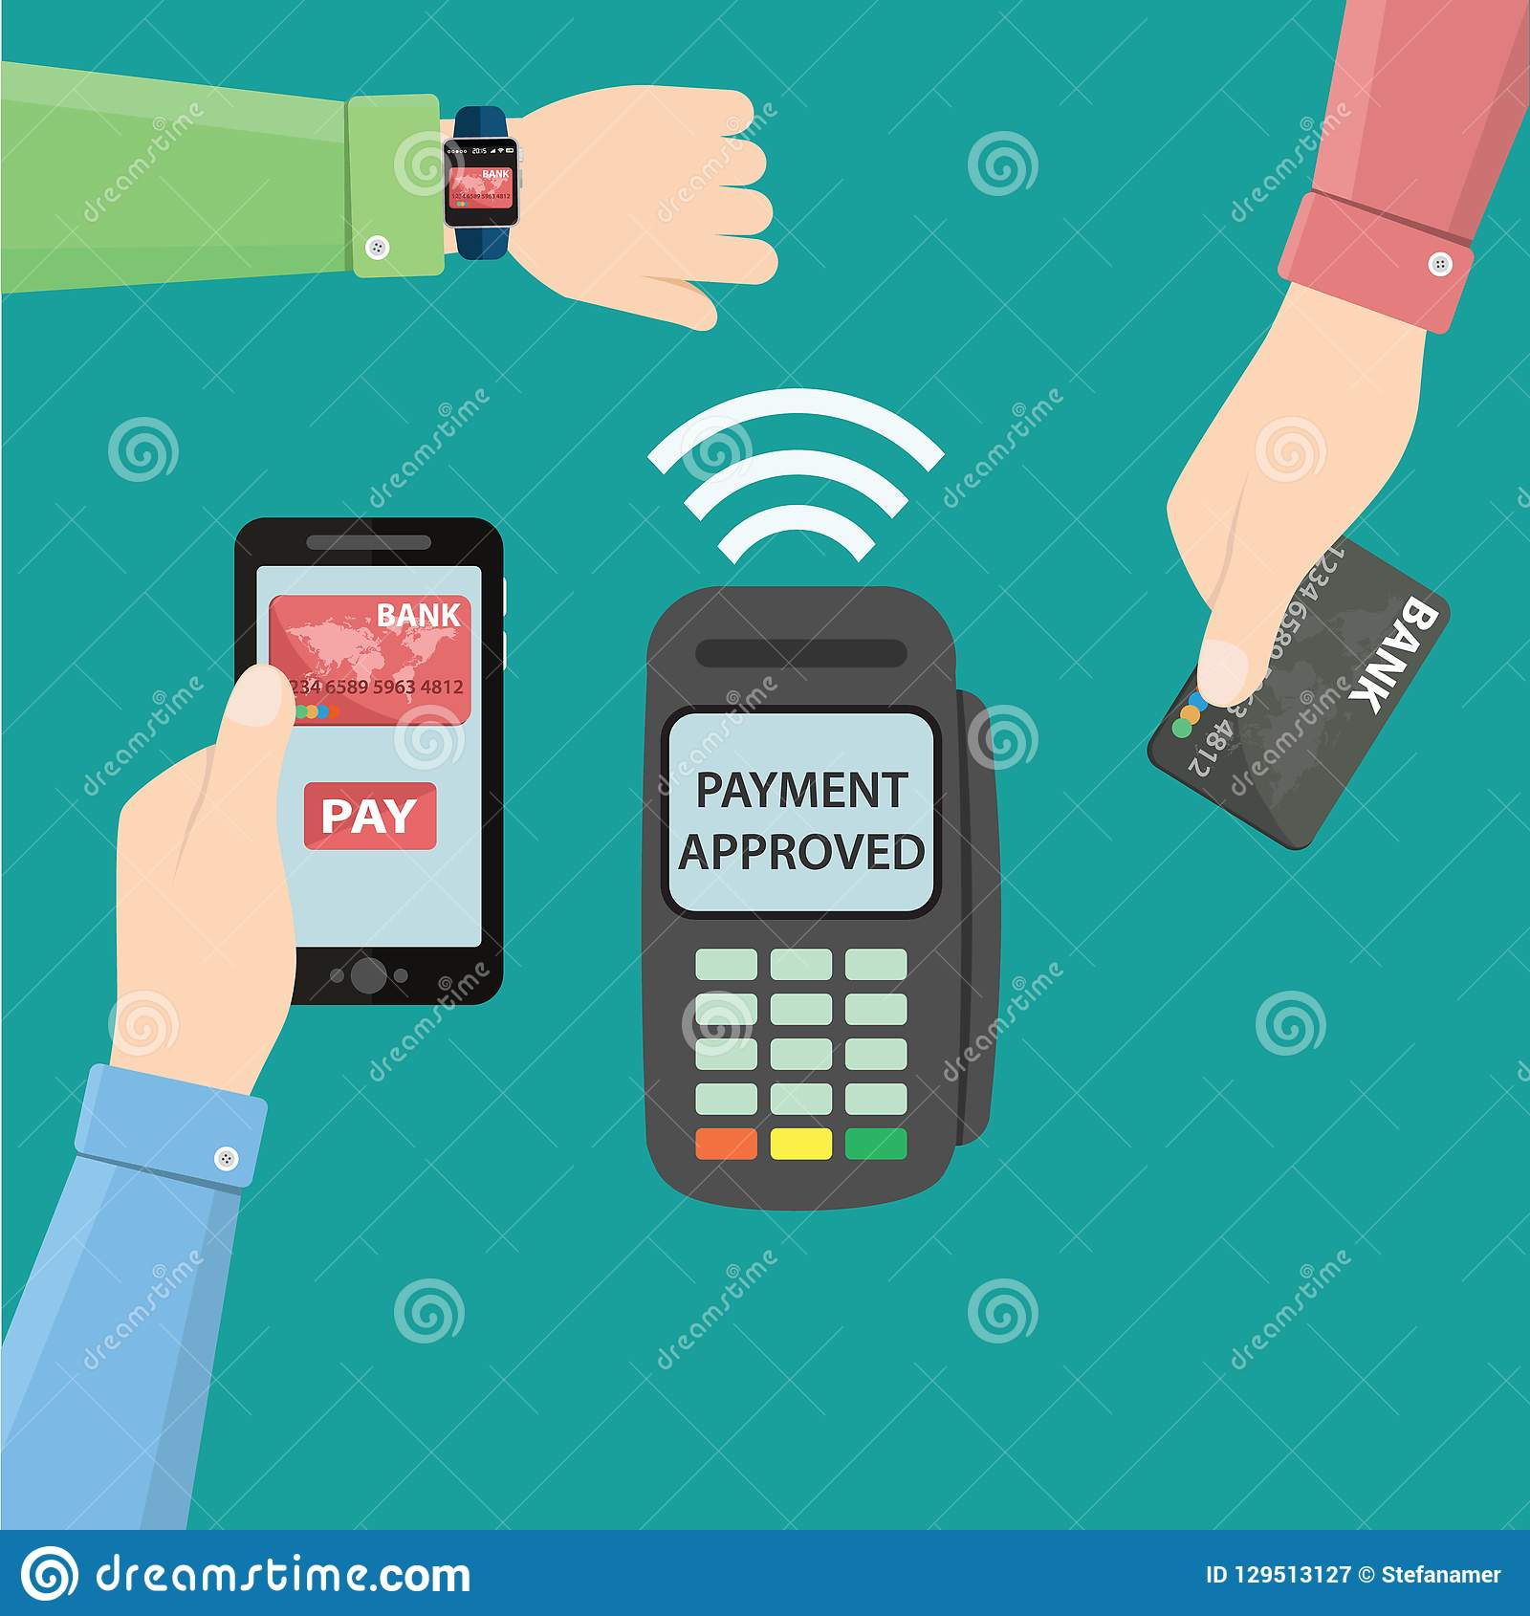
Application of RFID
RFID systems are used in various applications.
Toll Road Payments
Passports
Identification
Libraries
Shipping
Back
Next

Slide 10
Materials like metal & liquid can impact signals. Sometimes not as accurate or reliable as barcode scanners. Cost – RFID readers can be 10x more expensive than barcode readers. Implementation can be difficult & time-consuming.
Disadvantages of RFID
Back
Next

Slide 11
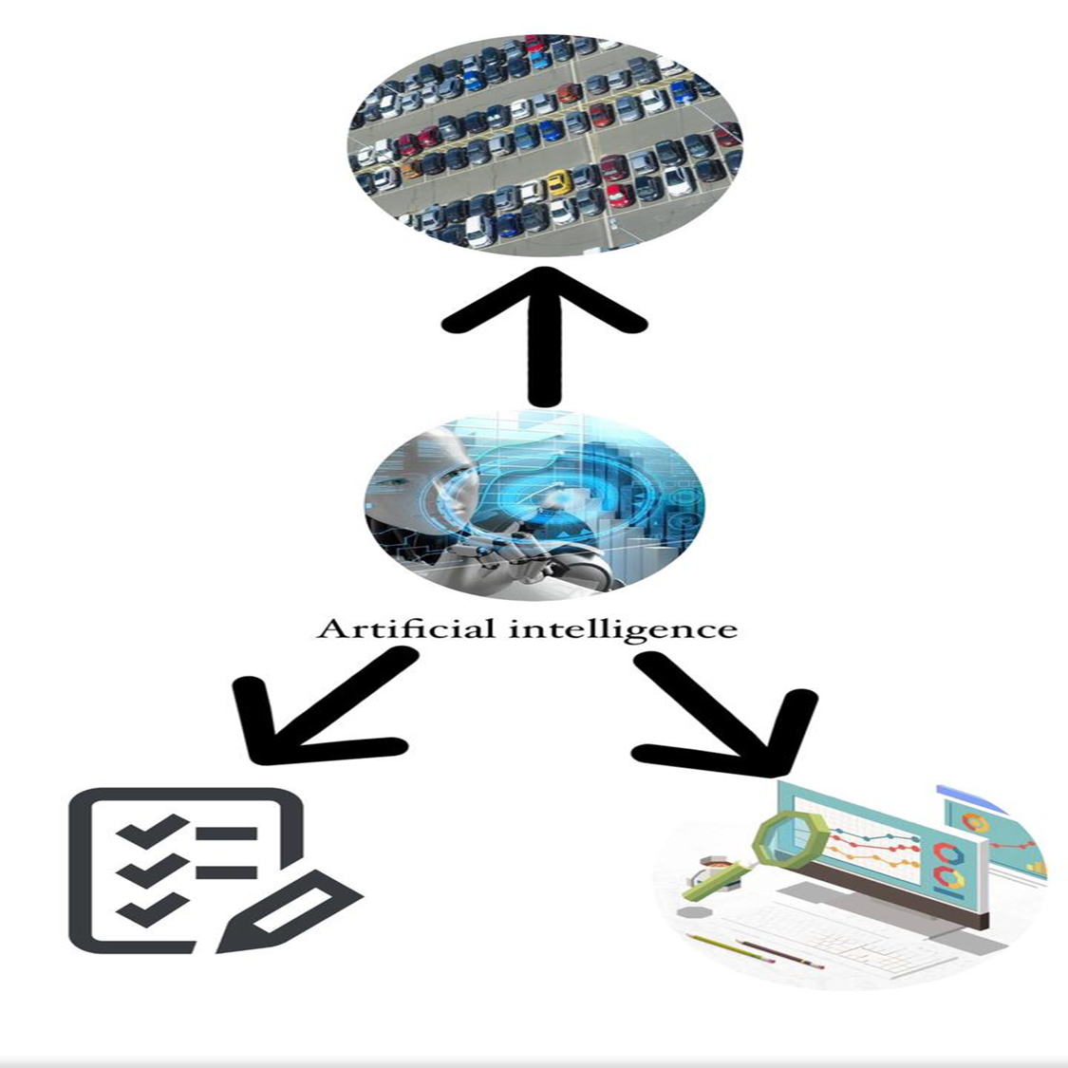
Artificial Intelligence
Back
Next

Slide 12
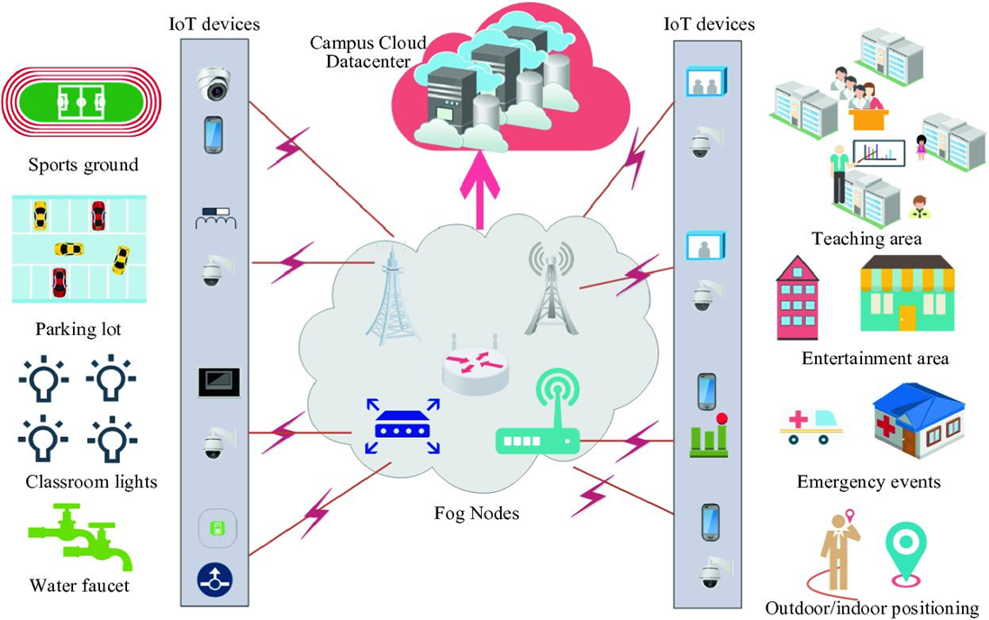
Transformation
In transforming a university campus we focus on developing infrastructure to be capable of smart systems installation. The smart transformation includes RFID connected to university equipment, smartphone applications, and smart software to collect data and monitor university campus facilities.
Back
Next

Slide 13
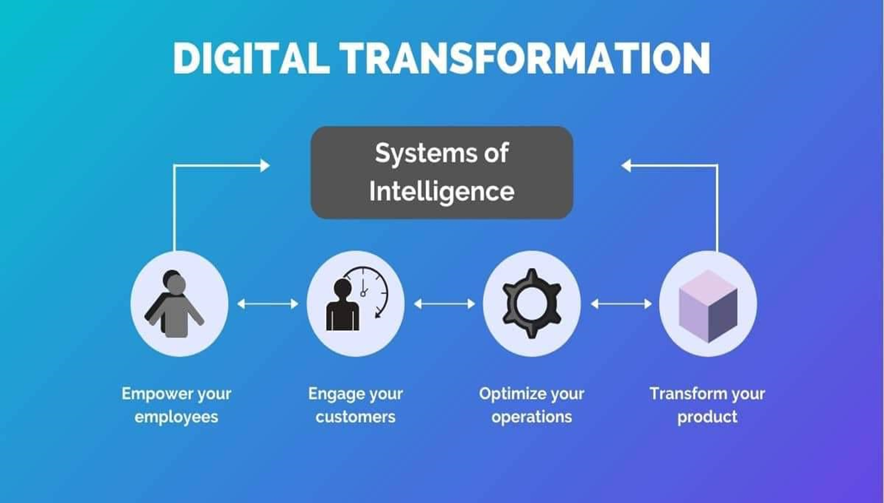
Back
Next

Slide 14
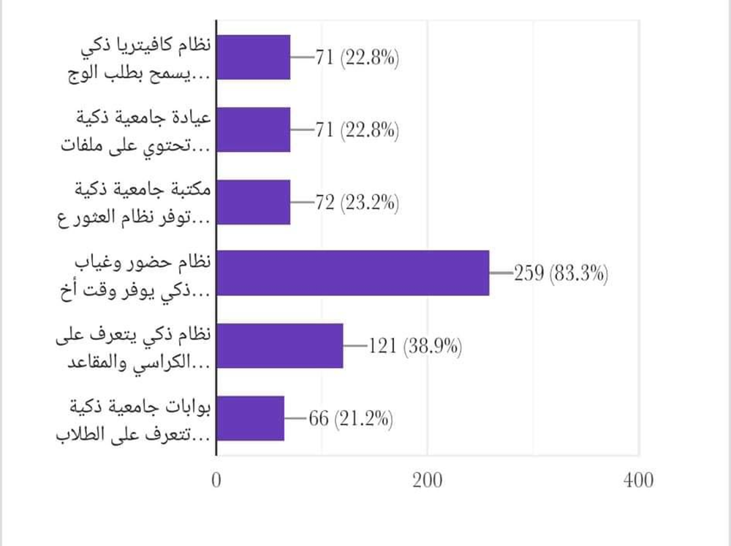
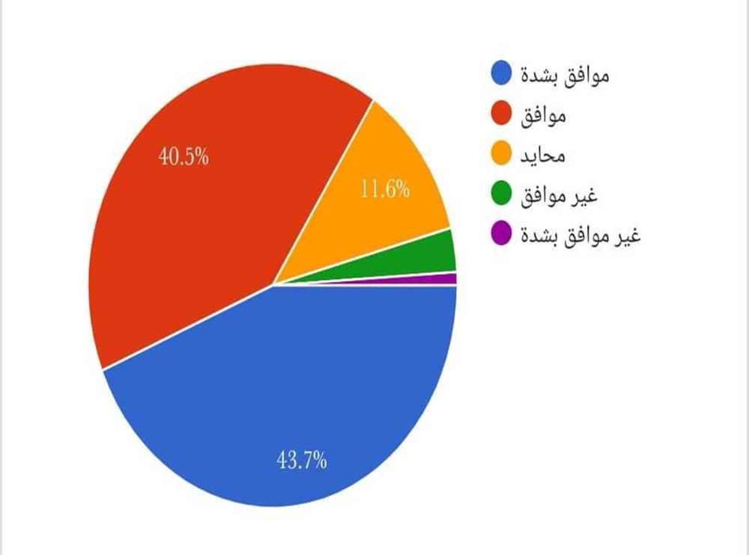
Analysis
Based on the surveys that we conducted during the preparation of the project, we reached these results:
Back
Next

Slide 15
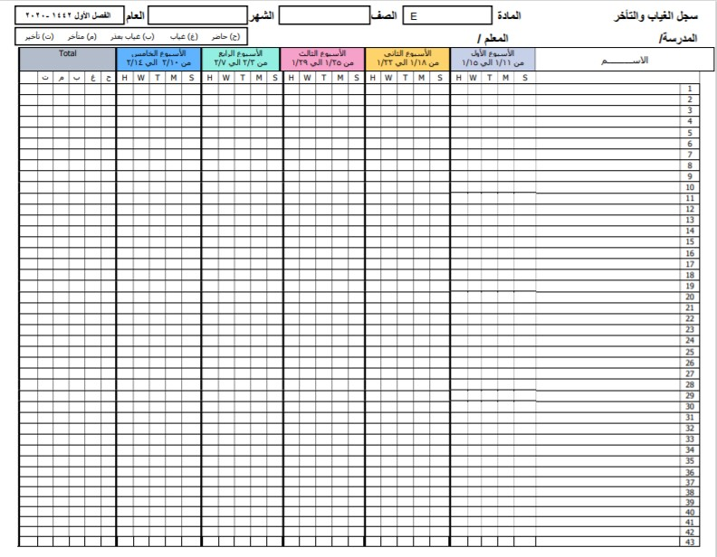
Case study: Attendance Table
83%
Traditional process
The process of attendance and absence is done on paper, which takes up time from the lecture, with an average of 7 minutes
Smart process
Converting this process into an automated process, where the lost time may reach zero minutes

Slide 16
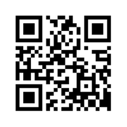
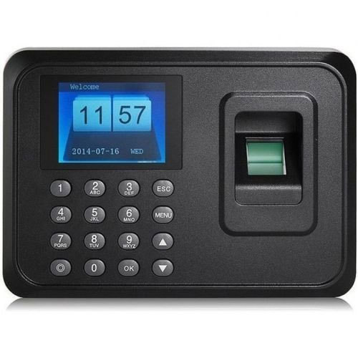
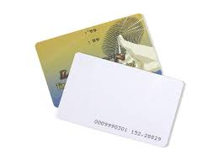
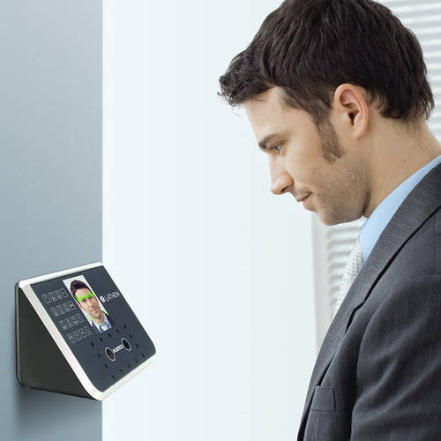
Solutions suggestions
QR Code
The fingerprint system
Smart-University ID Card
Face Recognition model

Slide 17
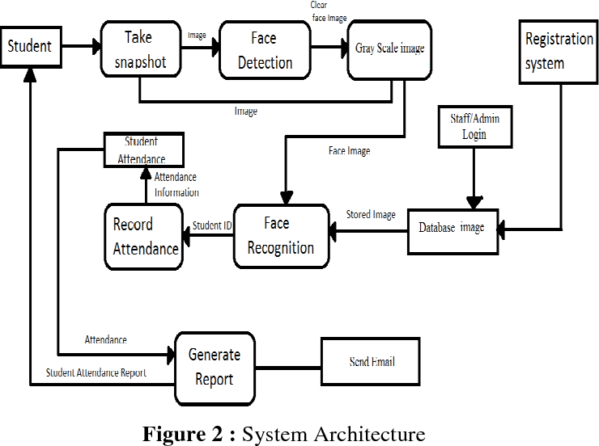
Face Recognition model
Principle of work
Back
Next

Slide 18
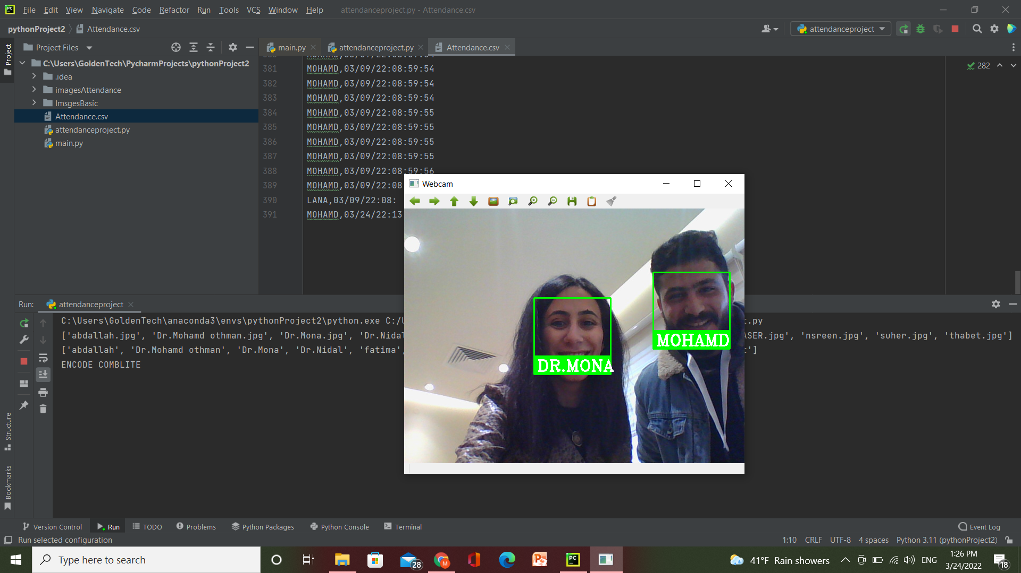
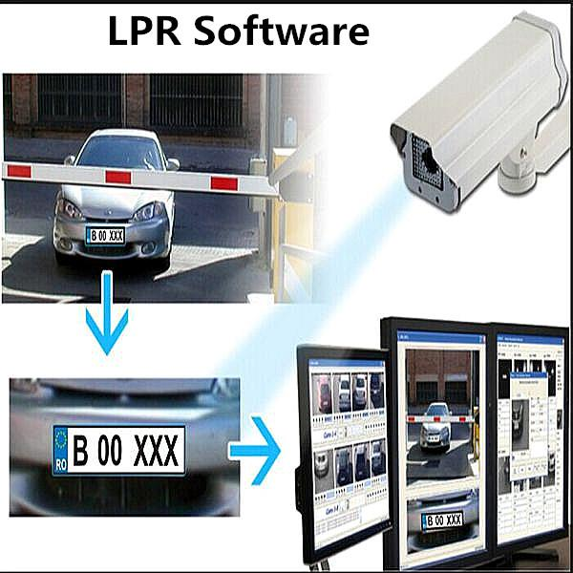
Application of face recognition

Slide 19
Research Limit
Difficulty in implementing some regulations as a result of certain policies.
Financial obstacles to implementing some systems such as RFID
The credibility and reliability of some systems as a result of misuse by students.
High information system

Slide 20
Recommendation
At the end of this project, we recommend the importance of applying smart systems and technologies that contribute to improving and developing all processes and making them less complex and more efficient.

Slide 21
Conclusion
To address some of the challenges that students and academics face at An-Najah National University, we have used the Internet of Things innovation and invention to address some of those challenges. Creating a smart campus that allows us to keep up with development and makes it simple for all types of users to transfer their knowledge to the rest of the world.
A smart campus can help improve three important factors: experience, efficiency, and education. It can help reshape how students study, how they learn, what they learn, and how they interact with an institution.
Back
Next

Slide 22
Thx!!

