Slide 1
Smart Parking System
(SPS)
Prepared by:
Ma’ali Hasan.
Noora Dmedi.

Slide 2
Outline:-
Introduction
What is SPS?
Main Features?
Used Tools.
Problems.
Future Work.
Demo.

Slide 3
Introduction:-
The continuous increase in the production of cars.
Rapid growing of parking places.
Need a suitable, fast way to arrange the process of parking inside these places.
Efficient secure way for payment.

Slide 4
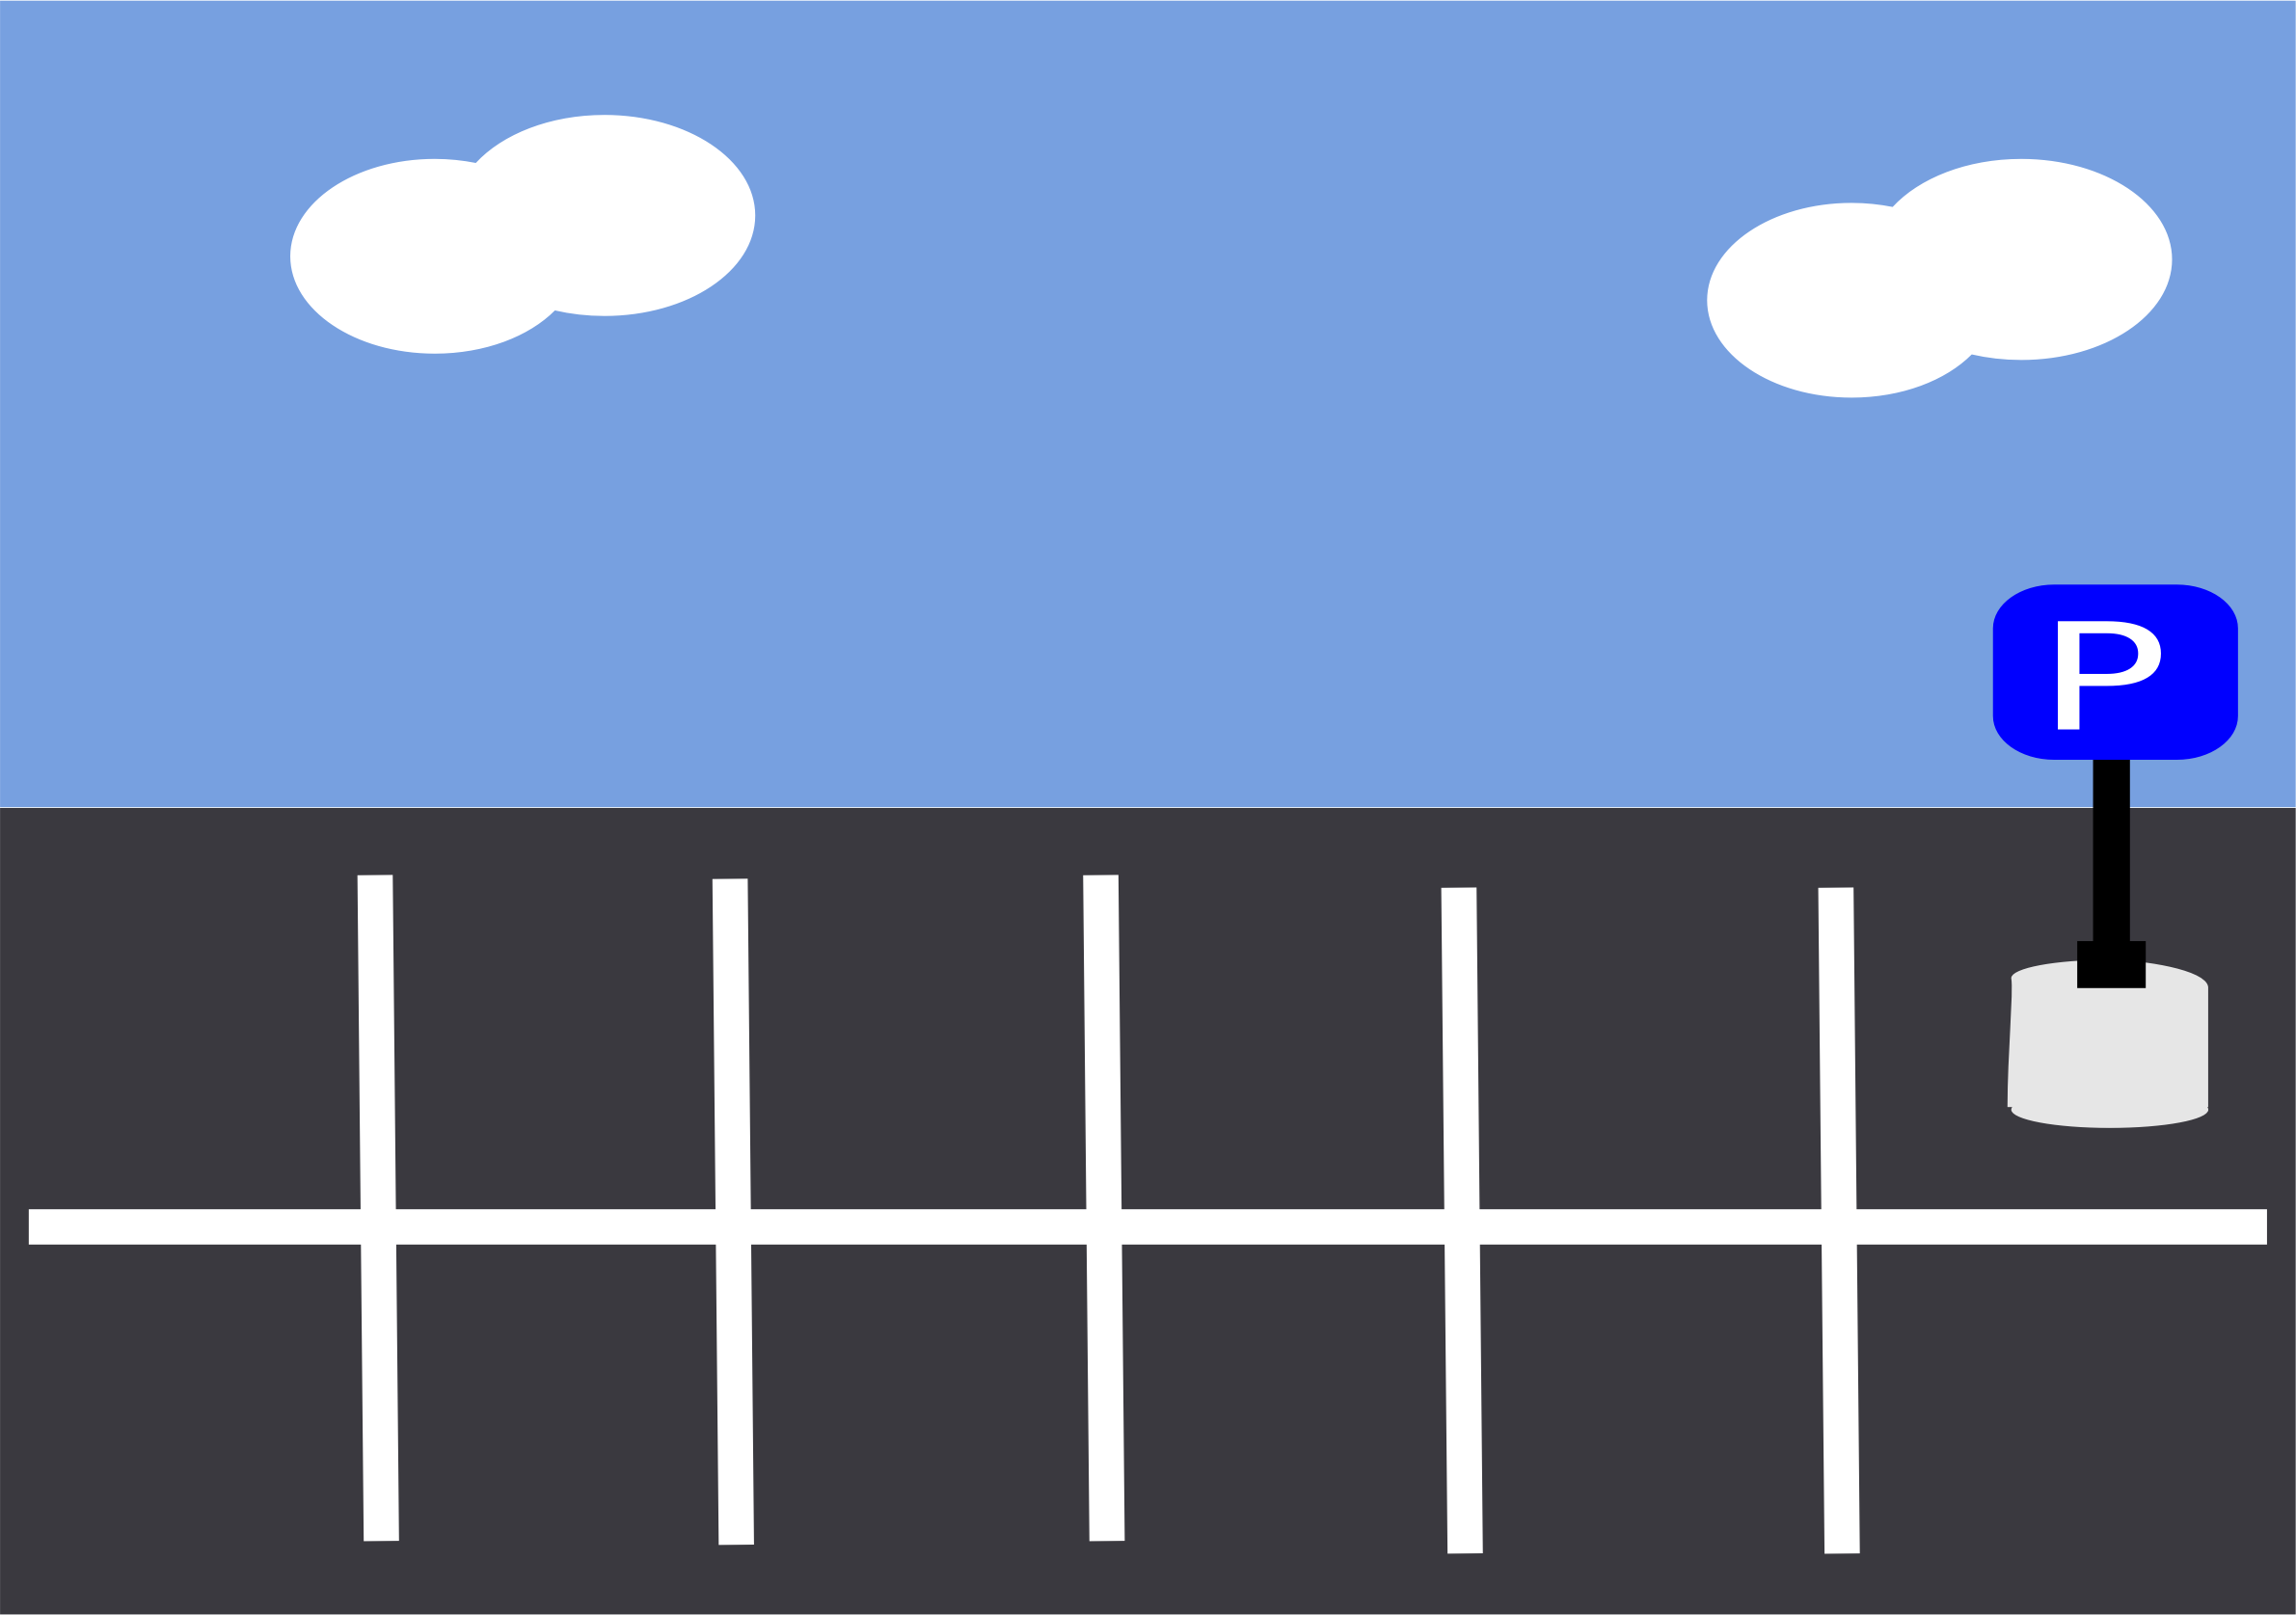
What is SPS ?
Smart parking system is an integrated system to inform the driver about the available parking Lot.
Organize cars in closed parks.
Gives an accurate way of payment according to the time that the car has reserve the slot.

Slide 5
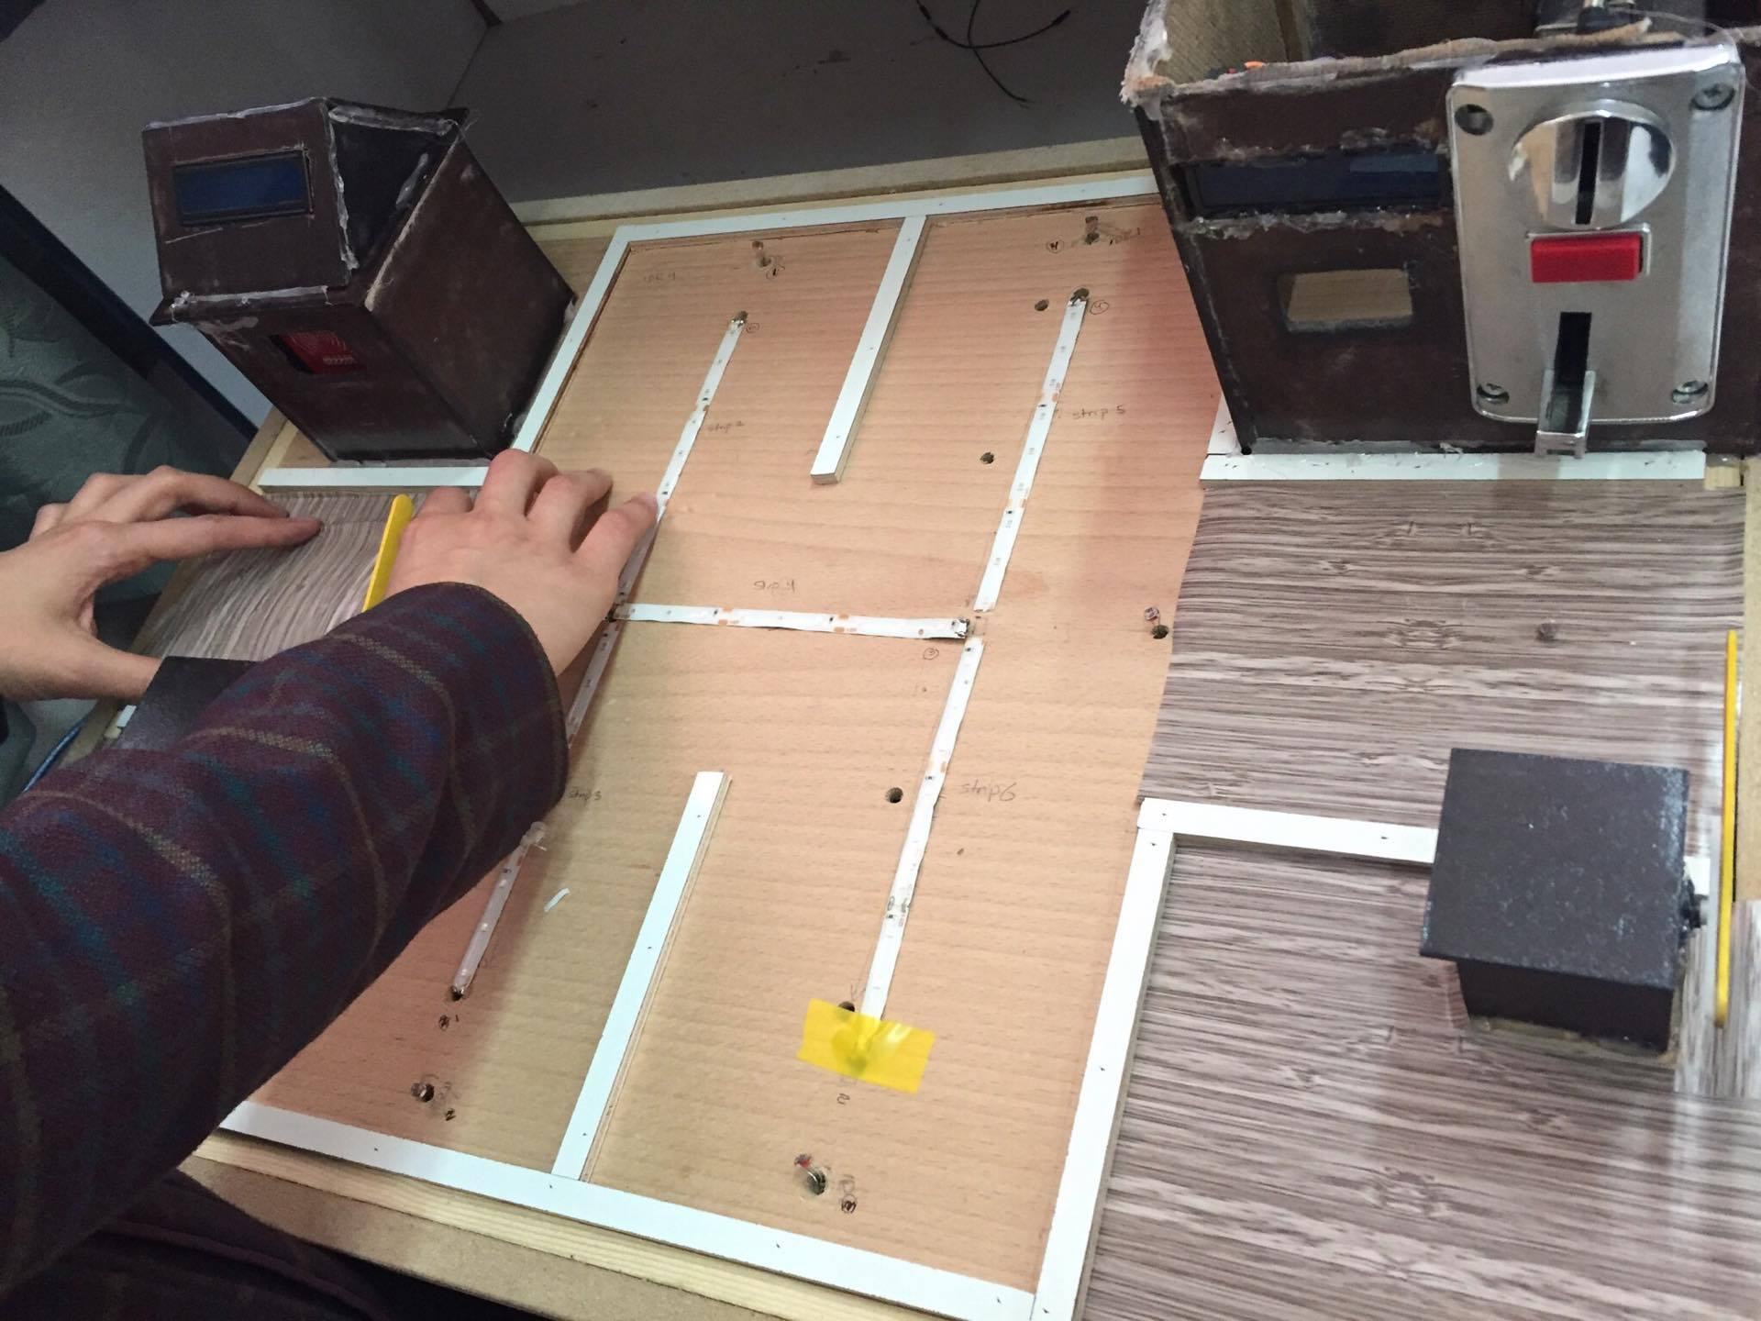
What is SPS?

Slide 6
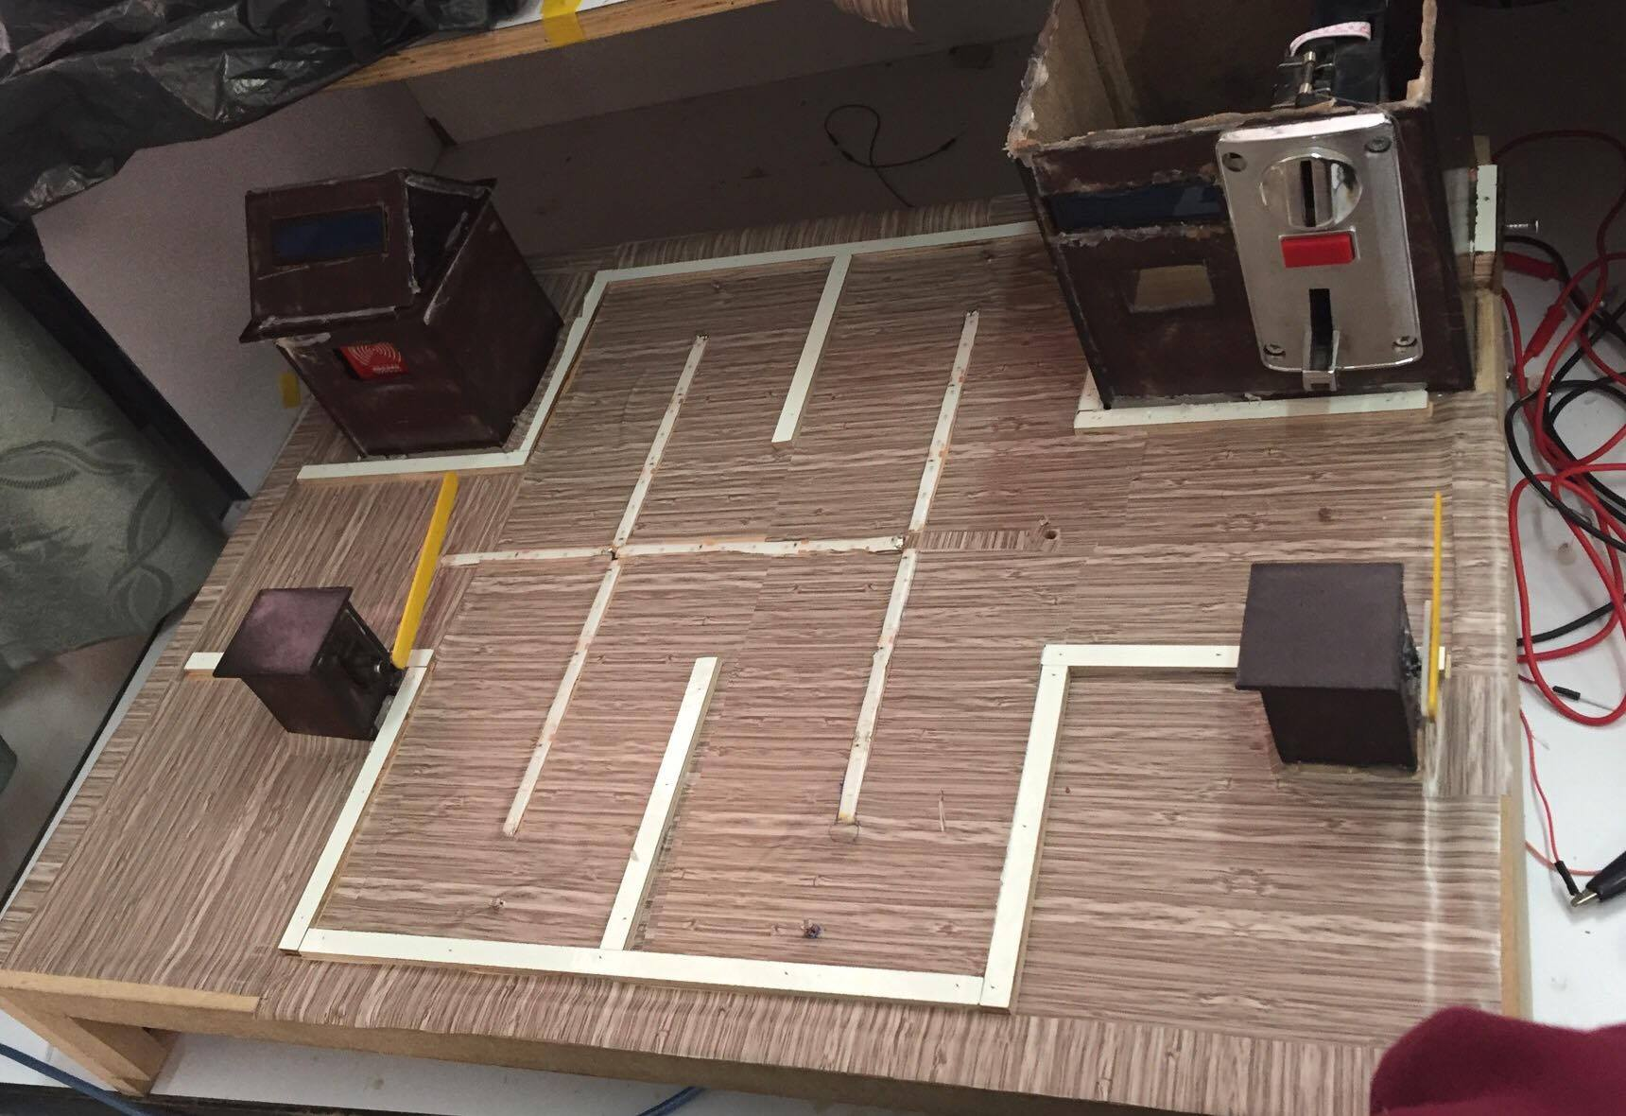
What is SPS?

Slide 7
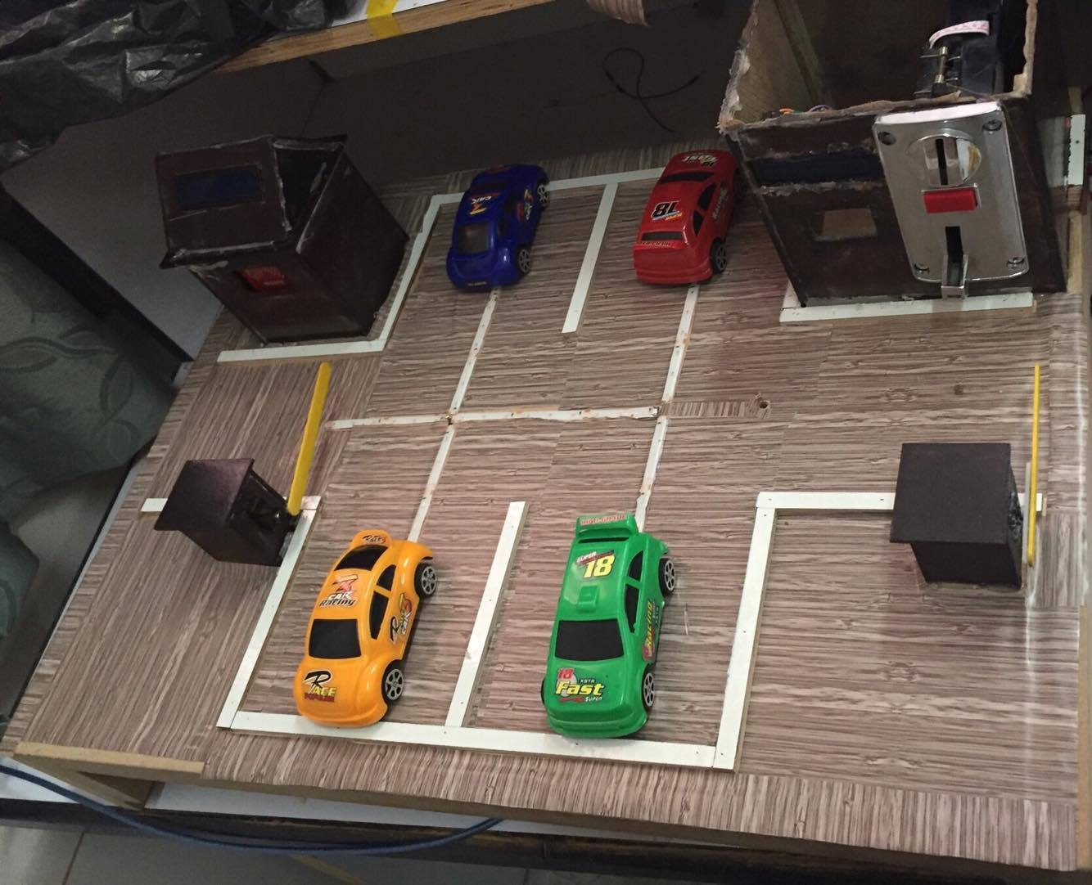
What is SPS?

Slide 8
Main Features
Design a smart ,user friendly system for closed parking .
Save time and effort for drivers to park their cars in an easy way .
Give the driver the shortest path for the empty slot.

Slide 9
Used Tools:-
ARUDINO MEGA 2650.
Force Sensor.
LCDs.
Coin Acceptor.
Servo motors.
DS1307 clock.
RFID Reader and Tags.
LDRs.
LED strip.
Darlingtone Array.
Resistors.

Slide 10
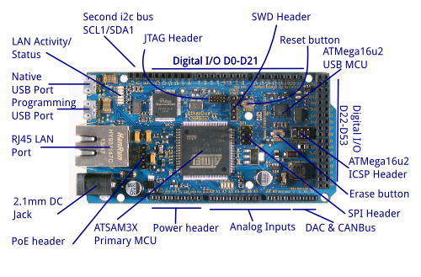
Arduino Mega(2560) :-
54 digital input/output pins.
16 analog inputs.
4 UARTs (hardware serial ports).
The Arduino IDE(1.6.7 v).

Slide 11
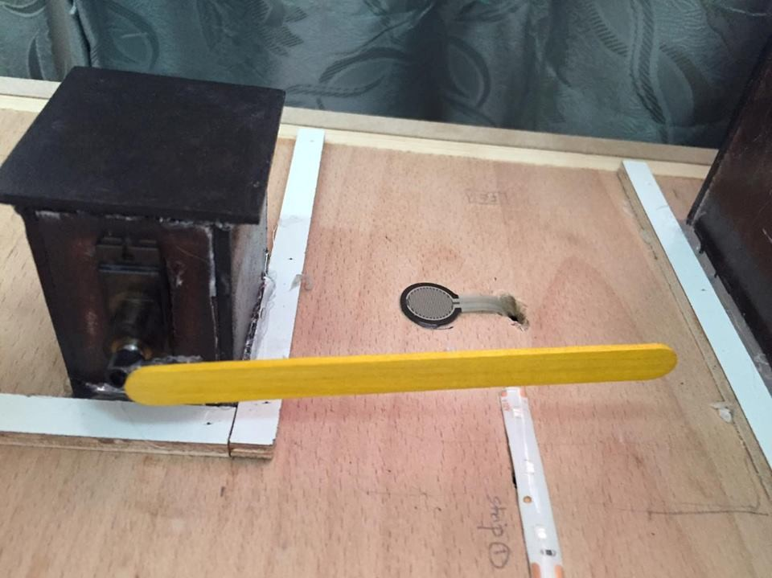
Force Sensor
Used as an indicator if a car is on the gate and need to enter.
Used to control the position of the shaft for the servo motor to open the gate.
Read analog value from force sensor .
Whenever it exceeds a certain value then it is known a car wants to enter the park.
10KOhm to connect it with the Arduino.

Slide 12
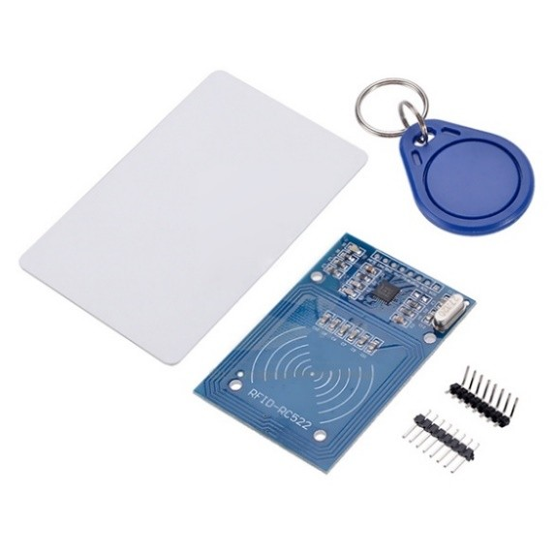
RFID Reader and Tags
RFID device serves the same purpose as a bar code .
It provides a unique identifier for each driver.
To connect it with Arduino we use the SPI protocol.
Consider the Arduino as master and the readers as slaves.
Notes:
which is a synchronous serial data protocol used by microcontrollers for communicating with one or more peripheral devices quickly over short distances.

Slide 13
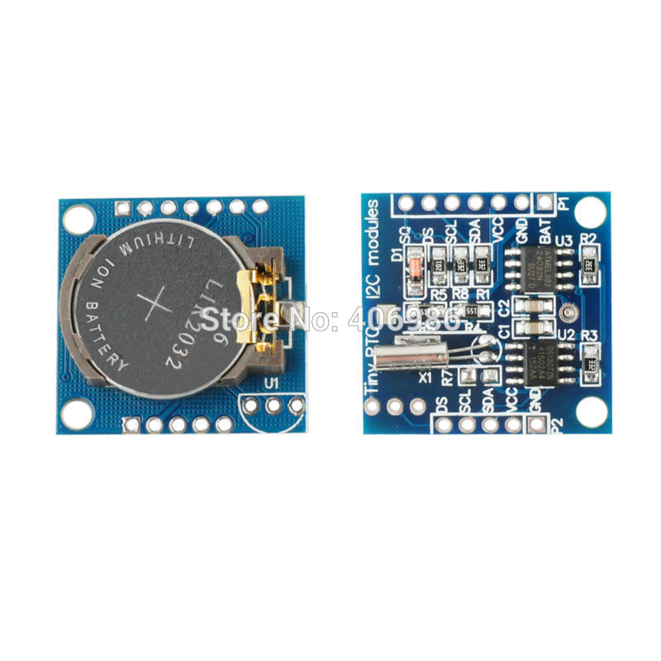
Real Time Clock DS1307
To save the time of entering and leaving for each driver.
Use the I2C protocol to connect it with the Arduino.

Slide 14

Servo Motor
Servo Motor which is used for controlling shaft movement.
The servo shaft movement is determined by the weight present on the force sensor.
SERVO MOTOR shaft is controlled by varying the duty ratio of PWM signal generated by Arduino Mega.

Slide 15
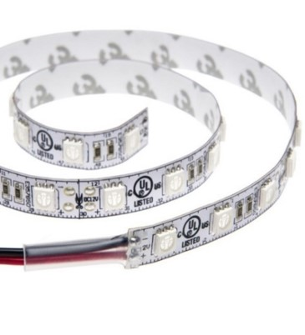
LED Strip
It is a waterproof flexible LED adhesive light strip series.
It operates on 12VDC. So we used Darlington array Chip “ULN2003” to amplify this signal.
We used LED strip to give the driver the direction to the shortest path to the first empty slot.

Slide 16
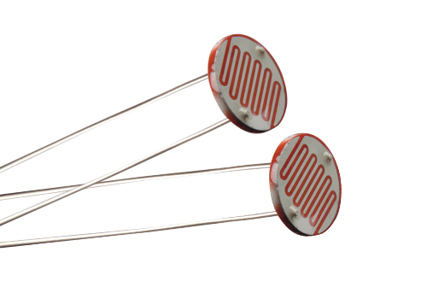
LDR Sensor ( Light Dependent Resistor)
It is an optical sensor, whose resistance changes with the intensity of light falling on.
Used to sense both the existence and exit of the cars in the parking .

Slide 17
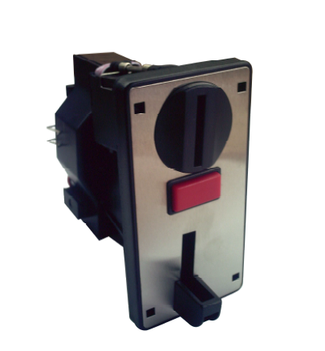
Coin Acceptor(DG006F)
Enable it to recognize 3 groups of coins (2,5,10)NIS.
Connect it serially with the Arduino.
Works on 12V.
Whenever an acceptable coin is inserted it will send
a signal to the Arduino.

Slide 18
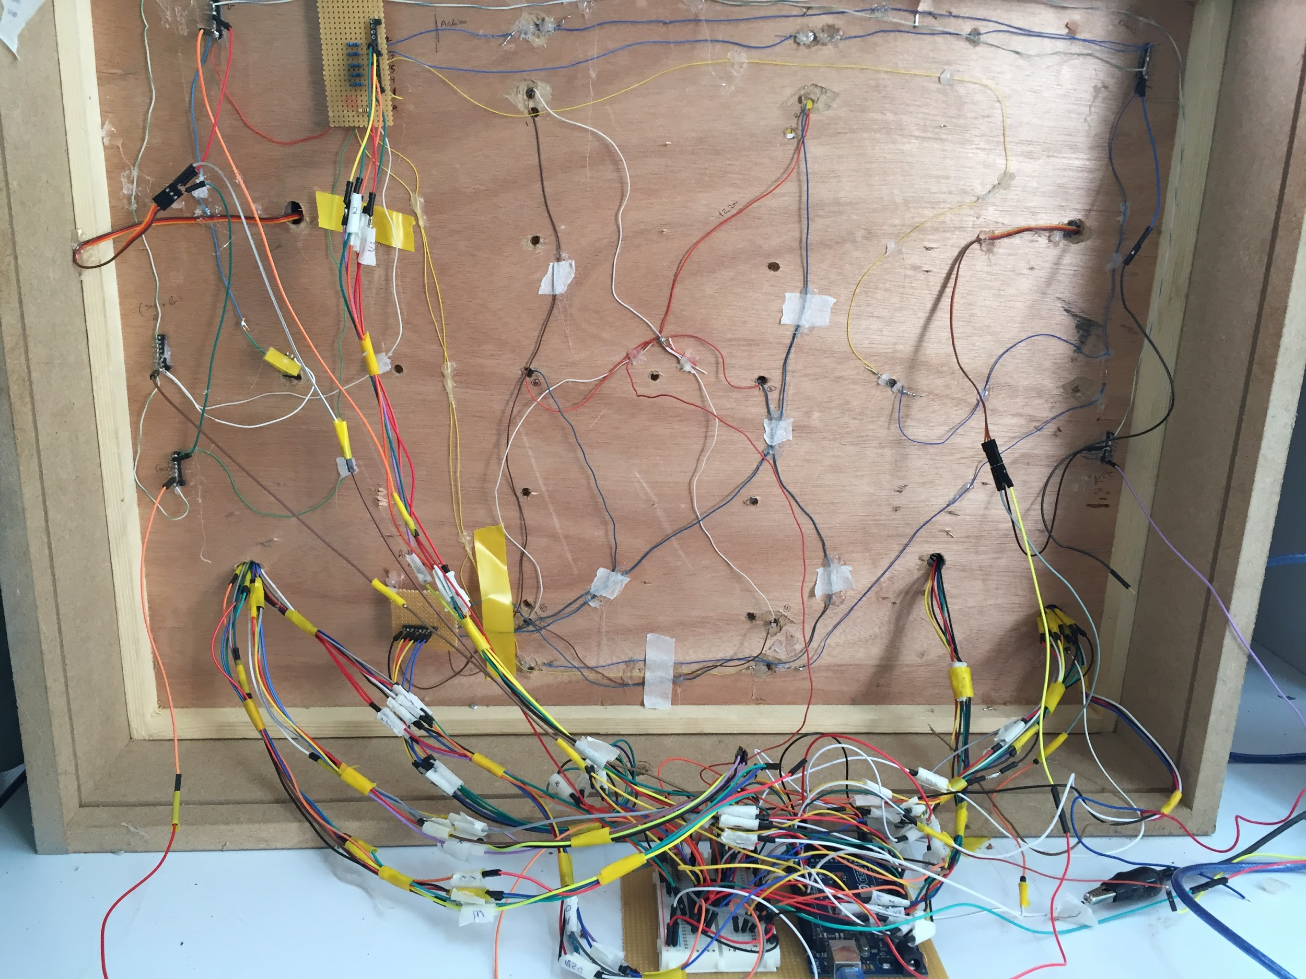
Problems:-
Running out of pins: our project takes approximately all the pins of the Arduino Mega.

Slide 19
Problems:-
Design the whole circuit thus connecting the circuit more than once.
Problems in programming multiple RFIDs and interface them correctly with Arduino.
Problems in serial communication between the Arduino and PC.

Slide 20
Future Work:-
Apply this system in real parking places.
Support more than one floor.
Connect it with a mobile application so that a driver can reserve his slot earlier.

Slide 21
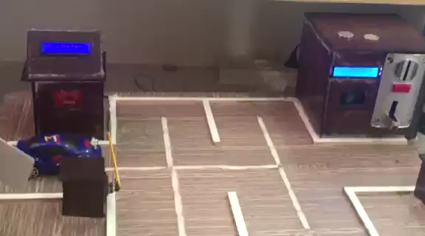
Demo:-

Slide 22
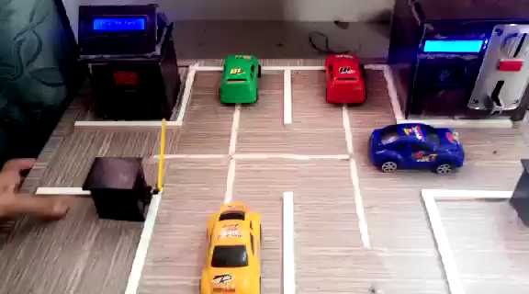
Demo:-

Slide 23
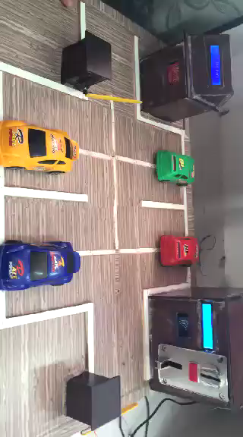

Slide 24


