Slide 1


Temperature Controlled Liquid Mixing System
Students:
Abdallah Sweidan
Obada Jabr
Mohammed Almasri
Supervisor: Dr. Bashir Nouri
June 2026

Slide 2
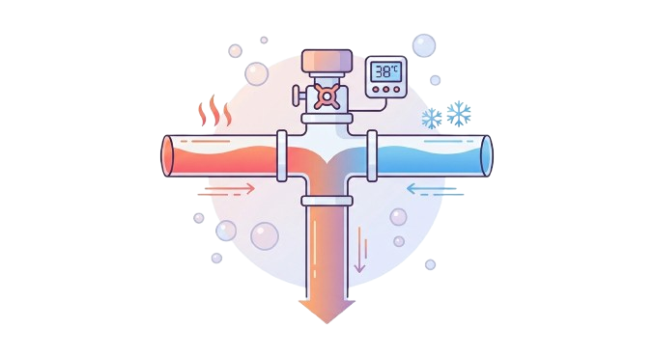
Introduction
  Temperature controlled liquid mixing systems automatically mix liquids at different temperatures to achieve a desired outlet temperature
  These systems regulate the proportion of hot and cold liquids
  They eliminate continuous manual adjustment and provide consistent performance under varying operating conditions
  Accurate temperature control is essential for:
1- Safety and user comfort
2- Product quality and process stability
3- Energy efficiency

Slide 3
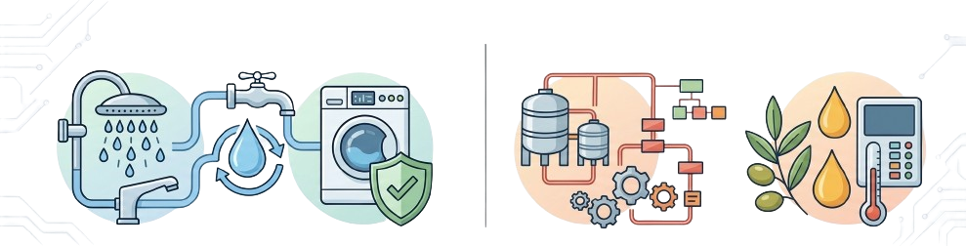
Applications
Household Applications:
  Faucets and showers
  Washing machines and dishwashers
  Improved safety and reduced water waste
Industrial Applications:
  Pasteurization processes
  Olive oil extraction
  preserving product flavor and nutrients

Slide 4
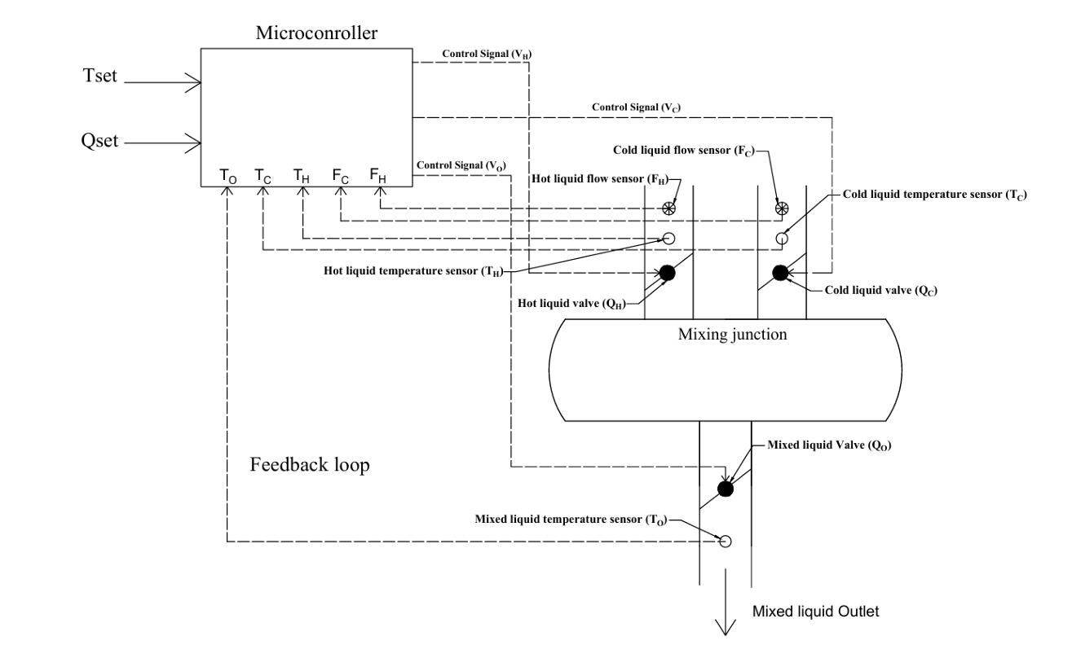
Proposed System Overview

Slide 5
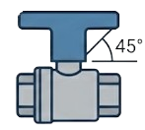
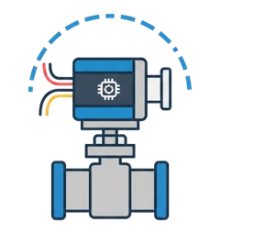
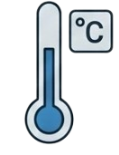
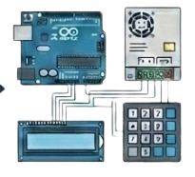
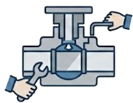
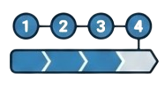
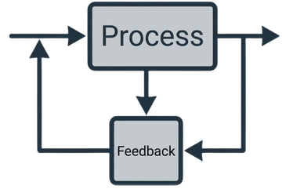
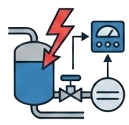
Design Methodology
Valve Initial Position
Temperature Measurement
Select Other Components
Actuator Selection
Mechanical and Electrical Assembly
Open Loop Sequence
Closed Loop Control
Disturbance Handling

Slide 6
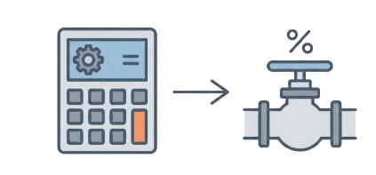
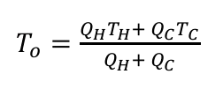
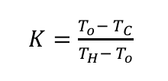
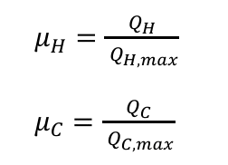
Valve Initial Position
1- Apply Heat Balance Equation
2- Calculate Flow Ratio (K)
3- Determine Operating Mode
4- Convert Flows to Valve
Openings
Hot Flow Dominant (K>1)
Balanced Flow (K=1)
Cold Flow Dominant (K<1)

Slide 7
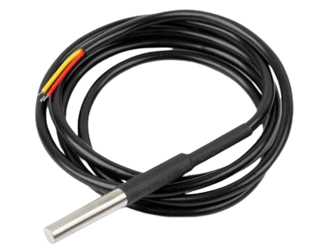
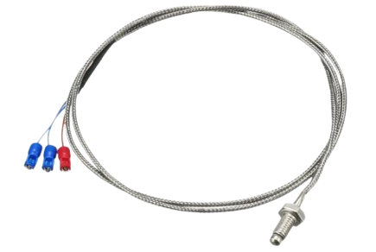
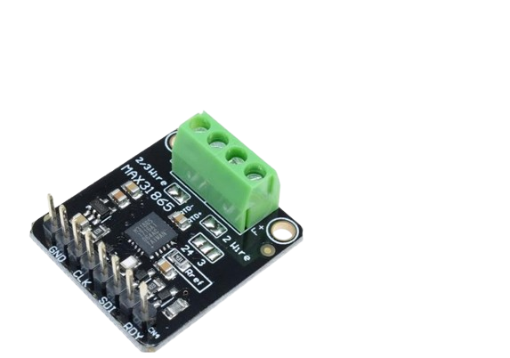
Temperature Measurement System
Hot & Cold Inlets → DS18B20
Mixed Outlet → PT100 (Platinum RTD)
  Temperature change with resistance change (Linear relationship)
  Needs signal conditioning (MAX31865)
  Converts resistance change into voltage change
  Waterproof digital sensor
  Direct digital output (no external signal conditioning required)
  Easy microcontroller interface

Slide 8
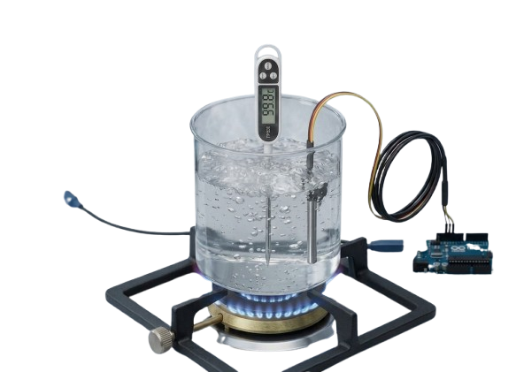
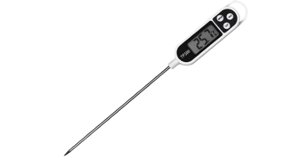
Experimental Setup & Sensor Testing
Cold water → gradual heating to boiling
Reference digital thermometer (±1 °C accuracy)
Compare PT100 + MAX31865 vs DS18B20

Slide 9
Experimental Results – Sensor Accuracy Evaluation
🔄 Thermal Lag
sensors showed delay in response under dynamic heating.
🎯 Sensitivity
both sensors linear, sensitivity ≈ 1 (proportional response).
📏Accuracy
steady‑state readings within ±1 °C; PT100 more precise than DS18B20.

Slide 10
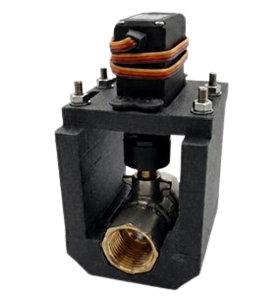
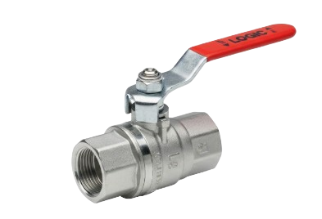
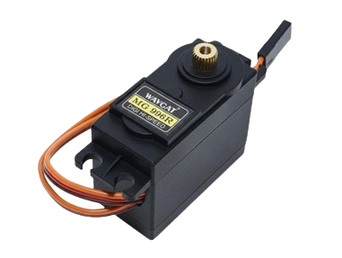

The Actuator-Valve and RC Servo Motor System

Slide 11
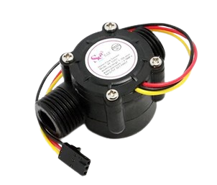
Actuator Testing & Flow Characterization
  Flow sensor used: YF‑S201
  Purpose: establish valve opening ↔ flow rate relationship
  Multiple flow rates tested: 3.8 → 12.8 L/min
  PWM steps: 500–1500 µs (increments of 100 µs)
  Hysteresis experiments at 6.49 L/min and 8.44 L/min
YF-S201 Flow Sensor

Slide 12
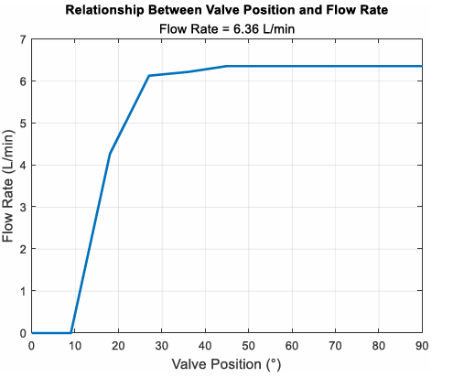
Key Results – Valve Position vs Flow Rate
  Initial Range (0°–9°) → Almost no flow, valve nearly closed.
  Main Regulation (9°–18°) → Largest change in flow %, rapid increase.
  Secondary Regulation (18°–27°) → Flow rises slower, less sensitive control.
  Extended Range (27°–45°) → Flow approaches maximum, valve nearly fully open.
  Beyond 45°–90° → Valve fully open, further angle adds no significant flow.

Slide 13
Key Results – Valve Position vs Flow Rate
  Valve shows extremely nonlinear behavior
  Effective regulation range ≈ 9°–45°
  Main regulation: 9°–18° (largest change in flow %)
  Dead band ≈ 30 µs PWM
  Alternatives: V‑port ball valve (linear)
  Lookup tables implemented in code → map required flow rate to PWM value

Slide 14
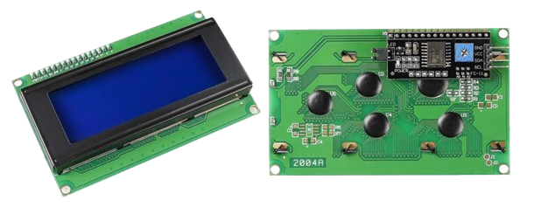
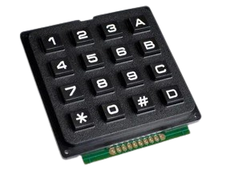
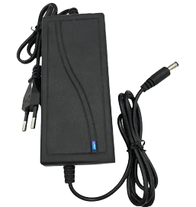
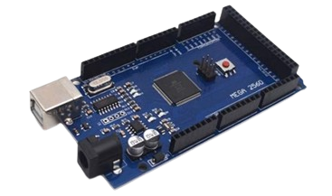
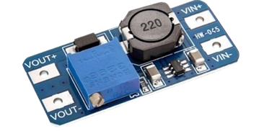
Selection of Supporting System Components
20×4 I2C LCD (LCD2004)
4×4 Matrix ABS plastic keypad module
5V, 10A DC Power Supply
Arduino Mega microcontroller
Boost Converter Module

Slide 15
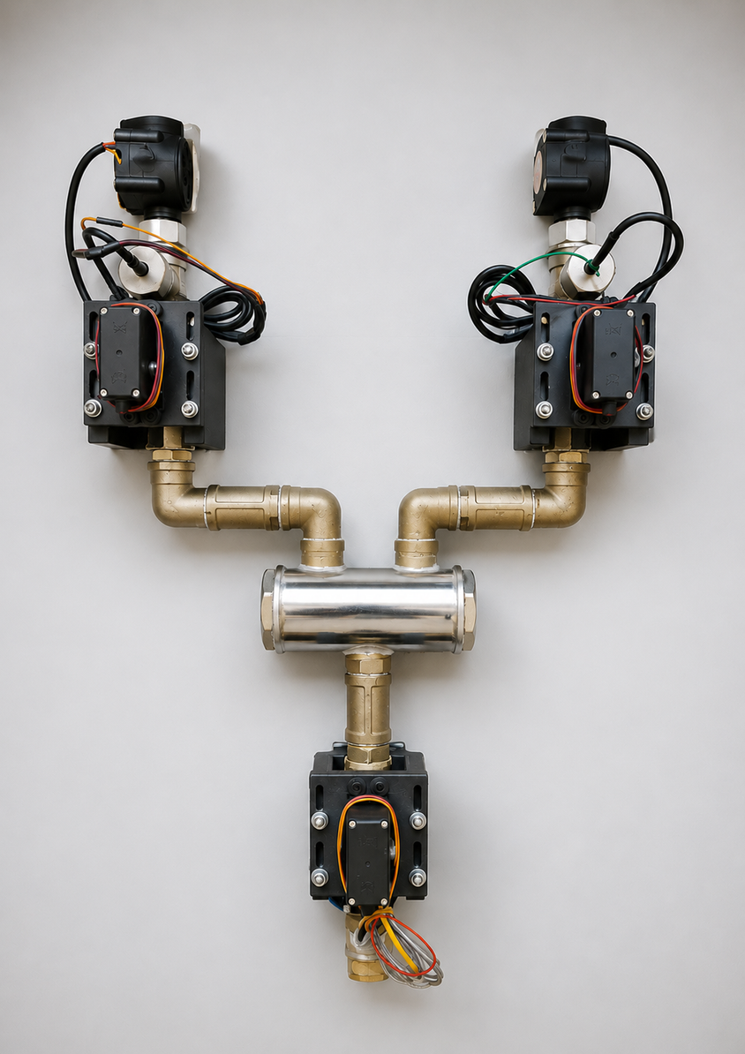
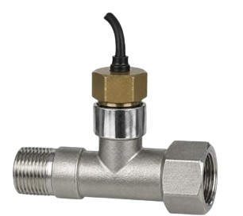
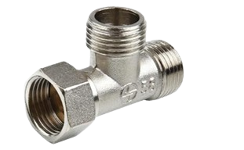
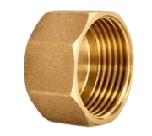
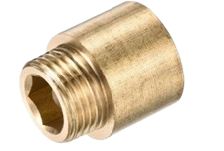
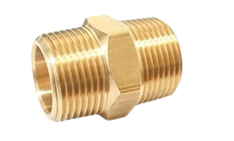
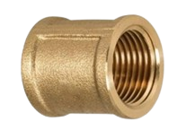
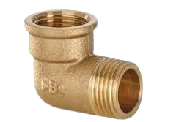
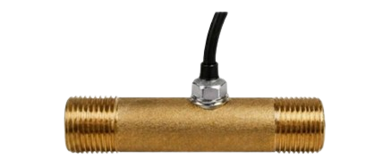
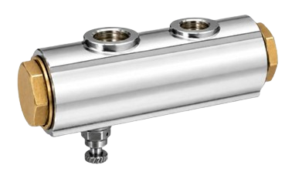
Mechanical and Electrical Assembly of the project

Slide 16
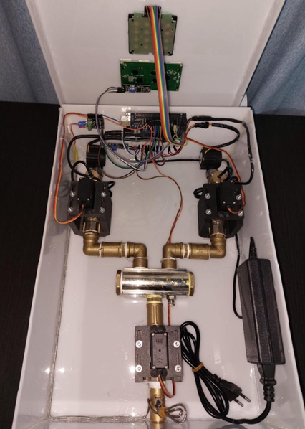
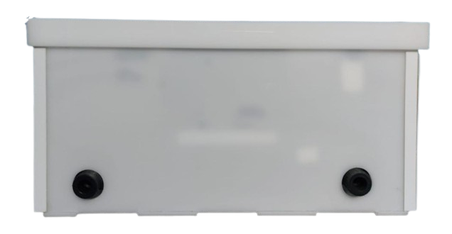
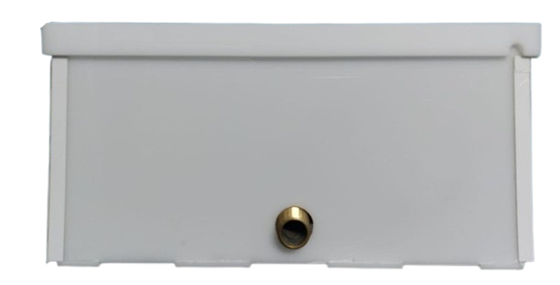
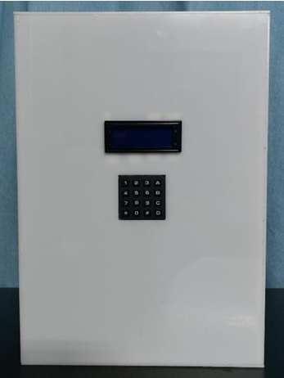
Mechanical and Electrical Assembly of the project
Back view
Front view

Slide 17
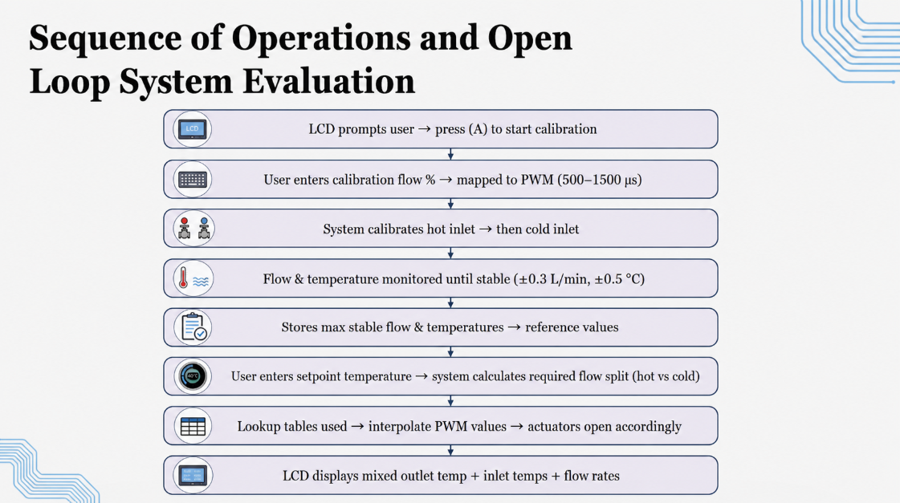
(500 -1000 ) µs

Slide 18
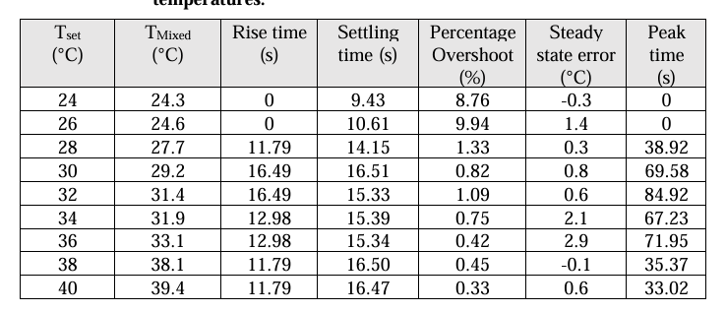
Performance indicators of open loop system at different set point temperatures

Slide 19
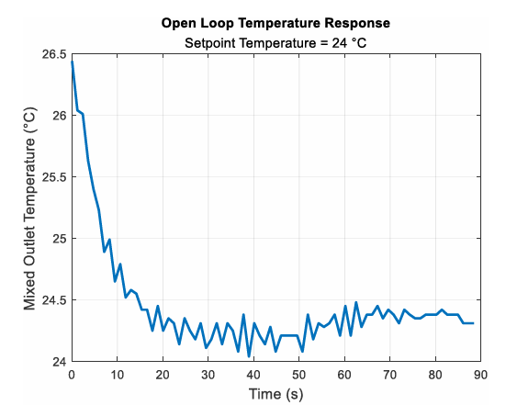
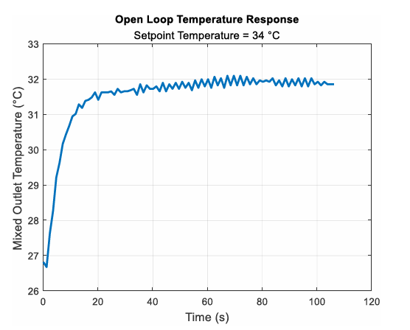
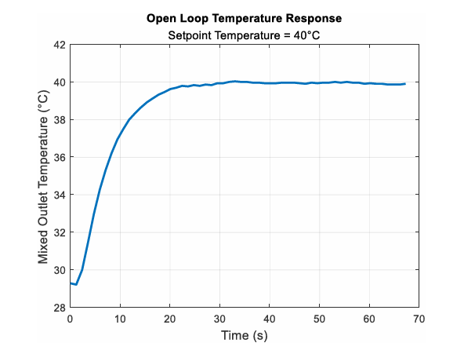
Open Loop System Experimental Results

Slide 20
Discussion of the Open Loop System Results
  Sensor Noise → ±0.5 °C, more visible at low setpoints (zoom effect)
  Steady State Error → mostly <1 °C, few cases up to 2.9 °C (valve nonlinearity, lookup interpolation)
  Overshoot → very small (<1.33%), outliers at 24–26 °C due to initial condition
  Rise Time → consistent (11.8–16.5 s), zero at 24–26 °C (room temp start)
  Settling Time → 9.4–16.5 s, longer for higher setpoints
  Overall → acceptable open loop, but closed loop feedback needed to eliminate error & handle disturbances

Slide 21
Closed Loop System Configuration
Sensor Lag
delay in measured temperature causes overshoot
Transport Delay
liquid travel time delays system response
Valve Nonlinearity
small angle changes
large flow changes
Actuator Dead Band minimum 30 µs PWM needed for movement
System Sensitivity Variation
depends on setpoint proximity to inlet temps

Slide 22
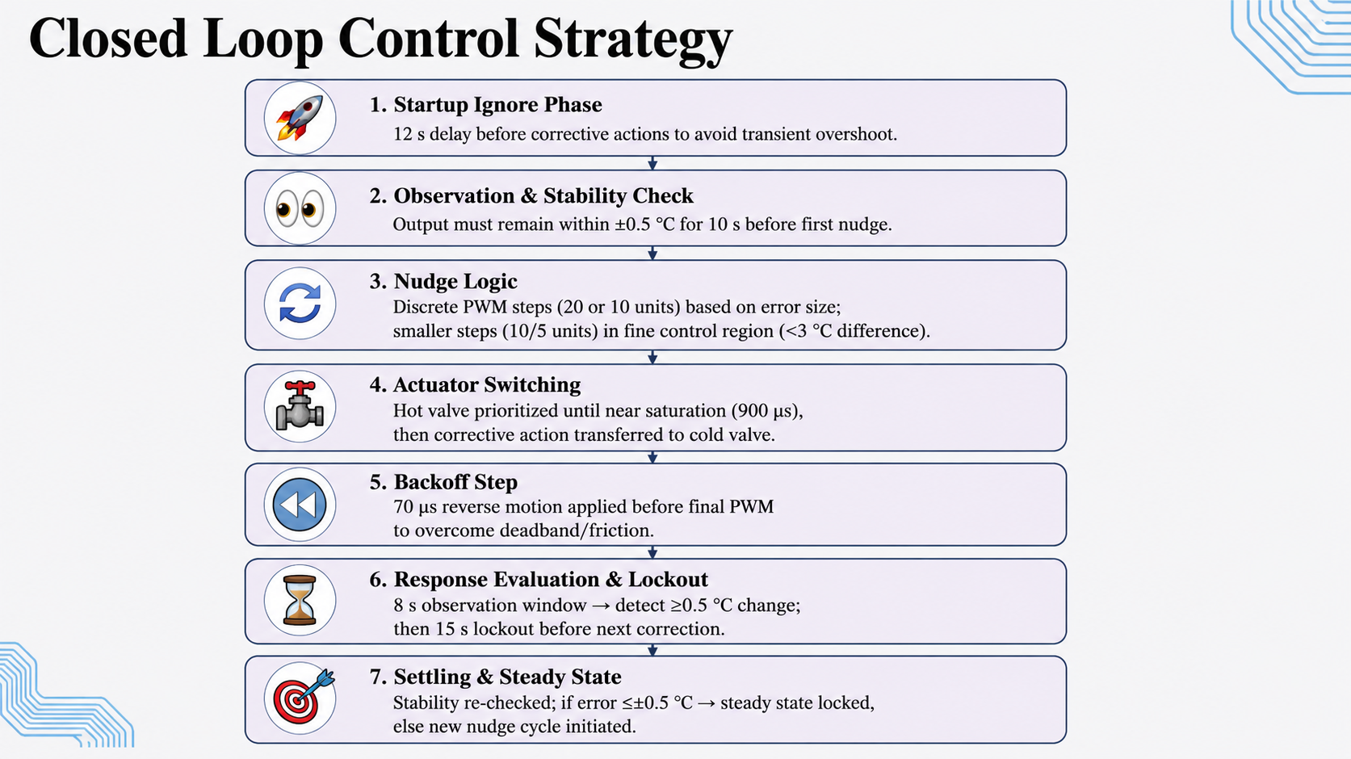

Slide 23

Performance indicators of closed loop system at different set point temperatures

Slide 24



Closed Loop System Experimental Results

Slide 25
Discussion of the Closed Loop System Results
  Steady State Error → reduced to ≤ ±0.5 °C, eliminating larger errors seen in open loop.
  Rise & Settling Time → increased due to intentional waiting (sensor lag + transport delay).
  Valve Backlash → initial nudges caused slight cooling before correction took effect.
  Setpoint Variation → some cases converged faster when initial valve positions were close to target.
  Overall Performance → stable operation, no overshoot/oscillations, accurate regulation under nonlinear constraints.

Slide 26


System Response to Flow and Temperature Disturbances
Mixed outlet temperature response with flow disturbance at Tset = 27 °C.
Mixed outlet temperature response with temperature disturbance at Tset = 32 °C.

Slide 27

Future Work
  🔧 Hardware Improvements: Better valves (V‑port / dedicated control) + industrial actuators → reduce nonlinearity, backlash, dead band.
  🚰 Sensor & Measurement: Use precise flow meters + faster temperature sensors → improve accuracy, reduce lag, enhance disturbance detection.
  🧠 Control Strategy: Explore advanced controllers (MPC, fuzzy logic) → faster response, less settling time, higher stability.
  📱 System Expansion: Extended testing up to 80 °C + wireless interface (Wi‑Fi/Bluetooth) + multi‑fluid mixing → wider real‑world applications.

Slide 28
Temperature Controlled Liquid Mixing System
THANK YOU

