Slide 1
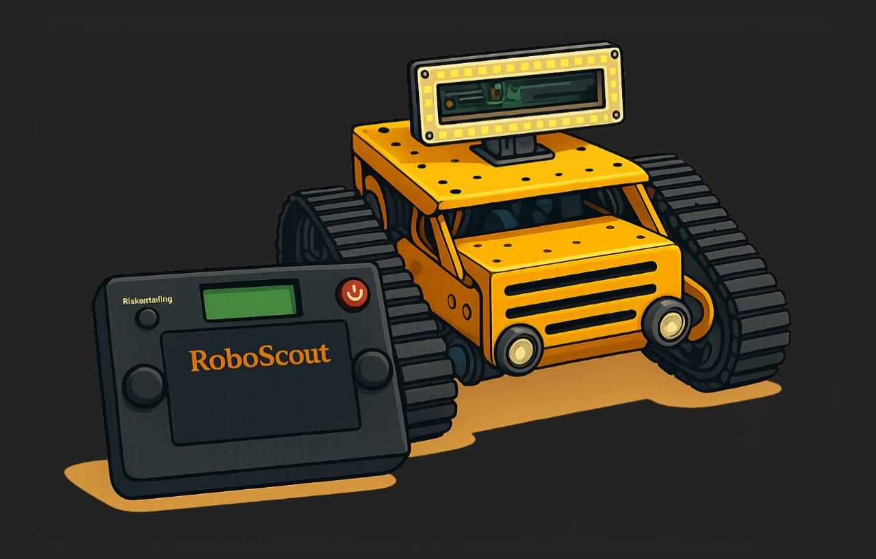

RoboScout
Aseel Maradwi
Noor al-huda Yahya

Slide 2
TABLE OF CONTENTS
01
Introduction
Introduction
02
Problem Statement
03
Poject Objective
04
System Overview
05
Hardware Component
06
Challenges
07
Future Work
08
Software Component
02

Slide 3
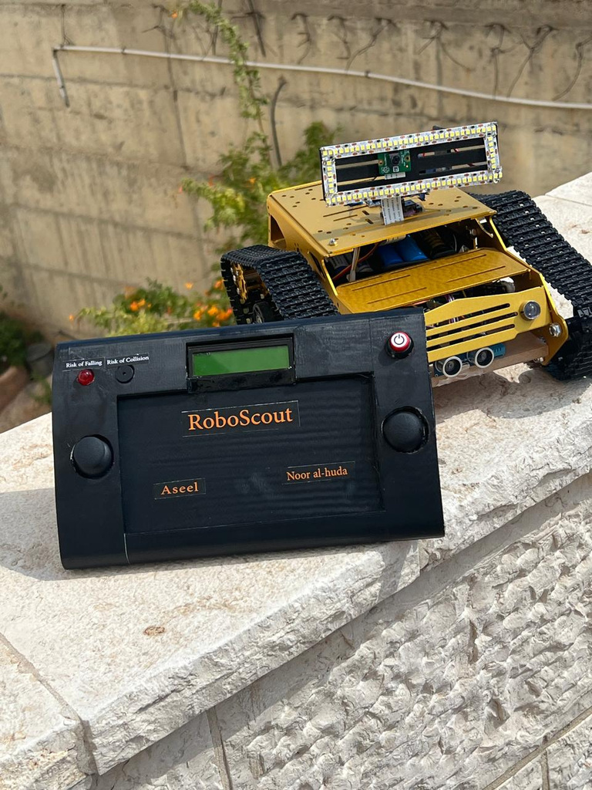
INTRODUCTION
The Cave Exploration Car project is designed to access areas that are difficult or unsafe for humans. The car is equipped with sensors to measure temperature, gas levels, and battery status. It also features a movable camera that streams video to a handheld phone for remote control, an ultrasonic sensor to detect obstacles and temporarily stop, and a smart lighting system that automatically turns on in the dark.
Introduction
04

Slide 4

PROBLEM STATEMENT
01
02
Exploring hazardous or hard-to-reach areas exposes humans to serious risks.
Lack of real-time environmental data (gas, temperature, tilt, obstacles, battery) makes exploration unsafe.
03
Existing remote systems are often costly, limited in functionality, and do not provide full monitoring with live audio-visual feedback.
03

Slide 5
PROJECT OBJECTIVES
01
02
03
Safe Exploration
Real-time Monitoring
Live Streaming
05

Slide 6
SYSTEM OVERVIEW
01
02
03
Vehicle body with drivers and motors.
Environmental sensors (temp, gas, battery)
Camera with live streaming.
and mobile app.
04
05
06
Ultrasonic & gyroscope sensors
Smart lighting system
Handheld alerts (buzzer & LED)
06

Slide 7
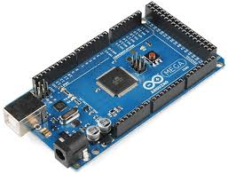
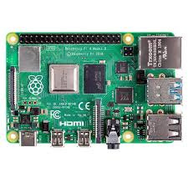
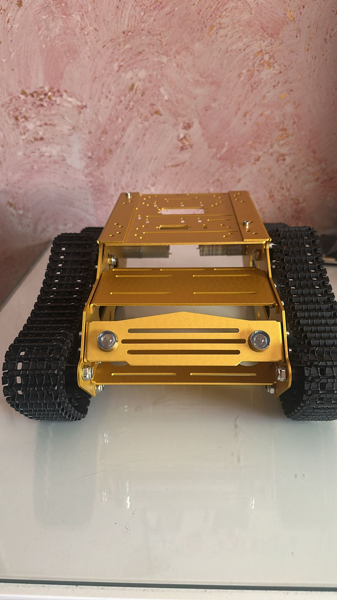
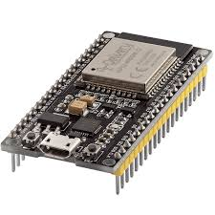
HARDWARE COMPONENT
Arduino mega
raspberry pi 4
Tank Chassis
ESP32
07

Slide 8
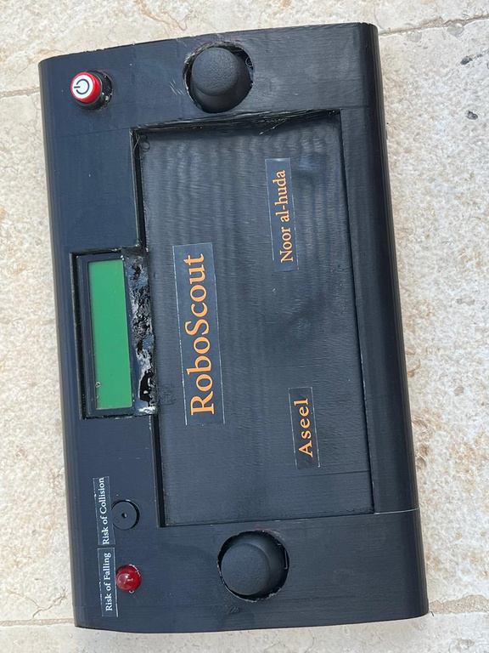
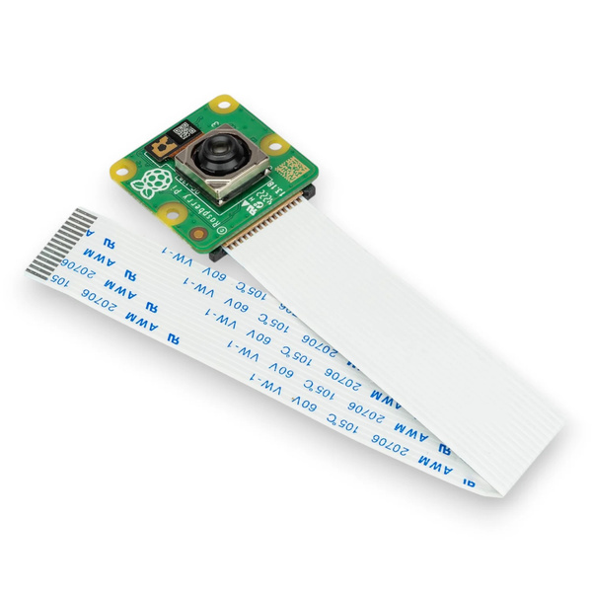
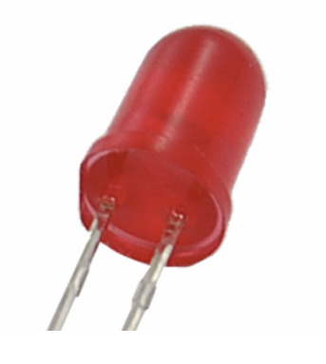

3D-Printed Controller Enclosure
camera raspberry
pi
LED
Headlights
08

Slide 9

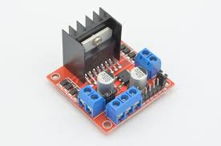
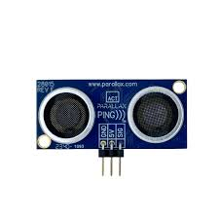
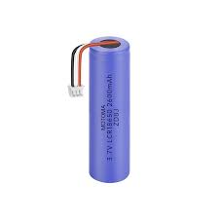
micro servo
L298N Motor Driver
Ultra sonic
Lithium battery
09

Slide 10
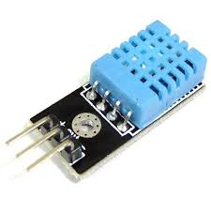
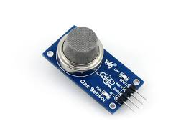
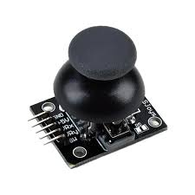
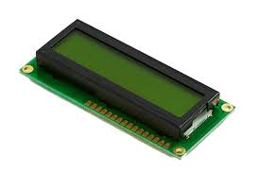
Tempreture sensor
Gas sensor
joystick module
LCD
10

Slide 11
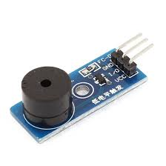
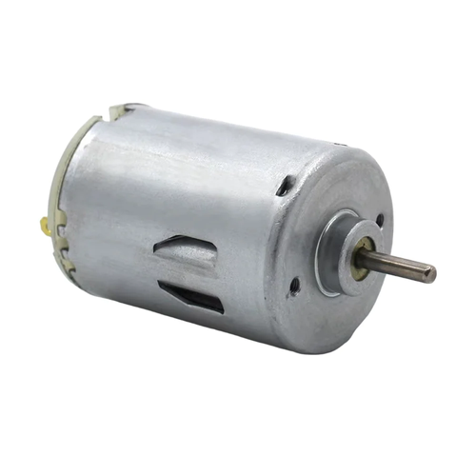
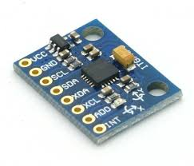
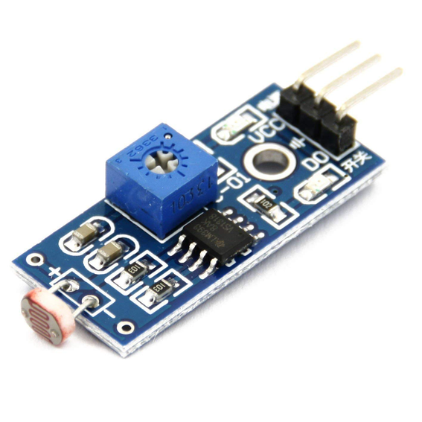
Buzzer module
DC motor
gyroscope
LDR sensor
11

Slide 12
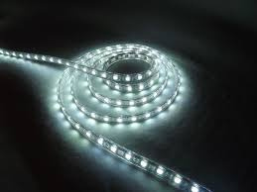
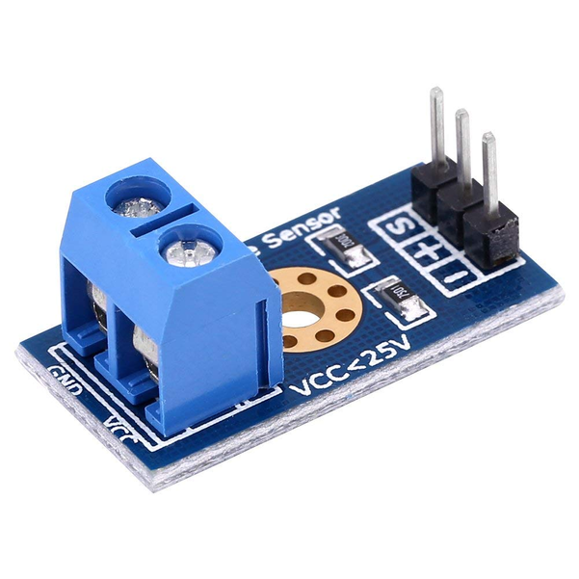
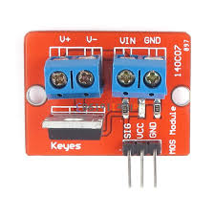
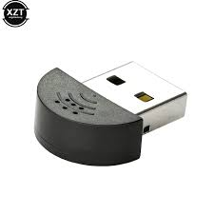
LED stripe
Voltage sensor
module
MOSFET module
Super mini mic
12

Slide 13
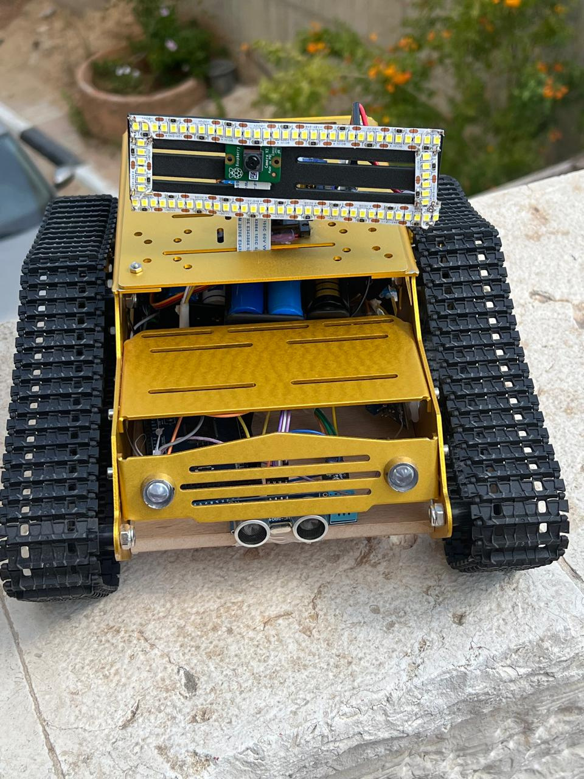
FUTURE WORK
  GPS location tracking
  Longer battery life
  AI-Based Object Detection
  Robotic arm support
  3D orientation display
13

Slide 14
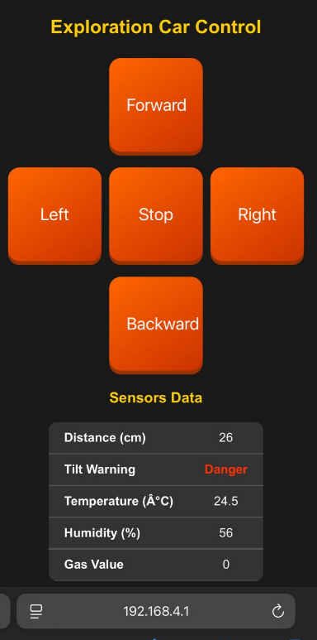
SOFTWARE COMPONENT
Mobile Application
  Control the vehicle
  Monitor sensor data
Email Address
hello@reallygreatsite.com
Address
14

Slide 15
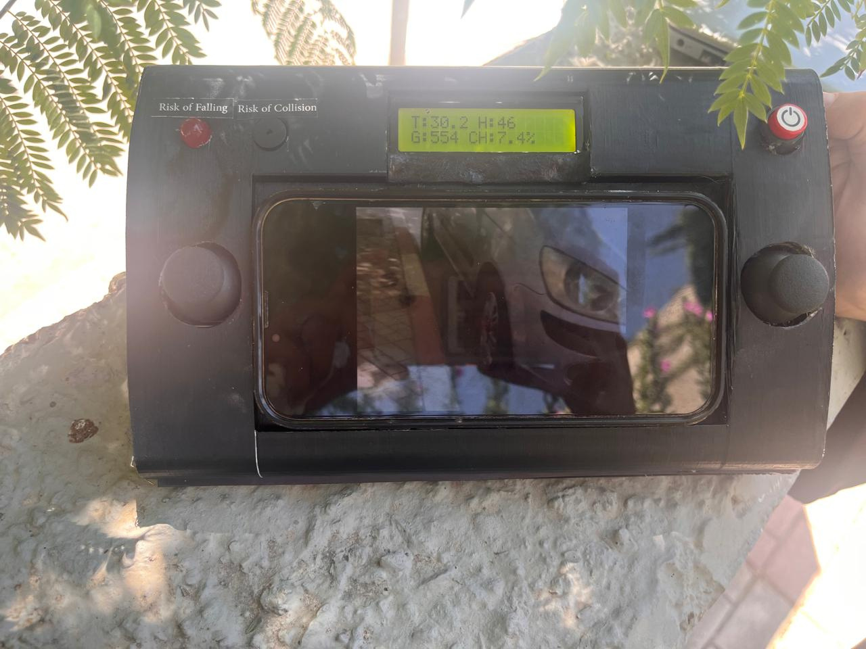
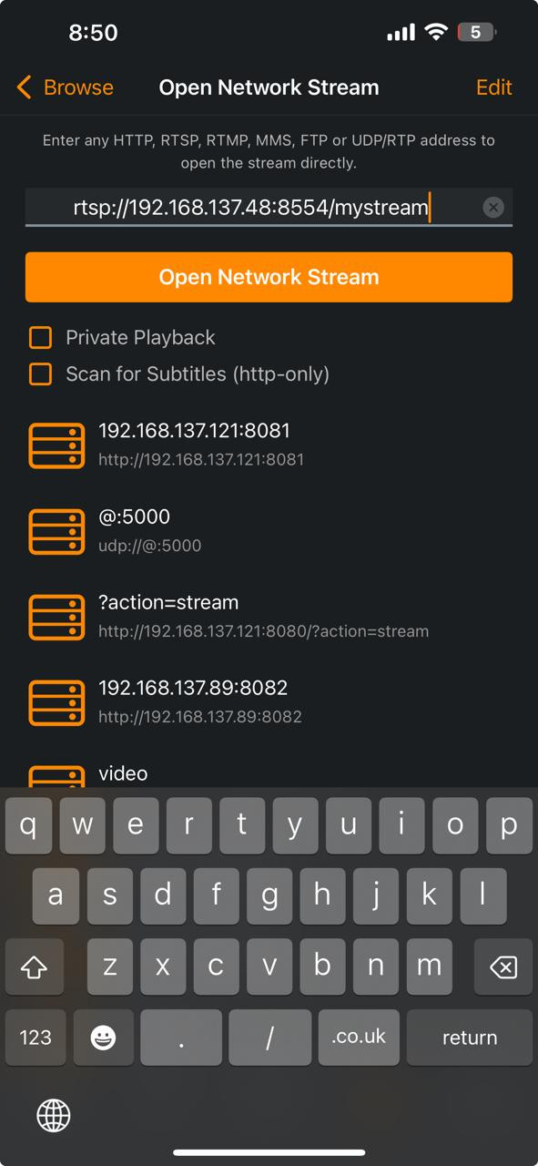
VLC PLAYER
View live video & audio stream from Raspberry Pi
13

Slide 16
CHALLENGES
01
01
02
03
Cost
Time
Power Limitations for Servo motors
ESP Reliability
16

Slide 17
THANK
YOU
For Your Attention

