Slide 1

Graduation Project II
Analysis and Redesigned of Water Distribution Network and Design of Wastewater
collection Network for Kefel Haris village.
Prepared By :
Amjad Hussam Abu Ya’qoub
Abdull-Raoof shehadeh
Nser Ali Bouzia
Mohammad Lahloh
Supervision of Eng. Hamees Tubeileh

Slide 2
Outline: -
✔ Introduction .
✔ Objectives and significance of the work .
✔ Study area .
✔ Methodology.
✔ Modeling, Analysis and Design with their resultd.
✔ Conclusion and recommendation .

Slide 3
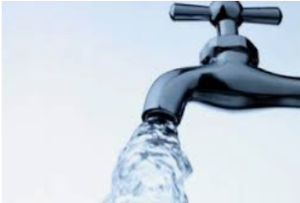
Introduction
Water take a great importance to humans in everyday life most of the activities we do need water. So that demand is continuously increasing, this means increasing the wastewater production, where wastewater constitutes about 85% of water demand .

Slide 4
Objectives
Analyze the existing water network.
Redesign the water network in the village.
Design the Wastewater network in the village.

Slide 5
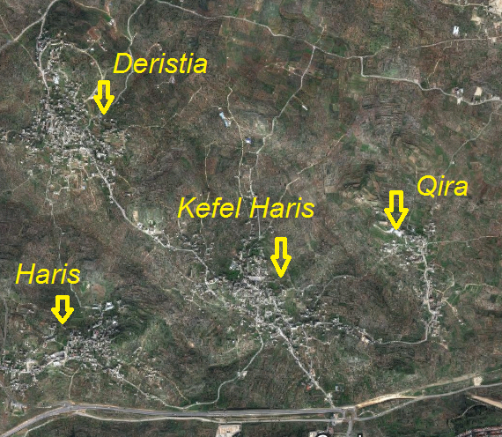
Location

Slide 6
Study area

Slide 7
Study area
Location :
Kefel Haris is a village that is located 4.5 km north of Salfeet city
Climate :
The mean annual maximum temperature is 26.5 ºC and the mean annual minimum is 11.5 ºC.

Slide 8
Study area
Population :
The total population of the villege was 4084 capita in 2017.
Water resources :
Water supply of the village is from Macorot.

Slide 9
Analyzing the Network

Slide 10
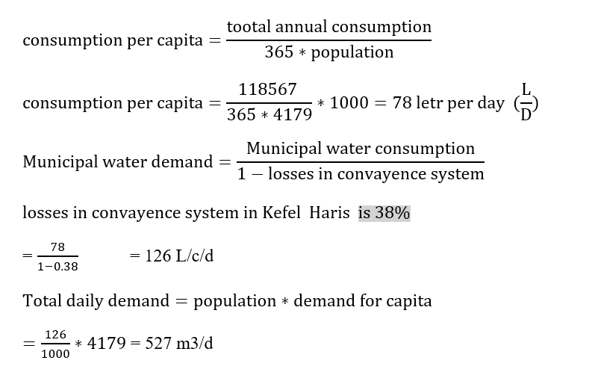
Modeling of WDN

Slide 11
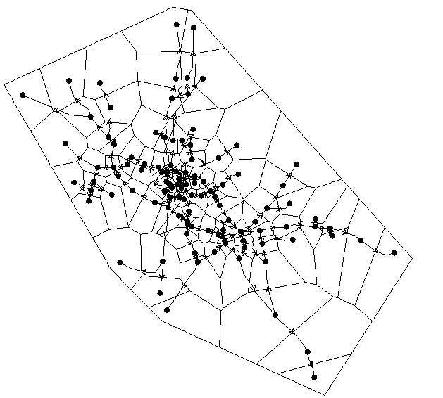
Network with Thiessen Polygon

Slide 12
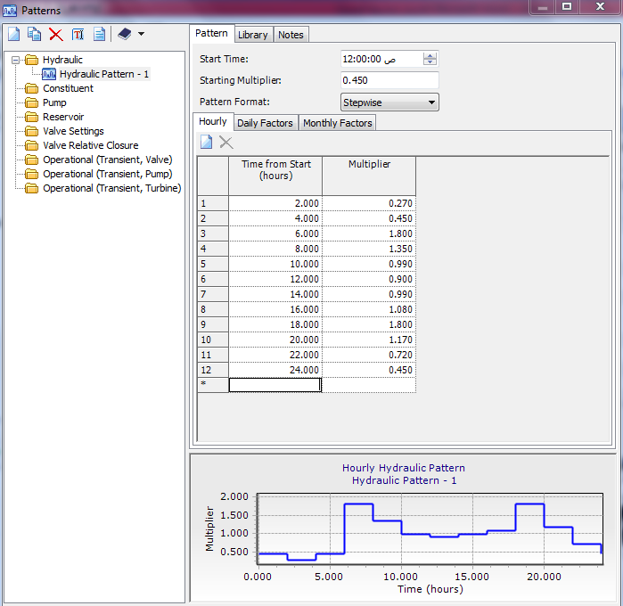
Using load builder being distributed the demand by proportional distribution by area .
We enter a pattern demand.

Slide 13
WDN
Number of Elements | Elements
1 | Reservoirs
107 | Nodes
119 | Pipes

Slide 14
WDN
Design constraints:
Pressure at junction between (20-100) m.H₂O.
Velocity in pipe (0.1-3.0) m/s.

Slide 15
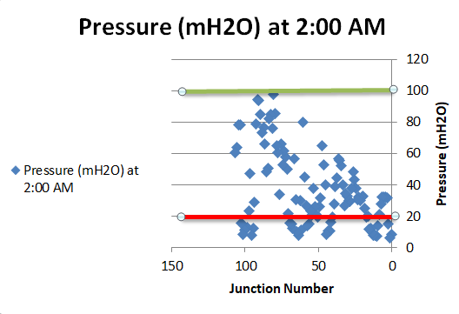
Result of analysis of WDN
Pressure at minimum demand (2:00 am).

Slide 16
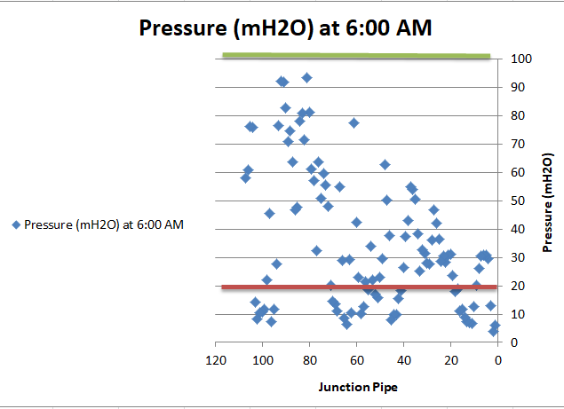
Pressure at maximum demand (6:00 am).

Slide 17
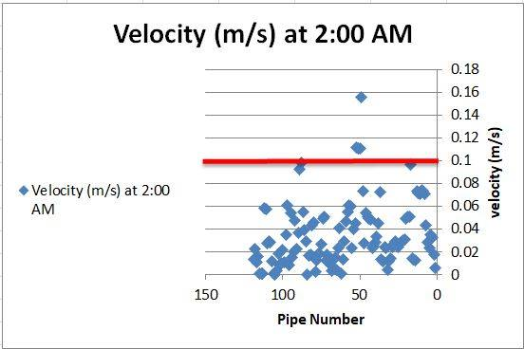
Velocities at minimum demand (2:00 am).

Slide 18
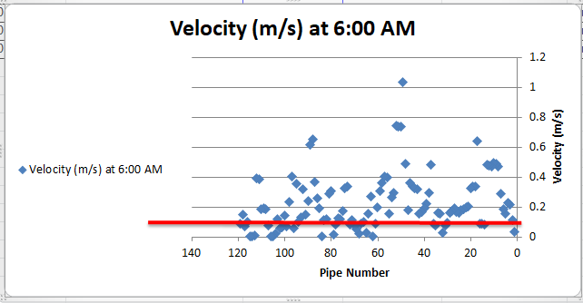
Velocities at maximum demand (6:00 am).

Slide 19
Redesign of WDN

Slide 20
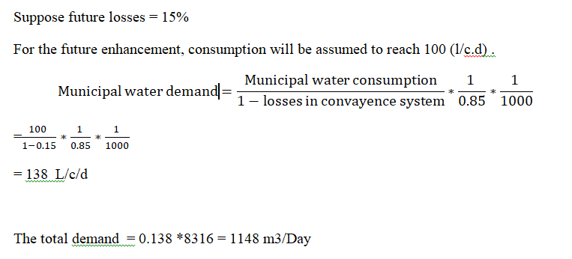
Data of future population
Future population in 2048 =8316

Slide 21
WDN
Number of Elements | Elements
2 | Reservoirs
109 | Nodes
114 | Pipes

Slide 22
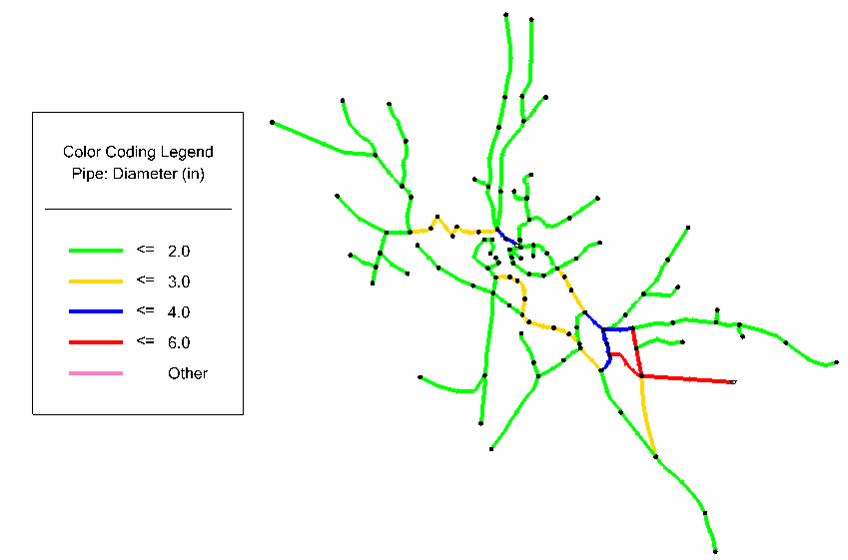

Slide 23
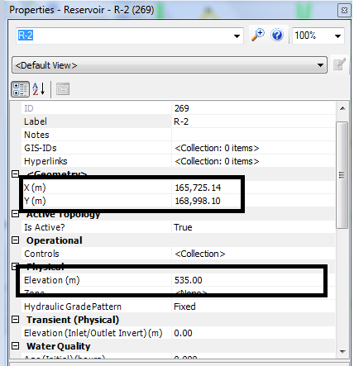
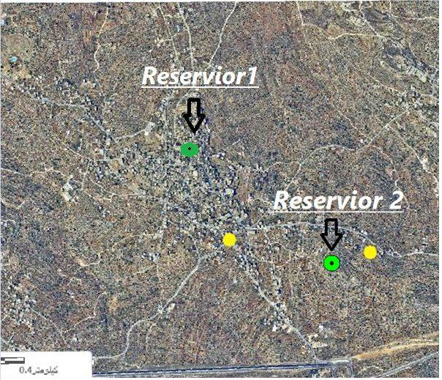
Reservoirs location
Reservoir 1&2 location
Reservoir 2 coordinates

Slide 24
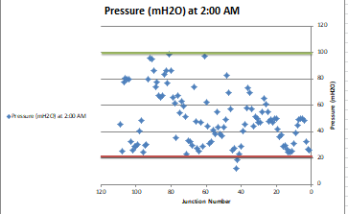
Results of WDN for Design
Pressure at minimum demand (2:00 am).

Slide 25
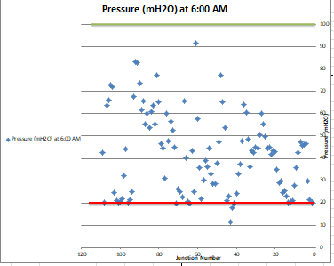
Pressure at maximum demand (6:00 pm).

Slide 26
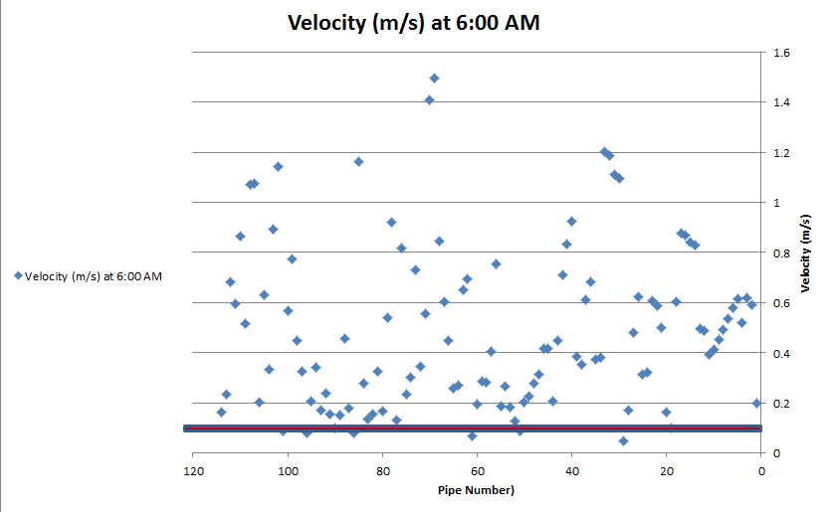
Velocity at maximum demand (6:00 am).

Slide 27
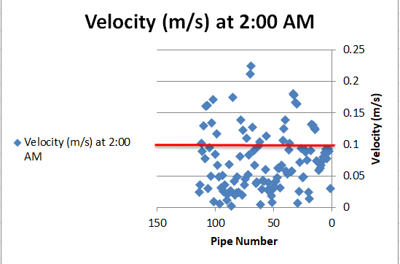
Velocity at minimum demand (2:00 am).

Slide 28
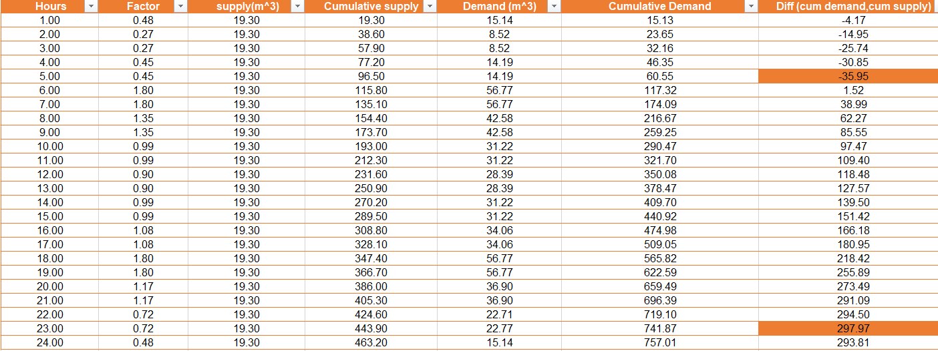
Reservoir volume calculations

Slide 29
Reservoir volume calculations

Slide 30
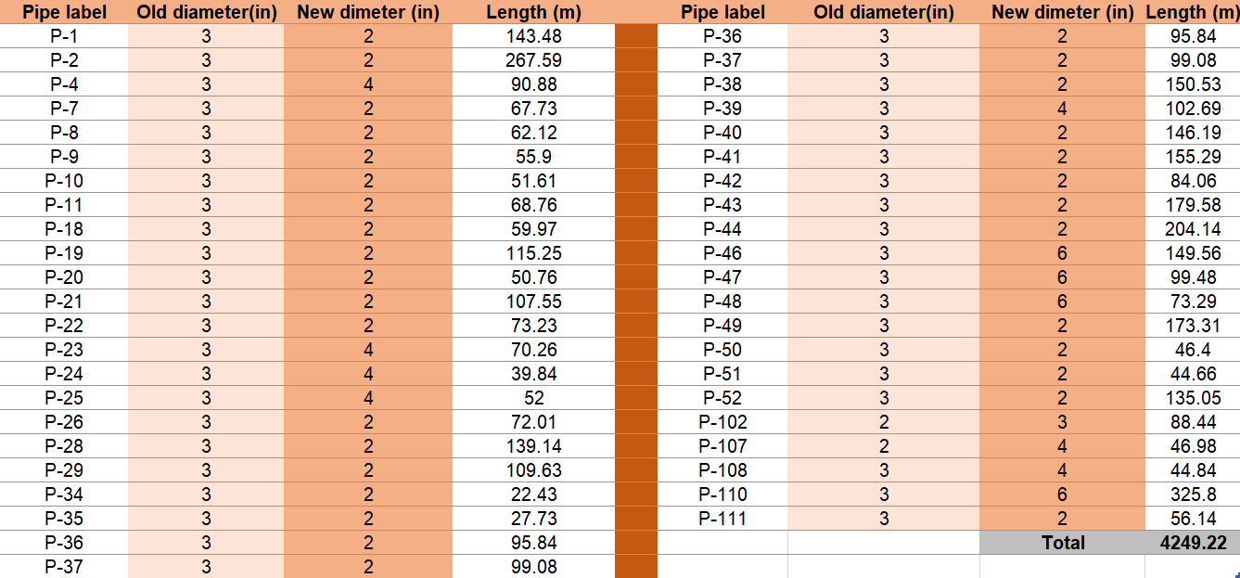

Slide 31
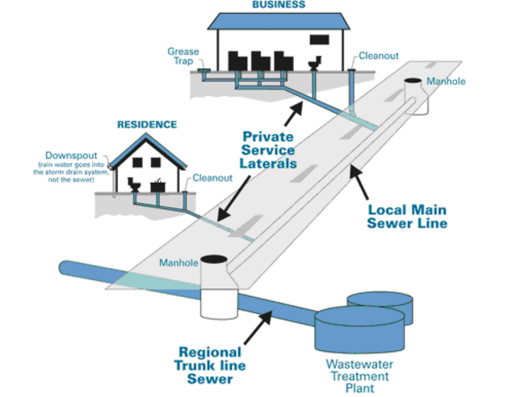
Design of Wastewater network

Slide 32
WWCN
Conduites
Manholes
Outfalls
Length <=30
Diameter>=8in
Material (PVC)
Diameter
Drop Manhole
Material
Loads
Elevation
Location
Elevation
Slope

Slide 33
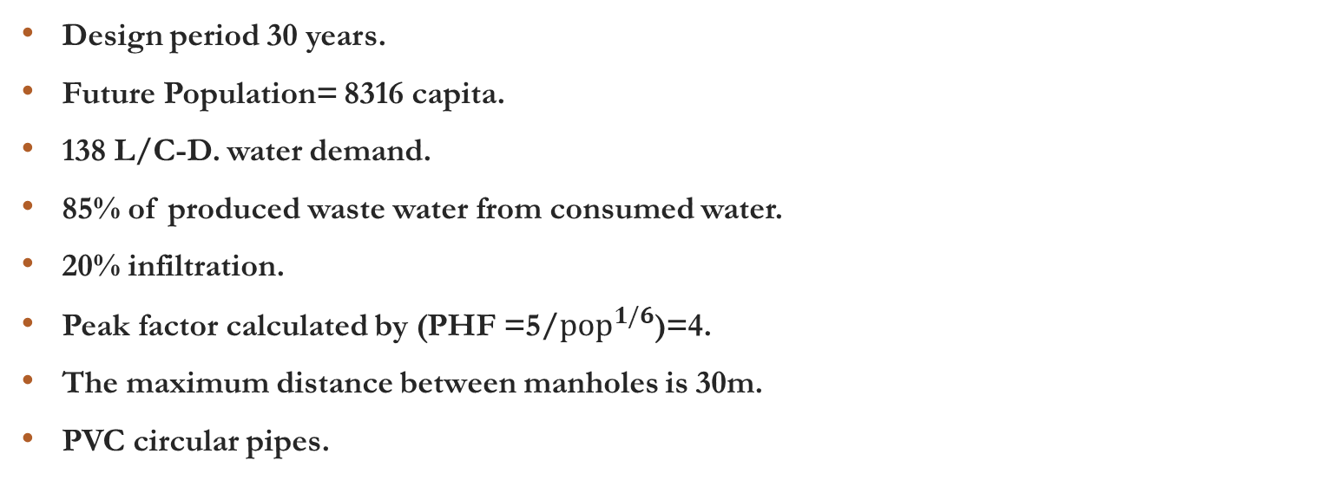
Data required of Wastewater
Design period 30 years.
Future Population= 8316 capita.
138 L/C-D. water demand.
85% of produced waste water from consumed water.
20% infiltration.
Peak factor calculated by (PHF =5/${pop}^{1/6}$)=4.
The maximum distance between manholes is 30m.
PVC circular pipes.

Slide 34
Wastewater Generation Calculations

Slide 35
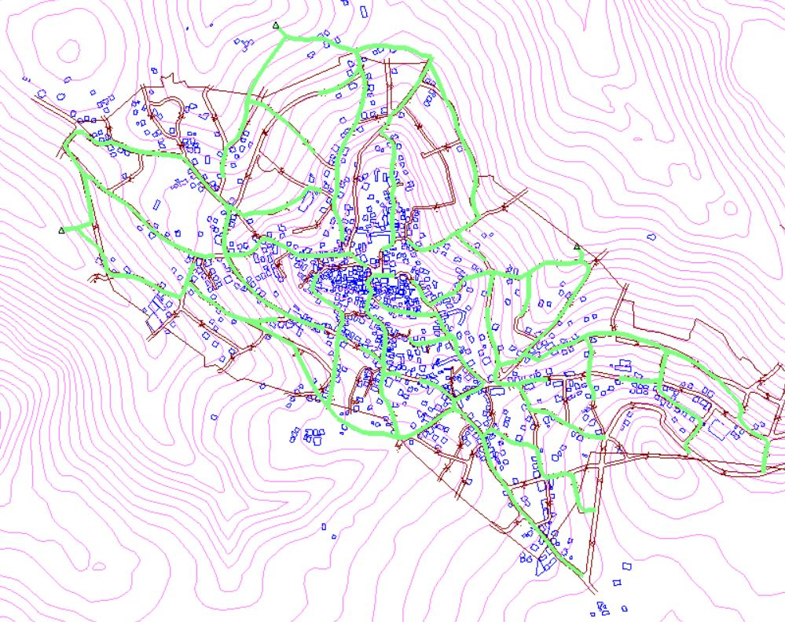
Model of the wastewater network

Slide 36
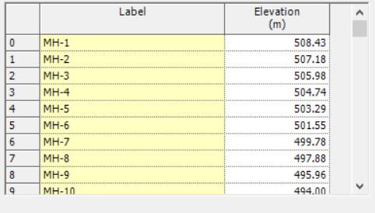
Manholes Elevation
Using Trex function on sewercad to find the elevation:

Slide 37
Design constraint
Velocity between (0.6 – 3) m/s.
Cover between (1 –5) m.
Slope between (1 – 12) %.

Slide 38
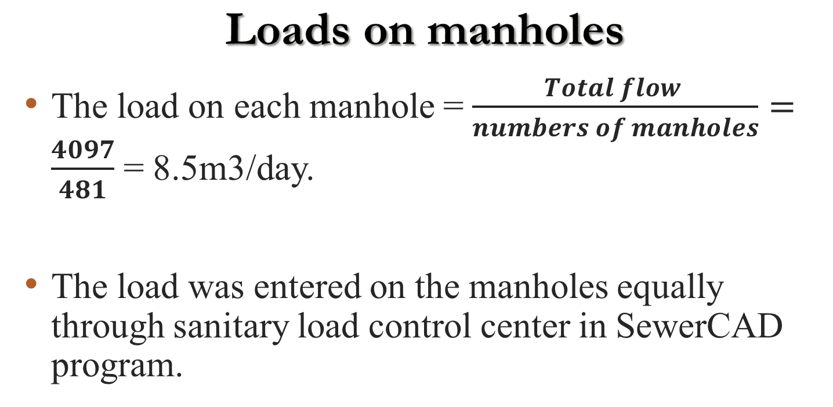
Loads on manholes
The load on each manhole =$\frac{Total flow }{numbers of manholes}=$ $\frac{4097}{481}$ = 8.5m3/day.
The load was entered on the manholes equally through sanitary load control center in SewerCAD program.

Slide 39
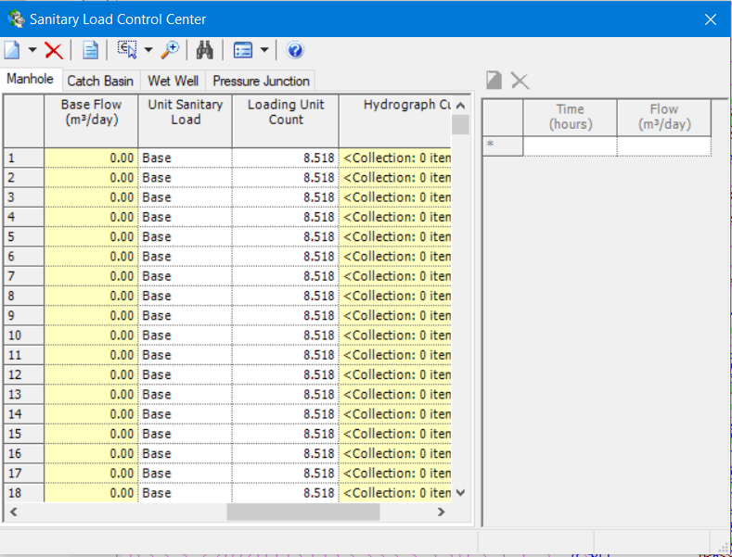

Slide 40
The Outfalls

Slide 41
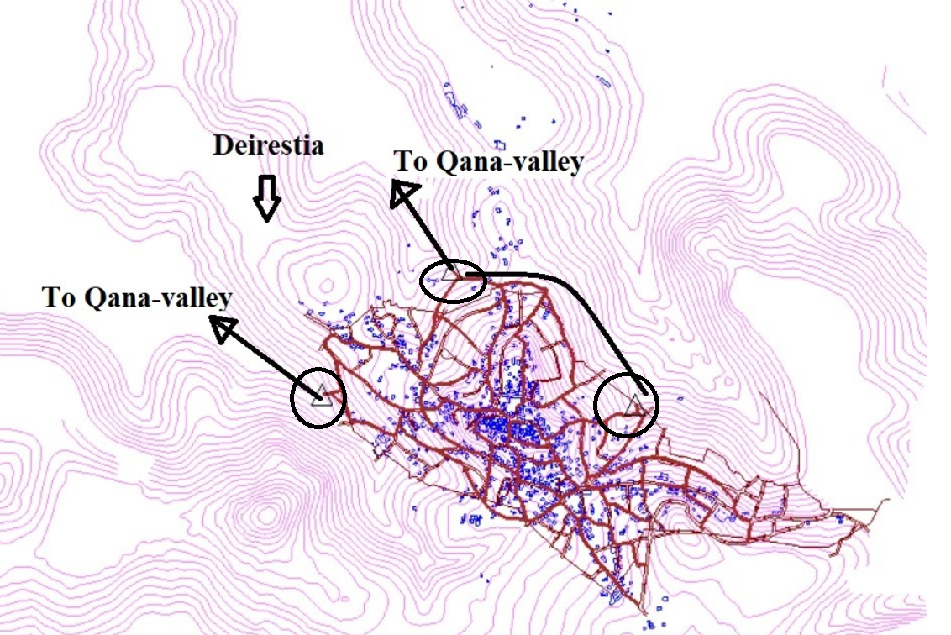
All of outfall tends to valley-Qana

Slide 42
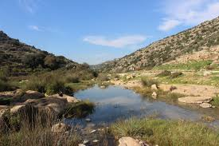
Valley-Qana

Slide 43
Results

Slide 44
WWCN
Elements | Manholes | Conduits | Outfall
No. of elements | 481 | 481 | 3

Slide 45
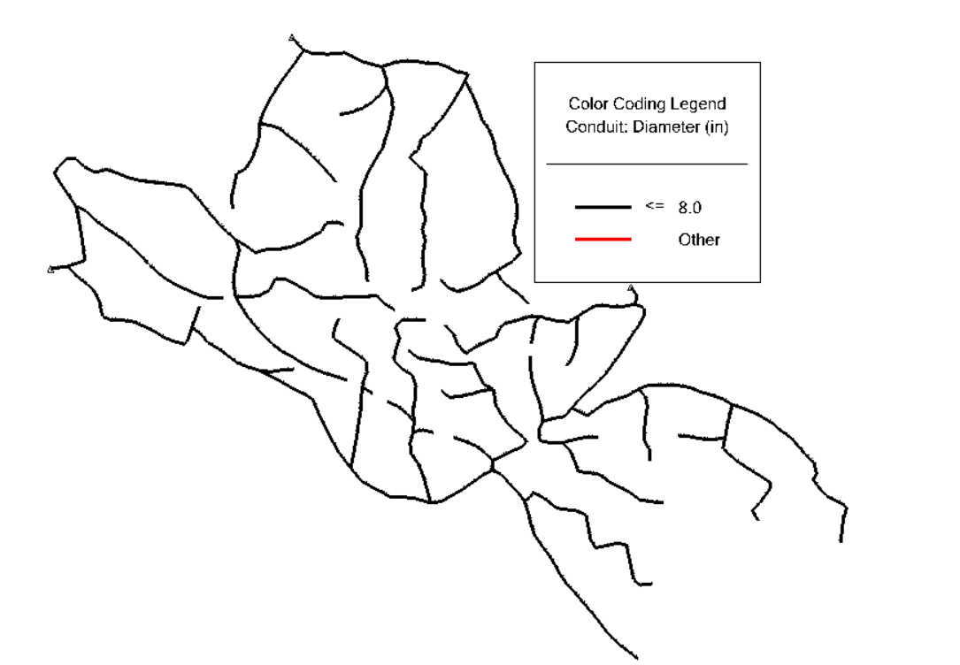
Conduit Diameter

Slide 46
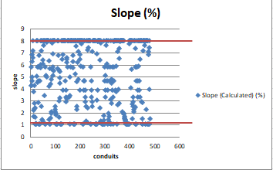
Slope Result

Slide 47
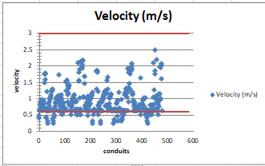
Velocity Result

Slide 48
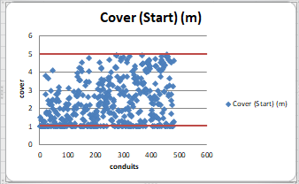
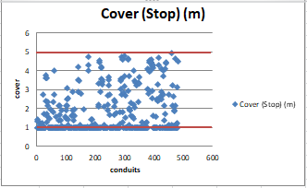
Cover Result

Slide 49
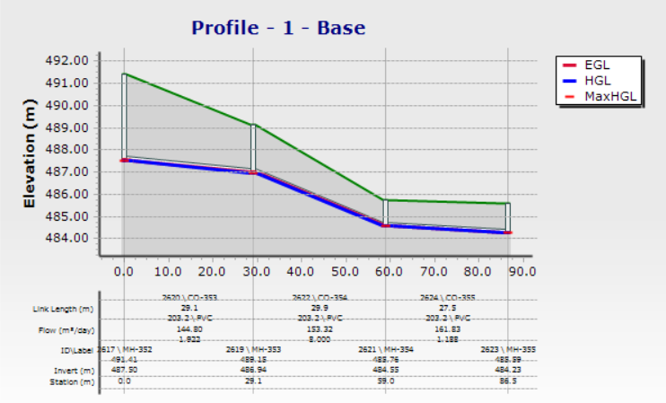
Profile

Slide 50
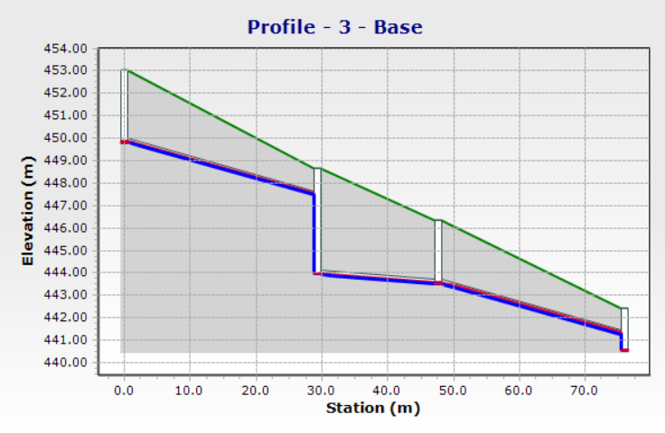

Slide 51

Cost estimation

Slide 52
Cost estimation for water distribution network
Total price ($) | Unit price ($) | Quantity | Unit
70,000 | 200 | 350 | M^3 | new reservoir cost
31,414 | 5,9,11,16 | 4249 | M | Pipes cost
35,010 | 12 | 2917.6 | M^3 | excavation
40,855 | 12,25 | 2679 | M^3 | filling(base course &sand)
50,990 | 20 | 2549.5 | M^2 | paving cost

Slide 53
Cost estimation for
Sewer collection network
 | Unit | Quantity | Unit price ($) | Total price ($)
conduits cost | m | 13,718.6 | 8 | 109,749
excavation | m ^3 | 21230.6 | 18 | 382,150
filling (base course &sand) | m ^3 | 22591 | 12,25 | 309,305
manholes cost | number | 481 | 450 | 187,590
paving cost | m^2 | 10,288.9 | 20 | 205,778

Slide 54
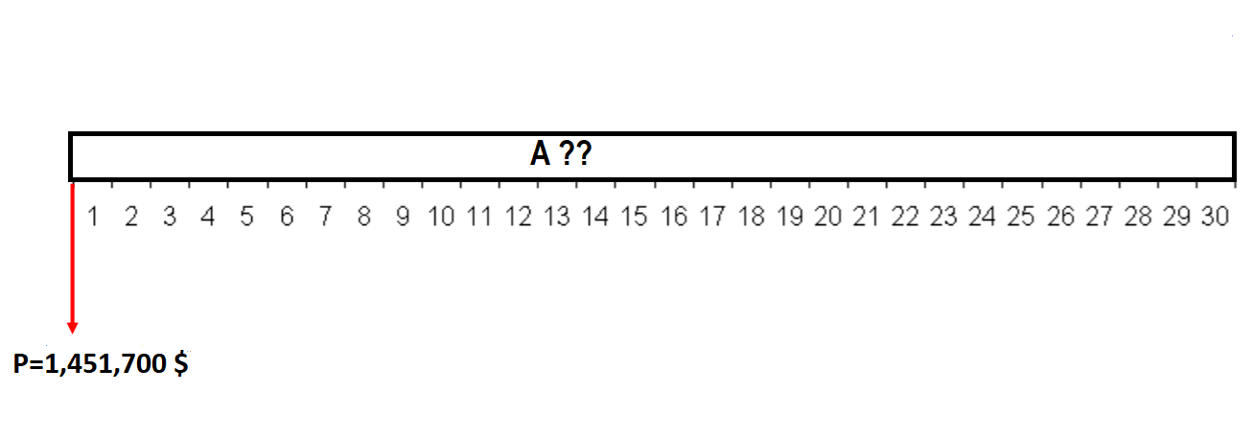
Distribute the total cost of our project to the population over a period of 30 years:

Slide 55
Total cost of the Sewer collection network = 1,223,435 $
Total cost of the water distribution network= 228,270$.
Total cost of the Sewer collection network and water distribution network = 1,451,700 $
Capital Recovery Factor A given P (A/P) = 0.0544, with an interest rate of 3.5% and n=30 year.
A= 0.0544 * 1,451,700 = 78,973 $/year.

Slide 56
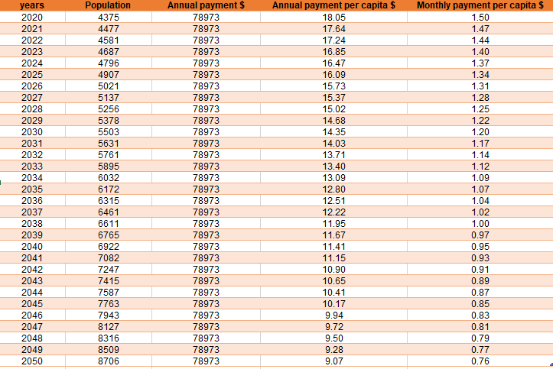

Slide 57

Conclusion and Recommendation

Slide 58
As required in the outline to use only gravity feed, which means the use reservoir at the highest point and non-use of pumps.
Because the village small, the demand on junctions was small, so we have many problems in this project such as, the flow is small in the pipes and therefore the velocity is very low.
The separation of the network into two parts led to the separation of the flow and thus the flow is low in the pipes and the velocities are low.
In some pipes the flow was in negative sign that's mean the direction of drawing pipe was inverse, so we can change it by right click on that's pipes and reversed it.

Slide 59
We design wastewater distribution by gravity flow. As we noticed above, we have some problems related to cover (max), and the diameters, velocity and slopes of all conduits are ok, so to deal with this problem, we have to make some adjustment such as reposition the manholes or add a new manhole at middle of the conduit.
We recommend to use a PVC and a circular sewer pipe because it has many advantages like light, durable, resistant (inert material), easy and fast installation.

Slide 60


