Slide 1
Data Mining & Analysis in decisions support
Supervisor:
Team Members:
Dr. Mohammed Dwikat
Mohammed Aker
Yaqob Quzmar
Adham Nassar

Slide 2
OUTLINE
Introduction
Project goals, Action plan, Data acquisition, Used tools
Design & Deployment models
- Decision tree model
- Association rule discovery model
Data preparation
Integration, Reduction, Transformation, Cleaning
Recommendation & Automation
RFM analysis
Dashboard
Automation

Slide 3
Introduction
Building Classification Model
Association Rule Discovery
Project Goals
Customer segmentation
Dashboard & Recommendation System
Automating the Processes
Notes:
في البداية وضعنا مجموعة من الاهداف لحل مشاكل استقرئناها من فهمنا للبزنس اوجيكتيفز
1-للتنبؤ ب الكلاس ليبل للميسينغ فاليوز
2- استكشاف الانماط بين العناصر المكررة مثال تحليلي السلة الشرائية
3-تقسيم الزبائن بناءا على سجل حركاتهم الشرائية

Slide 4
Introduction
Recommendation System
Action Plan
RFM Data
Build model
Dashboard Data
Set KPIs
Dashboard design
Business Understanding
Business objectives
Project goals
Situation evaluating
Data acquisition
Data Understanding
Collect data
Explore data
Data quality
Data Preparation
Select data
Integration
Reduction
Transformation
Data Cleaning
Modeling & Testing
Build model
Test design
Evaluate Result
Deployment
Deployment plan
Final report
Automation
Notes:
اعتمدنا في خطة العمل على ال كروس اندستري ستاندرد بروسيس المستخدمة بشكل واسع في تنفيذ عمليات التنقيب في البيانات و عملنا بعض الاضافات عليها بما انه يتلائم مع الاهداف اللي بدنا نحققها في نهاية مشروعنا

Slide 5


Introduction
Data Acquisition
Transactions data 2012-2014
Returned Orders 2012-2014
All transactions data 2012-2014
Transactions Data 2012-2015
Transactions data 2015
Notes:
في البداية لجئنا الى احدى الشركات المحلية للحصول على بيانات خام للبدء بعملية تنظيفها و التنقيب فيها و تحليلها الا انه البيانات اللي حصلنا عليها كانت غير مترابطة و تحوي عدد هائل من الاصناف و وجود كم كبير من الاخطاء و الميسينغ فاليوز فيها

Slide 6


Introduction
Used Tools
Microsoft Excel
Data preparation
Handling noise data
Attributes construction
Building the recommendation system
Tableau
Data visualization
  Dashboard
  Reports
  Charts

Slide 7


Introduction
Used Tools
SPSS
Exploring data
Remove Extreme values
RFM analysis
Rapid miner
Join attributes
Appending records
Association rules discovery
Decision tree constructing
Notes:
الرابيد ماينر احدى اهم التولز المستخدمة والتي يرتكز عيها40% من مشروعنا

Slide 8
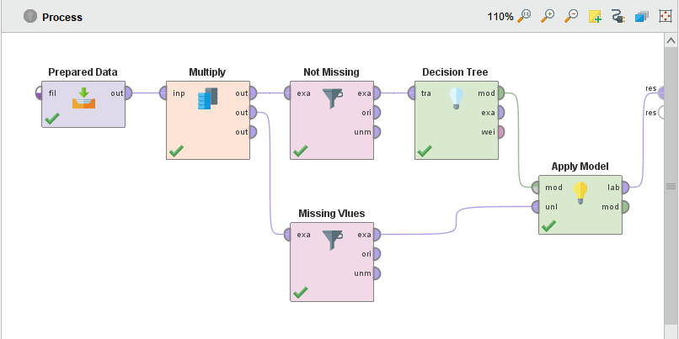
Model Design
Decision tree
To predict the missing returned transactions for 2015 data file using data about returned transactions 2012-2014.

Slide 9
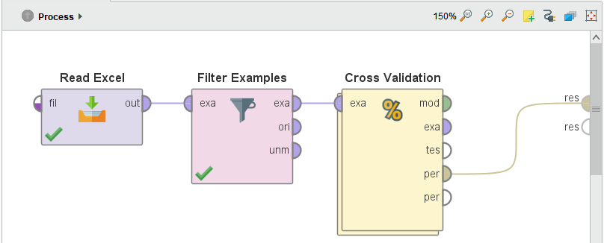
Model Design
Cross Validation
We measured the accuracy of the model by Cross Validation “K-fold”
Algorithm, that divide data into two parts one for training and other for testing.

Slide 10
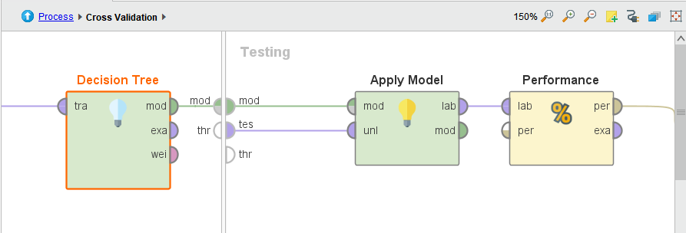
Model Design
Cross Validation Interior

Slide 11
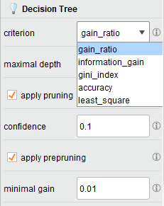
Model Design
Splitting criteria / Minimal Gain

Slide 12
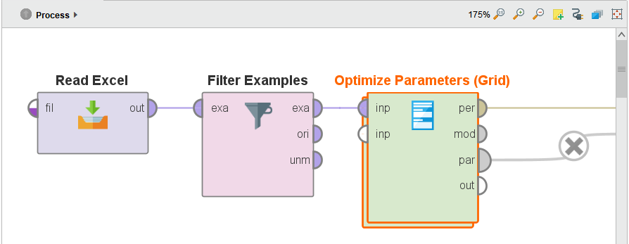
Model Design
Optimal Values

Slide 13
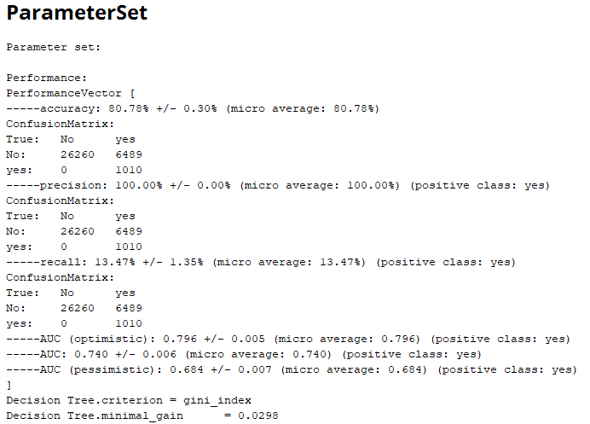
Results
Prediction Model

Slide 14
Deployment Results
Prediction Model

Slide 15
Design Model
Association Rules Discovery
What is association rule ??
  Hidden patterns
  Behavior of customers in store
  Store design

Slide 16
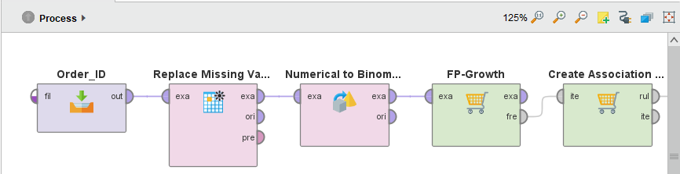
Design Model
Association Rules Discovery
    How did we apply it on Rapid Miner ??

Slide 17
Design Model
Association Rules Discovery
Outputs of Association rule
Trivial rules: {Table} ➔ {chairs}
Inexplicable rules: {Ink} ➔ {Photo Frame}
Useful rules:
Rule |  |  |  | Metrics
No. | Premises |  | Conclusion | Support | Confidence
1 | { Copiers } |  | { Appliances } | 0.09 | 0.78
2 | { Bookcase } |  | { Appliances } | 0.02 | 0.402
3 | { Binders, Arts } |  | { Copiers } | 0.12 | 0.45
4 | { Phones } | { Accessorizes } |  | 0.03 | 0.31

Slide 18


Deployment Results
Market Basket Analysis
Rule |  |  |  | Metrics
No. | Premises |  | Conclusion | Support | Confidence
1 | { Copiers } |  | { Appliances } | 0.09 | 0.78
2 | { Bookcase } |  | { Appliances } | 0.02 | 0.402
3 | { Binders, Arts } |  | { Copiers } | 0.12 | 0.45
4 | { Phones } | { Accessorizes } |  | 0.03 | 0.31
Cross-Selling
UP-Selling

Slide 19
Deployment Results
Market Basket Analysis
Rule |  |  |  | Metrics
No. | Premises |  | Conclusion | Support | Confidence
1 | { Copiers } |  | { Appliances } | 0.09 | 0.78
2 | { Bookcase } |  | { Appliances } | 0.02 | 0.402
3 | { Binders, Arts } |  | { Copiers } | 0.12 | 0.45
4 | { Phones } | { Accessorizes } |  | 0.03 | 0.31
Store & Webstore Design
Sales & Discount

Slide 20
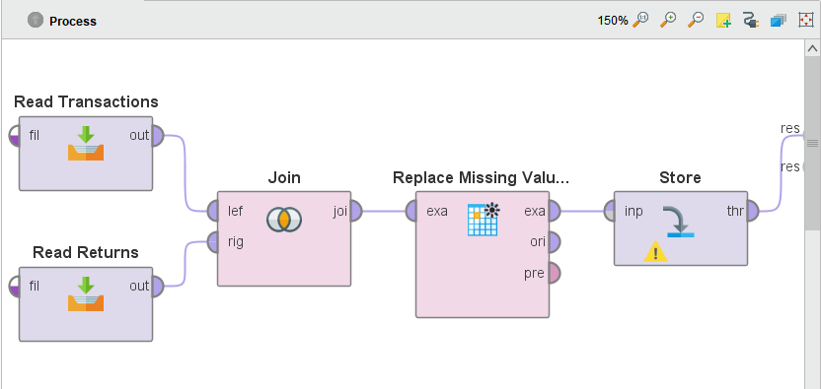
Data Preparation
Integration
Joining transactions data file (2012-2014) with the returns (2012-2014) by Rapid miner:

Slide 21
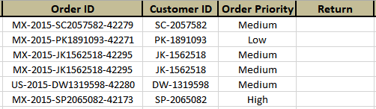
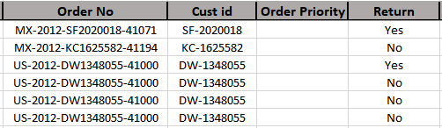
Data Preparation
Integration
Appending transactions data file (2015) on transactions data file (2012-2014) by Rapid miner:
Problem!!
The schemas are different that’s we call data inconsistency so at first we should to solve problem by Schema integration.
Return
Order ID
Customer ID
Order Priority

Slide 22
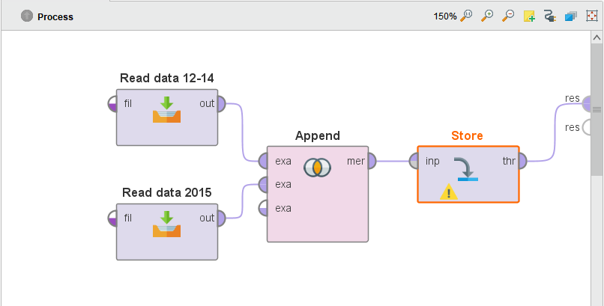
Data Preparation
Integration

Slide 23
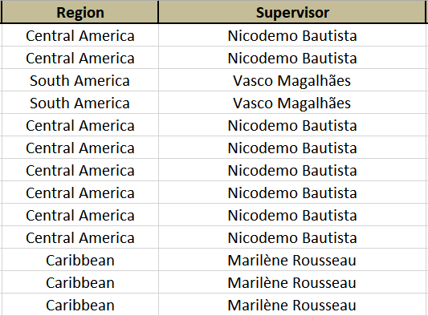
Data Preparation
Integration
Assigning the supervisor for each region by VLOOKUP

Slide 24
Data Preparation
Reduction
Dimensionality Reduction
Row_ID: dummy incremental ID
Postal_Code: many missing values
Order_Priority: many missing values
Checked: same values
Remove extreme values
We deleted all records that contains extremes values depending
on profit attribute.
Notes:
remove unimportant attributes in data file
Cant help us in classification or categorizing the data

Slide 25
Data Preparation
Transformation (Coding)
Category | Code | Sub-Category | Code
Furniture | Fur | Bookcases | Bo
 |  | Chairs | Ch
 |  | Furnishing | Fu
 |  | Tables | Ta
Office Supplies | Off | Appliances | Ap
 |  | Art | Ar
 |  | Binders | Bi
 |  | Envelops | En
 |  | Fasteners | Fa
 |  | Labels | La
 |  | Paper | Pa
 |  | Storage | St
 |  | Supplies | Su
Technology | Tec | Accessories | Ac
 |  | Copiers | Co
 |  | Machines | Ma
 |  | Phones | Ph
Then we sorted all products ascending and give each name incremental ID
Combined the three parts of the code with each other.
Example(OffPa540)

Slide 26
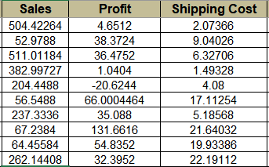
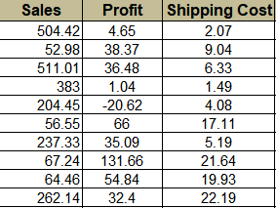
Data Preparation
Cleaning
Handling Noise
Rounding
ROUND((Value),2)

Slide 27

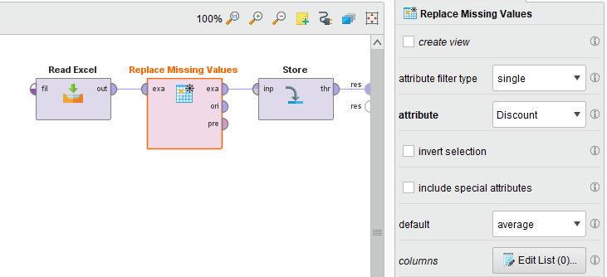
Data Preparation
Cleaning
Replacing Missing Values
Notes:
We use Average to fill Missing to maintain Average of all data( data that doesn’t have missing)

Slide 28

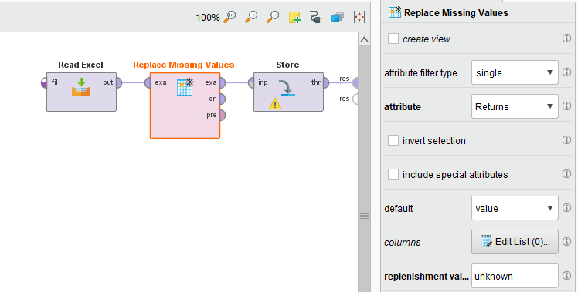
Data Preparation
Cleaning
Replacing Missing Values Temporary

Slide 29



RFM Analysis
Calculation
It groups customers based on their transaction history of purchases
Recency (R)
How recently
➔ Order_date
Frequency (F)
How often
➔ Customer_ID
Monetary (M)
How much
➔ Sales
Notes:
بعد انهاء عملية تحضير و تنظيف البيانات اشتقينا ملف خاص لبناء الأر اف ام موديل
It groups customers based on their transaction history – how recently, how often and how much did they buy.

Slide 30
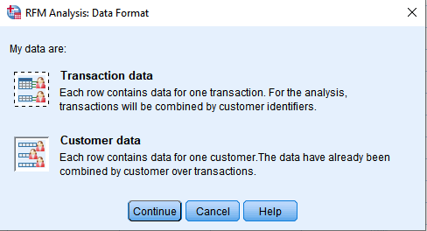
RFM Analysis
Calculation
BY SPSS, Direct Marketing >> RFM Analysis >> Transaction data

Slide 31
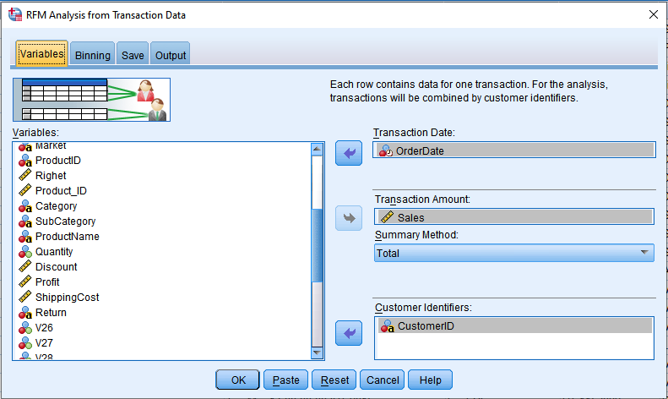
RFM Analysis
Calculation
Assigning attributes to calculate RFM

Slide 32
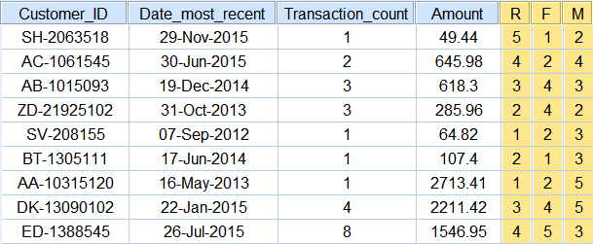

RFM Analysis
Results
Sample of the results
Notes:
Take example

Slide 33
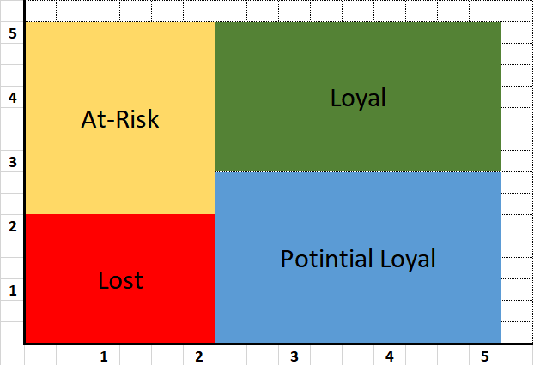
RFM Analysis
Customer Segmentation
F&M
Don’t Lose
Champions
Need Attention
Recent
R

Slide 34
RFM Analysis
Recommendation System
Customer segmentation
Combining customers data in one file
Give each type behavior description and a tip to deal with him
By Visual Basic and MS-Excel we build a simple Recommend system
Notes:
Take an example

Slide 35
Automation
Transform work to codes
What does it mean ??
Why we do it ??
How we did it ??

Slide 36
Dashboard
Uses of Dashboard
Understand Data.
Display ad-hoc reports and charts.
Help with making decisions based on the given visualizations

Slide 37
Dashboard Designing
Key Performance Indicators
Revenue Growth Rate.
Returned Products Rate.
Growth of Orders numbers per Period

Slide 38
Conclusion
Problems
Data acquisition.
Low Quality of row data.
Limitation of free trial tools.
Capabilities of our personal computers.

Slide 39
Thank you

