Slide 1

Runoff Factor Determination for Some Districts in West-Bank Based on SCS_CN Method By Different Conditions.
Supervisor:
Engineer. Hamees Tubeileh.
By:
Atallah Sad Eddin.
Ismail Qadoha.
Khalid Qadah.

Slide 2
Introduction
  Background
Introduction
Approach
Objectives
Significance of the work

Slide 3
Background
Rainfall-runoff relationship is very complex, influenced by various storm and drainage characteristics. There are several approaches to estimate the runoff. The Soil Conservation Service-Curve Number (SCS-CN) method developed by National Resources Conservation Service (NRSC), United States Department of Agriculture (USDA) in 1969, is simple, predictable and stable conceptual method for estimation of direct runoff depth.
Objectives
The objective of this study is to assess the quantity of surface runoff from the study area using GIS based The SCS-CN model is then applied to estimate the daily runoff from the sub-basin. The study was carried out in the West Bank watershed about 5860 km².
The summary of objectives can be listed as:
Determine Curve Number for each district on dry, average and wet conditions.
Find average rainfall depth for each districts.
Determine the volume of runoff for a specific districts.
Determine Run off coefficient for these districts.

Slide 4
Study Area
History
Geographical Location
West-Bank
Topography
Population
Area
District
Rainfall

Slide 5
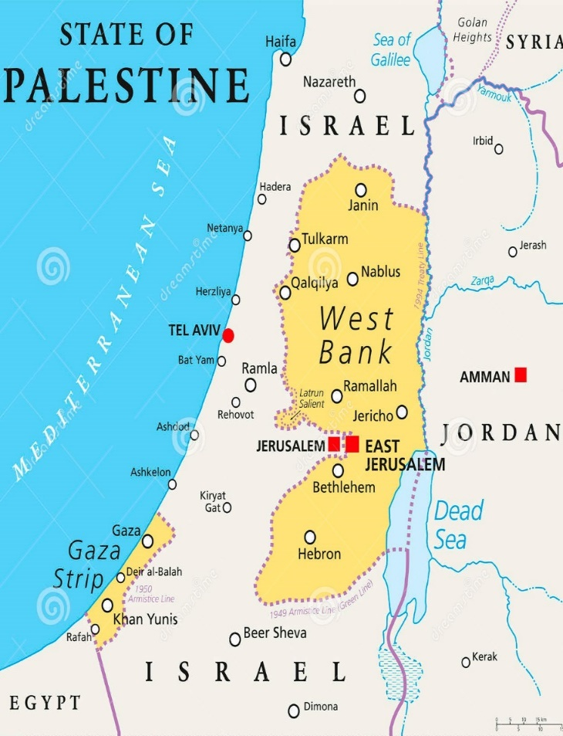
West-Bank History:
The term Jordan launched on the remaining part of Palestine which did not fall after the Nakba in 1948, and annexed to Jordan after the Battle of Jerusalem at the Jericho Conference in 1951.
Geographical Location:
West Bank lies in the west of Jordan. It is bordered to the east and is surrounded by 1948 Palestinian land from the north, west and south. The Jordanian authorities named it as the "West Bank" because it lies to the west of the Jordan River, while most of the territory of the Hashemite Kingdom of Jordan lies east of the river.
Its include the mountains of Nablus and the Jerusalem hills, including the eastern part of Jerusalem and the mountains of Hebron and the western Jordan Valley.
Figure 2.1: West-Bank Political Map.

Slide 6
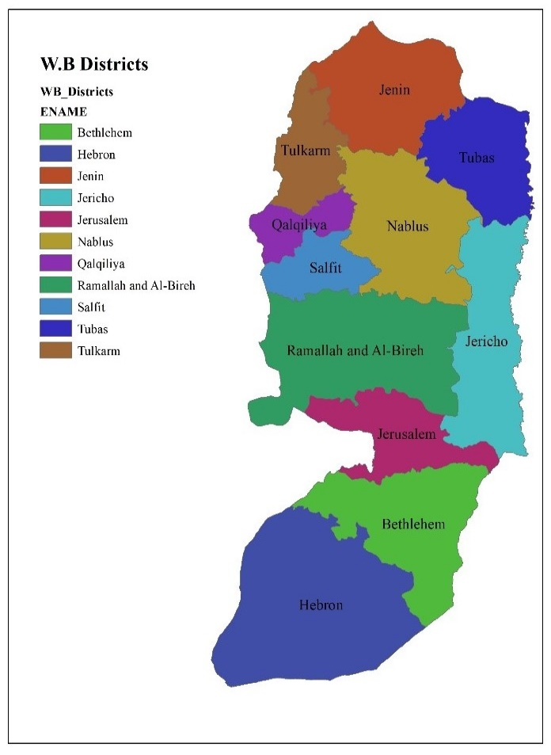
Population:
According to estimates of the Palestinian statistical system for 2013, the number of Palestinians in the West Bank is estimated at 2.8 million Palestinians.
In 2017, number of Palestinians in the West Bank is increased to 3.01 million Palestinians.
Area:
The area of the West Bank is approximately 21% of the historical area of Palestine (from the river to the sea), it’s about 5860 km².
West-Bank Districts:
In this study we divided West bank into the districts which are the cities of it, Nablus, Ramallah, Jerusalem and etc. we get curve number for each district then we get curve number for whole West Bank by apply weighted average.
Figure 2.4: West-Bank Districts.

Slide 7
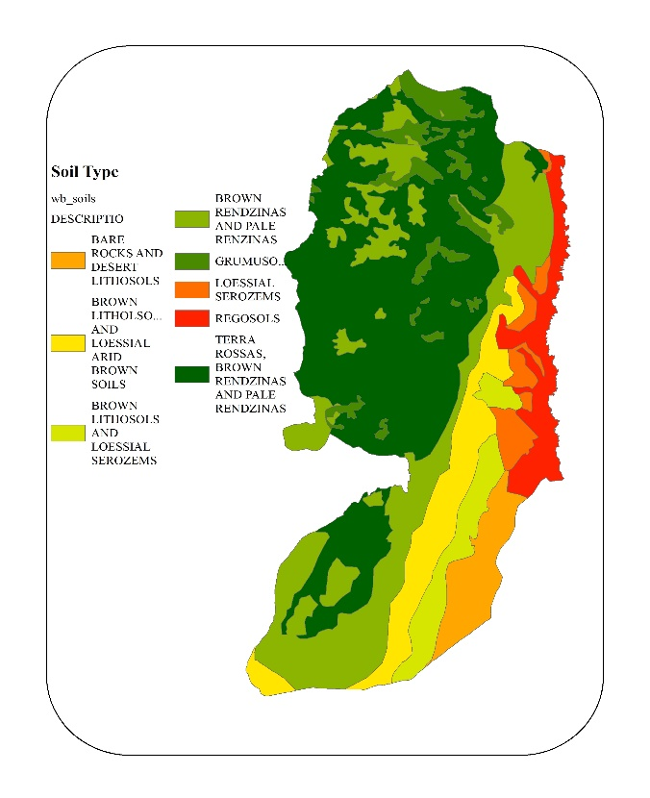
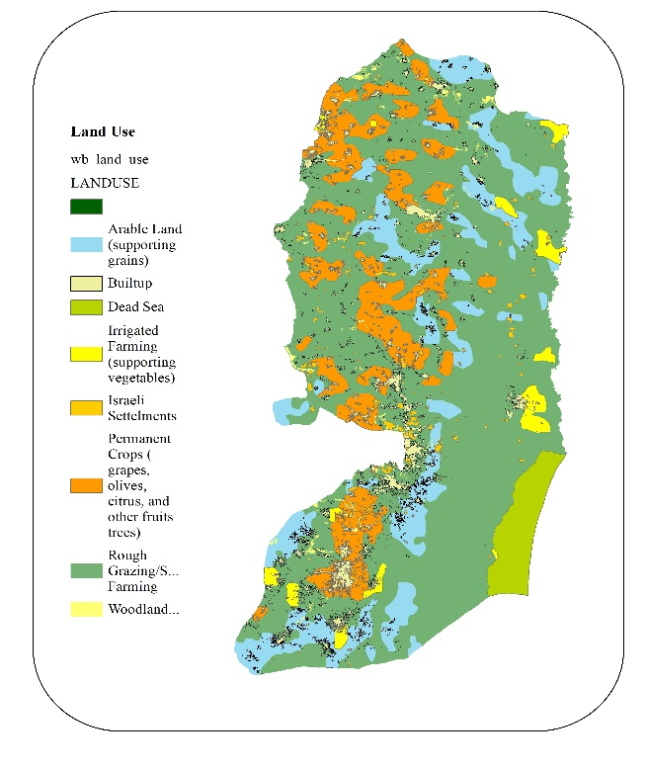
Topography:
Eight soil types exist in the West-Bank like TERRA ROSSAS, BROWN RENDZINAS AND PALE RENDZINAS etc.
Soil distribution is shown in figure 2.2.
The land use of the West Bank is classified into seven classes: built-up areas (5%), woodland/forest (0.7%), Israeli settlements (1.4%), arable land (14.31%), rough grazing/subsistence farming (61.7%), irrigated farming (2.63%), and permanent crops (14.3%), as shown in Fig 2.3.
Figure 2.2: West-Bank Soil Types.
Figure 2.3: West-Bank Land Use.

Slide 8
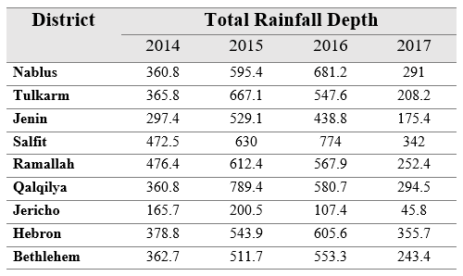
Rainfall in the West Bank:
The average rainfall in the West Bank ranges between 700 mm and 100 mm in the Dead Sea area, 500-600 mm in the western slopes and 100-450 mm in the eastern slopes.
Table 2.1: Rainfall depths in West-Bank districts.

Slide 9
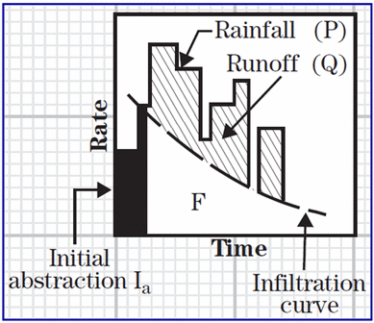
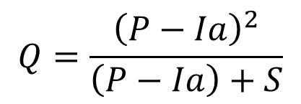
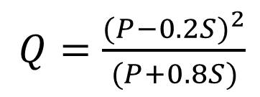
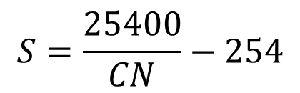
SCS-CN Method
$$Q=\frac{{\left(P−Ia\right)}^{2}}{\left(P−Ia\right)+S}$$
$$S=\frac{25400}{CN}−254$$
Ia = 0.2S
P: Rainfall depth.
I_{a}: Initial abstraction.
S: Potential maximum retention.
Q: Runoff depth.
CN: Curve Number.
Figure 3.1: Components of SCS Runoff Equation.
$Q=\frac{{(P−0.2S)}^{2}}{(P+0.8S)}$

Slide 10
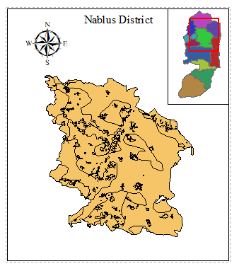
Generating CN map using Arc-map GIS
To create the CN map, the hydrologic soil group and land use maps were uploaded to the Arc map platform. The X tools extension of Arc map was used to generate the CN map.
For each district, hydrologic soil group field from the soil theme and the land use field from the land use map were selected for intersection. After intersection, a map with new polygons representing the merged soil hydrologic group and land use (soil-land map) was generated.
The appropriate CN value for each polygon of the Soil-Land map was assigned.
In this presentation, we will show to you how we work for Districts for example for Nablus district.
Figure 3.3: Nablus District.

Slide 11
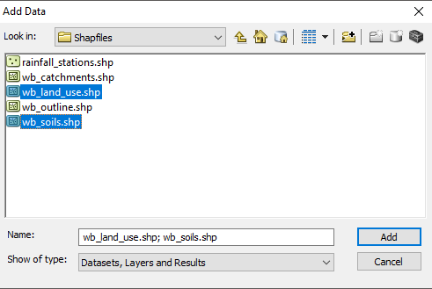
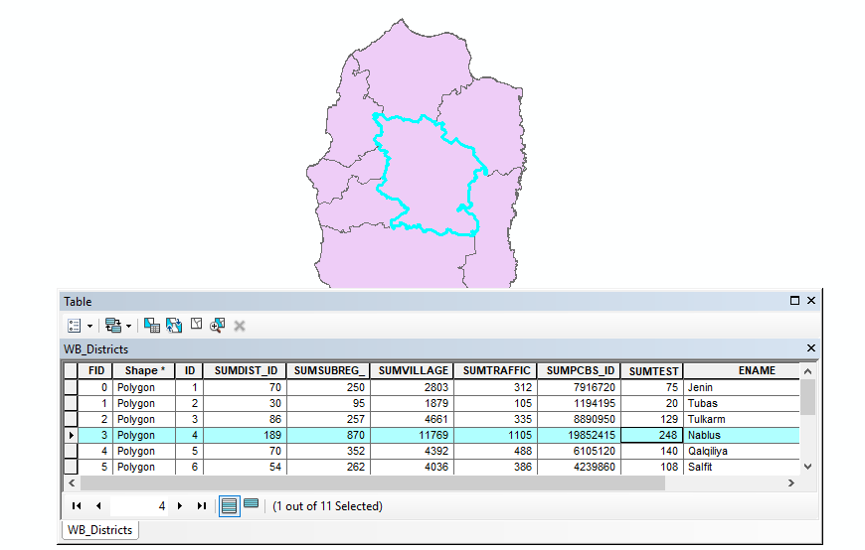
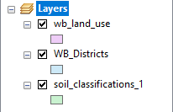
Arc-Map GIS Steps:
Add the Shape Files.
2. Choose the district from Attribute Table of West-Bank Districts Shape File.

Slide 12
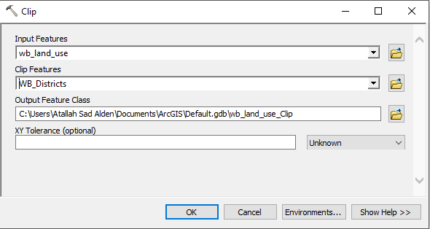
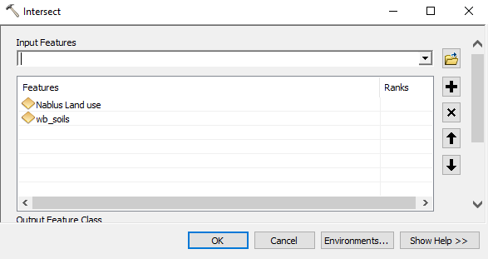
From Geoprocessing List we choose Clip tool and clip land use for Nablus district.
It produce a new shape file with name Nablus Land use.
From Geoprocessing list we choose Intersect Tool to make intersect between Nablus Land use and Soil Classification Shape files.
It produce a new Shape files with Name of Nablus Intersection.

Slide 13
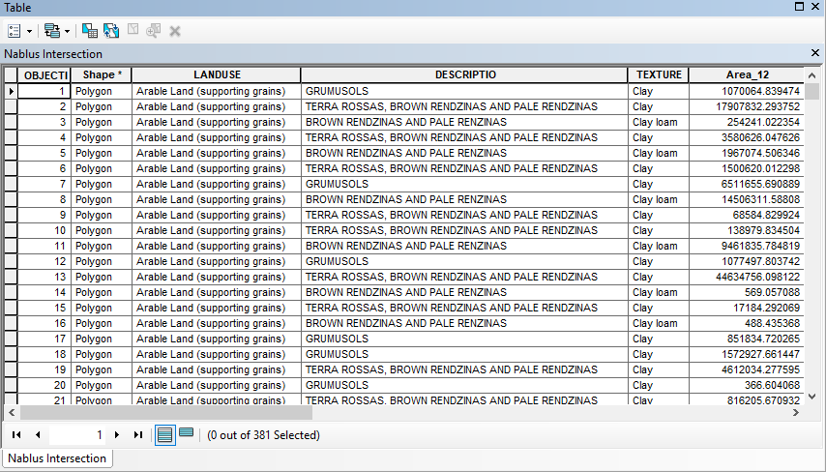
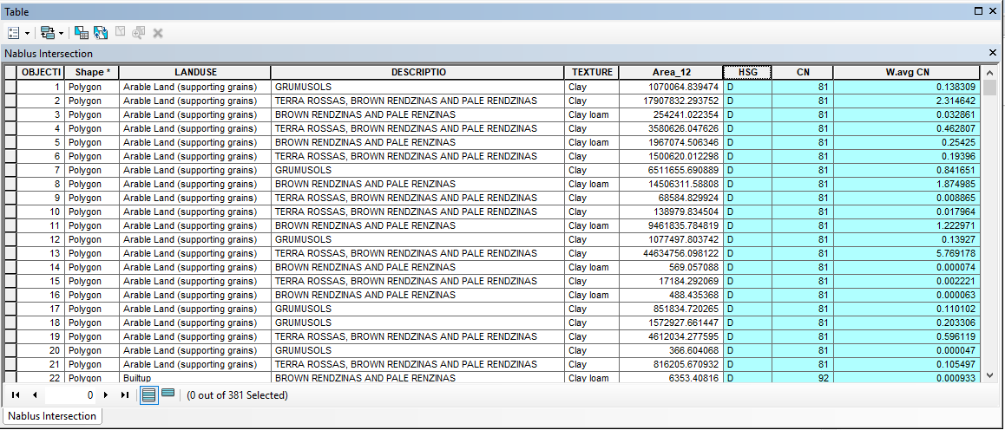
5. New Attribute Table was made to Nablus Intersect Shape File.
6. In this Attribute Table we add three Column which are (HSG, CN, W.avg CN)

Slide 14
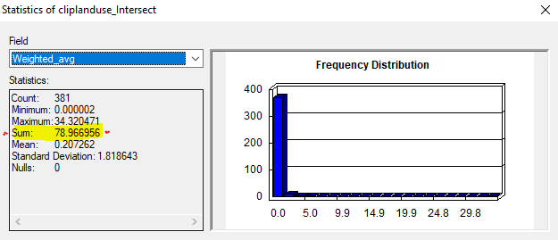
Note: to fill the new three column (HSG, CN, W.avg CN).
- First: we using select by attribute option to get soil texture for each type (A,B,C,or D).
Second: using select by attribute option for land use across HSG to get CN for each one.
Third: For W.avg CN, we use field calculation to multiply CN*Area/Total Area.
7. After we get the values of W.avg CN
from Statistics we get the Sum Value which equal to Curve Number for Nablus District.
Curve Number for Nablus District which is equal to 78.966.

Slide 15
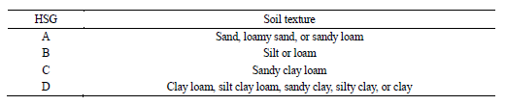
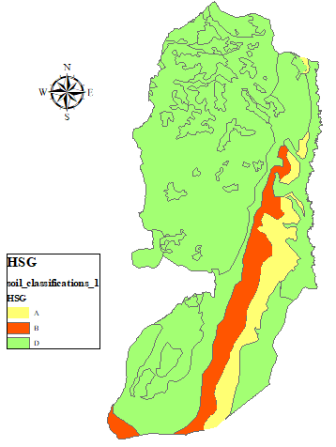
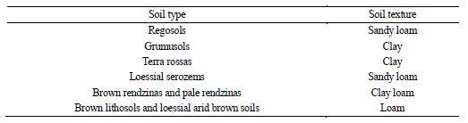
Hydrologic Soil Group (HSG)
As we said, to determine HSG for each type of soil and texture we based on two tables for Dr. Shadeed and Dr. Al-Masri.
HSG (Hydrologic Soil Groups) were distributed over West Bank with 8.248% For A, and 9.269% for B, and 0% for C, and 82.483% for D.
Table 4.1: HSG for USDA soil texture classes.
Table 4.2: Soil types according to soil texture.
Figure 4.1: Hydrologic Soil Group Distribution.

Slide 16
CN Values
To get CN value for each area, Land use must known with HSG and apply them into the tables 4.3(a & b).
- There is different land uses in West-Bank which are (Arable Land, built-up areas, woodland/forest, Israeli settlements, rough grazing/subsistence farming, irrigated farming, and permanent crops).
Built-up areas, woodland/forest, Israeli settlements, rough grazing/subsistence farming, irrigated farming, and permanent crops are Choose as this Land use:
Just For Arable Land Varies from district to another based on topographic for each district in our opinion, For example Arable Land in Nablus is choose Cultivated-Contoured-Terraced-Good which is different from Tubas Cultivated-Straight Row and so on.
Land Use | Name From Tables
Built Up Area | Residential Area with 65%
Irrigated Farming | Orchards with understory cover
Israel Settlement | Residential Area with 65%
Permanent Crops | Orchards with understory cover
Rough Grazing | Pasture-Good
Wood Land/Forest | Forest-Dense

Slide 17
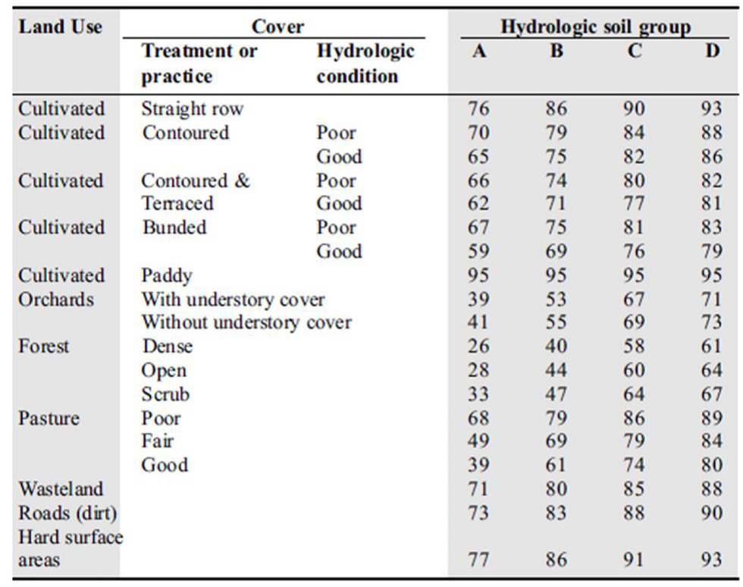
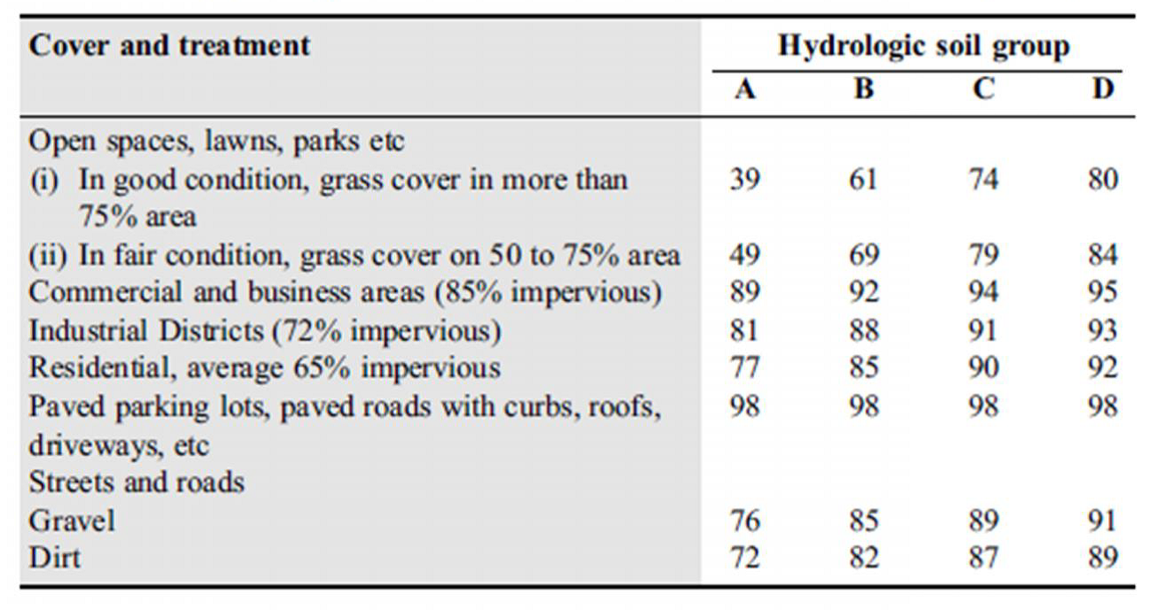
Table 4.3(b): CN values for Suburban and Urban Land Uses (under AMC II)
Table 4.3(a): Runoff Curve Numbers for hydrologic soil cover by complexes (under AMC II)

Slide 18
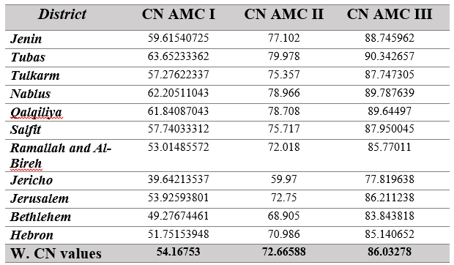
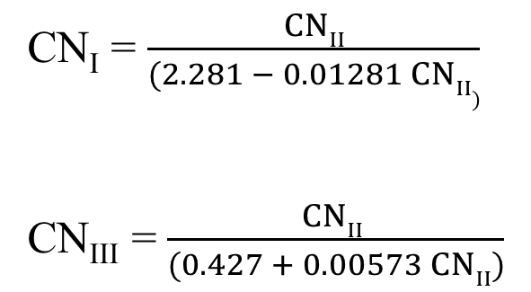
After we get statistics for W.avg CN to each district in West-Bank, We get CN II values and by applying this values to CN I & CN III equations we get all values for all district in West-Bank.
CN_{I} = $\frac{CNII}{(2.281 − 0.01281 CNII)}$
CN_{III} = $\frac{CNII }{(0.427 + 0.00573 CNII)}$
Table 4.5: Curve Numbers For all districts under the three AMC

Slide 19
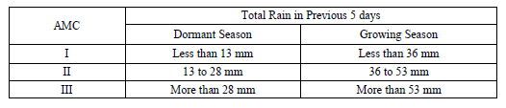
Antecedent Moisture Condition
The AMC is an attempt to account for the variation in curve number in an area under consideration from time to time. Three levels of AMC were documented by SCS AMC I, AMC II & AMC III. The limits of these three AMC classes are based on rainfall magnitude of previous five days and season (dormant season and growing season).
We assume that months September, October and November are Dormant Season, and in the other hand months December, January and February are Growing Season according to the plants natural in Palestine.
Table 4.6: Antecedence Moisture Conditions (AMC) for determining value of CN

Slide 20
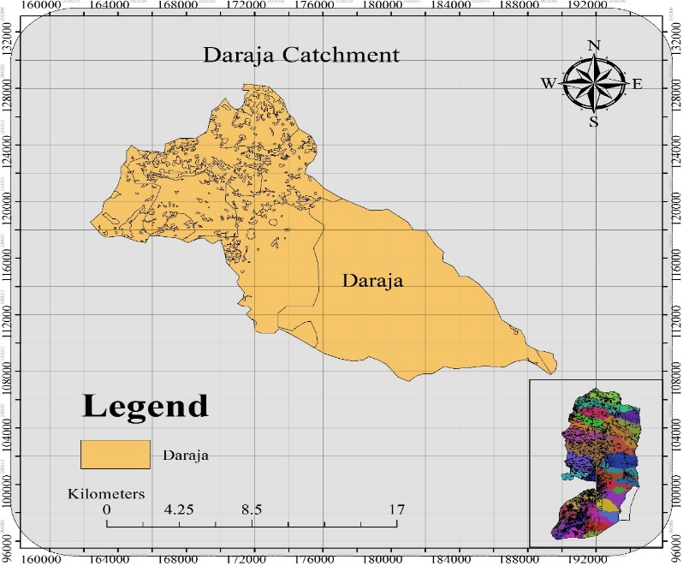
Performance of SCS-CN Method
This section provides a comparison between the storm runoff amounts estimated by the SCS-CN approach and observed runoff. Selected storm events in the Al-Faria, Al-Draja, and Al-Og (Al-Mukallak) Catchments.
In this presentation we will show Al-Daraja Catchment calculations.
Figure 4.4: Al-Daraja Catchment.

Slide 21
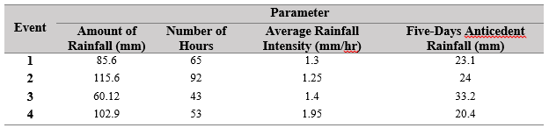

Four rainfall events were taken in 7 to 10 Jan 2015 (Event 1), 17 to 21 Feb 2015 (Event 2), 15 to 16 Apr 2015 (Event 3), and 24 to 26 Jan 2016 (Event 4). Characteristics of these events are summarized in table (4.9).
It is apparent that dry conditions prevailed for the four events, since the measured five-day antecedent rainfall was less than 35 mm. Therefore, CN_{I} for (AMC I) is equal 49.276. Calculations are shown in the table (4.10).
Table 4.9: Characteristics of four rainfall events for Al-Daraja catchment.
Table 4.10: Performance of SCS-CN method for Al-Daraja catchment events.

Slide 22
From the results for Al-Daraja Catchment that Shawn from table (4.10), Depth deviation ranged between 6.52% to 32.18% which is give an accurate to determine Runoff volume based on SCS-CN method 86 %.
For Al-Faria Catchment, Depth deviation ranged between 34.08% to 50% which is give an accurate to determine Runoff volume based on SCS-CN method 57%.
For Al-Mukallak Catchment, Depth deviation is equaled to 7.2 % which is give an accurate to determine Runoff volume based on SCS-CN method 92.8 %.
By considering all the rainfall events, the accuracy of the proposed approach in estimating direct surface runoff is found to be about 79 %. This value is good enough to assume the applicability of the SCS-CN method in predicting runoff generation amounts for West-Bank districts after taking into consideration that the effects of evapotranspiration in negligible.

Slide 23

Analysis of Runoff Depths
Growing Season-Dry Condition (AMC I)
For Dry conditions (Growing Season) we choose the storm at January 6th in Jenin District, day of storm and the five days previous rainfall depths are as the following table (4.10):
The sum of the previous five days which equal to 21.2 mm which is less than 36 mm.
Curve Number for Jenin District is CN_{I} equal to 59.6154
S=172.064 I_{a} = 34.412 mm. P = 52.2 mm.
P < I_{a} there is Runoff.
Table 4.16: 6th January 2015 and five days previously in Jenin

Slide 24
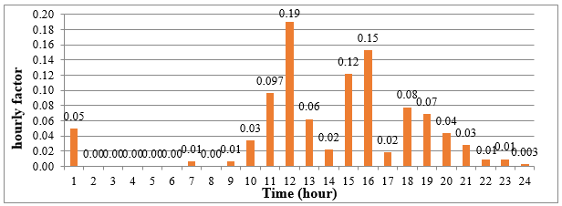
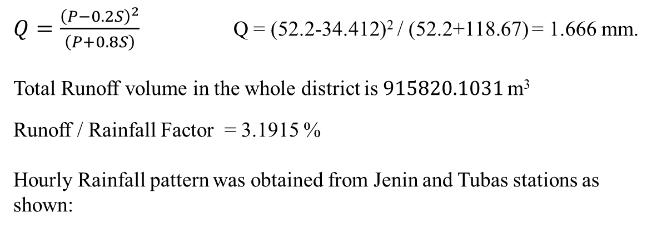
$Q=\frac{{\left(P−0.2S\right)}^{2}}{\left(P+0.8S\right)}$ Q = (52.2-34.412)² / (52.2+118.67) = 1.666 mm.
Total Runoff volume in the whole district is $915820.1031$m³
Runoff / Rainfall Factor = 3.1915 %
Hourly Rainfall pattern was obtained from Jenin and Tubas stations as shown:
Hour | Hourly Factor | Hourly Depth
1 | 0.05 | 2.61
2 | 0 | 0
3 | 0 | 0
4 | 0 | 0
5 | 0 | 0
6 | 0 | 0
7 | 0.01 | 0.522
8 | 0 | 0
9 | 0.01 | 0.522
10 | 0.03 | 1.566
11 | 0.097 | 5.0634
12 | 0.19 | 9.918
13 | 0.06 | 3.132
14 | 0.02 | 1.044
15 | 0.12 | 6.264
16 | 0.15 | 7.83
17 | 0.02 | 1.044
18 | 0.08 | 4.176
19 | 0.07 | 3.654
20 | 0.04 | 2.088
21 | 0.03 | 1.566
22 | 0.01 | 0.522
23 | 0.01 | 0.522
24 | 0.003 | 0.1566
Figure 4.6: Jenin and Tubas Rainfall Hourly Factor (Pattern).
Table 4.17: January 6th 2015 hour depth in Jenin.

Slide 25
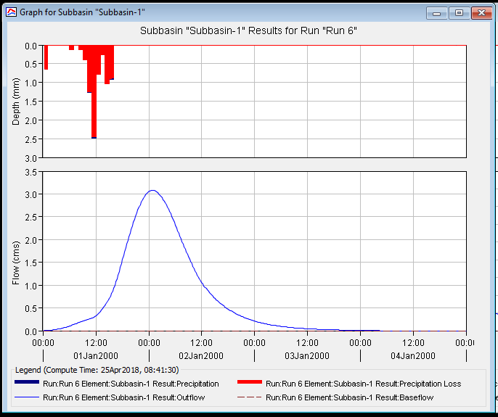
These values was used in HEC-HMS program to get the hydrograph of the storm, this hydrograph is shown in the figure (4.7):
Figure 4.7: Jenin Storm hydrograph.

Slide 26
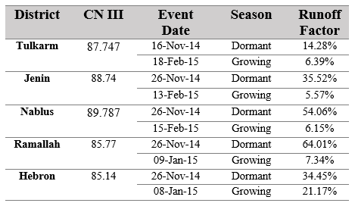
Discussion & Conclusion
It is notice that Runoff factor in growing season less than it in dormant season for the same district which is not match with theory of SCS-CN method for determining runoff that says infiltration capacity decrease with time, as shown in the figure 3.1 9.
This result ensure that runoff factor doesn’t dependent only on soil layer and land use, it also dependent on quantity of rainfall and the duration of raining and not raining before the event.
Table 5.2: Runoff Factor calculations for Dormant and Growing Seasons.

Slide 27
Thank You

