Slide 1

Causes of Contractors’ Failure
“ North West Bank”
Graduation Project
Alaa Abu Mhemeed
Ali Ramadan
Yousef Al-Thaher
Supervisor:
 |  | Eng. Mohammed Abu Ne’ma

Slide 2
Agenda
1
Introduction of study
2
Research Methodology
3
Data Analysis and Results
4
Conclusion and Recommendation
4
6
5
6

Slide 3
Objectives
Objectives of the study.
Identify the main causes of construction contractors' failure at North West Bank.
Classify these causes, based on the importance and their influence.
Determine the rate of occurrence of these causes.

Slide 4
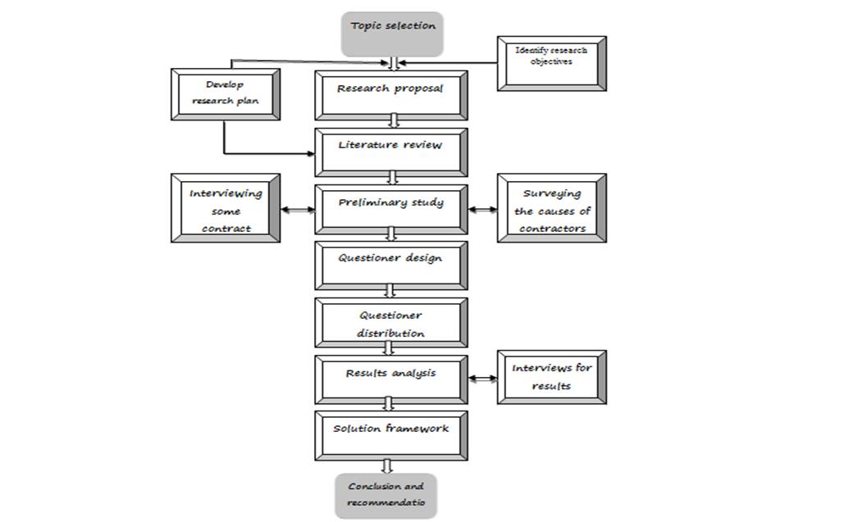
Methodology

Slide 5
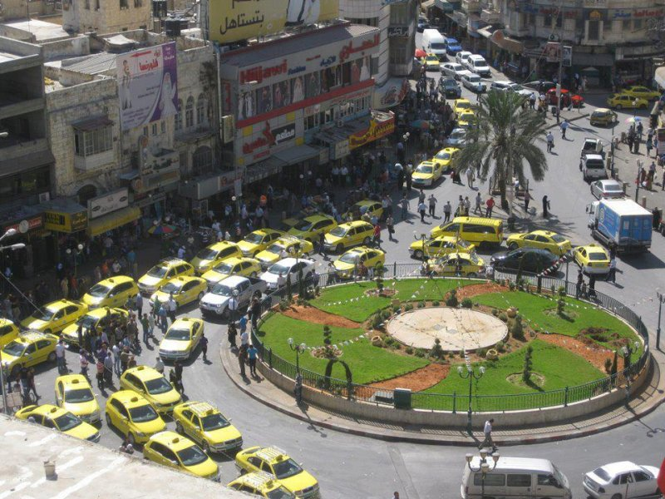
Data Analysis and Results
Questionnaire.
Nablus is a representative city in the North West Bank, it has 40 contractors (1st and 2nd class).
Notes:
about 51 contractors (1st , 2nd and 3rd classes) but here in this study only 1st and 2nd classes were into consideration.

Slide 6
Data Analysis and Results
Questionnaire.
40 contractors as a population.
50 questionnaires were sent and distributed among the contractors in Nablus while 37 questionnaires were gathered.
The questionnaire consists of two parts; Respondent characteristics, causes of contractors’ failure.
Notes:
, which means that we have got about 72% responding.
the respondent should answer the first part by answering the question and the second part by ranking the causes upon the importance degree from 1 to 5 in the likert scale.

Slide 7
Data Analysis and Results
Methods of distribution the questionnaire.
Written questionnaires
Telephones and faxes
E-mails and Google survey
Interviews
Notes:
Many methods and manners were involved in distributing the questionnaire starting with traditional ways, by distributing
and ending with modern ways by Using
. In addition to that, interviews were held.

Slide 8
Data Analysis and Results
Pilot- Tested Questionnaire
Questionnaire arbitration was made by interviewing two contractors, first and second classes and a new improved questionnaire was made.
Notes:
In order to get precise, accurate causes of contractors’ failure,
who made a brief changes on the previous questionnaire

Slide 9
Data Analysis
Part one of Questionnaire “respondent characteristics”
Each respondent characteristic was analyzed individually to understand the nature of the sample, and then comparison between the characteristics was made.
Notes:
In this part,
to notice the effects of each characteristic on the results and the effects together.

Slide 10
Data Analysis
Respondents level of education
 | 1st | 2nd | Total
Bachelor | 17 | 10 | 27
Master | 4 | 0 | 4
Ph. D. | 0 | 2 | 2
Other | 4 | 0 | 4

Slide 11
Data Analysis
Respondents experience
 | 1st | 2nd | total
(1-5) | 2 | 4 | 6
(5-10) | 4 | 1 | 5
(10-15) | 6 | 2 | 8
More than (15) | 13 | 5 | 18

Slide 12
Data Analysis
Number of projects the respondent were involved
 | 1st | 2nd | total
(5-10) | 3 | 4 | 7
(10-15) | 2 | 1 | 3
(15-20) | 2 | 1 | 3
More than (20) | 18 | 6 | 24

Slide 13
Data Analysis
Type of the respondents’ company
 | total
1st class | 25
2nd class | 12

Slide 14
Data Analysis
Work level of the respondent company
 | 1st | 2nd | total
Local | 5 | 7 | 12
National | 12 | 5 | 17
Regional | 6 | 0 | 6
International | 2 | 0 | 2

Slide 15
Data Analysis
Average number of projects the respondents company implement per year.
 | 1st | 2nd | total
(1-3) | 15 | 8 | 23
(4-6) | 7 | 2 | 9
(7-10) | 2 | 1 | 3
More than (10) | 1 | 1 | 2

Slide 16
Data Analysis
Number of projects the respondent has failed in it.
 | 1st | 2nd | total
None | 4 | 6 | 10
(1-3) | 11 | 5 | 16
(3-5) | 7 | 1 | 8
More than 5 | 3 | 0 | 3

Slide 17
Discussion of Results
First class | Second Class
Contractor negligence (time , contracts, money ) | lack of experience in the work
poor estimation practices | Negligence labor productivity and improvement
lack of experience in the work | Contractor negligence(time,contracts and money)
national slump in economy | national slump in economy (Environmental)
Delay in collecting debt from donors | Negligence assigning project leader in the site
low margin profit due to competition | Delay in collecting debt from donors
bad decisions in regulating company policy | bad decisions in regulating company policy
Negligence labor productivity and improvement | low margin profit due to competition
Border closure | company organization
cash flow management | High cost of materials

Slide 18
Causes of contractors’ failure upon contractors’ point of view.
Managerial causes | RII | Rank within group | Rank total
lack of experience in the work | 90.27 | 1 | 1
Contractor negligence(time,contracts,money) | 90.27 | 2 | 2
Negligence labor productivity and improvement | 84.86 | 3 | 6
bad decisions in regulating company policy | 82.16 | 4 | 8
company organization | 79.46 | 5 | 10
Bad procurement practices | 79.46 | 6 | 11
Negligence assigning project leader in the site | 78.92 | 7 | 12
Claims | 75.68 | 8 | 16
Lack of using project management techniques | 74.05 | 9 | 20
owner absent from the company | 73.51 | 10 | 22
Frauds | 71.58 | 11 | 27
replace key personnel | 68.11 | 12 | 32
Lack of using computer applications | 65.95 | 13 | 36

Slide 19
Continuous…
Financial causes | RII | Rank within group | Rank total
poor estimation practices | 86.49 | 1 | 3
low margin profit due to competition | 83.24 | 2 | 7
cash flow management | 78.92 | 3 | 13
financial problems in bill | 74.05 | 4 | 21
evaluate project profit in one fiscal year | 70.81 | 5 | 29
controlling equipment cost and usage | 68.65 | 6 | 31
employee benefits and compensations | 67.03 | 7 | 34

Slide 20
Continuous…
Expansion causes | RII | Rank within group | Rank total
increased size of projects | 78.38 | 1 | 14
increased number of projects | 75.68 | 2 | 17
change in the type of work | 72.43 | 3 | 25
lack of managerial development or maturity | 71.35 | 4 | 28
expansion into new geographic locations | 69.73 | 5 | 30
change from private to public or vice versa | 62.16 | 6 | 38
opening a regional office | 58.38 | 7 | 39

Slide 21
Continuous…
ENVIRONMENTAL CAUSES | RII | Rank within group | Rank total
National economic slump | 85.95 | 1 | 4
construction industry regulations in Palestine | 75.14 | 2 | 19
owner involvement in construction phase | 63.78 | 3 | 37
bad weather | 56.22 | 4 | 40

Slide 22
Continuous…
POLITICAL CAUSES | RII | Rank within group | Rank total
Delay in collecting debt from donors | 85.41 | 1 | 5
Border closure | 80 | 2 | 9
Banks policy | 76.76 | 3 | 15
Limitations on material import | 75.68 | 4 | 18
Segmentation of West Bank | 73.51 | 5 | 23
High cost of materials | 73.51 | 6 | 24
Lack of resources | 71.89 | 7 | 26
Difficulties in dealing with suppliers and traders | 67.57 | 8 | 33
Monopoly | 67.03 | 9 | 35

Slide 23
Conclusion and recommendation
Top Ten causes from contractors’ point of view regardless the type of the class
lack of experience in the work
Contractor negligence(time , contracts and money)
poor estimation practices
economic national slump
Delay in collecting debt from donors
Negligence labor productivity and improvement
low margin profit due to competition
bad decisions in regulating company policy
Border closure
company organization

Slide 24
Conclusion and recommendation
Recommendations
Study the bid documents well before apply to the work and be serious.
Don’t depend only on your previous knowledge
Bid documents’ should be studied by specialists’ technicians.
Study the nature and the environment of the site well before pricing the bid documents.
The profit margin should depend on accurate, previous studying not on competitions.
Notes:
The contractors have to
each contract should be treated upon the nature of the contract itself without depending on comparison with other contracts, because this may causes lack of attention, as a result, being in trouble.

Slide 25
Continuous…
The owner has to be committed in payments as the deal between the two parties
During implementing the work, depend on a studied plan and accurate schedule includes all details
Administrative hierarchy should be taken into consideration.
A highly skilled labor should be hired.
Notes:
, otherwise, the prices will increase, the trust between the owner and the contractor will decrease and negative cash flow will appear. As a result, the contractor may loss in the project.
, and it’s preferable to use a software program to achieve the work.

Slide 26
Contractors’ opinion about the results of the study
First class contractor commented on the study results as follows:
The results of the study are logical.
There is a disparity in causes
It is very important to focus on these causes and try to solve it with contractors’ union.
The results should be published in a clear manner and generalization in contractors’ and institutions sectors.

Slide 27
Continuous…
Second class contractor commented as follows:
The results of the study represent the reality.
The study should extend all over the north of West Bank.
It is essential to discuss the results in workshops.
The study should be published to benefit others.

Slide 28
Conclusion and recommendation
Further research
it’s recommended to apply the study over all West Bank and including all types of classes (1st , 2nd, 3rd , 4th and 5th ) classes.
The future researcher may develop the study by extending the questionnaire to include engineers’, owners’ and the governmental institutions’ point of view.
Notes:
The study is limited to the north of Palestine by choosing Nablus as a representative city, and it is also limited to the building first and second contractors only.

Slide 29
Continuous…
Some contractors suggested other different causes of failure beyond the questionnaire; such as, dealing with the Palestinian ministry of finance, employer belonging to the company, political situation.
Notes:
, equipments’ rental, finance, increased the prices of fuel, the policy of the court of law, unfair contractors’ classification in the contractors’ union, the company’s depend on the banks, so many taxes, the continuous increasing in prices and currency fluctuations. So the future researcher may develop the questionnaire to involve these causes.

Slide 30


Slide 31


