Slide 1
Development marketing plan for industrial engineering department at An-Najah National University"

Slide 2
CONTENTS OF THIS TEMPLET
INTRODUCTION
PROPLEM STATMENT
PROJECT DESCRIPPTION
DEVELOPMENT MARKETING PLAN
CONCLUSION AND RECOMMENDATIONS
LITERATURE REVIEW

Slide 3
INTRODUCTION
Marketing plays a major role in the success of institutions, it has become an important activity in non-profit organizations such as institutions of higher education.
Marketing is a global trend taken by many universities in the world, that universities marketing their educational services leads to higher production efficiency, thus expansion , continuing the market, represents the link between the university and society in raising awareness and providing administrative and academic departments with the needs of society.
The most important problems that universities face are the lack of marketing for their educational specializations. Therefore, this project focuses on developing and using the marketing research tool to develop a complete marketing plan for the industrial engineering specialization at Al-Najah National University-Nablus.

Slide 4
PROPLEM STATEMENT
The main problem is many institutions do not know anything about the industrial engineer, as he can benefit them through planning, implementation ,control , management , economics, total quality management, process design, human rescuers , layout , MRS , supply chain and safety.
Also, high school students are moving away from the specialty of industrial engineering because they believe it does not suit them, while specialization is one of the best ways to own a private business.

Slide 5

PROJECT DESCRIPTION
To develop a full marketing and promotional plan for the industrial engineering among employers and high school students.

Slide 6
CASE STUDIES
“Customers’ Attitudes and Beliefs Toward Internet Advertising in Palestine” (Anati study, 2013)
The study aimed to know the extent of Internet use in Palestine and to know consumer attitudes towards internet advertising.
The results showed that the Internet is the most used means of communication in Palestine with a minimum of three hours a day, followed by television, then newspapers, radio stations, and finally magazines.
They also realize that internet ads are useful for getting information about a product or service and for the promotion, they feel good about their ads, and they prefer and consider them essential.

Slide 7

An opportunity to market university services as an entry point to improve university education (Moji Study, 2001)
The study aimed at marketing thinking at the Faculty of Education at Ain Shams University by marketing its educational services, while discussing some proposals that may work to market those services.
The result showed the marketing of educational services plays a positive and effective role in achieving a rate of return on university investments
It works to contribute to the satisfaction of the beneficiaries of the university and its services.

Slide 8
DEVELOPMENT MARKETING PLAN FOR INDUSTRIAL ENGINEERING DEPARTMENT
DEVELOPMENT METHODOLOGY
(MARKETING MIX)
IMPLEMENTATION METHODOLOGY (STATEGIC MARKETING)
01
02

Slide 9

01 STATEGIC MARKETING
1.The first stage analysis of the current situation is divided into
SOWT Analysis
Used to analyze the current situation and score points, strengths and weaknesses are identified following the analysis of the internal environment and identify opportunities and threats following the analysis of the external environment.

Slide 10
Strengths
The presence of an industrial engineering major at An-Najah University from 1995.
The accredited certificate is a double certificate before the accreditation agency of the United States of America ABET.
Faculty members are highly qualified, as 100% of them possess a master’s degree and most of them hold Ph.Ds.
Weakness
There is no proper marketing for a specialty.
The small number of students enrolled in a major.
There is a lack of faculty with a PhD.

Slide 11
Opportunities
The business fields are wide and multi-domain.
There are various factories in the West Bank.
The great demand for specialization outside Palestine.
Thearts
Lack of awareness in society of industrial engineering specialization.
Lack of institutions awareness of the efficiency of the industrial engineer.
Open specialization in Industrial Engineering at Al-Quds University.

Slide 12
2
Determine competition from other institutions
There is competition for specialization in the West Bank only by Al-Quds
University, table 2 shows that there is no strong competition for specialization
by Al-Quds University , that An-Najah National University grants the top
students to the Industrial Engineering Department to study the Master , Doctoral
and employ it in the department to graduate other generations.
As there is little competition for industrial engineering specialization in the West
Bank.

Slide 13

Determining the marketing center for a major
Inputs
Outputs
1st
3rd
2nd
4th
Enviroment
Thoughtput
Students
Industrial Engineering graduates
Society, institutions, high school students and the market
current student and Advertising Center
University Open system

Slide 14
First element (environment):
Study the market needs of industrial engineers.
Study the awareness of institutions to specialize in industrial engineering.
Study the extent of institutions satisfaction about industrial engineers. Is it seeking to hire industrial engineers?.
Studying the awareness of high school students about industrial engineering.
Second element (inputs):
Comparing the number of annual students enrolled in the Industrial Engineering major with other majors in the college.
study ratio of male and female students enrolled in the major.
Third element (throughput):
Study the university’s endeavor to make advertisements about the major.
Current students' perception of an industrial engineering major.
Fourth element (outputs):
Determine the outputs (qualifications) that industrial engineering students acquire.
Find out the current graduates status.

Slide 15
2.The second stage determines the required situation
THE GOALS:
To expand awareness and recognition of industrial engineering specialization by society and its programs in an effort to enhance access to more students.
Increase awareness and effectiveness of the engineering site of the An-Najah National University branch. Use the website as your primary marketing tool.
To raise awareness and knowledge of operational institutions about the skills of the industrial engineer and his field of work.
Increase the awareness of high school students about specialization.
Increase the number of students enrolled in the industrial engineering specialization and keep the students enrolled in it.

Slide 16
02 MARKETING MIX
Developing the methodology as a process of making changes and modifications in the marketing plan in order to improve it for the better, and to be able to keep pace with technological developments and taking into account the potentials available in terms of costs, effort and time, when developing a marketing methodology, the marketing mix (4P’s) is used indicates an integrated promotional plan in which a set of tools is used In order to deliver the commodity (service) to the largest possible number of consumers and to reach more customers and different regions.

Slide 17
4P’s
Product (services)
1st
2nd
Promotion
Place
3rd
4th
Price
1st
Good or service that a company offers to customers
includes advertising, public relations, and promotional strategy
where a company sells a product and how it delivers the product to the market
is the price strategy

Slide 18
Product (services)
The mission of the Industrial Engineering Department is to contribute effectively to the progress and development of the Palestinian community by preparing distinguished industrial engineers and engineers, based on an interactive study plan with current and future needs and scientific research directed to the needs of the market and qualified educational cadres.
Multifaceted IE Marketing Vision:
1. Increase public awareness of the specialty of industrial engineering, especially institutions and high school students.
2. Increase gross enrollment and retention of students admitted to the major.
3. Create and publish a trademark for the Department of Industrial Engineering.

Slide 19
Promotion
Radio
News
Television
NAJAH FM/Advertisement is every week for a period of three months before the first academic year and every week for a period of two months before the second academic year
nn.Ps news/ Advertising
specialization in July, August
and January
Advertising
nbc channel /Advertising three time
every day for three months before
the first semester and three times
every day for two months before the
second semester.

Slide 20

Public Relations
INSTRUCTORS AND FACULTY
STUDENTS
IE DEPARTMENT
Student accomplishments and awards, Students acceptance to college and Students graduating
accomplishments, awards, and accolades
activities to the media for public relations.

Slide 21
Direct Marketing
Presentations PPT:
Publications:
Viewbook
Study program guide
Brochures
Posters
A definition of An-Najah University and the College of Engineering an introduction to the specialty of Industrial Engineering.
Skills.
Work placement.

Slide 22


Digtial Marketing
Youtube:
Facebook:
Facebook pages (The official university page. ,Dooz and Nbc
Sponsored on facebook
Graphic advertising for the Industrial Engineering Department

Slide 23
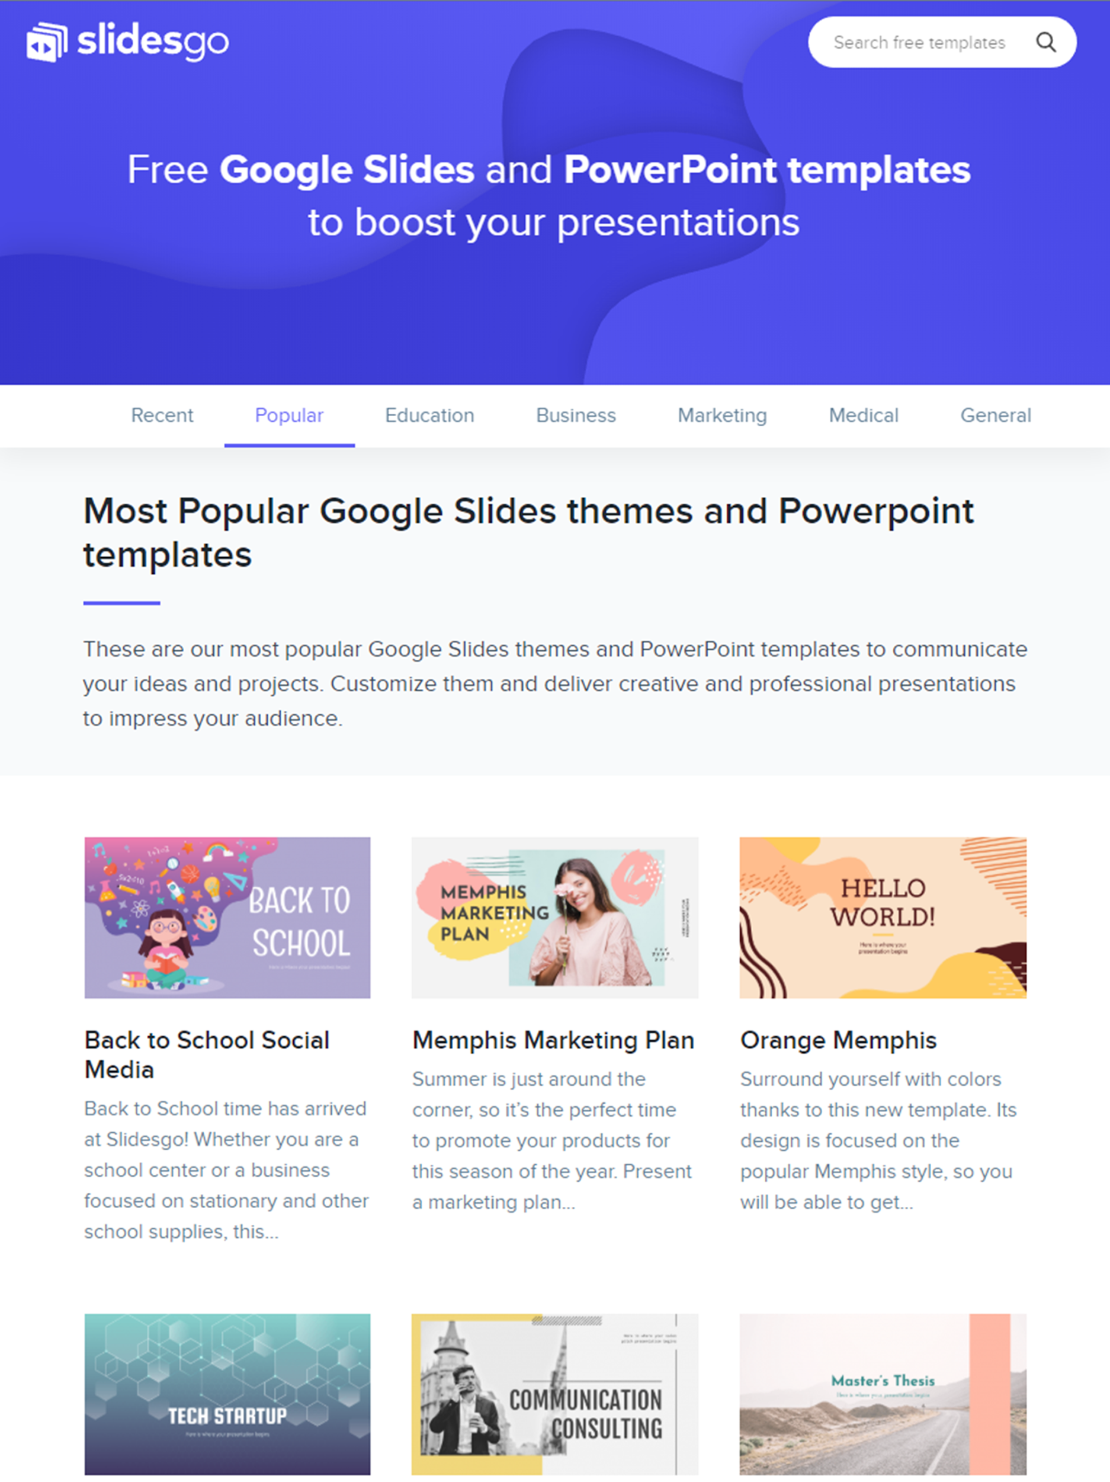

Web Site
The specialty website can be one of the most effective marketing and employment tools. It must include brief information on the industrial engineering major.
Website Objectives:
•Design the model to be consistent with other marketing materials.
•Designed to make the site more user-friendly and easy to navigate.
•Increase the number of images on the first page of the site.
Website Marketing Strategy:
We will direct all students, parents, counselors, teachers, etc. to our website.

Slide 24
Brand
Branding is an important component of any company trying to find its identity. In the case of the Department of Industrial Engineering at An-Najah University, we need to establish our brand and make it consistent in all areas.

Slide 25

CONCLUSION
This study reviewed the concept of industrial engineering specialization in all its aspects. In addition to the concept of the marketing plan.
The study tool is a development of a marketing plan designed to study the current situation in all its fields and study the required situation; the study addressed society as a whole, institutions, high school students and graduates of the Department of Industrial Engineering in particular , and questionnaires will be distributed consisting of a set of questions related to community awareness for the specialty of industrial engineering, and the questions will be analyzed for each university through the SSPS program. Based on the results, the marketing plan will be expanded to spread greater awareness about specialization to reach more students and institutions.

Slide 26

RECOMMENDATION
Scheduling marketing plan program.
Executing the marketing plan.
Preparing the emergency plan.
Monitor implementation of the plan.
Budget.
Determine the result.

Slide 27
THANKS
Do you have any questions?
PREAPERD BY:
ASEEL NABEEL
HADEEL RAMDAN.
Supervised By:
Dr. Suliman Aldaffi

