Slide 1

MECHANICAL SYSTEMS IN BUILDINGS
selfeEt mall
using Under Floor Heating and Cooling
Prepared by:
Bilal Qzq
Abdel Rahman Abu Salama
Oraib Awad
Moamen Hatab
Supervisor:
Dr. Ramiz Al Khaldi

Slide 2
In our project we will design the following mechanical systems:
Under Floor Heating and Cooling
Heat Ventilation and air conditioning (HVAC) system in selfeet mall .
Plumping system in selfeet mall .
Fire fighting in selfeet mall .

Slide 3
Building Description
selfeet mall building located in Salfeet city, which consists of seven floors. Basement floor, ground floor, first floor, second floor, third floor, fourth floor and fifth floor. Each floors have more one room such as bank, office rooms, shops rooms, and cinema.

Slide 4
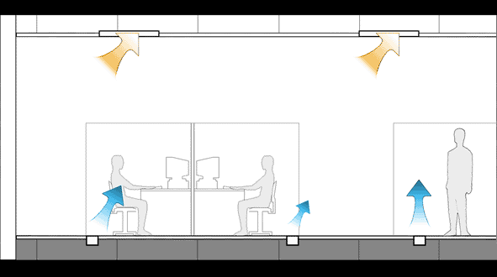
Under floor radiant cooling system
Under floor cooling systems are especially recommended for residential summer cooling and have become an extremely variable alternative to traditional air conditioning systems in recent years. They are comfortable, invisible and silent, whilst offering excellent thermal performance and versatility.

Slide 5
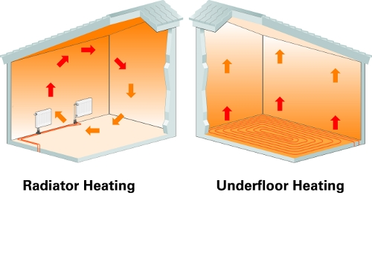
Advantages of system
1. Summer comfort
Silent working.2
Reduced energy consumption.3
5. The loss from the floor is less
6. Distributed the air cool is uniform

Slide 6
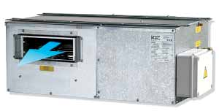
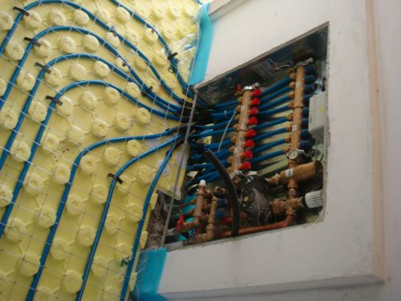

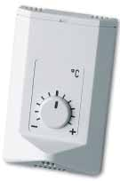
Component of the system
1 ) RNW dehumidifiers and heat recovery units
2 ) Control-Clima Thermoregulation Kit
and loops
3) RTU - HUMIDITY AND TEMPERATURE SENSOR
4 ) RT -TEMPERATURE SENSOR

Slide 7
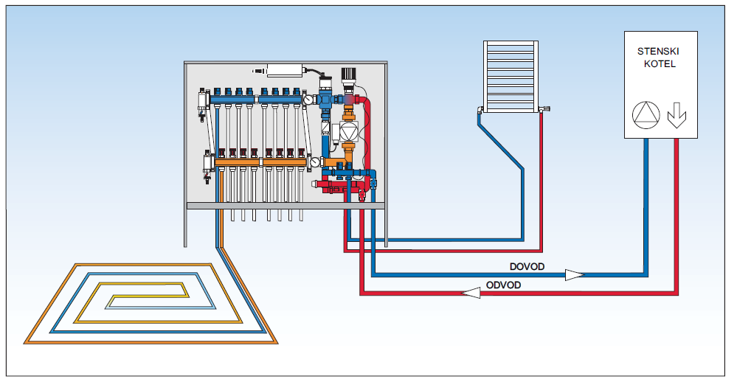
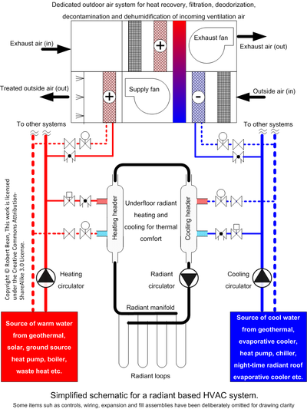
Construction of UFC-H system and haw is work

Slide 8
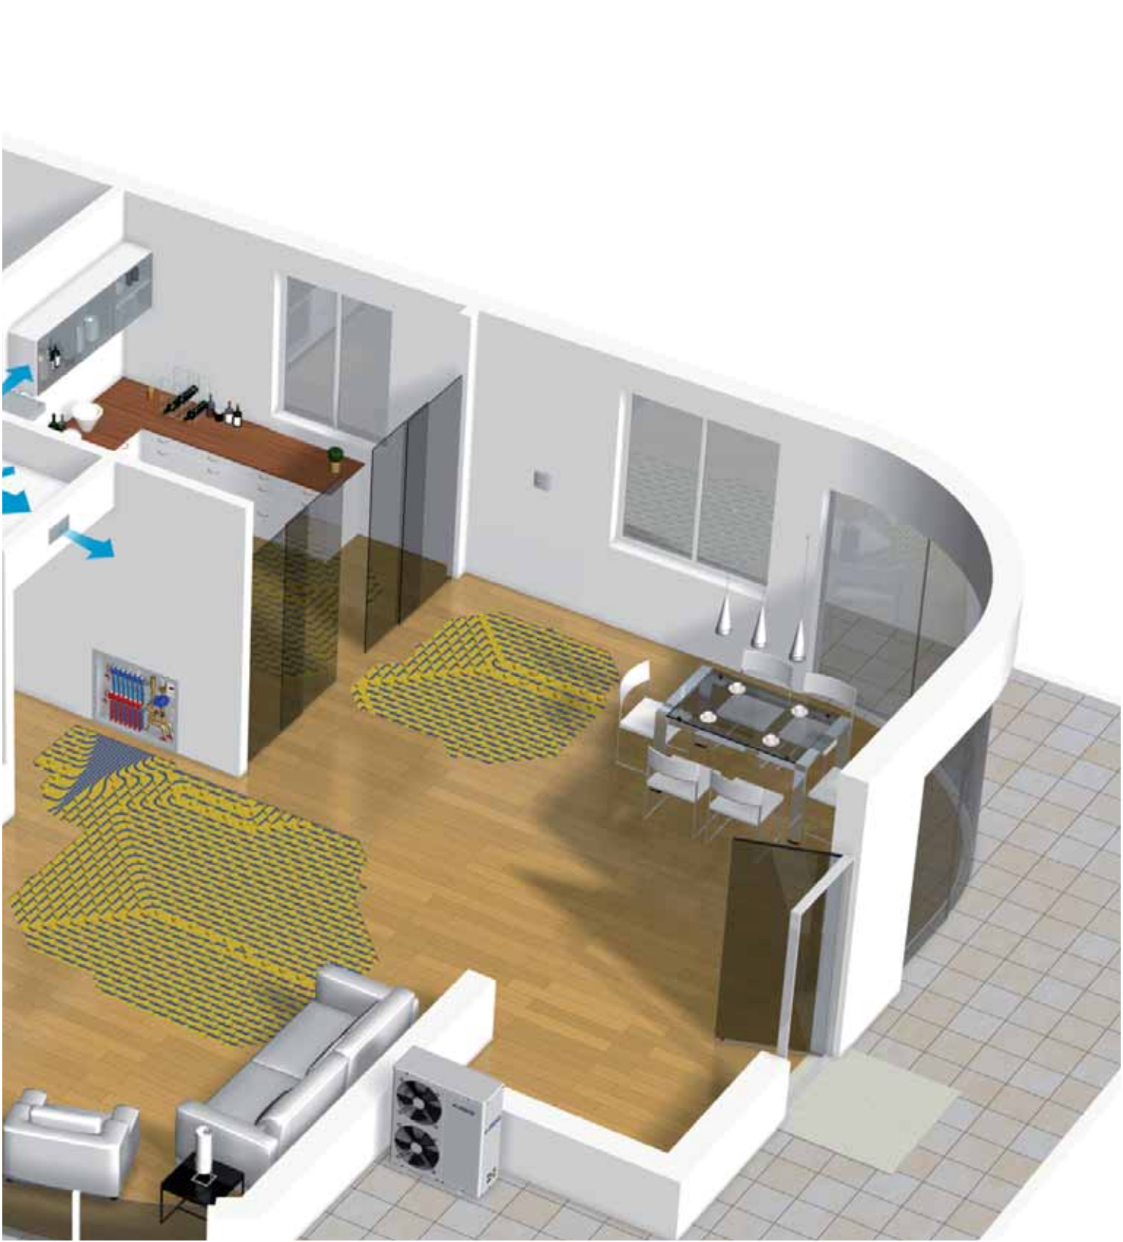
The Components in building
Kit Control Clima Duplex
RTU humidity and temperature sensor
HPAW-H heat pump

Slide 9
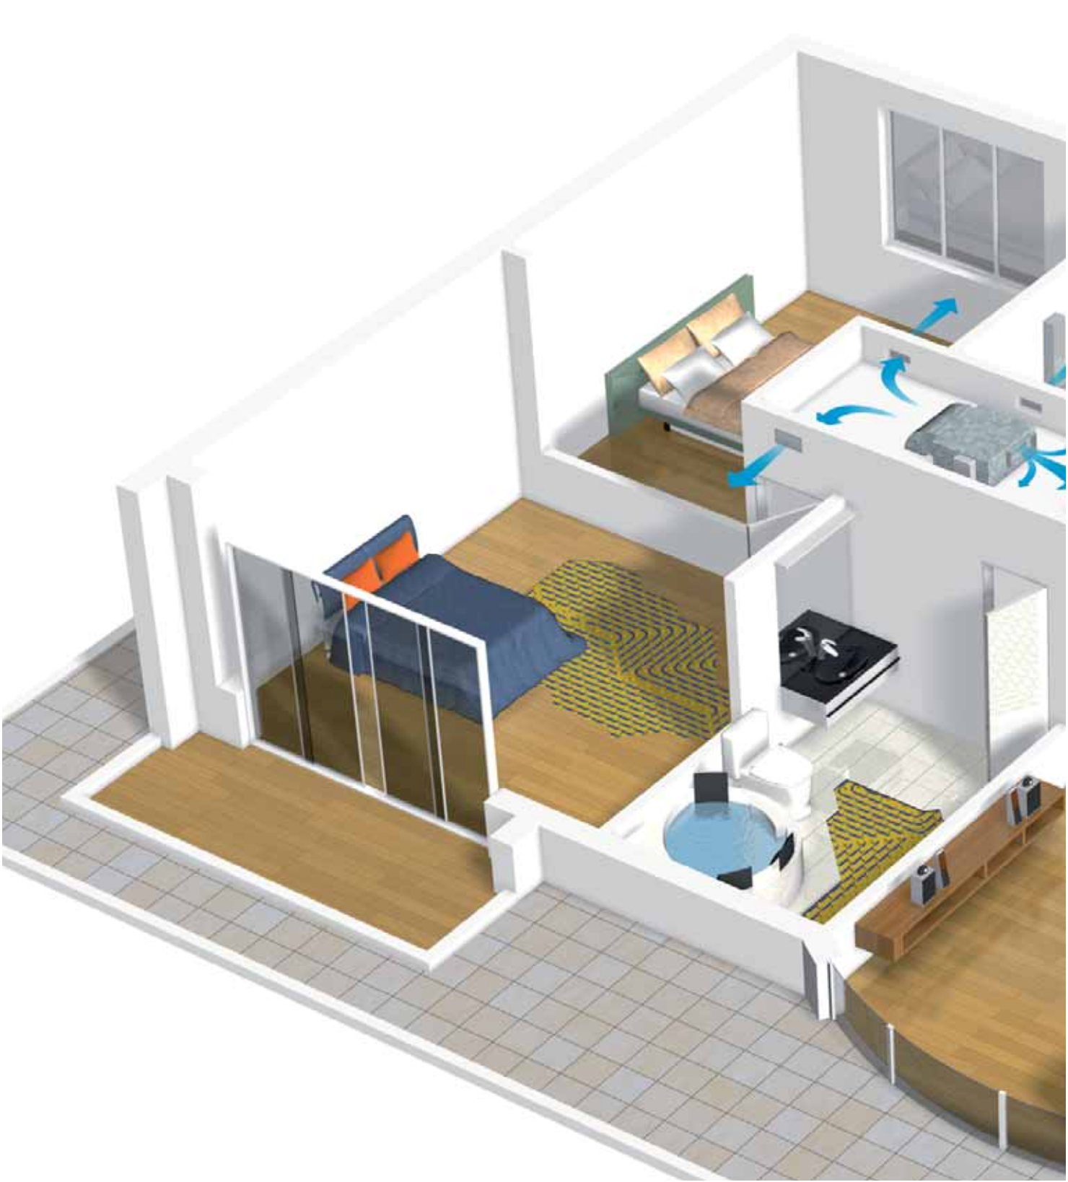
The Components in building
Air outlets
RNW 404 CS dehumidifier
Cover 30 radiant floor system

Slide 10
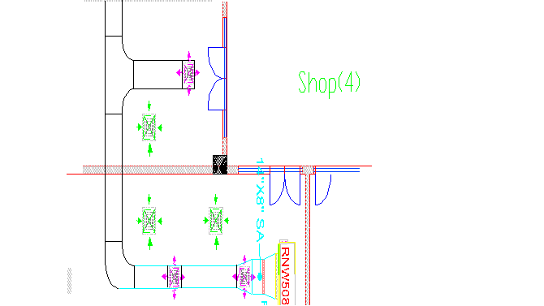
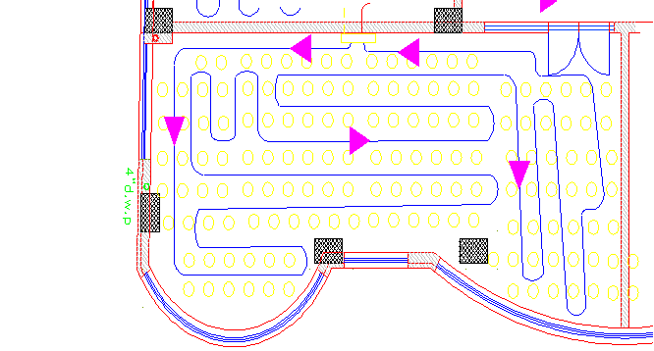
AutoCAD Drawing the under floor cooling
skittish figure from Auto CAD to show the RNW with duct connection on system
floor and loop (UFC SYSTEM)

Slide 11
Designing and calculation(UFC)
1) Designed for the heat flux (ql)… (w/m^2)
2) Designed the surface temperature by using figure and depending on pitch (8,16 .. Etc)
3) Designed for the (RNW) dehumidifier and selection it , depending on air flow and water flow
4) calculate the condensation by used psychometric chart

Slide 12
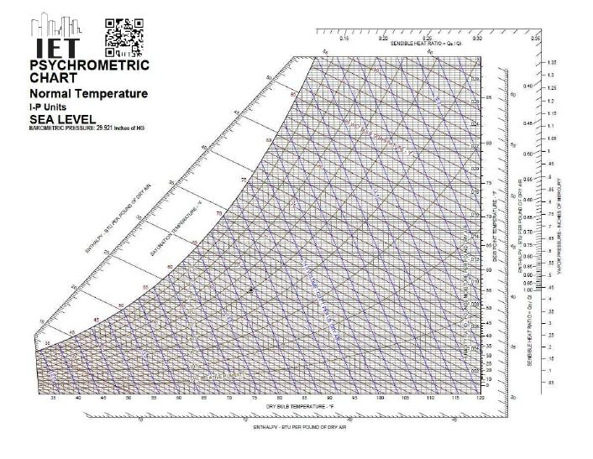
Condensation
Condensation occurs or not depending on the Dew point , calculate from psychometric charts.
Find Dew point from
𝒯i =24c0
Ф=50%
Dp=12.98C
if T surfs > T Dp
*No condensation occurs
if Ts < T Dp
Condensation is occurs
Dew point

Slide 13
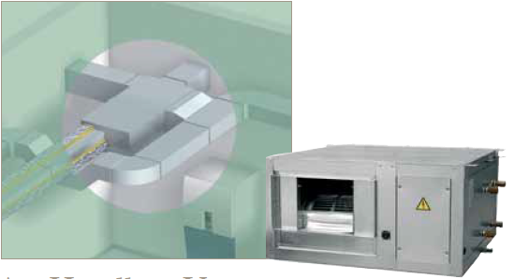
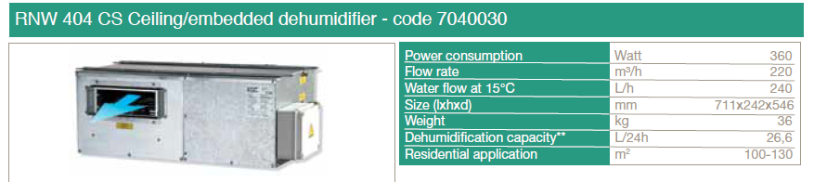
RNW CS Type

Slide 14
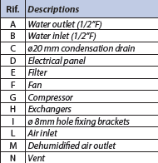
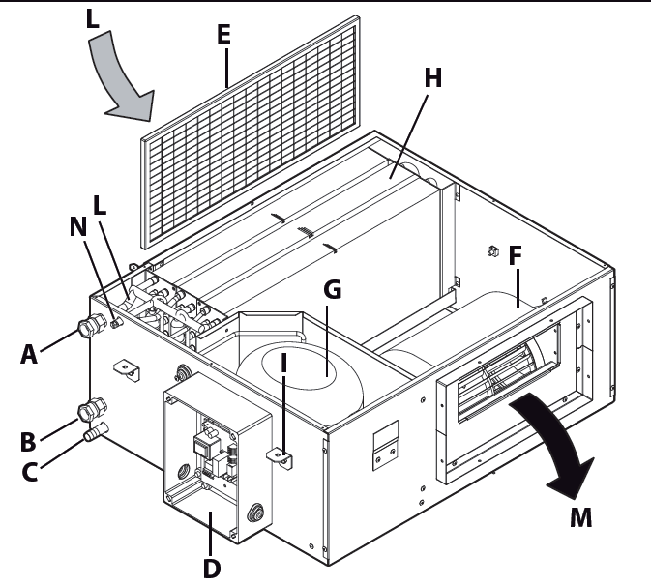
RNW construction and work

Slide 15
Under floor heating (UFH)
Under floor heating (UFH) transfers heat energy by natural radiation from a very large surface which only has to be slightly warmer than the room itself. Radiant energy is emitted from the floor in every direction.

Slide 16
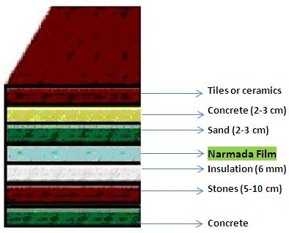
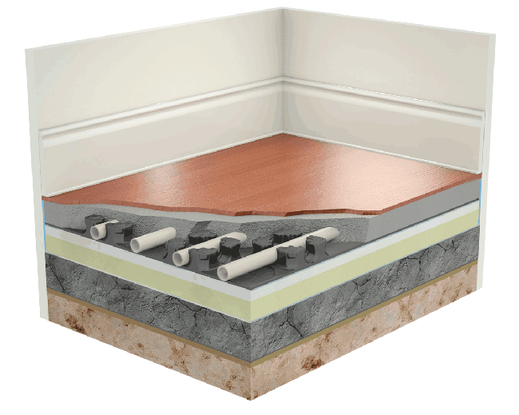
layer to construction of (UFH) and install of ceramics type
1- Leveling the ground to become a suitable place.
2- Install the insulation (PE-Foam) on all of the place area
3- Install the carbon films over the insulation and distributes it properly according to the engineering team.
4- Connecting the temperature controller and the heat sensor to the electricity for adjusting the temperature.
5- Put about 2 cm from the sand over the films
6- Connect the heating films to the electricity and try it.
7- Put the concrete and lay the ceramics and tiles.

Slide 17
Designing and calculation for (UFH)
1)Heat flux (qL) = Ql/Af ….. w/m^2
2) Floor surface temperature (Tl)
Tl =[( ql/8.92) ^1/1.1]+Ti
Ti = range from 22 to 24
3)Water temperature (Tk) we can find form figure relation shape between Tl and Tk depending on pipe spacing like (S30 or S25 )
4) Reverse Heat flow (qk) from figure depending on Tl
5) Total heat load Emitted by pipe (Qe)
Qe = (ql+qk)*Af
6)Mass flow reat of water for each loop
Mw= Qe/C.p*∆T …….. ∆T = Range from 5 to 8
7) Velocity in the pipe determined by mass flow
V = Mw /Ap*ρ …. Diameter for pipe is 16mm

Slide 18
Sample calculation:
Ground floor:
The Bank:
Length:28.76m width:9.66m T_{i}=24 º c , Q_{L}=9818
Area=28.76*9.66=277.8m²
qL=QL/Area = 9818/277.8
qL=35.3 Watts/m²
qL=8.92(TL-Ti)^{1.1}
TL=23.5 º c
At TL=23.5 and spacing = 30cm we find Tk=27º c
At TL=23.5 we find qK=11.2 w/m²
Q_{e} = (qL+qK)*A_{f} .
Q_{e} = (35.3+11.2)*277.8 =12929.6 watts.
Mw=Qe/Cp.(∆T)=9818/(4.18*1000*7) =0.442 kg/s.
D₀=20mm, Di=16mm, Thickness=2mm.
Vw=((4*Mw)/1000)/(π*0.016²)
Vw=2.2m/s.

Slide 19
Another example for Sample calculation for first floor
 |  |  |  | from figure | from figure |  |  |  |  |  |  | Floor (1)
Loop length | V (m/s) | m`w (kq/s) | Qe (w) | qk (w/m^2) | TK (c°) | TL (c°) | qL (w/m^2) | Af ( m^2) | QL( w) | Ti /2 (c°) | Ti (c°)
192.85 | 2.409682 | 0.484346 | 12147.4 | 29 | 10.8 | 15.4095 | 191.46 | 55.1 | 10549.5 | 12 | 24 | shop (1)
192.85 | 2.77026 | 0.556822 | 13965.1 | 30 | 10.91 | 15.6268 | 223.45 | 55.1 | 12312.1 | 12 | 24 | shop (2)
103.5097 | 1.128571 | 0.226843 | 5689.218 | 29 | 10.55 | 15.1998 | 163.37 | 29.5742 | 4831.566 | 12 | 24 | shop (3)
111.7235 | 1.869441 | 0.375758 | 9424.001 | 31 | 11.11 | 15.8783 | 264.23 | 31.921 | 8434.45 | 12 | 24 | shop (4)

Slide 20
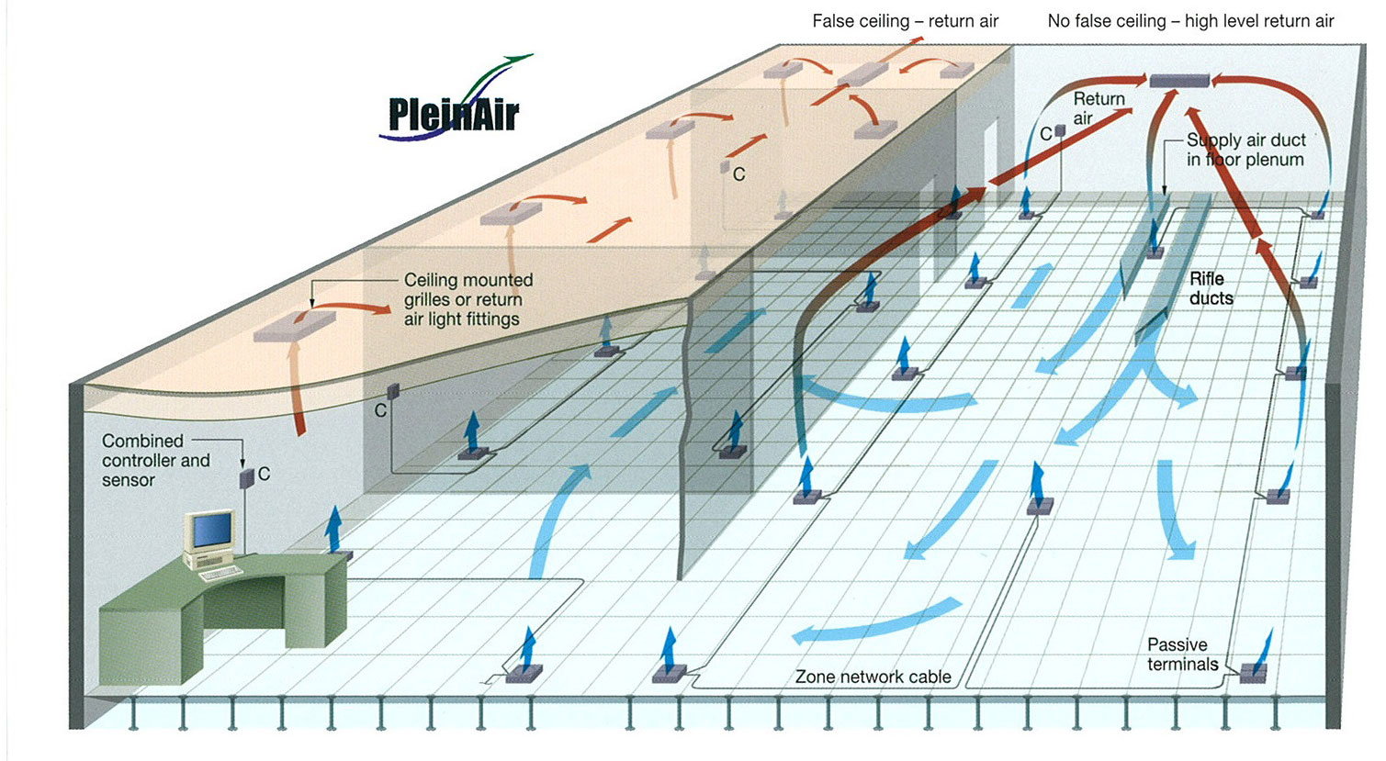
Uniform distribution of air cool

Slide 21


Advantages of the system :
1. Simple installation
2. Healthy& comfortable
3. Economic
4. Safe

Slide 22
HVAC System
HVAC means that Heat Ventilation and Air Conditioning system .
The main objective of air conditioning is to maintain the environment in enclosed space at conditions that achieve the feeling of comfort to human.

Slide 23
Inside and Outside Condition
winter:
Outside temperature (To) be 8.3˚C.
Inside temperature (Ti) be 24˚C.
Outside Relative humidity (Ф_{o}) is 72% .
Inside Relative humidity (Ф_{i}) is 50%.
Outside Moisture content (W_{o}) is
4.5 g of water/ Kg of dry air.
Inside Moisture content (W_{i}) is
19 g of water/ Kg of dry air.
SUMMER :
Outside temperature (To) be 31.9 ˚C.
Inside temperature (Ti) be 24 ˚C.
Outside Relative humidity (Ф_{o}) is 44%.
Inside Relative humidity (Ф_{i}) is 50%.
Outside Moisture content (W_{o}) is
16.4 g of water/ Kg of dry air.
Inside Moisture content (W_{i}) is
9.3 g of water/ Kg of dry air

Slide 24

Over all heat transfer coefficient, Uoverall
Uover all Deponds on the costruction of the unit.
Uover all is given by :
Uover all =
Rtotal = Ri + R +Ro
R = ∑

Slide 25
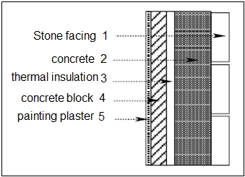
The Required UVER All Heat Transfer
External wall:
No. | Material | Thickness | Thermal conductivity (K) (W/m.K) | Thermal resistance (R) (m².K/W) | Density | Specific heat (CP) (KJ/Kg.C˚)
 |  | ∆X |  |  | (ρ) kg/m³
 |  | (m)
1 | Stone facing | 0.05 | 1.7 | 0.029 | 2250 | 1.675
2 | Concrete | 0.15 | 1.75 | 0.0857 | 2300 | 0.8374
3 | Thermal insulation | 0.03 | 0.04 | 0.75 | 25 | 0.8374
4 | Concrete block | 0.1 | 0.833 | 0.12 | 1400 | 0.8374
5 | Painted plaster | 0.02 | 1.2 | 0.0167 | 1800 | 0.8374

Slide 26
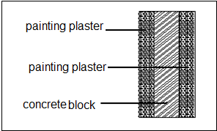
Internal wall:
 |  | Thermal conductivity (K) (W/m.K) | Thermal resistance (R) (m².K/W) |  | Specific heat (CP) (KJ/Kg.C˚)
Material | Thickness (m) |  |  | Density (ρ) (kg/m³)
Painted plaster | 0.02 | 1.2 | 0.0167 | 1800 | 0.8374
Concrete block | 0.1 | 0.833 | 0.12 | 1400 | 0.8374

Slide 27
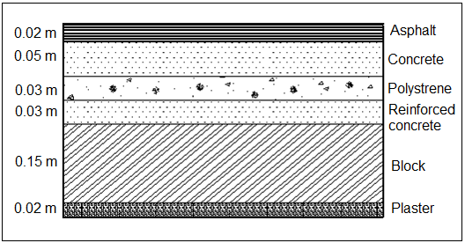
Ceiling:
material | Thickness (m) | Thermal conductivity (K) (W/m.K) | Thermal resistance (R) (m².K/W) | Density (ρ) (kg/m³) | Specific heat (CP) (KJ/Kg.C˚)
Asphalt | 0.02 | 0.7 | 0.0286 | 2000 | 1
concrete | 0.05 | 1.75 | 0.0286 | 2300 | 0.8374
Polystyrenes | 0.03 | 0.05 | 0.6 | 25 | 0.8374
Reinforced concrete | 0.03 | 1.75 | 0.0171 | 2300 | 0.8374
Cement brick (block) | 0.15 | 0.95 | 0.158 | 1400 | 0.8374
Plaster | 0.02 | 1.2 | 0.0167 | 1800 | 0.8374

Slide 28
Windows and doors:
Windows and doors | The Dimension | Thickness
bath room Windows | 0.8m*0.8m | Double clear glass with 6 mm thickness.
Rooms Windows | 1.2m*1.5m | Double clear glass with 6 mm thickness.
Rooms Windows | 0.7m*0.7m | Double clear glass with 6 mm thickness.
Internal door | 1.2m*2.2 m | 50mm thickness with wood
External door | 3m*2.8m | Made from glass.

Slide 29
Heat transfer coefficient (U)w/m^2.s.
External Wall | 3.1
External Wall(glass) | 2.67
Internal Wall | 2.47
Internal Wall(glass) | 3.5
Ceiling | 3.5
Floor | 5.6
Door(40mm-wood) | 0.148
Door(glass) | 0.8

Slide 30
Heating load calculation
Heating load sources :
The heating load calculation begins with the determination of heat loss through a variety of building for components and situations.
1- Walls
2- Roofs
3- Windows
4- Doors
5- Basement Walls Basement Floors
6- Infiltration Ventilation

Slide 31
Heating Load Equations
In summer :
Tun = Ti+(2/3)( To - Ti )
In winter :
Tun = Ti+(0.5)( Ti - To )
Tg= Ti+ ( rang from 5 to 10)
Parameters | T_{in} | T_{o} | T_{un} | T_{g} | Φ_{in} | Φ_{out} | W_{in} | W_{out}
Winter | 24 | 8.3 | 13.3 | 13.3 | 50% | 72% | 19 | 4.5
Summer | 24 | 31.9 | 28.8 | 36.9 | 50% | 44% | 9.3 | 16.4

Slide 32
The following equations were used to calculated the heating load:
Qs,cond = U A (Tin – To) .
Q s,vent,inf = 1.2 Vvent,inf (Tin – To).
Q l,vent,inf = 3 Vvent,inf (Wi- W o).
V_{vent} = n * value of ventilation
V_{inf} = (ACH * inside volume *1000) /3600
Qtotal = Qs,cond + Qs,vent,inf +Ql,vent,inf .

Slide 33
Heating Load Results
NO. of Floor | Qtotal(W) | Qtotal(KW) | Qtotal(Ton) | Qtotal(CFM)
GF FLOOR | 32624.92 | 32.62492 | 9.321406 | 3728.56229
First Floor | 41297.46 | 41.29746 | 11.79927 | 4719.70971
Second Floor | 36789.54 | 36.78954 | 10.5113 | 4204.51886
Third Floor | 3180.01 | 3.18001 | 0.908574 | 363.429714
Fourth Floor | 5632.9 | 5.6329 | 1.6094 | 643.76
Top Floor | 40849.38 | 40.84938 | 11.67125 | 4668.50057
TOTAL | 160374.2 | 160.37421 | 45.8212 | 18328.4811

Slide 34
The boiler is the main source of heating process, selection of boiler depends on its capacity. selection of boilers from De Dietrich company.
The total amount of heat in our project equal to 160.37 KW. Use catalog of boilers then the suitable boiler is that of type GT330 DIEMATIC- m³ .

Slide 35
Cooling Load calculation
Cooling load calculated at summer season.
Cooling design conditions (in summer):
Outside temperature (To) be 31.9˚C.
Inside temperature (Ti) be 24 ˚C.
Outside Relative humidity (Ф_{o}) is 44%.
Inside Relative humidity (Ф_{i}) is 50%.
Outside Moisture content (W_{o}) is 12.5 g of water/ Kg of dry air.
Inside Moisture content (W_{i}) is 9.4 g of water/ Kg of dry air.
The wind speed at SALFEET is (10.5 m/s).

Slide 36
Cooling loads classified by Source :
Heat transfer (gain) through the building skin by conduction, as a result of the outdoor – indoor temperature difference.
Solar heat gain (radiation) through glass or other transparent materials.
Heat gains from Ventilation air and/or infiltration or outside air.
Internal heat gain by occupants, light, appliances, and machinery.

Slide 37
Cooling load Equations
1 ) For ceiling :
Q=U*A*(CLTD)_{corr}
Where:
(CLTD)_{corr} = (CLTD + LM) K + (25.5 – Ti )+ (To – 29.4)
Where :
CLTD: cooling load factor
K:color factor:
K=1 dark color
K=0.5 light color

Slide 38
2) For walls :
Q=U*A*(CLTD)_{corr}
Where:
(CLTD)_{corr} =(CLTD + LM) K + (25.5 – Ti )+ (To – 29.4)
Where :
CLTD: cooling load factor
K:color factor: K=1 dark color
K=0.83 medium color
K=0.5 light color

Slide 39
3)For glass :
Heat transmitted through glass
Q=A*(SHG)*(SC)*(CLF)
SHG: solar heat gain
SC: shading coefficient
CLF: cooling load factor
Convection heat gain:
Q=U*A*(CLTD)_{corr}
(CLTD)_{corr} = (CLTD)+(25.5 – Ti )+ (To – 29.4)

Slide 40
4 ) For people :
Q_{s}=q_{s}*n*CLF
Q_{L}=q_{L}*n
where:
Q_{s},Q_{L}: sensible and latent heat gain
q_{s},q_{L}: sensible and latent gains per person
n: number of people
CLF: cooling load factor

Slide 41
5) For lighting :
Q_{s}=W*CLF
Where:
Q_{s}: net heat gain from lighting
W:lighting capacity: (watts)

Slide 42
6) For equipments :
Q_{s}=q_{s}*CLF
Q_{L}=q_{L}
Where:
Q_{s},Q_{L}: sensible and latent heat gain.
CLF: cooling load factor

Slide 43
Definition for term of Previous Equations
Q : heat loss ( watt) .
U : over all heat transfer coefficient (w/m2.k).
Tin : inside temperature (C) .
To : outside temperature ( C ).
LM : Latitude correction factor .
SHG: Solar heat gain .
SC :shading coefficient .
CLF : cooling load factor .
CLTDcorr : The correction of cooling load temperature difference.
n: number of people.
W: lighting capacity.
Q vent : the heat losses due to sensible ventilation .

Slide 44
Cooling load Results
NO. of Floor | Qtotal(W) | Qtotal(KW) | Qtotal(Ton) | Qtotal(CFM)
GF FLOOR | 79923.72 | 79.92372 | 22.83535 | 9134.13943
First Floor | 93239.07 | 93.23907 | 26.63973 | 10655.8937
Second Floor | 96067.56 | 96.06756 | 27.44787 | 10979.1497
Third Floor | 104331.1 | 104.3311 | 29.80889 | 11923.5543
Fourth Floor | 155931.3 | 155.9313 | 44.5518 | 17820.72
Top Floor | 656141.5 | 656.14151 | 187.469 | 74987.6011
TOTAL | 1185634 | 1185.6343 | 338.7526 | 135501.058

Slide 45
The chiller is the main source of cooling process, our selection depends on PETRA COMPANY.
The cooling load in our project is 338.752Ton. So we select 350 ton R 134-a chiller it's manufactured with two compressors and with the same compressors type.
The Chiller Code is: WPS a 350 2 S

Slide 46
Duct Design
Grills are calculated and distributed uniformly.
The duct is drawn and distributed before calculations
The sensible heat of floor is calculated.
V _{circulation} is calculated to determine the CFM.
The initial velocity is 5 m/s.
The loss ΔP/L is determined from figure A.1 by using velocity and V _{circulation}.
Area is calculated by:
A = V _{circulation} / velocity
The main diameter is calculated from figure A.1 At the same (∆P/L).
IF the duct rectangular; the height of the duct is known from design its width by dependent on the H and D by using software C.

Slide 47
Pipe Design
The total cooling load was calculated for the floor.
The mass flow rate for the water calculated (m).
The pressure head was estimated in (Kpa) .
The longest loop from the boiler to the far fan coil unit and return to the boiler was calculated multiplying by (1.5) due to fittings.
The pressure head per unit length is calculated and it should be between range from (200< ∆p/L<550).
Then the diameter of pipe entering to the floor is estimated .

Slide 48
Air Handling Units selection
Air handling units are used in both heating and cooling load.
They are selected from PETRA COMPANY, we selected Four AHU for the
Building.
Room name | Selection | Q (kw) | Q (ton)
Bank | PAH-H-C-50-C-6 H-2 X 2 | 36.325 | 10.4
Office | PAH-H-C-50-C-6 H-2 X 2 | 40 | 11.43
Cinema | PAH-H-C-120-C-6 H-2 X 2 | 85.7 | 24.5
Restaurant | PAH-H-C-62-C-6 H-2 X 2 | 48.7 | 14
Waiting room | PAH-H-C-40-C-6 H-2 X 2 | 30.5 | 8.72

Slide 49
Fan Coil Units selection
In Our project we need Ducted FCU and to ensure the high level of comfort we need the filtered FCU our selection from Petra catalogs is CBP type.
CBP
Ceiling Basic With Plenum (Galvanized Steel)
Designed for concealed ceiling installation above false ceiling with ducted supply and return air distribution. The plenum encloses the fan section of the basic unit. Units of this type consist of a coil, fan and a flat filter.

Slide 50
Ground floor
Room name | Fan name | Fan selection | In door unit type | air flow rate (cfm)
shop 1 | f.C.U 01 - GF | DC 06 - M -561 | ceiling mounted | 561
shop 2 | f.C.U 02 - GF | DC 10 - M -875 | ceiling mounted | 875
shop 3 | f.C.U 03 - GF | DC 06 - M -561 | ceiling mounted | 561
shop 4 | f.C.U 04 - GF | DC 12 - M -1056 | ceiling mounted | 1056

Slide 51
Cost of HVAC system
135$ /m^2
Then for 2711 m^2 the total area we need to cooling and heating
Then >> ( A * cost per m^2)
if we make calculate :
1 m^2 refrigeration _____ 135 $
2711 m^2 ________ X cost
X = 2711 m^2*135 $/m^2= 365985$

Slide 52
Compare between (UFC_H and HVAC)
UFC_H system
HVAC system
Temperature distributing
Is Uniform distributing for air cooling and heating
The total cost is :
314935$
Temperature distributing
Is not Uniform distributing for air cooling and heating
The total cost is :
365985$

Slide 53
Plumbing system
Plumbing system consist of :
1- Potable water system.
2 - Drainage system.
3 - Fire fighting system

Slide 54
Potable water system
Plumbing Fixtures
The most common plumbing fixtures are :
Kitchen sinks.
Lavatories (also called bathroom sinks).
Urinals.
sinks.
Water closets.

Slide 55
Calculation :
1- calculate of fu.
2- calculate flow rate .
3- calculate diameter .
4- calculate head pressure of the pump.

Slide 56
The plumping fixture unit in building
Type of fixture | No. of fixture | Size of pipe (in)
Water closet ( w .c ) | 5 | 1/2 , 3/8
Lavatory | 2 | 1/2 , 3/8
Kitchen sink | 2 | 1/2

Slide 57
Drainage System in Building
Size of pipe ( in ) | No .of fixture | Type of fixture
4 | 4 | Water closet
2 | 1 | Lavatory
2 | 3 | Kitchen sink
2 | 3 | Floor drain

Slide 58
Fire fighting system
Fire Protection Types :
1- Fire Sprinkler System .
2- Fire Extinguisher.
3- landing valve.
4- cabinet .

Slide 59
Fire Protection Components :
Fire Protection consist of the following components:
Fire pump sets (Main and Standby).
Jockey pump.
Fire Sprinkler.
Branch pipe with nozzles.

Slide 60
Calculation fire fighting :
Design of Farthest two landing valve .
Calculate the size and flow rate .
Size of landing valve 2 ½ in , cabinet 1 ½ in.
Flow rate of landing valve 500 gpm (tow landing valve) , and more tow 750 gpm .
Calculate of head pressure for pump
Calculation of sprinklers.

Slide 61
THANK YOU

