Slide 1

safety elevator
Presented By: haya shilleh, mira shahed

Slide 2
CONTENTS:
.1Introduction
.2 Primary Goals
.3 Constraints
.4Features
5.Hardware Parts
6.Conclusion

Slide 3
Introduction:
The elevator contains 3 slots to facilitate the exit of goods so that when reaching the desired floor, it moves inward so that workers can Transport the goods without the need to reach the inside of the elevator.
Placing a camera inside the elevator to monitor the condition of the goods, also the elevator uses password for security.
When electricity is cut off, the elevator continue its direction to arriving the floor that want to go to it .
Finally, cares about the temperature, as there may be goods that need a certain temperature so that they do not spoil.

Slide 4
PRIMARY goals:
Safe elevators used in factories to transport goods are very important to maintain the safety of workers or users from exposure to danger, as there are many workers who have ended up in a state of death, so our project involves the design and development of a smart elevator system aimed at enhancing safety and reducing the occurrence of accidents

Slide 5
Constraints:
Power consumption.
Finding suitable motors.
Handing small electrical parts.

Slide 6
FEATURES:
Contain 3 slots to push the goods to out of the elevator .
01
Send messages to sim card inside the elevator.
02
In the event of a power outage, the elevator continues to move to the desired floor.
03
Contains esp32 camera inside the elevator.
04
05
keypad for enhanced security and slots for self-propulsion respectively

Slide 7
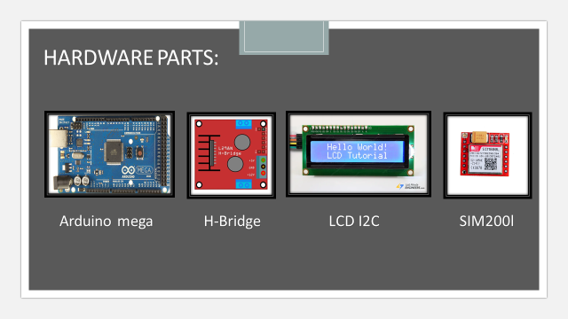

Slide 8
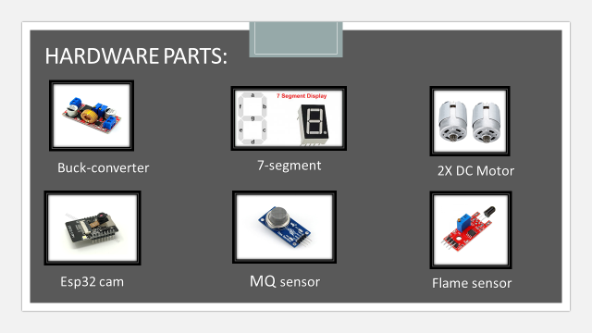

Slide 9
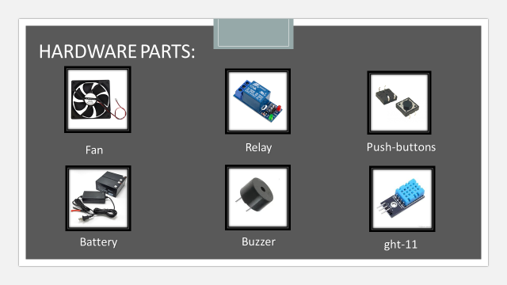

Slide 10
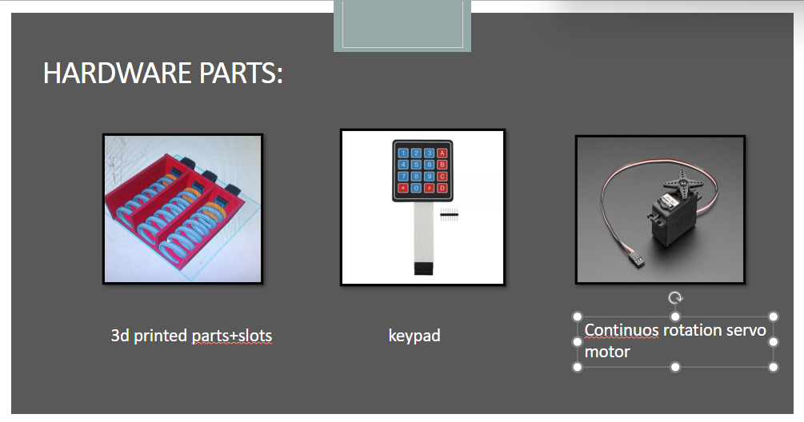

Slide 11
CONCLUSION:
Ultimately, this project not only ensures the safe transportation of goods but also introduces smart technological solutions into work environments, contributing to enhanced productivity and a safer, more efficient workplace.

Slide 12
Thank you !

