Slide 1

An-Najah National University
Faculty Of Engineering
Building Engineering Department
Graduation Project – II
People with special needs school
Prepared By:
Isra Abu Shamleh
Siren Odeh
Rania Bsharat
Project supervisor:
Dr. Ameer AL Aker

Slide 2
The Outline:
Introduction
Objectives
Methodology
Project design
  Architectural design
  Structural design
  Environmental design
  Electrical design
  Mechanical design and public Safety.
  Quantity survey & cost.
Conclusion

Slide 3



Introduction:
Graduation Project two
Redesign of the Existing Building in Howara town
Graduation Project one
Rehabilitation of the Existing Building in Howara town

Slide 4
Objectives
Redesigning the Building
Architectural
Structural
Environmental
Electrical
Mechanical
2) find the quantity Survey and Cost estimation

Slide 5

Methodology
Literature Review
(Statistics, research's, interviews…)
Standards
(Arch,str,Eniromental,…)
Case Studies
1-Friends of the Blind Association
2- Red Crescent Building
Project Redesign
Architectural
Structural
Environmental
Electrical
Mechanical
Conclusion

Slide 6
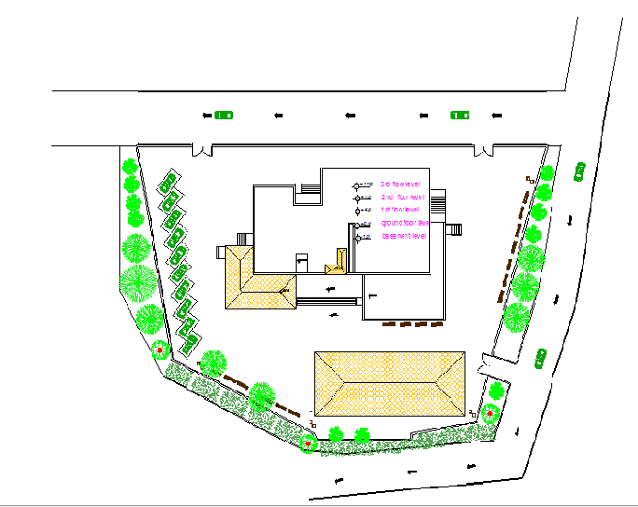







Architectural Design :(Site Analysis)
N

Slide 7
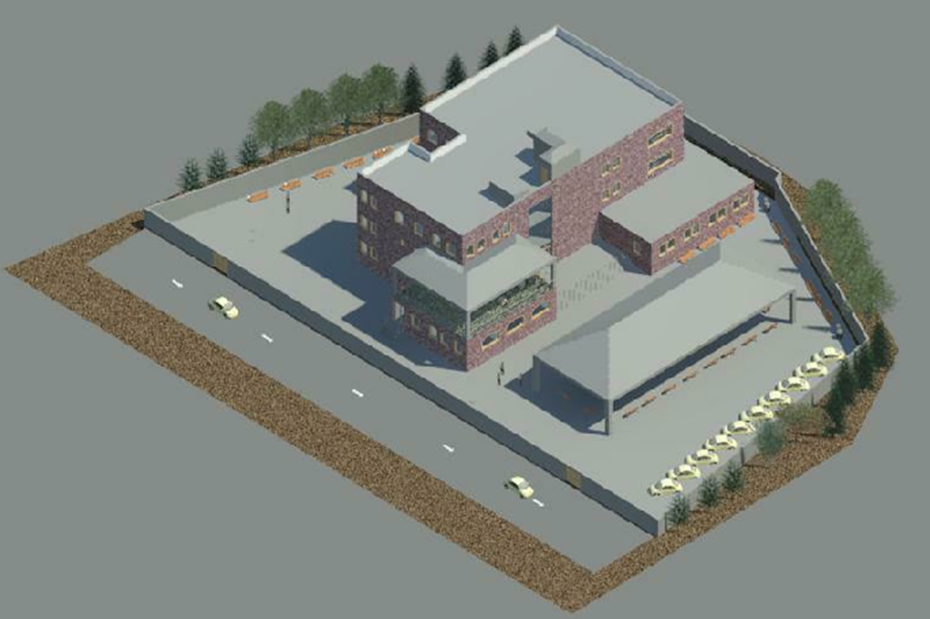
The total building area of the school is 2416.6 m²
The spaces in the school classified into three main categories:
1) Teaching Spaces
2)Services spacing
Architectural Design

Slide 8
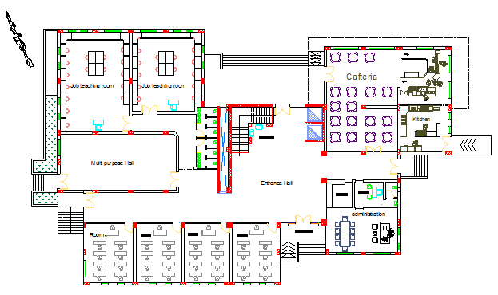
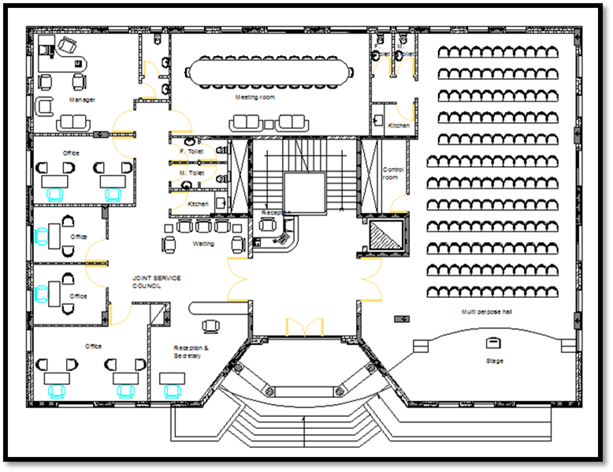
Ground Floor
After
Before
Area =1011.2 m²

Slide 9
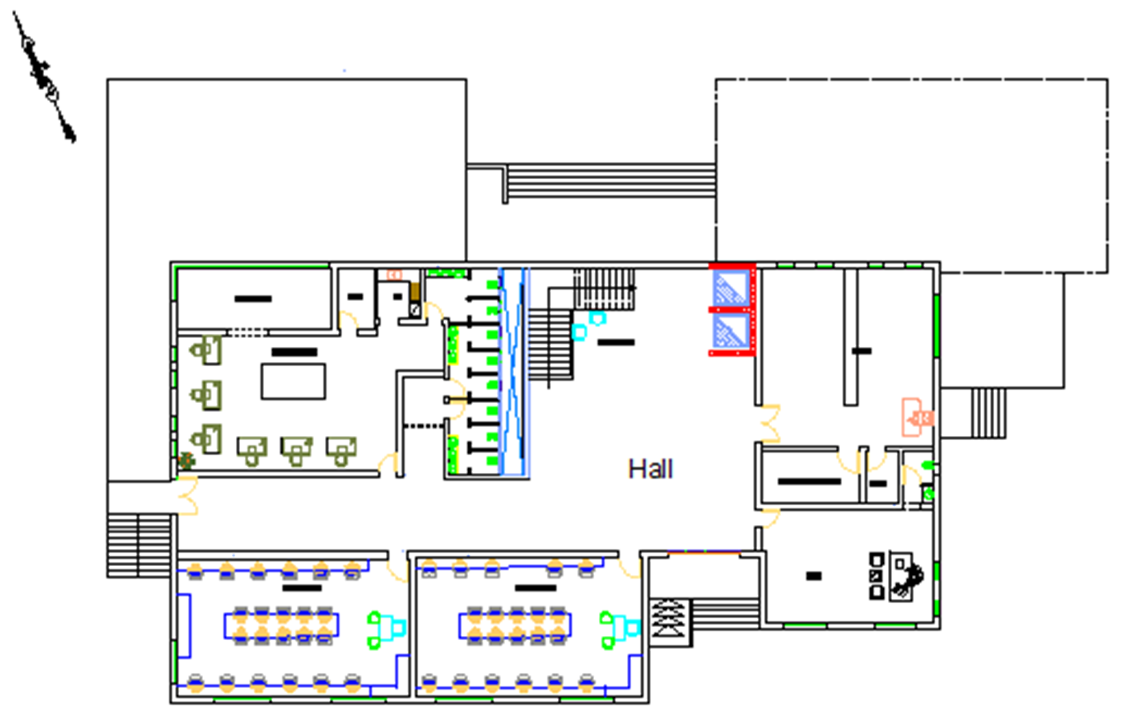
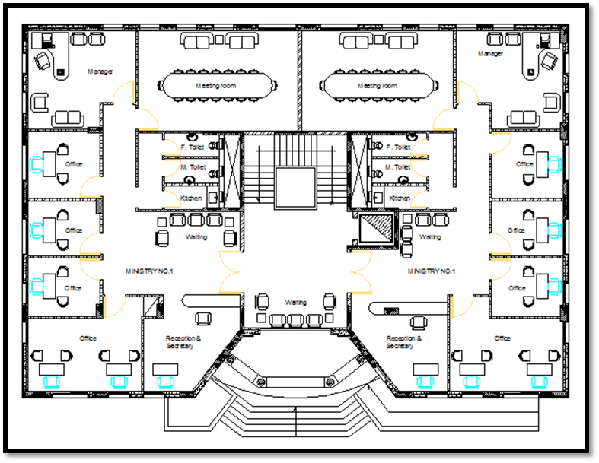
First Floor
After
Area =702.7 m²
Before

Slide 10
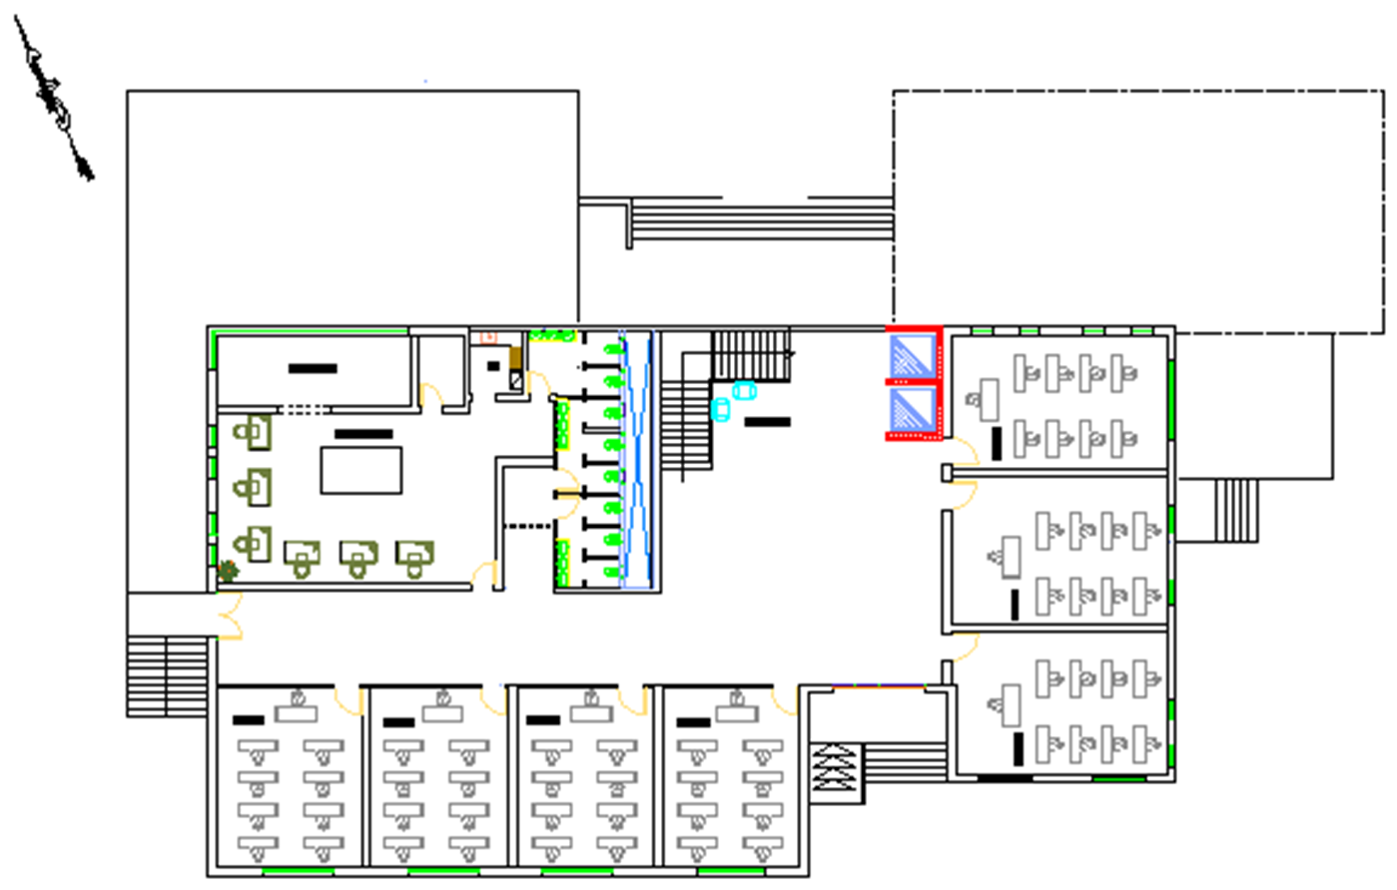
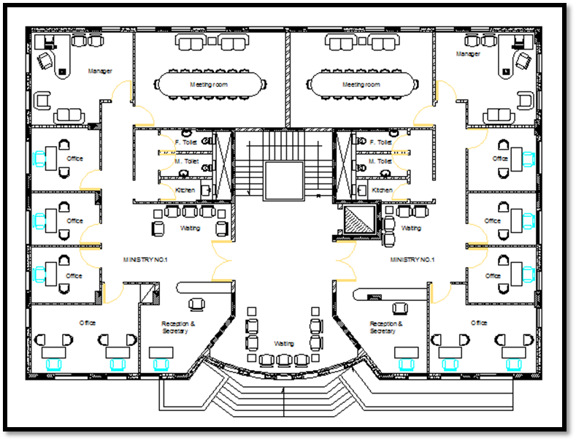
Second Floor
After
Before
Area =702.7 m²

Slide 11
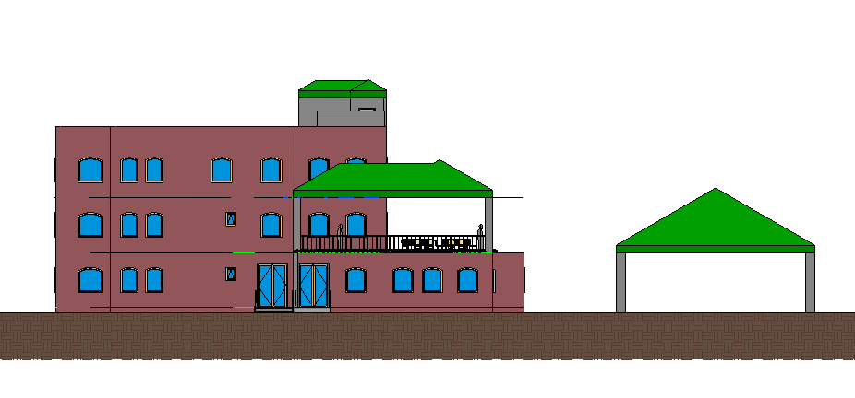


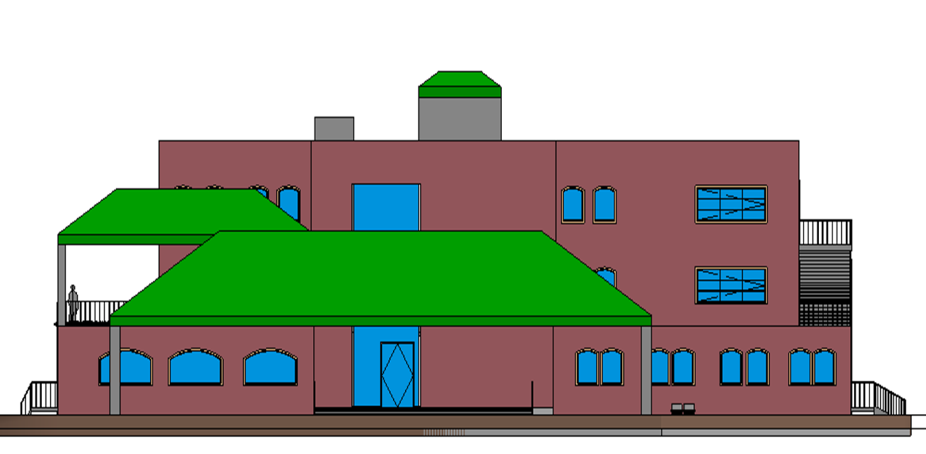
Elevations

Slide 12
Structural design
step1
Step2
Determine the type of slab reinforcement.
step3
Find primary Dimensions for columns
Separation the building into three parts by using tow earthquake breaks to have almost symmetry shapes.
Calculate the thickness of slab.
Calculate beams Dimension's.
step4
Step5
Use SAP2000 program
Makes the necessary checks on each model and the earthquakes' checks
Take the values of reinforcement steel in beams and columns and slabs

Slide 13
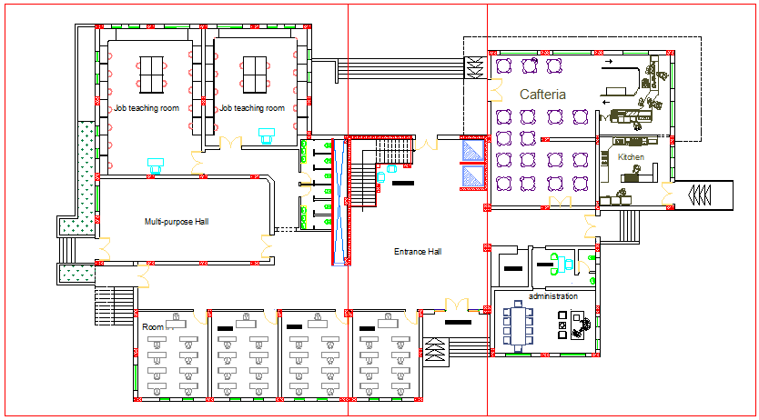
Structural design:
Break -2
Break -1
Block (2)
Block (1)
Block (3)

Slide 14
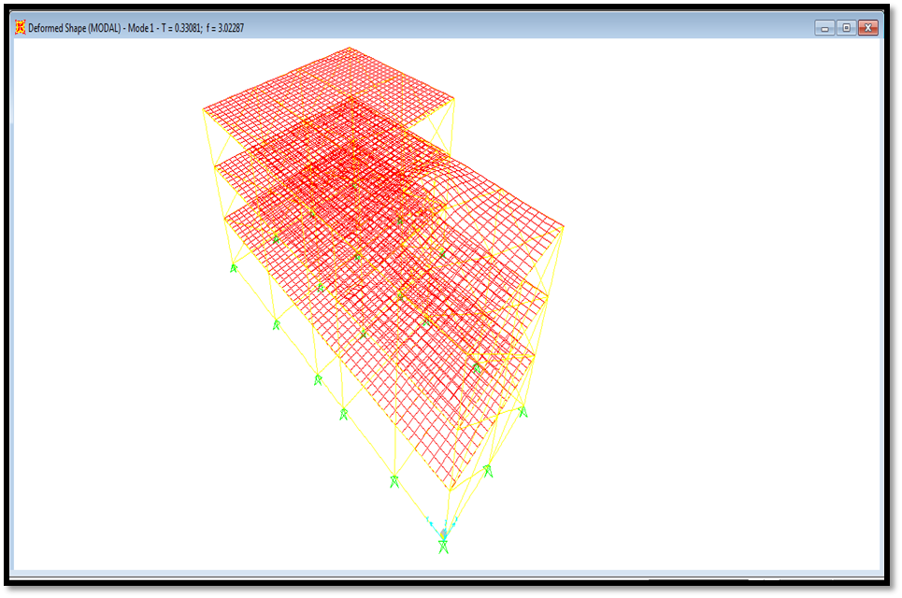
Block three Checks:
1) Compatibility Check:
Structural design:

Slide 15
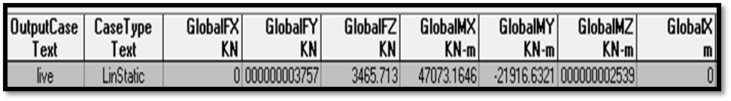
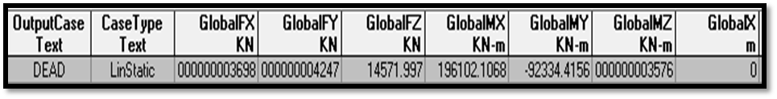
2) Equilibrium Check:
For the live load live load =3464.4 KN
Error =0.03% <5 % (OK).
For the dead load:
Total Dead Load = 14405.14KN
Error = 1 % <5 % (OK).
Structural design:

Slide 16
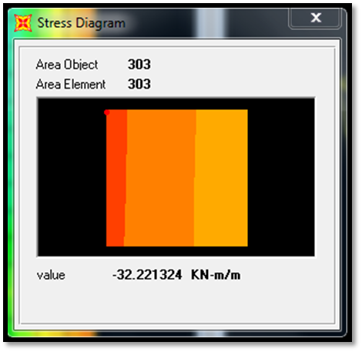
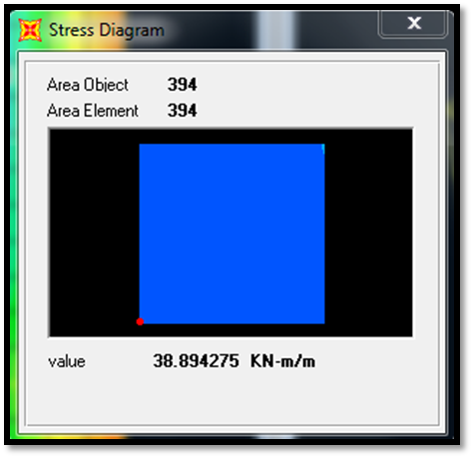
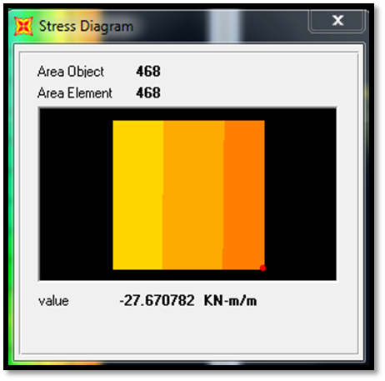
3) Local Equilibrium Check :
Moment on Slab:
From hand solution
M= (WL^2)/8 = 69.45 KN.m
From SAP Model :
M= 69.83KN.m
Error = 0.5% <10% So OK.
Structural design:

Slide 17



3) Local Equilibrium Check Moment on beam:
Structural design:
From hand solution :
M=(wl^2)/8. = 〖80(7)〗^2/8=490KN.m
From SAP Model :
M=441.44KN.m
Error = %9 < 10% its (OK)

Slide 18
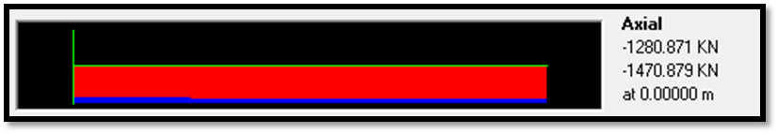
3) Local Equilibrium Check For Column:
Structural design:
From hand Calculation:
The axial load on the column from 3 floor = 1188.17KN
From SAP Model :
The axial load =1280.87KN
% of Error = 7 % <10%
its (OK)

Slide 19
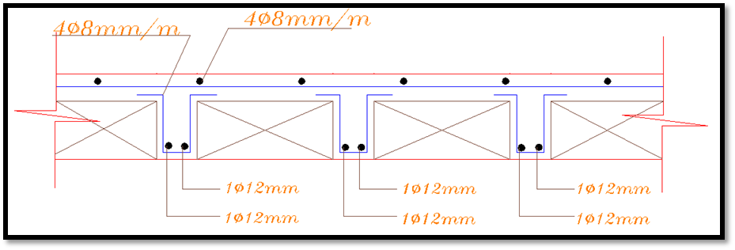
One way ribbed Slab:
Structural design:
Reinforcement Details:

Slide 20
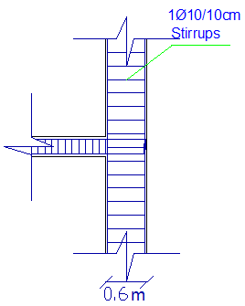
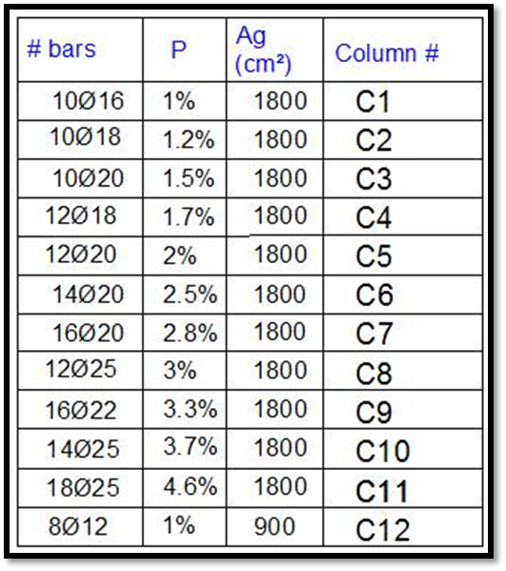
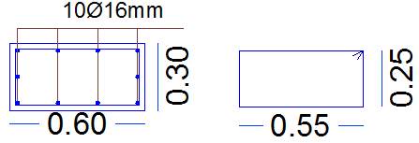
Columns:
Structural design:
Reinforcement Details:

Slide 21
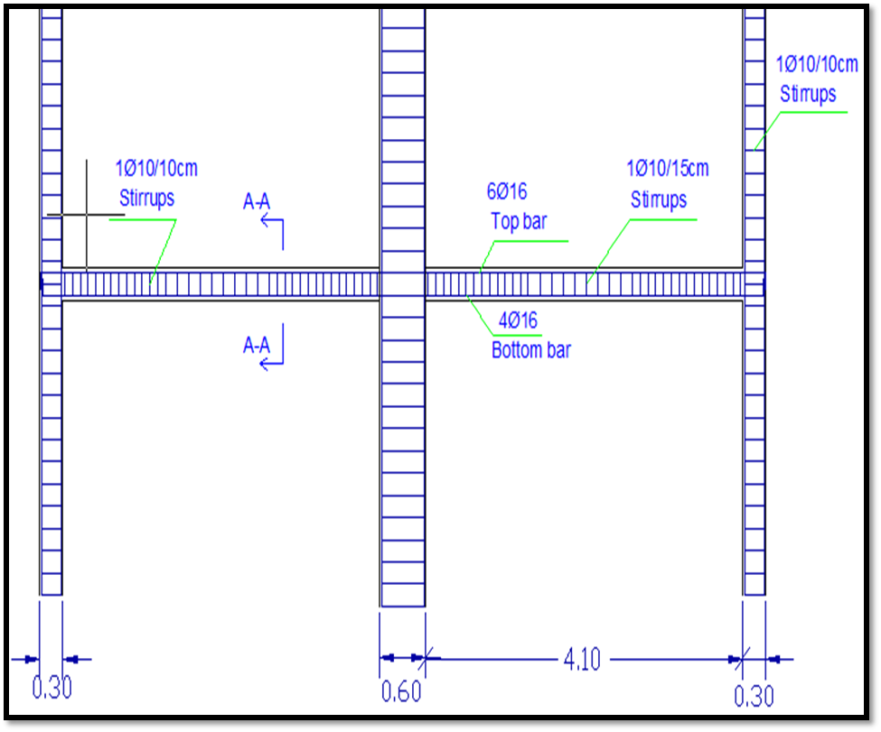
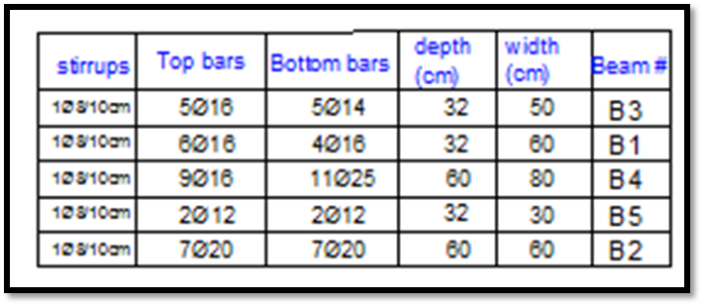
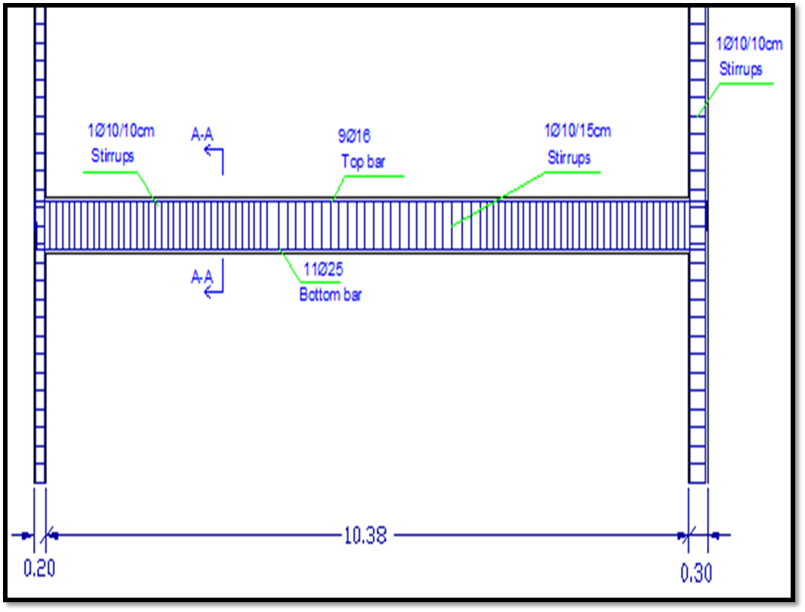
Structural design:
Reinforcement Details:
Beams

Slide 22
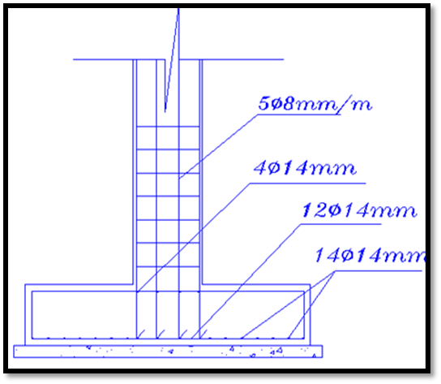
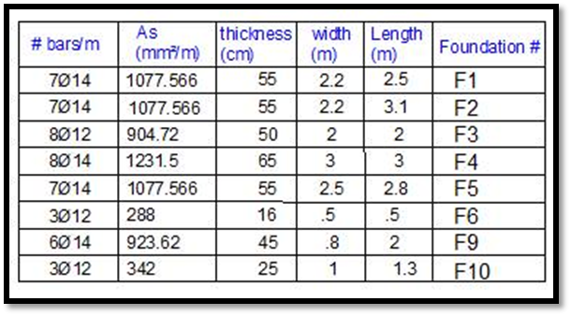
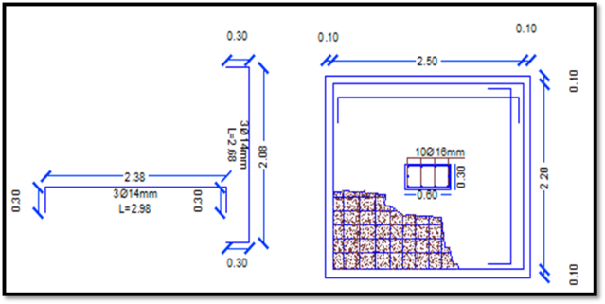
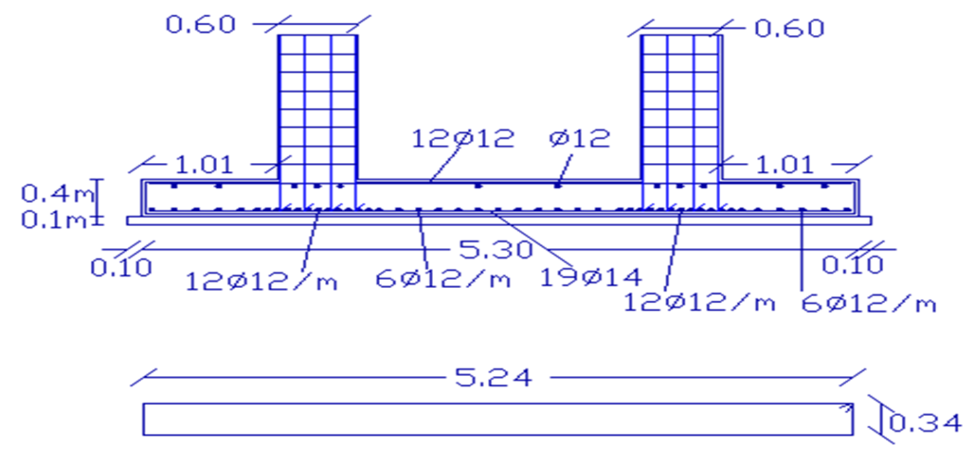
Footings:
Structural design:
Reinforcement Details:
Isolated footing
Combined footing

Slide 23
Environmental Design
Environmental Design Includes
Acoustics Design
Natural Daylight Design
Thermal Design
Issues

Slide 24
Environmental Design
Environmental Design Include:
Acoustics Design
Natural Daylight Design
Thermal Design
Issues
Environmental issues in the building :
This project is designed to solve the following issues:
Classrooms and laboratories and job education rooms are designed to be isolated to minimize sound transmission between spaces through the corridor.
The central Court works as internal wintry courtyard with wide open windows from the sides which allow heat release to outside and make air movement.
The classrooms are oriented toward the south direction, so the sun rays enter the classroom only a few in early mornings and at sunset during the summer.

Slide 25
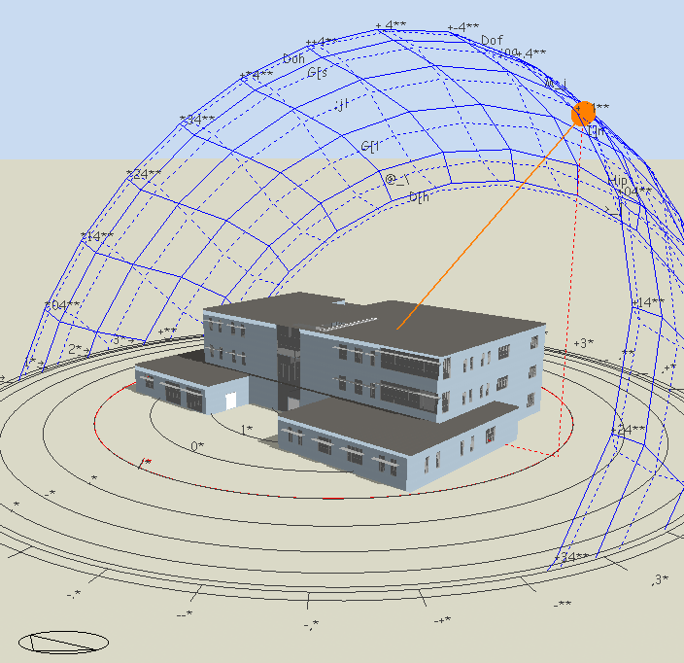
Environmental Design

Slide 26
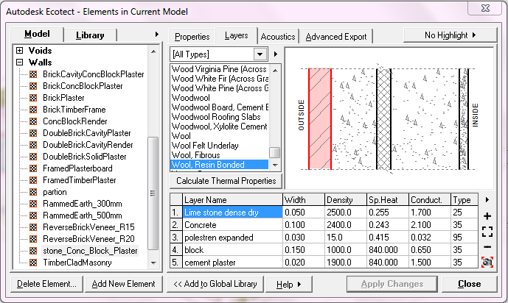
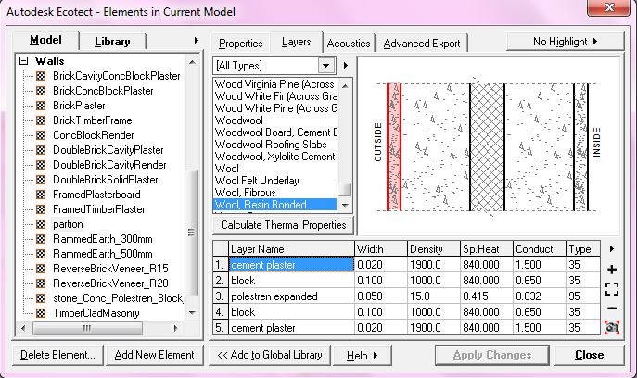
Materials Used in the School Building
External wall: ( U = 0.49)
Internal Partion: ( U = 0.48 )

Slide 27
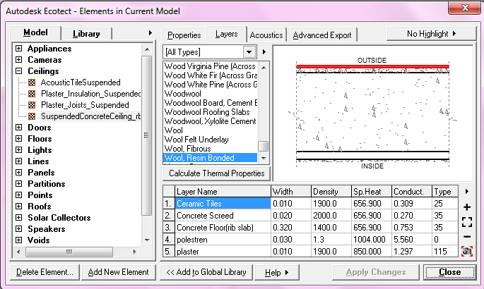
Floor: ( U = 2.16 W/m².K )
Ceiling: ( U = 0.67 W/m².K )

Slide 28
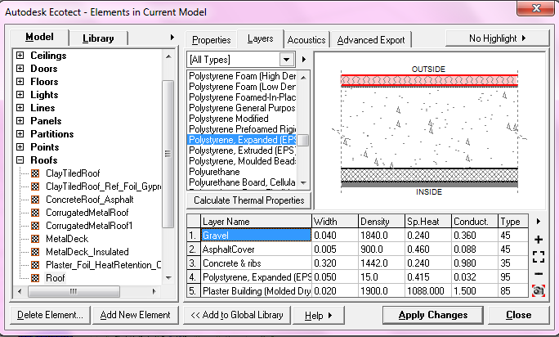
Roof: ( U = 0.44 )

Slide 29
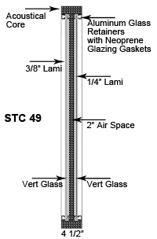
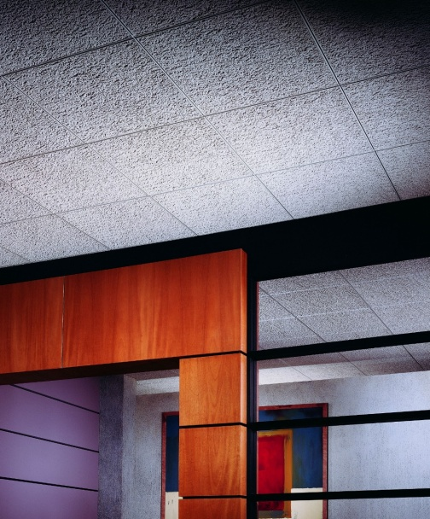
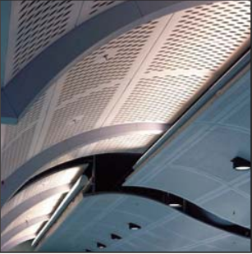
Other Materials:
1. Noise Stop window: With STC rating up to 49
2. False ceiling- Acoustic Tiles (Glacier)
3. Perforated metal -Noise S.T.O.P. ACOUSTIMETAL

Slide 30
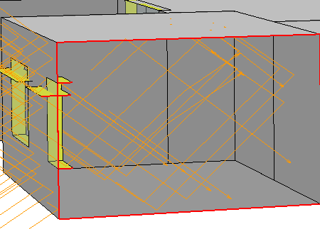
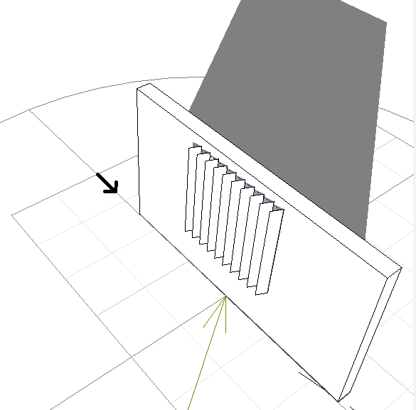
Natural Daylight Design
Daylight Calculation
Environmental Design Include:
Acoustics Design
Natural Daylight Design
Thermal Design
Issues
The desired goal is to achieve a 300 - 500 Lux in the classrooms.
By using upper windows with light shelves and normal Louvers the light level desired was achieved.

Slide 31
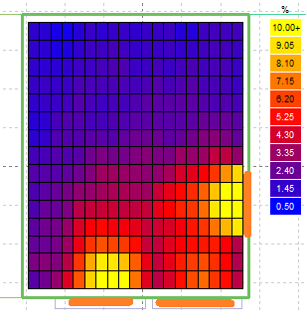
Natural Daylight Design
Daylight Calculation
Environmental Design :Include
Acoustics Design
Natural Daylight Design
Thermal Design
Issues
Sample of classes :
Day lighting Factor (Df)= 3.34%
Day lighting level = 300.83 Lux

Slide 32
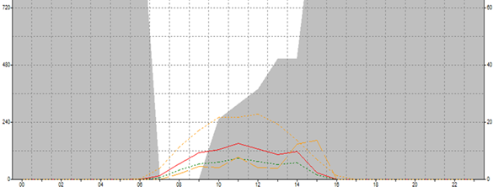
Natural Daylight Design
Solar Exposure
Environmental Design Include:
Acoustics Design
Natural Daylight Design
Thermal Design
Issues
Solar exposure calculations were made by choosing a south class wall which was treated by adding horizontal shading with light shelves, and the results were as the following:

Slide 33
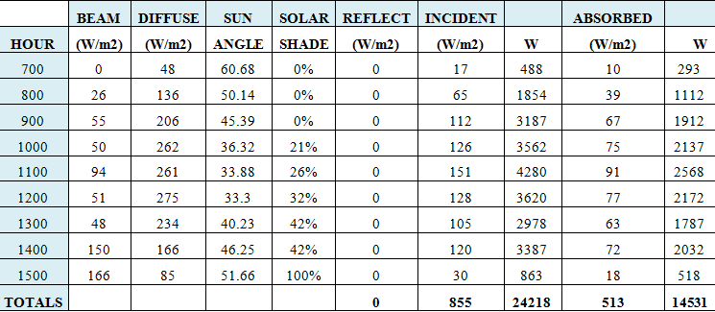
Natural Daylight Design
Solar Exposure
Environmental Design :Include
Acoustics Design
Natural Daylight Design
Thermal Design
Issues
The results are :

Slide 34
Thermal Design
Discomfort Degree Hours
Environmental Design :Include
Acoustics Design
Natural Daylight Design
Thermal Design
Issues
Although a full air conditioning are designed, for more comfort assurance evaluations by adaptive comfort concept is used beside of predict mean vote.
Ecotect tool implements different methods to estimate comfort adaptive. We used flat comfort bands, fixing elastic comfort band (18°C – 28 °C).

Slide 35
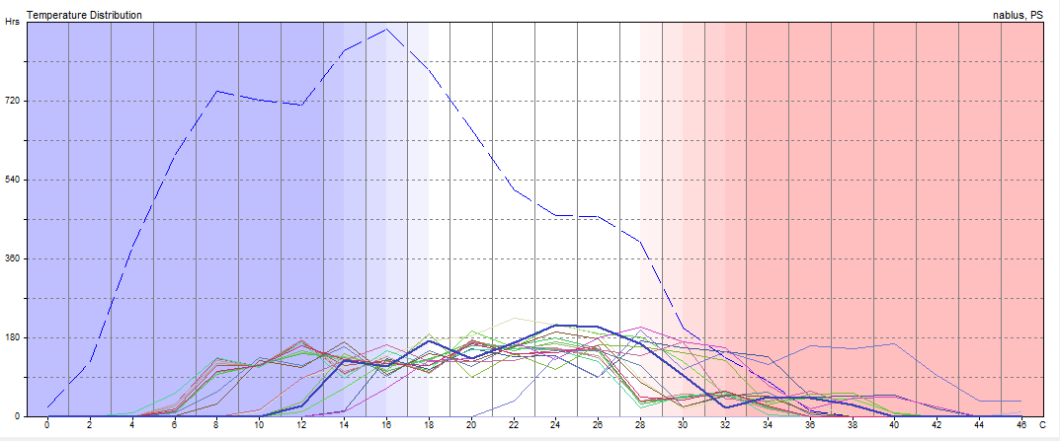
Thermal Design
Annual Temperature Distribution
Environmental Design Include:
Acoustics Design
Natural Daylight Design
Thermal Design
Issues
For classroom4:
Operation: Weekdays 08-14, Weekends 00-00.
Comfort Band: 18.0 - 28.0 C
In Comfort: 1060 Hrs (67.7%)

Slide 36
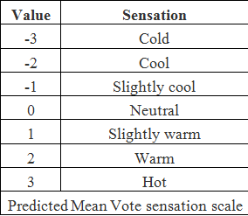
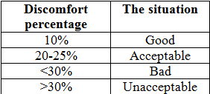
Thermal Design
Predicted Mean Vote & Percent Dissatisfaction
(PMV,PPD)
Environmental Design Include:
Acoustics Design
Natural Daylight Design
Thermal Design
Issues
The Predicted Mean Vote (PMV)
The PPD%, ISO 7730 thermal sensation scale:

Slide 37
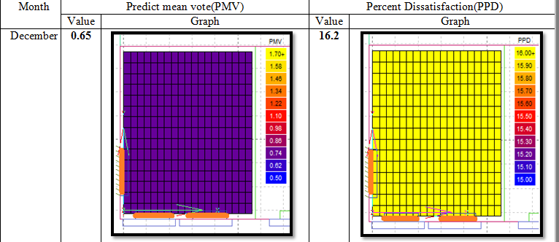
The following table shows the PMV and PPD results for class (4):
So it’s slightly warm and acceptable.

Slide 38
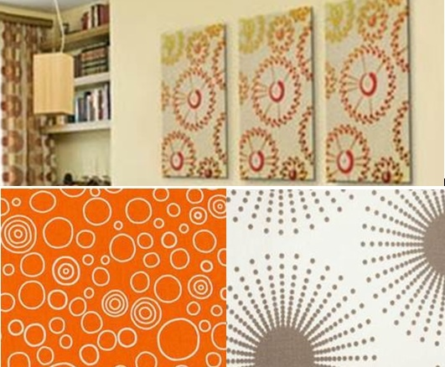
Acoustic Design
Reverberation Time (RT60)
The recommended RT60 range is between [0.6–0.8].
So we used internal partition with 5cm of expanded polystyrene isolation which have sound absorption characteristics. Also, decorative sound absorption materials are used in the halls, class rooms…etc
Environmental Design Includes
Acoustic Design
Natural Daylight Design
Thermal Design
Issues

Slide 39
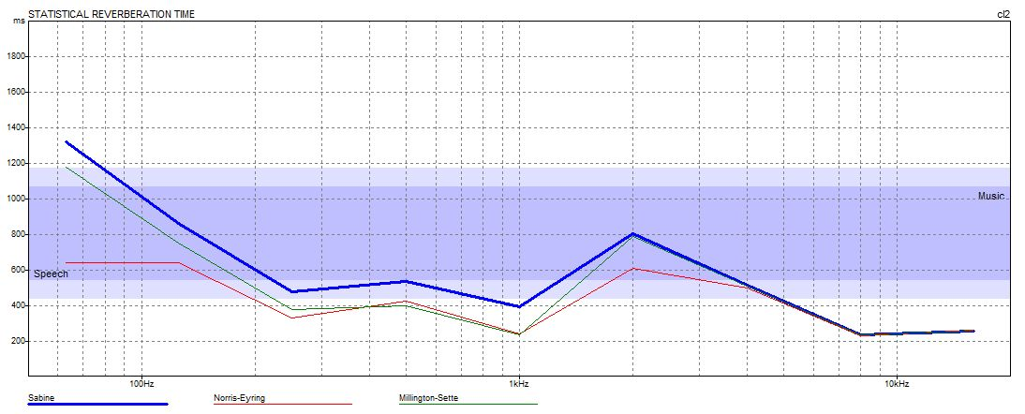
Acoustic Design
Reverberation Time (RT60)
Environmental Design Include:
Acoustic Design
Natural Daylight Design
Thermal Design
Issues
Results of RT₆₀ for classroom2 are as the following by using Ecotect :

Slide 40
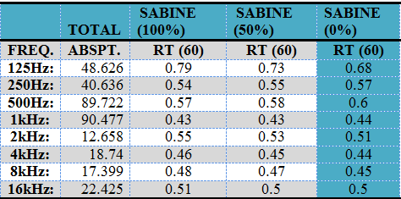
Acoustic Design
Reverberation Time (RT60)
Environmental Design Include:
Acoustic Design
Natural Daylight Design
Thermal Design
Issues
Volume : 140.6 m³
Surface Area: 171.9 m²

Slide 41
Acoustic Design
Sound Power Level (SPL)
Environmental Design Include:
Acoustic Design
Natural Daylight Design
Thermal Design
Issues
The speaker is 1m away of the white board → Q = 2.5
SPL first point = LW + 10 log = 81.56 dB
SPL second point = 77.3 dB
SPL third point = 72.6 dB
So, we achieved the range.

Slide 42
Acoustic Design
Sound Transmission Class (STC)
Environmental Design Include:
Acoustic Design
Natural Daylight Design
Thermal Design
Issues
-STC for the classroom must be >42
-STC for main wall of 0.3m concrete = 56db
No need for modification
-For partition wall of 0.1 block = 46 db
No need for modification
-IIC for the ceiling of 0.32m lightweight concrete = 56db
No need for modification.

Slide 43
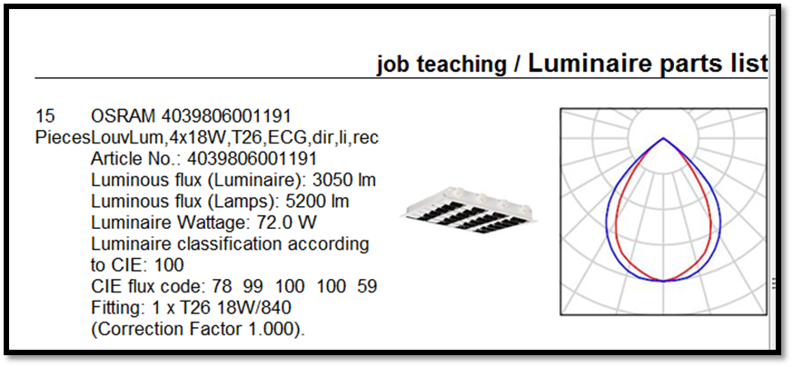
Electro-Mechanical Design
Electrical Design
Electric Lighting Design using DIALUX Program
Sample calculation :
job teaching room

Slide 44


Electro-Mechanical Design
Electrical Design
3D view

Slide 45

Electro-Mechanical Design
Electrical Design
results

Slide 46


Electrical Design
Sample calculation
job teaching room

Slide 47
Results
Electrical Design
Uniformity (U₀):
It is important to create a uniform distribution of luminance, and it should be >= (0.5)
Type of space | Maintenance illumination lux | E_{avg} | U₀
Classrooms | 300 | 394 | 0.638
Cafeteria | 500 | 430 | 0.581
Library | 500 | 603 | 0.504
Teachers' room | 500 | 473 | 0.546
Computer lab | 500 | 518 | 0.522
Job teaching | 500 | 428 | 0.680
Clinic | 300 | 296 | 0.444

Slide 48

Electro-Mechanical Design

Slide 49


Electro-Mechanical Design
Water supply
- P = 17.8 psi
P _{Critical} =10 psi
Total pressure = 17.8 psi
17.8 – 10 = 7.8psi
Total losses <=7.8 psi

Slide 50
Drainage System Design
Total dfus | Occupancy | Dfus for each one floor | Fixture
4 | Public | 2 | KT
28 | Public | 4 | W.C
7 | Public | 1 | Lavatory
39 |  |  | Total (d.F.U)
Total dfus | Occupancy | Dfus for each one floor | Fixture
2 | Public | 2 | KT
32 | Public | 4 | W.C
9 | Public | 1 | Lavatory
43 |  |  | Total (d.F.U)
Total dfus | Occupancy | Dfus for each one floor | Fixture
2 | Public | 2 | KT
32 | Public | 4 | W.C
9 | Public | 1 | Lavatory
43 |  |  | Total (d.F.U)

Slide 51


Drainage system

Slide 52


Drainage system

Slide 53

HVAC System Design
Mechanical Design
The design of the system depends on the largest load which is always the cooling load. And the heating will be by default included. This can be prevail to the whole building.
For the job teaching room:
The cooling load = 15.3KW
No. of diffusers = 12

Slide 54


Mechanical Design
HVAC System Design

Slide 55

Mechanical Design
HVAC System Design
Full Air Conditioning Load By Using Ecotect:

Slide 56

Mechanical Design
HVAC System Design
And the results are:
The average loads is [30-80] KW
Max Heating: 42430 W at 13:00 on 18th January
Max Cooling: 63642 W at 13:00 on 25th July
Monthly Heating/Cooling Load

Slide 57

Fire safety

Slide 58
Quantity Survey & Cost
Work | Unit |  | Quantity | Cost
 |  |  |  | NIS
slab | M³ |  | 99337 | 278001144
Tie beam | M³ |  | 3.5877 | 248370
Columns | ton |  | 3.5877 | 248370
Footing | M³ |  | 3974.78 | 550576124
Finishing
Plastering | M² |  | 1512.266 | 36294.4
Painting | M² |  | 1512.266 | 21171.72
Tiling | M² |  | 73394.8 | 1048.7
Total =338421 NIS

Slide 59
This project has achieved a lot of issues on all sides of the design by using both manual and programs to find the best solution and gives the right results. So, to conclude the following summary will show some aspect the design cover.
Conclusion and Summary
conclusion
Enviro-Architectural Design
Quantity Survey & Cost
Structurally Design
Electro-Mechanical Design

