Slide 1
Shinny
Supervisor: Dr. Read Qadi.
Prepared by: Amani Zaqzouq & Aseel Haydareah

Slide 2
Outlines
01
02
03
What is Shinny?
Motivation
Hardware Components
04
05
06
How does it work?
Constraints
Future Work

Slide 3
Motivation
Cheap
Clean
Renewable source of energy

Slide 4
What is Shinny?
Shinny is a dual-axis solar tracking system designed to convert solar energy
into electrical energy. It can be used to light homes, streets, and operate
electrical devices. It can also be used to operate factories and other
institutions.

Slide 5
Hardware Components
Arduino Nano
Solar Panel
LCD with I2C
Relay
Pump
Servo Motor
Voltage sensor
LDRs

Slide 6
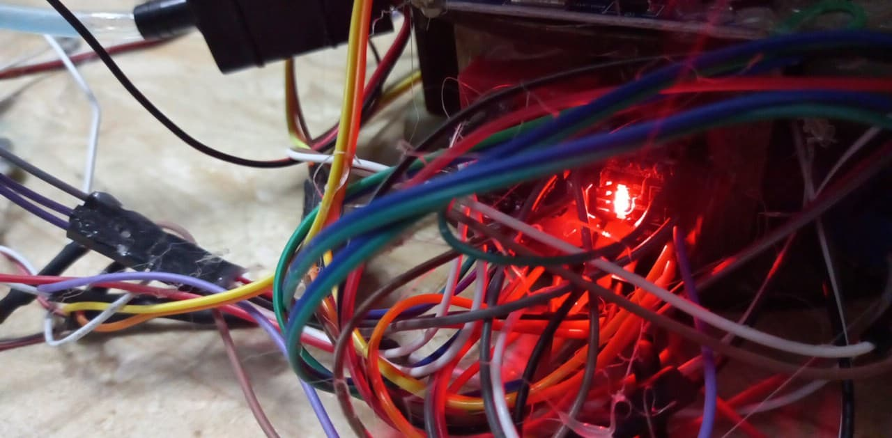
it is the brain of our project
How it works
Arduino

Slide 7
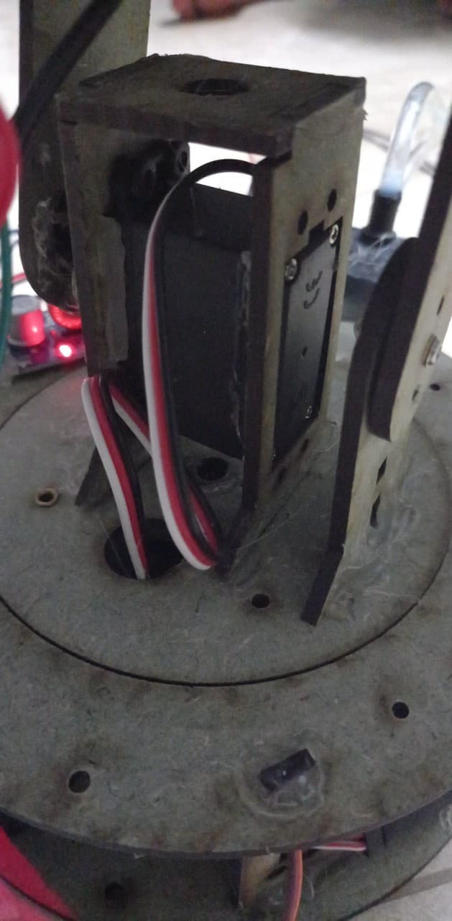
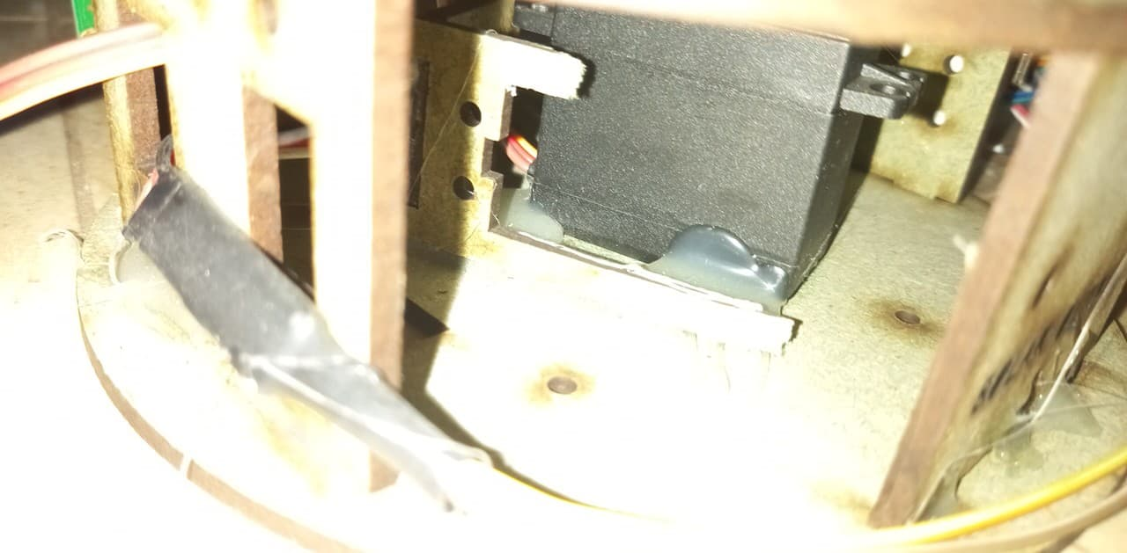
We connected the 2Servo to the Arduino
How it works
The two Servos

Slide 8
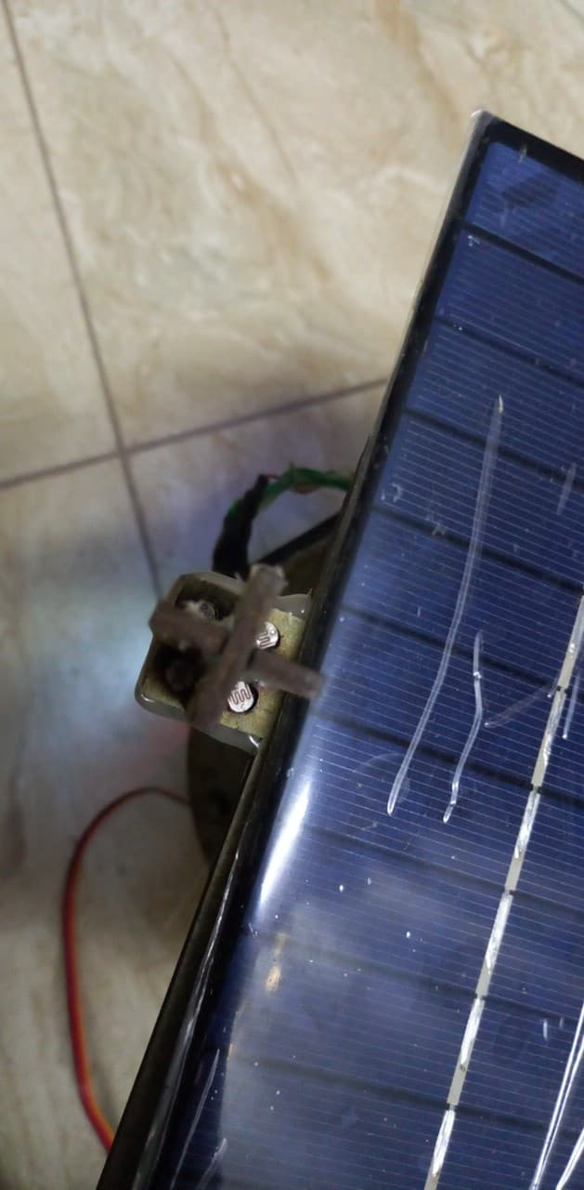
At first we connected the four LDRs with Arduino .
How it works
4 LDRs

Slide 9
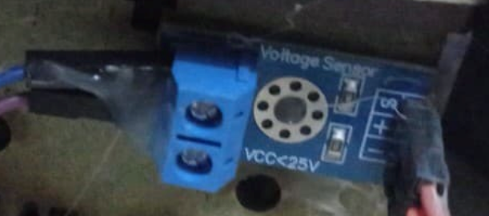
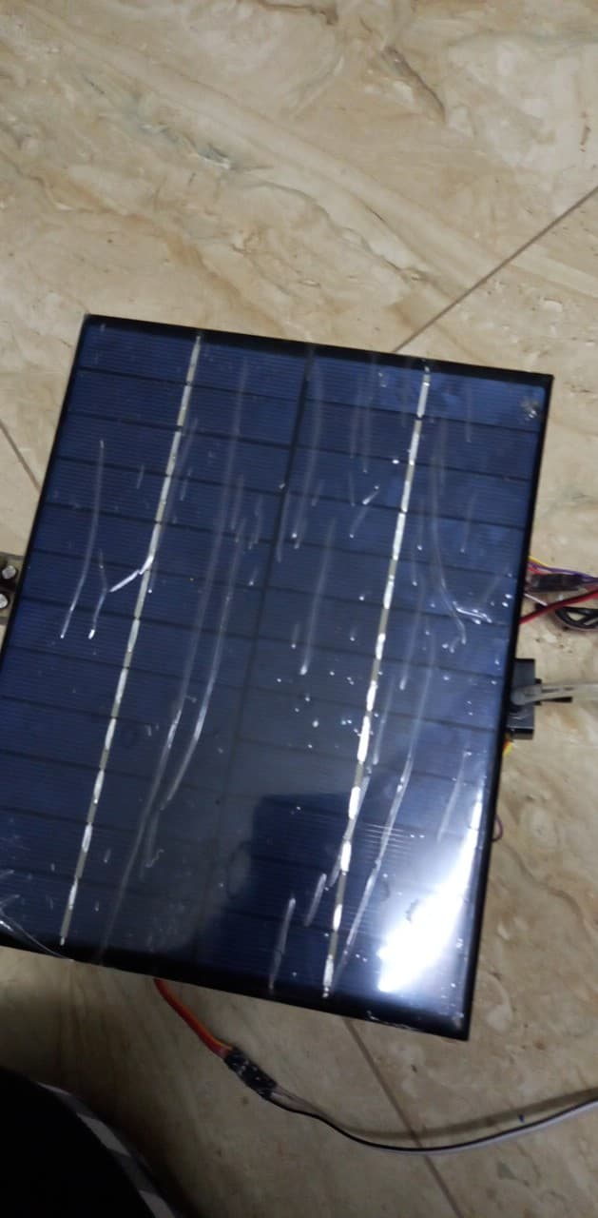
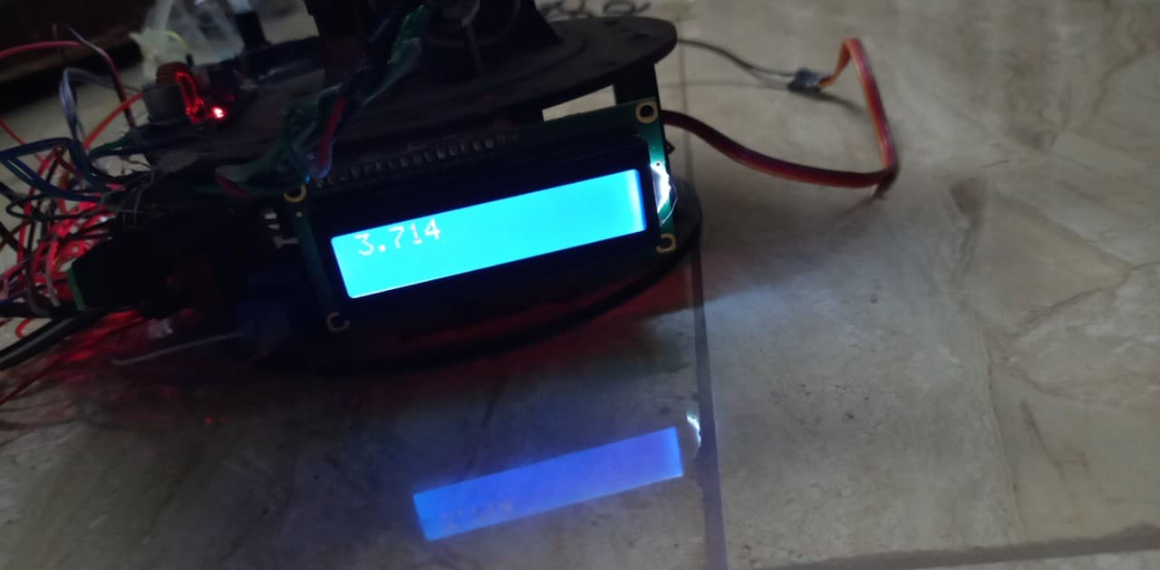
We connected the solar panel to the voltage sensor and then to the Arduino
How it works
LCD , Solar panel , Voltage sensor

Slide 10
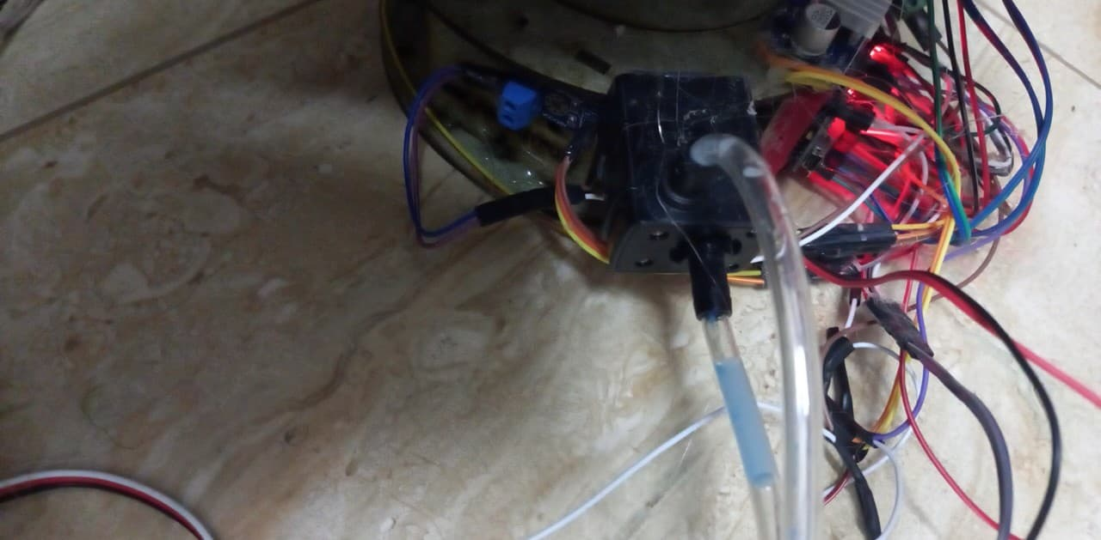
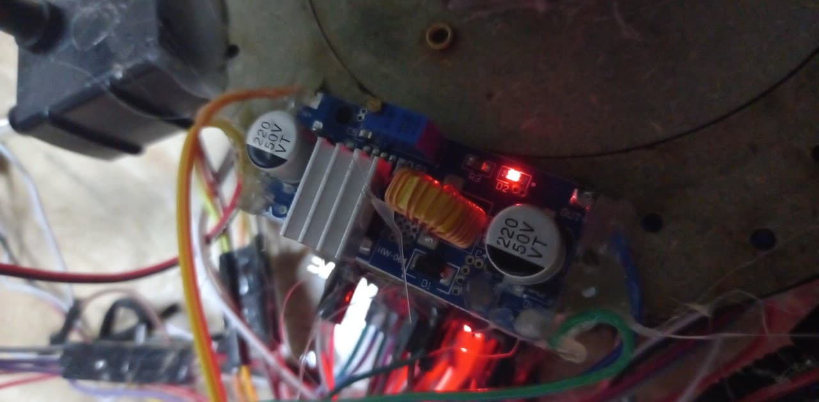
We connected the Relay to the Arduino and the other side od relay to the pump.
How it works
Pump & Relay

Slide 11
Summary
We connected all the previous equipment to the Arduino and downloaded the code attached to the Shinny report on the Arduino, and then we ran it, and as a result, Shinny tracked the highest intensity of light and washed itself when pressing the button.
The four LDRs checks the lighting intensity in the four directions and passes the values to the Arduino, the Arduino compares the four values and chooses the highest so the solar panel moves towards this direction through that the Arduino passes a command to the 2 servos to move to reach the desired direction.
The button, when pressed for the first time, moves the 2 servos to reach a direction that does not allow parts and tools to be exposed to water. Then, when pressed again, the water pump operates to wash the solar panel.
And we wrote a code that washes the solar panel at a certain time.
In all these stages, the temperature is checked on the surface of the solar panel and this value is displayed as a voltage on the LCD screen.

Slide 12
Constraints
It took us a lot of time to learn to program the Arduino.
The solar panel is heavy, and this requires a mechanical design that bears the weight of the solar panel and is able to move it.
Difficulty writing the code that checks the highest temperature, then moving the solar panels in the right direction.
We also encountered technical issues such as damage some tools and wires, which took us a long time to discover these issues

Slide 13
Future Work
replace the cleaning process by pressing the button by cleaning at a certain time
build a small application to control all the operations that Shinny does.
Connect a battery to store the energy absorbed from the solar panel

Slide 14
THANK YOU

