Slide 1

Saloonati
By:
Nada Abushanab
&
Noura Darwazeh
PROJECT SUPERVISOR: Muhannad Al-jabi

Slide 2
Outline
01
02
03
04
Introduction
Features
Technologies
Constraints
05
Future Work

Slide 3
01
Introduction

Slide 4

Many people have suffered from crowding problems in stores and beauty centers in general.
And they have become more in need of easier and more comfortable ways to save time and effort to search for the products they want, to shop from home, and to book appointments in the centers they want in easy and fast ways.
They also need to communicate with the owners of beauty centers from their homes without bothering to inquire about anything they want.

Slide 5
02
Features

Slide 6
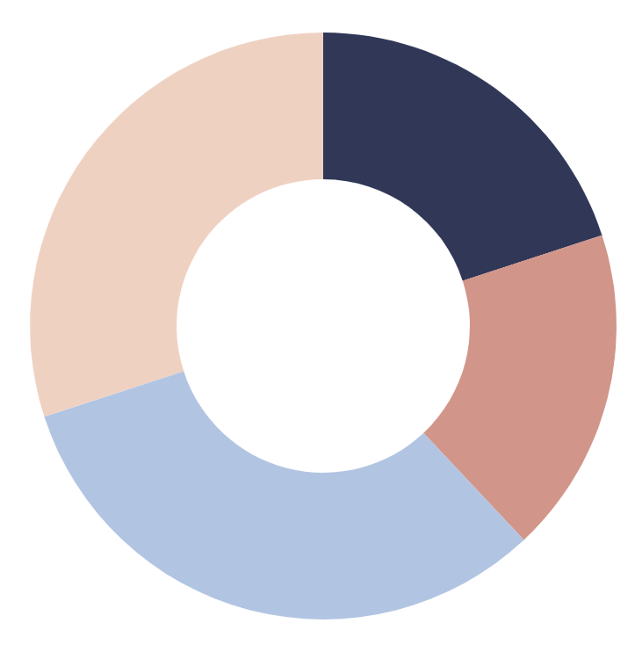
Features
Service Booking
Service Ordering
Chat
Map
The customer can book the appointment he wants in the center he wants, and if this appointment is not available, the application does not allow him to book, and the customer’s booking reach the owner of the center.
The customer can order the beauty products he wants through the application, and the customer's orders will reach the owner of the center.
The customer can communicate with the owner of the center at any time he wants from his home through the chat, and the owner of the center responds to him through the chat.
The customer can see the exact location of the center through Google Map.
Notification
A notification reaches the customer when he communicates with the admin through the application, and the notification shows him that his message has been sent to the admin

Slide 7



Technologies

Slide 8
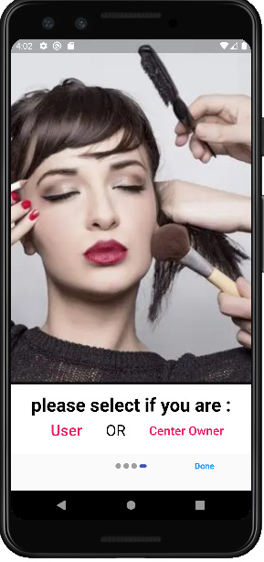
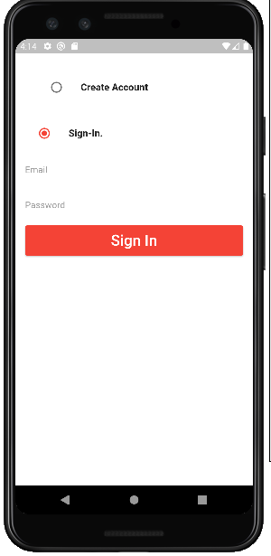
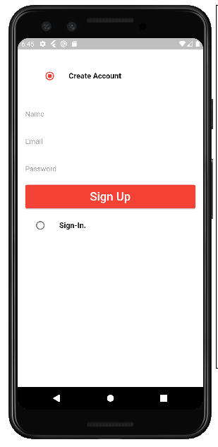
Common

Slide 9
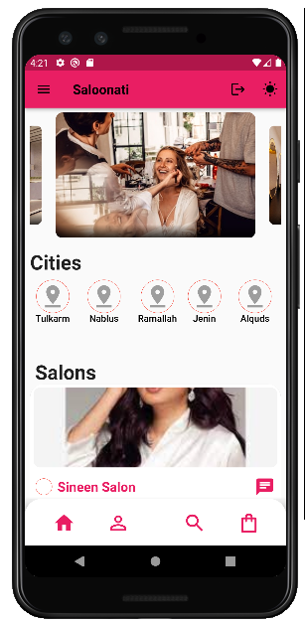
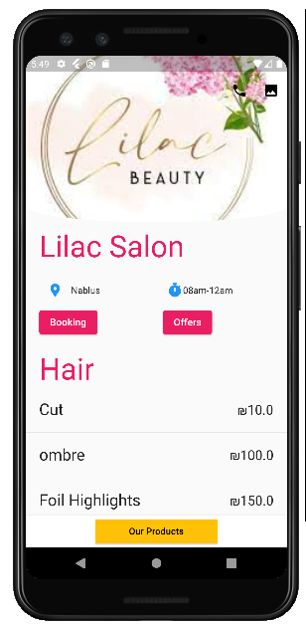
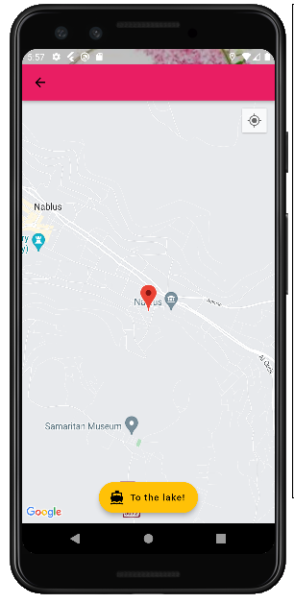
User

Slide 10
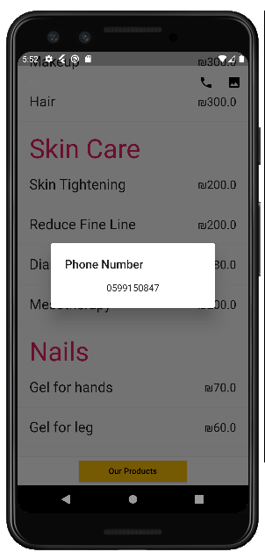
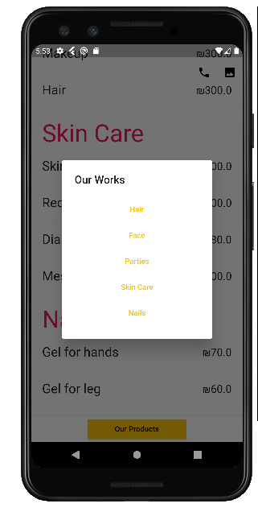
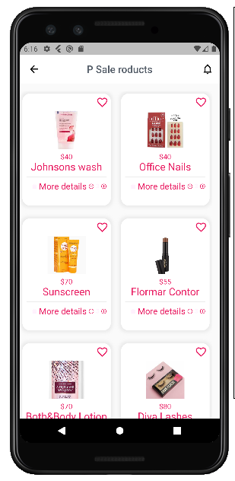
User

Slide 11
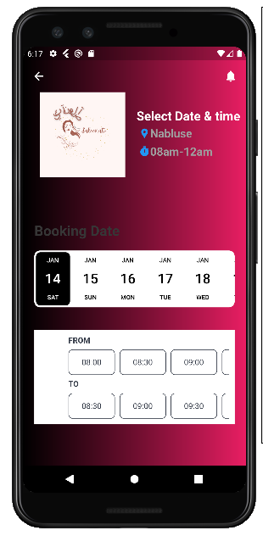
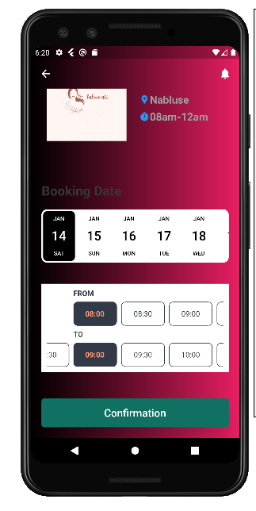
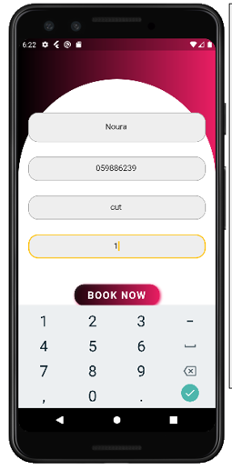
User

Slide 12
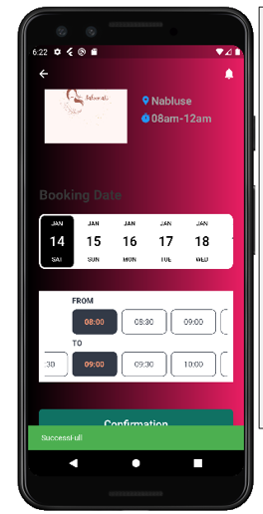
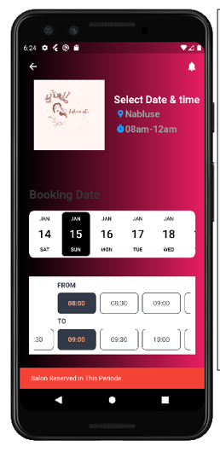
User

Slide 13
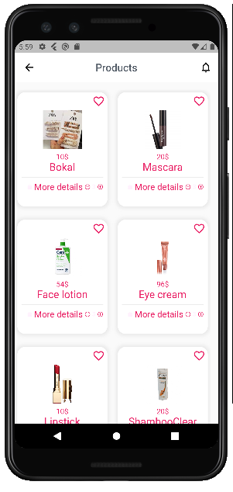
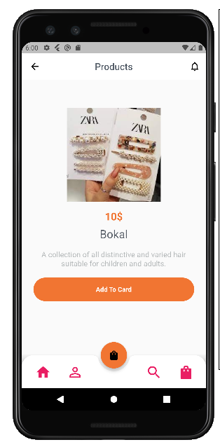
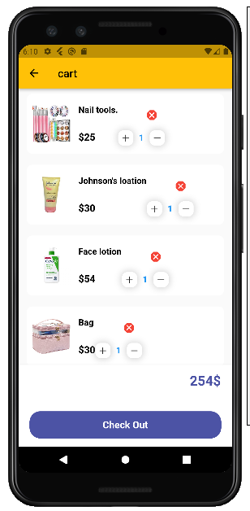
User

Slide 14
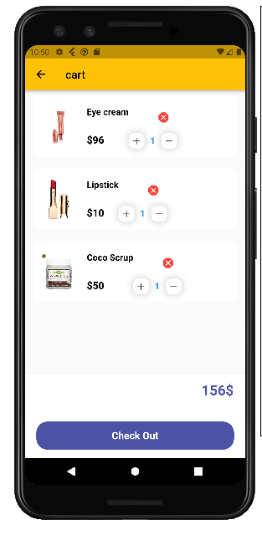
User

Slide 15
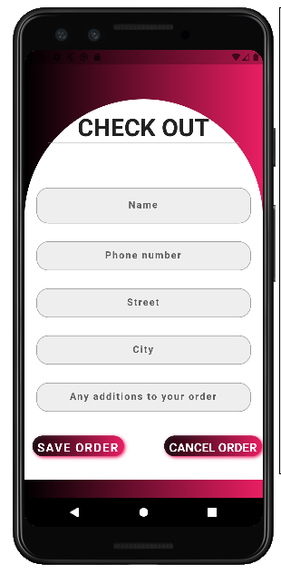
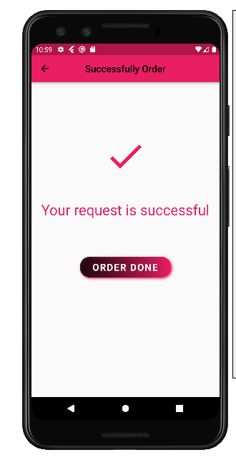
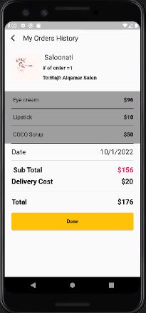
User

Slide 16
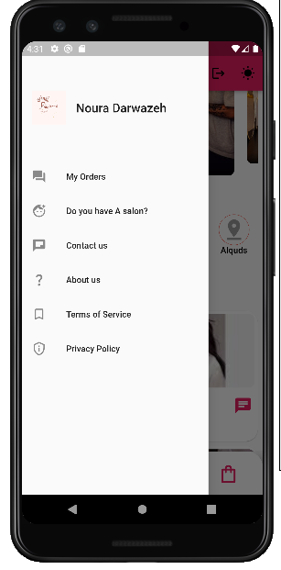
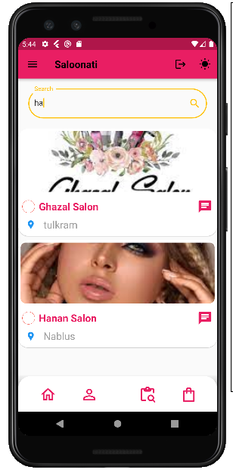
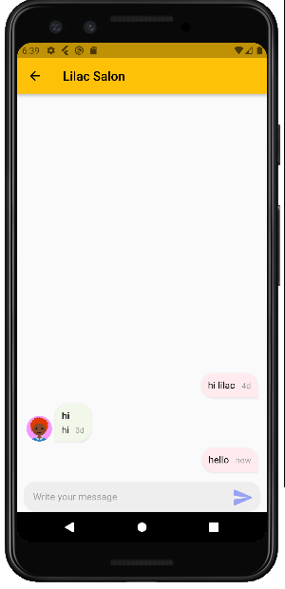
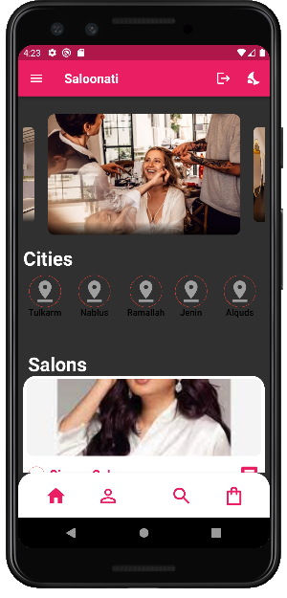
User

Slide 17
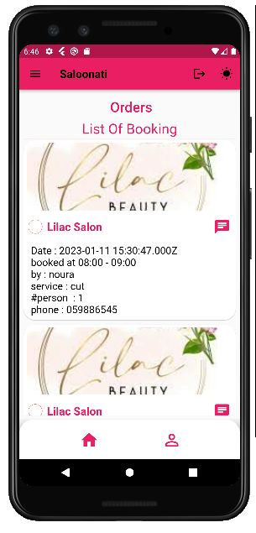
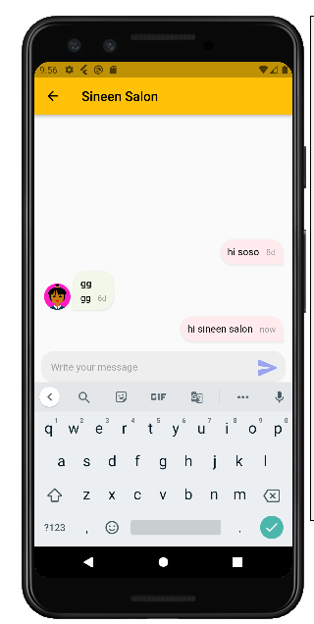
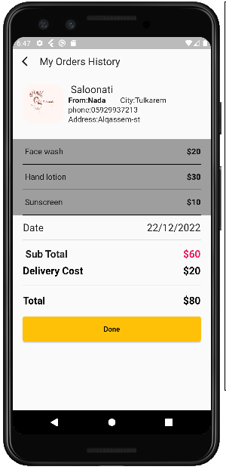
Center Owner

Slide 18
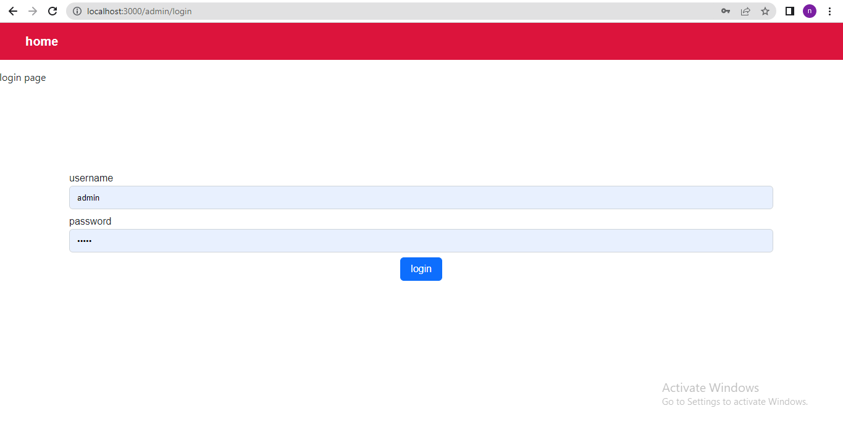
Admin

Slide 19
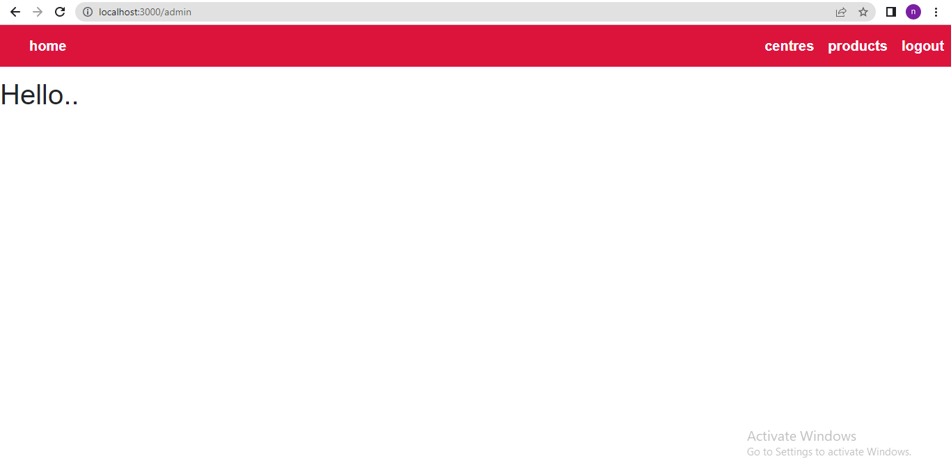
Admin

Slide 20
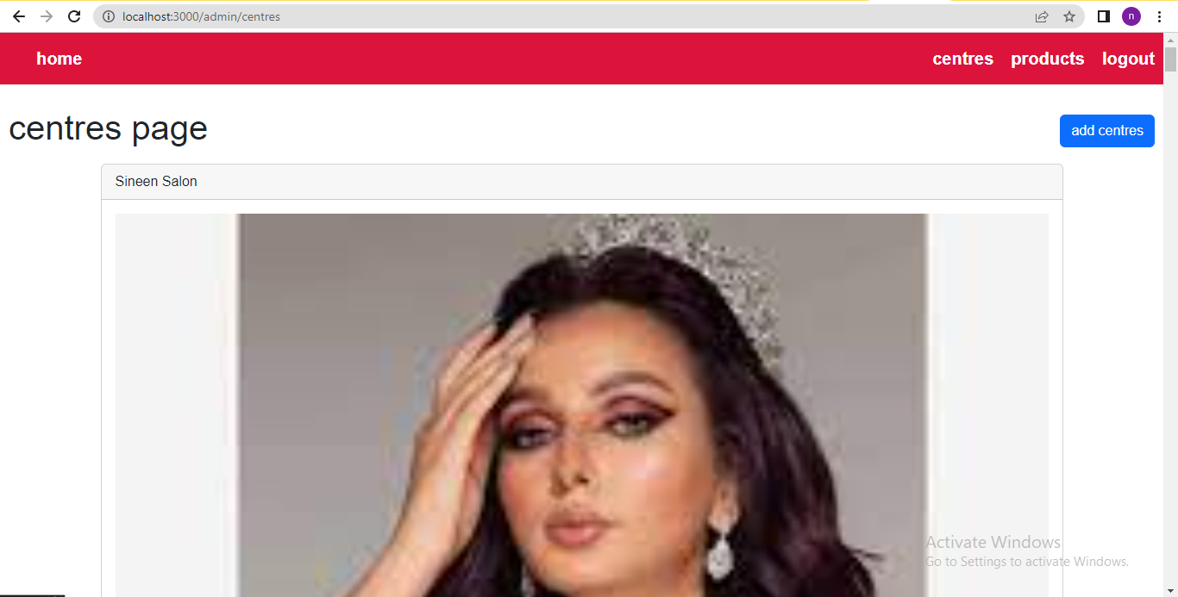
Admin

Slide 21
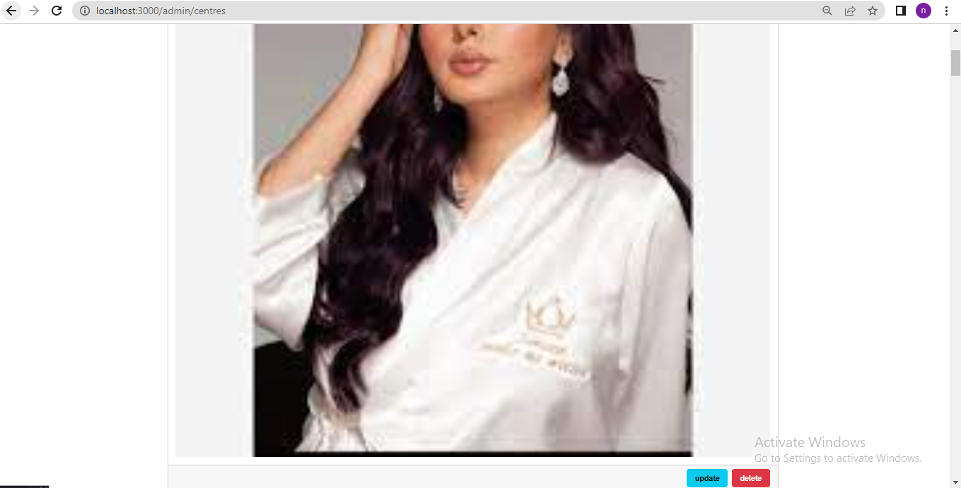
Admin

Slide 22
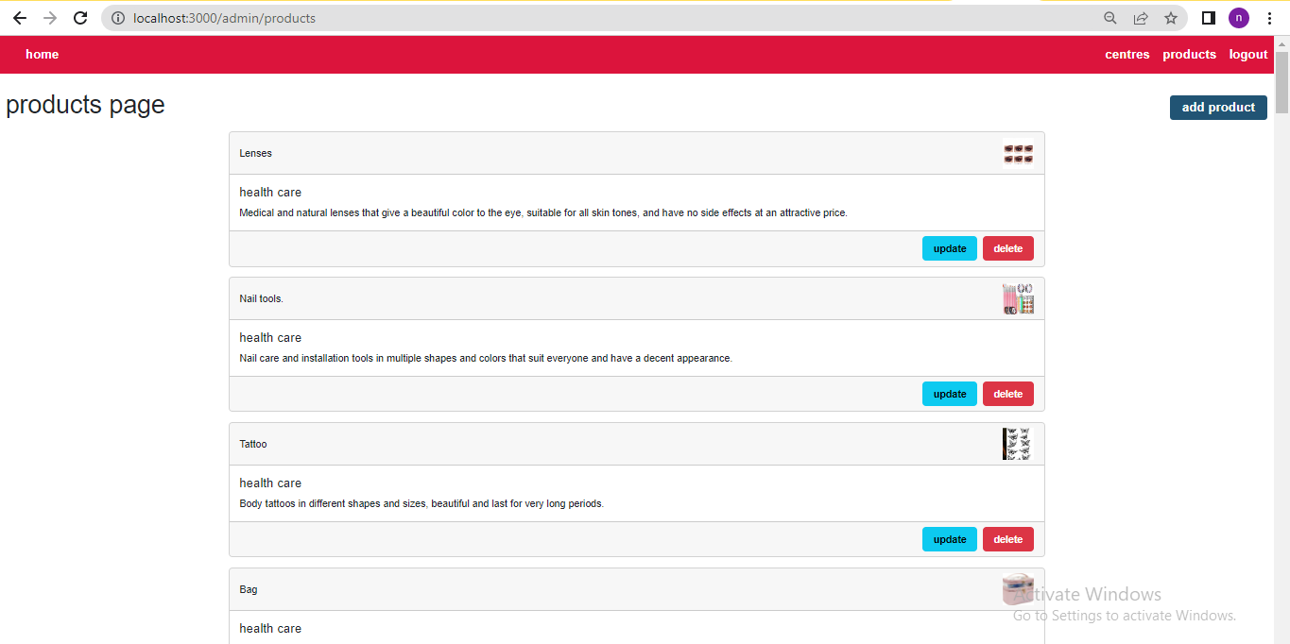
Admin

Slide 23
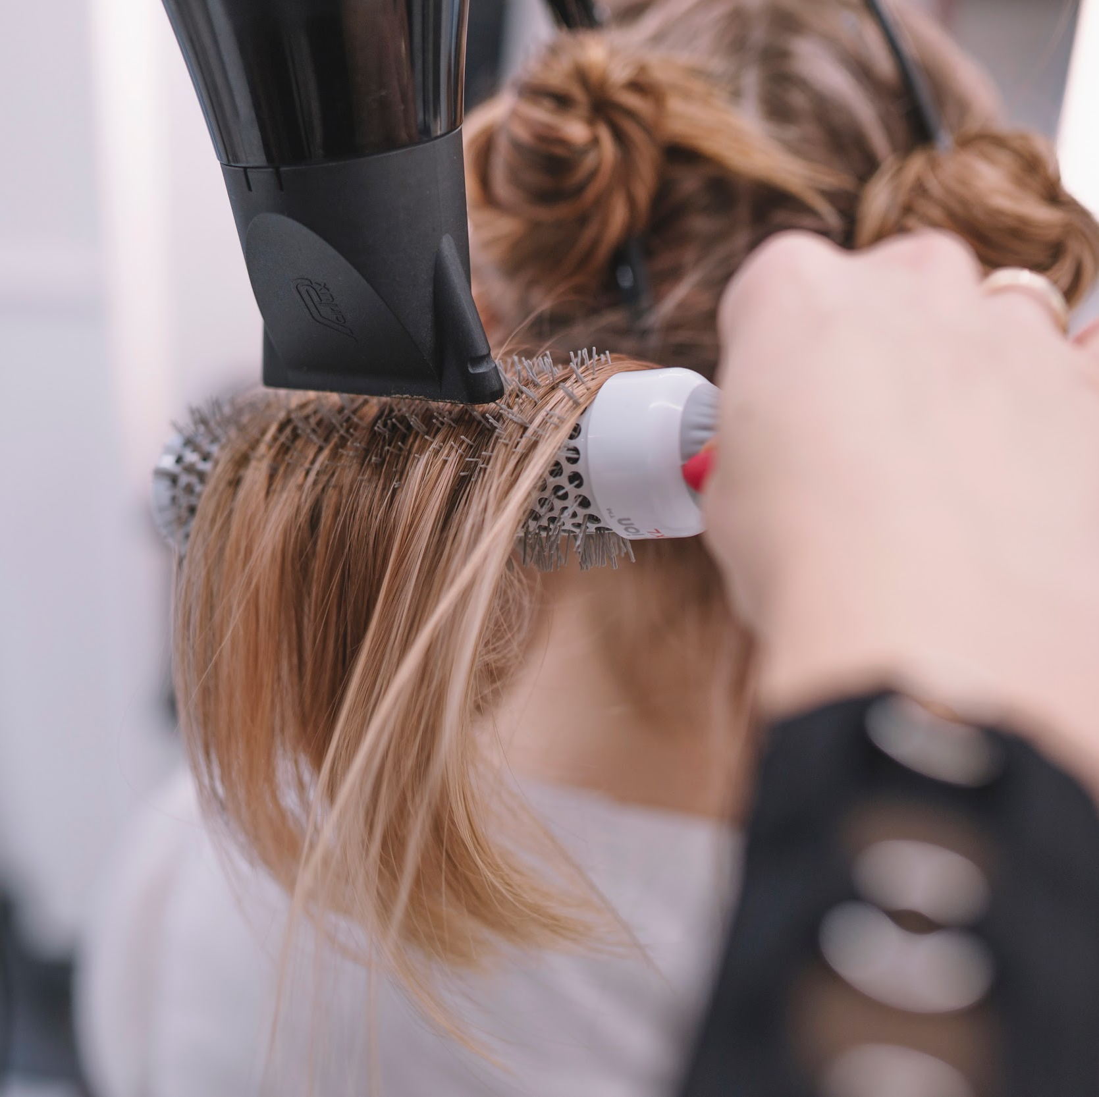
Future Work
Search for a specific product through its image.
Determine the nearest center to the customer's location through the application.
Adding a delivery company to the application to deliver products to the customer

Slide 24


