Slide 1


Building Engineering Department
Graduation project II presentation
Prepared By :
Esraa Atatreh.
Hala Al-Ahmad.
Shaimaa Al-Sayed.
Shaimaa Zean Al-Dean.
Supervised by:
Eng . Alaa shaheen
Eng .Hasan Mathar
Page 1
1

Slide 2
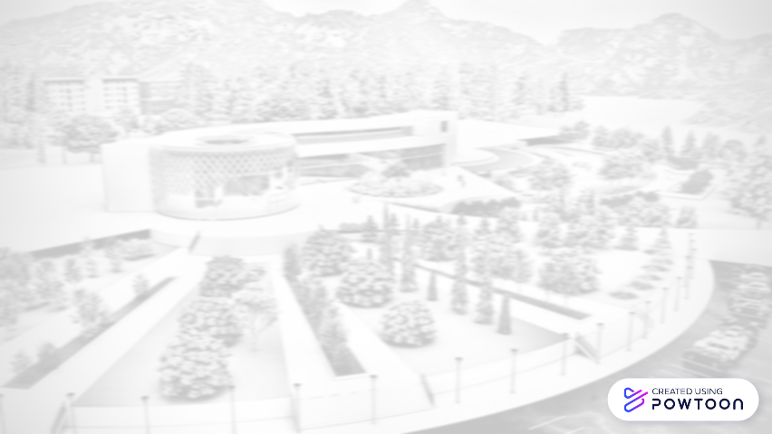

Introduction
Site Analysis
CONTENT
Architectural Aspect
Environmental Aspect
Structural Aspect
Electro-Mechanical
Aspect
Quantity surveying
Page 2

Slide 3
Introduction
Site Analysis
CONTENT
Architectural Aspect
Environmental Aspect
Structural Aspect
Electro-Mechanical
Aspect
Quantity surveying
Page 3

Slide 4

Page 4
3

Slide 5
Introduction
Site Analysis
CONTENT
Architectural Aspect
Environmental Aspect
Structural Aspect
Electro-Mechanical
Aspect
Quantity surveying
5
Page 5

Slide 6
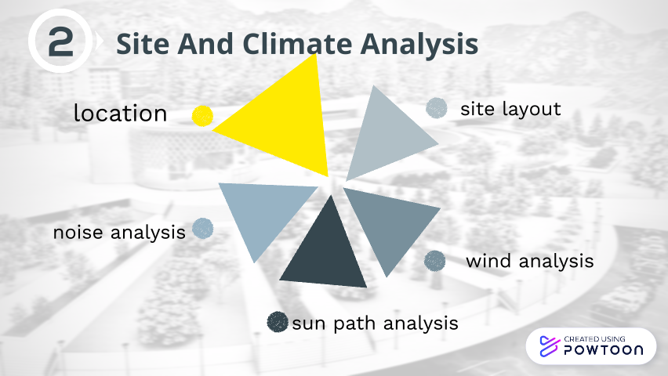
Page 6

Slide 7

Page 7
5

Slide 8
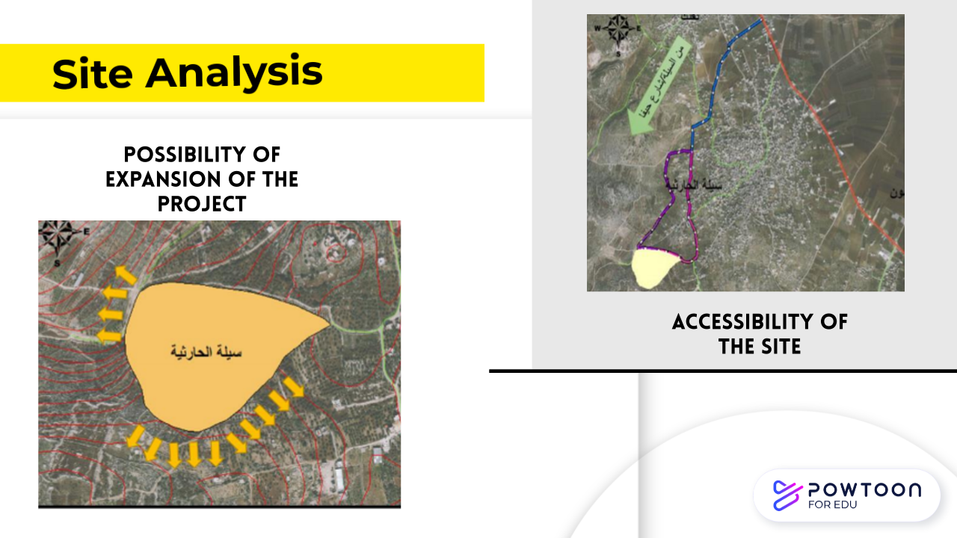

Page 8
6

Slide 9
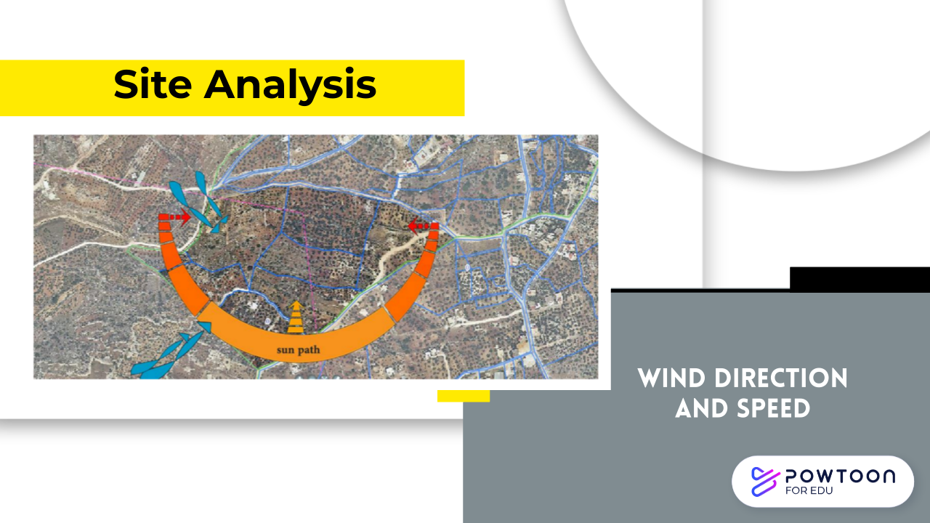
Page 9
8

Slide 10
Introduction
Site Analysis
CONTENT
Architectural Aspect
Environmental Aspect
Structural Aspect
Electro-Mechanical
Aspect
Quantity surveying
Page 10

Slide 11
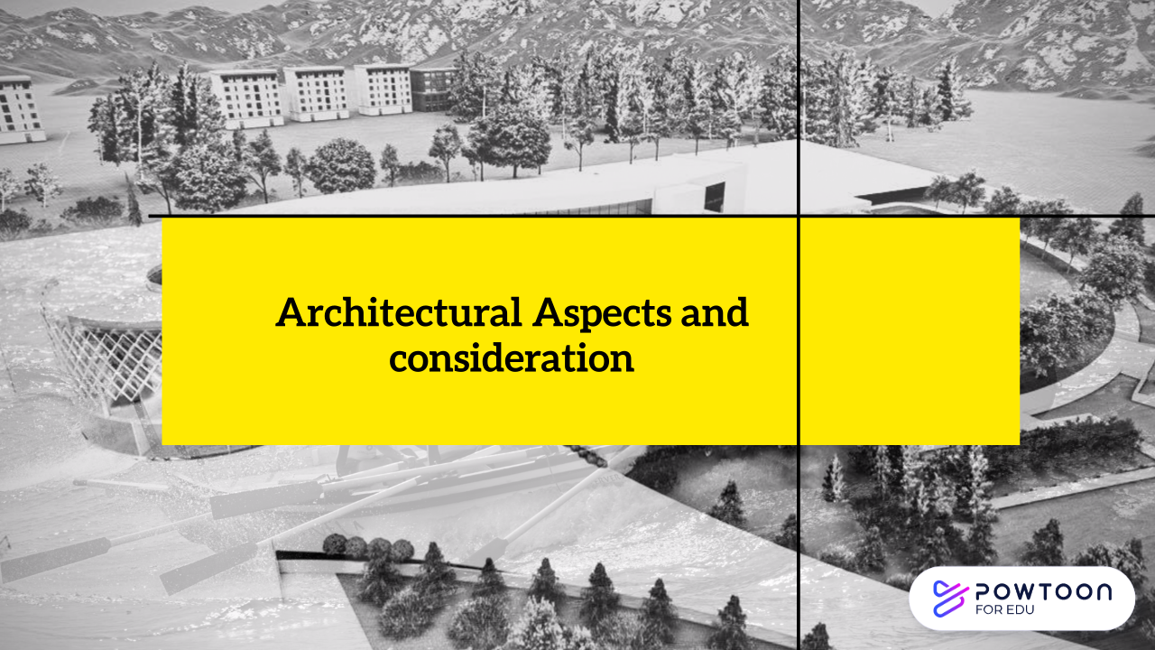
Page 11
12

Slide 12
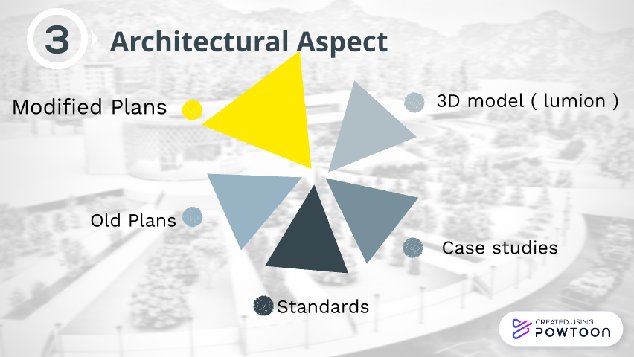
Page 12

Slide 13
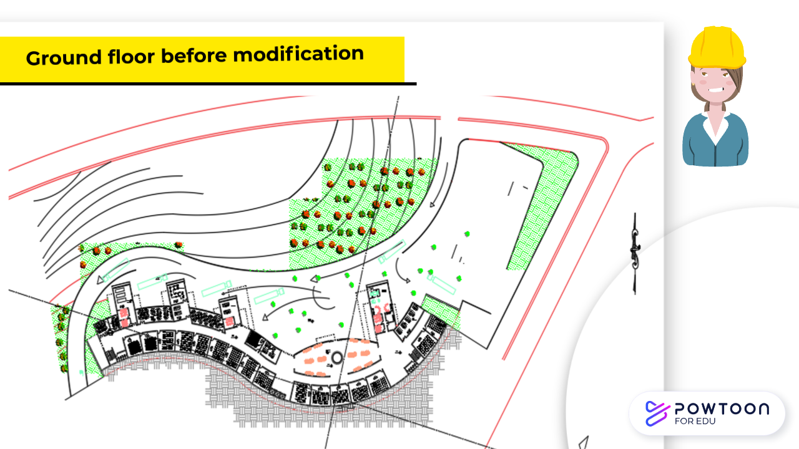
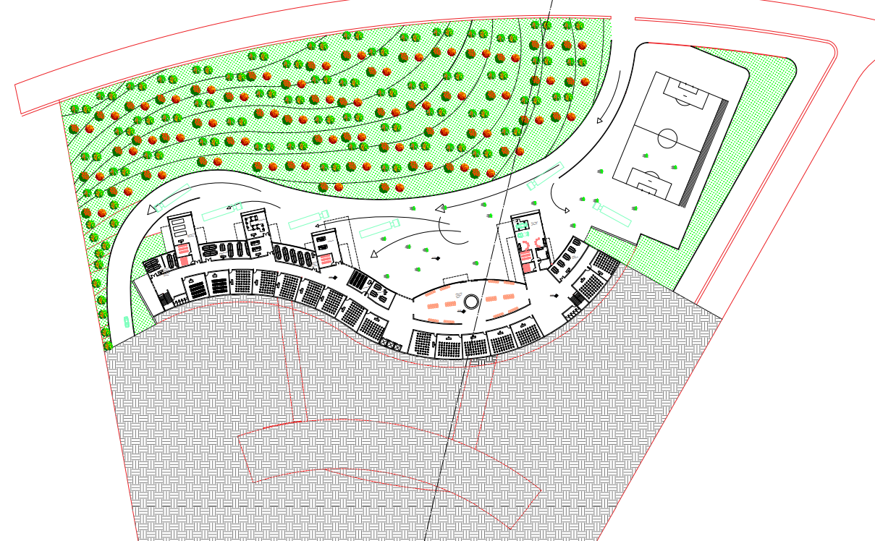
Page 13
13

Slide 14
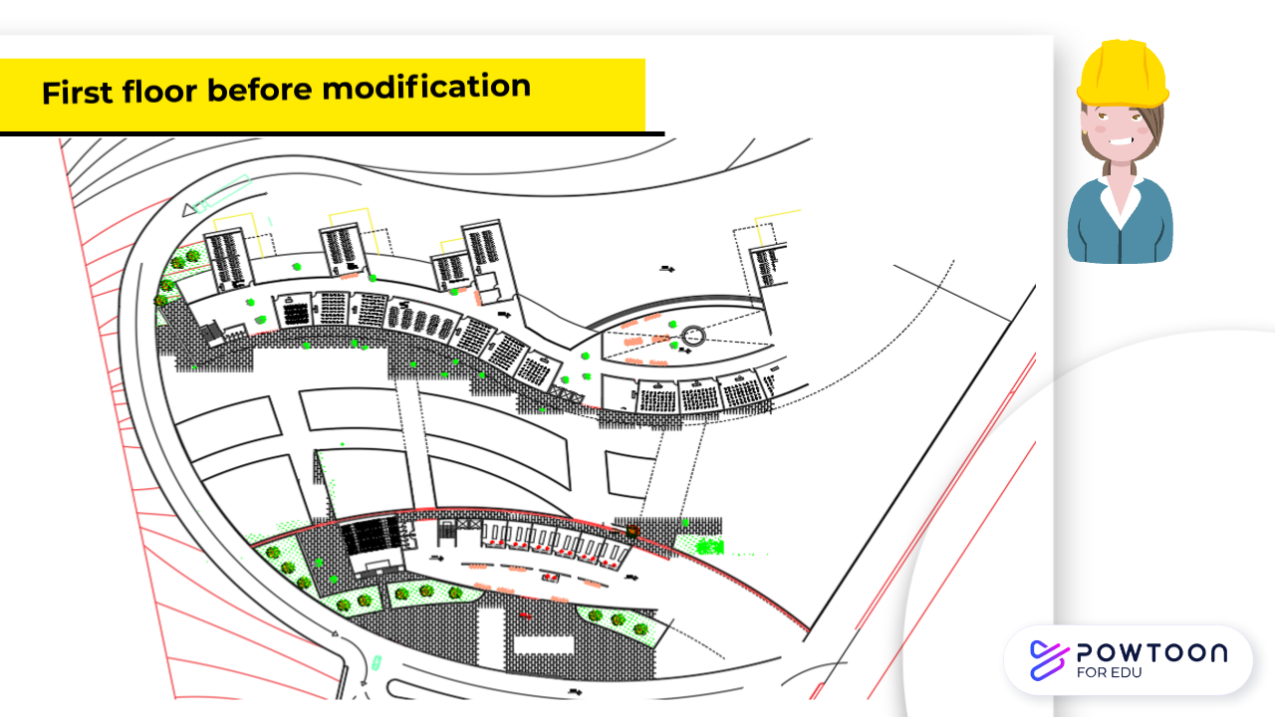
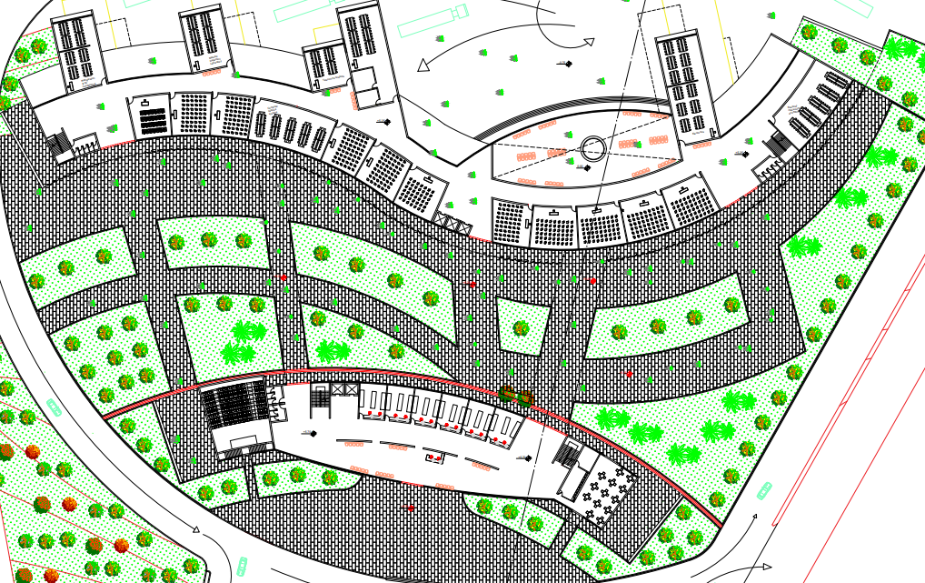
Page 15
14

Slide 15
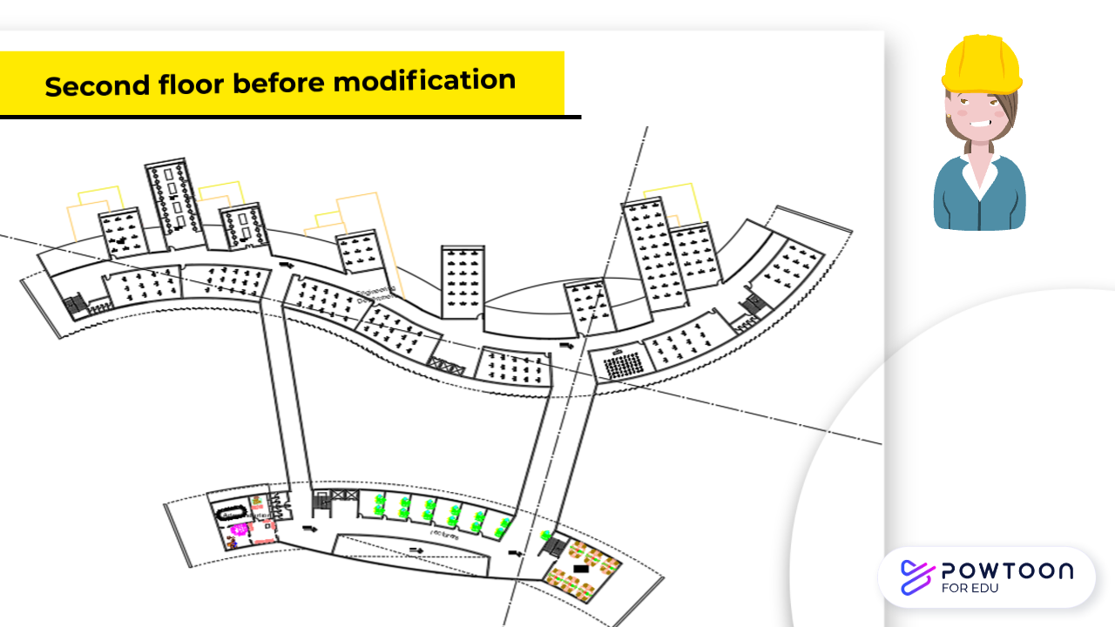
Page 17
15

Slide 16
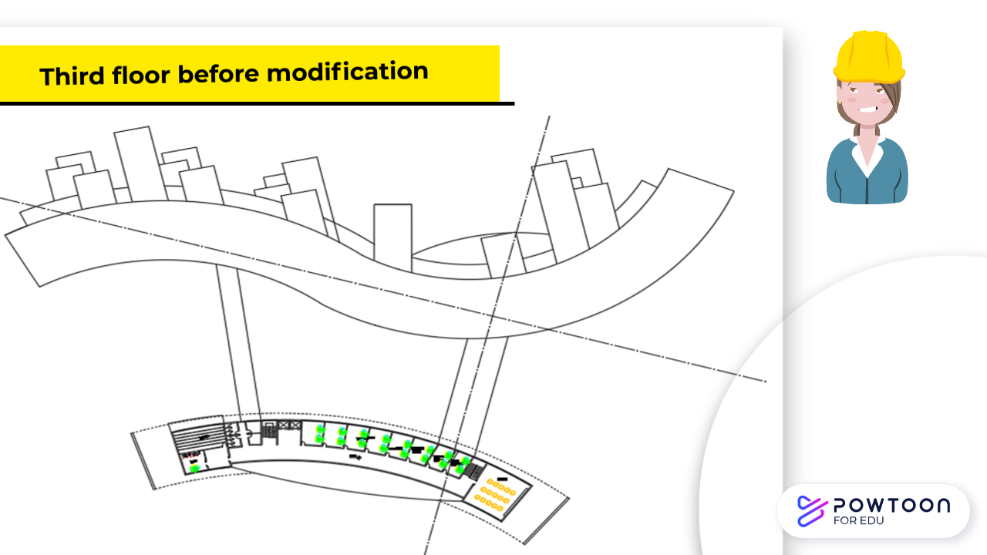
Page 19
16

Slide 17
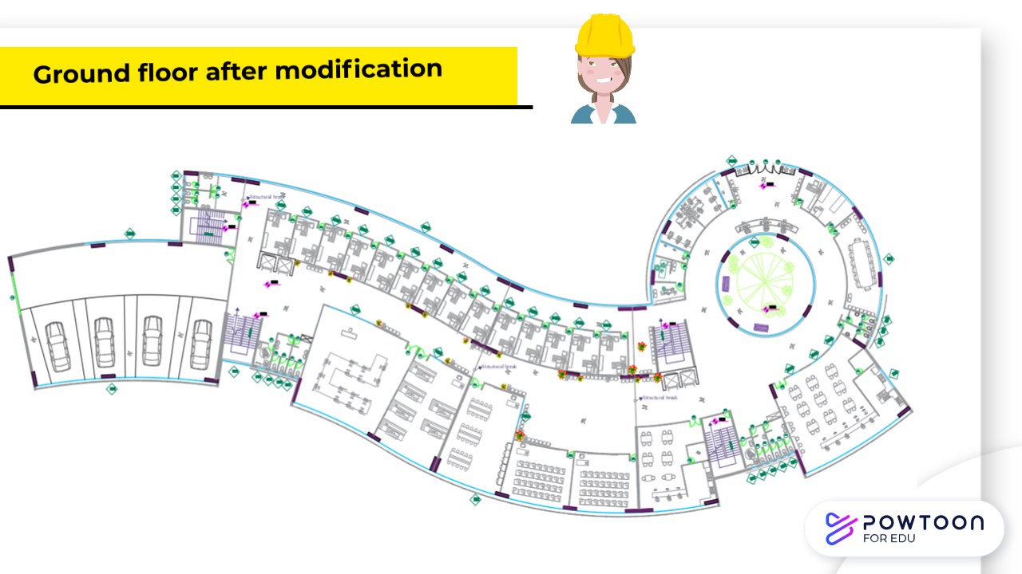
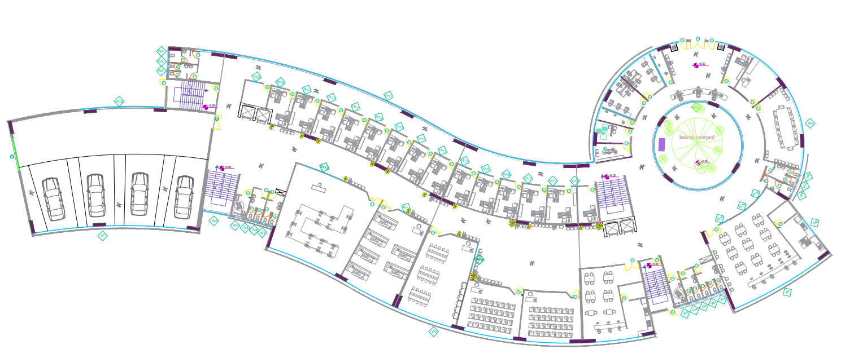
Zone2
Zone1
emergency staircase
Area = 3088.76 m2
Disabled bathroom
Zone3
Page 14
emergency staircase
Disabled bathroom
19

Slide 18
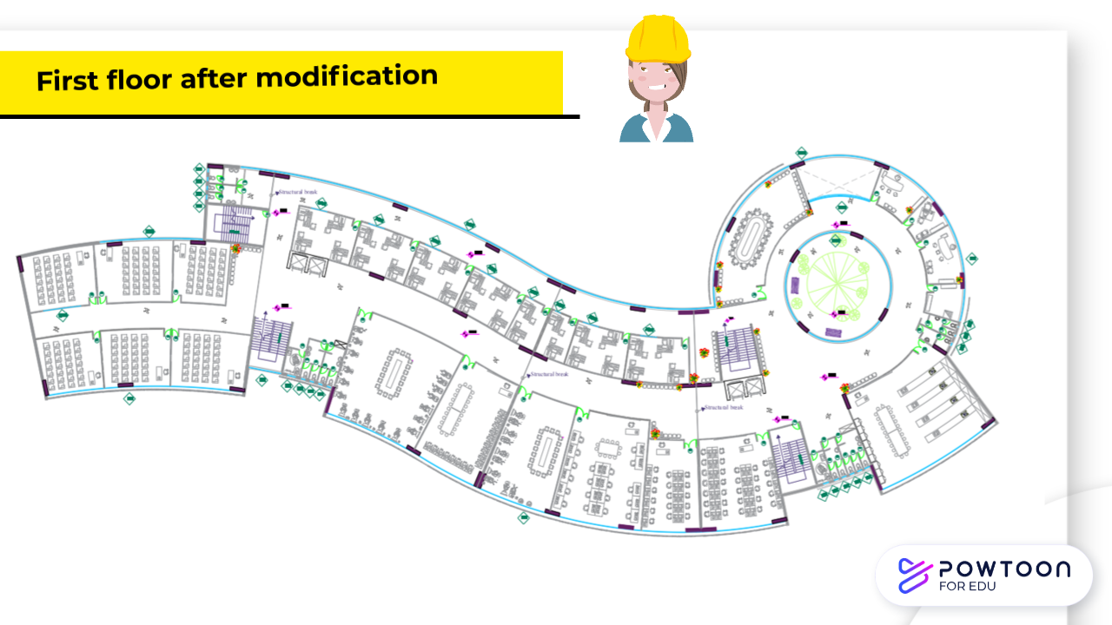
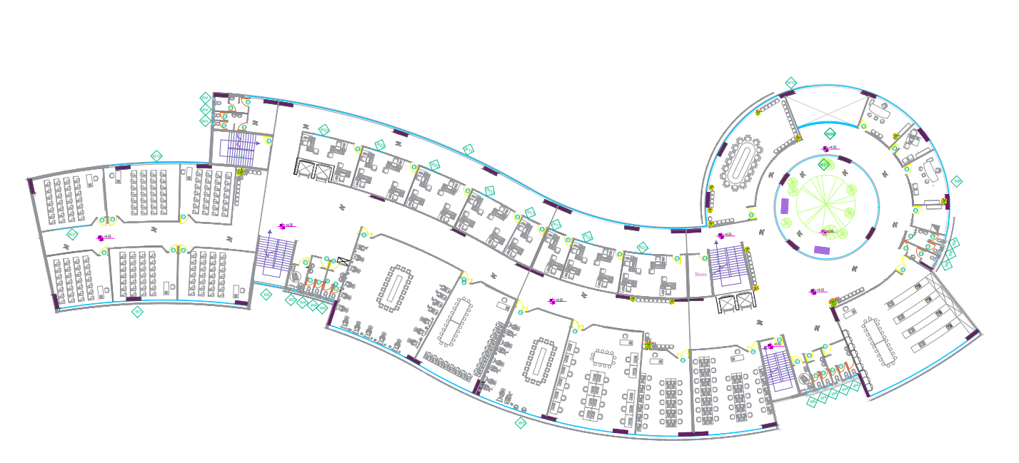
emergency staircase
Page 16
emergency staircase
20

Slide 19
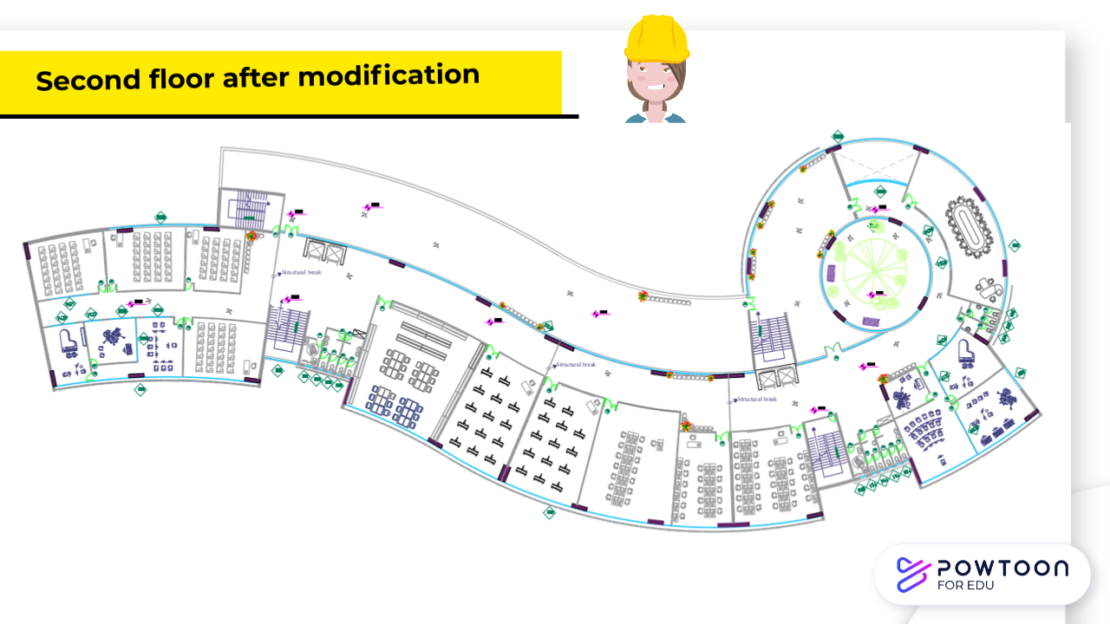
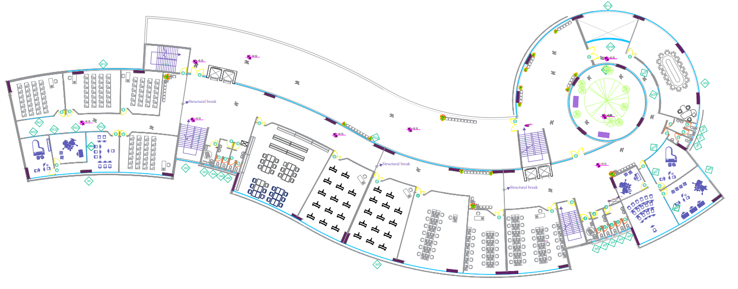
emergency staircase
Page 18
emergency staircase
21

Slide 20
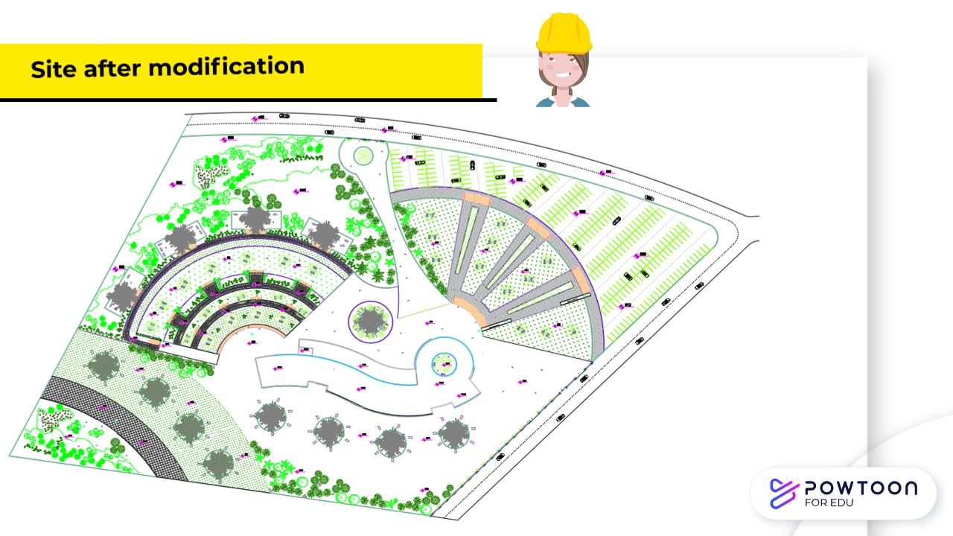
Page 20
22

Slide 21
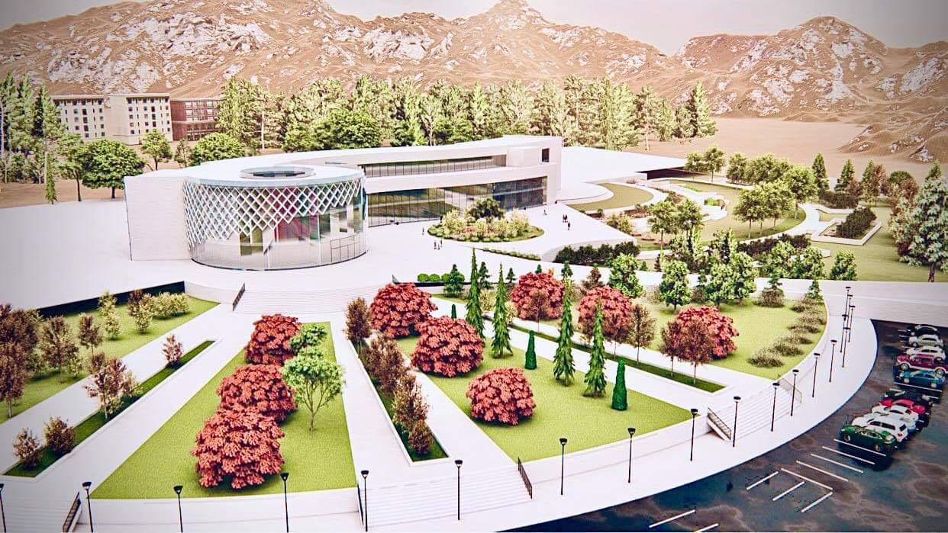


LUMION (3D MODEL )
Page 21
28

Slide 22
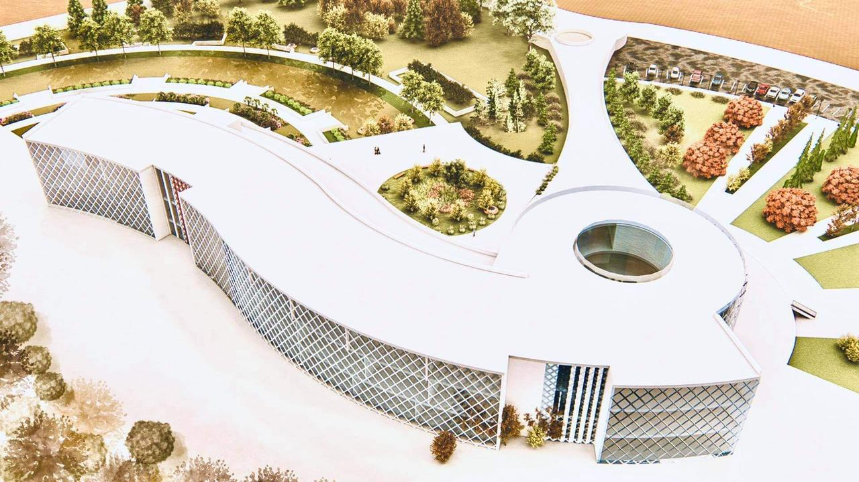
LUMION (3D MODEL )
Page 22
28

Slide 23
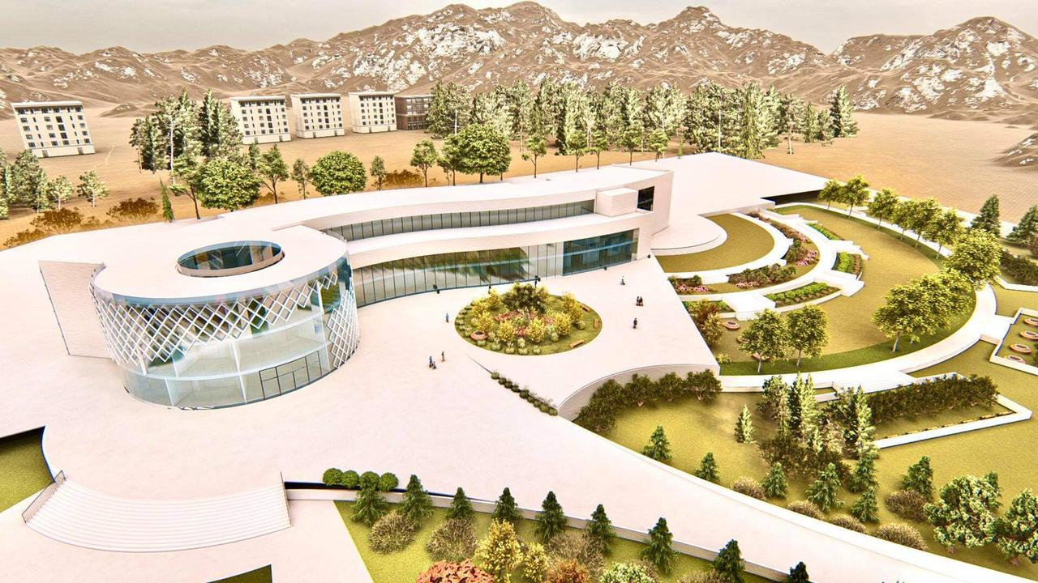
LUMION (3D MODEL )
Page 23
28

Slide 24
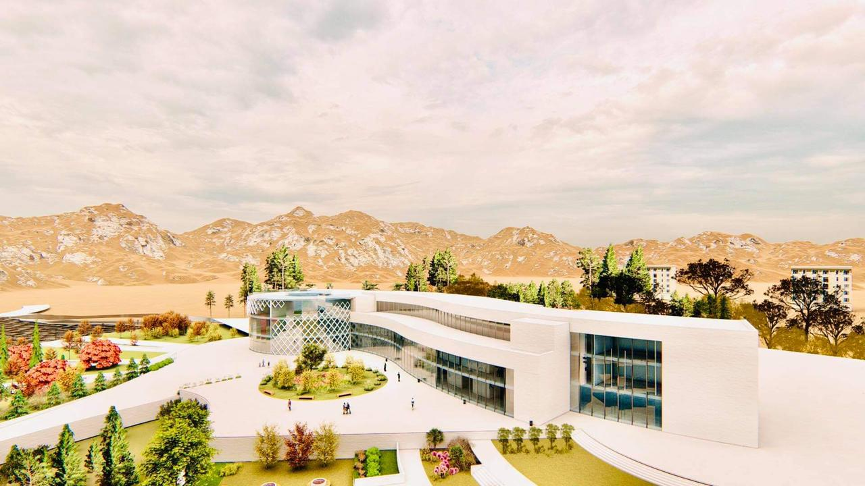
LUMION (3D MODEL )
Page 24
28

Slide 25
Introduction
Site Analysis
CONTENT
Architectural Aspect
Environmental Aspect
Structural Aspect
Electro-Mechanical
Aspect
Quantity surveying
Page 25

Slide 26

Page 26
29

Slide 27
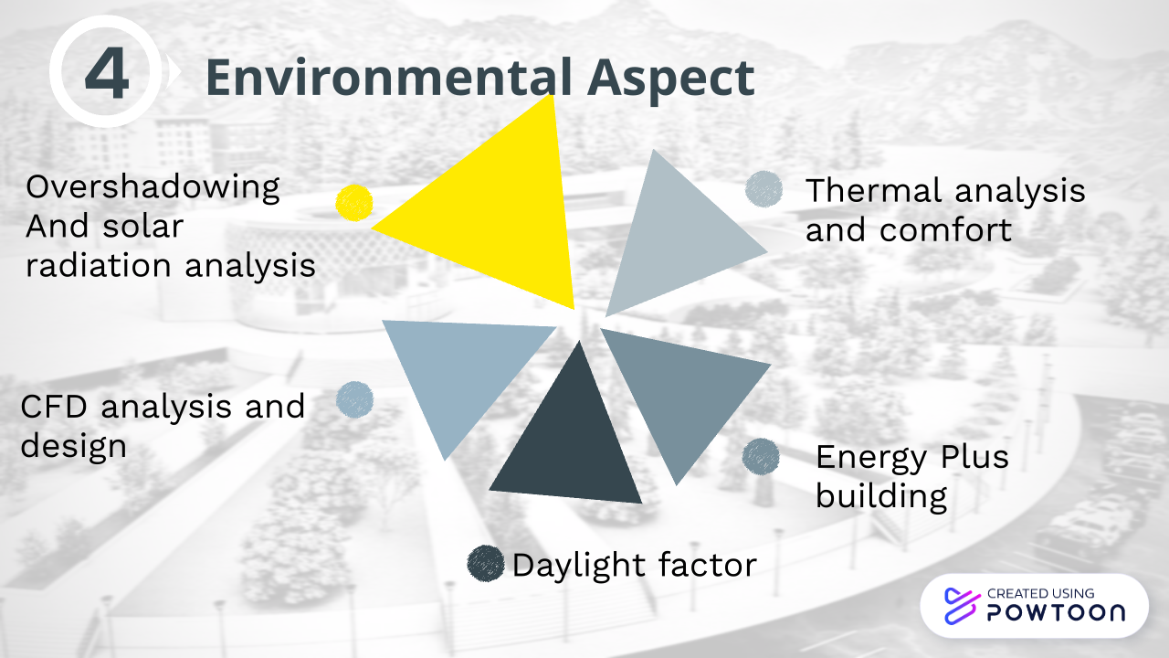
Page 27

Slide 28

Environmental analysis and design
summary of the cases that we have suggested to get less consumption
We chose Scenario number 4 (placed a curtain panel wall (Perforated Panels) on all the southern façade and use insulating materials for walls and roof and double glazing)
Page 33

Slide 29
Environmental analysis and design
Heating and cooling load
Total heating loads | 263.40Kw
Total cooling loads | 461.39Kw
Total consumption | 133.59Kwh/m2
Page 37

Slide 30
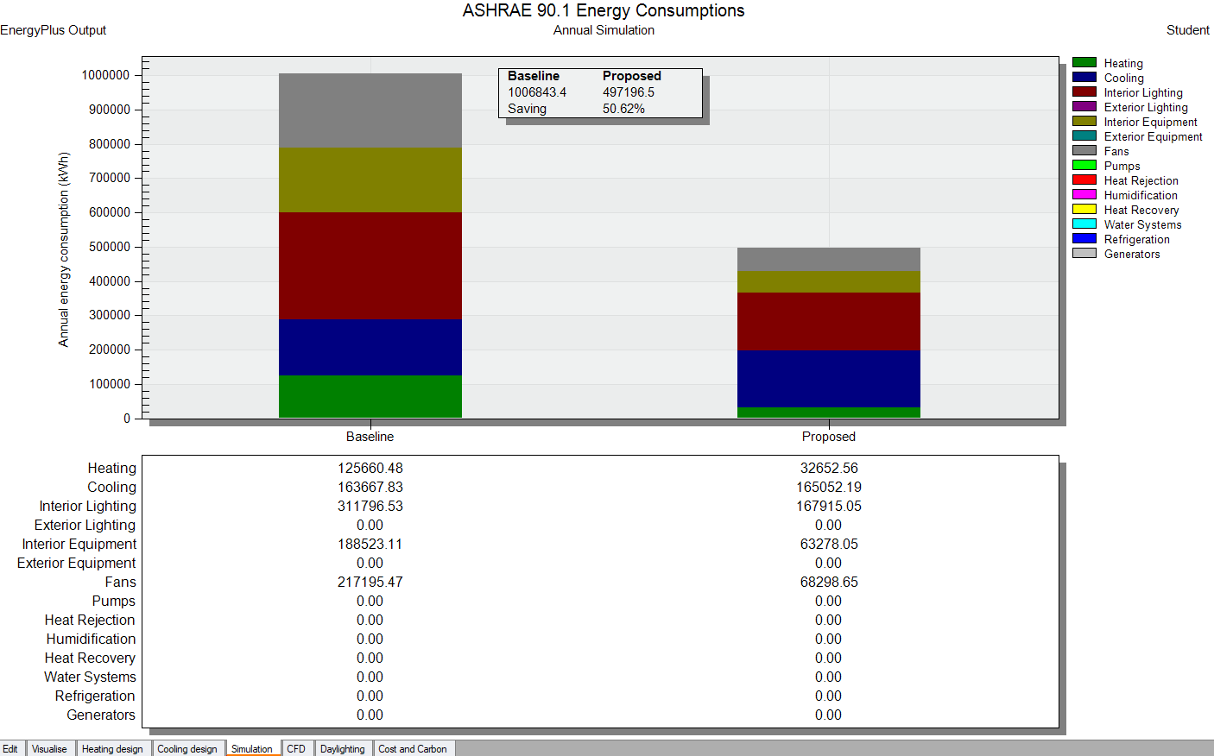
Environmental analysis and design
Design builder baseline comparison
The percentage of saving is 50.62 % in Scenario number 4.
Page 34

Slide 31
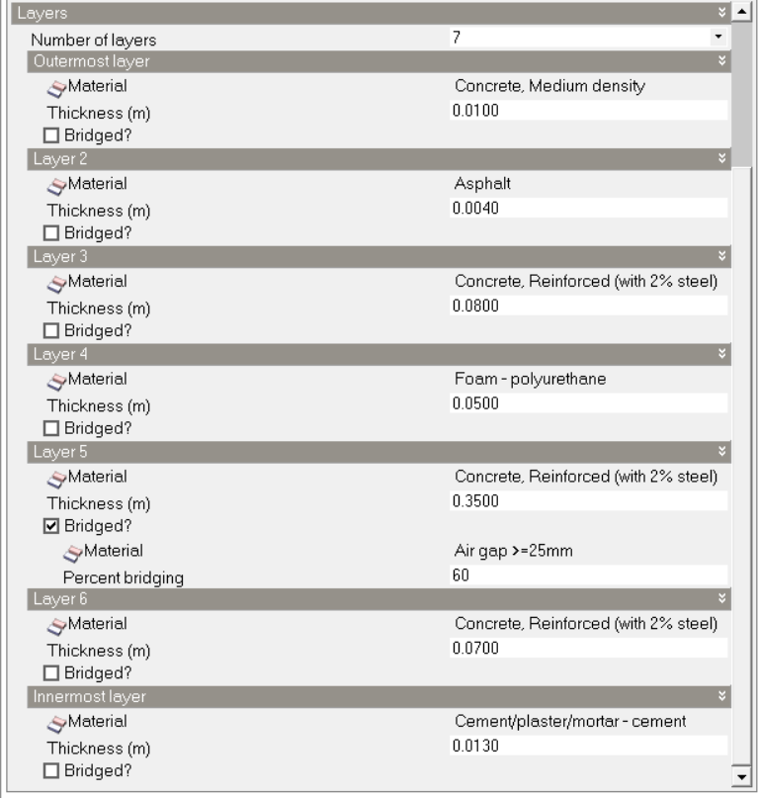
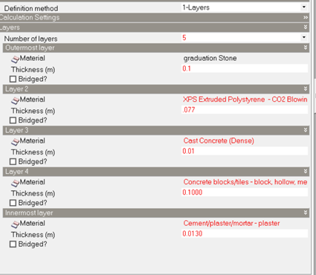
Environmental analysis and design
Thermal analysis and comfort
Roof with insulation material
Wall with insulation material
Double glazing
U-value = 2.185 ( (w/m^2.k).
Page 36
U-value =.459(w/m^2.k).
U-value =. 375 (w/m^2.k).

Slide 32
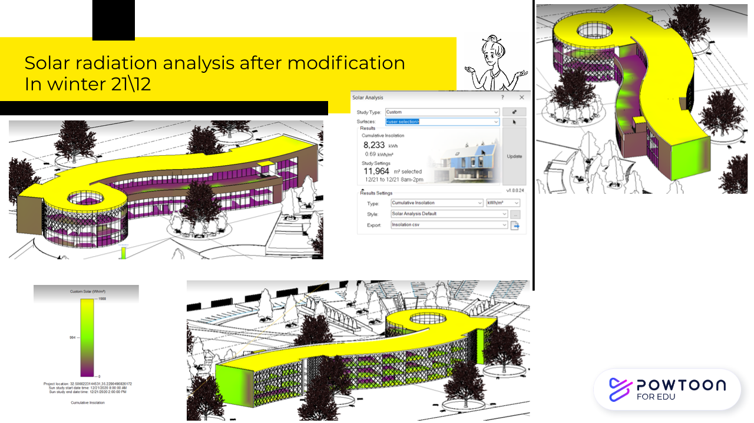
Page 28
43

Slide 33
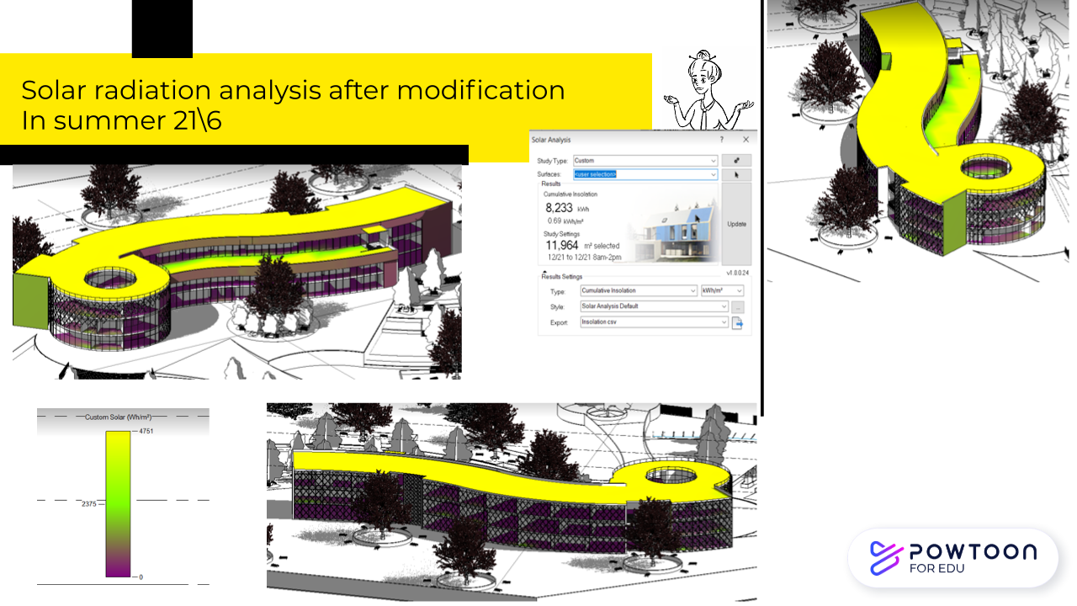
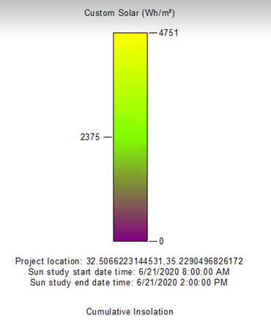
Page 30
45

Slide 34
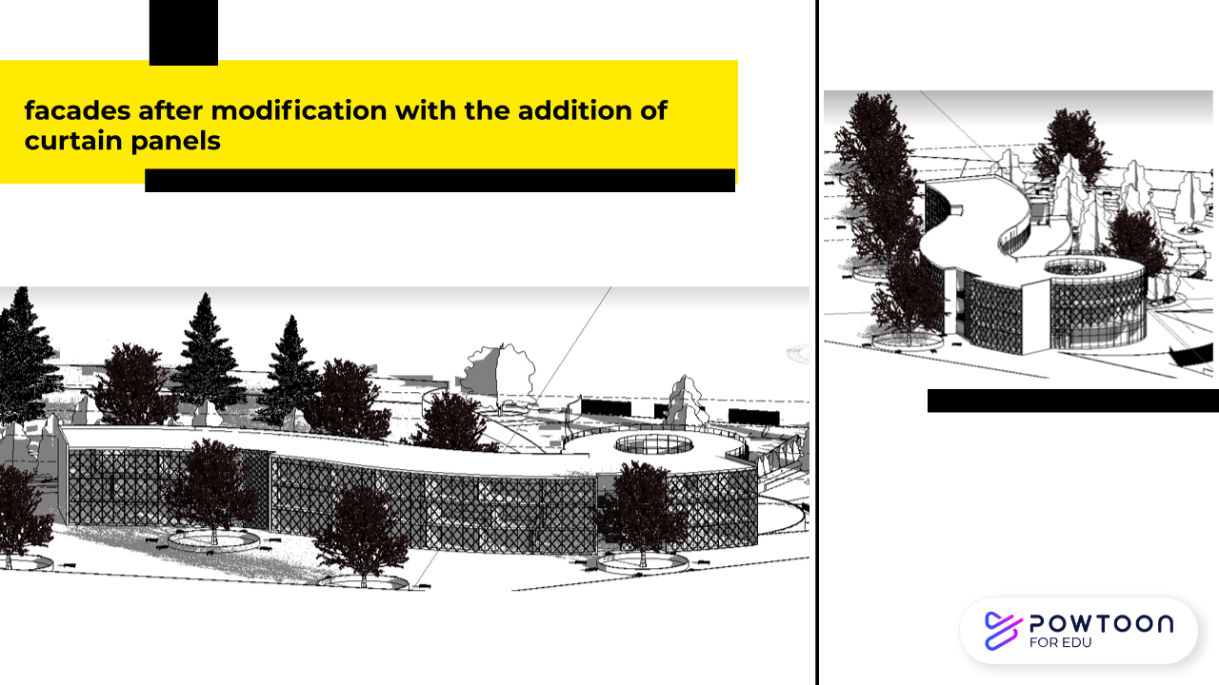
Page 32
39

Slide 35
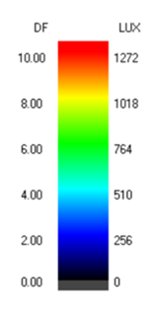
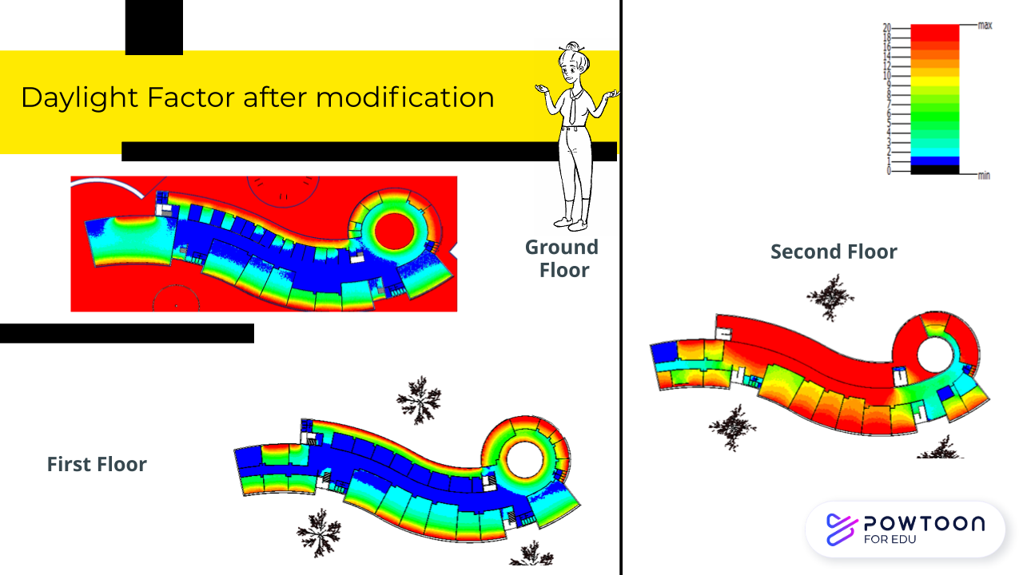
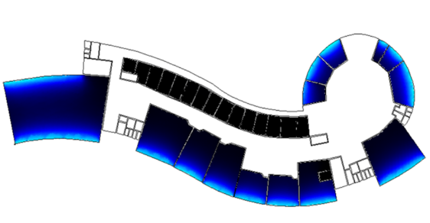
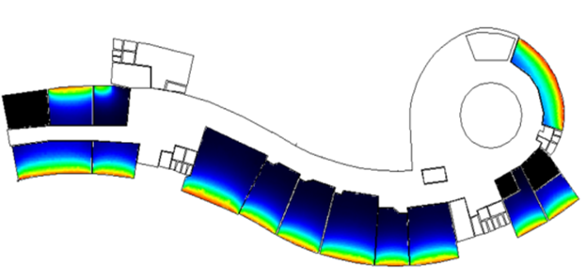
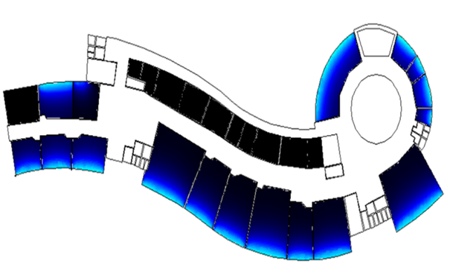
Page 35
40

Slide 36
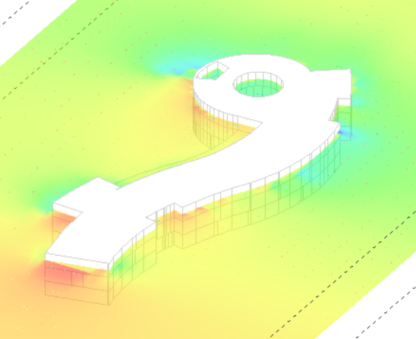
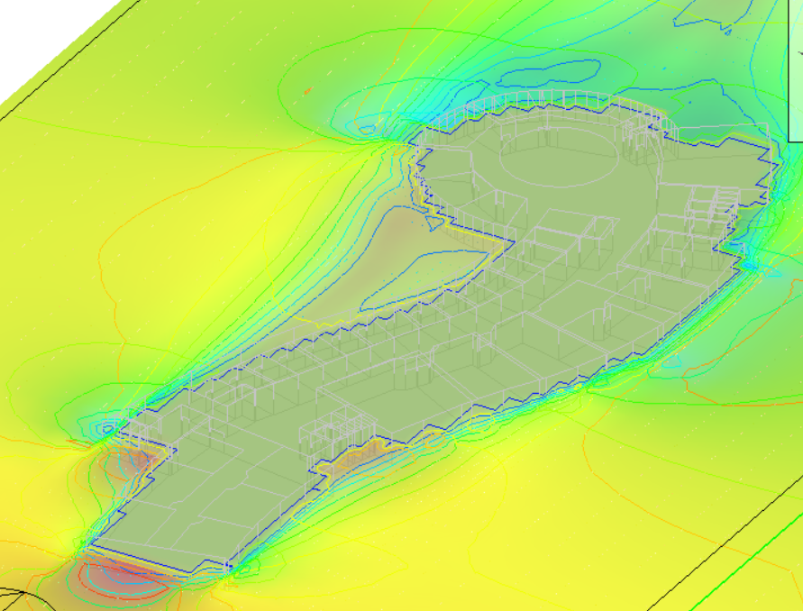

Environmental analysis and design
CFD analysis and design
Exterior CFD
Interior CFD
Page 38

Slide 37
Introduction
Site Analysis
CONTENT
Architectural Aspect
Environmental Aspect
Structural Aspect
Electro-Mechanical
Aspect
Quantity surveying
Page 39

Slide 38

Page 40
49

Slide 39
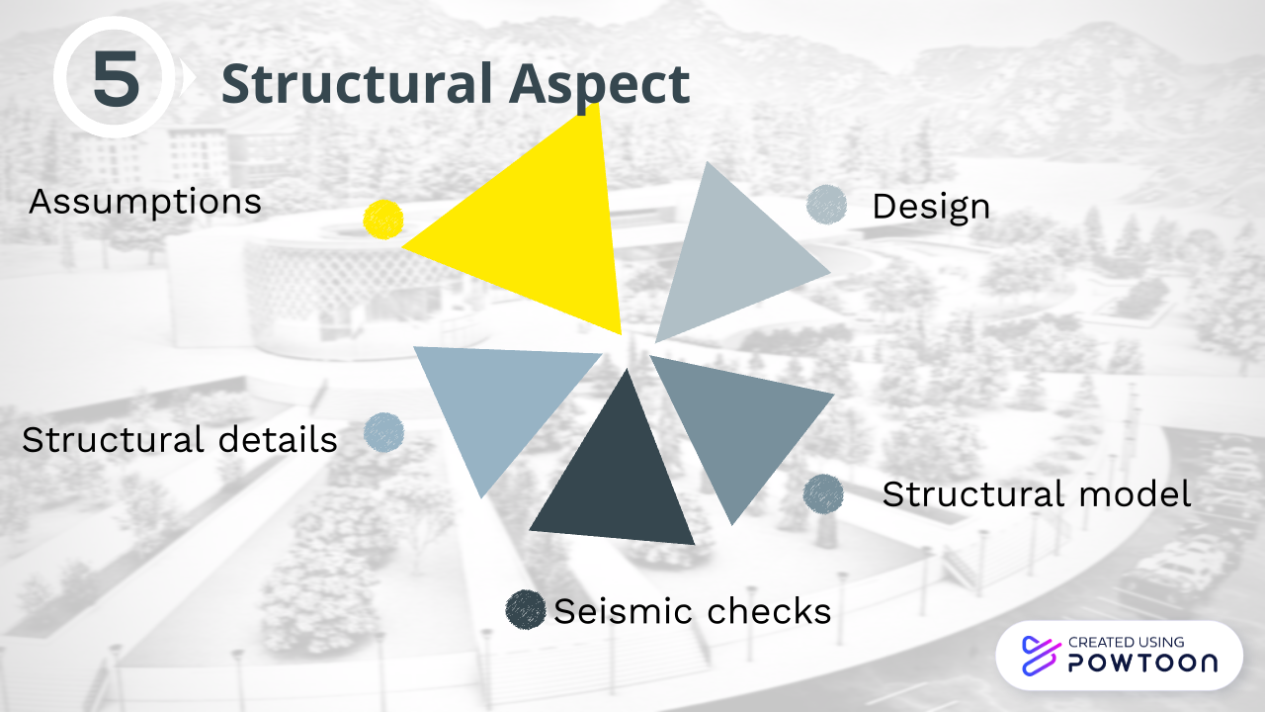
Page 41

Slide 40
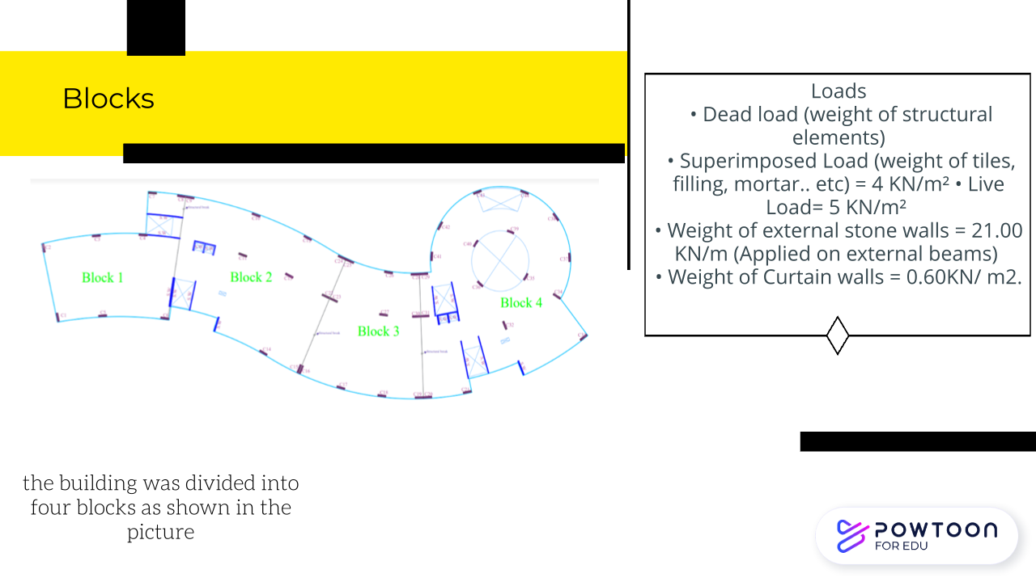
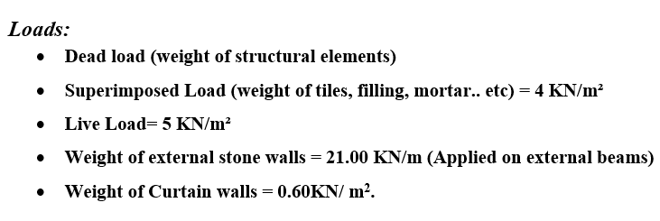
Page 42
50

Slide 41

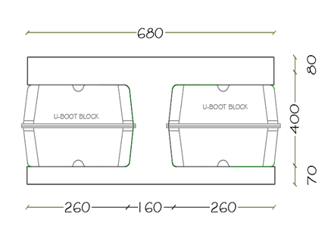
Design
Seismic Load
( Z) = 0.2 because the project in Jenin .
Soil type = SE.
q all =200 KN/m2
Seismic importance factor I= 1.25 .
Seismic system factor R=5.5.
Ca = 0.34 .
Cv = 0.64.
Slab system
Two-way voided slab (U-Boot) with drop beams
with U-Boot block thickness 400 mm as shown in figure we use 550 mm slab thickness,
Page 43

Slide 42
Design
Column’s
Column | Width (mm) | Depth (mm)
C1 | 1800 | 500
C2 | 1800 | 700
C3 | 1500 | 400
Shear wall
Shear wall | thickness (mm)
SW 1 | 200
SW 2 | 250
SW 3 | 300
SW 4 | 350
Page 44

Slide 43
Design
Beam | Dimensions
 | Width (mm) | Depth (mm) | span length (m)
DB1 | 1000 | 900 | 14.55
DB2 | 1000 | 900 | 16
DB3 | 1000 | 900 | 13.55
DB4 | 800 | 600 | 10
DB5 | 800 | 600 | 11.7
DB6 | 800 | 600 | 7
DB7 | 1000 | 900 | 4.5
DB8 | 1000 | 900 | 16.5
DB9 | 1000 | 900 | 17
DB10 | 1000 | 900 | 14.7
DB11 | 1000 | 900 | 12
DB12 | 800 | 600 | 9
DB13 | 800 | 600 | 9
DB14 | 1000 | 900 | 17
DB15 | 800 | 600 | 11.7
DB16 | 800 | 600 | 6.5
DB17 | 1000 | 900 | 15.2
DB18 | 800 | 600 | 10
DB19 | 800 | 600 | 8.5
DB20 | 800 | 600 | 11.5
B21 | 1000 | 550 | 9
Beam’s
Page 45

Slide 44

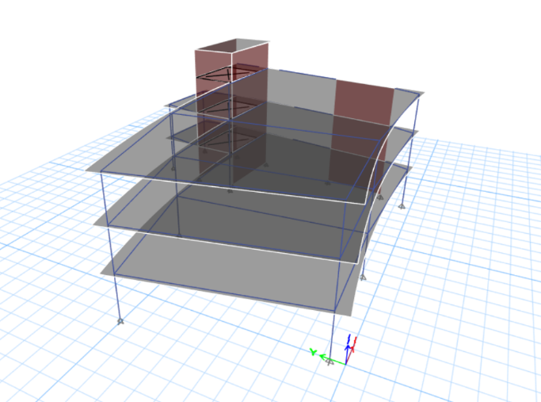
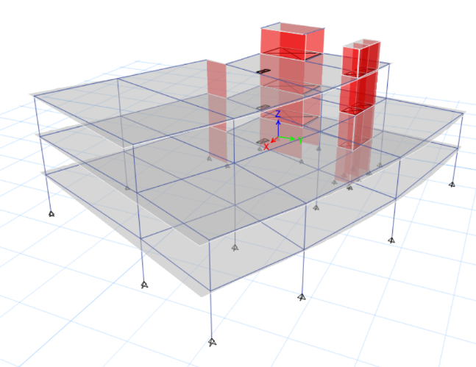
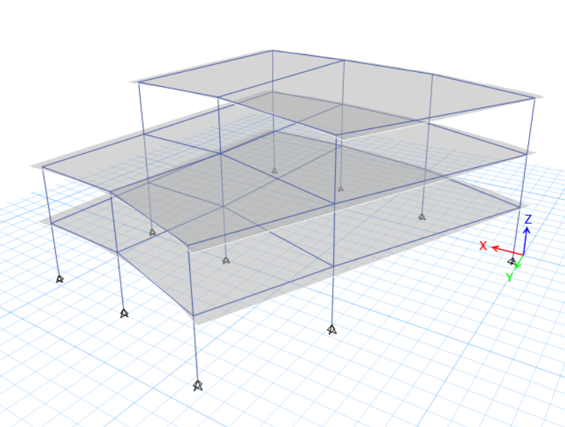
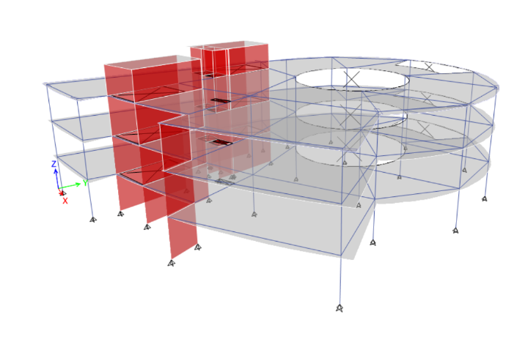
ETABS structural model
block 1
block 2
block 3
Page 46
block 4

Slide 45
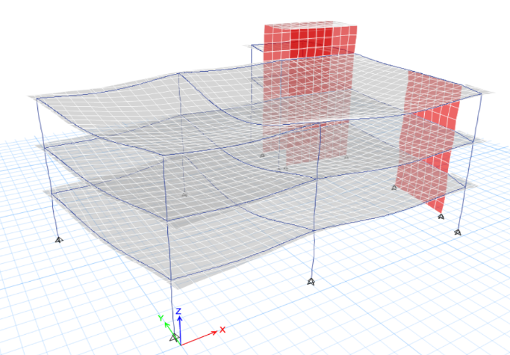
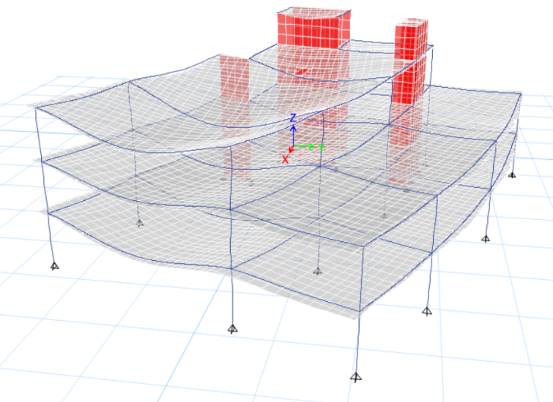
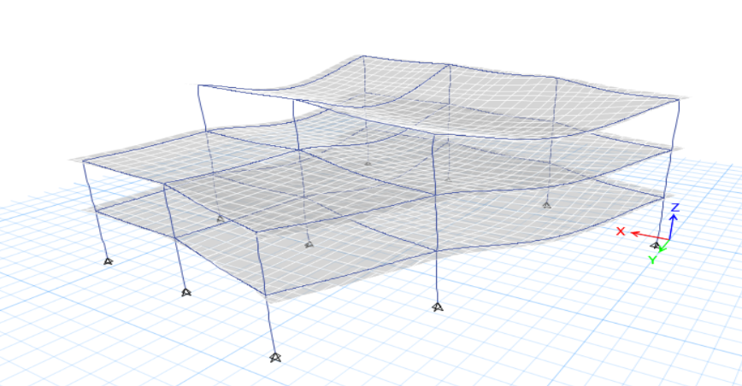
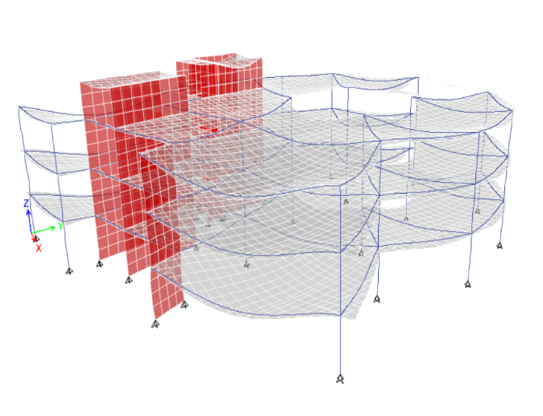
Structural Aspect
Compatibility check
block 1
block 2
block 3
Page 47
block 4

Slide 46
Structural Aspect
Block 1
Equilibrium check (block 1)
internal force check for slab
pattern |  | load |  | Error%
 |  | Manual | ETABS
Live |  | 7621.5 | 7621.1145 | 0.005
SID | On slab | 6097.2 | 10523.751 | 0.309
 | Walls | 4459.14
 | Total SID | 10556.34
Dead | Columns | 2160 | 22230.931 | 1.698
 | Beams | 6799.5
 | Slab | 12037.93
 | Walls | 1617.6
 | Total Dead | 22615.03
S1 | manual |  |  | ETABS | Error %
 | M11 (KN.m) | M(-) | 55.91 | 41 | 26.67
 |  | M(+) | 135.71 | 116 | 14.52
 |  | M(-) | 63.00 | 48 | 23.81
 | M22 (KN.m) | M(-) | 67.00 | 52 | 22.39
 |  | M(+) | 98.00 | 87 | 11.22
 |  | M(-) | 47.00 | 36 | 23.40
internal force check for columns
internal force check for beam
column | Axial load (KN) |  |  | Error%
C1 | Manual (from) |  | ETABS
 | beams | 1925.1 | 4899.5 | 0.465
 | slab | 2673.218
 | own weight | 324
 | Total | 4922.318
manual |  |  |  | ETABS | Error %
B1 | moment (KN.m) | M(-) | 172.27 | 285.9 | 39.74
 |  | M(+) | 368.95 | 242 | 34.41
 |  | M(-) | 548.10 | 339.45 | 38.07
 | shear (KN) |  | 313 | 287.24 | 8.23
Page 48
28

Slide 47
Structural Aspect
Block 2
Equilibrium check (block 2)
internal force check for slab
pattern |  | load |  | Error%
 |  | Manual | ETABS
Live |  | 10709 | 10707.25 | 0.016
SID | On slab | 8567.2 | 12421.052 | 0.222
 | Walls | 3881.43
 | Total SID | 12448.63
Dead | Columns | 2070 | 31758.837 | 3.572
 | Beams | 11448.75
 | Slab | 16914.54
 | Walls | 2502
 | Total Dead | 32935.29
 | manual |  |  | ETABS | Error%
S2 | M11 (KN.m) | M(-) | 26.06 | 18 | 30.92
 |  | M(+) | 32.00 | 21 | 34.38
 |  | M(-) | 81.00 | 63 | 22.22
 | M22 (KN.m) | M(-) | 34.00 | 20 | 41.18
 |  | M(+) | 42.00 | 33 | 21.43
 |  | M(-) | 103.00 | 90 | 12.62
internal force check for columns
internal force check for beam
column | Axial load (KN) |  |  | Error%
C1 | Manual- load due to |  | ETABS
 | beams | 1753.2 | 5463.68 | 0.400343
 | slab | 3408.353
 | own weight | 324
 | Total | 5485.553
 | manual |  |  | ETABS | Error %
B2 | moment (KN.m) | M(-) | 46.51 | 31.8 | 31.63
 |  | M(+) | 136.98 | 90.9 | 33.64
 |  | M(-) | 246.90 | 357.45 | 44.77
 | shear (KN) |  | 265.65 | 219 | 17.56
Page 49
28

Slide 48
Structural Aspect
Block 3
Equilibrium check (block 3)
internal force check for slab
pattern |  | load |  | Error%
 |  | Manual | ETABS
Live |  | 7906.5 | 7907.2398 | 0.009
SID | On slab | 6325.2 | 9047.2099 | 0.706
 | Walls | 2658.6
 | Total SID | 8983.8
Dead | Columns | 2430 | 20828.472 | 0.865
 | Beams | 6092.1
 | Slab | 12488.08
 | Walls | 0
 | Total Dead | 21010.18
S3 | manual |  |  | ETABS | Error%
 | M11 (KN.m) | M(-) | 13.00 | 8 | 38.46
 |  | M(+) | 31.00 | 20 | 35.48
 |  | M(-) | 23.62 | 17 | 28.01
 | M22 (KN.m) | M(-) | 52.00 | 34 | 34.62
 |  | M(+) | 39.00 | 28 | 28.21
 |  | M(-) | 112.00 | 97 | 13.39
internal force check for columns
internal force check for beam
column | Axial load (KN) |  |  | Error%
C3 | Manual (from) |  | ETABS
 | beams | 1553.4 | 10403.24 | 0.9159583
 | slab | 8621.129
 | own weight | 324
 | Total | 10498.53
 | manual |  |  | ETABS | Error%
B3 | moment (KN.m) | M(-) | 158.00 | 192 | 21.52
 |  | M(+) | 104.00 | 77.1 | 25.87
 |  | M(-) | 334.67 | 287.73 | 14.03
 | shear (KN) |  | 230 | 195.45 | 15.02
Page 50
28

Slide 49
Structural Aspect
Block 4
Equilibrium check (block 4)
internal force check for slab
pattern |  | load |  | Error%
 |  | Manual | ETABS
Live |  | 13670 | 13666.152 | 0.028
SID | On slab | 10936
 | Walls | 6006
 | Total SID | 16942 | 16889.619 | 0.309
Dead | Columns | 4230 | 39173.967 | 2.126
 | Beams | 10444.5
 | Slab | 21591.35
 | Walls | 3759
 | Total Dead | 40024.85
S4 | manual |  |  | ETABS | Error%
 | M11 (KN.m) | M(-) | 54.23 | 86 | -58.58
 |  | M(+) | 159.72 | 142 | 11.09
 |  | M(-) | 77.00 | 58 | 24.68
 | M22 (KN.m) | M(-) | 62.00 | 43 | 30.65
 |  | M(+) | 104.00 | 95 | 8.65
 |  | M(-) | 71.00 | 55 | 22.54
internal force check for columns
internal force check for beam
column | Axial load (KN) |  |  | Error%
C4 | Manual (from) |  | ETABS
 | beams | 1228.41 | 5147.38 | 0.2695
 | slab | 3608.845
 | own weight | 324
 | Total | 5161.255
 | manual |  |  | ETABS | Error%
B4 | moment (KN.m) | M(-) | 189.92 | 261 | 37.42
 |  | M(+) | 312.00 | 267.65 | 14.21
 |  | M(-) | 436.00 | 383.24 | 12.10
 | shear (KN) |  | 293 | 245 | 16.38
Page 51
28

Slide 50

Structural Aspect
Seismic checks For Block 1
Load Case/Combo | FX | FY | FZ
 | kN | kN | kN
Dead | -7.364E-07 | -0.000018 | 23965.42
Live | 0 | -0.0000072 | 7621.33
SID | 0 | -0.0000082 | 10523.92
EQx Max | 2644.92 | 1940.07 | 0
EQy Max | 1952.1 | 2544.73 | 0
Base shear check
Time period
EQx Max | 6662.7798 | 4887.2174
EQy Max | 4752.7509 | 6534.7019
Drift check
Story | Height (mm) | Dis-X(mm) | Dis-Y(mm) | Drift-X(mm) | Drift-Y(mm) | Delta-X(mm) | Delta-Y(mm) | Delta-Limit (mm) | Check
0 | - | 0 | 0 | - | - | - | - | - | -
1 | 4000 | 0.056 | 0.076 | 0.056 | 0.076 | 0.22 | 0.45 | 80 | OK
2 | 4000 | 0.187 | 0.249 | 0.131 | 0.173 | 0.78 | 1.03 | 80 | OK
3 | 4000 | 0.365 | 0.481 | 0.178 | 0.232 | 1.06 | 1.38 | 80 | OK
Page 52

Slide 51

Structural Aspect
Seismic checks For Block 2
Load Case/Combo | FX | FY | FZ
 | kN | kN | kN
Dead | 0 | 0.000001092 | 36334.2
Live | 0 | 0 | 12280.0
SID | 0 | 0 | 13716.7
EQx Max | 4674.77 | 2524.15 | 0.0000017
EQy Max | 2516.73 | 4711.37 | 0.000001343
Base shear check
EQx Max | 10244.2297 | 5359.1836 | 0.000003801
EQy Max | 4617.0078 | 10182.1932 | 0.000002718
Time period
Drift check
Story | Height (mm) | Dis-X(mm) | Dis-Y(mm) | Drift-X(mm) | Drift-Y(mm) | Delta-X(mm) | Delta-Y(mm) | Delta-Limit (mm) | Check
0 | - | 0 | 0 | - | - | - | - | - | -
1 | 4000 | 0.135 | 0.129 | 0.135 | 0.129 | 0.52 | 0.77 | 80 | OK
2 | 4000 | 0.423 | 0.42 | 0.288 | 0.291 | 1.71 | 1.73 | 80 | OK
3 | 4000 | 0.791 | 0.822 | 0.368 | 0.402 | 2.19 | 2.39 | 80 | OK
Page 53

Slide 52

Structural Aspect
Seismic checks For Block 3
Load Case/Combo | FX | FY | FZ
 | kN | kN | kN
Dead | -0.000009974 | -0.00001423 | 24476.30
Live | -0.000004917 | -0.000005817 | 8745.74
SID | -0.00000317 | -0.00000413 | 9646.41
EQx Max | 479.16 | 875.63 | 0.000000542
EQy Max | 1509.39 | 2912.14 | 0.000001776
Base shear check
Time period
EQx Max | 6935.56 | 3221.40 | 0.00000452
EQy Max | 2961.89 | 6884.78 | 0.00000402
Drift check
Story | Height (mm) | Dis-X(mm) | Dis-Y(mm) | Drift-X(mm) | Drift-Y(mm) | Delta-X(mm) | Delta-Y(mm) | Delta-Limit (mm) | Check
0 | - | 0 | 0 | - | - | - | - | - | -
1 | 4000 | 0.137 | 0.016 | 0.137 | 0.016 | 0.53 | 0.1 | 80 | OK
2 | 4000 | 0.41 | 0.096 | 0.273 | 0.08 | 1.62 | 0.48 | 80 | OK
3 | 4000 | 0.772 | 0.225 | 0.362 | 0.129 | 2.15 | 0.77 | 80 | OK
Page 54

Slide 53

Structural Aspect
Seismic checks For Block 4
Load Case/Combo | FX | FY | FZ
 | kN | kN | kN
Dead | -0.1838 | -0.2271 | 39787.33
Live | -0.0812 | -0.0915 | 13674.37
SID | -0.2341 | -0.1138 | 16896.193
EQx Max | 6137.74 | 2062.99 | 0.00001861
EQy Max | 2326.28 | 4983.47 | 0.0000232
Base shear check
Time period
EQx Max | 11610.70 | 3902.57 | 0.00003521
EQy Max | 3799.29 | 11575.63 | 0.0001
Drift check
Story | Height (mm) | Dis-X(mm) | Dis-Y(mm) | Drift-X(mm) | Drift-Y(mm) | Delta-X(mm) | Delta-Y(mm) | Delta-Limit (mm) | Check
0 | - | 0 | 0 | - | - | - | - | - | -
1 | 4000 | 0.122 | 0.169 | 0.122 | 0.169 | 0.47 | 1.01 | 80 | OK
2 | 4000 | 0.373 | 0.405 | 0.251 | 0.236 | 1.49 | 1.4 | 80 | OK
3 | 4000 | 0.733 | 0.705 | 0.36 | 0.3 | 2.14 | 1.79 | 80 | OK
Page 55

Slide 54

Structural details
beam plan
Page 56

Slide 55



Structural details
Column details
cross section of C1
Column | Width (mm) | Depth (mm) | % Rebar | Bars reinforcement | Stirrups
C1 | 1800 | 500 | 1.00 | 30 Ø 20 | 4 Ø 10 @ 250mm
C2 | 1800 | 700 | 1.00 | 40 Ø 20 | 5 Ø 10 @ 250mm
C3 | 1500 | 400 | 1.00 | 24 Ø 18 | 3 Ø 10 @ 250mm
cross section of C3
cross section of C2
Page 57

Slide 56






Structural details
Beam details
Page 58

Slide 57




Structural details
Beam details
Page 59

Slide 58





Structural details
Slab details
Page 60

Slide 59

Structural details
shear wall plan
Page 58
Page 61

Slide 60


Structural details
shear wall details
vertical section in shear wall 1
section in shear wall 1
Page 62

Slide 61

Structural details
Mat foundation ( foundation details)
Page 63

Slide 62

Structural details
Mat foundation ( foundation details)
Page 64

Slide 63


Structural details
Retaining wall design and Water tank design
Page 65

Slide 64

Structural details
Stairs design
Page 66

Slide 65
Introduction
Site Analysis
CONTENT
Architectural Aspect
Environmental Aspect
Structural Aspect
Electro-Mechanical
Aspect
Quantity surveying
Page 67

Slide 66

Page 68

Slide 67

Electro-Mechanical Aspect
Fire safety design - Evacuation ways for ground floor :
Page 107

Slide 68

Electro-Mechanical Aspect
Fire safety design - Evacuation ways for first floor :
Page 108

Slide 69

Electro-Mechanical Aspect
Fire safety design - Evacuation ways for second floor :
Page 109

Slide 70





Electro-Mechanical Aspect
Fire safety design - Evacuation ways for second floor :
The symbols of suppression system
Extinguishers
Sprinklers
Emergency signs and light
Fire Hose
Page 110

Slide 71

Electro-Mechanical Aspect
Fire safety design for ground floor
Page 111

Slide 72

Electro-Mechanical Aspect
Fire safety design for first floor
Page 112

Slide 73

Electro-Mechanical Aspect
Fire safety design for second floor
Page 113

Slide 74

Electro-Mechanical Aspect
Water Supply Design:
The maximum number of people may exist inside the technical education center at the same time, equals 800 person.
The average consumption of water for each person daily in such this building equals 7 L/day for each person.
Water demand amount in each floor.
floor | WSFU | Water flow for floor g/m
Ground floor | 157.2 | 58
first floor | 158.6 | 59
second floor | 124 | 50
The volume based on the number of people and their consumption of water: 800x 7= 5600 L/day ≈ 6 m3
Water tank elevation
Page 102

Slide 75




Electro-Mechanical Aspect
Water Supply Design:
Diameters of the used pipes for vertical feeder 1 .
1.4
Diameters of the used pipes for vertical feeder 2 .
Page 103

Slide 76

Electro-Mechanical Aspect
Water Supply Design for ground floor
Page 104

Slide 77

Electro-Mechanical Aspect
Water Supply Design for first floor
Page 105

Slide 78

Electro-Mechanical Aspect
Water Supply Design for second floor
Page 106

Slide 79

Electro-Mechanical Aspect
floor | DFU’S
Ground floor | 108
first floor | 110
second floor | 83
Drainage Design for ground floor
Page 97

Slide 80

Electro-Mechanical Aspect
Drainage Design for first floor
Page 98

Slide 81

Electro-Mechanical Aspect
Drainage Design for second floor
Page 99

Slide 82


Electro-Mechanical Aspect
Drainage Design
Page 100

Slide 83
Electro-Mechanical Aspect
Drainage Design
Manhole no. | Dimension (cm) | Top level (cm) | Interval level (cm) | Depth (cm)
1 | ɸ60 | 0 | -60 | 60
2 | ɸ60 | 0 | -62 | 62
3 | ɸ60 | 0 | -70 | 70
4 | ɸ60 | 0 | -87 | 87
5 | ɸ60 | 0 | -96 | 96
6 | ɸ80 | 0 | -106 | 106
7 | ɸ80 | 0 | -119 | 119
8 | ɸ80 | 0 | -122 | 122
9 | ɸ60 | 0 | -60 | 60
10 | ɸ60 | 0 | -64 | 64
11 | ɸ80 | 0 | -130 | 130
12 | ɸ80 | 0 | -145 | 145
13 | ɸ80 | 0 | -162 | 162
14 | ɸ80 | 0 | -177 | 177
15 | ɸ80 | 0 | -190 | 190
16 | ɸ60 | 0 | -60 | 60
17 | ɸ60 | 0 | -64 | 64
18 | ɸ60 | 0 | -68 | 68
19 | ɸ80 | 0 | -201 | 201
20 | ɸ100 | 0 | -211 | 211
21 | ɸ100 | 0 | -219/-73 | 219
22 | ɸ60 | 0 | -60 | 60
23 | ɸ60 | 0 | -63 | 63
24 | ɸ60 | 0 | -66 | 66
25 | ɸ60 | 0 | -69 | 69
26 | ɸ100 | 0 | -232 | 232
27 | ɸ100 | 0 | -246 | 246
Page 100

Slide 84

Electro-Mechanical Aspect
Drainage Design-Roof slope plan
Page 101

Slide 85





Electro-Mechanical Aspect
HVAC Design:
Filter design that controls and kills viruses
The system used for HVAC design is Variable refrigerant flow “ VRF system ”
Indoor unit
fan coil unit (ERV)
Outdoor unit
Page 90
Indoor unit

Slide 86

Electro-Mechanical Aspect
HVAC Design for ground floor :
Page 94

Slide 87

Electro-Mechanical Aspect
HVAC Design for first floor :
Page 95

Slide 88

Electro-Mechanical Aspect
HVAC Design for second floor :
Page 96

Slide 89


Electro-Mechanical Aspect
Acoustic design
Reverberation time for workshop
Workshop (blacksmithing room)
Page 66
Page 84

Slide 90






Electro-Mechanical Aspect
Acoustic design
Office
Library
Meeting room
Reverberation time
Reverberation time
Reverberation time
Page 85

Slide 91



Electro-Mechanical Aspect
Acoustic design
Reverberation time for cafeteria
Cafeteria
Page 86

Slide 92



Electro-Mechanical Aspect
Acoustic design for cafeteria
total SPL value
value of articulation loss
Value of direct SPL for cafeteria
Page 66
Page 87

Slide 93



Electro-Mechanical Aspect
Acoustic design -Sound insulation
Design of internal floors
Design of ceilings
Design of external glazing
Page 66
Page 88

Slide 94



Electro-Mechanical Aspect
Acoustic design -Sound insulation
Design For external wall
Design of glazed partitions
Design of normal partitions
Page 66
Page 89

Slide 95


Electro-Mechanical Aspect
Artificial lighting design
Type of used Luminaires:
Page 69

Slide 96



Electro-Mechanical Aspect
Artificial lighting design
Type of used Luminaires:
Page 70

Slide 97





Electro-Mechanical Aspect
Artificial lighting design
Teachers rooms :
counting department
Page 71

Slide 98



Electro-Mechanical Aspect
Artificial lighting design
Class room :
carpentry
Page 72

Slide 99






Electro-Mechanical Aspect
Artificial lighting design
Cafeteria for teachers
W.C
store
Kitchen
Page 73

Slide 100




Electro-Mechanical Aspect
Artificial lighting design
Computer room
Art room
Page 74

Slide 101




Electro-Mechanical Aspect
Artificial lighting design
library
corridor
Page 75

Slide 102



Electro-Mechanical Aspect
Artificial lighting design
Meeting room
Page 76

Slide 103


Electro-Mechanical Aspect
Artificial lighting design – plan for ground floor
Page 77

Slide 104

Electro-Mechanical Aspect
Artificial lighting design – plan for first floor
Page 78

Slide 105

Electro-Mechanical Aspect
Artificial lighting design – plan for second floor
Page 79

Slide 106
Electro-Mechanical Aspect
Power design
lighting power for spaces on the ground floor.
index | Manufacturer | Luminous flux (LM) | Maintenance factor | connected load (W) | Quantity | Power(watt)
Teacher room | Thorn | 3800 | 0.8 | 33 | 56 | 1848
Carpentry room | Thorn | 3800 | 0.7 | 33 | 30 | 990
Carpentry room | Thorn | 4600 | 0.7 | 42 | 2 | 84
Class room | Thorn | 3800 | 0.8 | 33 | 24 | 792
Class room | Thorn | 4600 | 0.8 | 42 | 4 | 168
Cafeteria teachers | Thorn | 2050 | 0.8 | 19.6 | 26 | 509.6
Meeting room | Thorn | 3378 | 0.8 | 34 | 16 | 544
Meeting room | Thorn | 17400 | 0.8 | 240 | 2 | 480
security room | Thorn | 3800 | 0.8 | 33 | 3 | 99
Counting department | Thorn | 3800 | 0.8 | 33 | 8 | 264
WC | Thorn | 2050 | 0.8 | 19.6 | 36 | 705.6
Corridor | Thorn | 3800 | 0.8 | 33 | 57 | 1881
Page 80

Slide 107


Electro-Mechanical Aspect
Power design – plan for ground floor
Page 81

Slide 108

Electro-Mechanical Aspect
Power design – plan for first floor
Page 66

Slide 109

Electro-Mechanical Aspect
Power design – plan for second floor
Page 83

Slide 110
Introduction
Site Analysis
CONTENT
Architectural Aspect
Environmental Aspect
Structural Aspect
Electro-Mechanical
Aspect
Quantity surveying
Quantity surveying
Page 114

Slide 111


Page 115
59

Slide 112


Cost summery
Page 116
60

Slide 113

Page 117
61

