Slide 1
Steam Turbine power plant
Students
Anas hawawreh
Izaldeen Shahroor
Anas Sadaqah
Rahmeh Daraghmh
Murad Baniodeh
Supervisor :
Dr. Ramez Kha

Slide 2
Introduction
The project is a work of designing a new source of power for generating electricity may be a good alternative to existing sources.... so it is a very high effectiveness, and whether progress is happening on the economic, environmental and service level as well, in addition over 35% of electrical energy demands are generated by steam turbine.
The project aims mainly to find an alternative for the production and generation of electricity with a high capacity and effectiveness of more compared to sources other, and also be a source of essential energy less than the economic terms of the costs, and also less damage and contamination of the environment, an environmental hand, in addition to the advancement and progress of society to the best position in all respects, especially technological.

Slide 3
Introduction
.Through this project will be to work on a limited model of size and space, the project would accept a small and limited equipment enough to work this model and also limited in size and shape input .. This whole in order to study the project and the study of what will be the results achieved through the work.. Will the results match what is status and its preparation, where Tank will be limited to a small-sized pump and boiler and turbine of limited size and the capacitor, to meet the request Model, And then compare the results with what has to prepare for it, and if the success of this project is starting to apply to a wider extent, so as to include the areas of equipment and more and bigger, always to reach the desired goal.

Slide 4
Introduction
As one of the main and fundamental objectives involved in the work on the project, is to focus on Target category of the project that will benefit or to be used for the project and will return them of the benefits, the project will work on all delusional levels to be very effective and try to reduce the faults problems that were suffering including current generator, The most important point of an economic sense, one of the cornerstones of the project , which has been focused on since the beginning of the project The project will work to reduce costs compared to existing generators, through the control of input costs where the project will be input with less cost compared to those generators, Also in terms of maintenance costs would be not expensive, also costs the user will be much less, Also the environmental aspect, which is also considered one of the very important aspects in terms of the safety of the environment and that have a significant impact on the population, where the project will reduce pollution of the environment and this will have a role in reducing the chronic diseases that are caused by a head of environmental pollution and the resulting residue, In addition there will be a project and use

Slide 5
Methodology
Unlike gas turbine and reciprocating engine CHP systems where heat is a byproduct of power generation, steam turbines normally generate electricity as a byproduct of heat (steam) generation. A steam turbine is captive to a separate heat source and does not directly convert fuel to electric energy. The energy is transferred from the boiler to the turbine through high pressure steam that in turn powers the turbine and generator. This separation of functions enables steam turbines to operate with an enormous variety of fuels, varying clean natural gas to solid waste, including all types of coal, wood, wood waste, and agricultural byproducts (sugar cane biogases, fruit pits and rice hulls). In CHP applications, steam at lower pressure is extracted from the steam turbine and used directly in a process or for district heating, or it can be converted to other forms of thermal energy including hot or chilled water.

Slide 6
Methodology
Main components :
2.1-steam turbine Generator
2.2- heat exchanger
2.3- pump
2.4-boiler
2.5- connections
2.6-pressur gauges
2.7- thermo meter
2.8- safety , manual control valves
2.9-cupper tubes
2.10- insulation materials

Slide 7
Methodology
2.1-steam turbine Generator
Theoretical information and specification:
Modeled from the very popular TS-315 steam turbine. This design incorporates an effective, high powered motor being used as a DC electrical generator producing 6 volts with as little as 10 psi, and a max output of 12 volts running the turbine at around 25,000rpm (20 psi). With as little as 15psi, it easily lights up 6+ LED's without any trouble, just to give an idea of its abilities.

Slide 8
Methodology
2.2-Heat Exchanger
The selection was both an air and water separately to decrease the temperature from the out let of the steam turbine generator to return to the form of saturated liquid (water)to make it possible enter to the pump.
the collection between the output of the steam turbine generator and the inlet of the pump is treated as heat exchanger.
we use three meters of copper tube (12ml) the thermal conductivity of the copper (400w/m.k) ,this tube is has one meter connection with ambient air ,the other two meters Submitted in box filled of water (the box dimension is:( 25*60*40 cm) the capacity of this box=60litter).
The figure shows the heat exchanger used in the power plant

Slide 9
Methodology
2.3-Pump
The pump speciation
1-radial flow
2-the maximum head is (65m)
3-the maximum flow rate is (25l/min)
the purpose of using a pump is to increase the pressure after the loss of pressure in both steam turbine in (measure losses) and heat exchanger (minor loss),anther of purpose is to control the flow of the water to prevent the backward of steam to escape from boiler to inverse direction (return to the out let of the heat exchanger).

Slide 10
Methodology
2.4-boiler
dimension :cylinder has a diameter of (30cm) height (55cm) the volume is (27litter of liquid water), it has three out lets as follows:
1-the first out let connected to pressure gage(from 0 to 15 bar)
2- the second out let connected to steam turbine (6.35 mm copper tube) connected to the inlet to the steam turbine generator, the thermos meter is connect to this out let

Slide 11
Methodology
2.6-Pressure gauge
We used tow pressure gauges the first one is connected to the out let of the boiler (from 0 to 15 bar ) and the second is connected at the out let of the steam turbine generator (from 0 to 5 bar).

Slide 12
Methodology
2.5-Connections
Type of connections:
1-On the pump copper connections ( from 3/4'' to 1/2'') (pair) .
2-on the steam turbine generator copper connection (from 1/4''to 1/8''), from(3/4''to 1/2'')
On the boiler copper connection (from 3/4'' to 1/2''),from(3/4'' to 1/4'')

Slide 13
Methodology
2.7-Thermometer
Digital Stainless steel pin thermometer has a scale from -40 to 300 c, the first one is connected at the out let of the boiler beside the pressure gauge and the second is connected at the out let of the steam turbine generator.
The figure show the thermometer :

Slide 14
Methodology
2.8-Safety , manual control Valves
For the safety valve we select one that opens at 4 bar and connected to the same out let of the pressure gauge of the boiler
for control valve we use a manual control valve made of stainless steel which withstands up to 10 bar

Slide 15
Results and calculations
steam turbine inlet pressure (bar) | steam turbine inlet temperature ( c ) | steam turbine outlet pressure (bar) | steam turbine outlet temperature ( c ) | h1 (kj/kg) | h2 (kj/kg) | s1 (kj/kg.k) | s2 (kj/kg.k) | mass flow rate (kg/s) | Voltage (volt)
1 | 145 | 0.25 | 130 | 2758.62 | 2746 | 2.67 | 2.023 | 0.0003 | 5.9
1.5 | 192 | 0.4 | 180 | 2852 | 2833 | 2.04 | 1.9959 | 0.0003 | 7.39
2 | 207 | 0.5 | 191 | 2880.75 | 2855 | 2.049 | 1.9968 | 0.0003 | 8.6
2.5 | 220 | 0.65 | 203 | 2907.74 | 2878 | 2.056 | 2.001 | 0.0003 | 8.775
3 | 234 | 0.8 | 210 | 2931 | 2891 | 2.0626 | 2.004 | 0.0003 | 10.73
3.5 | 251 | 0.9 | 220 | 2966 | 2915 | 2.06617 | 2.0058 | 0.0003 | 11.7

Slide 16
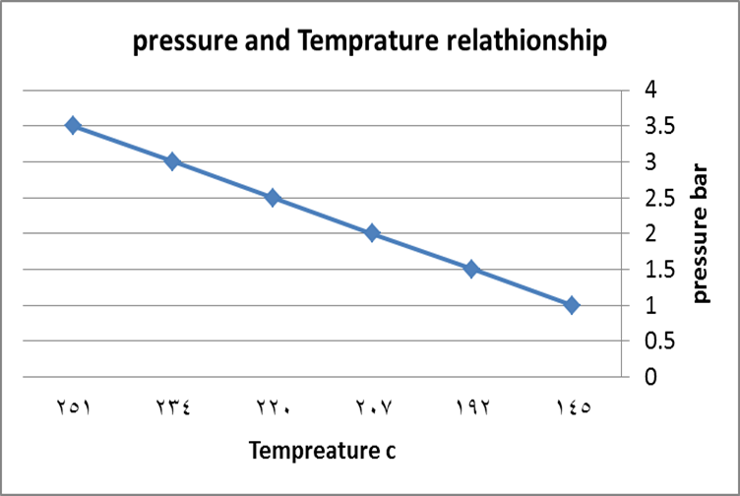
Results and calculations

Slide 17
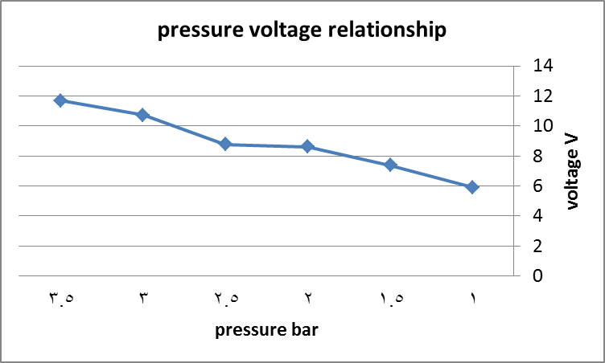
Results and calculations

Slide 18
Results and calculations
Tin ( c ) | hin ( kj/kg) | Tout ( c ) | Pout ( bar) | hout ( kj/kg) | Q (kj/kg) | S (kj/kg.k)
130 | 2746 | 52 | 1 | 2379 | 367 | 0.729
180 | 2833 | 74 | 1 | 2320.4 | 512.6 | 1.0035
191 | 2855 | 76 | 1 | 2317 | 538 | 1.027
203 | 2878 | 83 | 1 | 2300 | 578 | 1.11
210 | 2891 | 90 | 1 | 2283.2 | 607.8 | 1.19
220 | 2915 | 94 | 1 | 2270.2 | 644.8 | 1.238

Slide 19
Results and calculations
Wpump (kj/kg) | hout (kj/kg) | Pout (bar) | Tout ( c ) | hin (kj/kg) | Pin (bar) | Tin ( c )
1755 | 604 | 4 | 52 | 2379 | 1 | 52
1716.4 | 604 | 4 | 74 | 2320.4 | 1 | 74
1713 | 604 | 4 | 76 | 2317 | 1 | 76
1696 | 604 | 4 | 83 | 2300 | 1 | 83
1679.2 | 604 | 4 | 90 | 2283.2 | 1 | 90
1666.2 | 604 | 4 | 94 | 2270.2 | 1 | 94

Slide 20
Results and calculations
Wpump (kj/kg) | hout (kj/kg) | Pout (bar) | Tout ( c ) | hin (kj/kg) | Pin (bar) | Tin ( c )
1755 | 604 | 4 | 52 | 2379 | 1 | 52
1716.4 | 604 | 4 | 74 | 2320.4 | 1 | 74
1713 | 604 | 4 | 76 | 2317 | 1 | 76
1696 | 604 | 4 | 83 | 2300 | 1 | 83
1679.2 | 604 | 4 | 90 | 2283.2 | 1 | 90
1666.2 | 604 | 4 | 94 | 2270.2 | 1 | 94

Slide 21
Results and calculations
Q (kj/kg) | hout (kj/kg) | Pout (bar) | Tout ( c ) | Pin (bar) | Tin ( c ) | hin (kj/kg)
2154.62 | 2758.62 | 1 | 145 | 4 | 52 | 604
2258 | 2862 | 1.5 | 192 | 4 | 74 | 604
2276.76 | 2880.75 | 2 | 207 | 4 | 76 | 604
2303.74 | 2907.74 | 2.5 | 220 | 4 | 83 | 604
2327 | 2931 | 3 | 234 | 4 | 96 | 604
2362 | 2966 | 3.5 | 251 | 4 | 94 | 604

Slide 22
Results and calculations
Efficiency % | Pressure
82.9 | 1
83.6 | 1.5
83.8 | 2
47.9 | 2.5
73.8 | 3
72.7 | 3.5

Slide 23
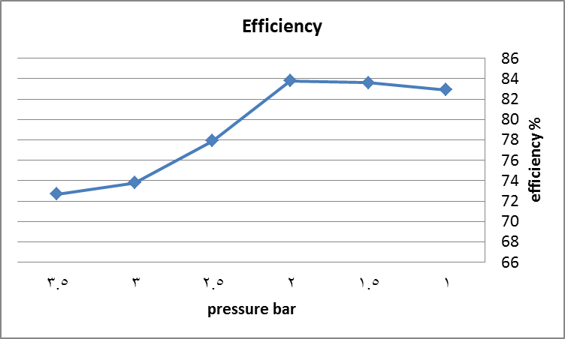
Results and calculations

