Slide 1

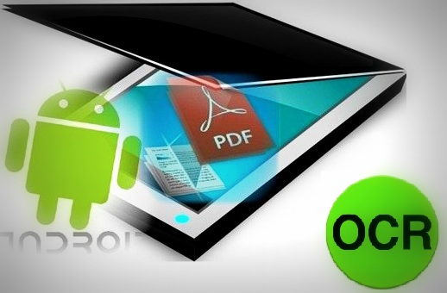
Software Graduation Project
Document Scanner
Done By:
Khawla Daghlas
Hiba Shabib
Supervised By:
Dr. Raed Al Qadi

Slide 2
Document Scanner
Introduction
Steps
Problems
Results

Slide 3
Introduction
Our graduation project is divided into two parts.
The first is image stitching.
The Second is Optical Character Recognition.
Used language: Android
Used Libraries: BoofCV
Tesseract

Slide 4

BoofCV is an open source Java library for real-time computer vision and robotics applications.
Functionality includes optimized low-level image processing routines, feature tracking, and geometric computer vision.

Slide 5
Image stitching refers to combining two or more overlapping images together into a single large image.
The goal is to find transforms which minimize the error in overlapping regions and provide a smooth transition between images.

Slide 6
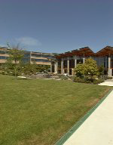
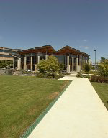
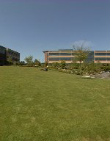
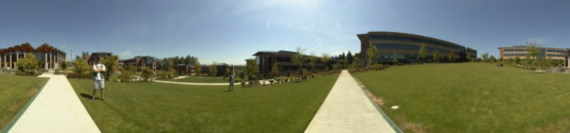
Image Stitching
+ … +
+

Slide 7
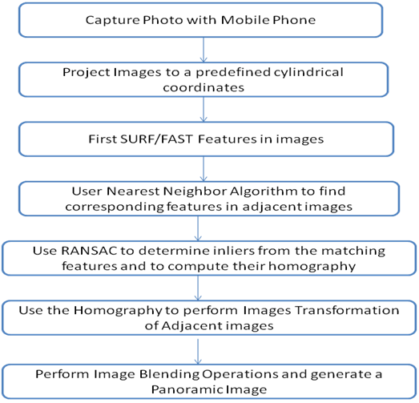
How to do Stitching ?

Slide 8
Step#1:Capture the desired images with a mobile phone:
1- Successive photos need to have roughly the same camera settings.
2- Enough overlap with each other and known camera parameters.

Slide 9
Step#2:Project images to a predefined cylindrical coordinates:
The cylindrical projection transform projects arbitrary point in 3D space (X, Y, Z) to the unit cylinder, converts points to cylindrical coordinates.

Slide 10

Step#3: Use SURF Algorithm to detect and describe interest points

Slide 11
Detect and Match Feature Points
• In each image detect distinctive “interest points”
(at multiple scales)
• Each point described by a feature vector (aka
feature descriptor)
• For each feature point in each image, find most
similar feature points in the other images (using
hashing or k-d tree to find approx. nearest
neighbors)

Slide 12
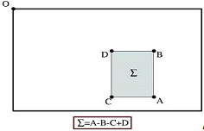
Interest Point Detection
Generate the integral image from the original image.

Slide 13
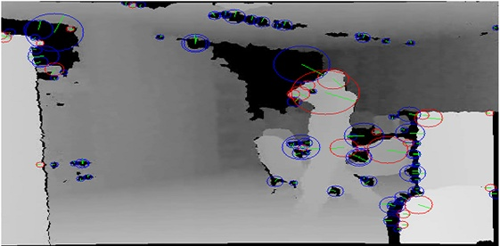
Interest point description
The direction is decided by the most orientation vector of haar wavelet features. Each 64, 128 dimensional interest point description are calculated by the calculated features of four, eight.

Slide 14
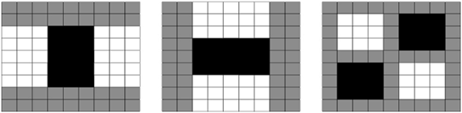
The approximate second order Gaussian simplified Gaussian filter is used in order to simplify calculations.

Slide 15
Step#4:Nearest Neighbor Algorithm:
the k-nearest neighbor algorithm (k-NN) is a method for classifying objects based on closest training examples in the feature space.
object is classified by a majority vote of its neighbors, with the object being assigned to the class most common amongst its k nearest neighbors.

Slide 16
Step#5: We used Ransac Algorithm to determine true matches from the matching features and to compute their homography.
the parameters of a transformation given a dataset.
find the parameters which are valid for most of the points, a consensus, by discarding the noisy points.
After running this for a fixed number of steps, the algorithm is guaranteed to converge to a better transformation (with a lower error
Notes:
The RANdom SAmple Consensus (RANSAC)
Randomly selected to define a model, representing one hypothesis. This model is then evaluated for the whole dataset with an error function. This is repeated several times by choosing new samples for each iteration and keeping the best transformation found. After running this for a fixed number of steps, the algorithm is guaranteed to converge to a better transformation (with a lower error), but it does not necessarily find the best one, as all the possibilities have not been tested.

Slide 17
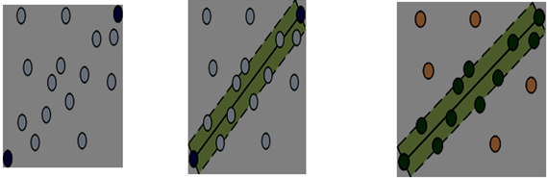
1- k items are chosen randomly among the set, k=2.
2- From these points, a model is defined. Here, a line is drawn between the 2 chosen points, with an area of validity defined by a given threshold.
Notes:
separates the dataset into two subsets: the inliers, in green (fitting to the model) and the outliers (ignored). The ratio of inliers relatively to the total number of items can give a numerical evaluation of the model ("goodness"). The initial model is generally recomputed taken all the inliers into account

Slide 18
3- The model is then evaluated by measuring the error for each point, here by computing the distance to the line

Slide 19
Step#6: we used the homography to perform images transformation of adjacent images.

Slide 20
Step#7:We performed image blending operations and generate panoramic images.

Slide 21
Object Character Recognition

Slide 22

OCR technology allows the conversion of scanned images of printed text or symbols (such as a page from a book) into text or information that can be understood or edited.
We are using open source OCR software called Tesseract as a basis for project.

Slide 23
Tesseract
An OCR Engine that was developed at HP Labs between 1985 and 1995 … and now at Google
We use fork of Tesseract Android Tools by Robert Theis called Tess Two. They are based on the Tesseract OCR Engine (mainly maintained by Google) and Leptonica image processing libraries.

Slide 24
A Grayscale or color image is provided as input
Adaptive thresholding
Connected-component labeling
Line ﬁnding algorithm
Baseline ﬁtting algorithm
Notes:
1-The algorithm assumes that in an image there are foreground (black) pixels and background (white) pixels. It then calculates the optimal threshold that separates the two pixel classes such that the variance between the two is minimal.
2-Tesseract searches through the image, identiﬁes the foreground pixels, and marks them as or potential characters.
3-Line ﬁnding algorithm - lines of text are found by analyze the image space adjacent to potential characters. This algorithm does a Y projection of the binary image and ﬁnds locations having a pixel count less than a speciﬁc threshold. These areas are potential lines, and are further analyzed to conﬁrm.
4-Baseline ﬁtting algorithm - ﬁnds baselines for each of the lines. After each line of text is found, Tesseract examines the lines of text to ﬁnd approximate text height across the line. This process is the ﬁrst step in determining how to recognize characters.

Slide 25
Fixed pitch detection
Non-ﬁxed pitch spacing delimiting
Word recognition
Notes:
1-Fixed pitch detection - the other half of setting up character detection is ﬁnding the approximate character width. This allows for the correct incremental extraction of characters as Tesseract walks down a line.
2-Non-ﬁxed pitch spacing delimiting - characters that are not of uniform width or of a width that agrees with the surrounding neighborhood are reclassiﬁed to be processed in an alternate manner.
3-Word recognition - after ﬁnding all of the possible character in the document, Tesseract does word recognition word by word, on a line by line basis. Words are then passed through a contextual and syntactical analyzer which ensures accurate cognition.

Slide 26
Building the Library
In order to build the library in Linux we have to download and extract source files for the Tesseract, Leptonica, and Android JPEG libraries prior to building this library.

Slide 27

Leptonica is a pedagogically-oriented open source site containing software that is broadly useful for image processing and image analysis applications.

Slide 28
Featured operations are
Affine transformations (scaling, translation, rotation, shear)
Seedfill and connected components
Image transformations combining changes in scale and pixel depth
Pixelwise masking, blending, enhancement, arithmetic ops, etc.
Notes:
on images of arbitrary pixel depth
Binary and grayscale morphology, rank order, and convolution

Slide 29
Limitations of Tesseract
Tesseract is an OCR engine, not a complete OCR program
It was originally intended to serve as a component part of other programs or systems.
Tesseract has no page layout analysis, no output formatting and no graphical user interface (GUI).

Slide 30
Building the Project
Build this project using these commands
cd <project-directory>/tess-two
ndk-build
android update project --path .
ant release

Slide 31

NDK
The NDK is a toolset that allows you to implement parts of your app using native-code languages such as C and C++.

Slide 32
Building the Project
Now import the project as a library in Eclipse. File -> Import -> Existing Projects into workspace -> tess-two directory.
Right click the project, Android Tools -> Fix Project Properties. Right click -> Properties -> Android -> Check Is Library.

Slide 33
Building the Project
Configure your project to use the tess-two project as a library project: Right click the project name -> Properties -> Android -> Library -> Add, and choose tess-two.
Then we are ready to OCR any image using the library.

Slide 34
Building the Project
After having the image in the bitmap, and we can simple use the TessBaseAPI to run the OCR like:
TessBaseAPI baseApi = new TessBaseAPI(); // DATA_PATH = Path to the storage
// lang for which the language data exists, usually "eng“
baseApi.init(DATA_PATH, lang); baseApi.setImage(bitmap); String recognizedText = baseApi.getUTF8Text(); baseApi.end();

Slide 35
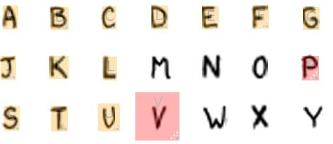
We can add various language support by having a preference and then downloading the required language data.
We have to put them in the assets folder and copy them to the SD card on start.

Slide 36
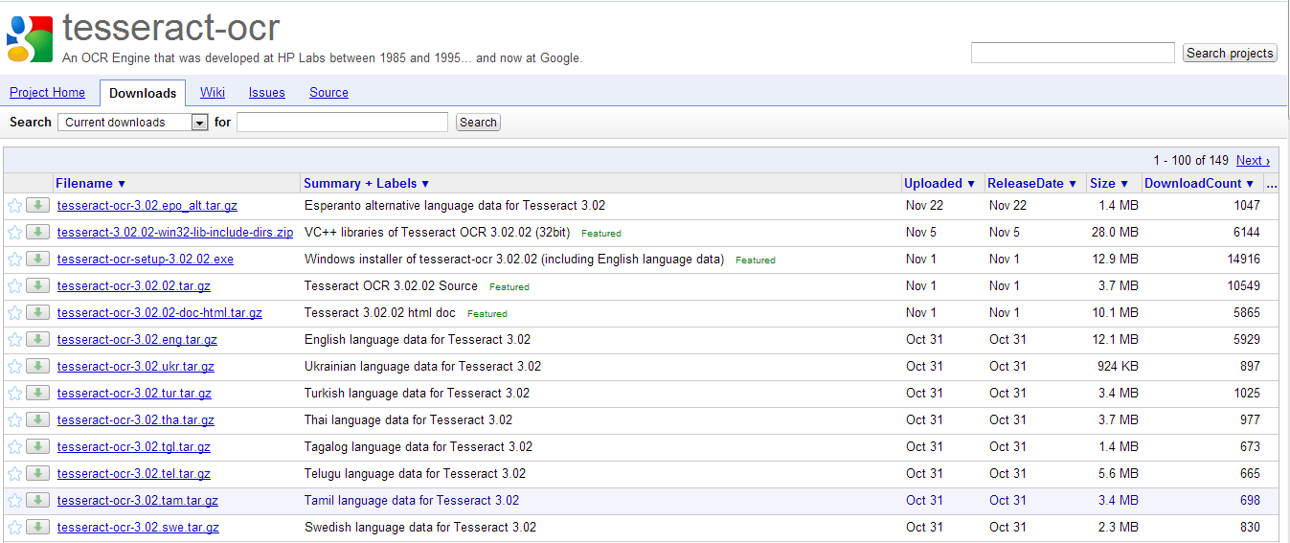

Slide 37
Difficulties
update the PATH variable for the commands to function, otherwise the command willnot found error.
For Android SDK, add the location of the SDK’s tools and platform-tools directories to your PATH environment variable.
For Android NDK, use the same process to add the android-ndk directory to the PATH variable.

Slide 38
PATH=$PATH:$HOME/bin
export PATH
export JAVA_HOME=/home/harshadura/Programs/jdk1.6.0_26
export JDK_HOME=$JAVA_HOME
export PATH=$JAVA_HOME/bin:$PATH
export ANT_HOME=/home/harshadura/Programs/apache-ant-1.8.2
export PATH=$ANT_HOME/bin:$PATH
export TESSERACT_PATH=/home/harshadura/Desktop/rmtheis-tess-two-171dba4/tess-two/external/tesseract-3.01
export LEPTONICA_PATH=/home/harshadura/Desktop/rmtheis-tess-two-171dba4/tess-two/external/leptonica-1.68
export LIBJPEG_PATH=/home/harshadura/Desktop/rmtheis-tess-two-171dba4/tess-two/external/libjpeg
export android=/home/harshadura/Android/android-sdk-linux/tools
export android_tools=/home/harshadura/Android/android-sdk-linux/platform-tools
export ndk_path=/home/harshadura/Android/android-ndk-r6b
export PATH=$android:$android_tools:$PATH
export PATH=$ndk_path:$PATH
export PATH=$TESSERACT_PATH:$PATH
export PATH=$LEPTONICA_PATH:$PATH
export PATH=$LIBJPEG_PATH:$PATH

Slide 39
Implement the Project

Slide 40
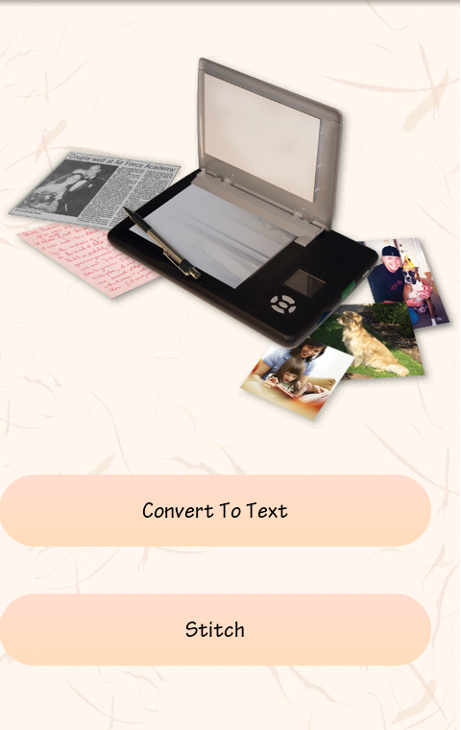

Slide 41
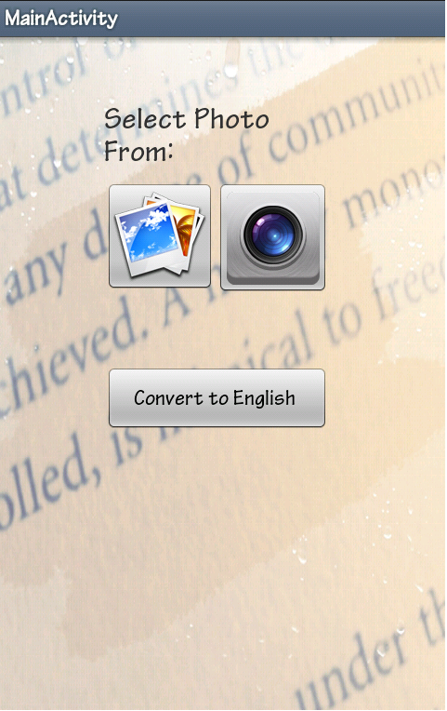

Slide 43
Problems and solutions
the source Code for BoofCV library was in Java, and we have to convert it into android, we faced many problem while implementing it in android.
The images used in Java is Buffered images, while the images used in Android is Bitmap images.

Slide 44
Problems and solutions
OutOfMemory Error we suffer a lot from this error, the solution was to recylcle the images everywhere they are used.
While capturing the photos differences in resolution of photo cause a problems while stitching.

Slide 45
Problems and solutions
While building the Tesseract library we face a lot of problem to build because there is no standerd way to build it.

Slide 46
Thanks…
First, we present our thanks for computer engineering department in AN-Najah National University.
Thanks to our supervisor:
Dr. Raed Al-qadi
Thanks to the Committee discussion members:
Dr. Luai Malhis
Mrs. Haya Sama’na

Slide 47


