Slide 1

An-Najah National University
Faculty of Engineering
Civil Engineering Department
Graduation Project 2
Design of Foundation Systems
Prepared by:
Moneer Zagloul
Maryana Dissi
Ahmad Sahly
Supervisor:
Dr. Isam Jardaneh
Submitted in partial fulfillment of the requirements for the degree of B.Sc. in Civil Engineering
Nablus – Palestine
January 2019

Slide 2
Out Line
Introduction of Foundations Engineering
Aim of the Project
Building Description
Types of soil
Structural System
Modeling of the structure
Quantity and Cost
Conclusion and Recommendation

Slide 3
Introduction of Foundations Engineering
Foundation is the part of a building which is located below ground level (lower portion of the structure) and transmits loads to the supporting soil or rocks.
The main function of foundation is to transmit the high concentrated column or wall reactions safely to the ground without causing failure of soil or unsafe differential settlement of the supported structure, there is two main types of foundations which are shallow foundations and deep foundations.

Slide 4
Aim of the Project
The function of the project is to set foundations for a multistory building and compare the type and cost of foundations for different types of rocks (Different Bearing Capacity).

Slide 5
Building Description
The building consists of 7stories all of them have the same plane area for each floor which is approximately 490 m². The plan area of the building is shown in Figure 1.1
Figure 1.1 Plan of the suggested building of the project.

Slide 6
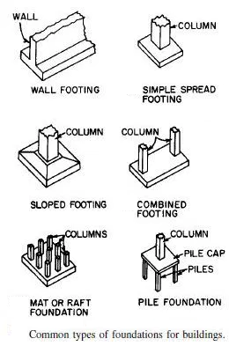
Types of Foundation
There are two main types of foundation, namely, shallow foundation and deep foundation.

Slide 7
Structural System
In Structural System we will explain Loads, Type of soil and rock that the structure design on it and Centerline of Columns and Modeling of the Structure.
Loads
Foundation design must support different kinds of loads. Such as dead load, live loads and snow loads, wind loads and seismic loads.
Foundation should be design in the way which meets building requirements.

Slide 8
The loads that a building foundation should support are:
Dead load: structure own weight
Superimposed dead load (S.D.L): These loads are mainly created by
the non- structural elements of the building, such as tiles, stones, partitions, filling materials and plastering and so on.
Live load: Are variable and temporary loads for short periods or moving loads such as movement of people within the origin
Types of soil
There are several types of soil that the building will set on and the
Bearing Capacity of the Soil
Type of soil | Bearing capacity
Very hard | 1000 KN/m²
Hard rock | 500 KN/m²
Weak rock | 300 KN/m²
Marl soil | 225 KN/m²

Slide 9
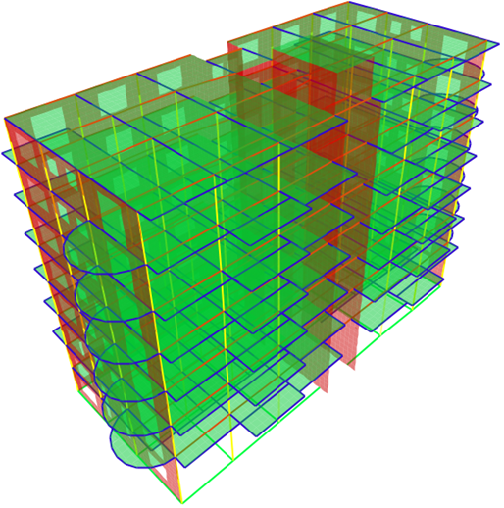
Modeling of the structure
Using SAP2000 to make 3D Model for structure for analysis and design,
Figure shows the building:
Property | Value
Compressive strength of concrete, (f’c) | 28 𝑀𝑝𝑎
Modulus of elasticity, (Ec) | 24.87∗10³𝑀𝑝𝑎
Unit weight of reinforced concrete, 𝛾 | 25 𝑘𝑁/𝑚³
Yield strength (fy) | 420 𝑀𝑝𝑎
Modulus of elasticity, (Es) | 2 * 10⁵ 𝑀𝑝𝑎
Load | Value
Dead load | own weight
Superimposed dead load (S.D.L) | 4.5 𝑘𝑁/𝑚²
Live load | 3 𝑘𝑁/𝑚²

Slide 10
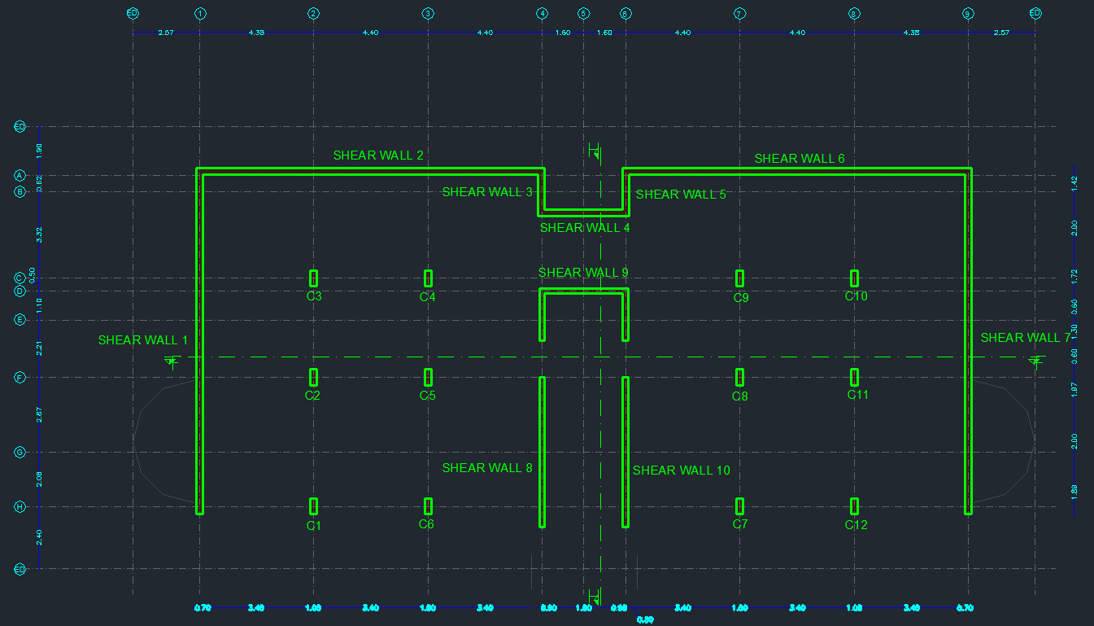
After make a 3D modeling on SAP2000 Program for the structure
we got the following table shows the reaction of each column
and shear wall from all load cases:
Group1 : Qall = 1525 KN
# of footing : 22
Group 2: Qall = 2080 KN
# of footing : 10

Slide 11
First design option (Very Hard Rock 1000KN )
Group 1 (1252 KN)
 | Dimensions |  |  | Reinforcement
 | L (m) | B (m) | h (m) | Long steel |  | Short steel
 | 1.50 m | 1.20 m | 0.50 m | 8 | Ø12 | 10 | Ø12
Group 2 (2080 KN)
 | Dimensions |  |  | Reinforcement
 | L (m) | B (m) | h (m) | Long steel |  | Short steel
 | 1.70 m | 1.40 m | 0.50 m | 12 | Ø12 | 16 | Ø12
Second design option (hard rock)
:Group 1 (1525 KN)
 | Dimensions |  |  | Reinforcement
 | L (m) | B (m) | h (m) | Long steel |  | Short steel
 | 2.00 m | 1.70 m | 0.50 m | 12 | Ø12 | 16 | Ø12
Group 2 (2080 K)
 | Dimensions |  |  | Reinforcement
 | L (m) | B (m) | h (m) | Long steel |  | Short steel
 | 2.30 m | 2.00 m | 0.60 m | 17 | Ø12 | 19 | Ø12

Slide 12
Third design option (weak rock)
: Group 1(1525 KN)
 | Dimensions |  |  | Reinforcement
 | L (m) | B (m) | h (m) | Long steel |  | Short steel
 | 2.55 m | 2.25 m | 0.50 m | 20 | Ø12 | 23 | Ø12
Group 2 (2080 KN)
 | Dimensions |  |  | Reinforcement
 | L (m) | B (m) | h (m) | Long steel |  | Short steel
 | 3.00 m | 2.6 m | 0.60 m | 22 | Ø12 | 25 | Ø12
Fourth design option (Marl soil) : Group 1 (1525 KN)
 | Dimensions |  |  | Reinforcement
 | L (m) | B (m) | h (m) | Long steel |  | Short steel
 | 3.10 m | 2.60 m | 0.50 m | 18 | Ø12 | 21 | Ø12
Group 2 (2080 KN)
 | Dimensions |  |  | Reinforcement
 | L (m) | B (m) | h (m) | Long steel |  | Short steel
 | 3.60 m | 3.00 m | 0.60 m | 26 | Ø12 | 29 | Ø12

Slide 13
Quantity and Cost
1.Labor cost (L):
For Isolated= 55 NIS/CM concrete
For combined= 65 NIS/CMconcrete .
For Matt=45 NIS/CMconcrete
2. Material cost (M):
For concrete: 310 NIS/CMconcrete .
For steel: 2700 NIS/Ton
Equipment (E):
25 NIS/CMExcavation

Slide 14
Conclusion and Recommendation
Table show the B.C of the soil and cost of the foundation for each design option
Design option | B.C (KN/m²) | Cost (NIS)
1 | 1000 | 83538 NIS
2 | 500 | 192148NIS
3 | 300 | 566836 NIS
4 | 225 | 1021182 NIS
Figure Relation between B.C and Cost (Actual Curve).

Slide 15
Cost = 3*10⁷*q_{all}^{-0.978}
Figure 7.2. Relation between B.C and Actual Cost ( Theoretical Curve ).

Slide 16
Thank you

