Slide 1
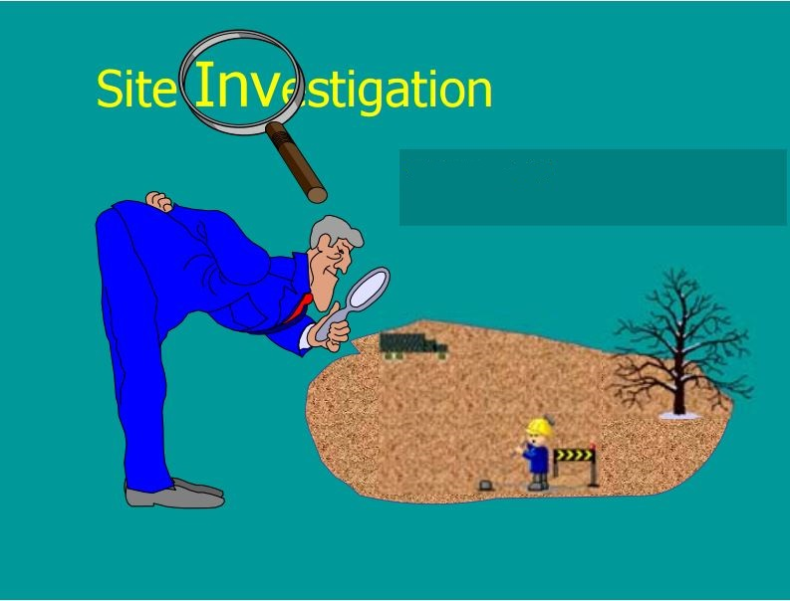
Site Investigation
Prepared By:
Aya Edaly
Bara’a Salhab
Saja Janem
Huda Qaddara
Supervisor:
Dr. Isam Jaradaneh

Slide 2
Definition of Site Investigation
Proposed Residential Rafedia Building
Proposed Toqan Building
Recommendations and Conclusions
Stages of Site Investigation
Purpose of Site Investigation

Slide 3
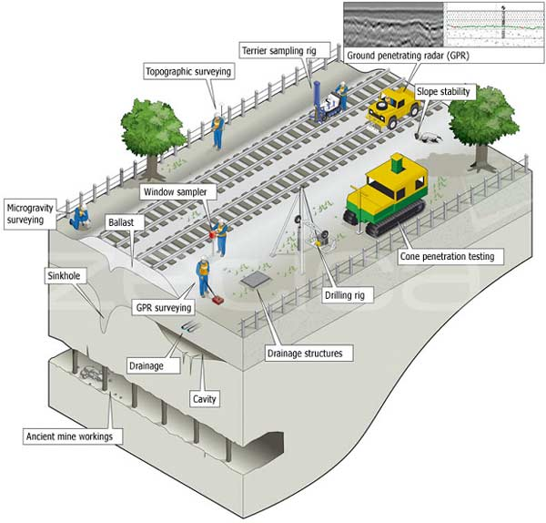
Definition
Site Investigation is the exploration or discovery of the ground conditions to enable engineers to make informed design decisions.

Slide 4
Purpose
Determine the suitability of the site for the proposed project.
Determine an adequate and economic foundation design.
Determine the difficulties which may arise during the construction process and period.
Determine the occurrence of all changes in subsoil conditions.

Slide 5
Stages of Site Investigation
Desk Study (Preliminary Work).
Site Reconnaissance(walk-over the site).
Detailed Site Exploration.
Planning.
Sampling.
Testing.
Result.
Report.

Slide 6
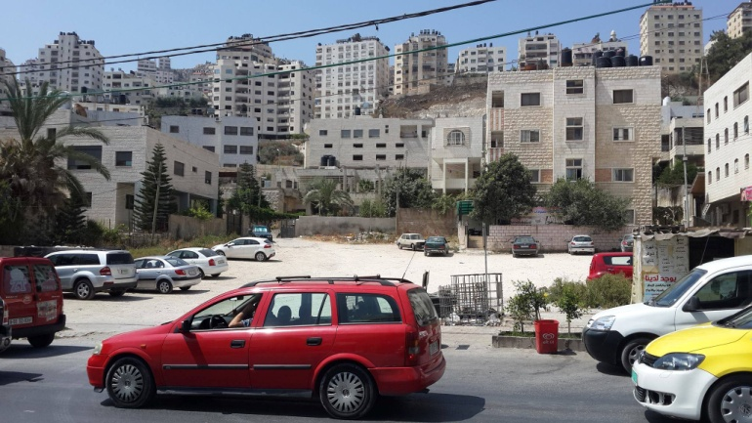
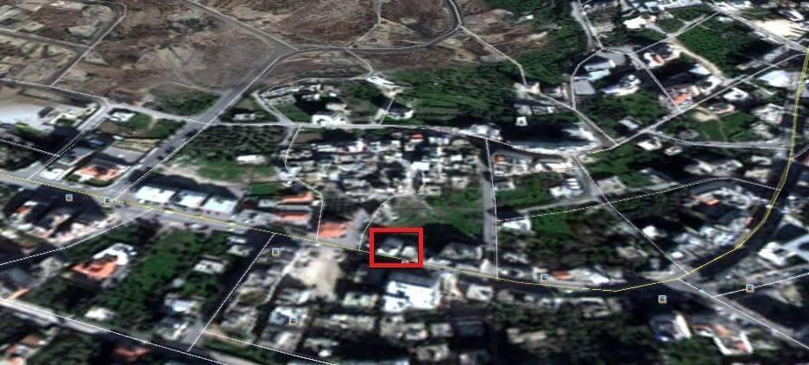
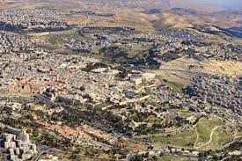
Residential Rafedia Building

Slide 7
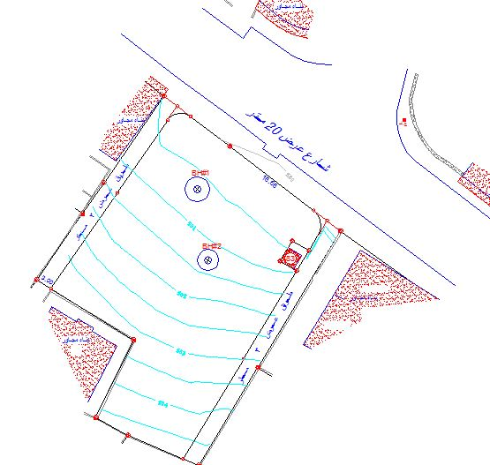
Proposed Residential Rafedia Building
This proposed building located opposite to Al-Motamayzon Supermarket at Rafedia Main Street.
The site has a plan area of about 1550m² and the proposed building will consist of 9 stories, each story will have a plan area equal 900 m².

Slide 8
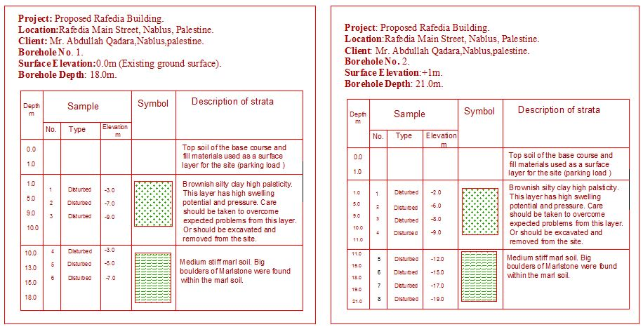
Boreholes Log

Slide 9
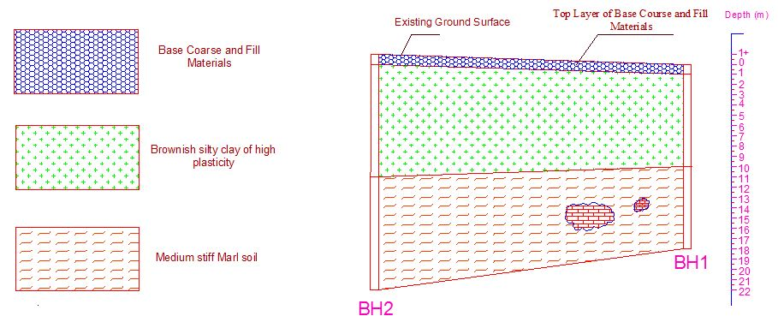
Typical Geological Section

Slide 10
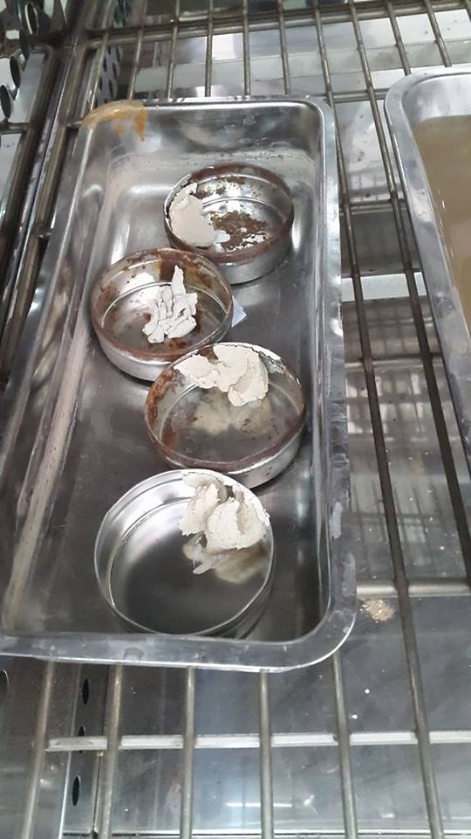
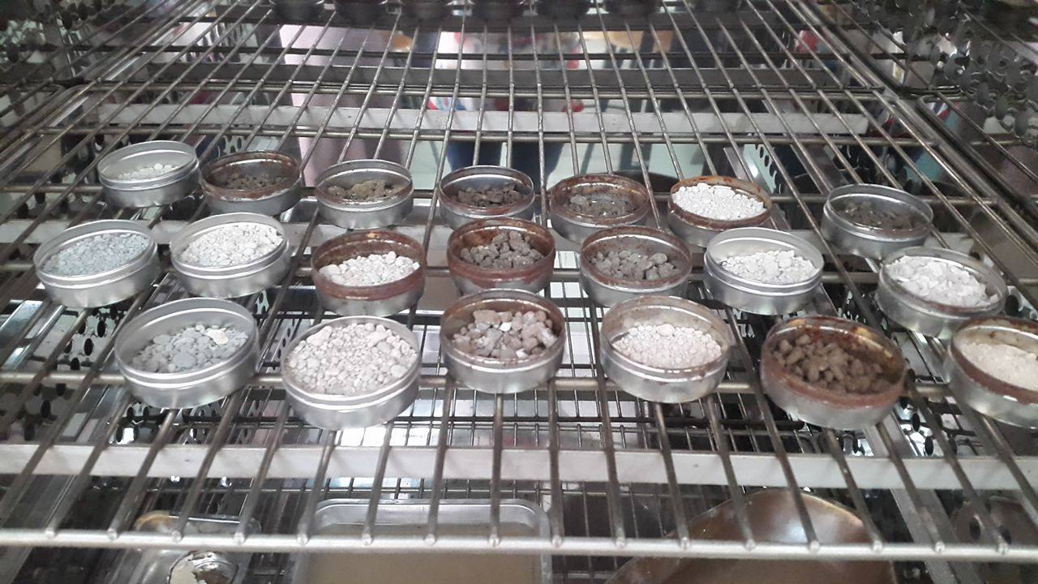
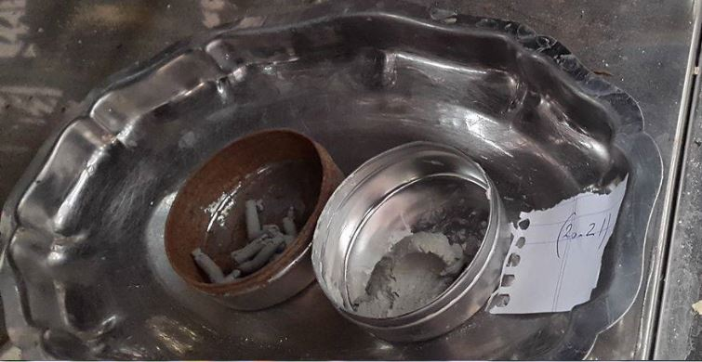
Laboratory Tests Carried Out
Classification tests:
Natural Moisture Contents.
Atterberg Limits(Liquid and Plastic).

Slide 11
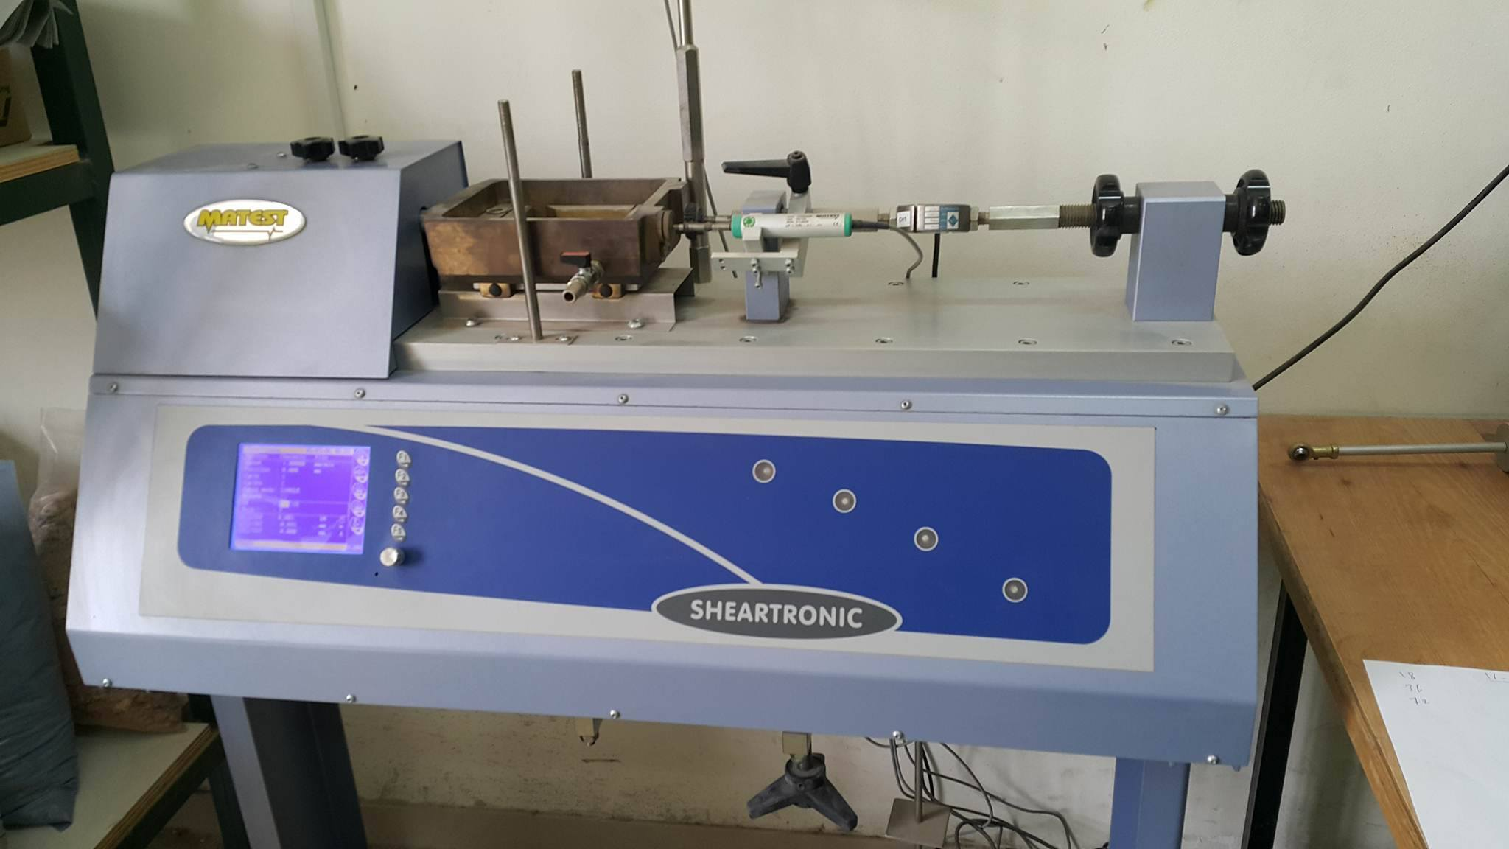
Laboratory Tests Carried Out
Strength Tests:
Direct Shear Test

Slide 12
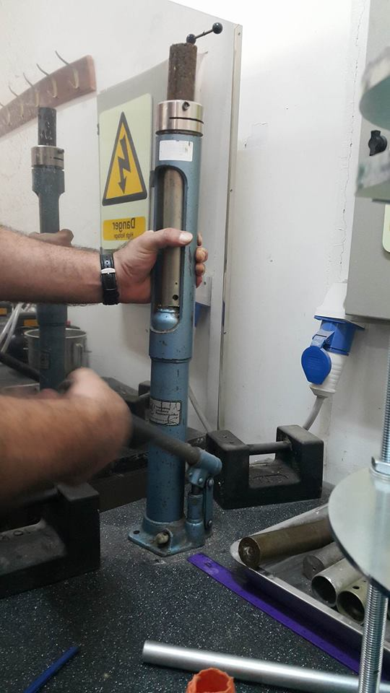
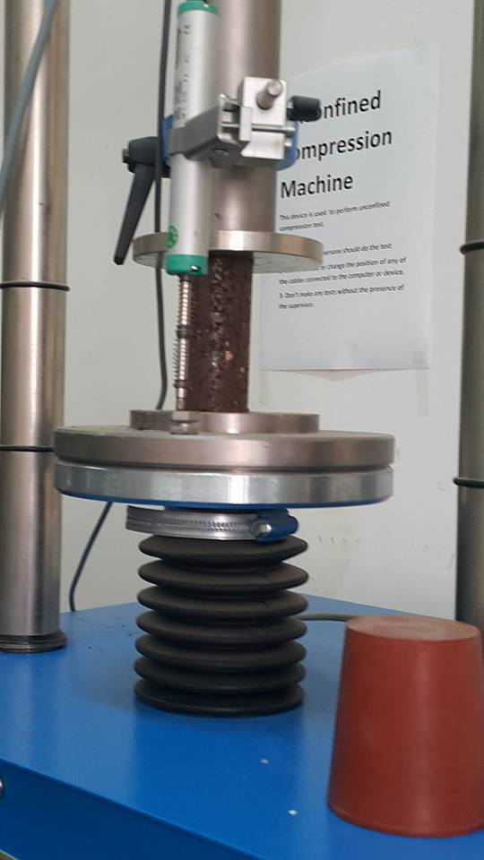
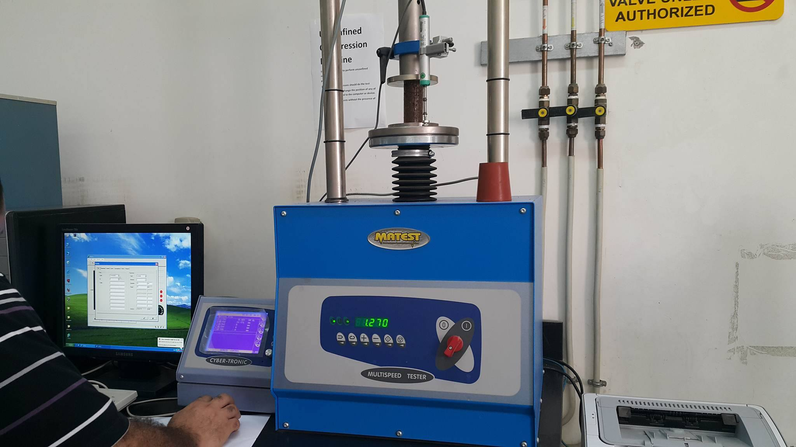
Laboratory Tests Carried Out
2. Unconfined Compression Test

Slide 13
    Recommendations and Results
Sallow foundation can be constructed on the Marl Soil. The allowable bearing capacity is 170kN/m².
Care should be taken to overcome expected problems from high water level.
Excavation support system should be designed and installed for the site if the excavation is greater than 4 m.
Retaining walls with adequate drainage system and good backfill materials is recommended.

Slide 14
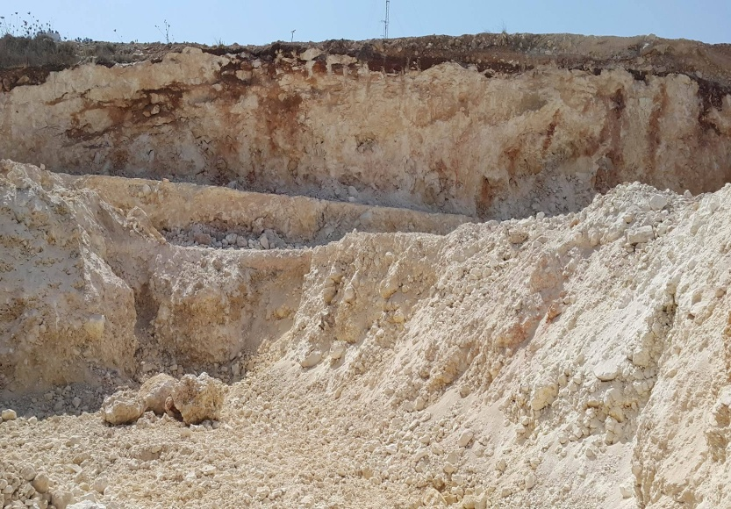
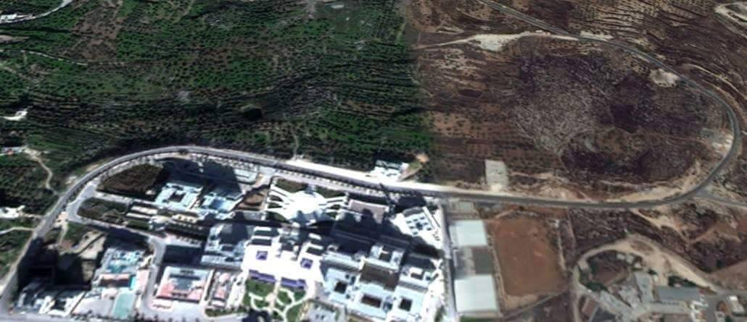
Toqan Building

Slide 15
Proposed Toqan Building
The proposed building is located near An-Najah N. University, Ring Load, Jenaid, Nablus, and Palestine.
The site has a plan area of about 930 m² and the proposed building will have a plan area equal 445 m² for each story. The proposed building will consists of 8 stories

Slide 16
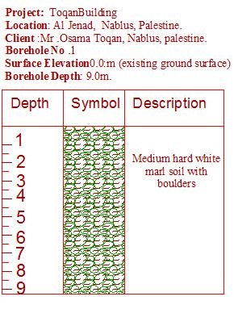
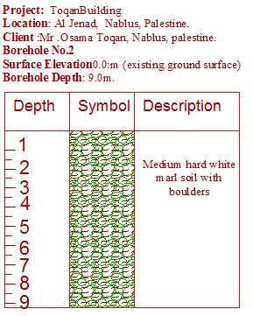
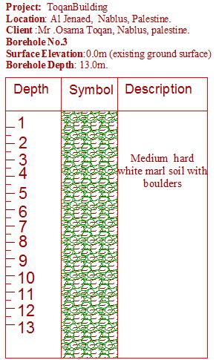
Boreholes Log

Slide 17
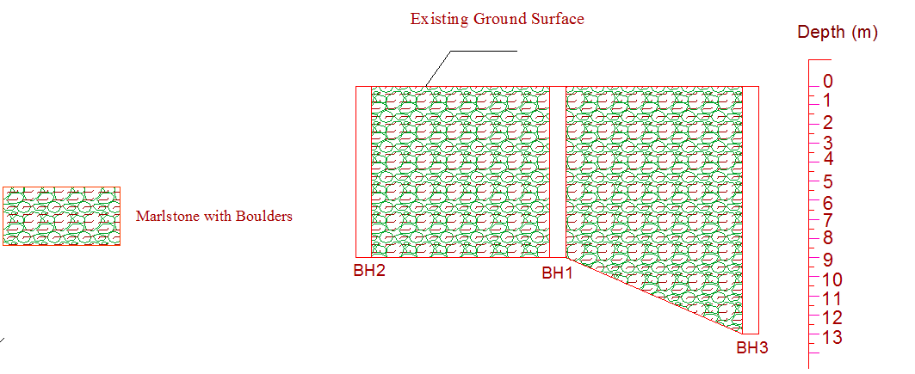
Typical Geological Section

Slide 18
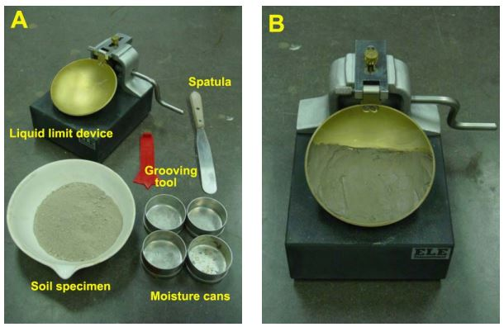
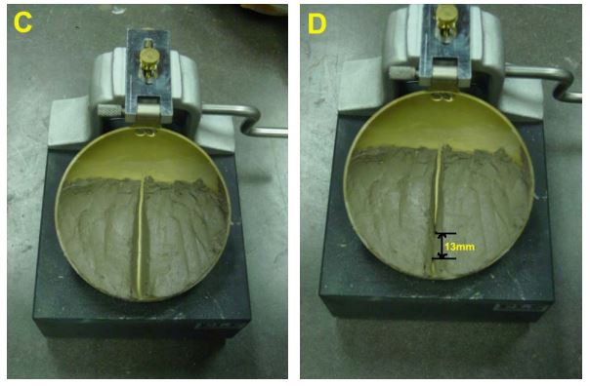
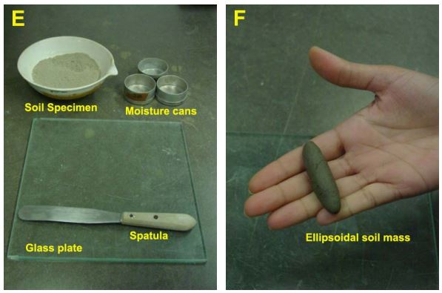
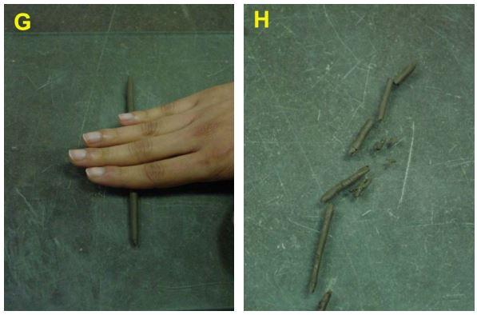
Laboratory Tests Carried Out
Atterberg Limits
Liquid Limit
Plastic Limit

Slide 19
Laboratory Tests Carried Out
2. Direct Shear Test

Slide 20
Recommendations and Results
The ability of the construction is recommended to be not more than 250 KN/m² on the depth 1.0m assuming that the shallow foundation will be on the poplar layer after compaction the level of the foundation.
It is recommended to use the soils result from the excavation from the surface layer in the backfilling works.
Care should be taken, and save the building from water effects and ponding of water in the foundation places.

Slide 21
Conclusions and Recommendations of the project
site investigation is very important before constructing any structure to determine the geotechnical properties.
Site investigation techniques should be done according to standards and international codes.
The techniques of site investigation should be reliable and developed.
It is recommended to use as possible and available field tests.

