Slide 1
Tech Shop Website With AI Sales Forcasting
Nour Ayyoub and Ameed Hudhud

Slide 2
introduction
Developing an e-commerce and forcasting platform tailored for electronic products.
Providing a vast selection of items including games, computers, and related accessories.
Incorporating an advanced feature to predict the company’s sales using AI models(Admin).
Integrating an advanced feature to predict game prices using artificial intelligence models.(customer)
Implementing efficient and reliable order processing.
Integrating a payment system that supports payment upon delivery.

Slide 3
Aimed to solve
Simplify navigation to improve user experience and reduce frustration.
Implement accurate sales predictions using AI-powered predictive analytics to enhance inventory management, preventing stockouts and overstock situations.
Improve inventory management efficiency, reducing operational costs and ensuring customer expectations are met.

Slide 4
User roles
Customers are the end users who browse and purchase electronic products. They can create accounts, log in, search for products, add items to their shopping cart, and manage their orders.
Administrators manage the back-end operations of the platform. Their roles include adding and updating product details, managing customer orders, and overseeing inventory levels. They also use an AI-powered predictive analytics tool to forecast a company's sales over a specific period.

Slide 5
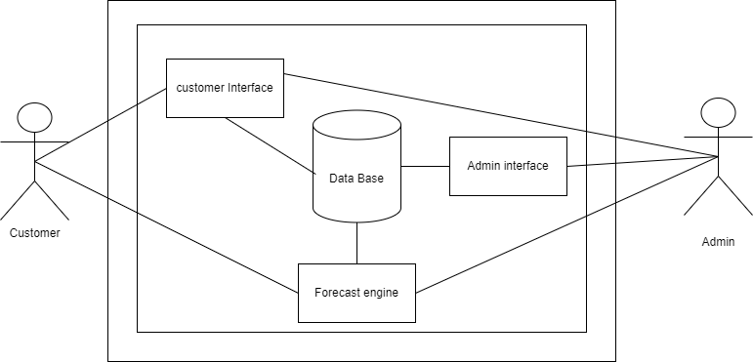
System Environment

Slide 6
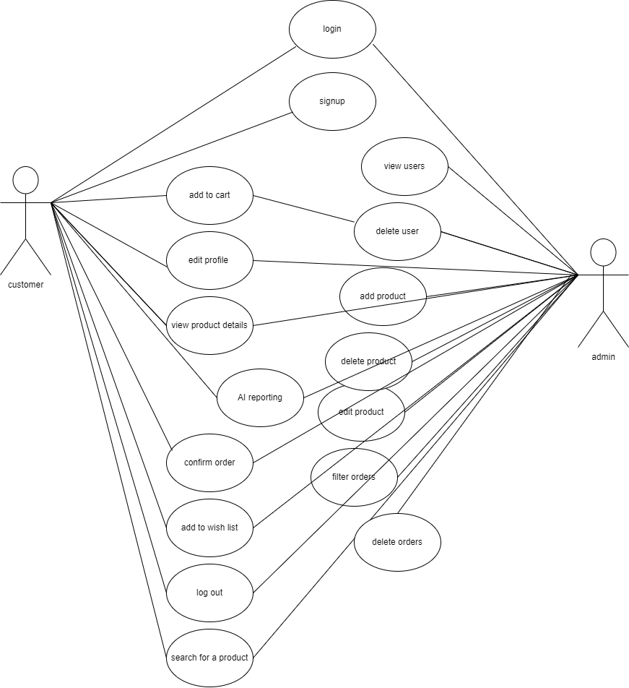
Use Case

Slide 7
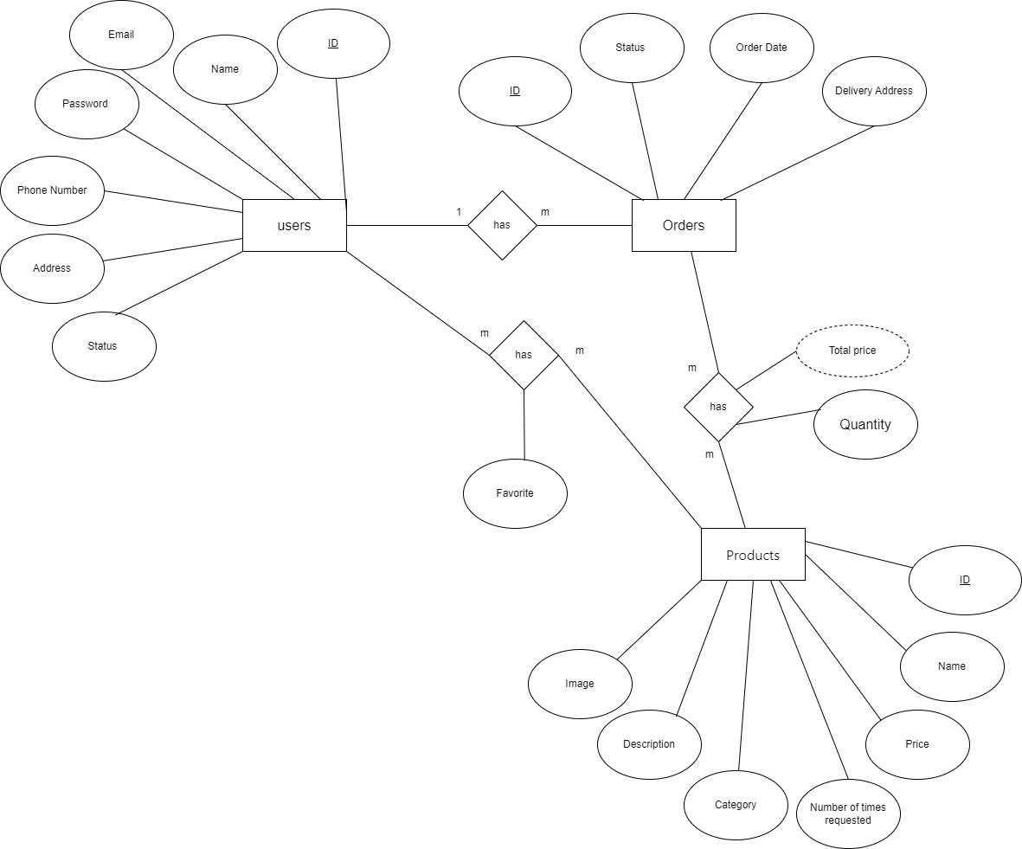
ERD

Slide 8
Activity Diagram

Slide 9
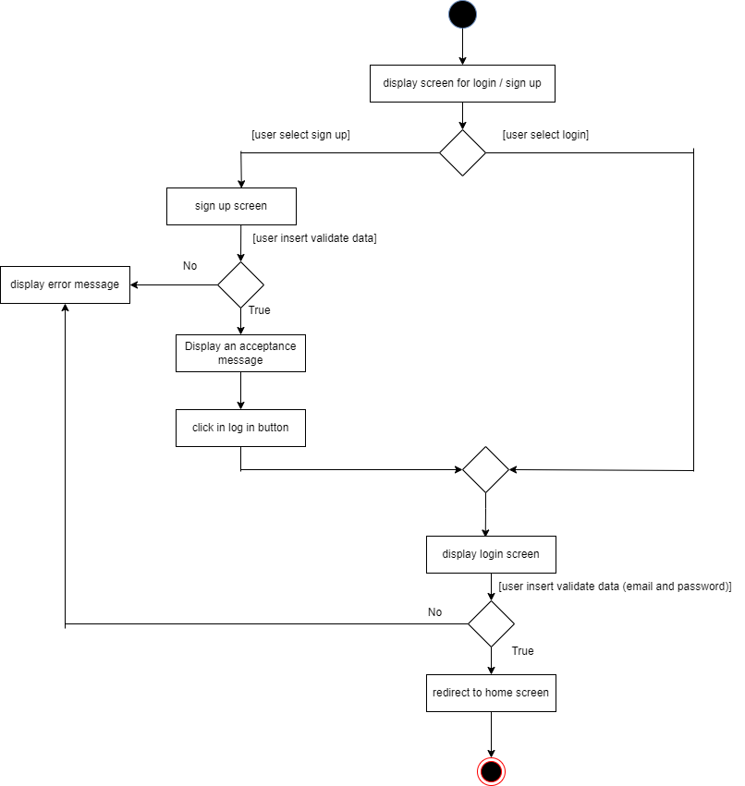
Login And Register

Slide 10
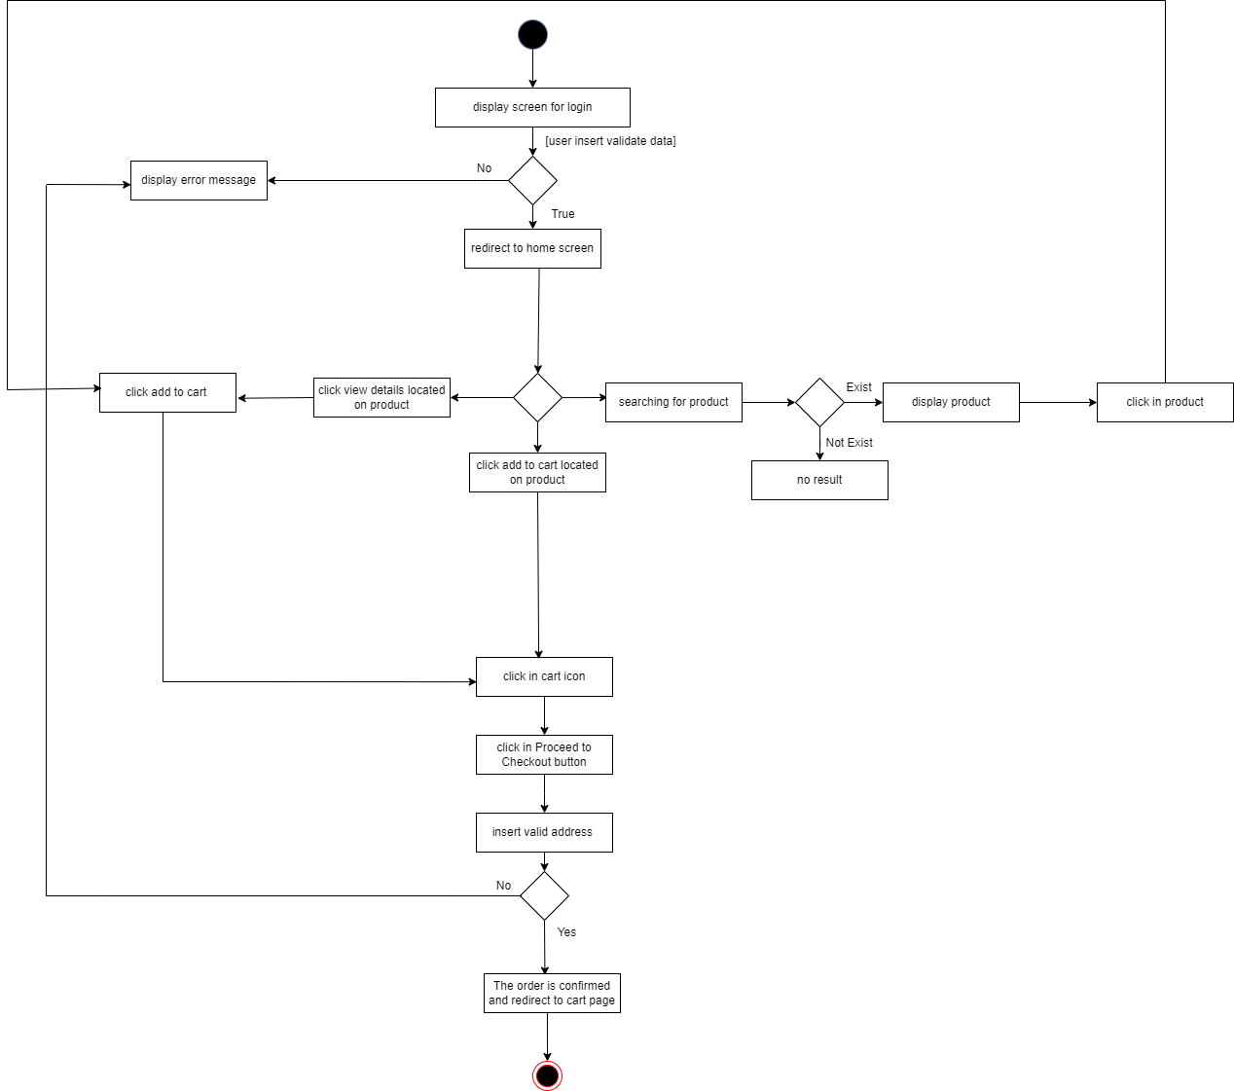
Create Order

Slide 11
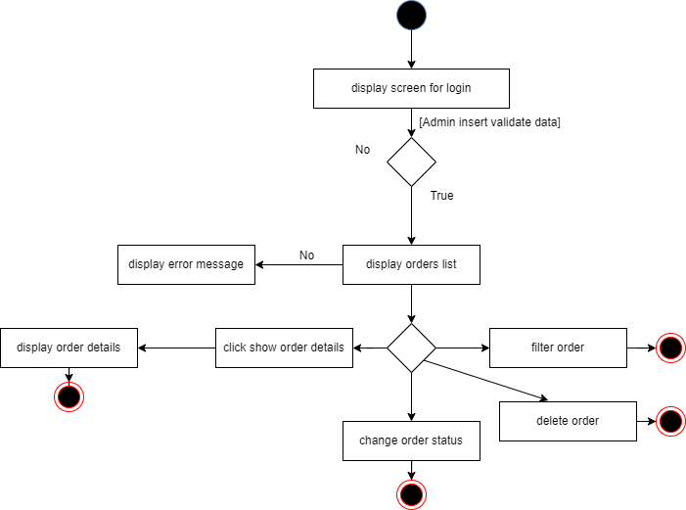
Order Managment

Slide 12
artificial intelligence (AI)

Slide 13
Forecasting Sales
Part one

Slide 14
Description of the data set
Source: kaggle
This dataset contains about 1,826 samples
Features in dataset :-
Date - The date of the sales record.
sales - The sales amount on the given date.

Slide 15
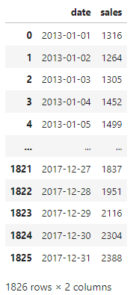
Dataset

Slide 16

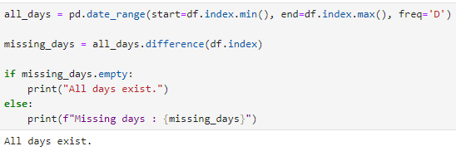
Dataset Cleaning
No missing data
All days exist

Slide 17
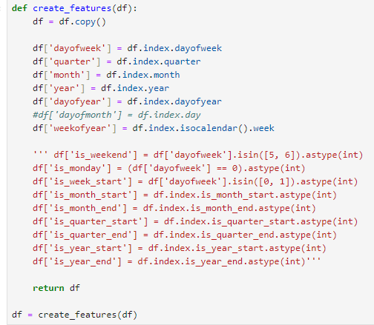
Data preprocessing and preparation
We need to add features

Slide 18
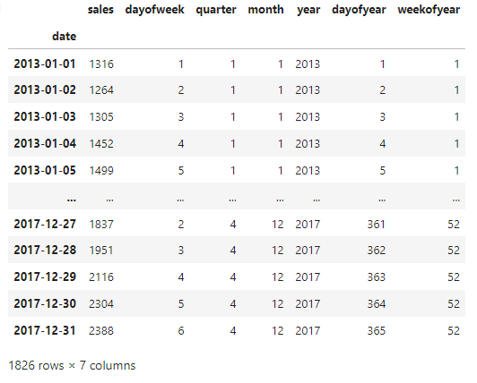
Data preprocessing and preparation
The dataset has become like this

Slide 19

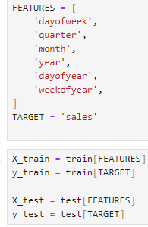
Machine Learning Models
split the dataset training and testing

Slide 20
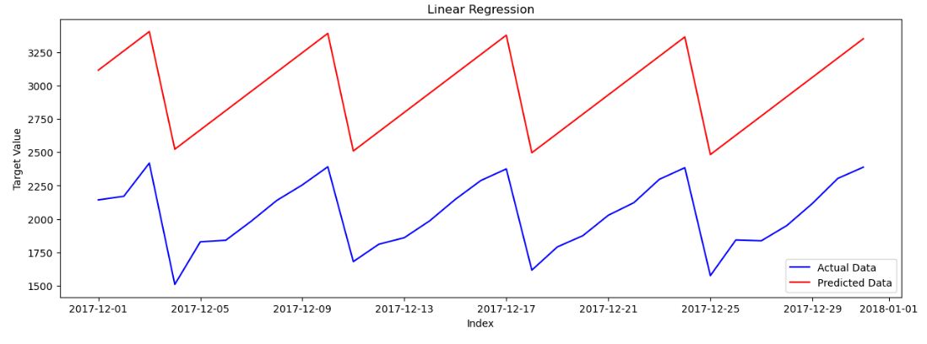
Machine Learning Models
Linear regression
Test RMSE: 938.44, Test MAE: 936.39, Test MAPE: 46.72%, Test R^2: -12.15

Slide 21
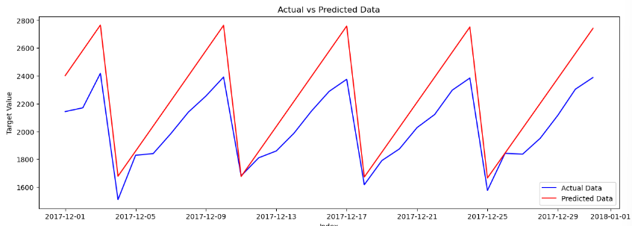
Machine Learning Models
Polynomial Regression (degree = 2)
Polynomial - Test RMSE: 246.52, Test MAE: 217.73, Test MAPE: 10.27%, Test R^2: 0.09

Slide 22
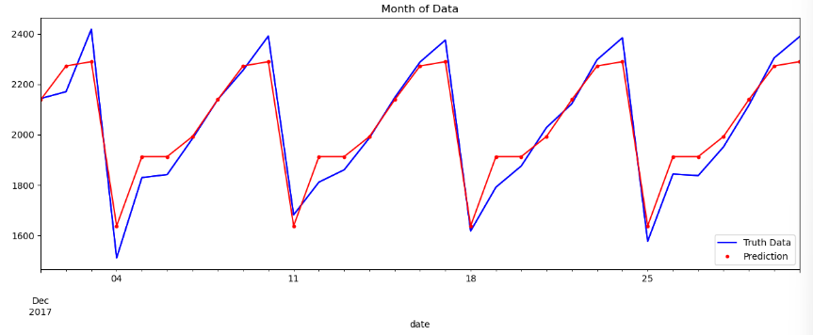
Machine Learning Models
Xgboost regression
XGBoost - Test RMSE: 68.06, Test MAE: 55.14, Test MAPE: 2.79%, Test R^2: 0.93

Slide 23
conclusion
XGBoost - Test RMSE: 68.06, Test MAE: 55.14, Test MAPE: 2.79%, Test R^2: 0.93
Polynomial - Test RMSE: 246.52, Test MAE: 217.73, Test MAPE: 10.27%, Test R^2: 0.09
Linear - Test RMSE: 938.44, Test MAE: 936.39, Test MAPE: 46.72%, Test R^2: -12.15
Xgboost regression The best among them

Slide 24
Video Games Sales
Part two

Slide 25
Description of the data set
Source: vgchartz.com
This dataset contains about 16500 samples
Features in dataset :-
Rank - ranking of overall sales
Name - the games name
Platform - platform of the games release (i.e., PC, PS4, etc.)
Year - year of the game's release
Genre - genre of the game
Publisher - publisher of the game
Na_sales - sales in north America (in millions)
Eu_sales - sales in Europe (in millions)
Jp_sales - sales in Japan (in millions)
Other_sales - sales in the rest of the world (in millions)
Global_sales - total worldwide sales.

Slide 26
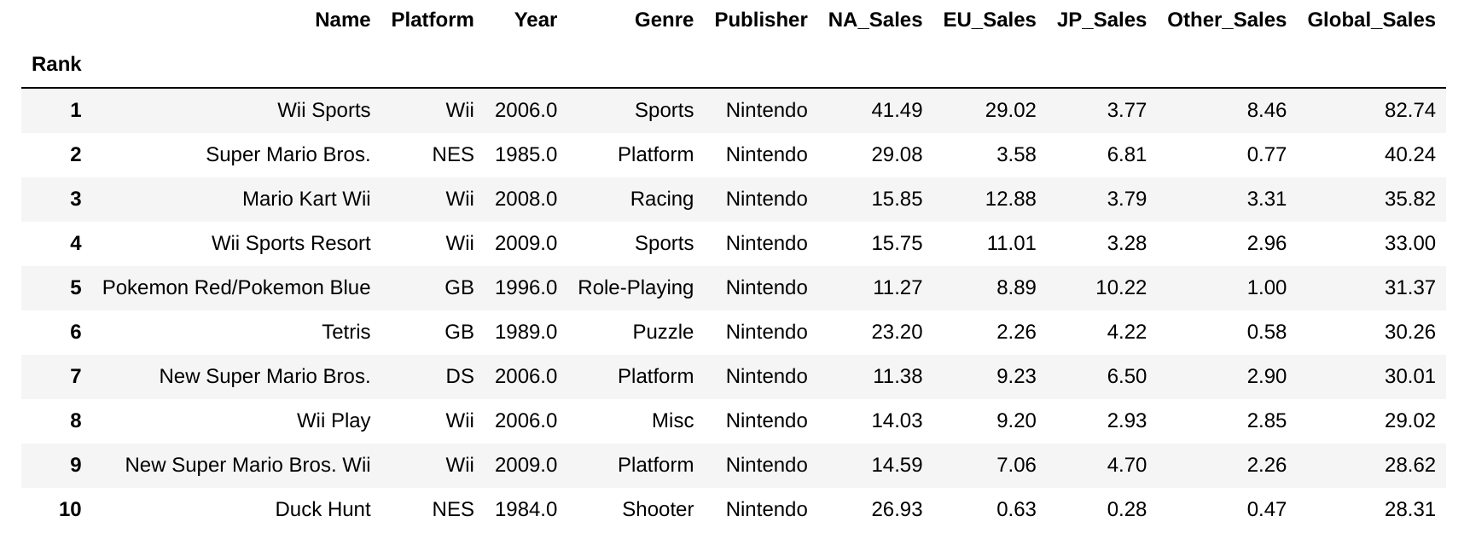
Dataset

Slide 27
Dataset Cleaning
Delete features that are not important.

Slide 28
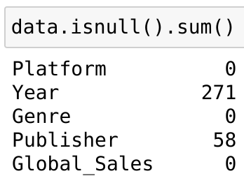
Dataset Cleaning
We checked the count of missing values in the dataset.
Fill in the missing values in “Year”.
Ignore the missing values in “Publisher”.

Slide 29
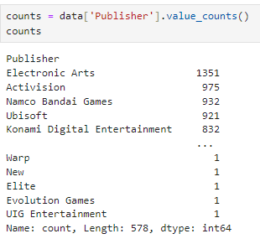
Data preprocessing and preparation
Visualization for Publisher .
their number is about 600

Slide 30
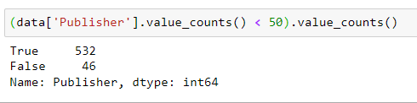
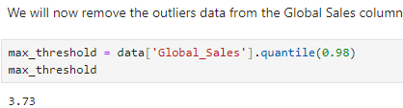
Data preprocessing and preparation
Solve the problem of publishers
Remove outliers

Slide 31
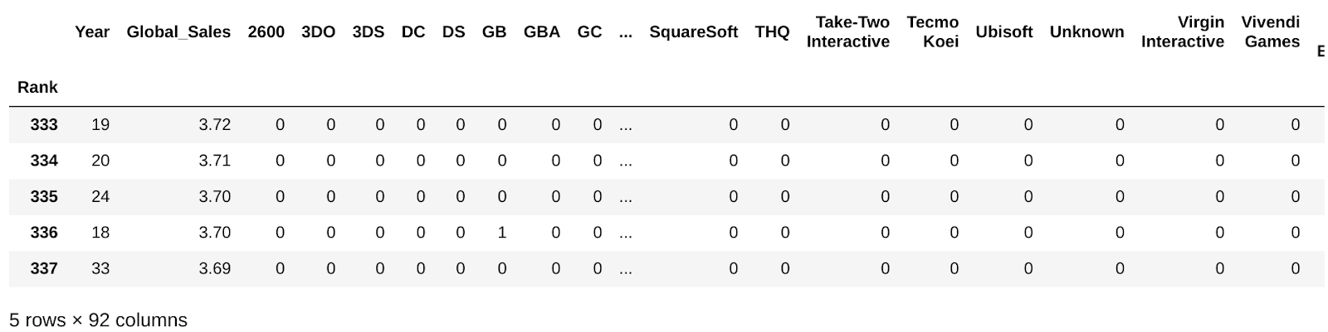
Data preprocessing and preparation
Encoding for the Categorical variables :
'Platform’
'Genre’
'Publisher’
Use onehot encoding

Slide 32
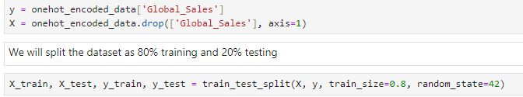
Machine Learning Models
split the dataset training and testing

Slide 33
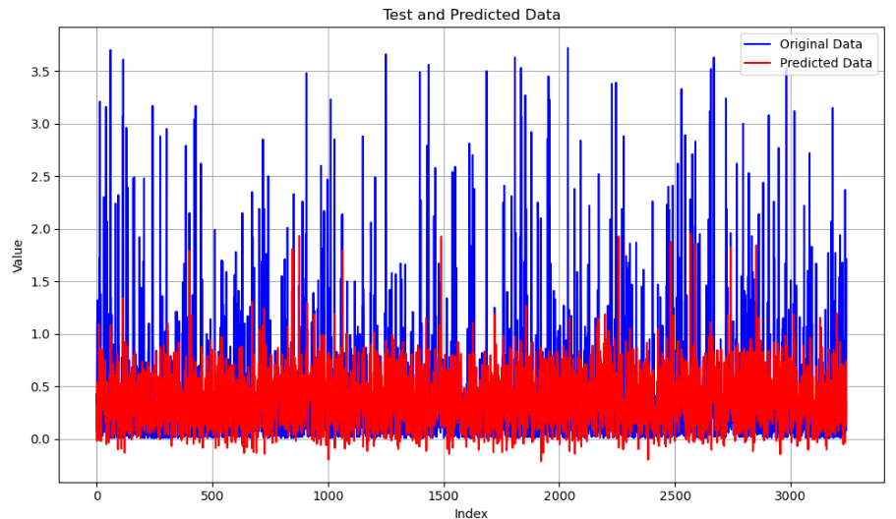
Machine Learning Models
Linear regression
Test RMSE: 0.52, Test MAE: 0.32, Test MAPE: 315.79%, Test R^2: 0.20

Slide 34
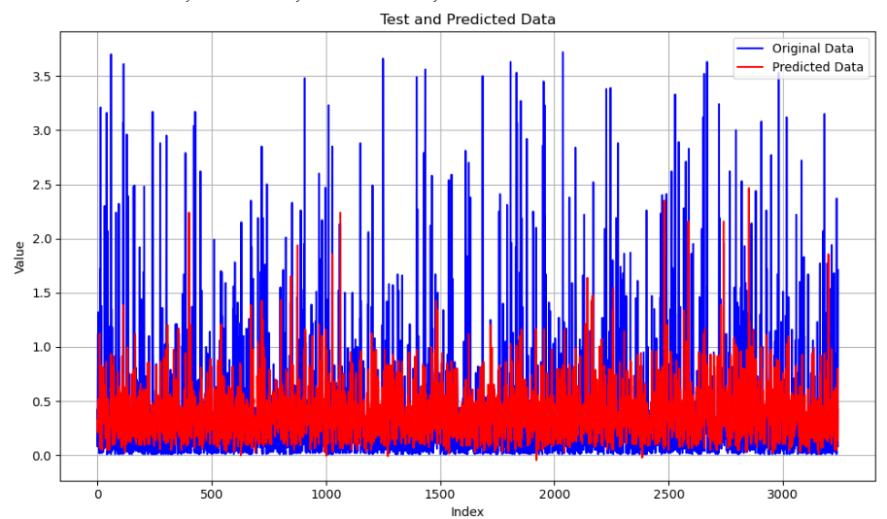
Machine Learning Models
Xgboost regression
XGBoost - Test RMSE: 0.52, Test MAE: 0.31, Test MAPE: 314.70%, Test R^2: 0.22

Slide 35
DEMO

Slide 36
Future Work.
Integrate recommendation system for personalized user experiences.
Implement neural networks for forecasting and data analytics.
Add features for product evaluations and customer reviews.
Implement a contact system for technical support.

Slide 37
Thank You

