Slide 1
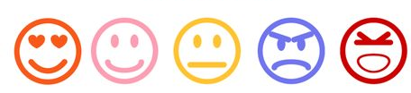
Sentiment Analysis
By:
Haneen , Yasmeen , Bayan

Slide 2

Sentiment Analysis, Social Media, WHY?
Determine marketing strategy
measure campaign success
measure product messaging
measure customer service
Test business KPIs
Generate leads

Slide 3
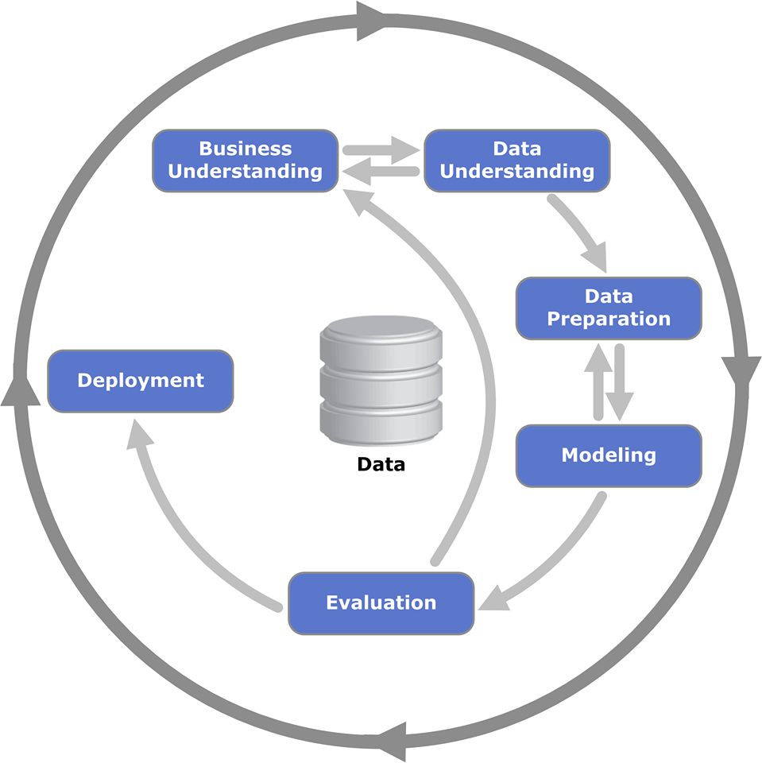


Slide 4
ETL(Extract, Transform, Load)

Slide 5
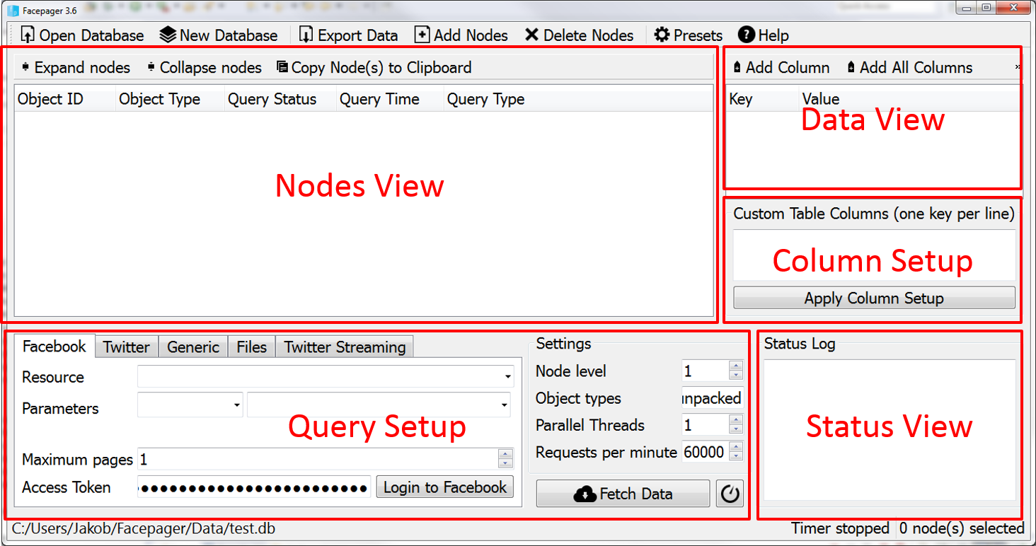
Extract Facebook Data

Slide 6
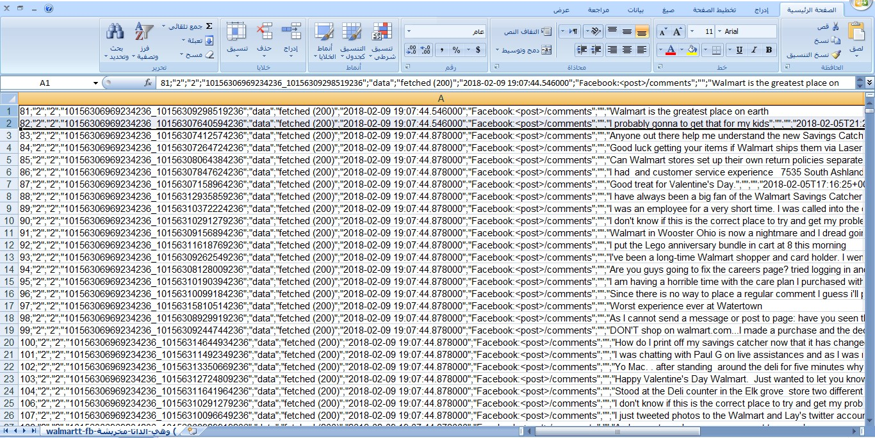

Slide 7
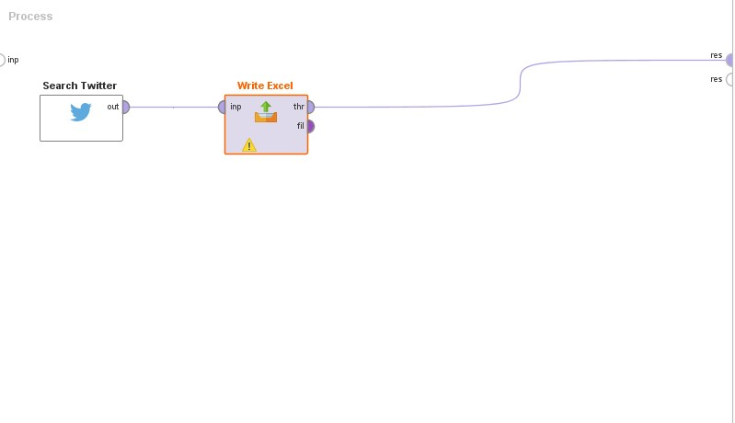
Extract twitter Data

Slide 8
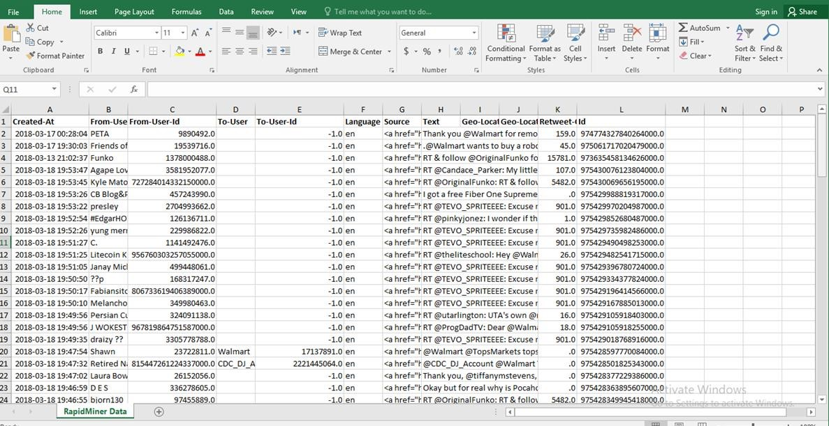

Slide 9
ETL(Extract, Transform, Load)

Slide 10
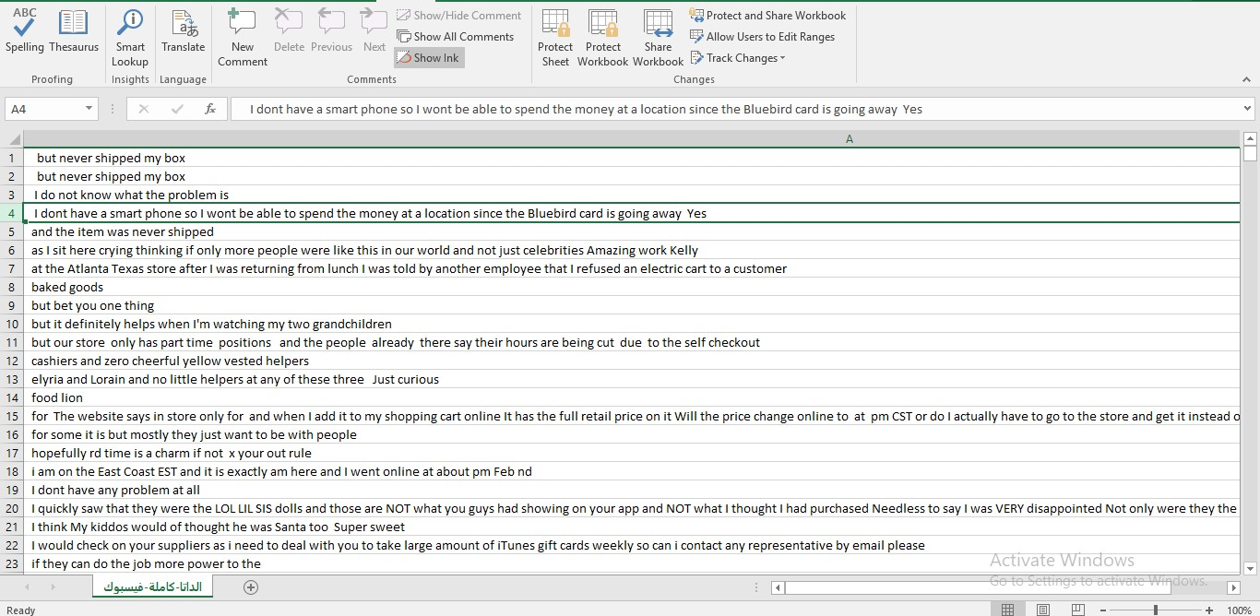
Cleaning Facebook Data With Excel

Slide 11
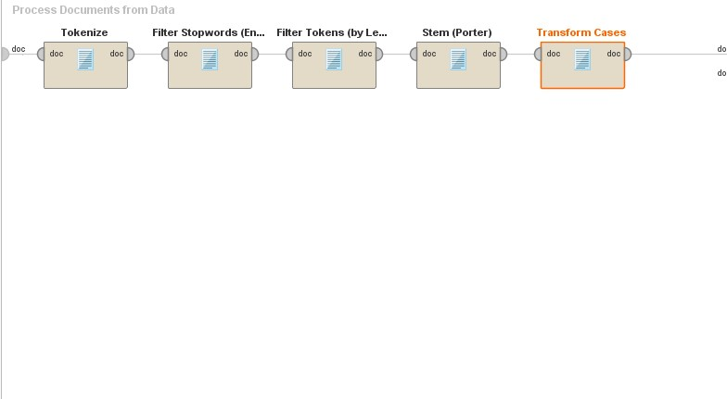
Cleaning Data With RapidMiner

Slide 12
The Creation Of Training Data

Slide 13
ETL(Extract, Transform, Load)

Slide 14
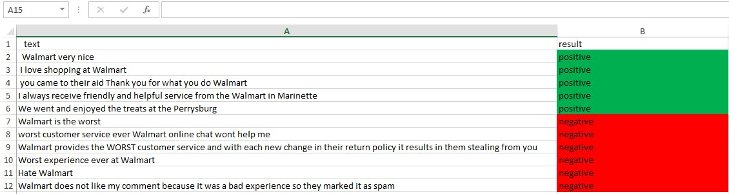
With Two Classes

Slide 15
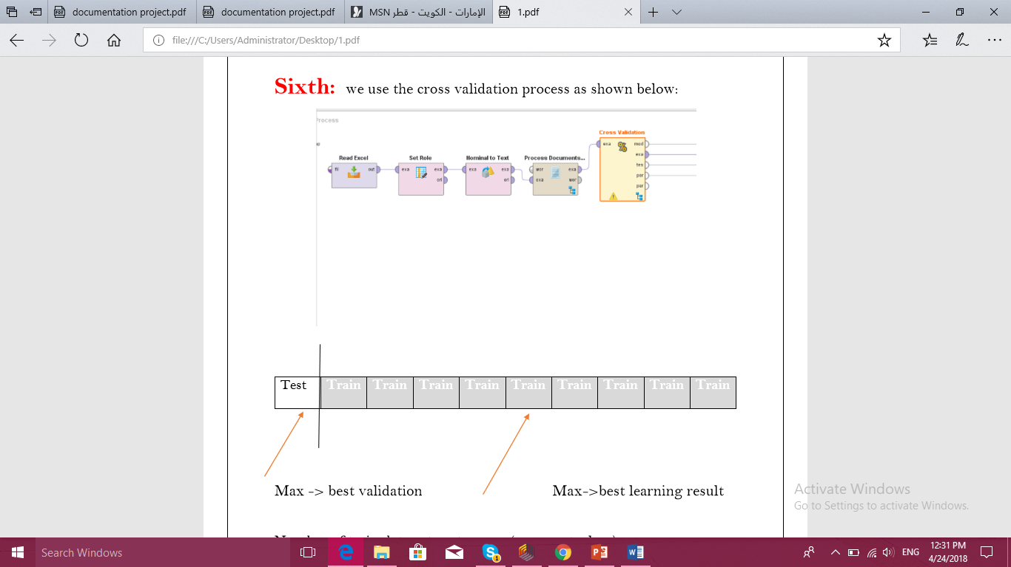

Slide 16
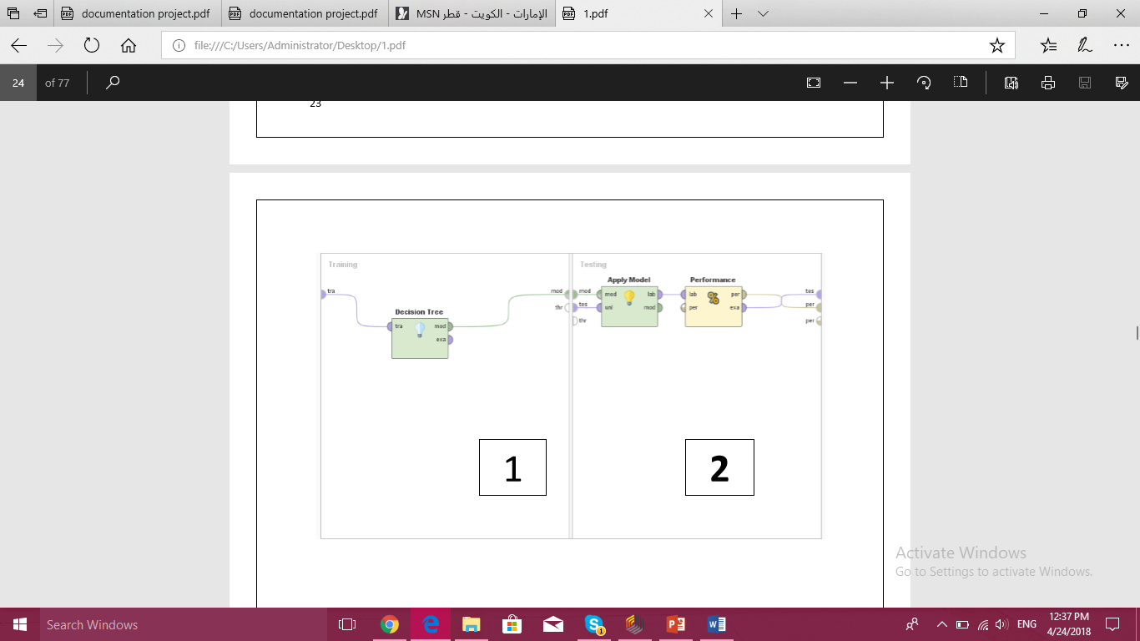

Slide 17
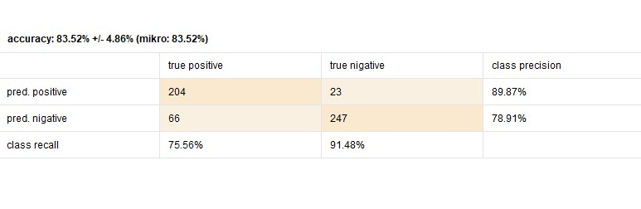

Slide 18
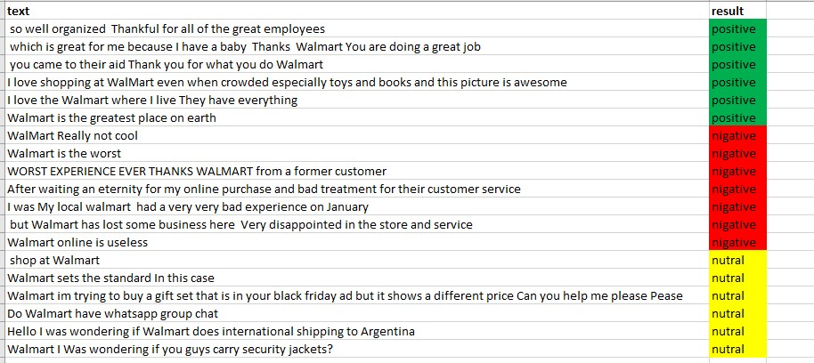
With Three Classes for Facebook

Slide 19
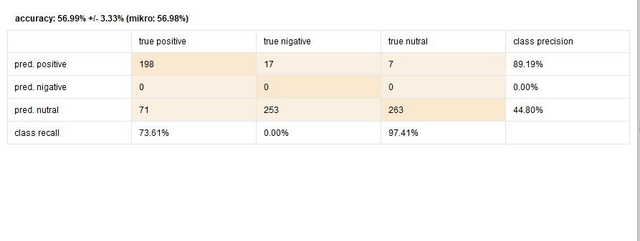

Slide 20
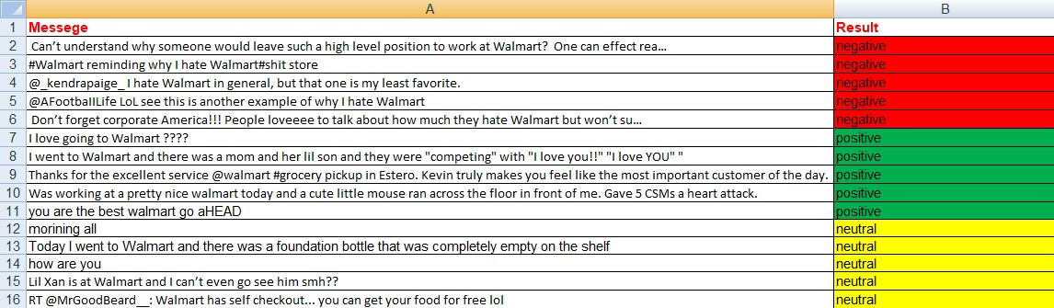
With Three Classes for Twitter

Slide 21
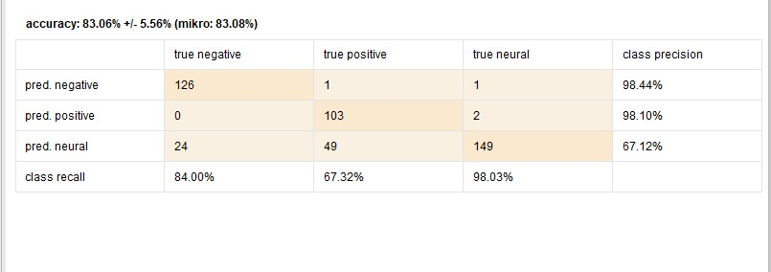

Slide 22
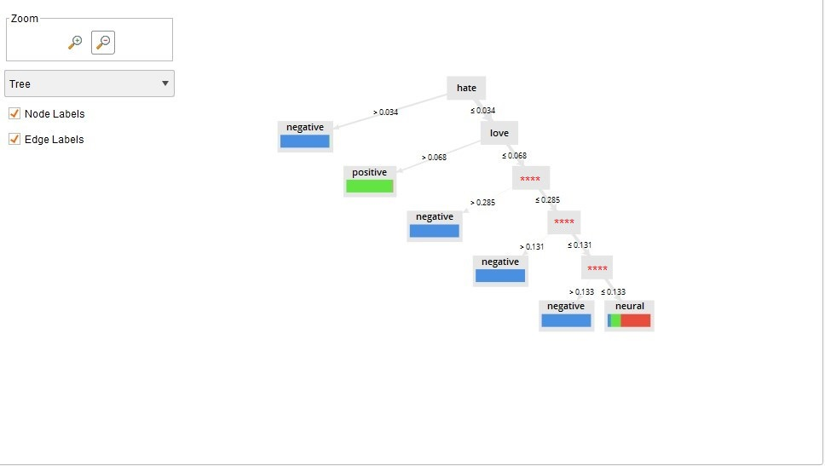

Slide 23
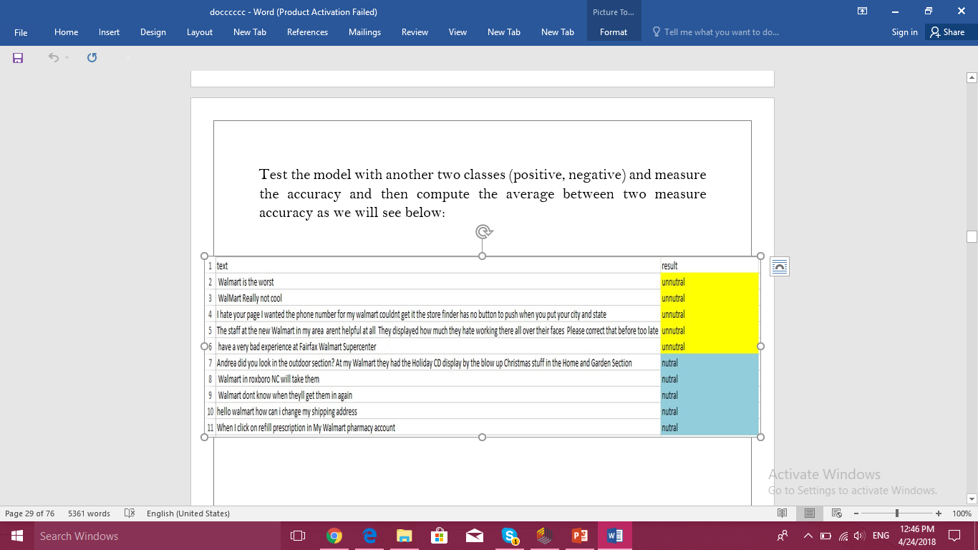
The two steps
First :

Slide 24
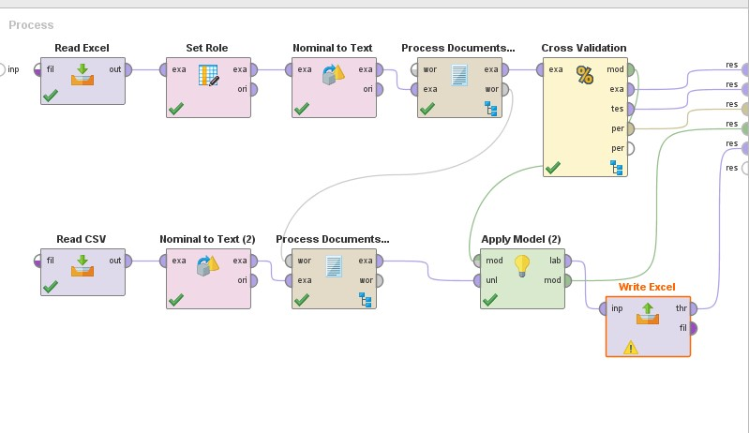

Slide 25
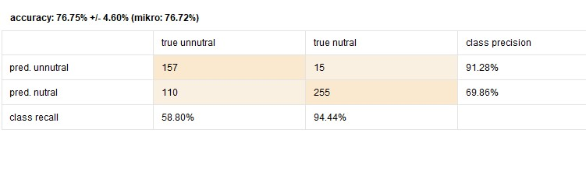

Slide 26
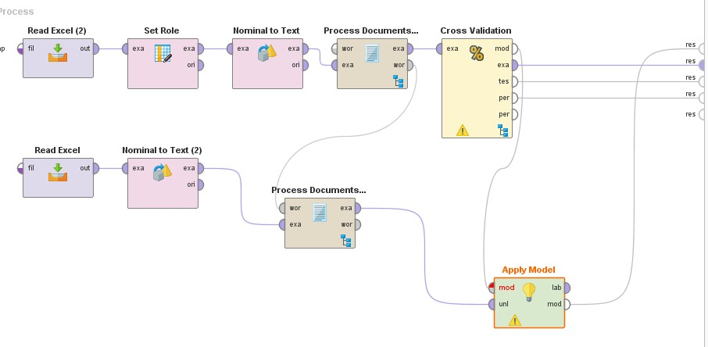
Step 2

Slide 27
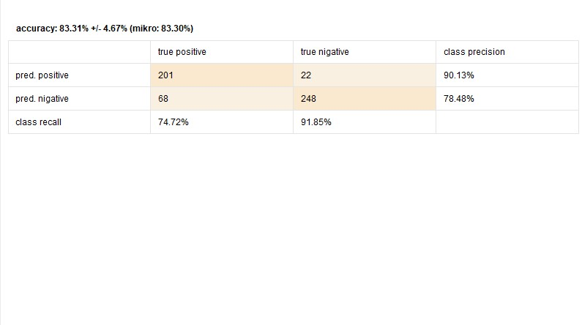

Slide 28
Here we found that the accuracy of using these two processes is
(76.62+83.31)/2
=79.9

Slide 29
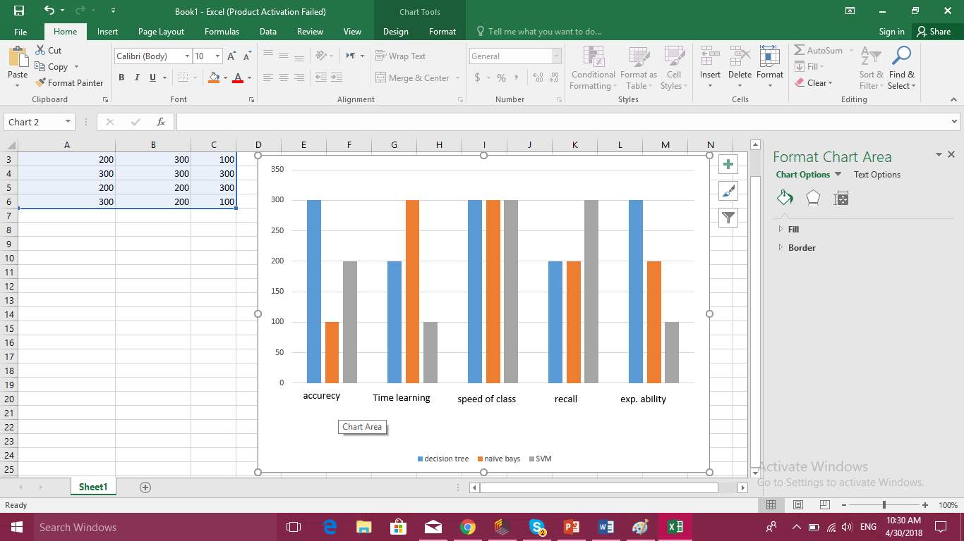
The Comparison Between The three Classification Models

Slide 30
The future expectation
We have a desire in the future to work in Arabic data and to know more details about it.
2. Through the experience we have seen, if we want to use a tool in the future we use paid tools.
3. After our study of sentiment analysis, we have the experience and the ability to solve any problems we face in this field.
4. The next step will be easy for us because we have become aware of concepts and terminologies.
5. The difficulties we faces in importing data will not have presence in the future.

Slide 31
Results:
To take more attention about their website and e-buy and its online services
To take attention about the customers services and the relationships between the employees
There is a lot of crowding and this obliged the customers to wail a lot of time .
There's no attention to the negative comments on social media and sometimes it was deleted
There is no online chat .
Any organization must has sentiment analysis processes to develop there work .

