Slide 1

Structural Re-Design Of Al-Quds Open University
(Salfit Branch)
Prepared by:
Aya Anan Ghazal
Ayah Osama Braik
Under the supervision of:
Dr. Mohammad Samaaneh

Slide 2
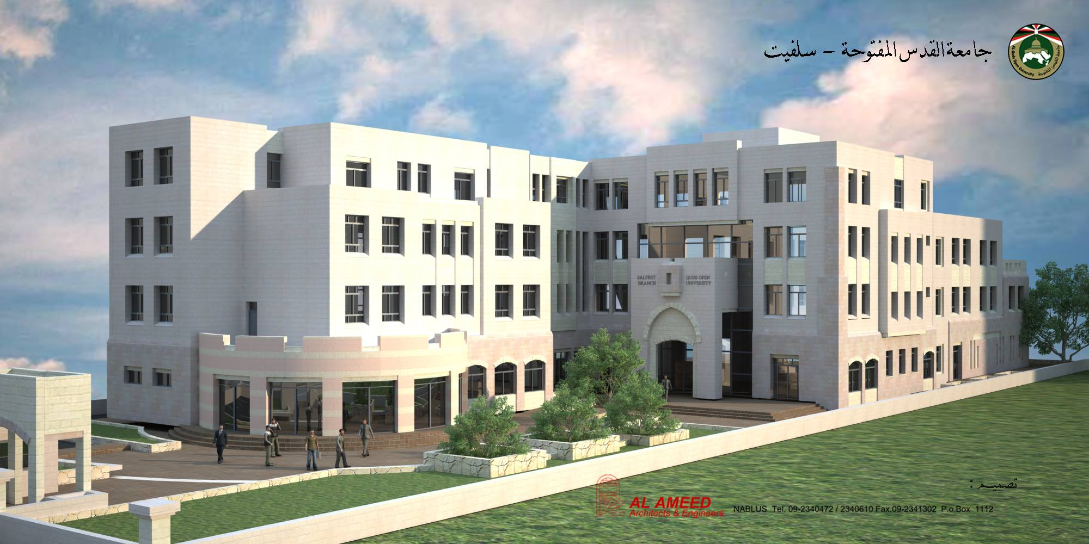
3D Architectural Model Of The Project

Slide 3
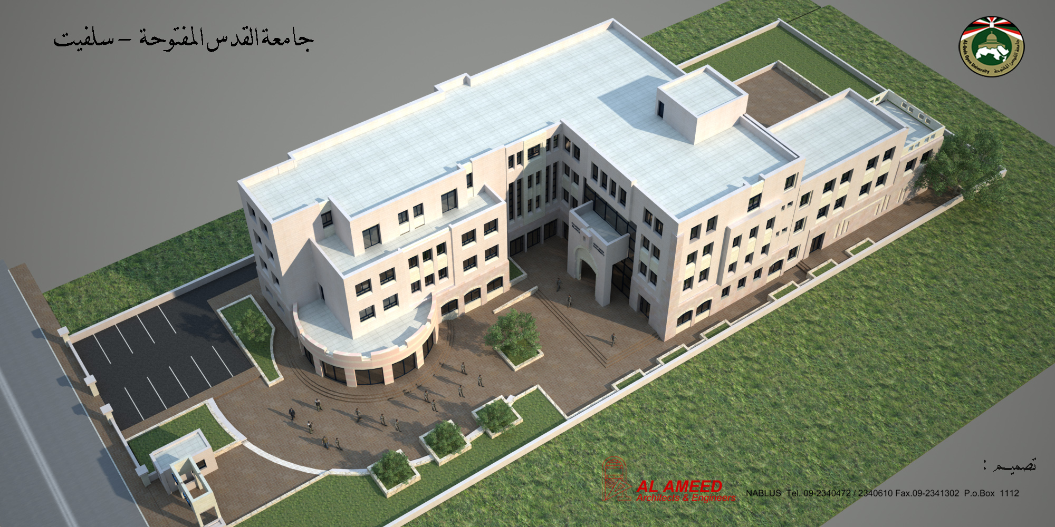
3D Architectural Model Of The Project

Slide 4
Outline
1
Introduction
2
Materials
3
Codes and Specifications
4
Loads and Load Combinations
5
Preliminary Dimensions of Structural Elements
6
Seismic Analysis
7
Design for Gravity and Seismic Loads

Slide 5
Introduction

Slide 6
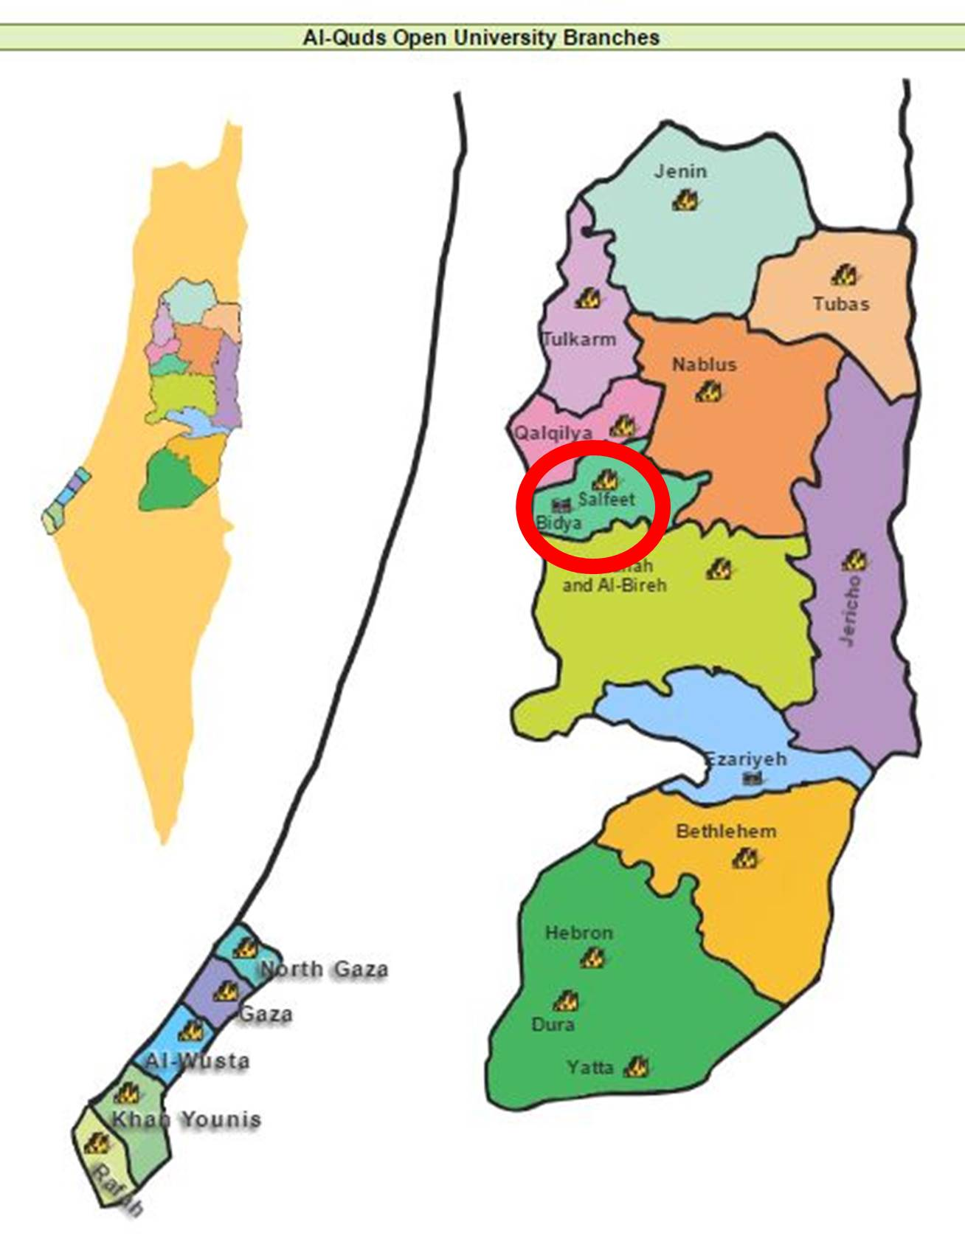
● Project Description
-One of Al-Quds Open University 19 branches.
-Educational , Social and Economical importance.
-Total area = 4887.5m²
-Total volume = 19745.54m³

Slide 7
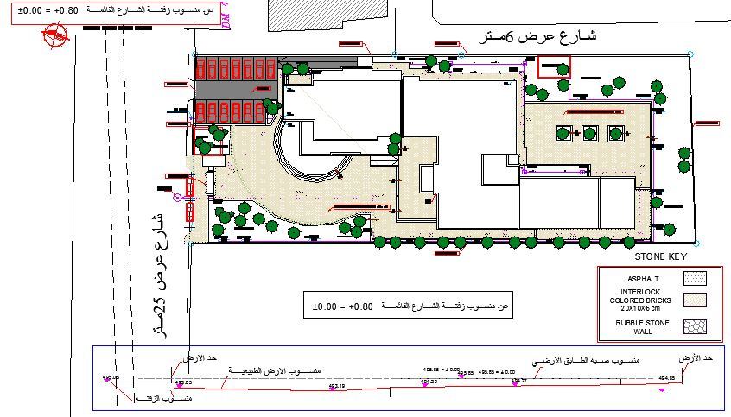
● Project Description - Site Plan

Slide 8
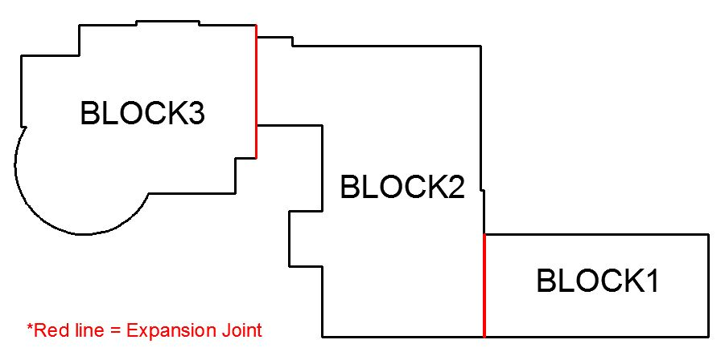
● Project Description - Blocks

Slide 9
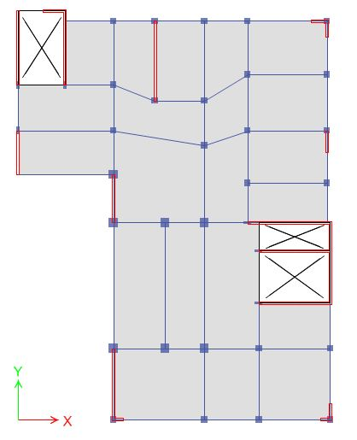
● Block(2) Plan View

Slide 10
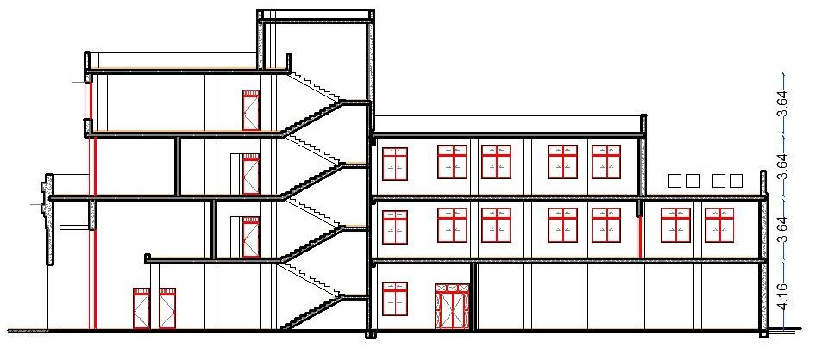
● Floors Heights

Slide 11
Materials

Slide 12
● Materials of Structural Elements:
1) Concrete:
E (MPa) | f'c (MPa) | Unit Weight (γ) (kN/m³) | Element | Material
23025.204 | 24 | 25 | Slabs, Beams | Concrete
24870.06 | 28 | 25 | Columns and Shear Walls
18800 | 16 | 25 | Base of Footings | Blinding Concrete
2) Reinforcing steel:
-Yield strength of steel (fy) =420MPa
-Modulus of elasticity (E) =200GPa

Slide 13
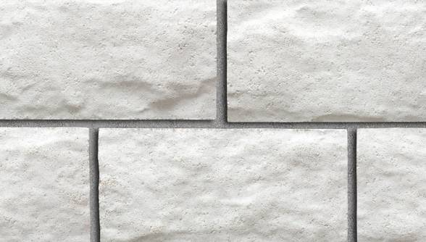
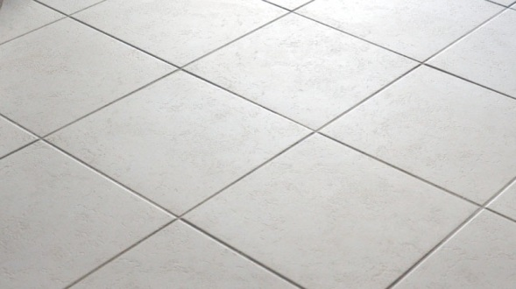

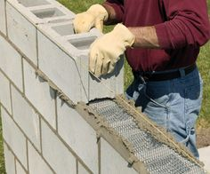
● Materials of Non-Structural Elements:
2) Masonry Stone {Unit weight (γ) = 27 kN/m³}
3) Tiles {Unit weight (γ) = 27 kN/m³}
4) Plastering {Unit weight (γ) = 20 kN/m³}
5) Mortar {Unit weight (γ) = 23 kN/m³}
6) Hollow Blocks {Unit weight (γ)= 12kN/m³:
Partitions and External Walls

Slide 14
Codes and Specifications

Slide 15
● The following codes and specifications were used:
1) American Concrete Institute Code (ACI 318-11).
2) American Society Of Civil Engineers (ASCE 7-10).
3) International Building Code (IBC-2012).
4) Jordanian Code

Slide 16
Loads

Slide 17
● Expected Loads on Structure:
Lateral Loads : Earthquake
Gravity Loads
1) Dead Load: Structure own weight.
2) Live load: 5 kN/m² is used for both blocks.
Occupancy or use | Live load (kN/m²)
Computer rooms | 4.79
Corridors | 4.79
Libraries: Reading rooms | 2.87
Offices | 2.4
Dining rooms and restaurants | 4.79
Gymnasium | 4.79
Classrooms | 1.92
First floor corridors | 4.79
Stadiums and arenas with fixed seats | 2.87

Slide 18
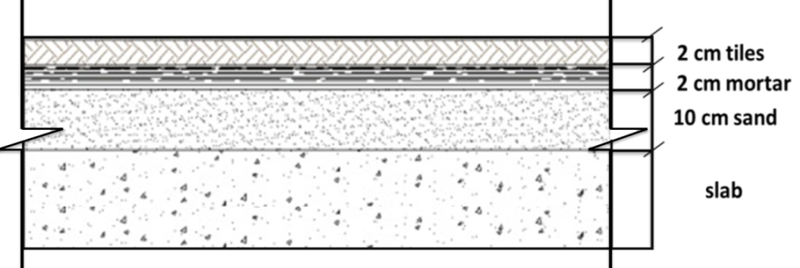
● Expected Loads on Structure:
3) Super imposed dead load:
-Floor Layers = 3.1 kN/m²
-Internal partitions = 12*0.1 = 1.2 kN/m²
-Plastering = 0.02*2*20 = 0.8kN/m²
→Total SD on slab = 3.1+1.2+0.8 = 5.1 kN/m²

Slide 19
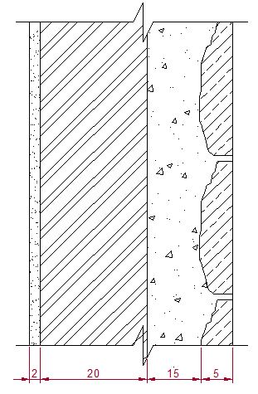
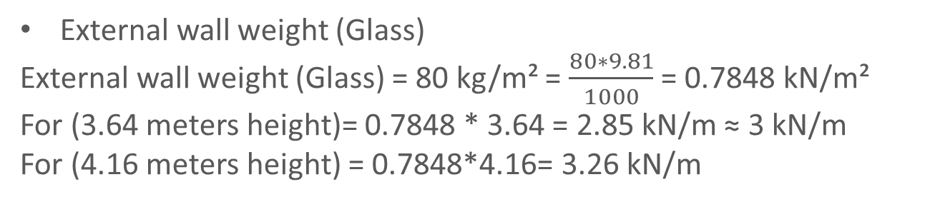
● Expected Loads on Structure:
External wall weight (Masonry)
=0.04*26+0.15*23+0.2*12+0.02*20= 6.4 kN/m²
For (3.64 meters height) = 6.4*3.64= 23.296 kN/m
For (4.16 meters height) = 6.4*4.16= 26.624 kN/m
External wall weight (Glass)
External wall weight (Glass) = 80 kg/m² = $\frac{80∗9.81}{1000}$ = 0.7848 kN/m²
For (3.64 meters height)= 0.7848 * 3.64 = 2.85 kN/m ≈ 3 kN/m
For (4.16 meters height) = 0.7848*4.16= 3.26 kN/m
Section in Masonry External Wall

Slide 20
Load Combinations

Slide 21
● Load Combinations:
According to the specifications ASCE7-10, the load combinations that are used in the design are given as follows:
Service Load Combinations | Ultimate Load Combinations
1. D | 1. 1.4D
2. D + L | 2. 1.2D + 1.6L + 0.5(Lr or S or R)
3. D + (Lr or S or R) | 3. 1.2D + 1.6(Lr or S or R) + (L or 0.5W)
4. D + 0.75L + 0.75(Lr or S or R) | 4. 1.2D + 1.0W + L + 0.5(Lr or S or R)
5. D + (0.6W or 0.7E) | 5. 1.2D + 1.0E + L + 0.2S
6a. D + 0.75L + 0.75(0.6W) + 0.75(Lr or S or R) | 6. 0.9D + 1.0W
6b. D + 0.75L + 0.75(0.7E) + 0.75S | 7. 0.9D + 1.0E
7. 0.6D + 0.6W
8. 0.6D + 0.7E

Slide 22

● 3D Analysis and Design was conducted using ETABS v16.3

Slide 23
Preliminary Dimensions of the Structural Member of of Block(2)

Slide 24
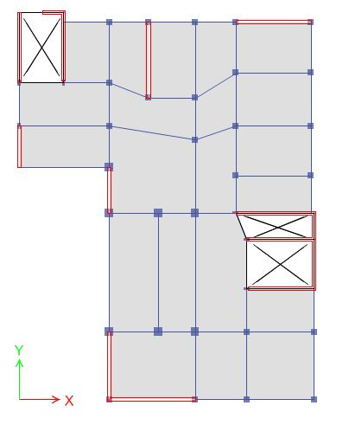
● Block(2) Plan View

Slide 25
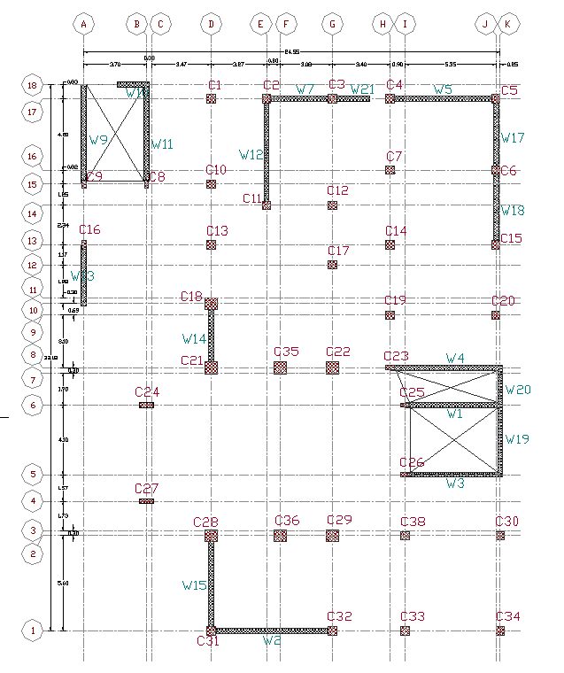
● First and Second Floor
Columns Layout

Slide 26
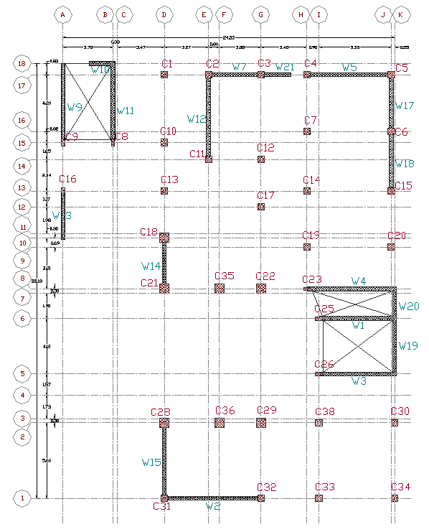
● Third and Fourth Floor
Columns Layout

Slide 27
● Preliminary Dimensions of Columns
Width (mm) | Depth (mm) | Column name | Column Group
700 | 700 | C21,C28,C29, C22,C18,C35,C36 | 1
500 | 500 | C1,C2,C3,C4,C5,C6,C7,C10 C11,C12,C13,C14,C15,C17, C19,C20,C30,C31,C32,C33, C34,C38 | 2
500 | 250 | C8,C9,C16,C23,C25,C26 | 3
800 | 300 | C24,C27 | 4

Slide 28
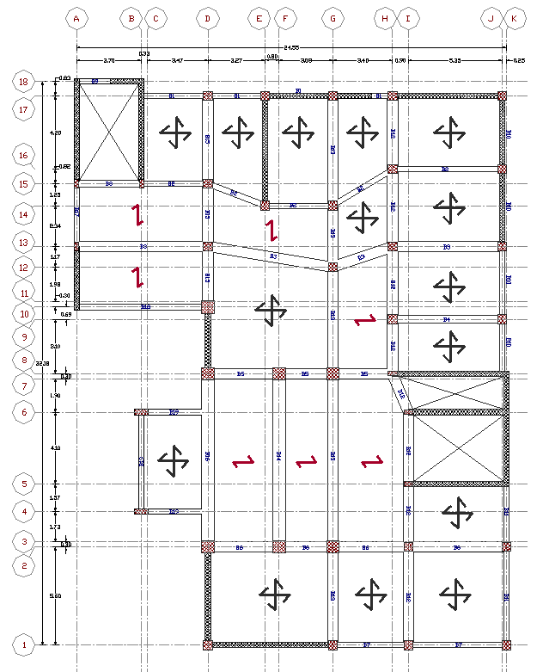
● Slab Load Path
solid slab
Slab thickness = 180 mm

Slide 29
● Preliminary Dimensions of Beams
Beam | B | H
B1 | 300 | 400
B2 | 300 | 500
B3 | 600 | 600
B4 | 400 | 500
B5 | 600 | 600
B6 | 600 | 600
B7 | 300 | 600
B8 | 400 | 500
B9 | 300 | 400
B10 | 300 | 400
B11 | 300 | 600
B12 | 600 | 600
B13 | 600 | 600
B14 | 700 | 700
B15 | 600 | 600
B16 | 700 | 700
B17 | 300 | 400
B18 | 300 | 700
B19 | 300 | 500
TB1 | 300 | 500
TB2 | 300 | 500
TB3 | 300 | 500

Slide 30
3D Checks of Block(2)

Slide 31
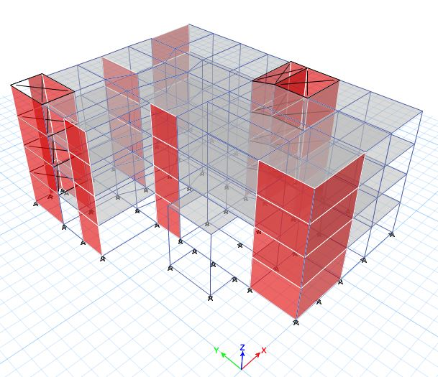
● 3D Model

Slide 32
● Modifiers
Element type | M11 | M22 | M12
Beam | 0.35 | 0.35 | 0.35
Column | 0.7 | 0.7 | 0.7
One way slab | 0.25 | 0.25 | 0.25
Two way slab | 0.25 | 0.25 | 0.25
Shear Walls | 0.7 | 0.7 | 0.7

Slide 33
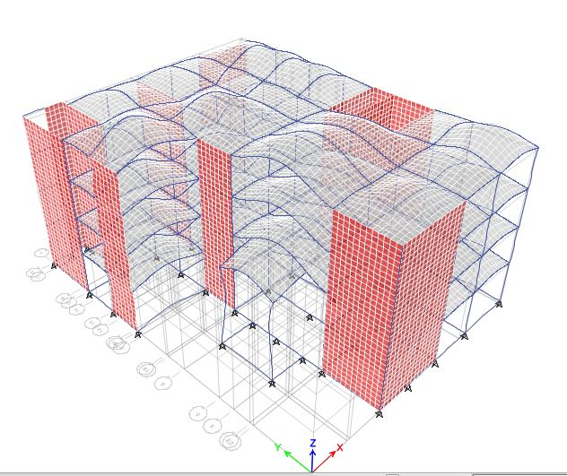
● 3D Checks:
-Compatibility Check

Slide 34
● 3D Checks:
-Equilibrium Check
%of Error | ETABS Value | Manual Value | Load
0.28% | 29113.95 | 29196.5 | Dead
0% | 11141.5 | 11141.5 | Live
0% | 20023.5 | 20023.51 | Superimposed Dead
3.4% | 186.67 | 193.32 | Snow

Slide 35
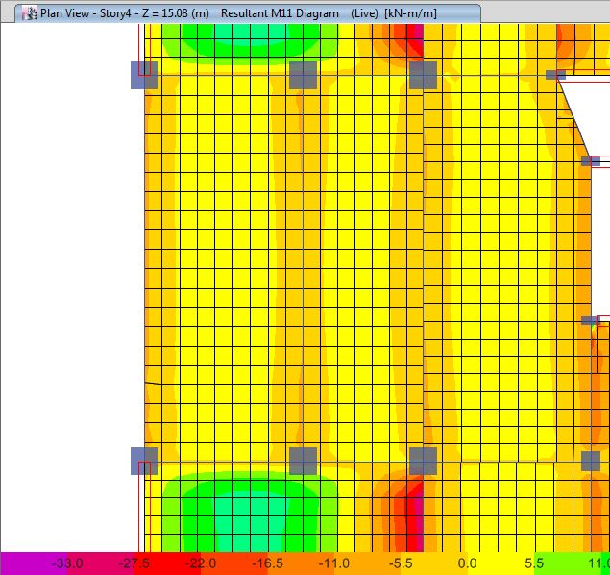
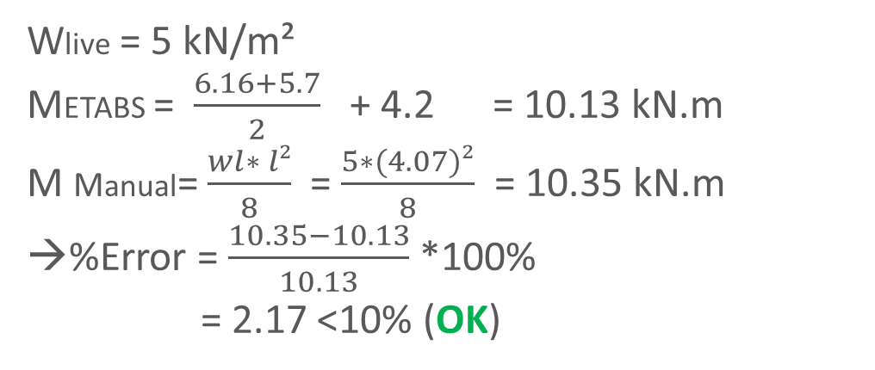
● 3D Checks:
-Stress Strain Check (Slab Check)
Wlive = 5 kN/m²
METABS = $\frac{6.16+5.7}{2}$ + 4.2 = 10.13 kN.m
M Manual= $\frac{wl∗ l²}{8}$ = $\frac{5∗(4.07)²}{8}$ = 10.35 kN.m
→%Error = $\frac{10.35−10.13}{10.13}$ *100%
= 2.17 <10% (OK)

Slide 36
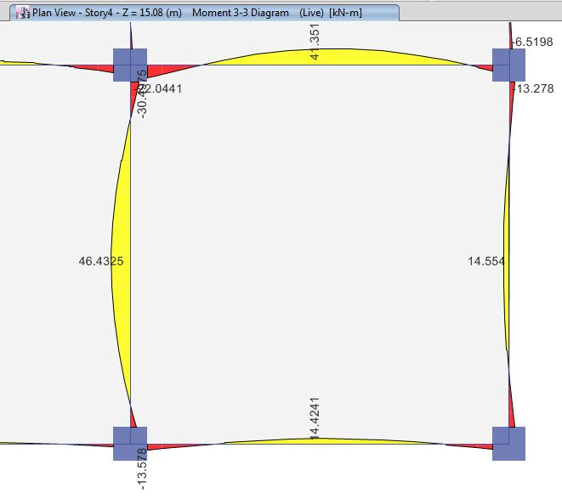
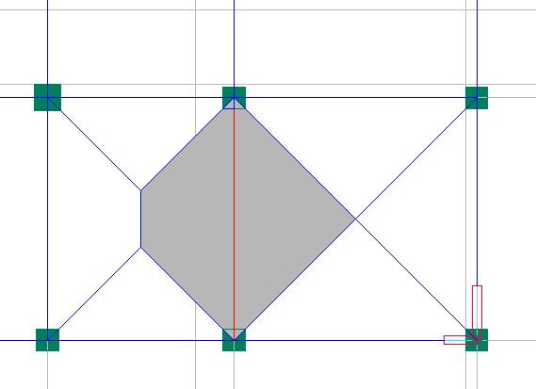
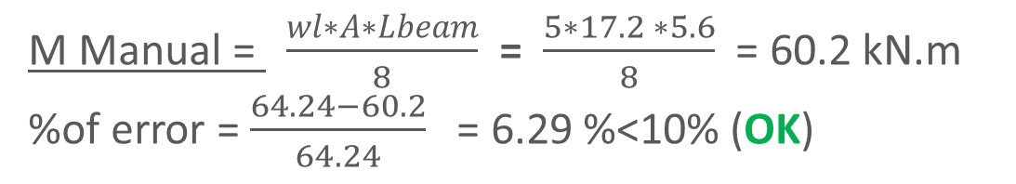

● 3D Checks:
-Stress Strain Check (Beams Check)
Beam ( Label B34) was chosen for this check
M Etabs = $\frac{22.0441+13.578}{2}$ + 46.4325 = 64.24 kN.m
M Manual = $\frac{wl∗A∗Lbeam}{8}$ = $\frac{5∗17.2 ∗5.6}{8}$ = 60.2 kN.m
%of error = $\frac{64.24−60.2}{64.24}$ = 6.29 %<10% (OK)
Tributary area of Beam(B34) = 17.2m²

Slide 37
Seismic Analysis

Slide 38
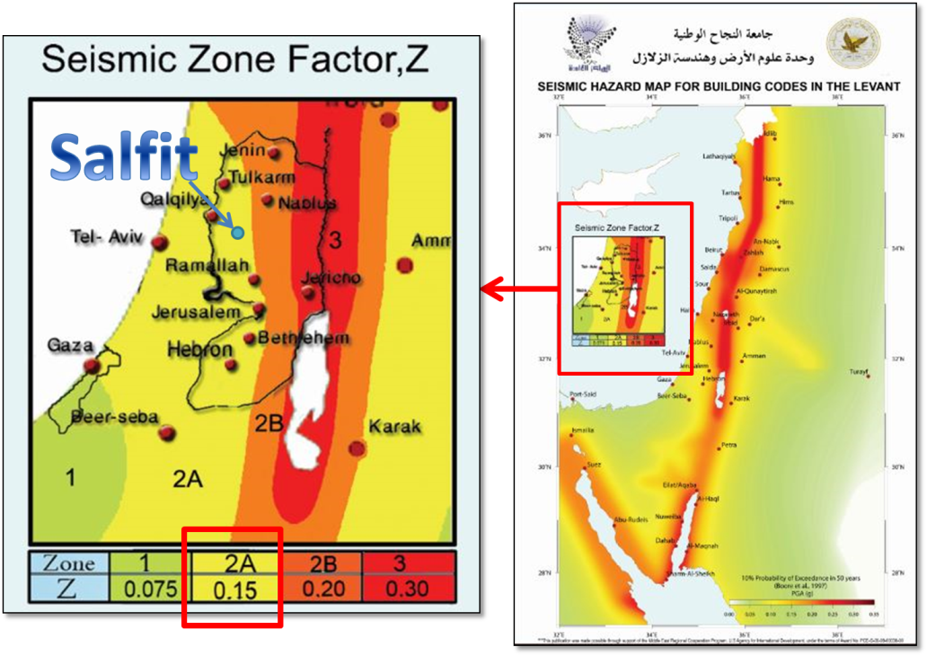
● Seismic Parameters
1- Risk Category : lll (ASCE7-10)
2- Mapped Acceleration Parameters
Z for Salfit = 0.15
S_{s} = 2.5 * Z (Israeli Code)
= 0.375
S₁ = 1.25 * Z (Israeli Code)
= 0.1875
Seismic Zone Factor (Z) – Palestinian Seismic Hazard Map - Earth Sciences and Seismic Center (ESSEC) at
An-Najah University

Slide 39
● Seismic Parameters
3- Soil Classification:
Allowable Bearing Capacity (Qall ) = 350 kN/m²
Soil Class (B)
4- Site Coefficients F_{a} and F_{V} (ASCE7-10)
F_{a} =1 and F_{V} =1
5- Maximum considered earthquake spectral response accelerations adjusted for site class effects (ASCE7-10) (10% probability of exceedance):
S_{MS} = F_{a}* S_{S} = 0.375
S_{M1} = F_{V} * S1 = 0.1875

Slide 40
● Seismic Parameters
6- Design Spectral Acceleration parameters:
S_{DS} = S_{MS}= 0.375
S_{D1} = S_{M1} = 0.1875
7- Seismic Design Category
From ASCE7-10 , SDC : C
8- Importance Factor
→ From ASCE7-10 (Table 1.5-2), Ie : 1.25

Slide 41
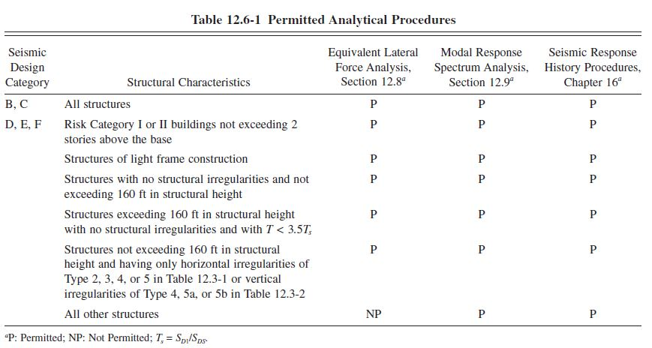
● Permitted Analytical Procedures
Table 12.6-1 in ASCE7-10

Slide 42
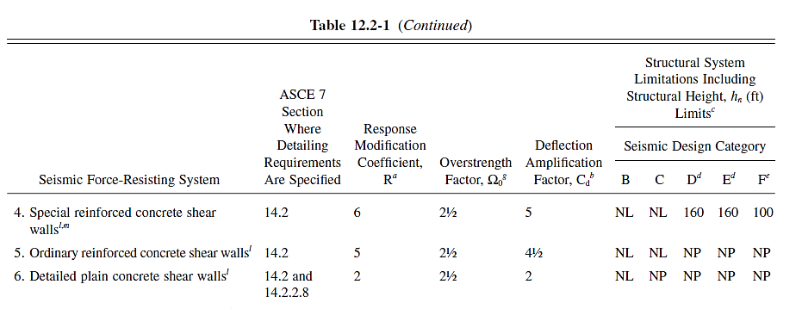
● Seismic Parameters
9- Response Modification Factor (R), Deflection Modification Factor (Cd) and
Over-strength Factor (Ω₀) :
Building Frame System coefficients - Table 12.2-1 - ASCE7-10

Slide 43
● Structural System Type Determination:
→ Using Equivalent Lateral Force procedure:
Direction | Shear wall reactions (kN) | Total Base shear(kN) | % of load
X-direction | 3973.63 | 4513.1 | 88%
Y-direction | 3998.61 | 4513.1 | 88.6%
→ The structural system is: Building frame system with ordinary reinforced concrete shear walls as assumed.

Slide 44

● Equivalent Lateral Force (ELF) Procedure:
1- Base Shear:
V = Cs * W (Equation (12.8-1) in ASCE7-10)
C_{s(seismic response coeff)}=$\frac{SDS}{\frac{R}{Ie}}=0.0937$
C_{s (max)} = $\frac{SD1}{T(\frac{R}{I})}$ = 0.17
C_{s (min)} = 0.044*S_{DS}*I_{e} ≥0.01
= 0.021 ≥0.01
0.021 < Cs = 0.0937 < 0.17 (OK)

Slide 45
● Equivalent Lateral Force (ELF) Procedure:
Base Shear:
Total(W)= 49749.86 kN
Weight (Manual) (kN) | Load Pattern
26940.98 | Dead
2785.37605 | 0.25*Live
20023.50557 | SD
49749.86 | Total weight (W)
The manual value of base shear
(V_{Manual}) = Cs * W = 0.0937*49749.86
= 4664.049kN
(V_{ETABS}) = 4513.029 kN
%Error = 3.34%

Slide 46
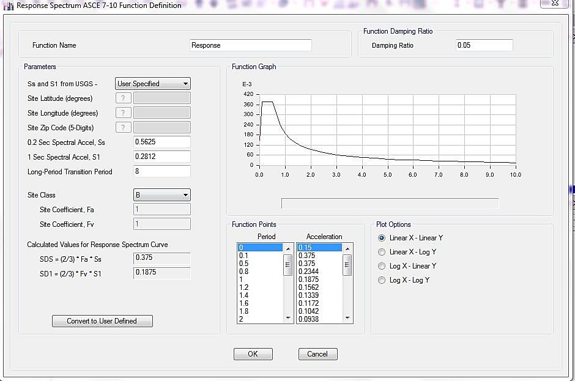
● Response Spectrum Analysis:

Slide 47
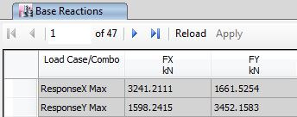
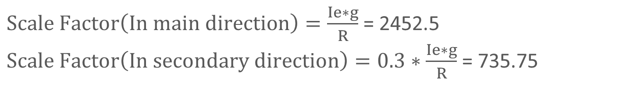
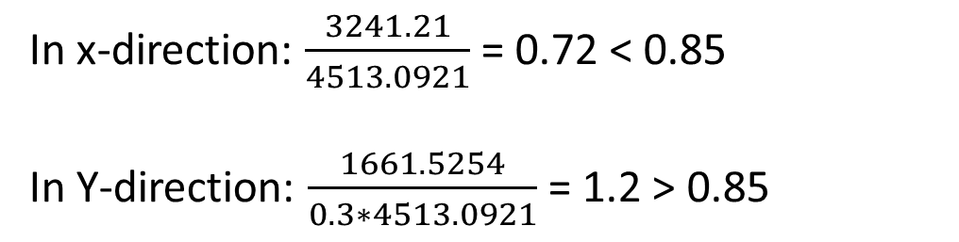
● Response Spectrum Analysis:
Base Shear:
$Scale Factor\left(In main direction\right)=\frac{Ie∗g}{R}$ = 2452.5
$Scale Factor\left(In secondary direction\right)=0.3∗\frac{Ie∗g}{R}$ = 735.75
→ ELF base shear = 4513.0921 kN
In x-direction: $\frac{3241.21}{4513.0921}$ = 0.72 < 0.85
In Y-direction: $\frac{1661.5254}{0.3∗4513.0921}$ = 1.2 > 0.85

Slide 48

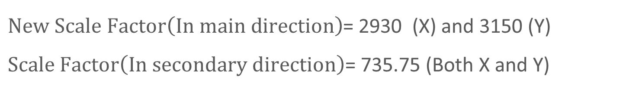
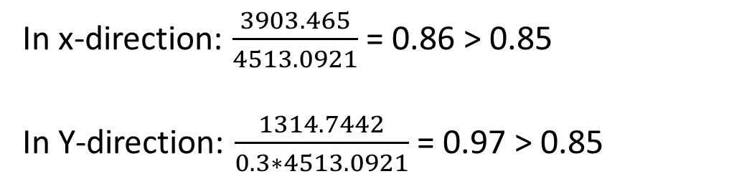
● Response Spectrum Analysis:
Base Shear:
$New Scale Factor\left(In main direction\right)$= 2930 (X) and 3150 (Y)
$Scale Factor\left(In secondary direction\right)$= 735.75 (Both X and Y)
In x-direction: $\frac{3903.465}{4513.0921}$ = 0.86 > 0.85
In Y-direction: $\frac{1314.7442}{0.3∗4513.0921}$ = 0.97 > 0.85

Slide 49
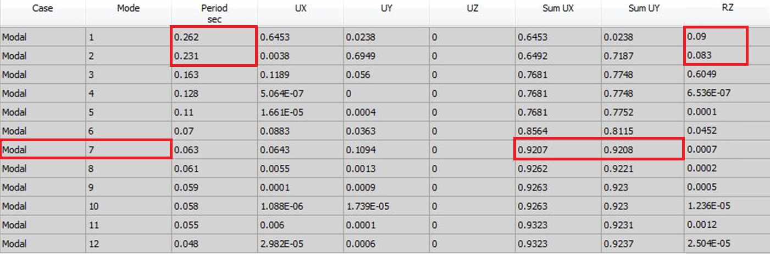
● Design Checks:
Period Check:
T ≤ Cu * Ta (ASCE)
T_{a} = C_{t}*h_{n}^{x}
C_{t} = 0.0488, x = 0.75
h_{n} = 15.08 m
T_{a} = 0.0488*15.08^{0.75}= 0.3734 sec
C_{u}*T_{a}=1.525*0.3734=0.5694 sec
Cu*Ta > T_{fundamental = 0.262 ➔ OK}

Slide 50
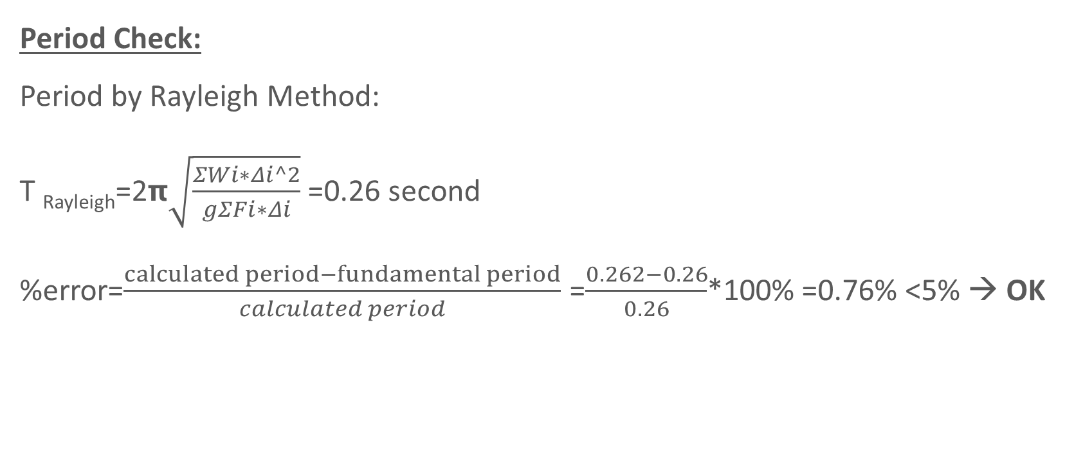
● Design Checks:
Period Check:
Period by Rayleigh Method:
T _{Rayleigh}=2𝝿$\sqrt{\frac{ΣWi∗Δi^2}{gΣFi∗Δi}}$=0.26 second
%error=$\frac{calculated period−fundamental period}{calculated period}$ =$\frac{0.262−0.26}{0.26}$*100% =0.76% <5% → OK

Slide 51
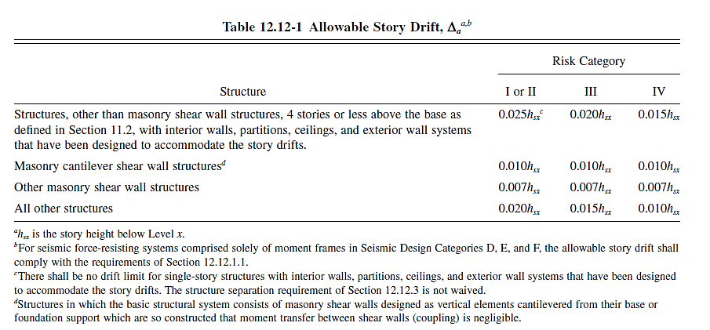

● Design Checks:
Drift Check:
𝞭_{x}=$\frac{Cd∗δxe}{Ie}$
Comparison with code limit | Inelastic Drift(y) | Inelastic Drift(x) | Story
<0.0624 m (OK) | 0.000462 | 0.000474 | Story1
<0.0546 m (OK) | 0.000618 | 0.00065 | Story2
<0.0546 m (OK) | 0.000716 | 0.000758 | Story3
<0.0546 m (OK) | 0.000702 | 0.000724 | Story4

Slide 52
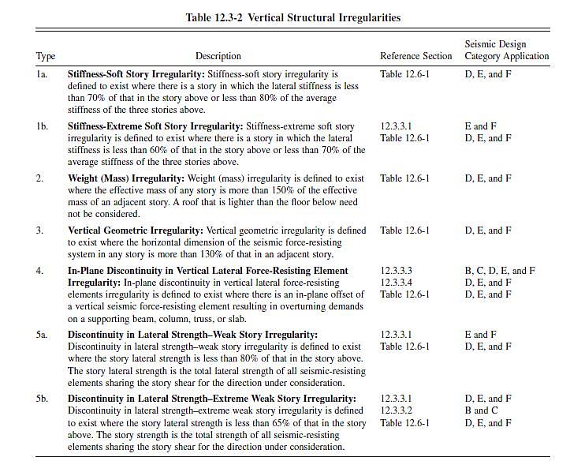
● Design Checks:
Vertical irregularities:
Model was checked and there is no
Vertical irregularities in the structure.

Slide 53
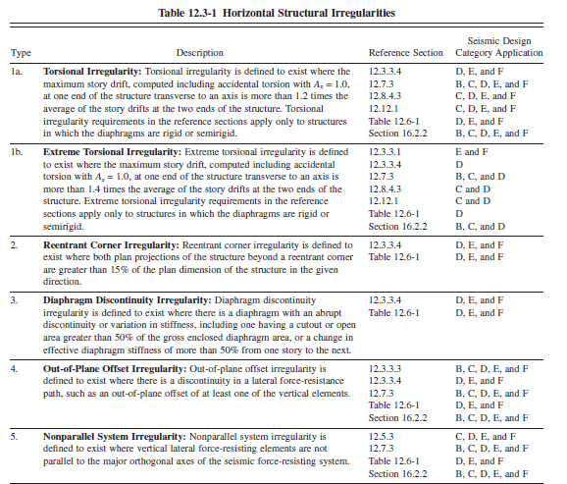
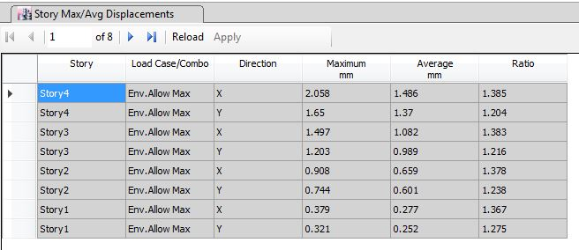
● Design Checks:
Horizontal irregularities:
The structure has only one horizontal
Irregularity type (1a) .

Slide 54
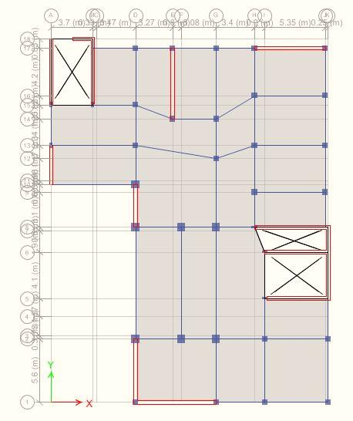
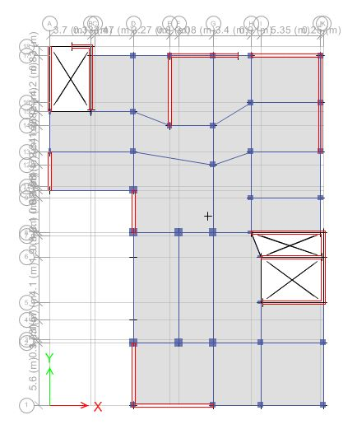
●Modification Of Model :
CM
CM
CR
CR

Slide 55
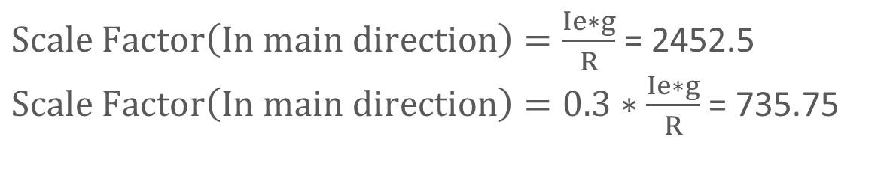

● Response Spectrum Analysis:
Base Shear:
$Scale Factor\left(In main direction\right)=\frac{Ie∗g}{R}$ = 2452.5
$Scale Factor\left(In main direction\right)=0.3∗\frac{Ie∗g}{R}$ = 735.75
ELF base shear = 4666.72 kN
$\frac{3970.6024}{ 4666.7259}$ = 0.85 → OK
$\frac{3967.4303}{4666.7259}$ = 0.85 → OK

Slide 56
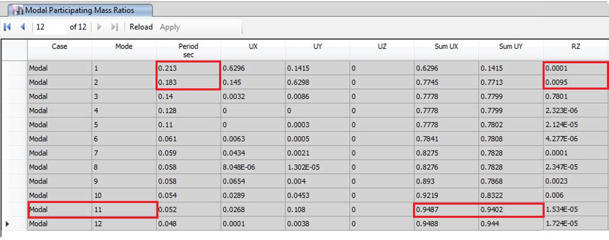

● Design Checks:
Period Check:
Cu*T_{a} = 1.525*0.3734
=0.5694 second
T_{fundamental} = T_{model} = 0.213sec
Ta > T_{fundamental ➔ OK}
T _{Rayleigh}=0.21 second
%error=$\frac{calculated period−fundamental period}{calculated period}$ =$\frac{0.213−0.21}{0.213}$*100% = 3.33 % <5% → OK

Slide 57
● Design Checks:
Drift Check:
𝞭_{x}=$\frac{Cd∗δxe}{Ie}$
Story number | Elastic drift x (m) | Elastic drift y (m) | Inelastic drift x (m) | Inelastic drift y (m) | Comparison
Story1 | 0.000193 | 0.000159 | 0.000386 | 0.000318 | <0.0624>>OK
Story2 | 0.000259 | 0.000209 | 0.000518 | 0.000418 | <0.0546>>OK
Story3 | 0.000281 | 0.000224 | 0.000562 | 0.000448 | <0.0546>>OK
Story4 | 0.00026 | 0.000209 | 0.00052 | 0.000418 | <0.0546>>OK

Slide 58
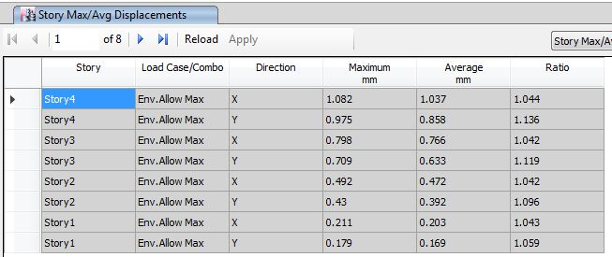
● Design Checks:
Structural irregularities:
Model was checked and there is No Vertical nor horizontal irregularities in the structure.

Slide 59
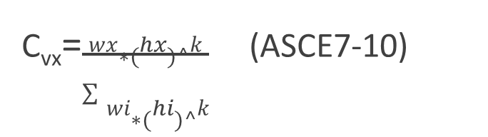
● Comparison of ELF and Response Spectrum Distribution of Base Shear:
F_{x}= C_{vx} * V (ASCE7-10)
C_{vx}=$\frac{wx∗(hx)^k}{\sum{wi∗(hi)^k}}$ (ASCE7-10)
Vertical Distribution of Seismic Forces – As per ASCE7-10:
Sum Fx | F_{x} (kN) | Base V (kN) | Cvx | W*hx | K | hx | Weight (kN) | story
4664.05 | 511.291 | 4664.049 | 0.1096 | 50107.63 | 1 | 4.16 | 12045.10 | 1
4152.759 | 1016.409 | 4664.049 | 0.2179 | 99610.28 | 1 | 7.8 | 12770.55 | 2
3136.35 | 1454.677 | 4664.049 | 0.3119 | 142561.5 | 1 | 11.44 | 12461.67 | 3
1681.673 | 1681.673 | 4664.049 | 0.3606 | 164807.6 | 1 | 15.08 | 10928.88 | 4
 |  |  | 1 | 457086.9 | TOTAL

Slide 60
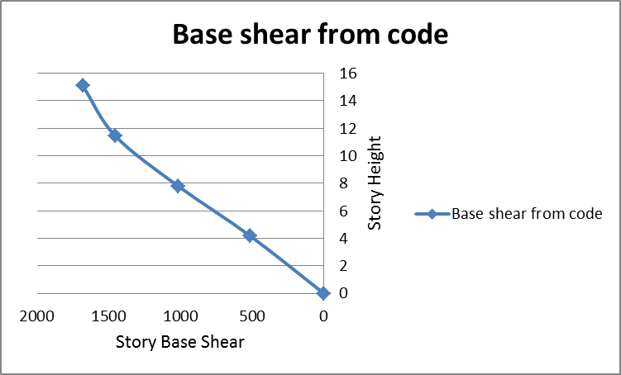


● Comparison of ELF and Response Spectrum Distribution of Base Shear:

Slide 61

● Deflection Check (Serviceability Check):
Table of Deflection Limits – ACI318-11

Slide 62


● Deflection Check (Serviceability Check):
λΔ = $\frac{\text{ξ}}{\text{(}\text{1 }\text{+ }\text{50}\text{∗}\text{ρ}\text{′)}} ($Equation (9-11) in ACI318-11code)
Multiplier of Long Term Deflection – ACI318-11 code
ξ = 2.0 represents a nominal time-dependent factor for a 5-year duration of loading.
The long term deflection(∆LT ) =∆L + ʎ*∆D + ʎT* ∆Ls
= ∆_{LT} =2*(∆ _{D}) + 1.25*(∆ _{L})

Slide 63

● Deflection Check (Serviceability Check):
Deflection Check for Slab:

Slide 64
● Deflection Check (Serviceability Check):
Deflection Check for Slab:
Panels Number | Dead Deflection {ETABS} (mm) | Superimposed dead deflection {ETABS} (mm) | Live Deflection {ETABS} (mm) | Immediate allowable value (mm) | Long-term allowable value (mm) | Long-term value {ETABS} (mm) | Comment
1 | 4.714 | 5.168 | 5.21 | 20.11 | 30.167 | 22.77 | OK
2 | 5.791 | 6.248 | 4 | 27.5 | 41.25 | 23 | OK
3 | 3.668 | 4.897 | 3.651 | 15.6 | 23.33 | 18 | OK

Slide 65

● Deflection Check (Serviceability Check):
Deflection Check for Beams:
→ Immediate Deflection (∆L = 3.694 mm < 55 mm) OK
∆ D = 6.065 mm and ∆ SD = 4.069mm
→ Long term deflection (∆LT) =24.9 mm < 41.25 mm (Long-term Deflection is OK).

Slide 66
Gravity and Seismic
Design

Slide 67
● Design for Gravity and Lateral Loads
The structural system is: Building frame system with ordinary reinforced concrete
shear walls and ordinary frames.
The structural members that were designed are:
1- Columns
2- Beams
3- Slabs (One way and two way solid slab)
4- Shear walls
5- Footings
6- Stairs

Slide 68

● Design for Gravity and Lateral Loads
Design of Columns
1-Sway –Non sway Check :
(Equation (10-10) in ACI318-11 code)
Stability Index Determination from lateral deflection in X-direction
story | Pu | Delta (x) | Vu | Lc | Pu*delta | Vu*Lc | Q | comparison
1 | 12045.1 | 0.000193 | 4664.05 | 4.16 | 2.30 | 19402.45 | 0.0001198 | Q<0.05 (Non-sway)
2 | 12770.55 | 0.000259 | 4152.759 | 3.64 | 3.31 | 15116.00 | 0.0002188 | Q<0.05 (Non-sway)
3 | 12461.67 | 0.000281 | 3136.35 | 3.64 | 3.50 | 11416.30 | 0.0003067 | Q<0.05 (Non-sway)
4 | 10928.88 | 0.00026 | 1681.673 | 3.64 | 2.84 | 6121.30 | 0.0004642 | Q<0.05 (Non-sway)
Stability Index Determination from lateral deflection in Y-direction
story | Pu | Delta (y) | Vu | Lc | Pu*delta | Vu*Lc | Q | comparison
1 | 12045.1 | 0.000159 | 4664.05 | 4.16 | 1.92 | 19402.45 | 9.87E-05 | Q<0.05 (Non-sway)
2 | 12770.55 | 0.000209 | 4152.759 | 3.64 | 2.67 | 15116.00 | 0.00017657 | Q<0.05 (Non-sway)
3 | 12461.67 | 0.000224 | 3136.35 | 3.64 | 2.80 | 11416.31 | 0.000244511 | Q<0.05 (Non-sway)
4 | 10928.88 | 0.000209 | 1681.673 | 3.64 | 2.28 | 6121.30 | 0.000373146 | Q<0.05 (Non-sway)

Slide 69




● Design for Gravity and Lateral Loads
Design of Columns
$\frac{K∗lu}{r}$≤ 34 – 12 *$\frac{M1}{M2}$ ≤ 40
(Equation (10-7) in ACI318-11 Code
2- Slenderness Check :
Sample Calculation: Column (C29)
P_{u}=1316.5 kN
M1= 75.2 kN.m
M2=192.6 kN.m
→ K = 1 (Conservatively)
$\frac{K∗L}{r}$ = $\frac{1∗4.16}{0.3∗0.7}$ = 19.8
34 – 12 * $\frac{M1}{M2}$ = 34 – 12 * $\frac{75.2}{192.6}$ = 29.4
→$\frac{K∗L}{r}$ =19.8< 29.4 < 40 → (OK)
→Column is consider short.

Slide 70
● Design for Gravity and Lateral Loads
Design of Columns
3- Shear on columns from the seismic load
Vc = 0.17 * (1+$\frac{Nu}{14∗Ag}$ ) λ * $\sqrt{f′c}$ *bw * d (Equation (11-4) in ACI318-11 code)
Vu/ᴓ | Vu/ᴓ | Vc | d | h | bw | Ag | Nu | Vu(S33) | Vu (S22) | column
35.33 | 108.00 | 105.74 | 430.00 | 500.00 | 250.00 | 125000.00 | 163500.00 | 26.50 | 81.00 | 50*25
19.33 | 8.13 | 207.77 | 730.00 | 800.00 | 300.00 | 240000.00 | 183700.00 | 14.50 | 6.10 | 30*80
78.67 | 109.47 | 253.09 | 430.00 | 500.00 | 500.00 | 250000.00 | 1080100.00 | 59.00 | 82.10 | 50*50
468.00 | 88.45 | 472.84 | 630.00 | 700.00 | 700.00 | 490000.00 | 1316500.00 | 351.00 | 66.34 | 70*70
Vc > $\frac{Vu}{ᴓ}$ , so minimum shear reinforcement can be used

Slide 71
● Design for Gravity and Lateral Loads
Design of Columns
Ties in the middle of column | Ties near supports | As | As | As Required | ρ | Width | Depth | Columns | Group
 |  | used | of the | (mm²) |  | (mm) | (mm) | Labels | Number
 |  | (mm²) | column
2 φ10/ 200 mm | 2 φ10/ 100 mm | 4908.74 | 16 φ20 | 4900 | 1% | 700 | 700 | C21,C28 | 1
 |  |  |  |  |  |  |  | C29,C22
 |  |  |  |  |  |  |  | C18,C35
 |  |  |  |  |  |  |  | C36
2 φ10/ 200 mm | 2 φ10/ 100 mm | 2513.27 | 8 φ20 | 2500 | 1% | 500 | 500 | C1,C2, C3,C4 | 2
 |  |  |  |  |  |  |  | C5,C6, C7,C10
 |  |  |  |  |  |  |  | C11, C12, C13,C14
 |  |  |  |  |  |  |  | C15,C17
 |  |  |  |  |  |  |  | C19,C20
 |  |  |  |  |  |  |  | C30,C31
 |  |  |  |  |  |  |  | C32,,C33
 |  |  |  |  |  |  |  | C34,C38
2 φ10/ 200 mm | 2 φ10/ 100 mm | 1608.5 | 8 φ16 | 1250 | 1% | 500 | 250 | C8,C9, | 3
 |  |  |  |  |  |  |  | C16,C23
 |  |  |  |  |  |  |  | C25,C26
2 φ10/ 200 mm | 2 φ10/ 100 mm | 2513.27 | 10 φ18 | 2400 | 1% | 800 | 300 | C24,C27 | 4

Slide 72

● Design for Gravity and Lateral Loads
Design of Columns
Sample Design (Column C29)
Dimensions : Square (70X70)cm
L= 4.16m
Ultimate Axial (P_{u})= 1316.5 kN
Axial Capacity (Ø P_{n,max})= Øλ (0.85 fc` (Ag-As) +fyAs) = 7073.76 kN
Reinforcement Ratio = 1%
A_{s} = 4900 mm² (16 Ø 20)

Slide 73



● Design for Gravity and Lateral Loads
Design of Columns
Sample Design (Column C29)

Slide 74


● Design for Gravity and Lateral Loads
Design of Beams
Sample calculation (B16)
From ETABS:
M+= 347.8141 kN.m → ρ= 0.00332
As = 0.00332*700*640 = 1486.1 mm² (6ᴓ18)
ETABS As = 1511 mm² (6ᴓ18) (OK)

Slide 75
● Design for Gravity and Lateral Loads
Design of Beams
Beams | Width (mm) | Depth (mm) | Φ (Top steel) | Φ (Bottom Steel) | Reinforcement near supports | Reinforcement at the middle
B1 | 300 | 400 | 4ϕ12 | 4ϕ12 | 1φ10/12 | 1φ10/25
B2 | 300 | 500 | 4ϕ12 | 4ϕ12 | 1φ10/12 | 1φ10/25
B3 | 600 | 600 | 6ϕ16 | 6ϕ16 | 1φ10/20 | 1φ10/25
B4 | 400 | 500 | 4ϕ16 | 4ϕ14 | 1φ10/15 | 1φ10/25
B5 | 600 | 600 | 6ϕ16 | 6ϕ16 | 1φ10/20 | 1φ10/25
B6 | 600 | 600 | 6ϕ16 | 6ϕ16 | 1φ10/20 | 1φ10/25
B7 | 600 | 300 | 4ϕ14 | 4ϕ14 | 1φ10/12 | 1φ10/25
B8 | 400 | 500 | 4ϕ14 | 4ϕ14 | 1φ10/15 | 1φ10/25
B9 | 300 | 400 | 4ϕ12 | 4ϕ12 | 1φ10/12 | 1φ10/25
B10 | 300 | 400 | 4ϕ12 | 3ϕ12 | 1φ10/12 | 1φ10/25
B11 | 300 | 600 | 3ϕ16 | 3ϕ16 | 1φ10/20 | 1φ10/25
B12 | 600 | 600 | 6ϕ16 | 6ϕ16 | 1φ10/20 | 1φ10/25
B13 | 600 | 600 | 6ϕ25 | 6ϕ16 | 1φ10/20 | 1φ10/25
B14 | 700 | 700 | 7ϕ20 | 6ϕ18 | 1φ10/20 | 1φ10/25
B15 | 600 | 600 | 6ϕ16 | 6ϕ16 | 1φ10/20 | 1φ10/25
B16 | 700 | 700 | 7ϕ22 | 6ϕ18 | 1φ10/20 | 1φ10/25
B17 | 300 | 400 | 3ϕ12 | 3ϕ12 | 1φ10/15 | 1φ10/20
B18 | 300 | 700 | 3ϕ18 | 4ϕ16 | 1φ10/20 | 1φ10/25
B19 | 300 | 500 | 4ϕ12 | 4ϕ16 | 1φ10/20 | 1φ10/25
TB-1 | 300 | 500 | 3ϕ18 | 4ϕ12 | 1φ10/7 | 1φ10/10
TB-2 | 300 | 500 | 2ϕ25 | 4ϕ18 | 1φ10/5 | 1φ10/7
TB-3 | 300 | 500 | 3ϕ14 | 3ϕ14 | 1φ10/10 | 1φ10/22

Slide 76
● Design for Gravity and Lateral Loads
Design of Beams
Design Key
Based on the ACI318-11 code in section (21.2.2), Beams shall have at least two of the longitudinal bars continuous along both the top and bottom faces. These bars shall be developed at the face of support.

Slide 77

● Design for Gravity and Lateral Loads
Design of Beams
Sample Design (B6)

Slide 78



● Design for Gravity and Lateral Loads
Design of Slab
: Slab check for shear:
ᴓVc = $\frac{0.75}{6}$ * $\sqrt{24}$ * 1000*140 = 85.732 kN
All of shear values are < 85.732 kN (OK)

Slide 79

● Design for Gravity and Lateral Loads
Slab
(Design For Moments): (X-Direction)
Positive Steel: 4∅12/m
Negative Steel:
For M=13.1 kN.m or less (4∅12/m)
For M= 35 kN.m (5∅14/m)
For M= 30 kN.m (4∅14/m)

Slide 80

● Design for Gravity and Lateral Loads
Slab
(Design For Moments): (Y-Direction)
Positive Steel: 4∅12/m
Negative Steel:
For M = 22 kN.m or less (4∅12/m)
For M = 24 kN.m (5∅12/m).

Slide 81

● Design for Gravity and Lateral Loads
Shear wall
Sample Calculation, Shear Wall (W15)
Dimensions:
L=5050mm ,Thickness=300mm
Pultimate =3252.7kN ,Muy=99kN.m, Mux=1700kN.m
Vux=63.9kN , Vuy=918.5kN
Check shear in x-direction:
ᴓVc = $\frac{0.75}{6}$ * $\sqrt{24}$ * (300-40)*$\frac{5050}{1000}$ = 804 kN > Vux (OK)
Vc = 1072*0.8 = 857.8 kN

Slide 82

● Design for Gravity and Lateral Loads
Shear wall
Design for shear in y-direction {Horizontal Reinforcement}:
Vs = $\frac{Vuy}{ᴓ}$ - Vc = $\frac{918.4618}{0.75}$ – 857.8 = 366.82 kN
→ $\frac{Av}{s}$= 0.25 → $\frac{0.25}{300}$ = 0.00038 < 𝜌𝑡 (minimum steel ratio from ACI318-11 code ) = 0.0025
→ use 𝜌=0.0025
As = 0.0025 *300*5050 = 3787.5 mm²
Assume (2ᴓ12)/250 mm → $\frac{As}{Av}$ = $\frac{3787.5}{226.2}$ = 16.74
(17ᴓ12 in each layer ) (1 ᴓ 12 / 250 mm )

Slide 83

● Design for Gravity and Lateral Loads
Shear wall
Design for moment Muy:
As = $\frac{Muy}{ᴓFy (d−d^{′})}$ = $\frac{99∗10^6}{0.9∗420∗ (260−40)}$ = 1190.5 mm²
Design for axial force and moment around X axis {Vertical Reinforcement}
Shear wall was modeled in ETABS as a column to get the interaction diagram for the shear wall. The column was assigned to concentrated force (Pu = 3252.7 kN) and (Mux= 1700 kN.m)

Slide 84



● Design for Gravity and Lateral Loads
Shear wall
Interaction Diagram Data Representation in EXCEL Interaction Diagram from ETABS
(1700, 3252.7)
As (from Pu and Mux) = 0.0025 *300*5050 = 3787.5 mm²
Total Vertical Steel = 1190.5+3787.5 = 4978 mm²
For one layer → $\frac{4978}{2}$ = 2489 mm² (17ᴓ14) = (1 ᴓ14 / 250 mm)

Slide 85
● Design for Gravity and Lateral Loads
Shear wall
Shear walls were assigned as piers in ETABS and they were designed as ordinary shear walls. The following table shows the values of horizontal and vertical reinforcement from ETABS
Shear Wall Group | Spacing between bars | Vertical Bars | Vertical Reinforcement (2 layers) | Spacing between bars | Horizontal Bars | Horizontal (2layers) (mm²/m) | Pier# | Wall Label
SW1 | 20 cm | 5∅12/m | 5655 | 30 cm | 4∅12/m | 750 | P1 | W9
SW1 | 20 cm | 5∅12/m | 3393 | 30 cm | 4∅12/m | 750 | P2 | W13
SW1 | 20 cm | 5∅12/m | 5429 | 30 cm | 4∅12/m | 750 | P3 | W15
SW1 | 20 cm | 5∅12/m | 1810 | 30 cm | 4∅12/m | 750 | P4 | W10
SW1 | 20 cm | 5∅12/m | 5429 | 30 cm | 4∅12/m | 750 | P5 | W11
SW2 | 18 cm | 6∅12/m | 3619 | 30 cm | 4∅12/m | 750 | P6 | W14
SW1 | 20 cm | 5∅12/m | 5881 | 30 cm | 4∅12/m | 750 | P7 | W12
SW1 | 20 cm | 5∅12/m | 3845 | 30 cm | 4∅12/m | 750 | P8 | W7
SW1 | 20 cm | 5∅12/m | 2262 | 30 cm | 4∅12/m | 750 | P9 | W21
SW1 | 20 cm | 5∅12/m | 5881 | 30 cm | 4∅12/m | 750 | P10 | W5
SW1 | 20 cm | 5∅12/m | 4072 | 30 cm | 4∅12/m | 750 | P11 | W17
SW1 | 20 cm | 5∅12/m | 4298 | 30 cm | 4∅12/m | 750 | P12 | W18
SW1 | 20 cm | 5∅12/m | 6107 | 30 cm | 4∅12/m | 750 | P13 | W4
SW2 | 18 cm | 6∅12/m | 2262 | 30 cm | 4∅12/m | 750 | P14 | W20
SW1 | 20 cm | 5∅12/m | 5429 | 30 cm | 4∅12/m | 750 | P15 | W1
SW1 | 20 cm | 5∅12/m | 4072 | 30 cm | 4∅12/m | 750 | P16 | W19
SW1 | 20 cm | 5∅12/m | 5203 | 30 cm | 4∅12/m | 750 | P17 | W3
SW1 | 20 cm | 5∅12/m | 6786 | 30 cm | 4∅12/m | 750 | P18 | W2

Slide 86

● Design for Gravity and Lateral Loads
Shear wall

Slide 87

● Design for Gravity and Lateral Loads
Footings
1- Single
2- Combined
3-Wall Footings

Slide 88



● Design for Gravity and Lateral Loads
Footings: Single Footings
Single footing of column (C12)
P service = 1511 kN
P ultimate = 1768.90 kN
P ultimate(including self-weight) = 1768.9 + 0.1*1768.9
= 1945.79 kN
Area of footing:
A_{footing} = $\frac{Pservice}{qall}$ = $\frac{1511}{350}$ = 4.32 m² (2.2*2.2 m²)
→ New A_{footing} = 2.2 * 2.2 = 4.84 m²
L1
qu = $\frac{Pu}{A}$ qu = $\frac{1945.79}{4.84}$ = 402 kN/m²
L₁ = (2.2-0.5)/2 = 0.85 m

Slide 89


● Design for Gravity and Lateral Loads
Footings: Single Footings
Single footing of column (C12)
Thickness of footing:
Wide beam shear:
ᴓVc = $\frac{0.75}{6}$ * $\sqrt{24}$ * 1000*d (1)
Vu = qu * (L₁-d) (2)
→ From (2) and (30), d= 0.85 m
Punching Shear Check:
L1
Vu,p = Pu - qu*A1 = 1214.51 kN
ᴓVc,p ≤ ᴓ (0.17) * (1+$\frac{2}{β}$ ) * $\sqrt{f′c}$ * b0 * $\frac{d}{1000}$ = 8579.71 kN
≤ ᴓ (0.83) * ($\frac{αs∗d}{b0}$ ) * $\sqrt{f′c}$ * b0 * $\frac{d}{1000}$ =87865.98 kN
≤ ᴓ (0.33) * $\sqrt{f′c}$* b0 * $\frac{d}{1000}$ = 5551.58 kN > Vu,p = 1214.51 kN (OK)
→ H = 1m

Slide 90


● Design for Gravity and Lateral Loads
Footings: Single Footings
Design for Flexure :
Mu = $\frac{qu∗L1²}{2}$ = 145.23 kN.m → ρ= 0.000535 < ρmax 0.0155 (OK)
As = 454.75 mm² < As(min) = 1800 mm²
→ Use As min = 1800 mm² { 1ᴓ16 / 100 mm }
→ Shrinkage steel {1ᴓ16 / 100 mm }
Checking development length :
Ldt = $\frac{0.48∗fy∗db}{\sqrt{f′c}}$ = 658 mm > 300 mm (OK)
L₁ = 0.85
L = 0.85 – 0.05 = 0.8 m > 0.658

Slide 91


● Design for Gravity and Lateral Loads
Footings: Single Footings

Slide 92

● Design for Gravity and Lateral Loads
Stairs:
Practical reinforcement for the stairs was used:

Slide 93
THANK YOU ☺

