Slide 1
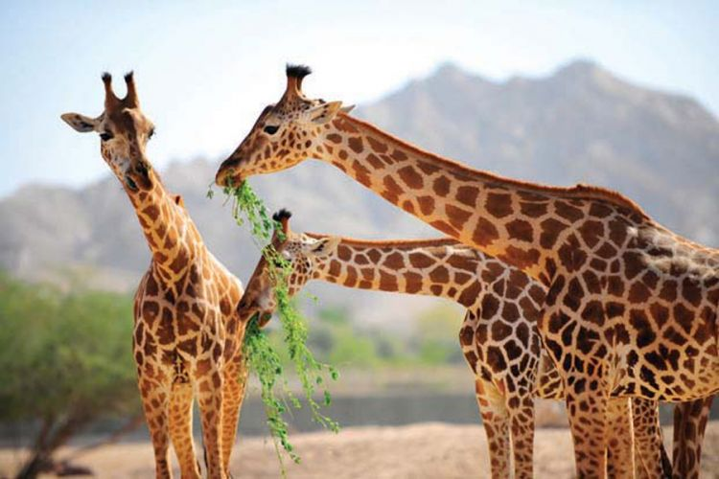
An-Najah National University
Faculty of Engineering & Information Technology
Industrial Engineering Department
Implementation of Lean Services principles Using Balanced Scorecard Concepts: The Case of Qalqilia Zoo.
Supervisor: Dr. Ayham Jaaron

Slide 2
Our Team
Ameera Alsaad
Lamees Saleh
Roula Qassab
Ashwaq Mousa
Duaa Ordoneya

Slide 3
1
Introduction
2
Problem Statement
3
Objectives
Outline
4
Methodology
5
Results and Analysis
6
Conclusion and Recommendation

Slide 4
Introduction
The tourism sector plays an important role in reflecting the cultural and entertainment sides in Palestine. It also contributes prominently in improving the economic and social sides.
we seek to improve a well-known tourism site and a natural reserve that includes a variety of animals in the west bank which is Qalqilia zoo.

Slide 5
Introduction
Lean thinking is generally related to doing the best practices and processes which optimizing resources that yields the best service with least waste and at the lowest cost.
The Balanced Scorecard (BSC) is a performance measurement system that was created in 1990 by Kaplan and Norton. It aims at measuring how well the organization is doing in view of competing stakeholder needs.

Slide 6
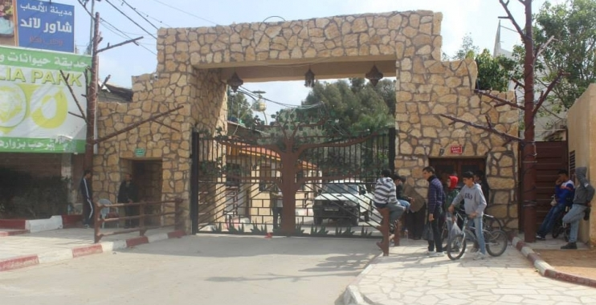
Qalqilia Zoo
Founded in 1986 with an area of 50 Acres.
The visitor finds in it animals, recreational integrated city, also it includes family meeting place, it also includes games and special pool for the children, and restaurant for visitor’s services.
it has scientific, geology, space and agriculture museums, and the establishment of Palestinian Medical Wildlife.
The zoo is being an important tourist site as the only, biggest in Palestine.
The Zoo contains 60 kinds of animals, 30 kinds of mammals, 7 kinds of reptiles, 22 kinds of birds, and one kind of amphibians.

Slide 7
Problem Statement
1
Delays in necessary processes within the Zoo.
2
No clear procedures or step by step instructions related to ranching animals and maintaining the Zoo fixtures.
3
Low level of quality in plans and arrangements of the Zoo layout.

Slide 8
Problem Statement
4
The atmosphere sometimes affects the animals negatively . Some animals couldn't live at high or low temperatures as they used to.
5
Animals are fed by visitors in a wrong way, which causes disorders in the diets that are served to them by dieticians.

Slide 9


Objectives
Documentation of the steps for each operation.
1
Improve layout
2
Eliminate NVA activities.
3
Reduce delay
4
Improve the services provided through the development of the current management system
5

Slide 10





Methodology
Kick-off Meetings
System Understanding
Observation & Data Collection
Data Analysis and tools application
Solutions and findings stages
Stage 01
Stage 02
Stage 03
Stage 04
Stage 05

Slide 11
Kick-off Meetings
System Understanding
Observation & Data Collection
Data Analysis and tools application
Solutions and findings stages
Stage 01
Kick-off Meetings
With the zoo general director.
With the vet.

Slide 12
Kick-off Meetings
System Understanding
Observation & Data Collection
Data Analysis and tools application
Solutions and findings stages
Stage 02
System Understanding
Understanding the overall processes in the zoo, including managerial processes about the animal.

Slide 13
Kick-off Meetings
System Understanding
Observation & Data Collection
Data Analysis and tools application
Solutions and findings stages
Stage 03
Observation & Data Collection
Interviews
Process tracking
Work watches
Questionnaire

Slide 14
Kick-off Meetings
System Understanding
Observation & Data Collection
Data Analysis and tools application
Solutions and findings stages
Stage 04
Data Analysis and tools application
Optimizing process Flowcharts.
Value Stream Mapping.
Judoka.
Kaizen.
  5S.
Key Performance Indicator.

Slide 15
Kick-off Meetings
System Understanding
Observation & Data Collection
Data Analysis and tools application
Solutions and findings stages
Stage 05
Solutions and findings stages
Results gained from applying each of the previous tools

Slide 16
Questionnaire:
Questionnaires have been developed and completed
by the targeted entities
The questionnaire contained 2 parts. The first part has 10 questions related to employees’ challenges and problems they face during their work day. The second part is 17 questions special to understand the visitors’ level of expectation and their satisfaction with the services provided 25 employees and 160 visitors participated in the questionnaire and provided excellent data and feedback. Using Destructive Statistics and SPSS programs we were able to analyze the data.

Slide 17
Questionnaire:
The questionnaire poll is the first step taken to prove that the current process and procedures are failing to satisfy visitors and staff needed.
Through a questionnaire poll we were able to obtain information regarding the zoo visitors’ impression on the operations. The questionnaire poll covered others topics such as their satisfaction on the services provided and the problems facing the zoo employees on the daily basis.
The poll results will help us understands the major challenges facing the zoo. It will allow us to develop the zoo operations and minimize waste through the Lean methods.

Slide 18
PFC
VSM
5S
Jidoka
Kaizen
Optimizing process Flow Charts in the Zoo
A flowchart is a type of diagram that represents an algorithm, workflow or process, showing the steps as boxes of various kinds, and their order by connecting them with arrows. This diagrammatic representation illustrates a solution model to a given problem. Flowcharts are used in analyzing, designing, documenting or managing a process or program in various fields
Due to the fact that any system should be deeply understood in order to be improved, our very first tool used in the project was flowcharting the general processes in the zoo. We have built the flowcharts of the current state of 10 operations. In addition, we have proposed significant new processes for the park and have drawn up its flowcharts

Slide 19
Applying VSM on the zoo
PFC
VSM
5S
Jidoka
Kaizen
Value stream mapping (VSM) is a lean techniques and a preferred tool to visualize and understand a process flow that involves process mapping technique. VSM is drawn as pictures of processes with the purpose of identifying the flow of work, information, as well as understanding the structure of departments. It helps to reduce waste and lead time in delivery service and even support the administration and management.
Based on the constructed flowcharts of the process in different departments, we have built the Value Stream Map for each process.
And VSM’s include the needed processes between the related units and the time of value added and non-value added activities.

Slide 20
Figure 1: Maintenance process flowchart.

Slide 21
Figure 2: maintenance process new flowchart

Slide 22
Figure 12: Maintenance process VSM

Slide 23
Figure 13: Maintenance process new VSM.

Slide 24
Figure 3: Feeding process flowchart.

Slide 25
Figure 4: feeding process new flowchart

Slide 26
Figure 14: Feeding process VSM.

Slide 27
Figure 15: Feeding process new VSM.

Slide 28
Figure 5: Risk prevention process flowchart.

Slide 29
Figure 6: Risk prevention process new flowchart.

Slide 30
Figure 16: Risk prevention process VSM.

Slide 31
Figure 17: Risk prevention process new VSM.

Slide 32
Figure 7: Training process flowchart.

Slide 33
Figure 8: Training process new flowchart

Slide 34
Figure 18: Training process VSM.

Slide 35
Figure 19: Training process new VSM.

Slide 36
Figure 9: Request material from the store process flowchart.

Slide 37
Figure 10: External training process flowchart

Slide 38
Figure 11: Purchase process flowchart.

Slide 39
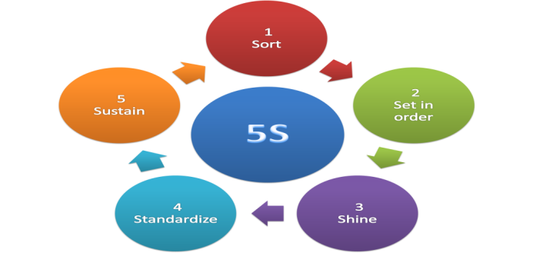
PFC
VSM
5S
Jidoka
Kaizen
Applying 5S on the Zoo
5S is a tool used to organize and arrange the work place and set the technique to keep it organized. This tool is used to make maximum use of existing space and improve the utilization of transport and storage equipment and reduce time and waste.

Slide 40
We proposed to apply the 5S in the zoo to the stores (the large store and the small store) and on the refrigerator In order to get rid of the chaos in them and keep the working environment clean and tidy.

Slide 41
Current situation
The existence of large areas in the warehouse is not exploited
The lack of special places for tools such as cleaning tools and skinning protective clothing
Place all food items with each other without classifying them
Lack of cleanliness of the stores and the refrigerator and the tools in them
There are many tools that are not usable.

Slide 42
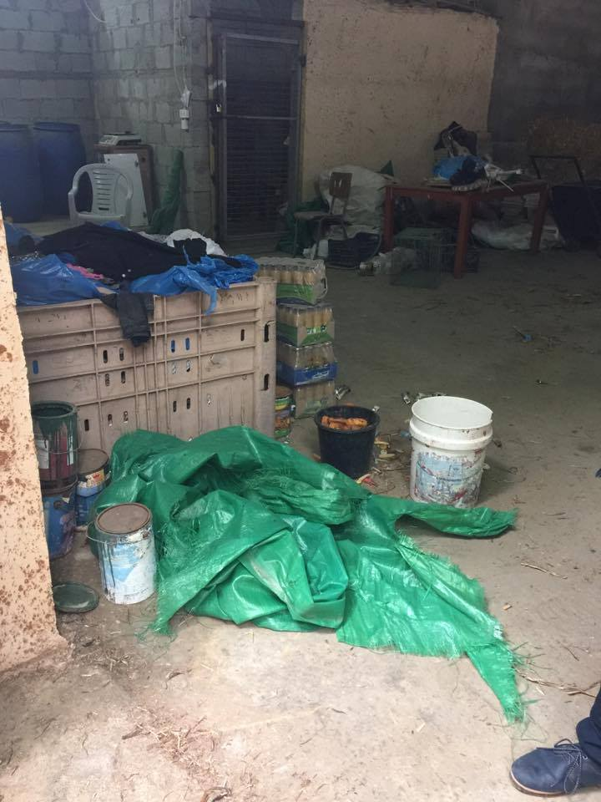
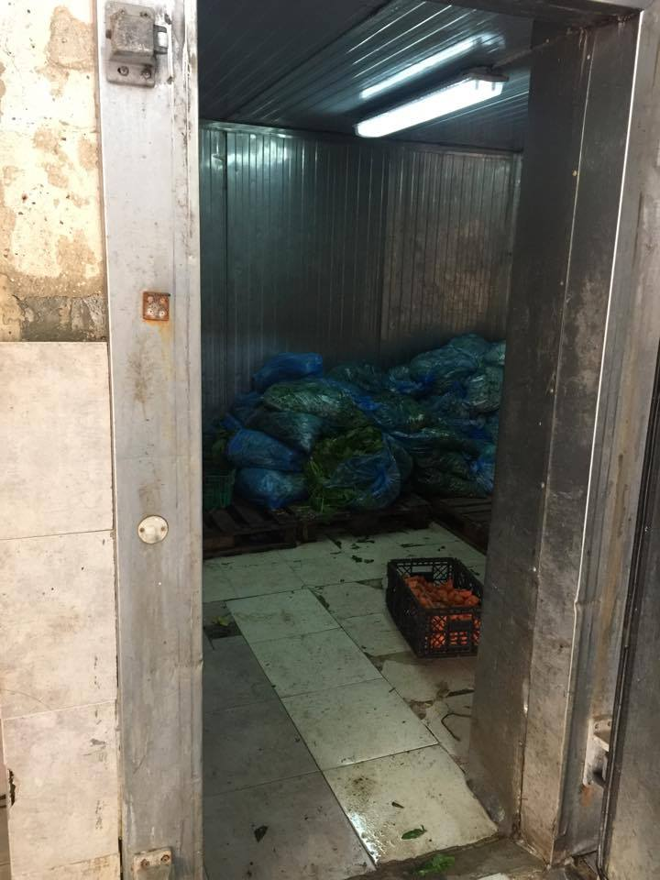
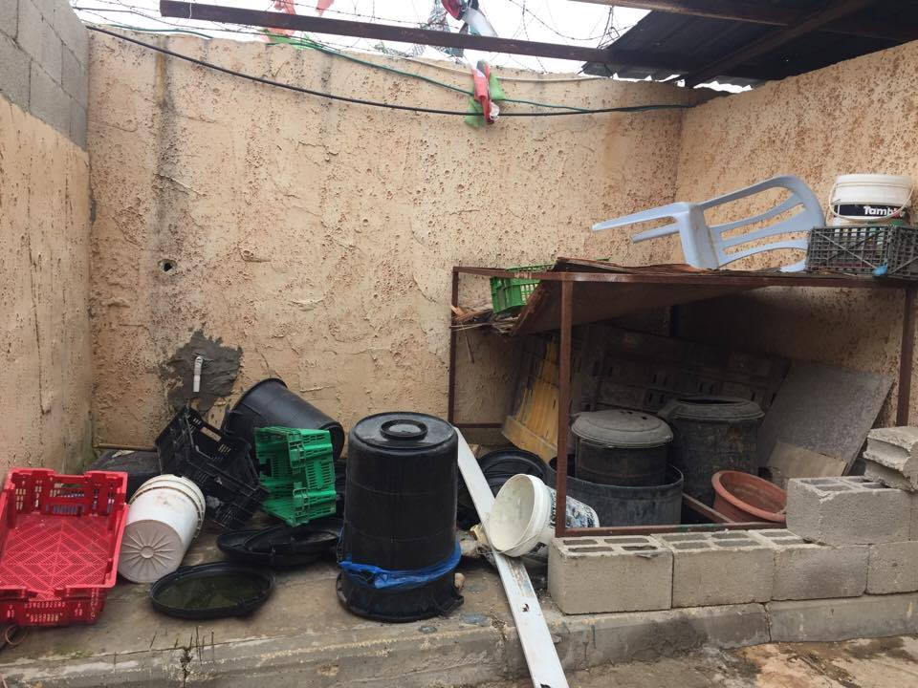

Slide 43
PFC
VSM
5S
Jidoka
Kaizen
food Refrigerators
Making stands u-shaped and arranged on top of each inside the refrigerator.
Give the number or code for each type.
Dividing freezer into two parts to separate animals' dead from the meat part.
Arrange food in the place dedicated in the refrigerator
Classification items (meat, vegetables, fruits, dead animals) to necessary and unnecessary.
Remove and dispose all items that unnecessary
Sorting
Set in order
Shining
Put an instructions plate determine amount of food for each animals.
Put system to enter and leave
Maintain the cleanliness of Refrigerator constantly.
Maintain the order of the food in the refrigerator.
Standardizes
Sustain
Meetings and courses on the need to educate workers applying the above criteria.
Train warehouse manager on special programs to facilitate the work.

Slide 44
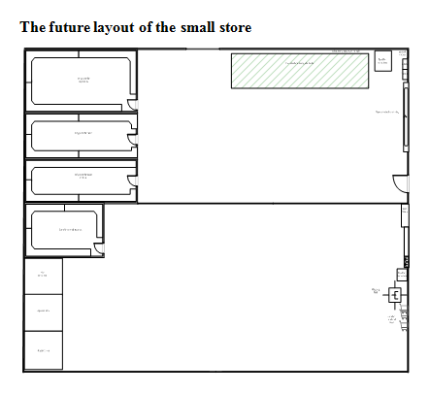
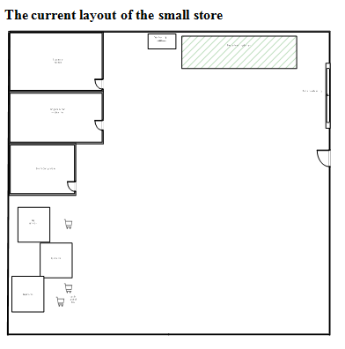

Slide 45
PFC
VSM
5S
Jidoka
Kaizen
Big store
Put a wardrobe for cleaning materials.
Numbering tools as steps to use.
The allocation of a place to store feed.
A special place for the warehouse manager.
A special place to transport vehicles.
Rid of all non-essential purposes, undamaged and unused.
Study the cause of the chaos and the reason for the existence of obstacles in the workplace to overcome them.
Sorting
Set in order
Shining
System to clean the store and continue checking it.
System to recording material entering and leaving the warehouse.
Place an instructions plate in the warehouse.
Clean floor warehouse constantly.
Cleaning cupboards and office administrator and transport vehicles after each use.
Standardizes
Sustain
Meetings and courses on the need to educate workers applying the above criteria.
Train warehouse manager on special programs to facilitate the work.

Slide 46
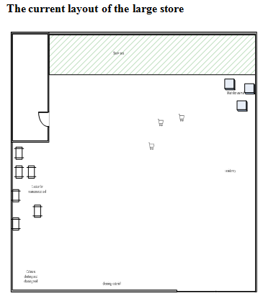
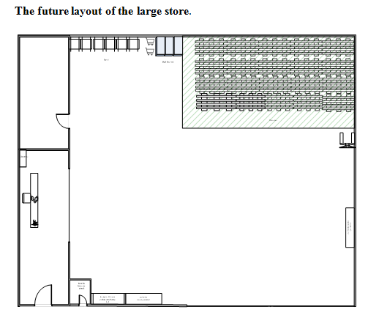

Slide 47
PFC
VSM
5S
Jidoka
Kaizen
Jidoka
Jidoka uses mistake proofing methods, such as poka yoke, self-check, and successive check, as well as visual control. It brings human intelligence into the automation process to ensure reliability, flexibility, and precision and to reduce process malfunctions in the maintenance department.
Apply Jidoka in the zoo to enable a process to keep equipment running without human assistance or supervision.

Slide 48
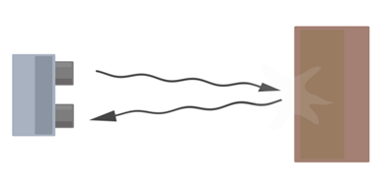
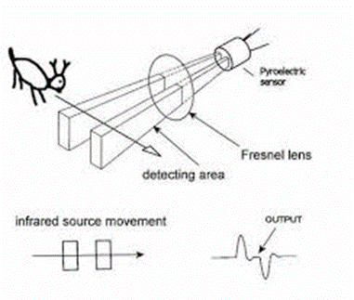
PFC
VSM
5S
Jidoka
Kaizen
In order to increase safety for visitors and animals, especially in the area of predators, it was suggested that the installation of several sensors
sensors
Passive infrared sensor (PIR):Its fundamentally made of a pyro electric sensor, which can detect levels of infrared radiation.
Ultrasonic sensor: It's a device that can measure the distance to an object by using sound waves.

Slide 49
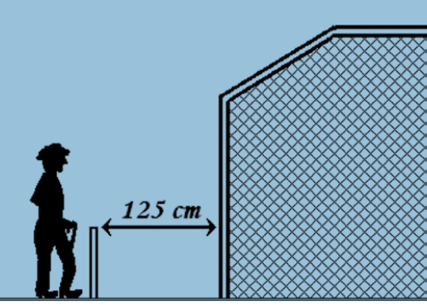

sensors
Stand-off barriers should be designed to prevent children getting through, under or over them and adults from reaching the animal or enclosure. A space of approximately 1.25 meters and approximately 110 cm in height between the stand-off and normal barrier will ensure a safe distance from the enclosure or fence. However, some animals may reach further than this.
Ultrasonic and PIR sensors :
In the event that a visitor in the area of predators penetrating the front barrier and trying to access the animal display These two Sensors give a warning sound indicates the existence of a danger and alert the workers and the other visitors for the existence of danger and also the removal of cloth or plastic reinforced to prevent the arrival to animal to the visitor and his injury
Human work
Machine work

Slide 50
Automatic Door
Animal’s doors are closed manually after entering the animal into the feeding room by the keeper animal
the animal is introduced into the feeding room and the responsible worker will automatically close the door while he standing outside the cage.
Human work
Machine work

Slide 51
Electro-Magnetic Lock
Current method at the zoo: Opening and locking the cages doors can be done manually by the animal’s keeper. These locks are not reliable where the visitors and employees don’t feel safe in the event the doors are left open.
These locks are exposed to weather conditions such as rain and humidity; as a result they are subject to rust. These locks can be easily manipulated and opened without a key, which is dangerous and unacceptable.
Proposed situation: Replace the manual locks with automatic electromagnetic locks to ensure safety for visitors and employees.
The lock contains a sensor to send the door status signals to the building maintenance department to help in remote monitoring and ensuring all doors are in the closed position.
The status signal can be sent in a form of indication light or a beep sound. Upon receiving the indication signal the maintenance department will provide the required action based on the signal type.

Slide 52
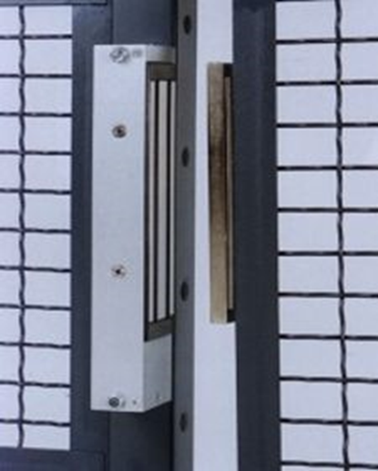
Electro-Magnetic Lock:
Components:
1. LIGHT PANEL (LP) is the external long distance visibility indicator panel (color change, red/green/off),visible from both the rear and side of the Electromagnetic Lock, indicating the status, insecure/secure or power-off.
2. DOOR STATUS SENSOR (DSS) is the monitoring device of the door position by a switch within the magnetic lock body (door open/door closed), providing switching of normally open dry contacts for remote alarm indication.

Slide 53

Surveillance cameras
Take time in the morning session of the regular test by keeper the animal
The keeper may not pay attention that the animal suffers from a health problem.
the lateness of finding out a health problem in the animal.
Watching animal's health constantly.
Early detection of diseases.
Watching and being sure of the safety of barriers, doors and locks.
Watching the behaviours of the keeper and the extent of mastering his work.
Watching visitors' behaviours with animals.
Making sure of the animals' nutritional health through the meals provided to him.
Human work
Machine work

Slide 54
PFC
VSM
5S
Jidoka
Kaizen
proposed Kaizen Plan
Action | Frequency | Responsible | Justification | 1year | 2year | 3year | 4year | 5year
Check refrigerators | Daily | Storekeeper | To ensure the cleanliness of the shelves and put the vegetables and meat in the places allocated according to the divisions of each shelf. | yes | yes | yes | yes | Yes
External audit | Every 6 months | Employee from Qalqilia Municipality | Effectiveness and efficiency of operations. Reliability of financial and management reporting. Compliance with laws and regulations. Safeguarding of Assets | Yes | Yes | Yes | Yes | Yes
Training [for Electro-Magnetic Lock, Automatic Door] | 2 months | Maintenance department official | To teach the workers the mechanism of using the electromagnetic door as it's a new addition to the zoo and it hasn't been used before. Increasing awareness about the benefits and risks of using electromagnetic doors. | yes

Slide 55
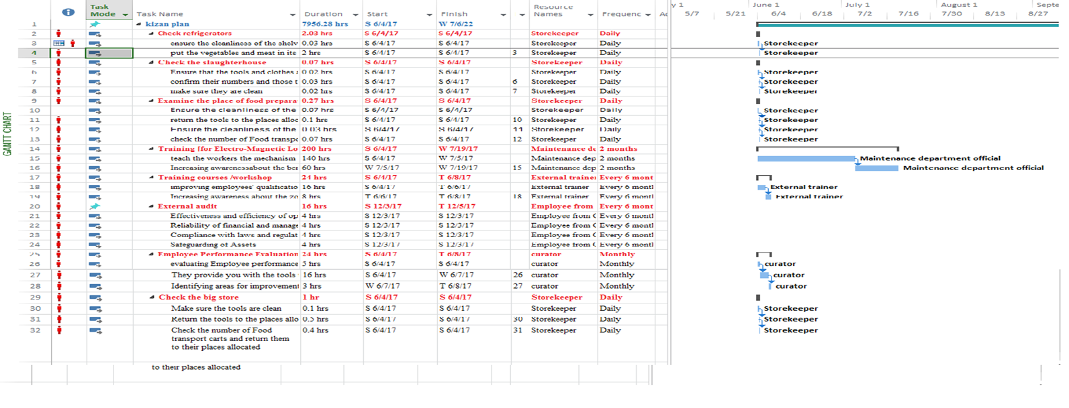
proposed Kaizen Plan
Gantt chart for kaizen plan:

Slide 56

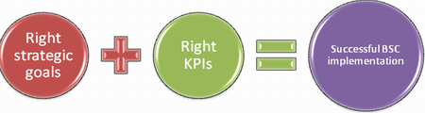
Balanced scorecard
is a strategy performance management tool, that can be used by managers to keep track of the execution of activities by the staff .
To maintain a balance between perspectives; it must know score of a set of Key Performance Indicators (KPIs)

Slide 57
Applying KPI on the Zoo
Measurable indicators that will be used to report progress that is chosen to reflect the critical success Strategic.
Determine the gap between actual and targeted performance and determine organization effectiveness and operational efficiency.
In this project, KBI was used as a measure of the performance of the development plan and improvements in the processes that was carried out, in order to achieve the objectives of the park.

Slide 58
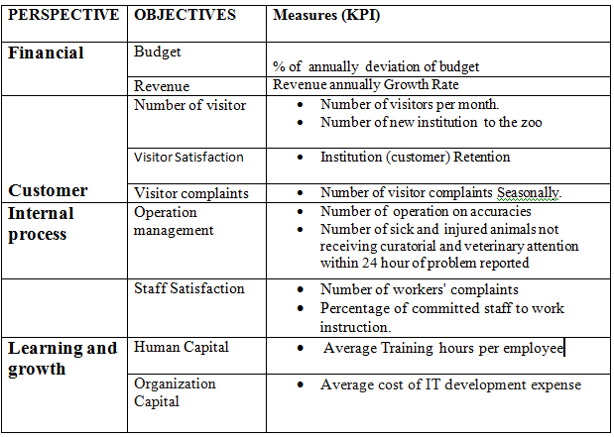
KPI selected for the Balanced Scorecard

Slide 59
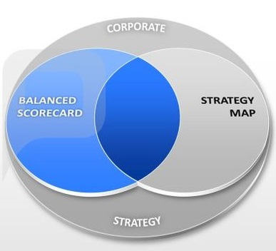
Strategy Map
Strategy Map is a logical and comprehensive architecture for describing strategy and can be useful in determining the main sources and their connections for an organization's strategy

Slide 60
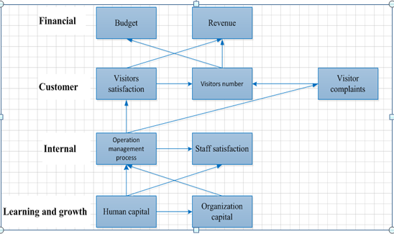
Strategy Map based on the four Balanced Scorecard Perspectives

Slide 61

Organizational structure and Job description
After take a closer look at the tasks and responsibilities assigned to the workers in the zoo, especially in animals section. It shows that the zoo needs to re-distribute of workers functions and to determine each one’s capacities and qualifications.
a new organizational structure has been put
a new job description has also been developed

Slide 62
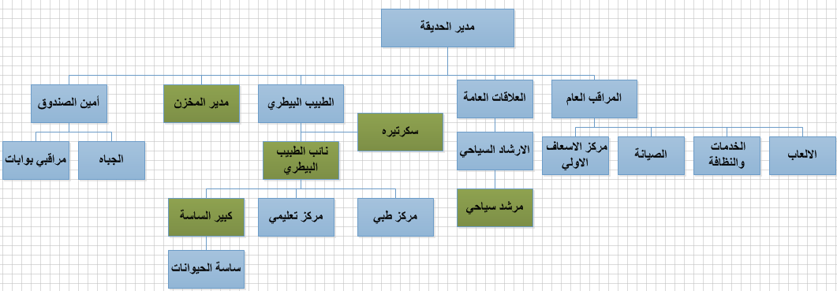
The new organizational structure

Slide 63


The new job description

Slide 64
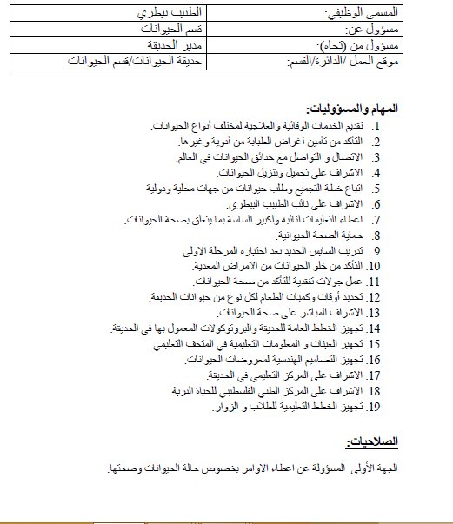


Slide 65
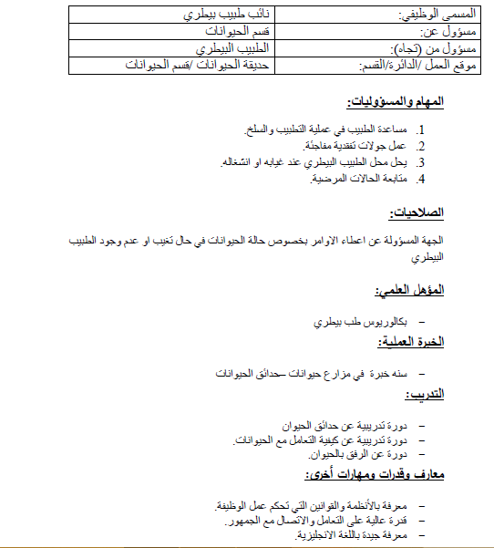

Slide 66
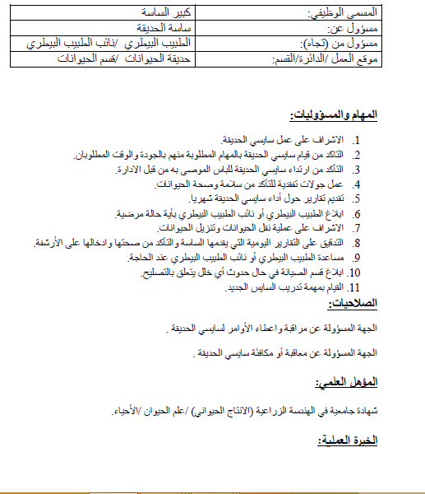

Slide 67
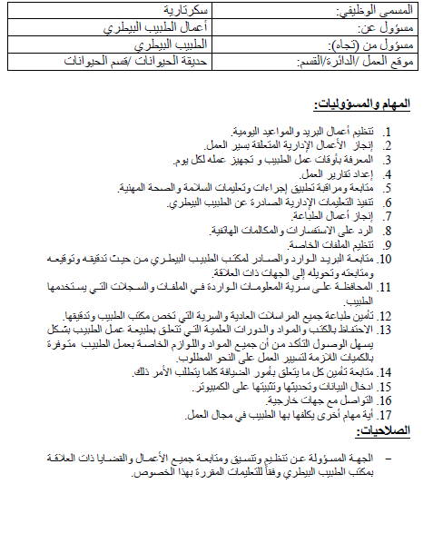


Slide 68
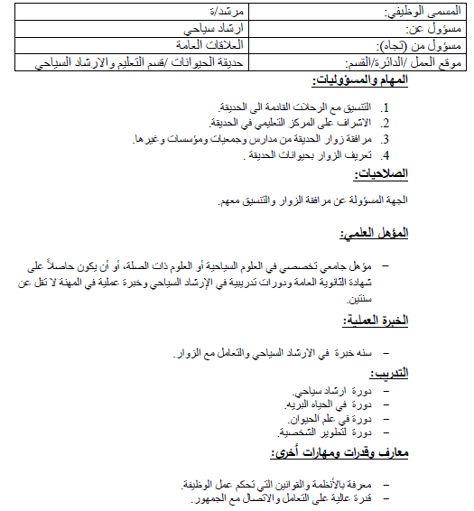

Slide 69
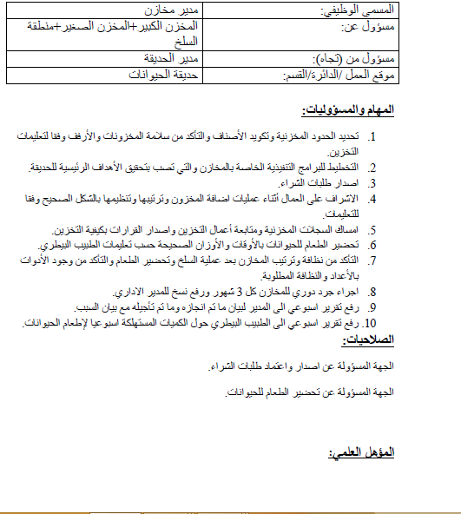


Slide 70
Conclusions and Recommendations
After the deep understanding of the zoos' systems in general and Qalqilia zoo system in specific, we have run into diverse some recommendations.

Slide 71

Recommendations
Apply the principles of lean to achieve the desired goals of this research.
Lean services
Measure the effectiveness of lean by using BSC concepts.
BSC
Make a functional description of the positions we mentioned
Job description

Slide 72
Recommendations
Increase the number of safety guidelines and distribute them throughout the zoo.
There is a need for guidance boards on the location of each animal to facilitate the arrival of visitors to the desired place.
The need for attention to clean sanitation.
The need to take care of the psychological aspect of the animal through the process of entertainment and the creation of new ways of entertainment.
Refreshing and activating the marketing aspect through social media and campaigns.
Train workers to respond to emergencies in case something happens.

Slide 73
Recommendations
Each employee at the zoo should wear an identification card displaying their names and an emergency contact number along with a suitable dress.
Contracting with a qualified staff with experience in the field of high animal parks either administratively or technically and if not found this crew, people are selected, trained and sent to zoos to learn and intensive training.
9. When animals are brought in, they must be isolated and equipped with a special location within them to accommodate them and not to be exposed to any injuries caused by changing the place.
10 . Guiding plates talking about recycling and the economy in the water and electricity.

Slide 74



