Slide 1


An-Najah National University
Faculty of Engineering & Information Technology
Industrial Engineering Department
Utilizing Six Sigma approach to Improve Production Efficiency at the National Carton Factory
Submitted by
Lara Jaser Alqddomi
Lama Alaa Shanaa
Supervised by
Dr. Ahmad Ramahi

Slide 2
Outline
01. overview
02. Problem Statement
03. objectives and aims
04.Litreture review
05. METHODOLOGY
06. Processes
07. Analysis and results
08. Conclusion and recommendations

Slide 3

overview
Six Sigma is a management concept to increase process performance by minimizing process variance, decrease defects, enhance productivity, shorten cycle time, and lower costs.
The study found that the factory is facing challenges in optimizing its production processes to meet increasing demand while maintaining quality and reducing cost and defects and has been experiencing high defection rates.

Slide 4




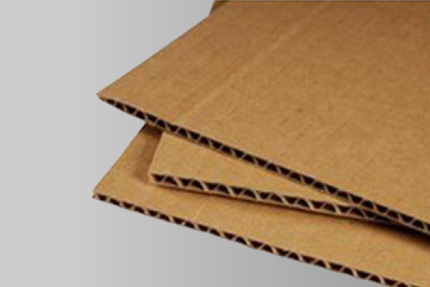

The National Carton Manufacturing Company
The company started its operation in 1989
Kinds of products:
Cardboard panels
Closed carton boxes
Rolls
Open cartons

Slide 5
Problem Statement
The factory is facing challenges in optimizing its production processes to meet increasing demand while maintaining quality and reducing cost and defects.
The factory has been experiencing high defection rates.

Slide 6


objectives and aims
The main goal of this project is to improve production performance at the National Carton Manufacturing Company
Study the process and operations with concentration on the carton slabs production line.
Propose some Recommendations and changes to improve production performance

Slide 7

Literature Review
Overview of Six Sigma
Definition Applications Benefits
02
Tools and Techniques of Six Sigma
DMAIC (define, measure, analyze, improve, and control) is a data-driven quality technique for process improvement. The letters in the acronym indicate the five phases of the process, as well as the tools needed to finish those phases

Slide 8
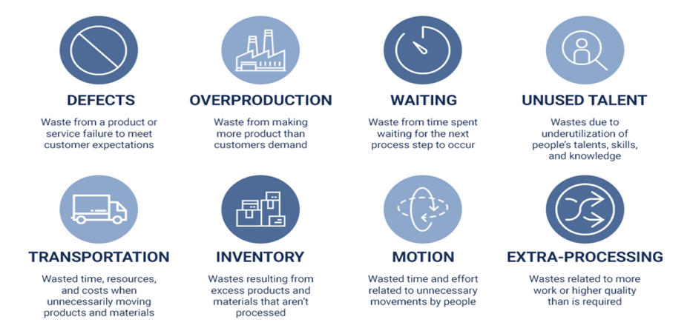
03
8 Wastes

Slide 9
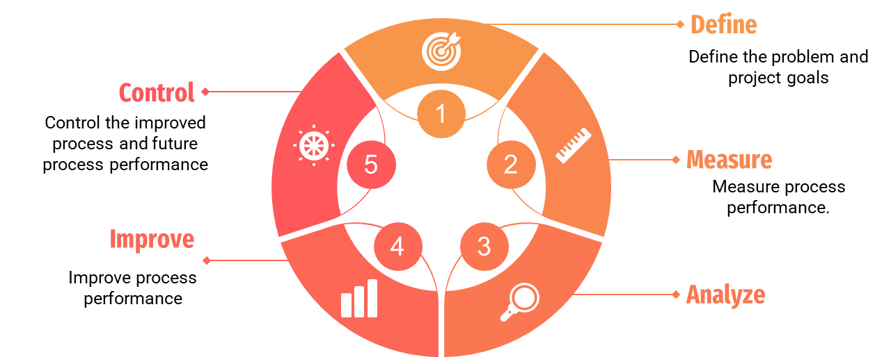
METHODOLOGY
Analyze the process to determine root causes of variation and poor performance

Slide 10
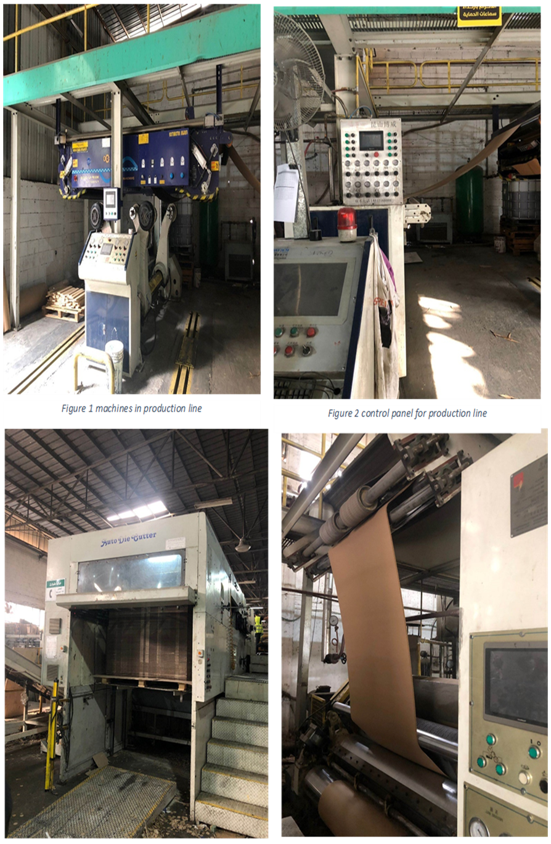
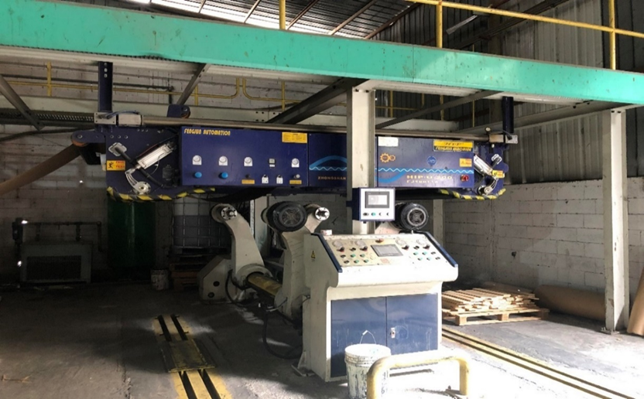
Processes
.
Wavy ribbing process.
Conversion process.
Die cutting.

Slide 11


The main defects:
1)Delamination
2)Moisture damage

Slide 12
Data analysis
 | Weight of Roll (ton) | Trim weight(kg) | Waste percentage
1 | 0.2521584 | 17.651088 | 7
2 | 2.430827 | 136.948 | 5.633802817
3 | 0.6902742 | 31.9858 | 4.633781764
4 | 1.11984336 | 30.68064 | 2.739726027
5 | 3.841647018 | 112.020582 | 2.915951973
 | Weight of Roll (ton) | Trim weight(kg) | Waste percentage
6 | 2.94121692 | 262.72308 | 8.932461874
7 | 6.337485 | 181.071 | 2.857142857
8 | 0.35858592 | 11.38368 | 3.174603175
9 | 1.8506475 | 150.0525 | 8.108108108
10 | 1.55844 | 126.36 | 8.108108108

Slide 13

 | Weight of Roll (ton) | Trim weight(kg) | Waste percentage
11 | 0.72735 | 25.6206986 | 3.522471795
12 | 0.99004136 | 16.21165812 | 1.637472814
13 | 0.592842978 | 30.8183967 | 5.198407984
14 | 0.245789544 | 13.25047339 | 5.390983349
15 | 0.40598404 | 22.59032952 | 5.564339308
 | Weight of Roll (ton) | Trim weight(kg) | Waste percentage
16 | 2.388746052 | 170.087148 | 7.120352867
17 | 3.64602875 | 280.46375 | 7.692307692
18 | 0.59701824 | 24.87576 | 4.166666667
19 | 0.88020464 | 60.80361 | 6.907894737
20 | 4.933344 | 167.232 | 3.389830508

Slide 14
 | Weight of Roll (ton) | Trim weight(kg) | Waste percentage
21 | 2.36386656 | 44.46144 | 1.880877743
22 | 0.642506184 | 16.322328 | 2.540415704
23 | 1.11984336 | 30.68064 | 2.739726027
24 | 0.45869616 | 12.86064 | 2.803738318
25 | 0.78387408 | 12.74592 | 1.62601626

Slide 15
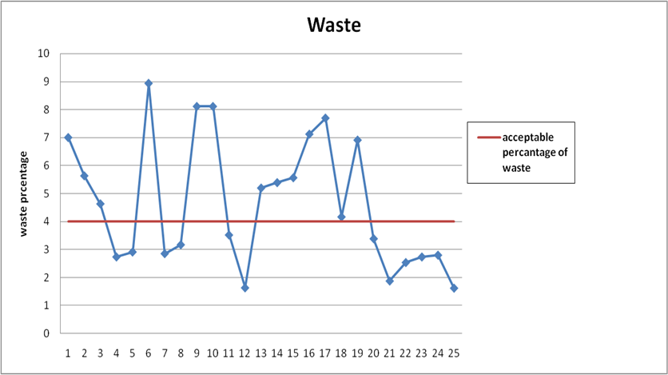

Slide 16
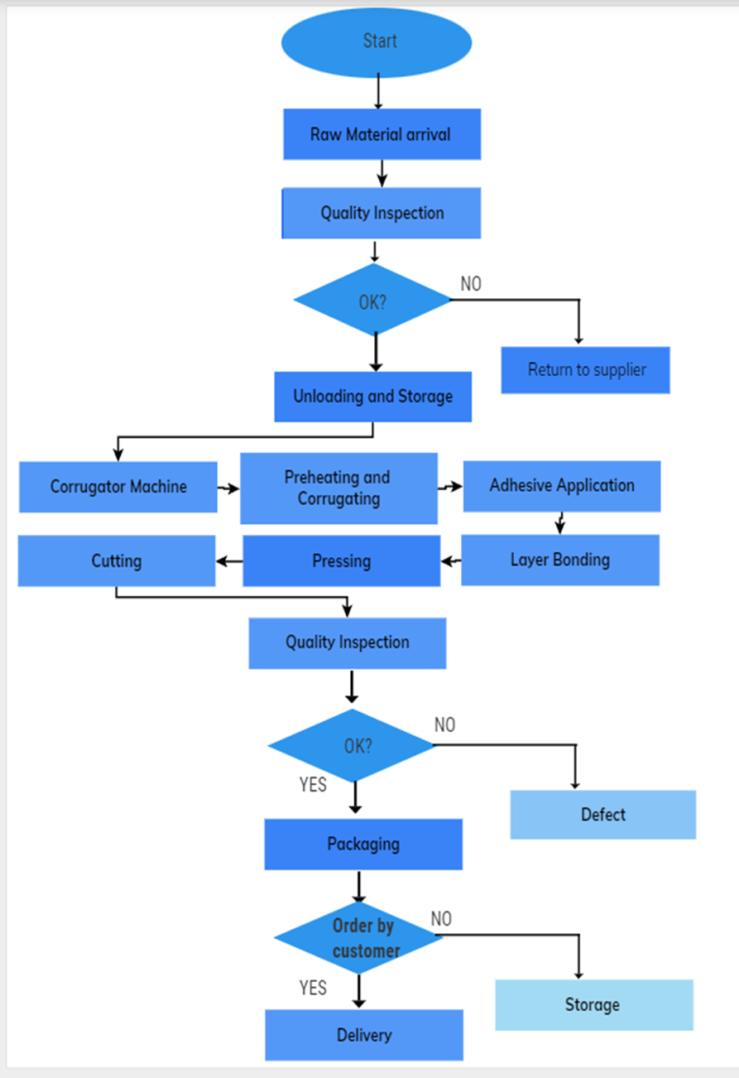
Process Mapping

Slide 17
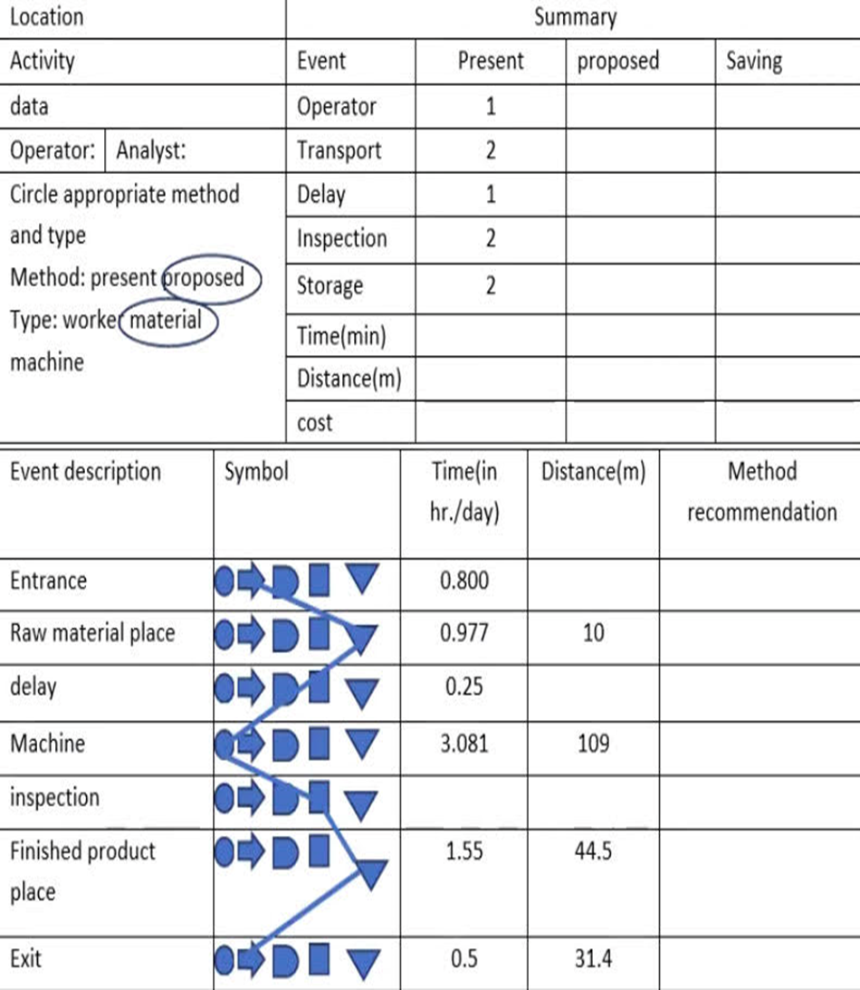
Flow chart

Slide 18
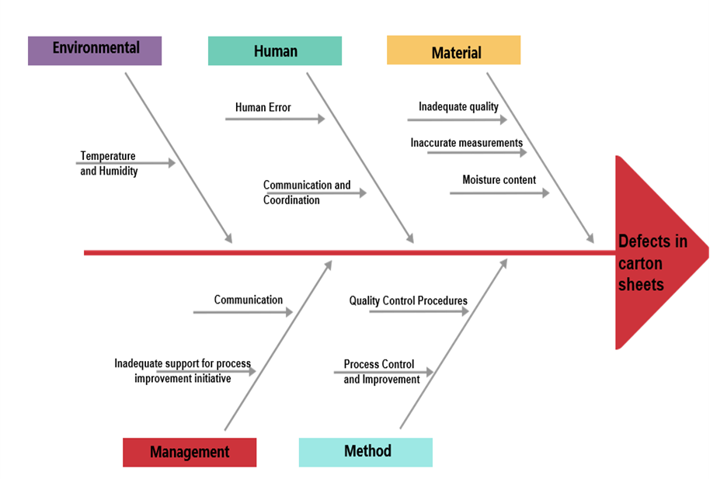
FISHBONE DIAGRAM

Slide 19

5’S
SORT
SET IN ORDER
SHINE
STANDARIZE
SUSTAIN

Slide 20
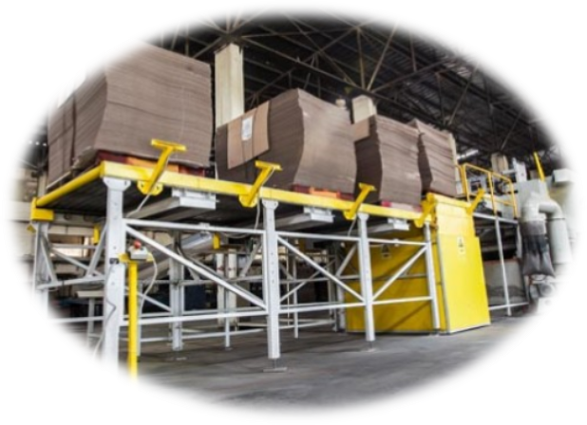
Result
Reasons why defects may occur in the procedure of producing carton sheets:
The dimensions of the raw materials
Efficiency of the production process
Waste reduction
Cost savings
Human error
Environmental factors
Inadequate quality control

Slide 21

Conclusion
After implementing Six Sigma in the carton sheets factory, the research concludes that the methodology has proven to be effective in identifying factors for improving the quality and efficiency of the production process several recommendations are given in regards .

Slide 22
Recommendation
• Invest in automation and technology
Computer-aided design and manufacturing (CAD/CAM)
Automated quality control systems
Implement automated inspection systems
Monitor industry trends and best practices
Collaborate with Suppliers and Technology Providers

Slide 23
Recommendation
• Enhance communication and collaboration
Light Signaling System
• Improve material handling and logistics
Efficient transportation methods
Real-time tracking and visibility

Slide 24


