Slide 1

AN-Najah National University
Faculty of Engineering & Information Technology
Mechanical and Mechatronics Engineering Department
Graduation Project 2
Design a Small Hydro-Turbine in Wadi Al Farrah
DONE BY:
Anas Abu Al Rob
Ibrahem Kojok
Ahmad Salamah
SUPERVISOR:
Dr. Mahmoud Assad
30/12/2021

Slide 2
Outline
Introduction
Aims
Mechanical Design
Electrical Design
Conclusion
Future Work

Slide 3
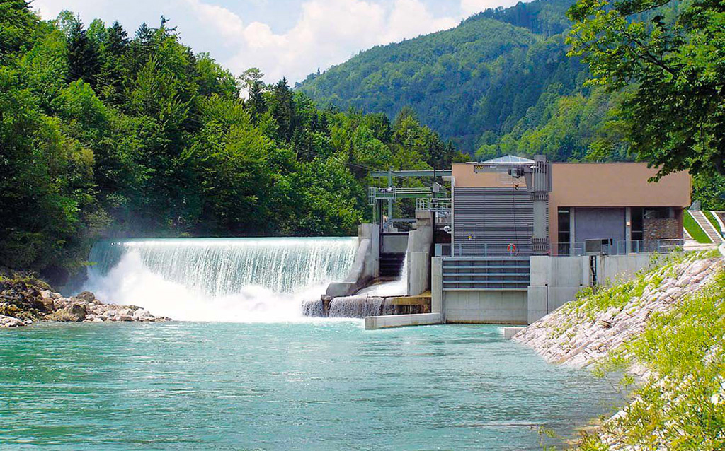
Introduction
Palestine sits under occupation, and it has large amount of lost energy, so it imports 85% of it is power need from “Israel”.
Hydro Power Turbine is a turbine works on converting water potential and kinetic energy into mechanical energy in order to transform it into electric power.
Making a hydro turbine for the first time in Nablus,
Farrah cannel, besides it is useful for the surrounding region, but it opens a wide door for additional well-use energy in Palestine.

Slide 4
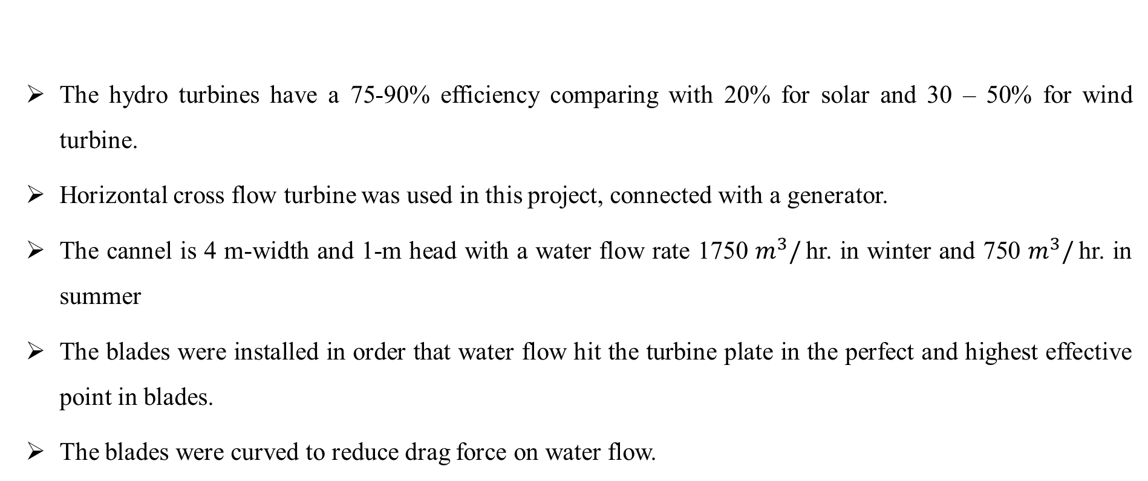
Introduction
The hydro turbines have a 75-90% efficiency comparing with 20% for solar and 30 – 50% for wind turbine.
Horizontal cross flow turbine was used in this project, connected with a generator.
The cannel is 4 m-width and 1-m head with a water flow rate 1750 $m^{3}/$hr. in winter and 750 $m^{3}/$hr. in summer
The blades were installed in order that water flow hit the turbine plate in the perfect and highest effective point in blades.
The blades were curved to reduce drag force on water flow.

Slide 5
Aims
To well-use of waste energy in Palestine generally and water energy especially.
Lightning the next street by the produced power.
Design the turbine with the perfect dimensions to be appropriate with water flow differences in summer and winter.
Design a Sprocket that maximize power, by increasing rpm.
Implementing and building a prototype and examining the system.
Initiate a starting points for a future work developments.

Slide 6
Mechanical Design
The overall mechanical system consists of multiple subsystems listed below:
Turbine blades
Turbine vertical and horizontal holder
Sprocket ( to increase RPM )
Select the material
Cylinder, Horizontal Shaft and welding design.

Slide 7
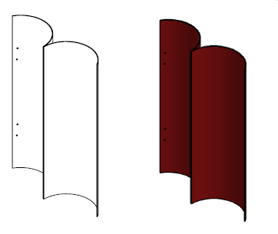
Major Component
Blades : the main surfaces that will receive water flow and the most significant part of the rotor, the turbine has 6 blades, all made from PVC.
The blades were designed in this shape to make them rotate or produce power at any angle water hit them as shown beside.

Slide 8
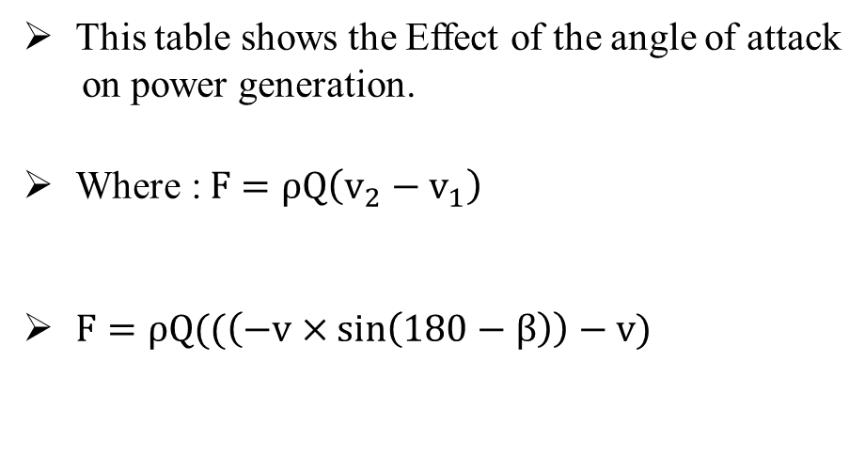
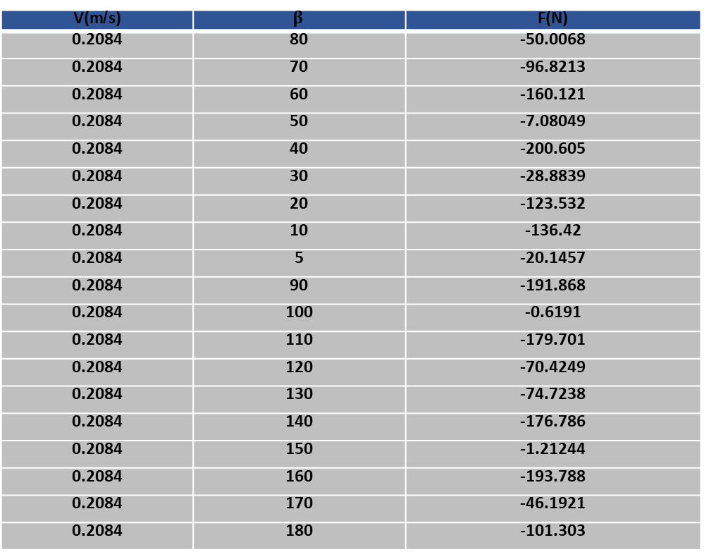
Major Component
V(m/s) | $$β$$ | F(N)
0.2084 | 80 | -50.0068
0.2084 | 70 | -96.8213
0.2084 | 60 | -160.121
0.2084 | 50 | -7.08049
0.2084 | 40 | -200.605
0.2084 | 30 | -28.8839
0.2084 | 20 | -123.532
0.2084 | 10 | -136.42
0.2084 | 5 | -20.1457
0.2084 | 90 | -191.868
0.2084 | 100 | -0.6191
0.2084 | 110 | -179.701
0.2084 | 120 | -70.4249
0.2084 | 130 | -74.7238
0.2084 | 140 | -176.786
0.2084 | 150 | -1.21244
0.2084 | 160 | -193.788
0.2084 | 170 | -46.1921
0.2084 | 180 | -101.303
This table shows the Effect of the angle of attack
on power generation.
$\text{Where}\text{ :} F=ρQ\left(v_{2}−v_{1}\right)$
$F=ρQ((\left(−v×\sin\left(180−β\right)\right)−v)$

Slide 9
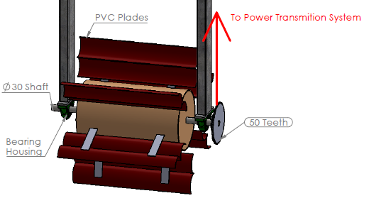
Major Component
Stand: the main component that held the turbine, it was planned to add a plate to the turbine, but it canceled because turbine became horizontal cross section instead of being vertical.
The turbine had designed to be vertical cross turbine, but because the water level between June and October gives less than the required efficiency, the turbine has been designed to be horizontal cross flow turbine as shown.

Slide 10
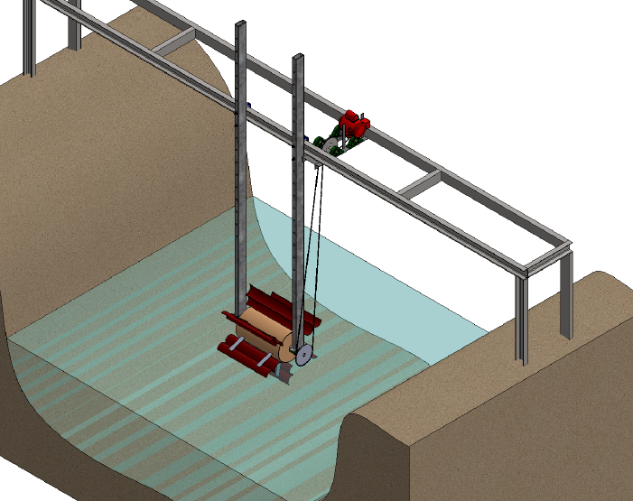
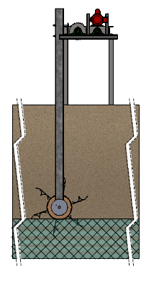
Turbine Structure
This picture shows the whole turbine structure.
This picture shows how water
hit the whole turbine in the channel.

Slide 11
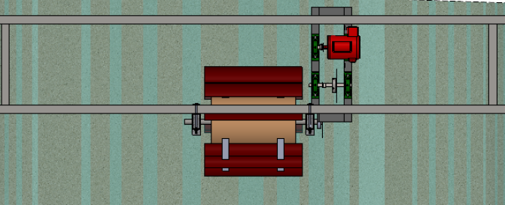
Top View
Top view of the turbine with dimensions and the water flow stream.
Blade Diameter = 4 inches X 2 = 8 inches
Turbine height = 200 + 300+ 200 mm = 700 mm
Turbine width = 820 mm
Cylinder : Width is 520 mm, diameter is 300 mm and a 5 mm wall thickness.
The horizontal shaft diameter is 30 mm and 820 mm length

Slide 12
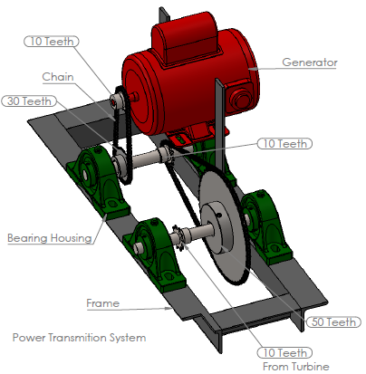
Sprocket Design
This picture shows the sprocket used in the turbine which consists of 50 to 10 teeth ratio.
The generator designed to have 30 to 10 teeth ratio, all to increase rpm rate.
The sprocket and generator connected to the horizontal bar.

Slide 13
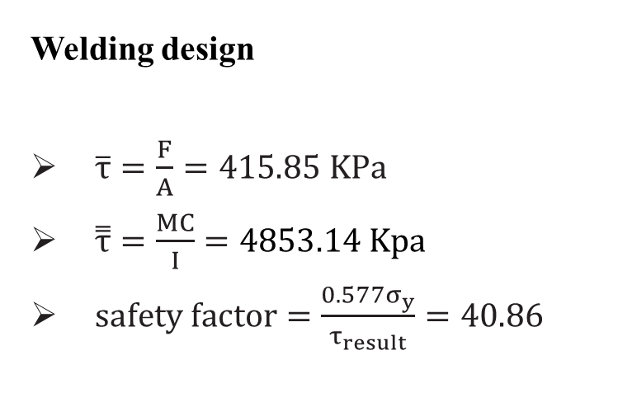
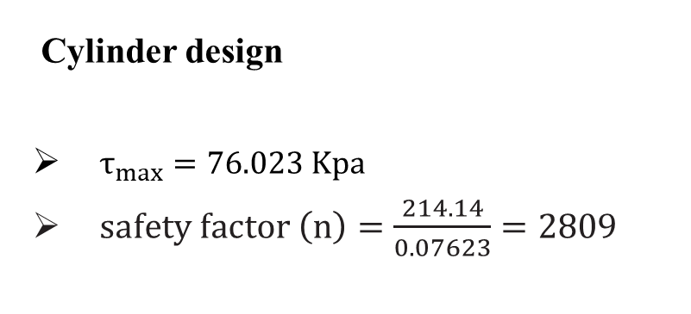
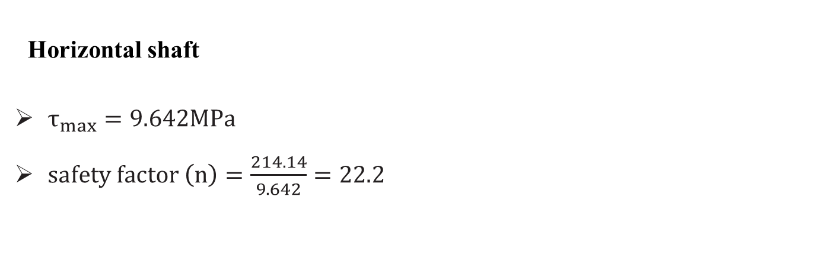
Cylinder, Horizontal Shaft and Welding design
Cylinder design
$τ_{max}=76.023 Kpa$
$safety factor \left(n\right)=\frac{214.14}{0.07623}=2809$
Welding design
$\overline{τ}=\frac{F}{A}=415.85 KPa$
$\overset{̿}{τ}=\frac{MC}{I}=4853.14 Kpa$
$safety factor=\frac{0.577σ_{y}}{τ_{result}}=40.86$
Horizontal shaft
$τ_{max}=9.642MPa$
$safety factor \left(n\right)=\frac{214.14}{9.642}=22.2$

Slide 14
Cylinder, Horizontal Shaft and Welding design
Why safety factor is too big ?
The cylinder and shaft and were already been exist
The calculations were made based on the dimensions of the model that built

Slide 15
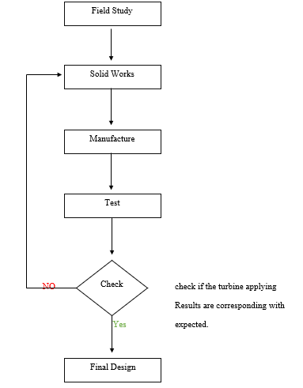
The project Flow chart
This flow chart shows the detailed procedures of how the project has been designed

Slide 16
Electrical Design
The overall electrical system consists of subsystems listed below:
Generator selection and installation : 80% efficiency Italian generator has been chosen, carried by the horizontal fixed beam ( which carry the turbine).
Connections with loads: initially, it was for testing, 15 watt lamp had used, and now turbine ready to be connected with any loads.

Slide 17
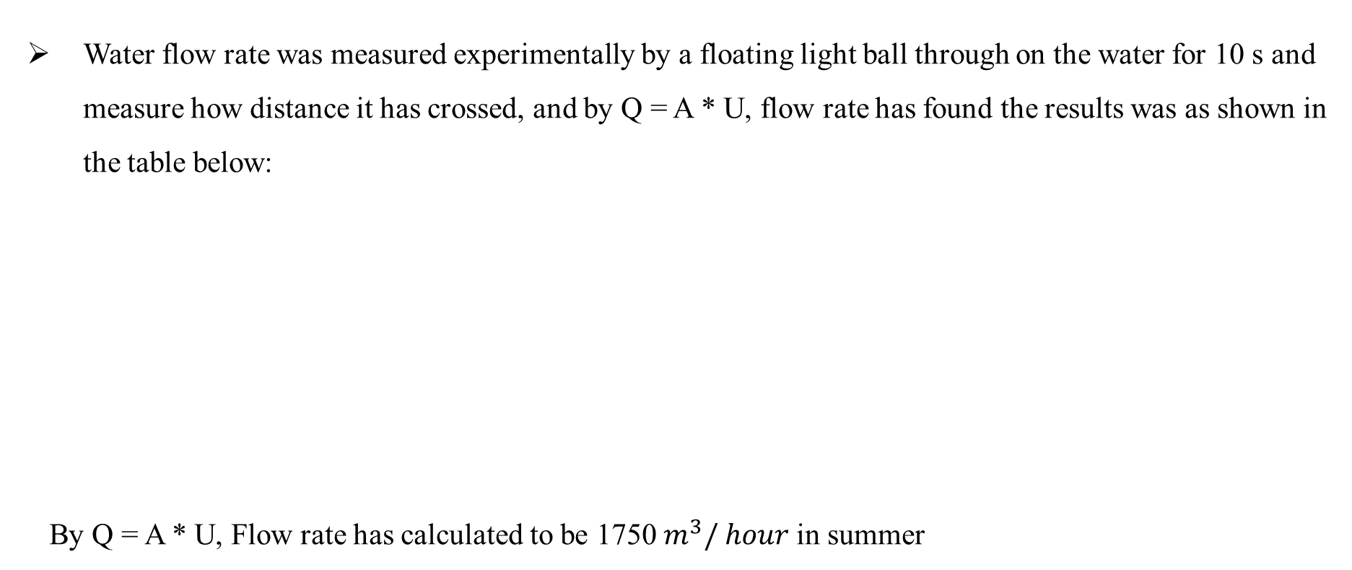
Results
Water flow rate was measured experimentally by a floating light ball through on the water for 10 s and measure how distance it has crossed, and by Q = A * U, flow rate has found the results was as shown in the table below:
By Q = A * U, Flow rate has calculated to be 1750$m^{3}/ hour$ in summer
Experiment number | Crossed distance in the water m
1 | 1.9
2 | 2.2
3 | 1.95
4 | 2.29
5 | 2.09

Slide 18
Results
The blades were designed to be 60 cm width.
Measurements have taken after 10 min of turning the turbine on.
The turbine power was 500 – 1000 Watt. As a result of 365 days a year, 4380 – 8760 KW a year will be produced to save (2190 – 4380) NIS / year, makes payback period to be maximum about 18 months.

Slide 19
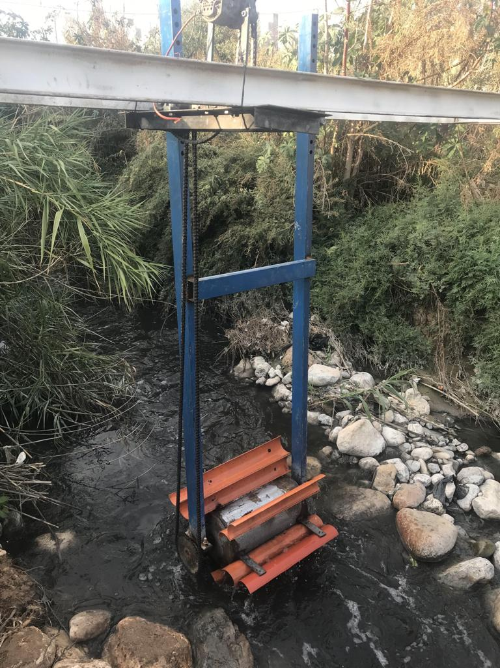
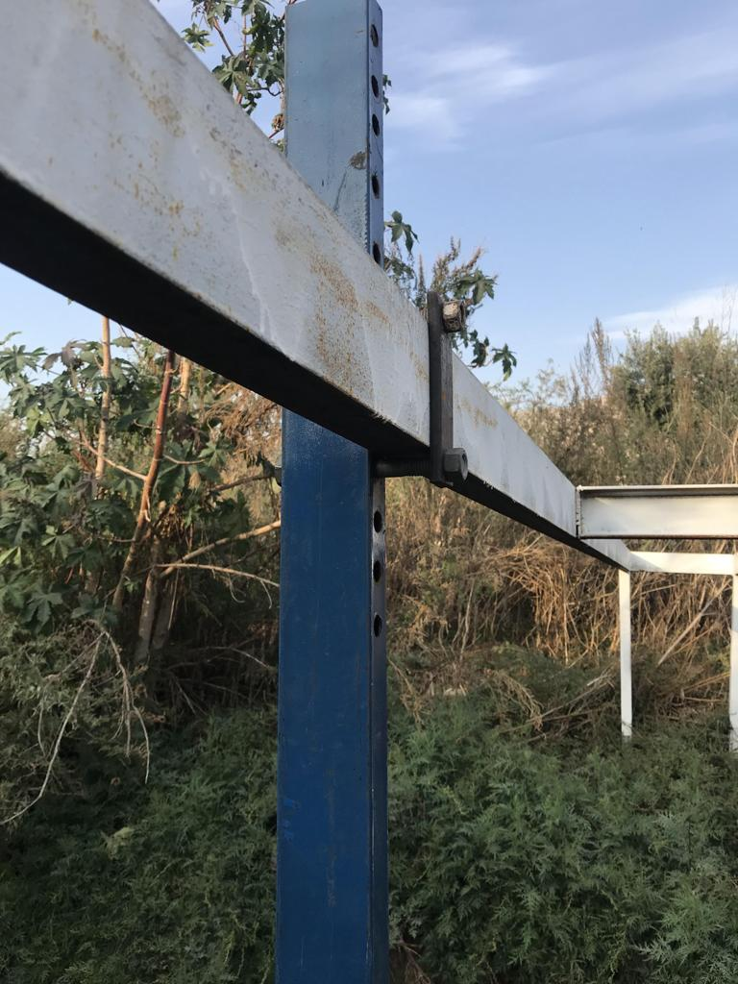
Results

Slide 20
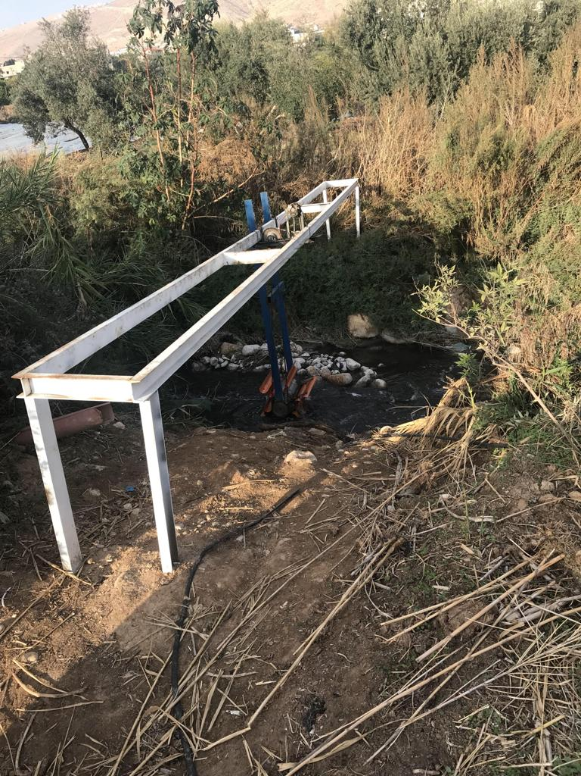
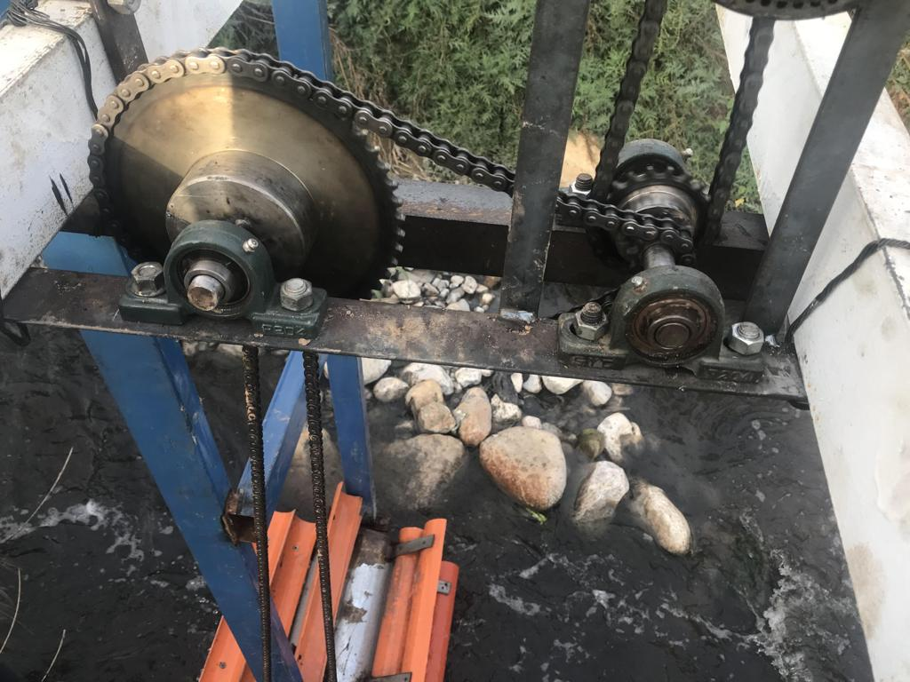
Results

Slide 21
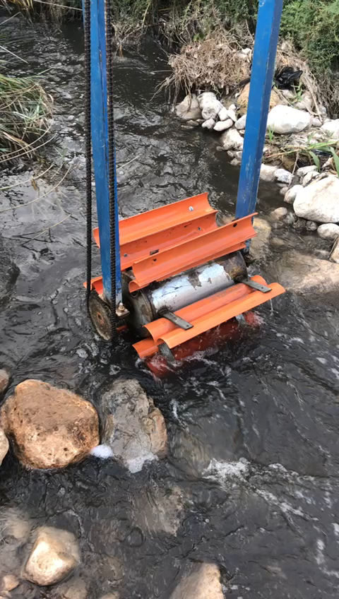

Slide 22
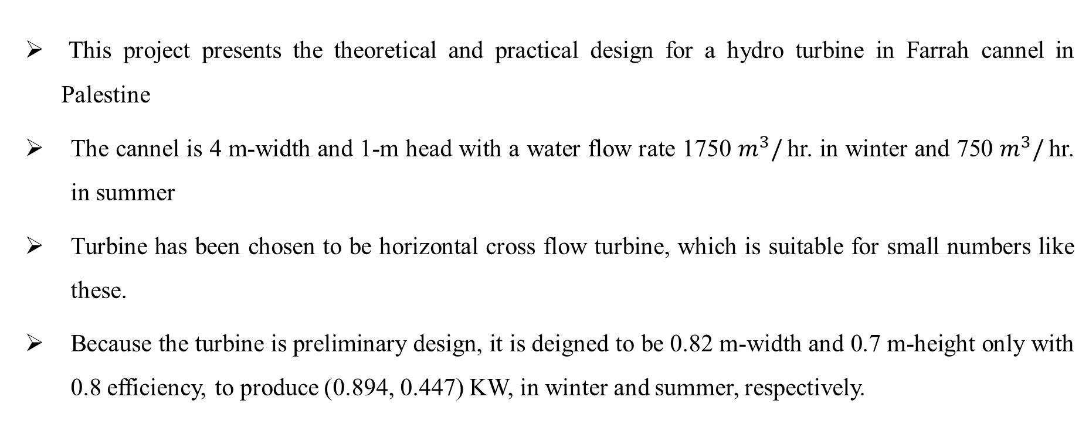
Conclusion
This project presents the theoretical and practical design for a hydro turbine in Farrah cannel in Palestine
The cannel is 4 m-width and 1-m head with a water flow rate 1750 $m^{3}/$hr. in winter and 750 $m^{3}/$hr. in summer
Turbine has been chosen to be horizontal cross flow turbine, which is suitable for small numbers like these.
Because the turbine is preliminary design, it is deigned to be 0.82 m-width and 0.7 m-height only with 0.8 efficiency, to produce )0.894, 0.447) KW, in winter and summer, respectively.

Slide 23
Conclusion
The mechanical design also was studied by defining each component in the design then building it using SOLIDWORKS

Slide 24
Future Work
Design the turbine to be 4-m width and 1.5 – 2 m-height.
Turbine will produce 3.8 KW and 1.5 KW in winter and summer respectively.
A chain of series turbines will be constructed in the same cannel to produce more energy and feed the next neighborhood.
Reduction the mechanical losses in the overall system and that can on many configurations.
Improve materials selecting process for the hydro turbine configurations.
Connect the rotating part with a floating body to make the turbine balance it is high level perfectly with water level

Slide 25
Thanks !
Any questions ?

