Slide 1
An Optimum Design of Photovoltaic Pumping system
By Dalia Hajhamad
Supervisor Tamer Khatib

Slide 2
Objective:
Design a Photovoltaic Pumping system.
Achieve pre-feasibility to such system.
Study and identify the combination of PV’s and pumps as a hybrid/off-grid system and its importance to Palestinian farmers as a challenge to the Israeli occupation.

Slide 3
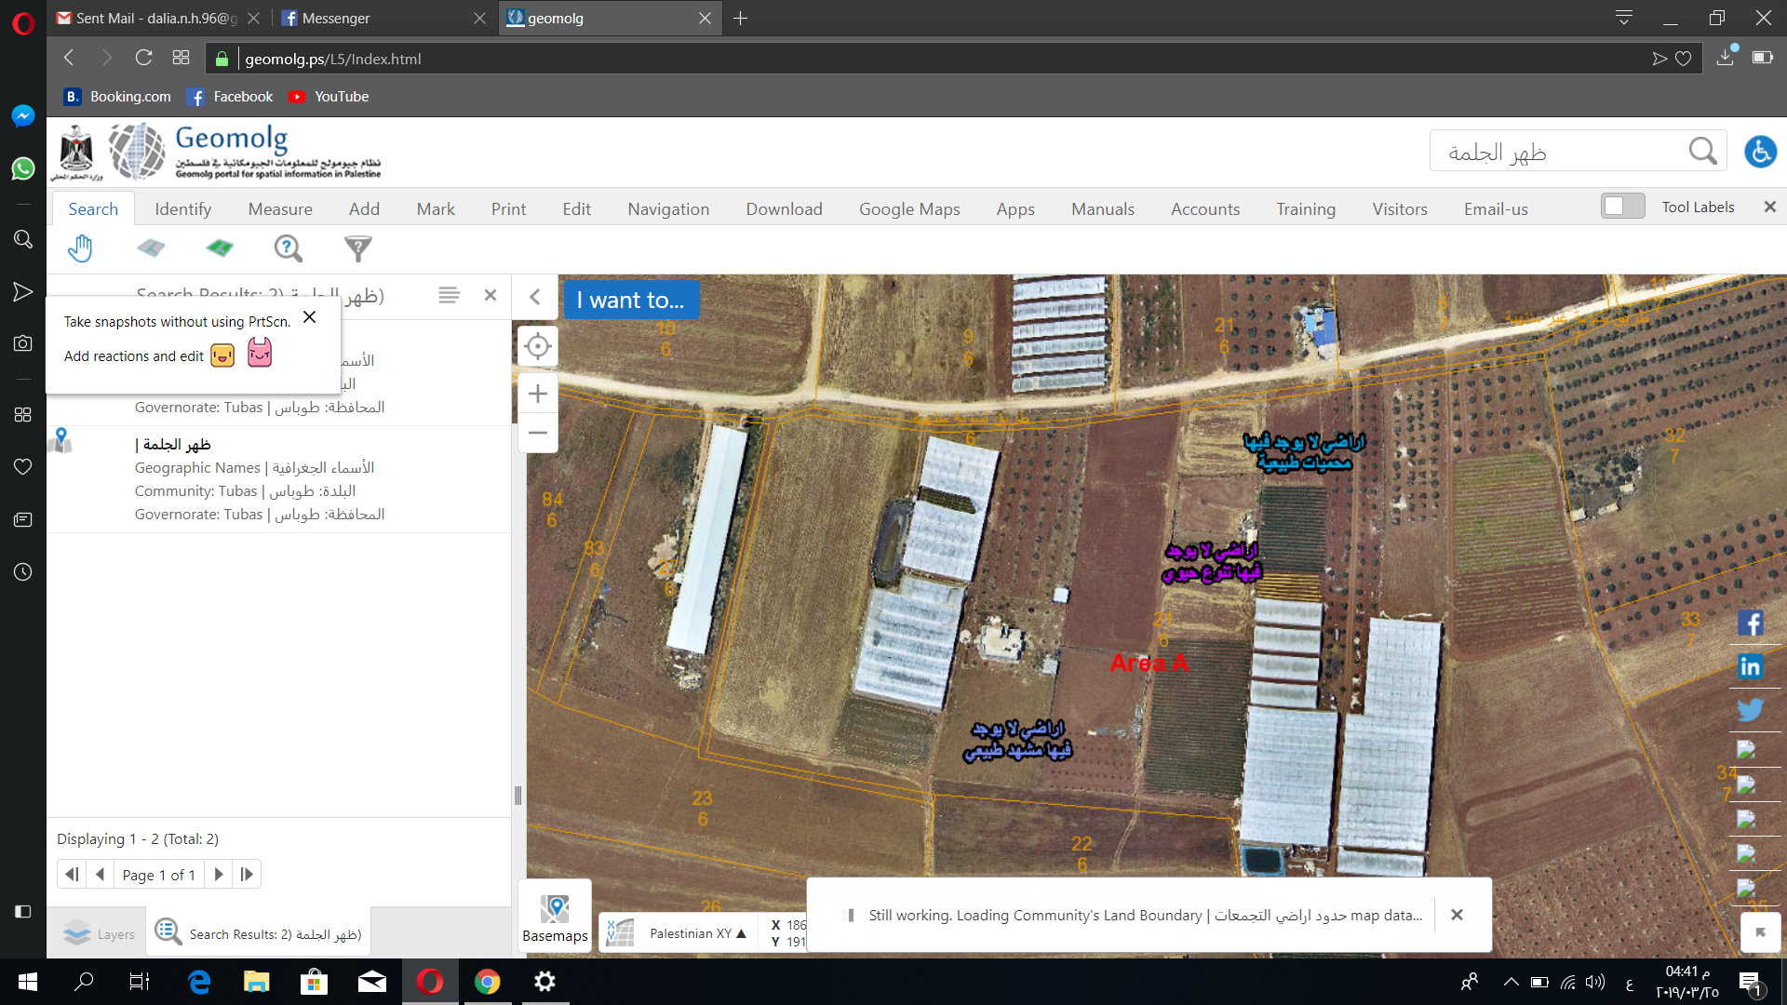
Case study layout description

Slide 4
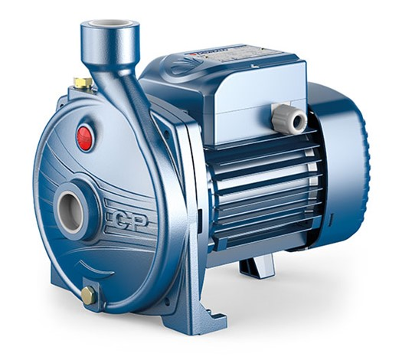
imec water pump cpm 200

Slide 5
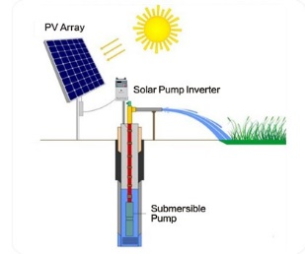
Concept of the system

Slide 6
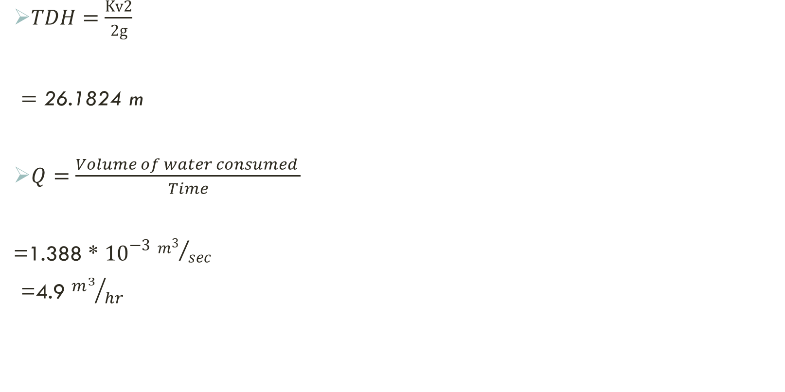
Pump sizing
$TDH=\frac{Kv2}{2g}$
$=\text{26.1824 }\text{m}$
$Q=\frac{Volume of water consumed }{Time}$
=1.388 * ${10}^{−3}$ ${m^{3}}/{sec}$
=4.9 ${m^{3}}/{hr}$

Slide 7
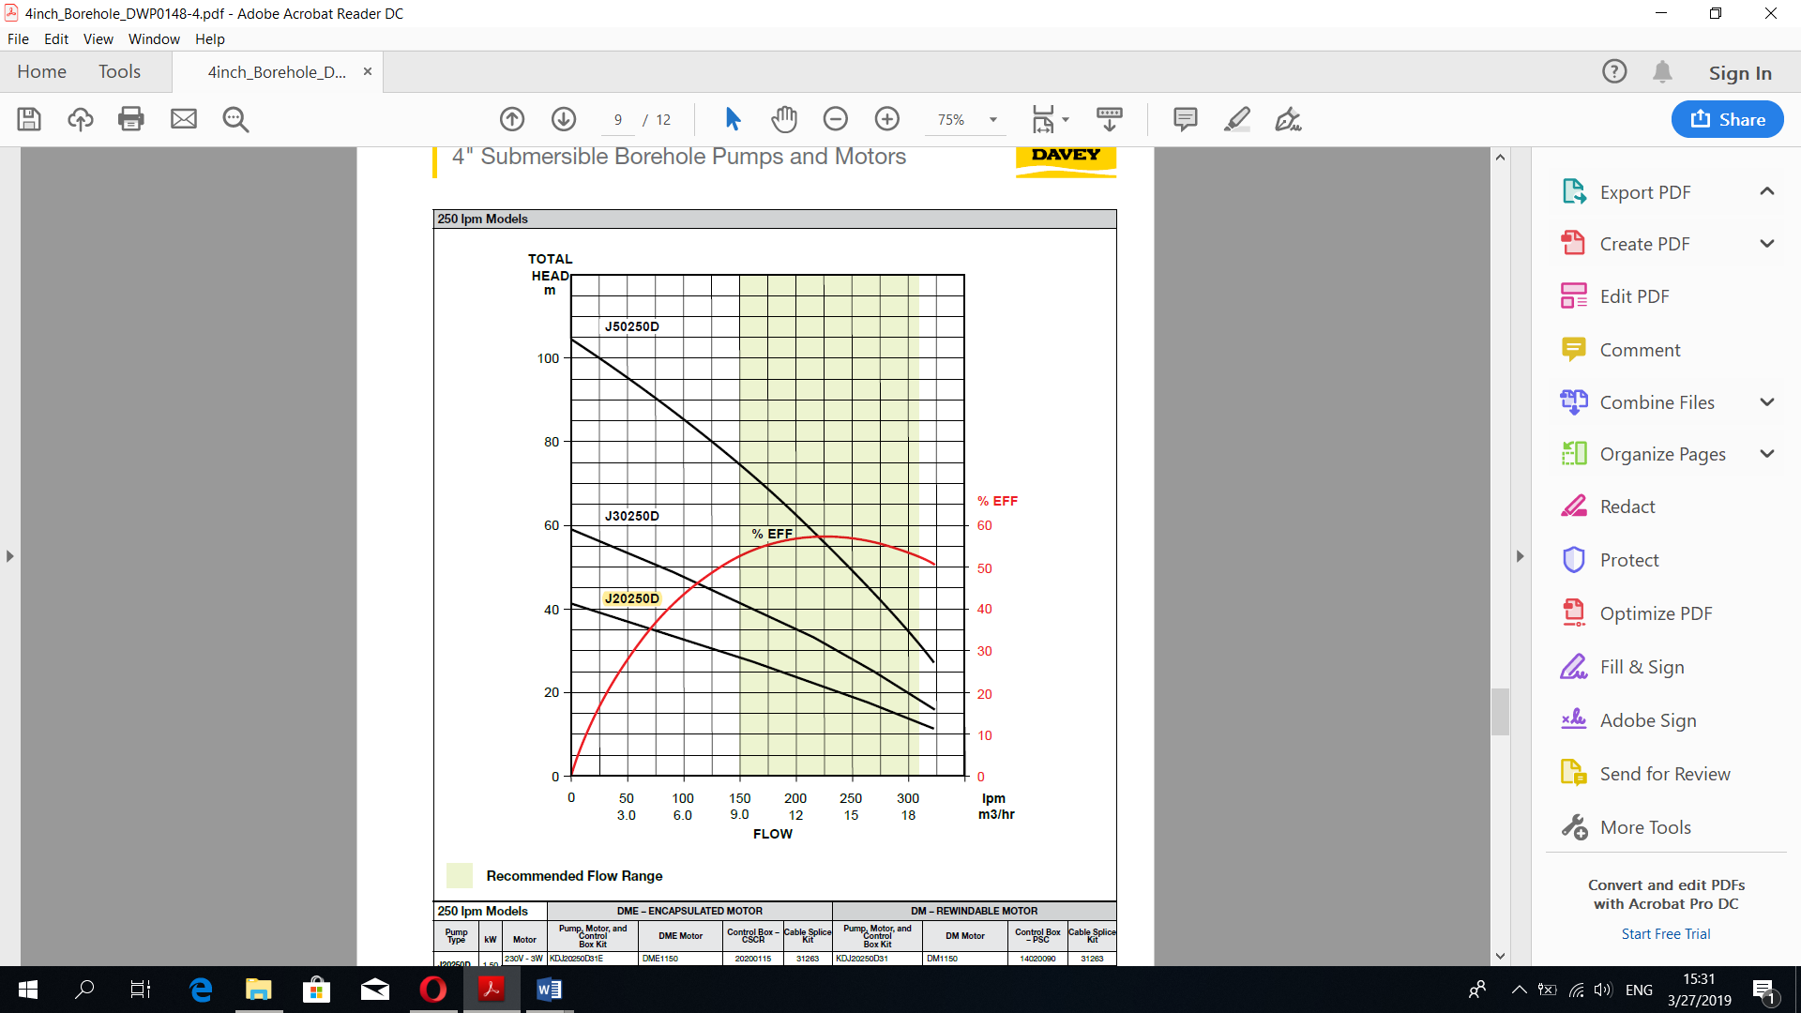
Selecting proper pump depending on TDH and Flow rate

Slide 8
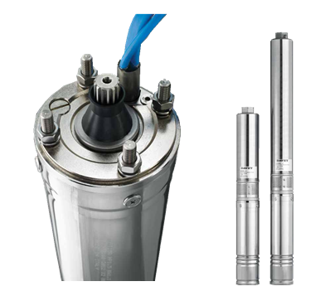
Submersible pump
Model | 50250D
Power (kW) | 3.7
Efficiency | 35-40%

Slide 9
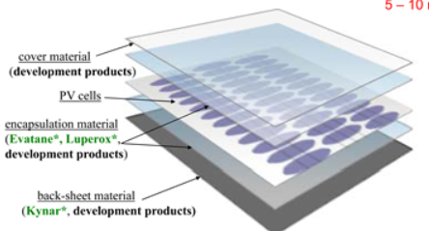

Photovoltaic panels
#PV panels = $\frac{System size (watt)}{each PV panels power (watt)}$
$= \frac{3700 watt}{320}$=12
Peak Power (Wp) | 320
Max voltage (V MPP) | 37.1
Max Current (I MPP) | 8.63
Module efficiency | 16.5

Slide 10
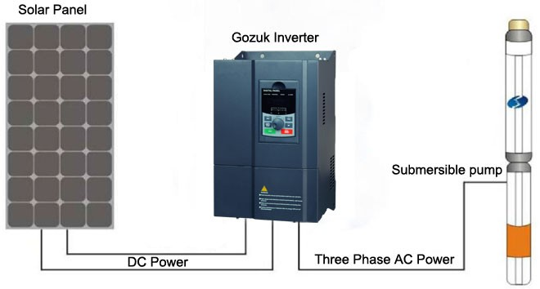
Inverter connection

Slide 11

      PV modules connection method.
Series connected modules = $\frac{V inverter}{V max mpptPV}$
$\frac{445}{37.1}$= 12 module

Slide 12
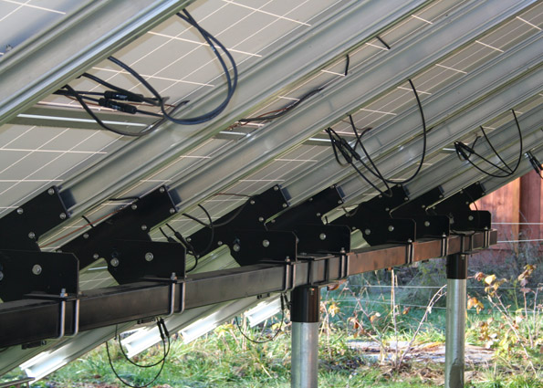
Wiring system
Cables (DC & AC)
Circuit breakers
Fuses
Surge arresters

Slide 13
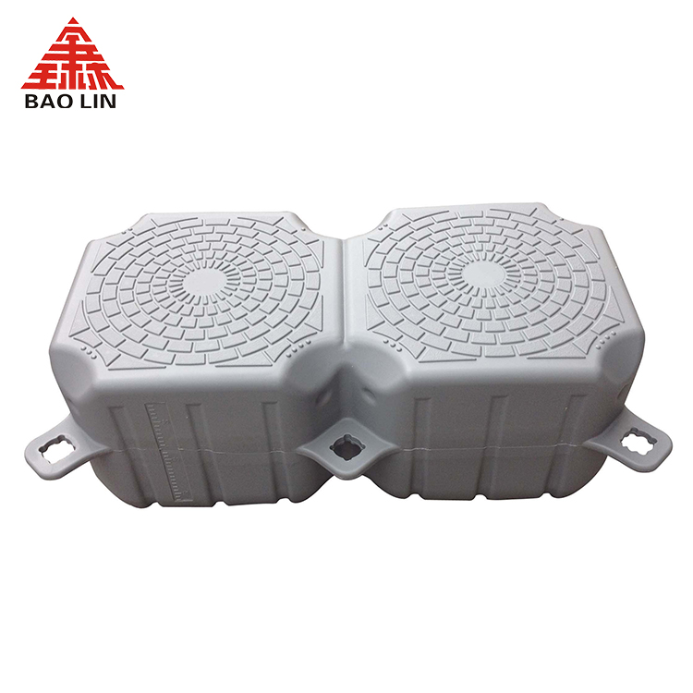
Floating system (HDPe)

Slide 14
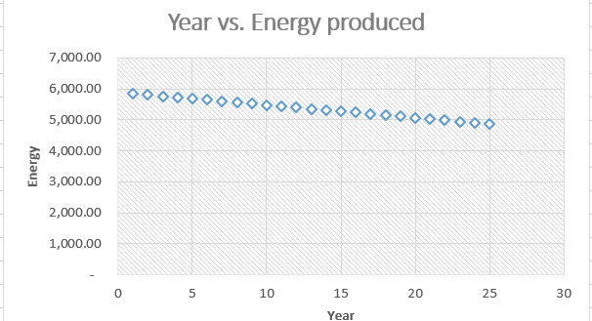

Pre-Feasibility study
Important information
Dollar rate | 3.58 ILS
Project capacity [kWp] | 3.7
Energy tariff | 0.13
Profit($) | 2,770.98
Selling price | 25,000.00
kWp Cost price [$] | 4,486.33
Project cost [$] | 16,599.42
SPP = $\frac{Project cost (\$)}{First year Profit (\$)}$
= $\frac{16,599.42 (\$)}{2,770.98 (\$)}$
=5.99 years

Slide 15
Constrains
Area coverage
Exact amounts and time
Feasibility

Slide 16
Conclusion
Photovoltaic power for irrigation costs are competitive with traditional energy sources for small, remote applications, if the total system design and utilization timing are carefully considered and organized to use solar energy as efficiently as possible. In the future, when the prices of fossil fuels rise and the economic advantages of mass production reduce the peak watt cost of the photovoltaic cell, photovoltaic power will become more cost competitive and more common.

Slide 17


