Slide 1

Graduation Project - II
Faculty of Engineering & Information Technology
Department of Building Engineering
Redesign of the United Motor Trading Company in Nablus
Prepared by:
Supervisor:
Eng. Haitham Sawalha
Abdallah Omar
Qays Dasoqi
Qusay Hassanein
Date: 24/12/2018

Slide 2
Content
Site Analysis
Architectural Design
Electrical Design
Environmental Design
Structural Design
Quantity Surveying
Mechanical Design

Slide 3
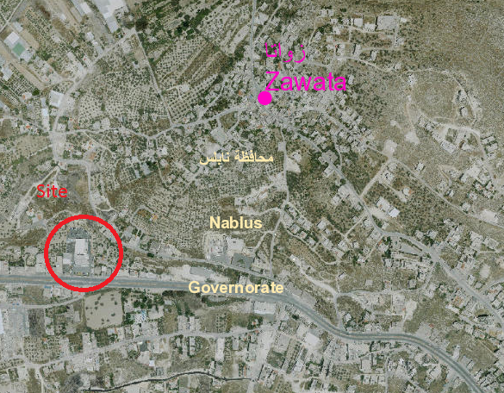
Site analysis
Site location

Slide 4
Architectural Design
- The project was divided into two blocks.
- Each block consists of three floors.
- The first block consists of Showrooms, and multipurpose hall
- The second block consists of offices, workshop and painting shop
Block | Area (m²)
First | 2382
Second | 3946

Slide 5
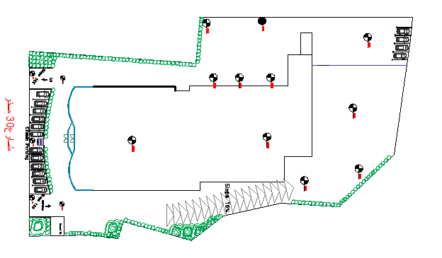
Site plan

Slide 6
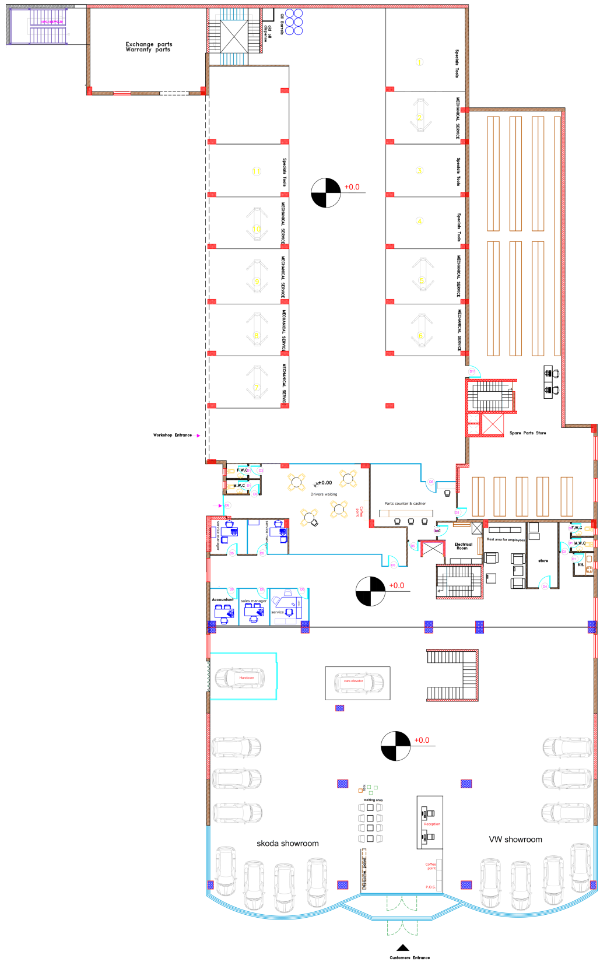
Ground floor plan

Slide 7
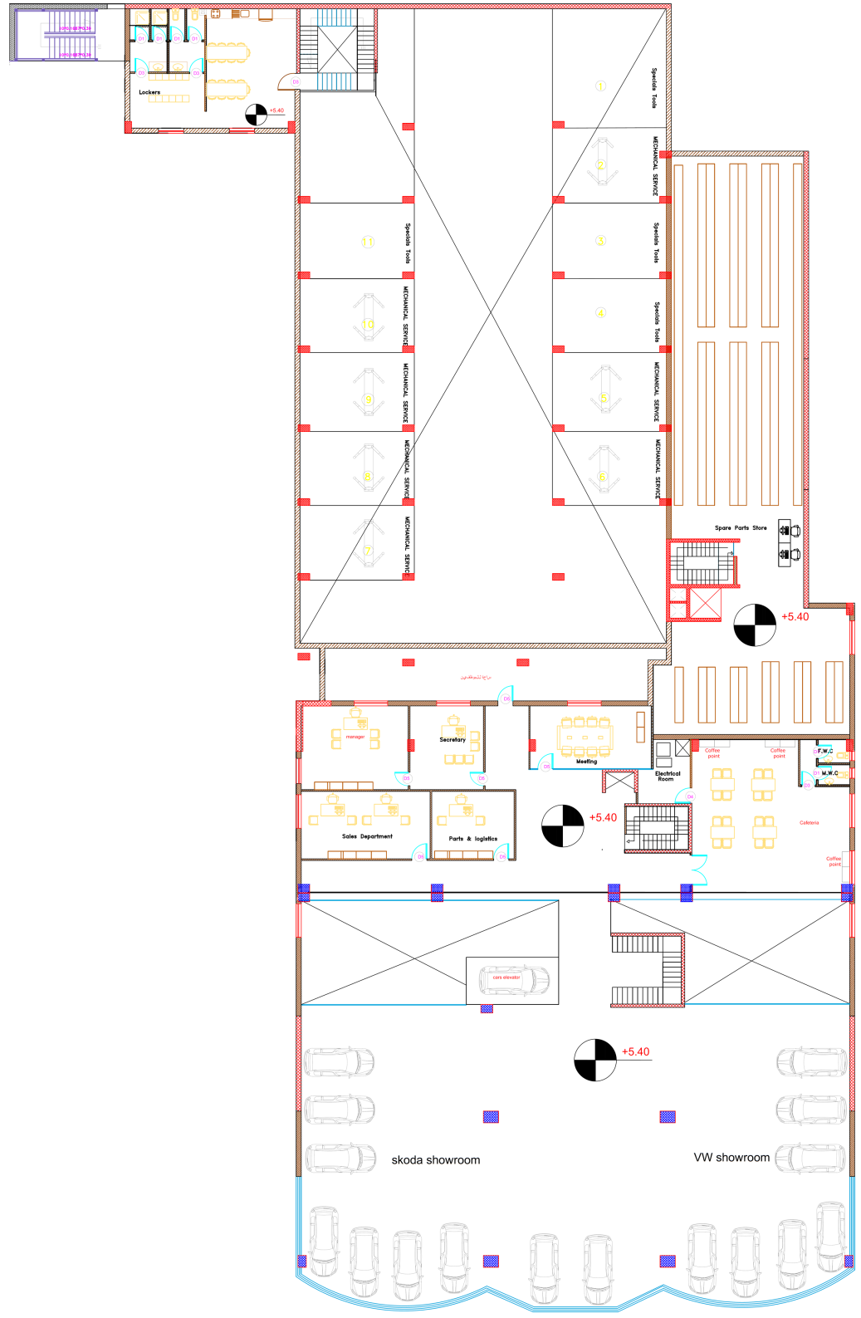
First floor plan

Slide 8
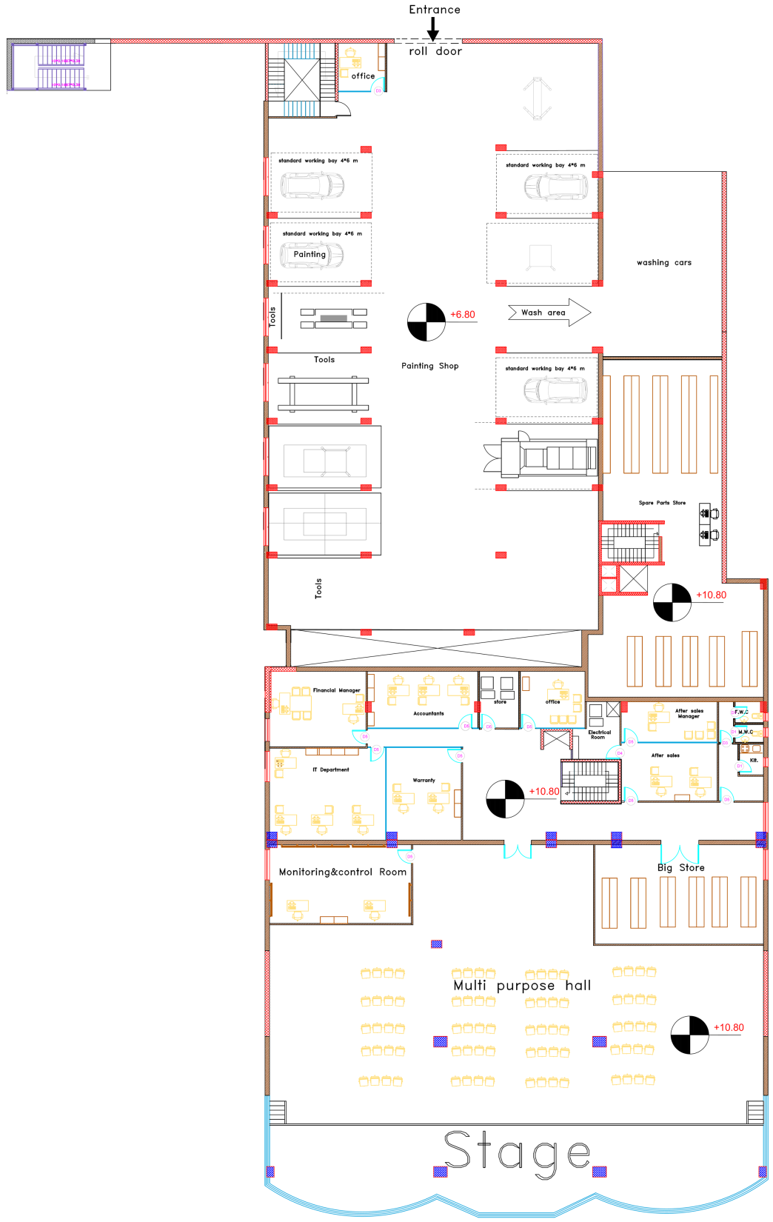
Second floor plan

Slide 9
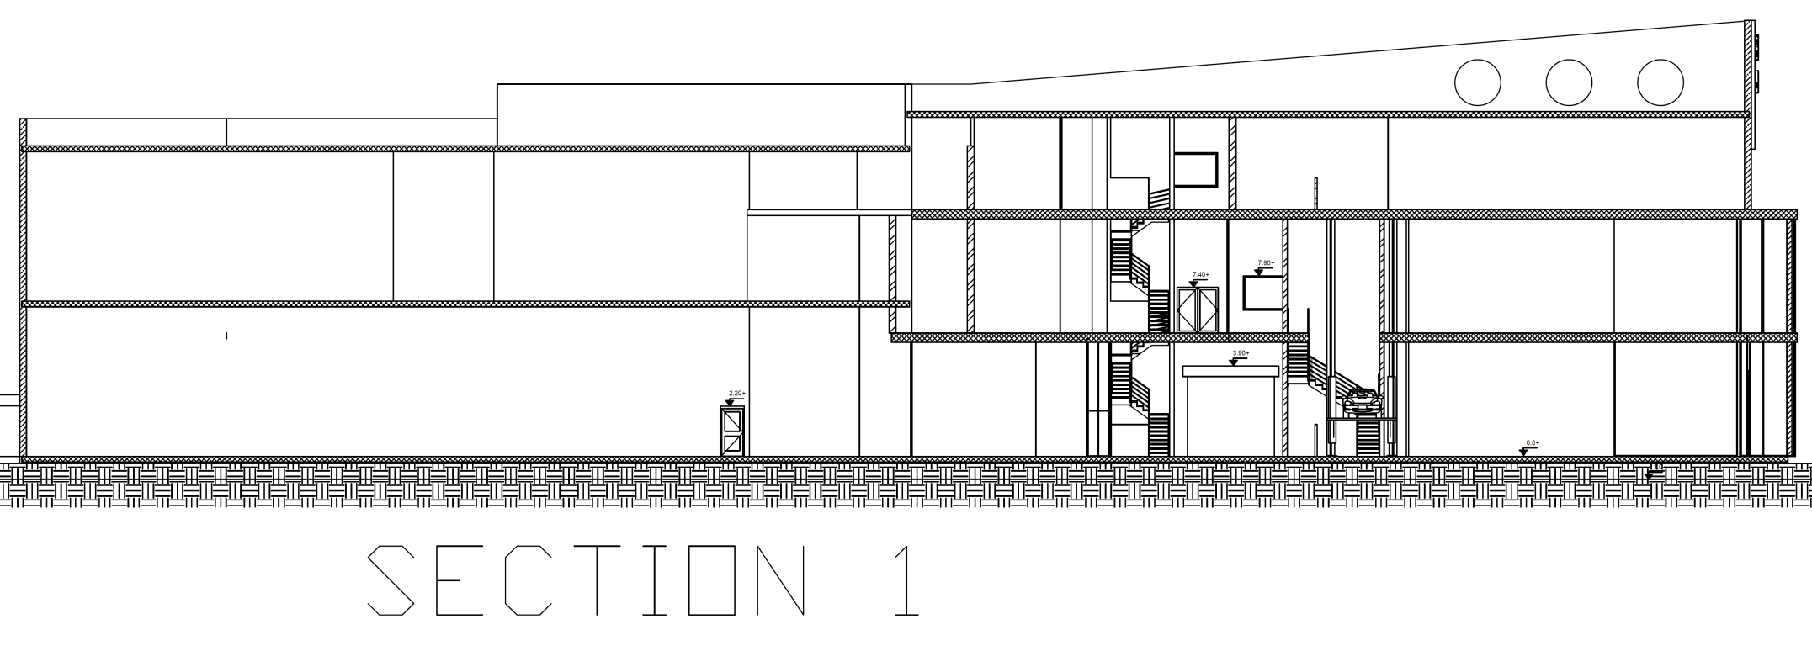

Slide 10
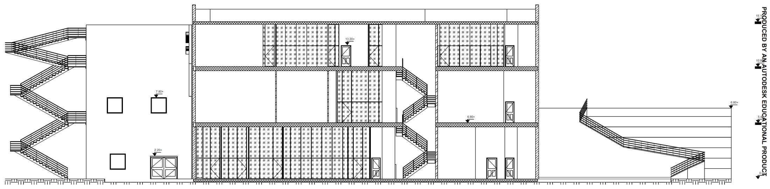

Slide 11
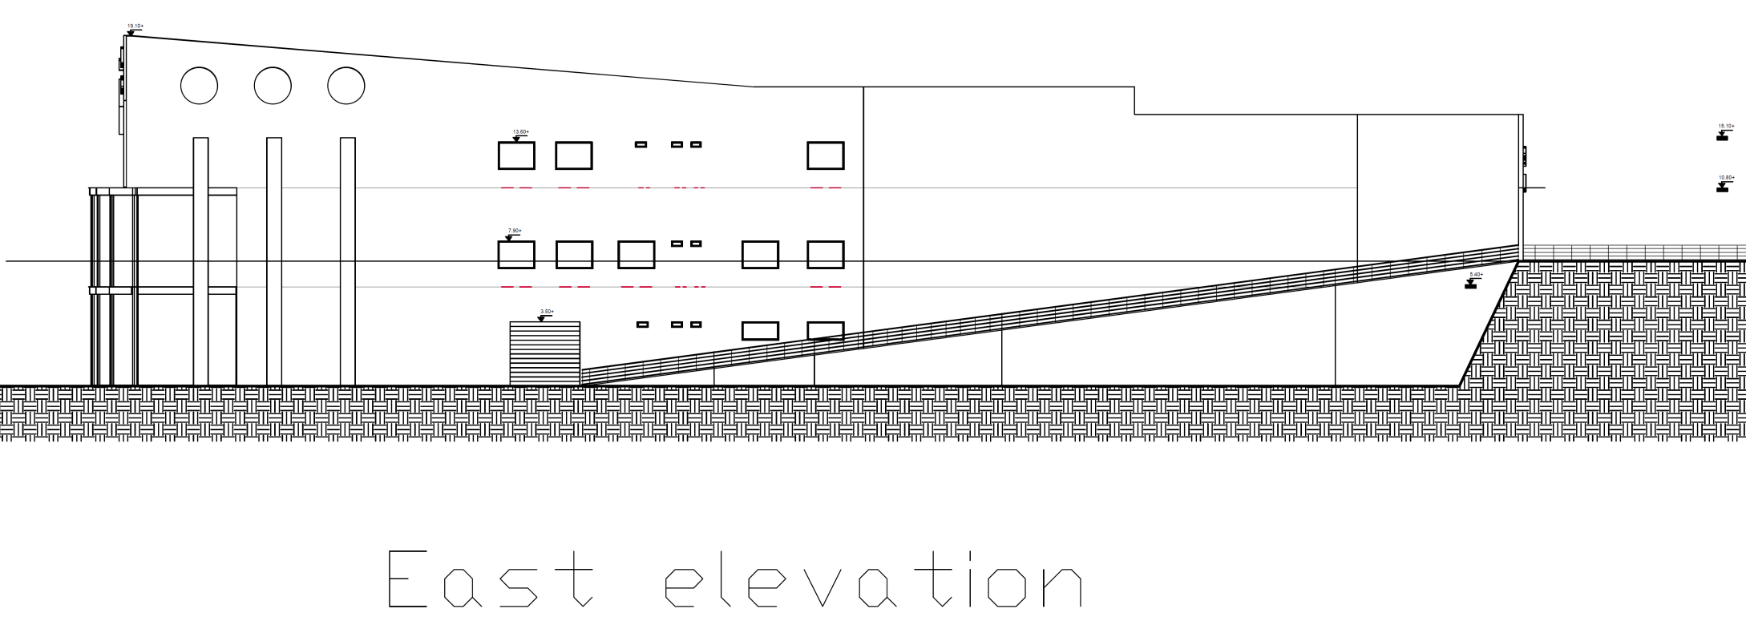

Slide 12
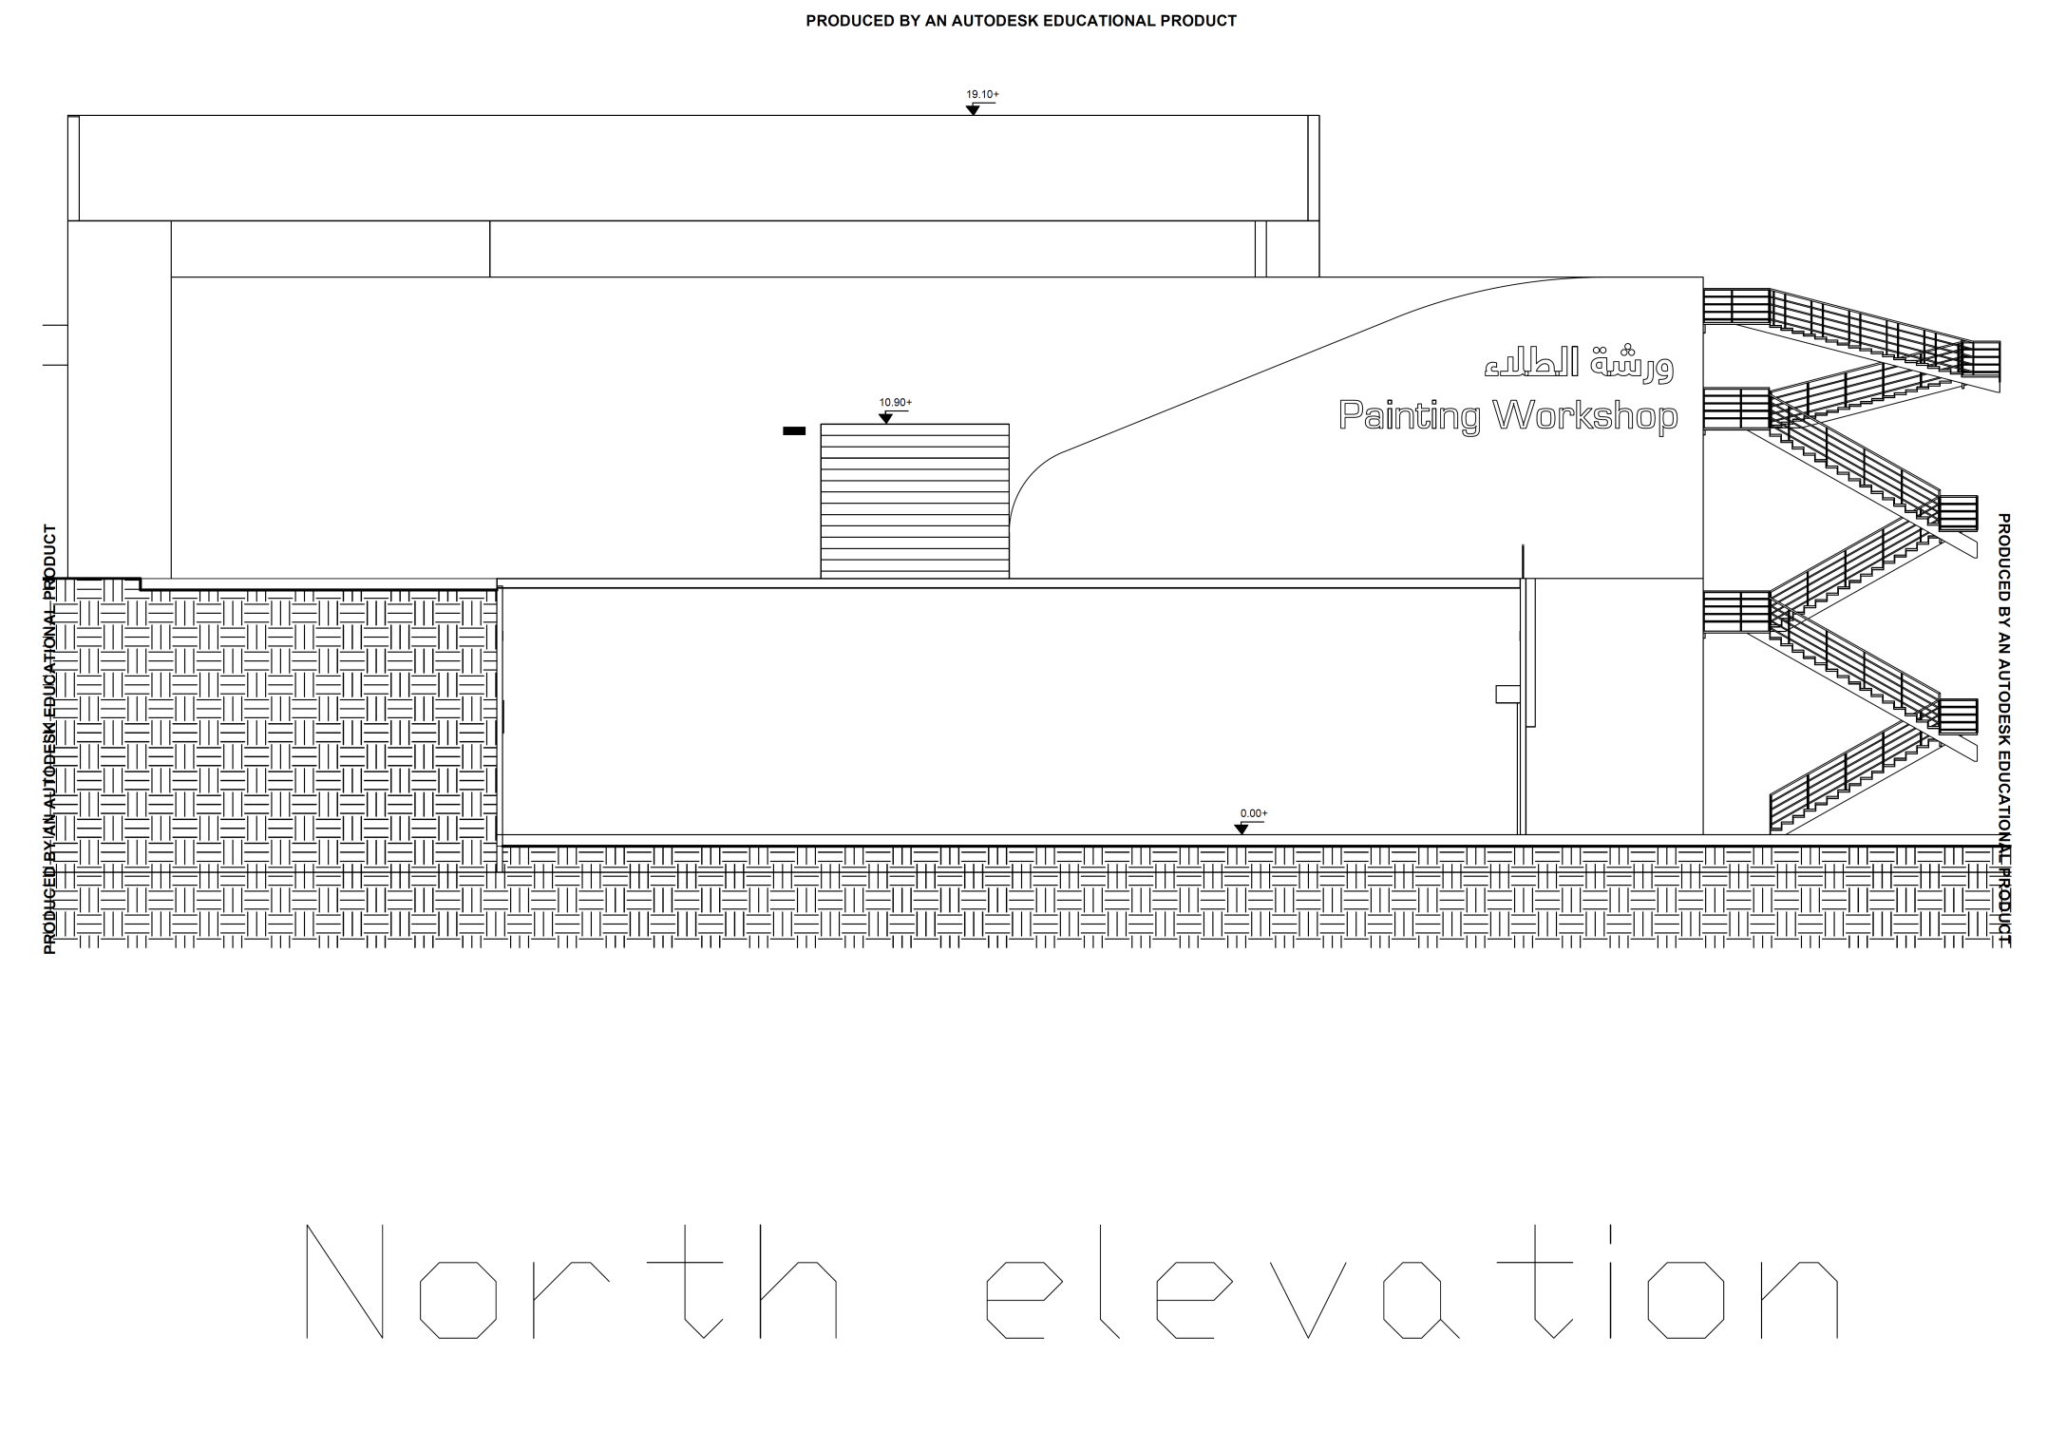

Slide 13
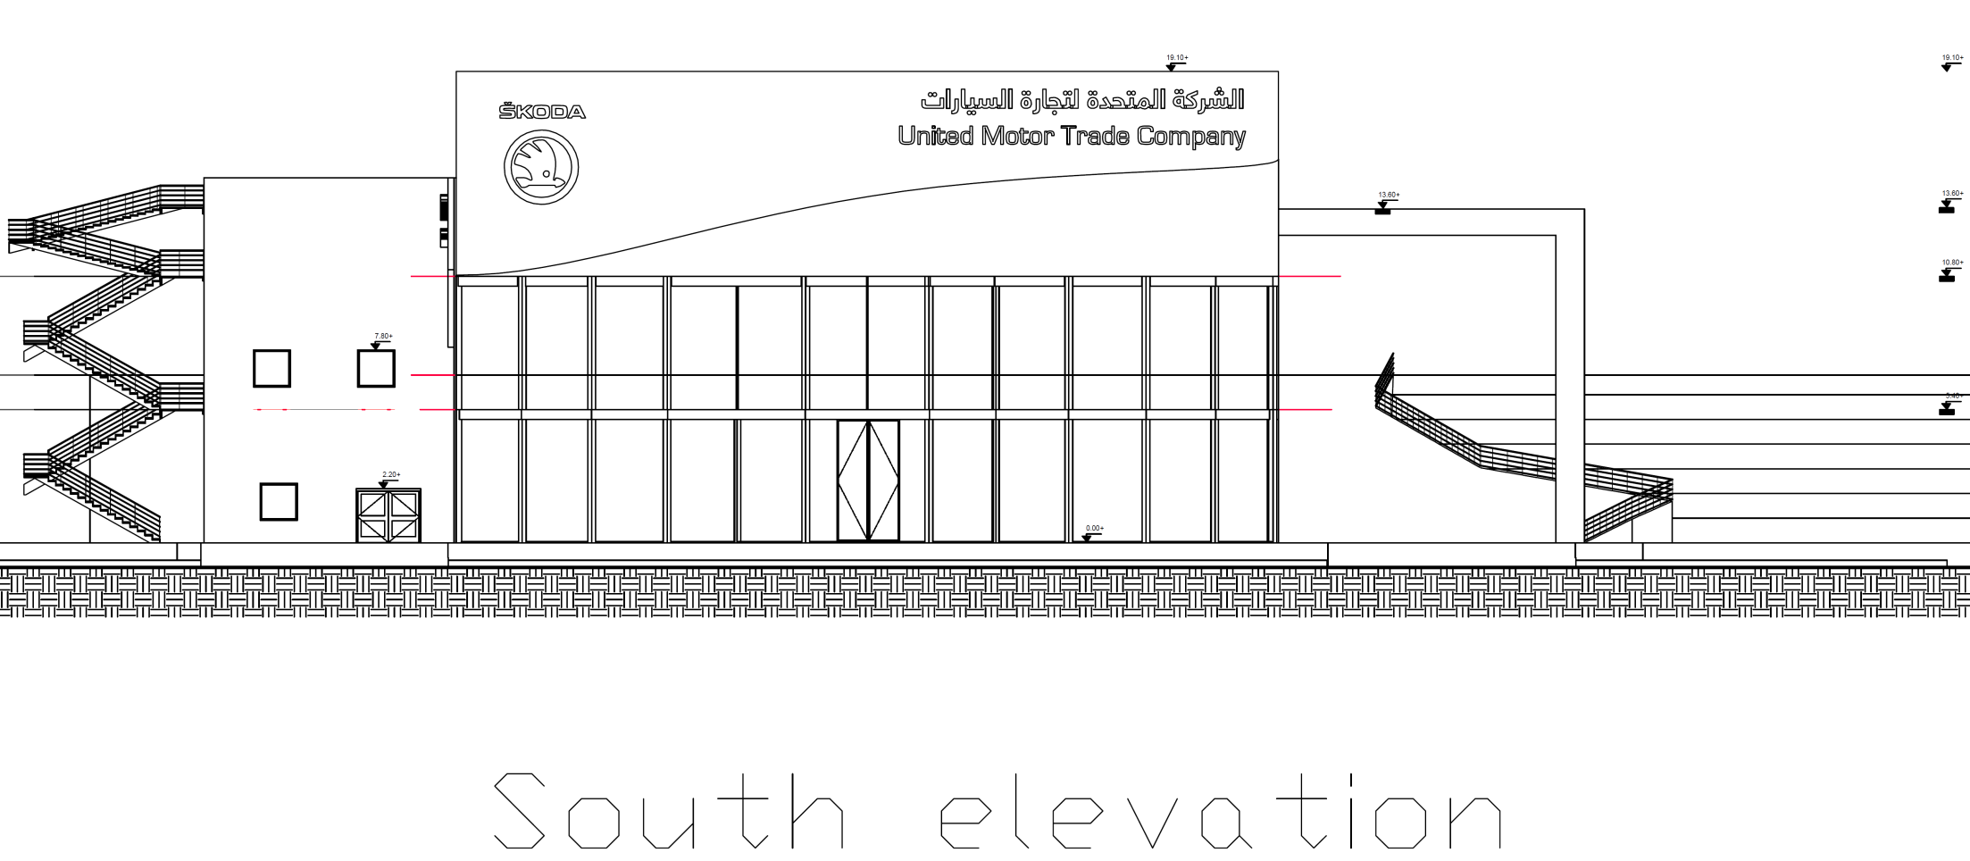

Slide 14
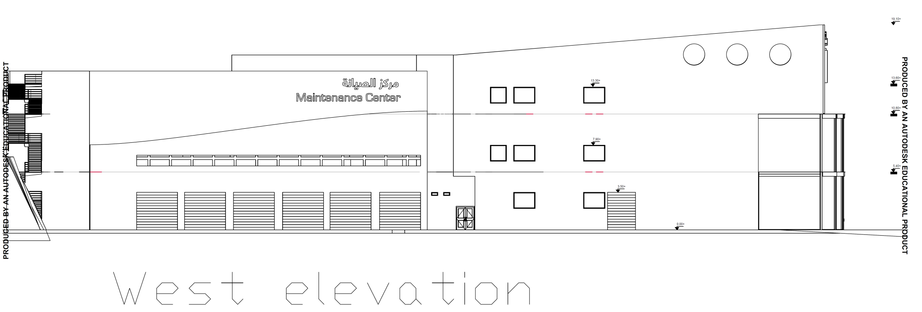

Slide 15
Mechanical Design
1
Water supply system
3
HVAC system
4
Firefighting system
2
Drainage system

Slide 16
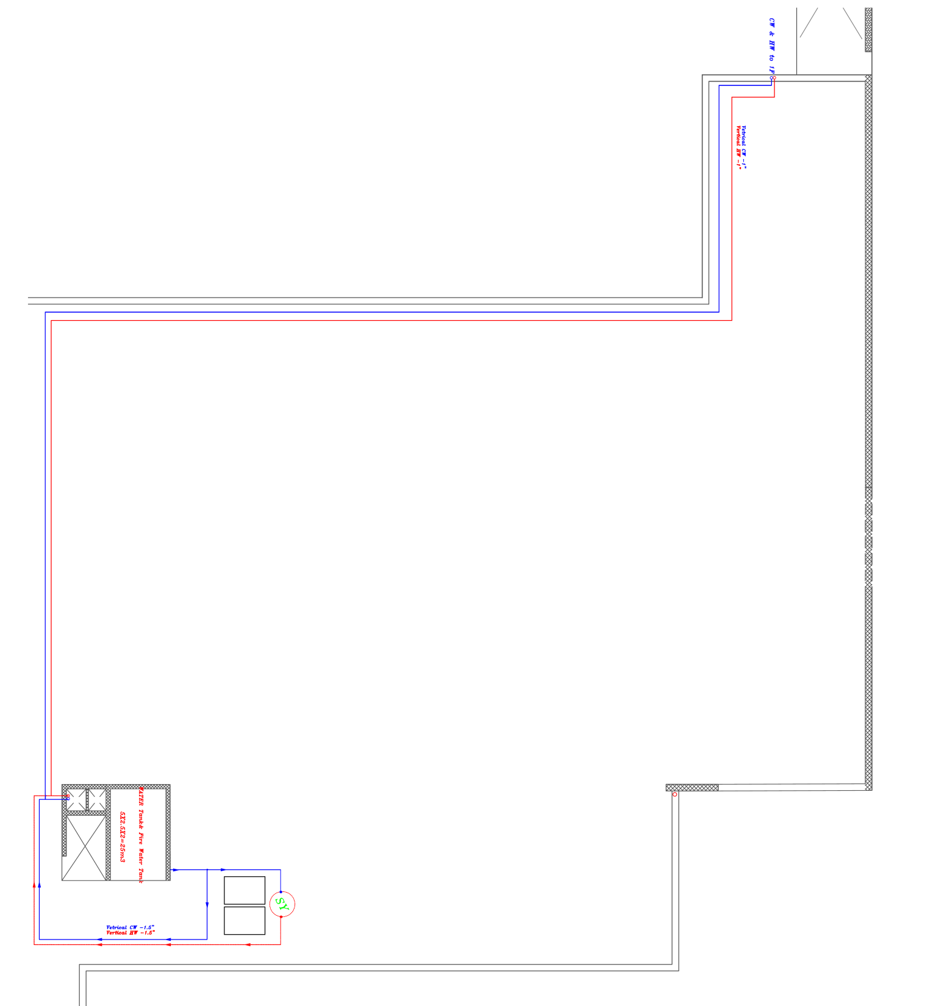
Water supply system
Tank and main feeders in roof

Slide 17
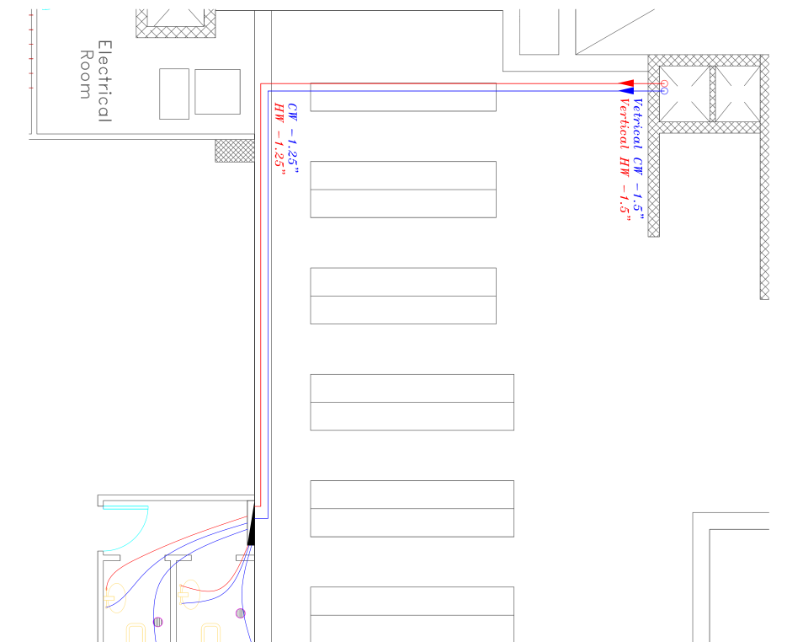
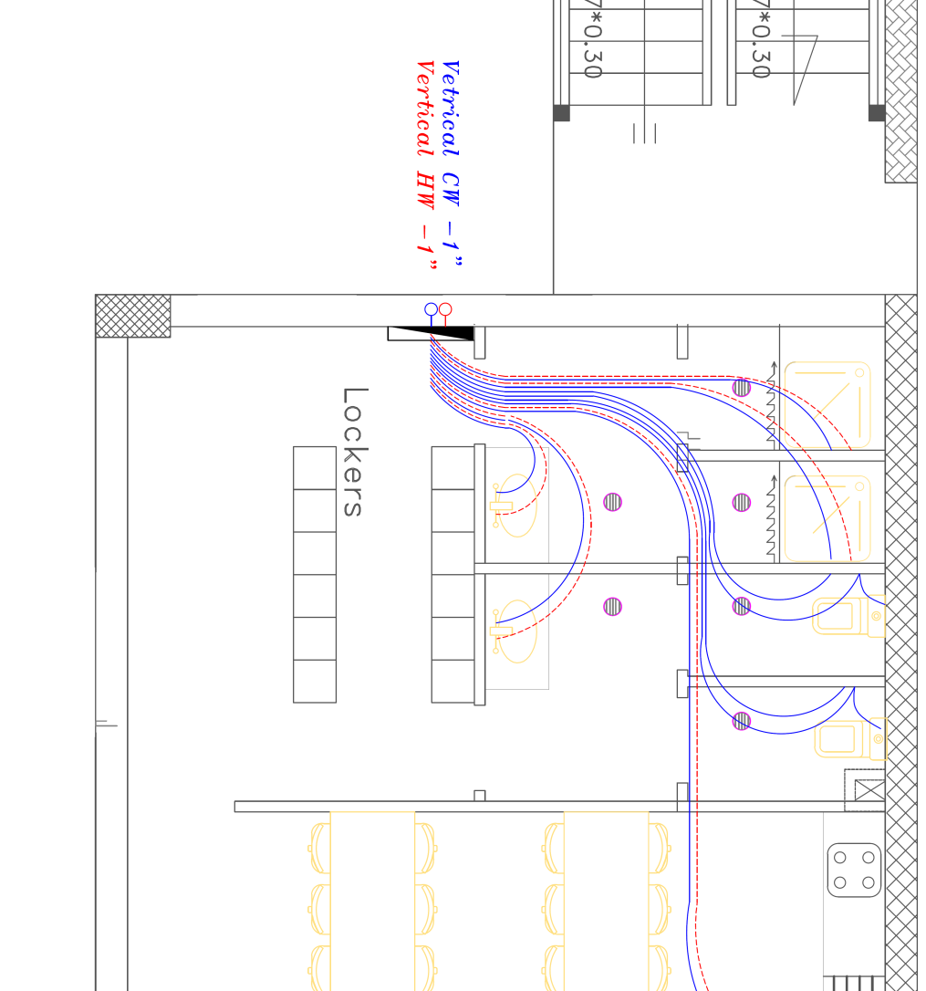
Sample in first floor

Slide 18
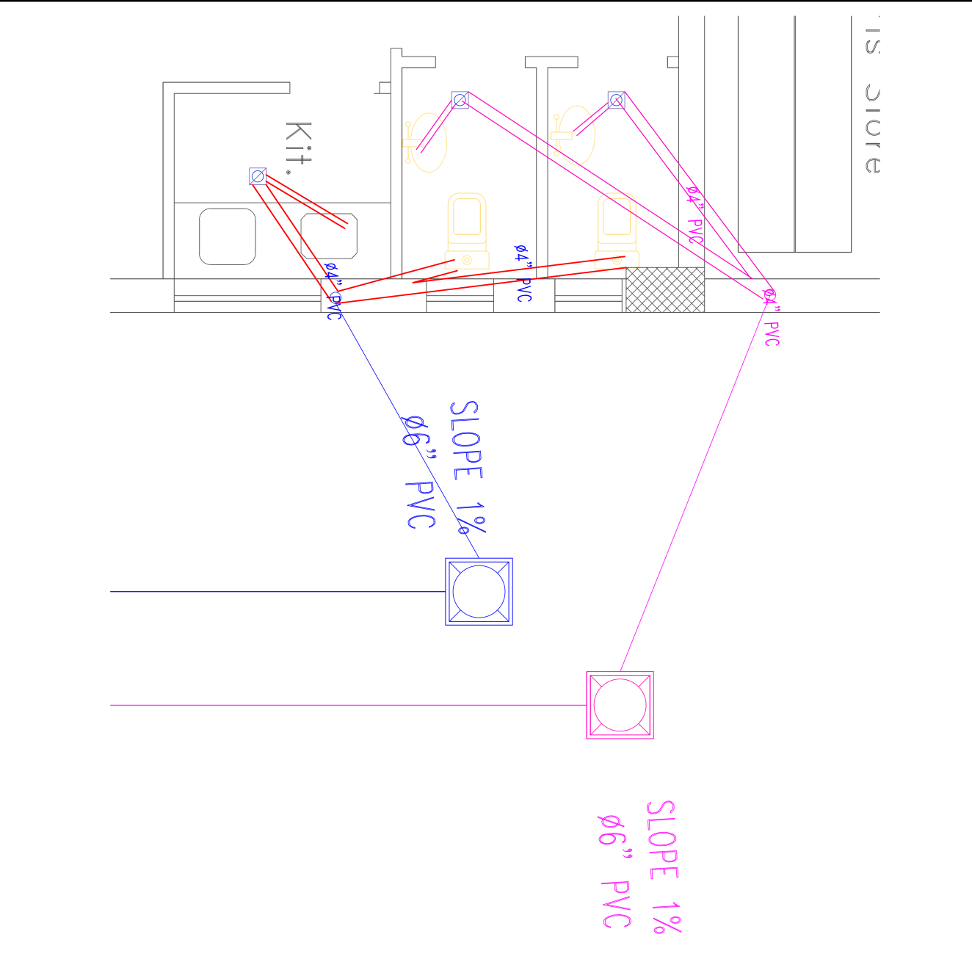
Drainage system
Sample in ground floor

Slide 19
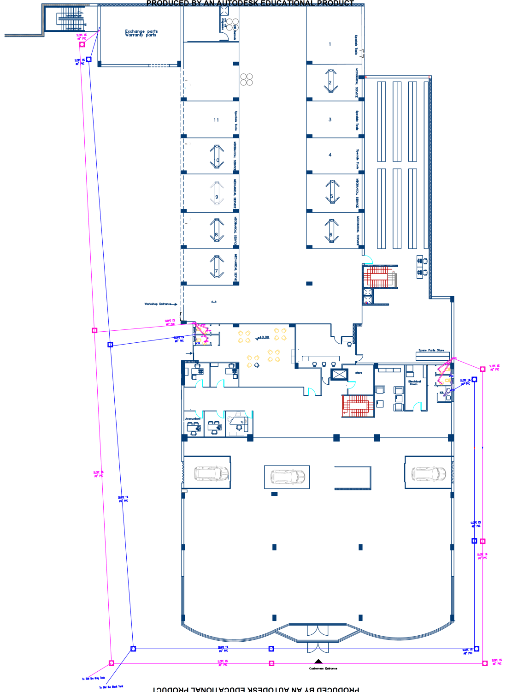
Manholes distribution

Slide 20
HVAC system
Heating load (KWh) | 27472.85
Cooling load (KWh) | 75212.70
Energy per total area building KWh/m2 | 73.06<100 it is OK

Slide 21
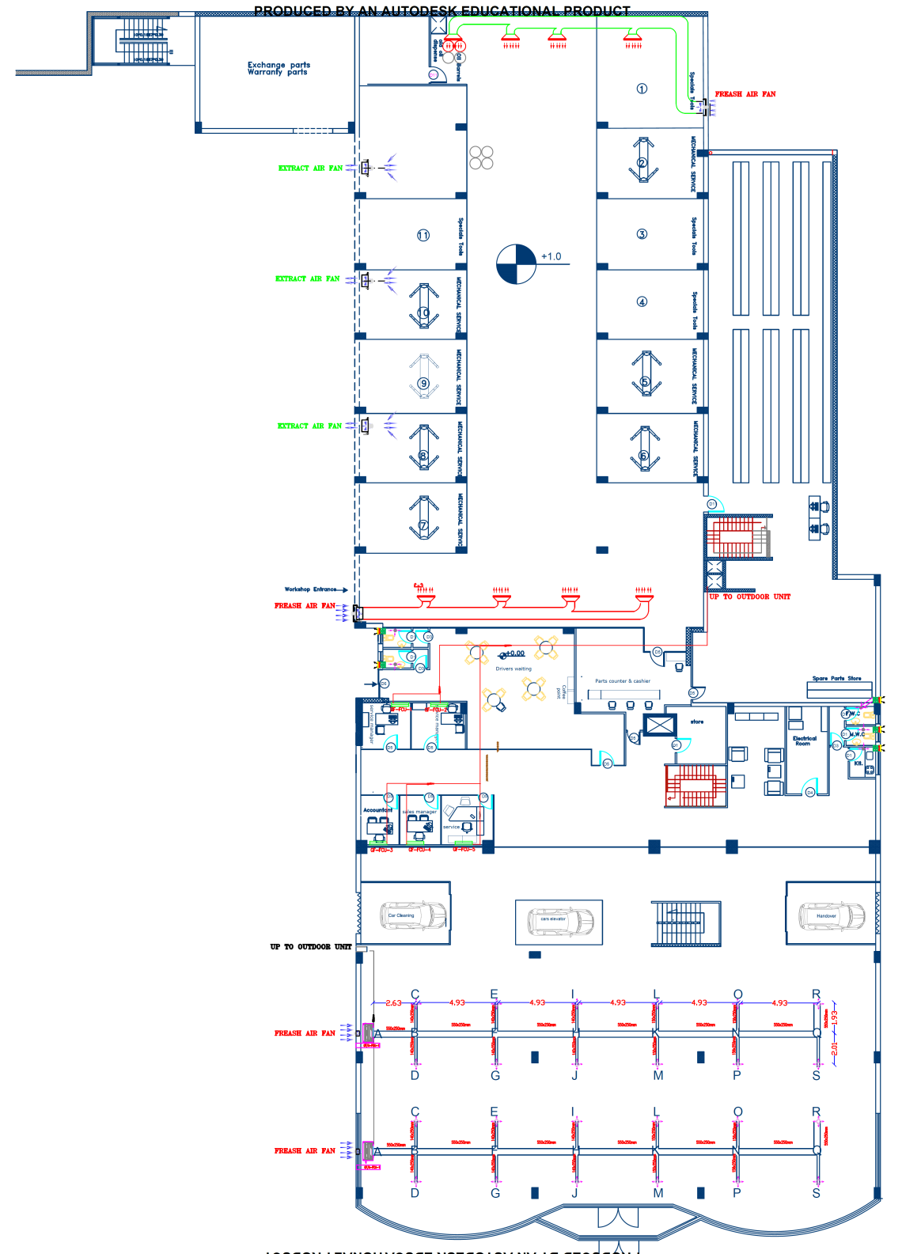
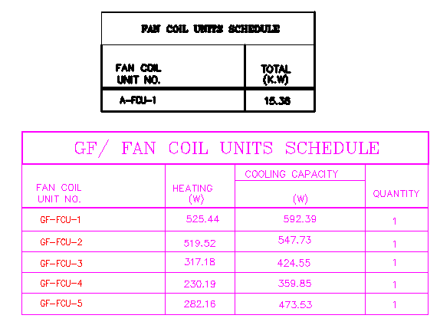

Slide 22
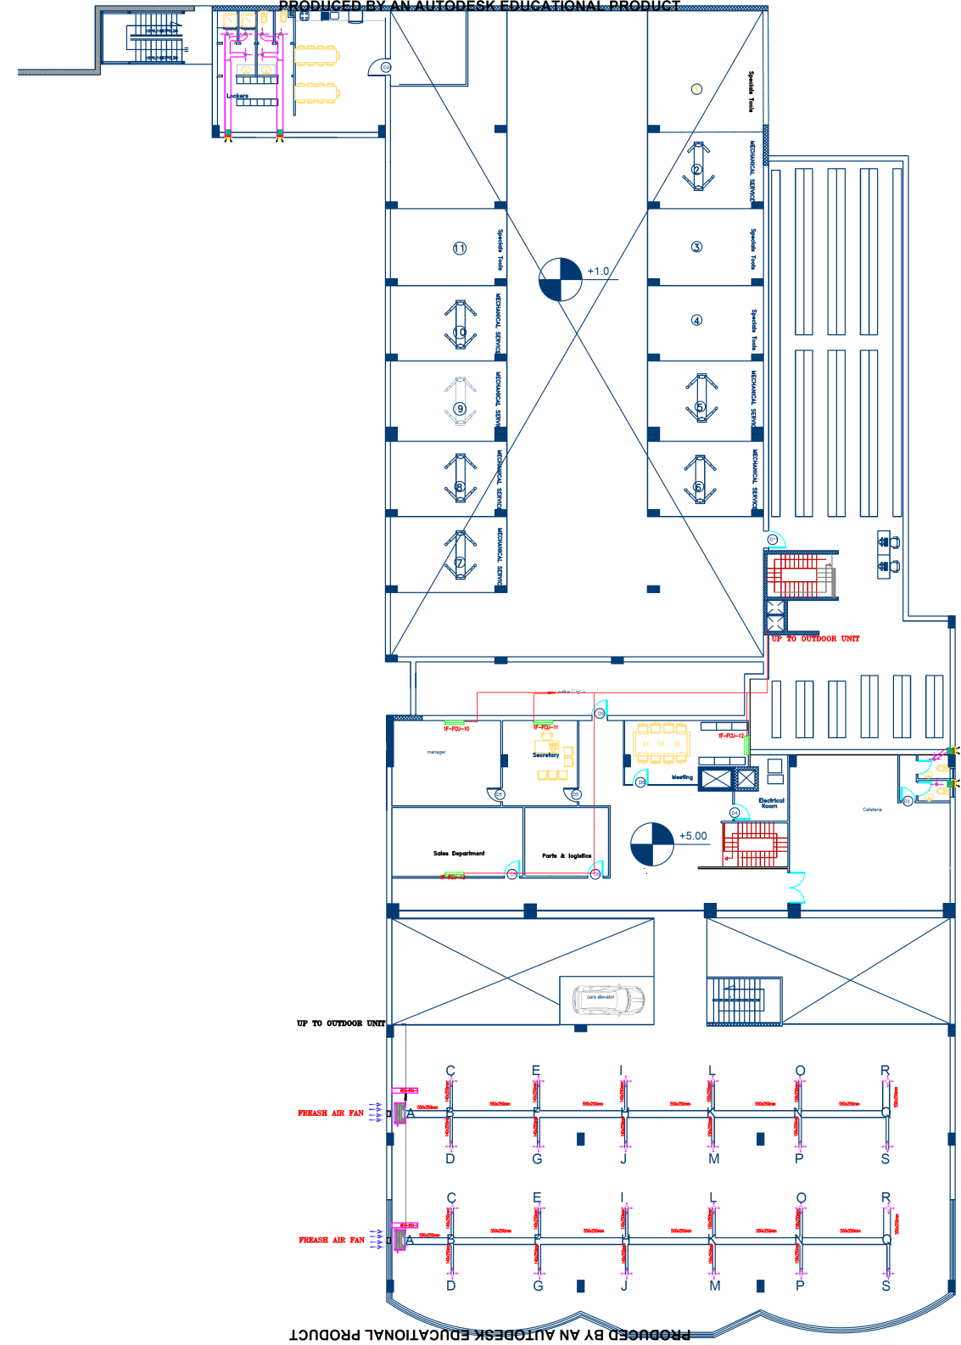
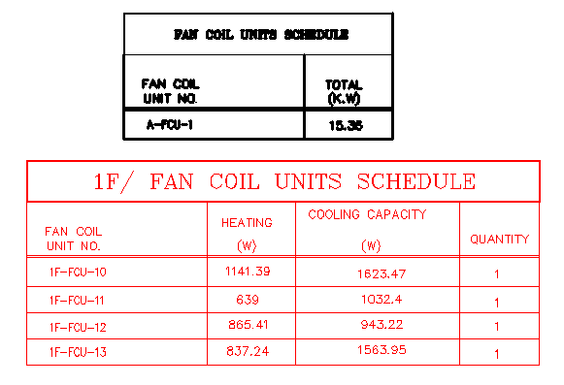

Slide 23
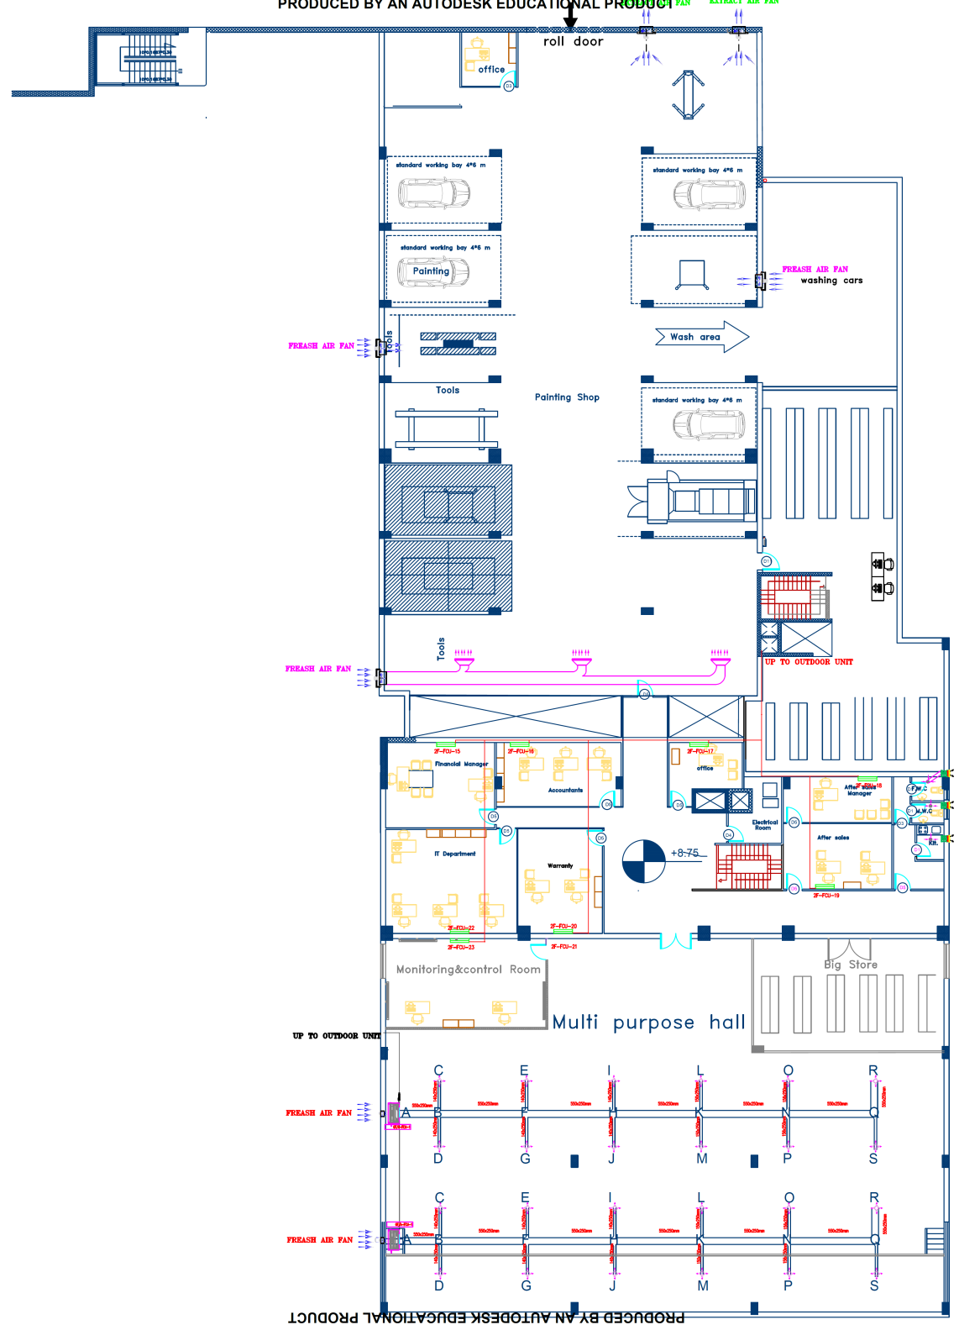
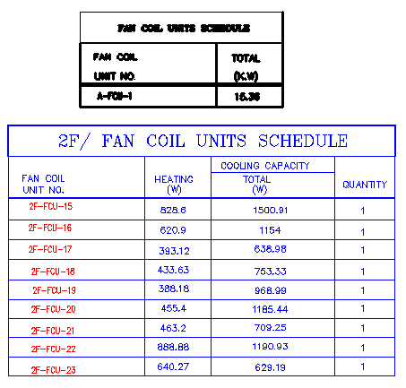

Slide 24
Firefighting system
Types of safety systems used in building
Sprinklers
Extinguishers
Hose station
Fire exit signs

Slide 25
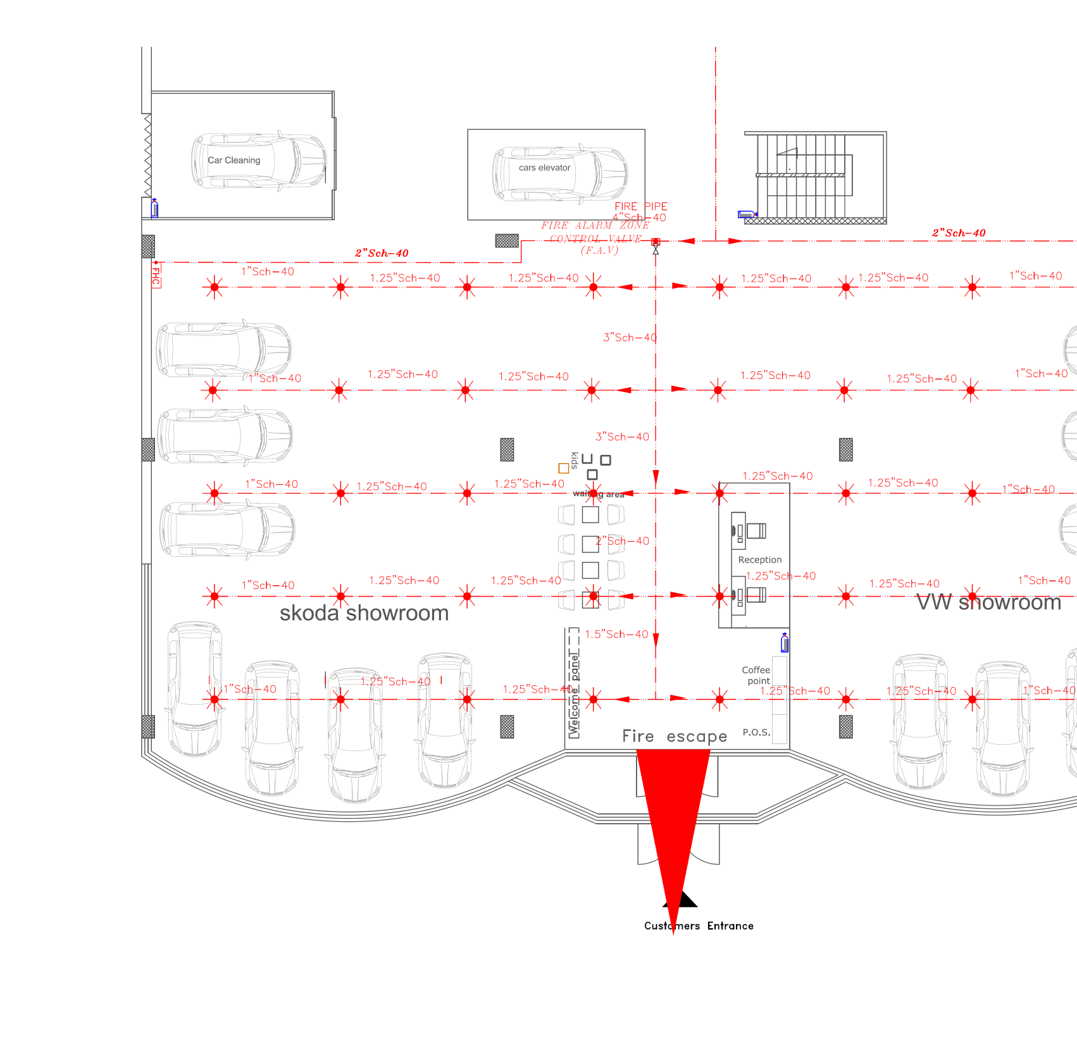

Slide 26
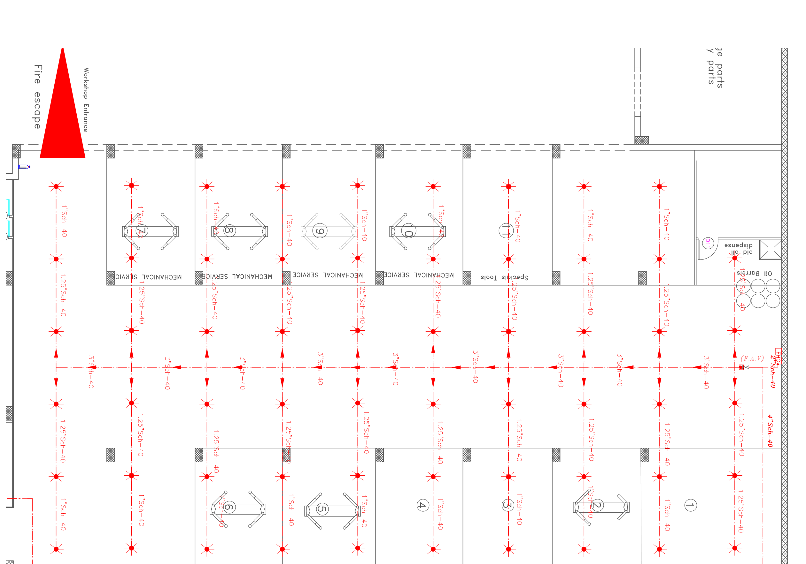

Slide 27
Electrical Design
1
2
sockets distribution
Lighting Design

Slide 28
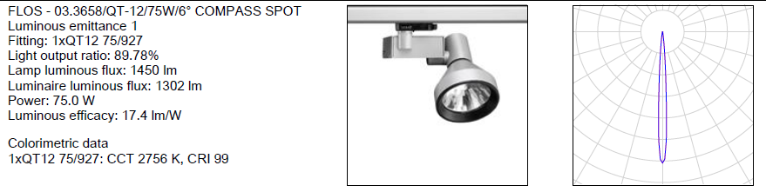
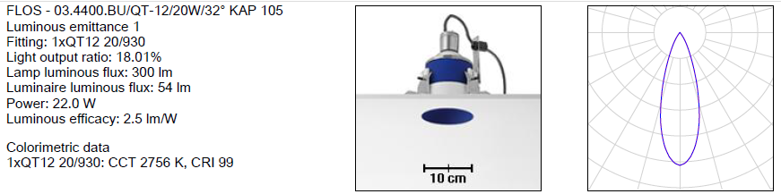
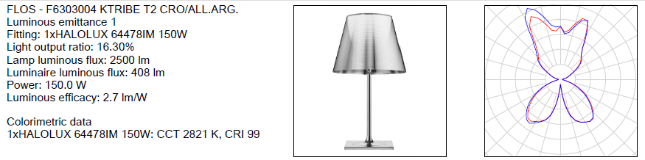
Lighting Design
Luminaries used

Slide 29
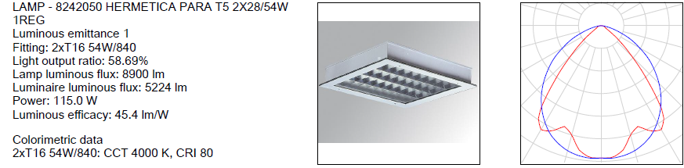
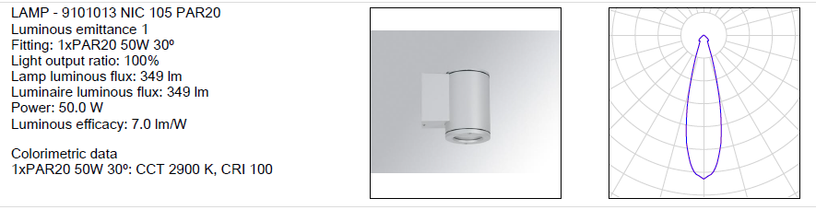
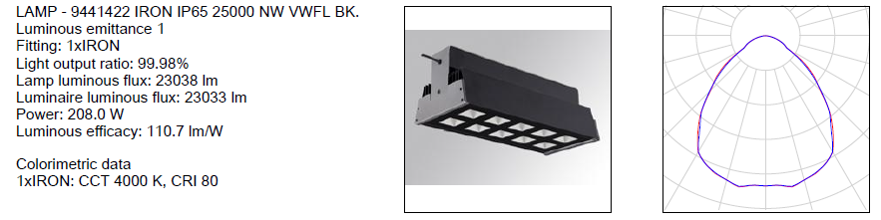

Slide 30
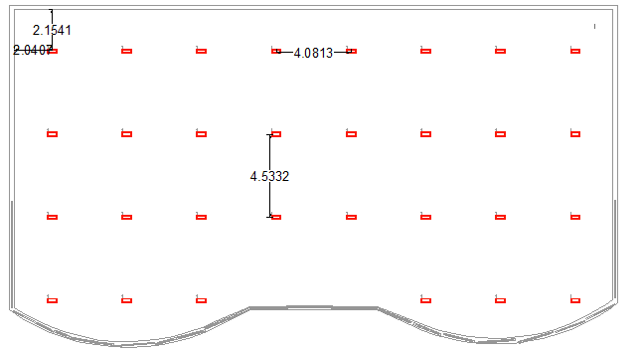
- Showroom
Zone | Standard target Lux | Designed Lux | UGR | Assessment
Showroom | 800 | 868 | <10 | OK

Slide 31
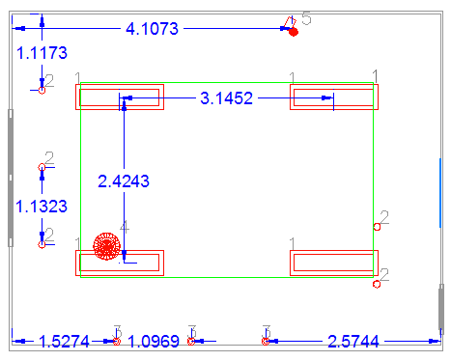
- Manager office
Zone | Standard target Lux | Designed Lux | UGR | Assessment
Manager office | 500 | 548 | 16.6 | OK

Slide 32
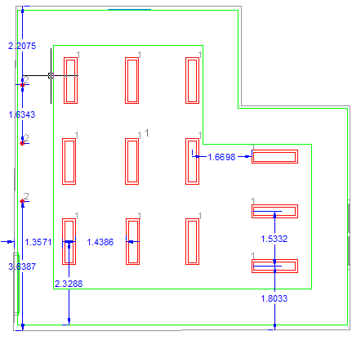
- Cafeteria
Zone | Standard target Lux | Designed Lux | UGR | Assessment
Cafeteria | 300 | 301 | < 10 | OK

Slide 33
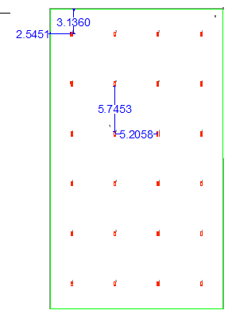
- Workshop
Zone | Standard target Lux | Designed Lux | UGR | Assessment
Cafeteria | 250 | 264 | 26.3 | OK

Slide 34
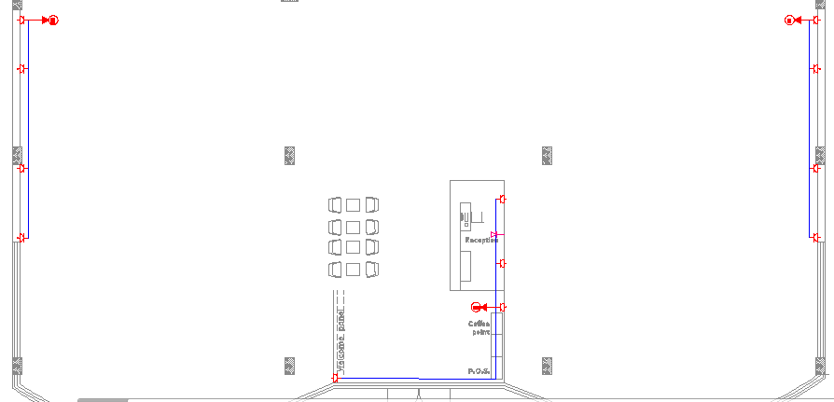
Electrical Discription and sockets layout
Space | Number of sockets
Showroom | 19
Office | 4
cafeteria | 6
Workshop: each part has 2 sockets, one for personal work and other for general.

Slide 35
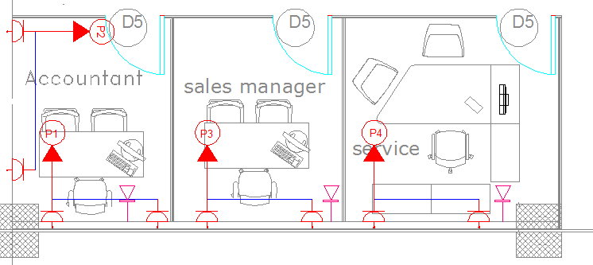
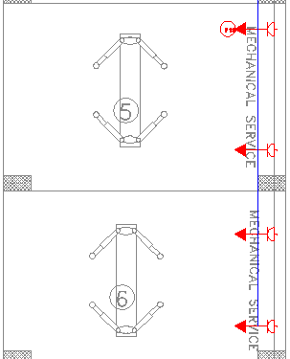
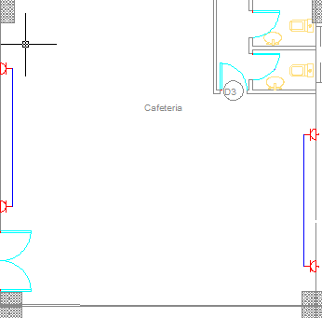

Slide 36
Environmental Design
1
2
Acoustical Design
Thermal Design

Slide 37
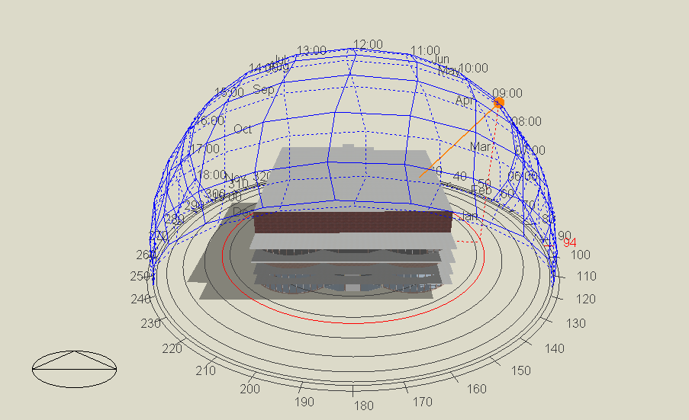
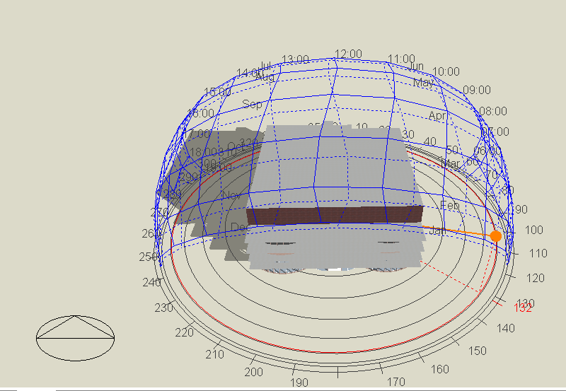
Thermal Design
At 9:00 AM
21/7
21/1

Slide 38
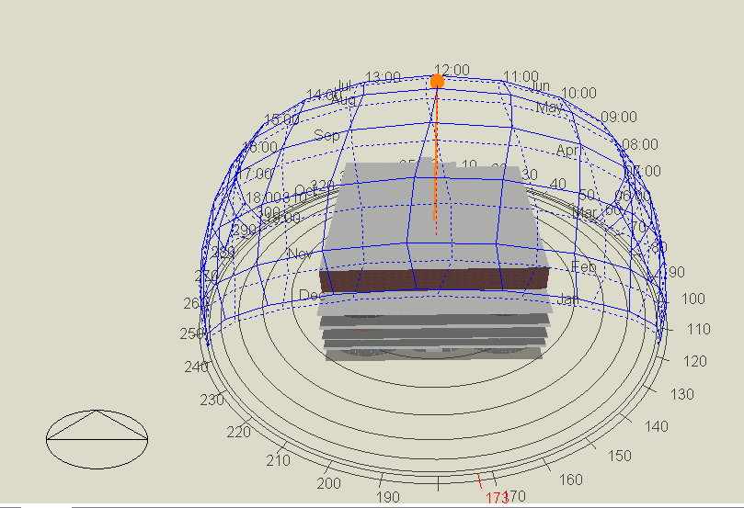
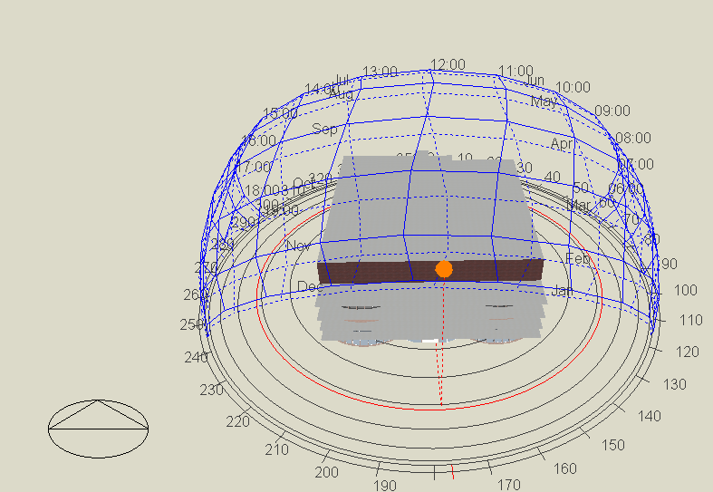
At 12:00 PM
21/7
21/1

Slide 39
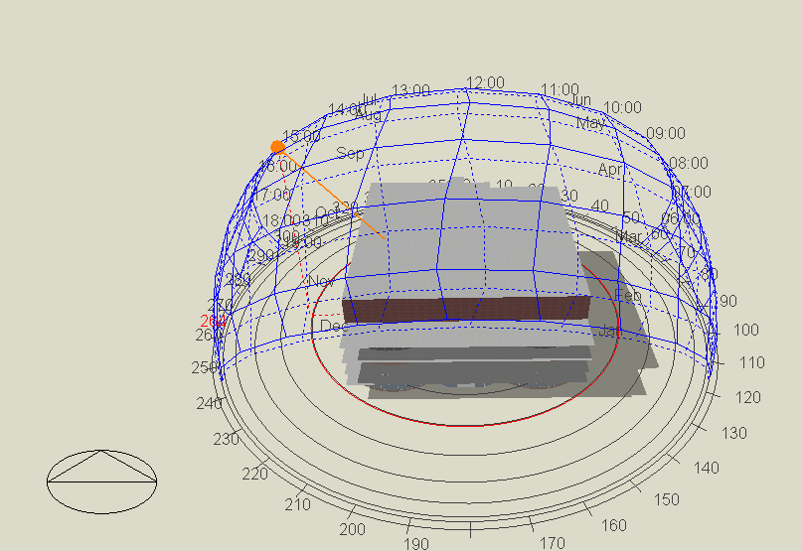
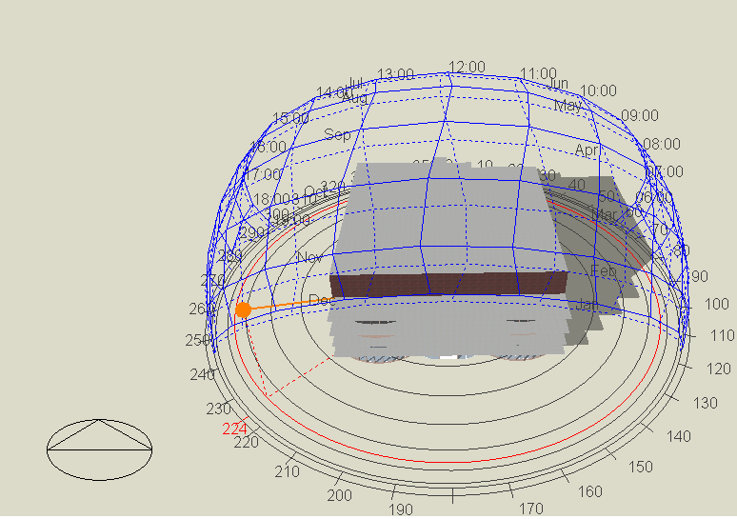
At 3:00 PM
21/7
21/1

Slide 40
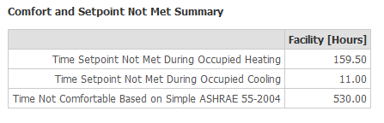
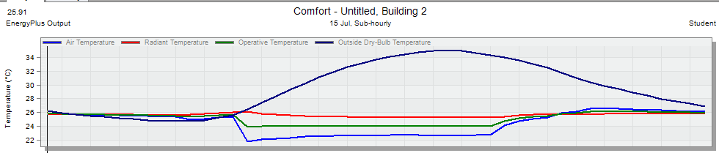
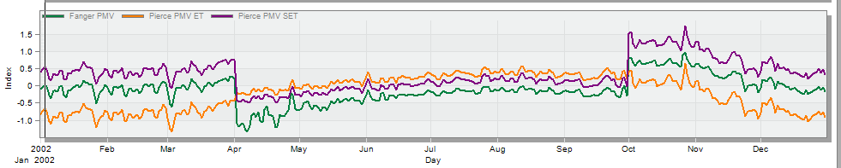
- Not comfortable hours
- Operative and air temperatures
- PMV values

Slide 41
case | comment
Pierce PMV ET values are ranged between – 1 to 0.5. | The values are relatively not very bad.
Time Not Comfortable Based on Simple ASHRAE 55-2004 equals 530 hour per year. | This value is less than 1000 hour per year, so there is good comfort inside the building.
The heating air temperature equals 24°C and the operative air temperature equals 22 °C. | The difference between two values is equals 2 °C, so it is a good indicator for thermal comfort.

Slide 42
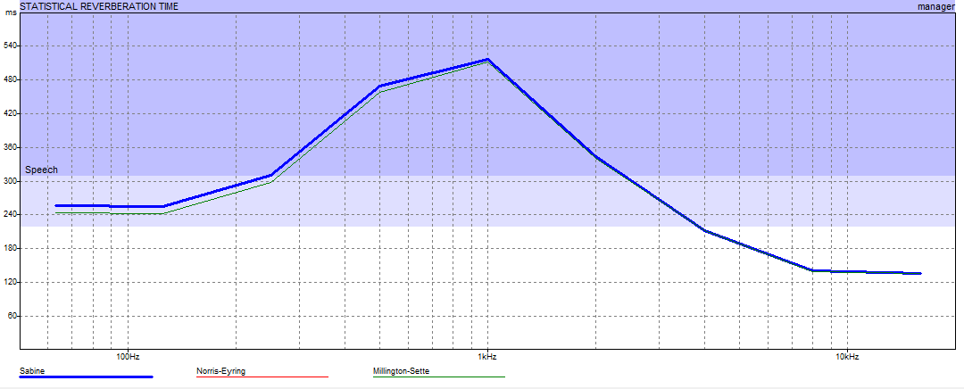
Acoustical Design
Reverberation time checks
      Manager office
Maximum value of RT60 in manager office at used frequencies equals 0.50 s at 1 kHz,
The values of RT60 at all used frequencies is within the range which is less than 1.2s , OK

Slide 43
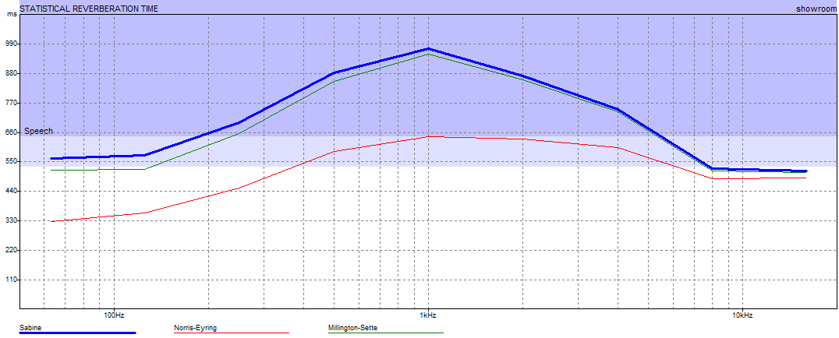
      ii. Showroom
Maximum value of RT60 in showroom at used frequencies equals 0.97 s at 1 kHz,
The values of RT60 at all used frequencies is within the range which is less than 2s , OK

Slide 44
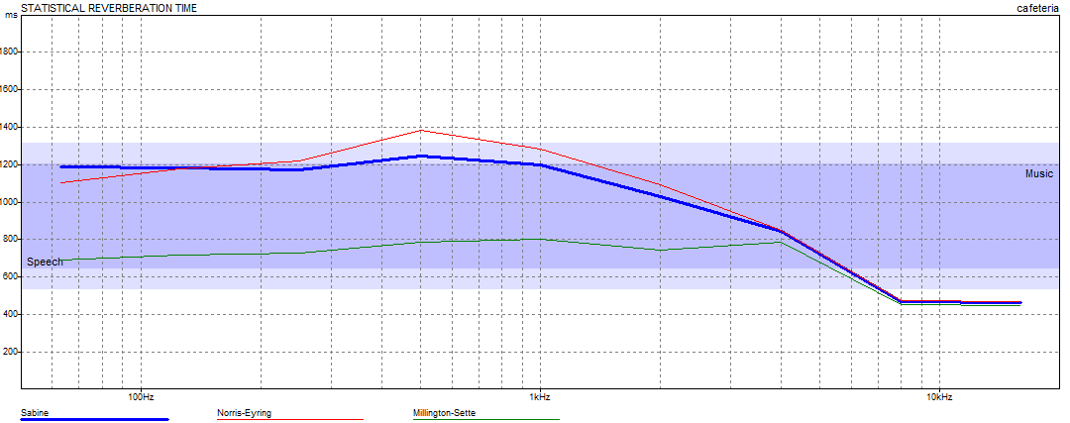
      iii. Cafeteria
Maximum value of RT60 in cafeteria at used frequencies equals 1.25 s at 500 Hz
The values of RT60 at all used frequencies is within the range which is less than 1.6 s , OK

Slide 45

      iv. Workshop
Maximum value of RT60 in work shop at used frequencies equals 1.32s at 125 Hz
The values of RT60 at all used frequencies is within the range which is less than 2 s , OK

Slide 46


STC checks
Ceiling
Internal walls
Required value | Designed value | Assessment
50 dB | 76 dB | OK
Required value | Designed value | Assessment
30 dB | 29 dB | OK

Slide 47


Glazing wall
External wall
Required value | Designed value | Assessment
35 dB | 41 dB | OK
Required value | Designed value | Assessment
45 dB | 46 dB | OK

Slide 48


Structural Design
General description

Slide 49
Geology of the site
- The bearing capacity of soil for site land equals 300 KN/m².
Codes used in design
ACI -318-14 for reinforced concrete structural design.
UBC -97 for earthquake load computations.
Construction materials
Loads
Compressive strength concrete with different strengths
1. B300: for slabs and beams.
2. B350: for columns and walls.
Yielding strength steel ( Fy = 420 Mpa).
1. Live load = 5 kN/m2
2. SID = 4 kN/m2

Slide 50

Seismic Design data
The city of structure is Nablus.
The seismic zone factor. Z = 0.2.
The soil profile is type Sd.
The acceleration seismic coefficient Ca = 0.28
The velocity seismic coefficient Cv = 0.40
The Seismic importance factor I = 1
The structural design type is intermediate, R=5.5

Slide 51

Sections Dimensions
Slabs sections
Columns sections
Two way waffle slab
40 cm
One way solid slab
30 cm
C1 | 70*50
C2 | 70*90
C3 | 50*70
C4 | 70*40
C5 | 40*70
Beams sections
Footing sections
B1 | 50*80
B2 | 40*50
B3 | 50*30
B4 | 70*50

Slide 52

Verification of the model
Equilibrium check
Load | ETABS results (KN) | Manual results (KN) | Difference (%)
D.L | 21256 | 21768 | 2.4
L.L | 11019 | 10980 | 0.35
SID | 9204 | 8784 | 4
Compatibility check

Slide 53
Seismic Design checks
Check for time period (T)
Block | Hn (m) | T_{methodA} | 1.3* T_{methodA} | T from ETABS | Assessment
First block | 14 | 0.35 | 0.46 | 0.52 | OK
Check for base shear (V)
Direction | ETABS result | Manual value
X | 6226 | 6188
Y | 6269 | 6188
Check for story drift
Story | Limitation (mm) | 𝛥 S (mm) | 𝛥 m (mm) | Assessment
Ground | 125 | 5.06 | 19.48 | OK
First | 125 | 13.65 | 52.55 | OK
Second | 110 | 24.17 | 93.05 | OK

Slide 54

Check for modal participation mass ratio
direction | Value from sixth mode
X | 0.9871
Y | 0.9651
Check for slab deflection
Maximum deflection | Limit
41 | 46.25

Slide 55

Slabs and beams layout

Slide 56


Beams reinforcement

Slide 57

Columns reinforcement

Slide 58

Columns reinforcement

Slide 59

Footing reinforcement

Slide 60
Quantity Surveying
Structural total cost (NIS) | 5,821,938
Mechanical total cost | 803,376
Electrical total cost | 64,271
Total cost | 6,689,585
Total unit cost

