Slide 1
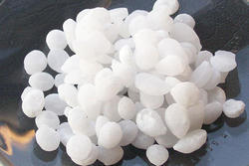
Carbon dioxide capture from automobile flue gas: Materials and technology potentials
Asmaa Khuwaireh
✵ Aseel Mousa
✵ Muna Shubaiteh
Supervisor: Prof. Hamdallah Bearat

Slide 2
Table of content:
Introduction
 Reactors
Experiment and Result
System I:Compressed Air system
 System II: Pure CO2 system
 Conclusions and Recommendation

Slide 3


Slide 4


What is the problem?

Slide 5

● How we can solve it?

Slide 6
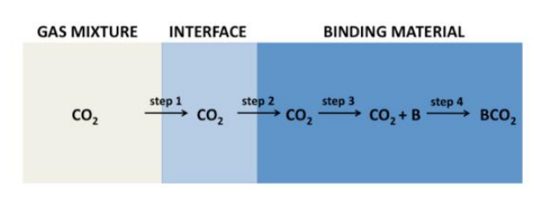
CO2 capture process steps
Fig1: CO2 capture process steps

Slide 7
We used Sodium hydroxide as binding material to capture CO2
NaoH is a white solid with a melting point of 318°C.
Sodium hydroxide crystals absorb water very easily.
Solid sodium hydroxide burns the skin.
Solid sodium hydroxide reacts easily with CO2 .

Slide 8
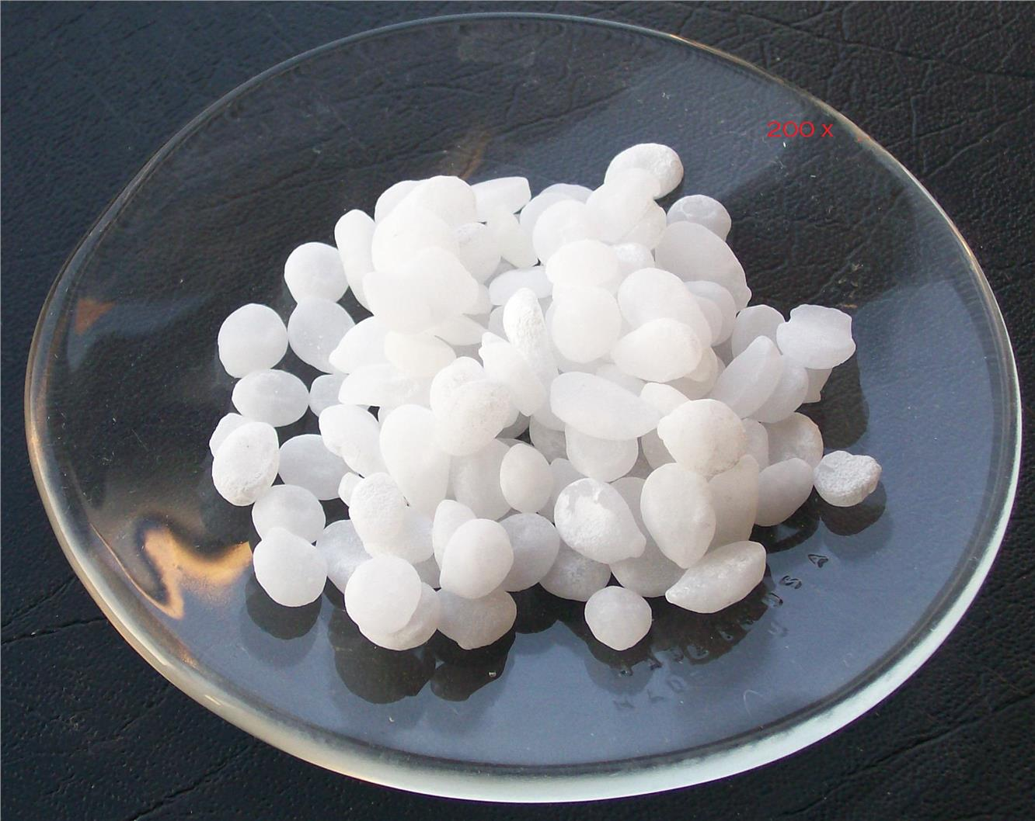
Fig 2 :Sodium Hydroxide NaOH

Slide 9

NaOH & CO2 reactions
2NaOH + CO2 → Na2CO3 + H2O ∆H = -169.8 kJ/mol CO2
NaOH+ CO2⟶NaHCO3 ∆H = -127.44 kJ/mol CO2
These reactions are very exothermic.

Slide 10
Reactors
Table 1:Group reactors and their specifications
 | Reactor 1 | Reactor 2 | Reactor 3
Alloy | 316L SS | 304L SS | 316L SS
Length | 8 inch (203 mm) | 10.9 inch (277mm) | 14.5 inch (365mm)
Diameter | 1.9 inch (48.2 mm) | 3.5 inch (88.9mm) | 1.9 inch (48.2 mm)
Thickness | 0.24 inch (6.1) | 0.18 inch (4.6mm) | 0.24 inch (6.1)
Weight | 3 lb (1.362 kg) | 6.5 lb (2.9kg) | 5.6 lb (2.5kg)
Internal Volume | 150 ml | 1000ml | 300ml
Pressure Rating | 5000 psi (344 bar) | 1800 psi (124 bar) | 5000 psi (344 bar)

Slide 11
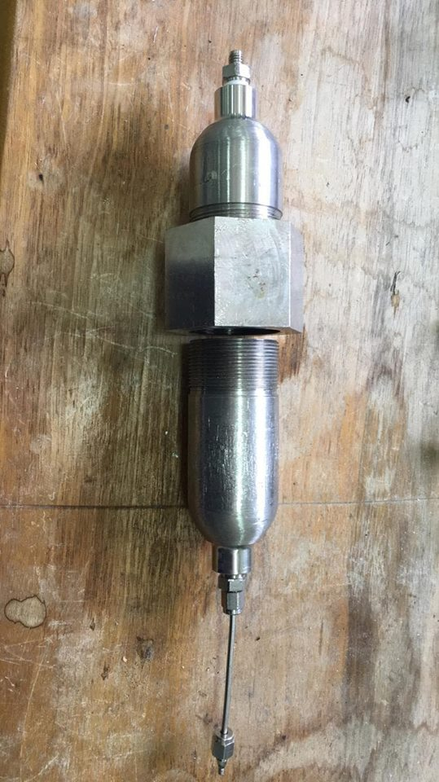
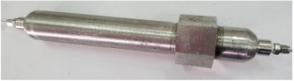
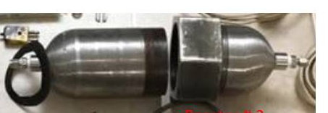
Fig3 : Bearat’s Group reactors

Slide 12
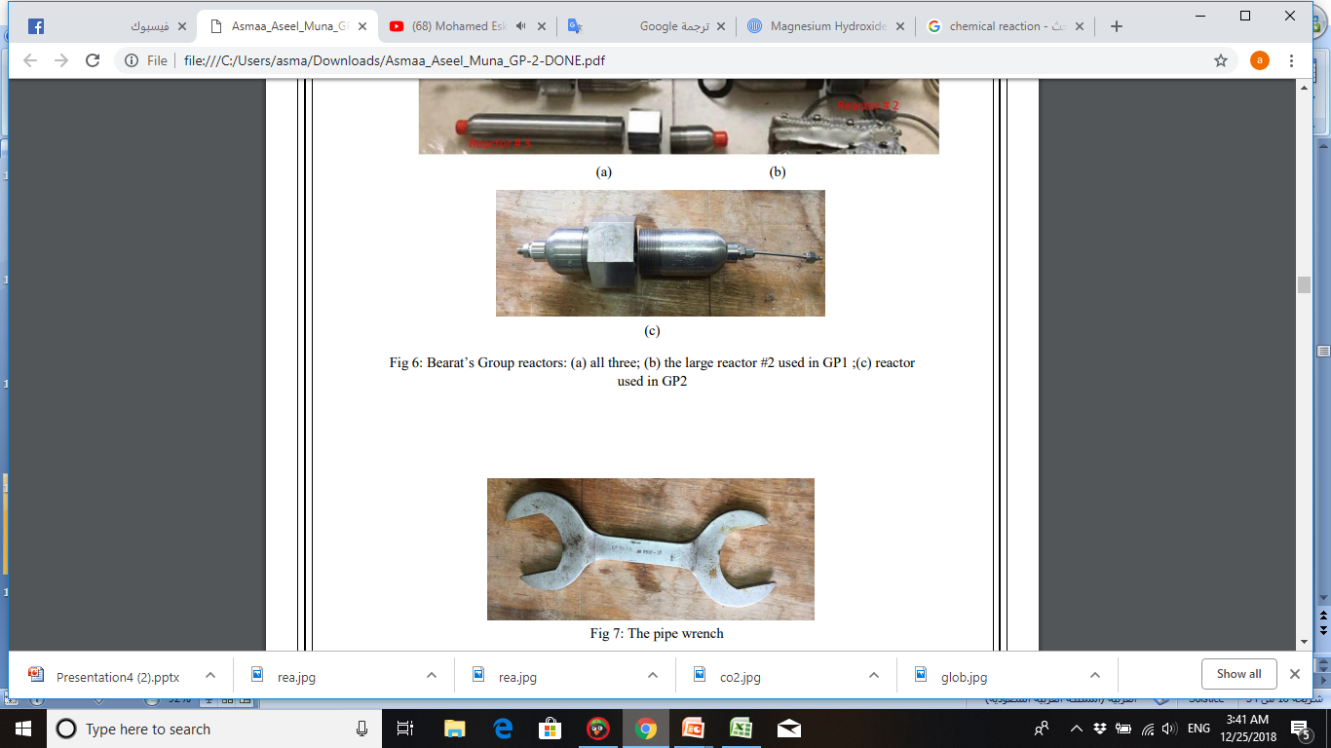
Fig 4:The reactor used in GP2
Fig 5:The pipe wrench

Slide 13
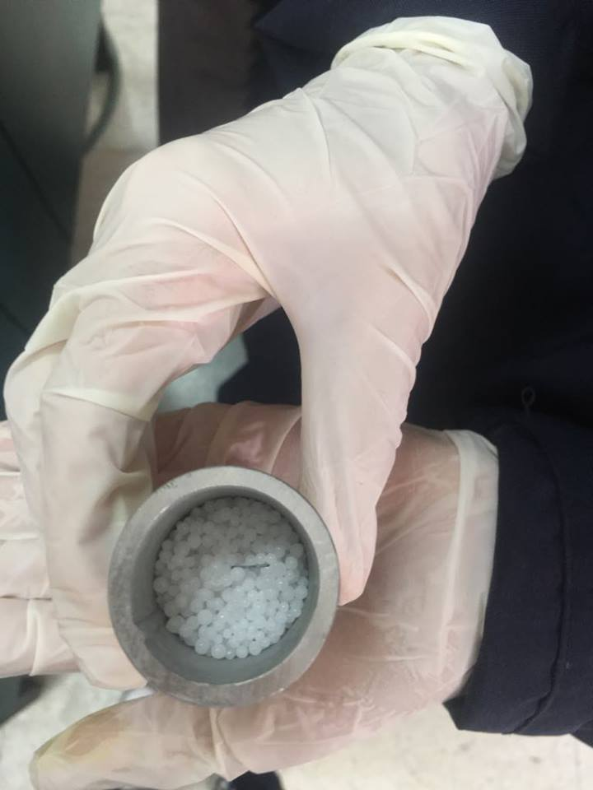
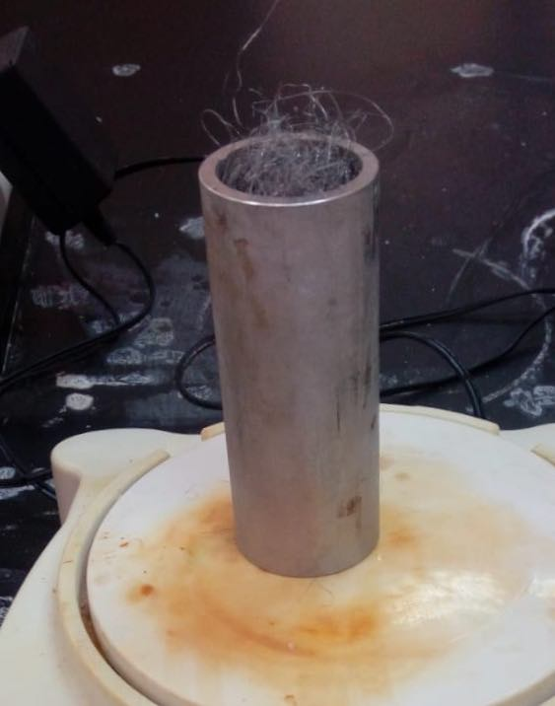
Fig6 : Cylinder used .

Slide 14

Experiment and Result

Slide 15

In our experiments we used two systems :
System I: For reaction between NaOH with Air.
System II: For reaction between NaOH with pure CO2.

Slide 16
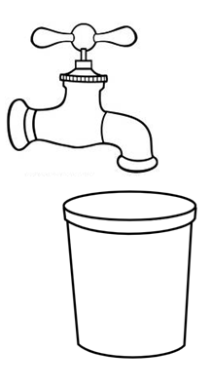
System I:Compressed Air system
Compressed air source.
Plastic container.

Slide 17
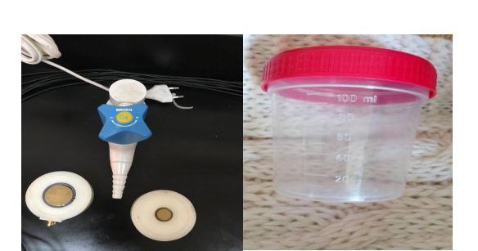
Fig7:Compressed Air Source Fig8 :Sample Container

Slide 18
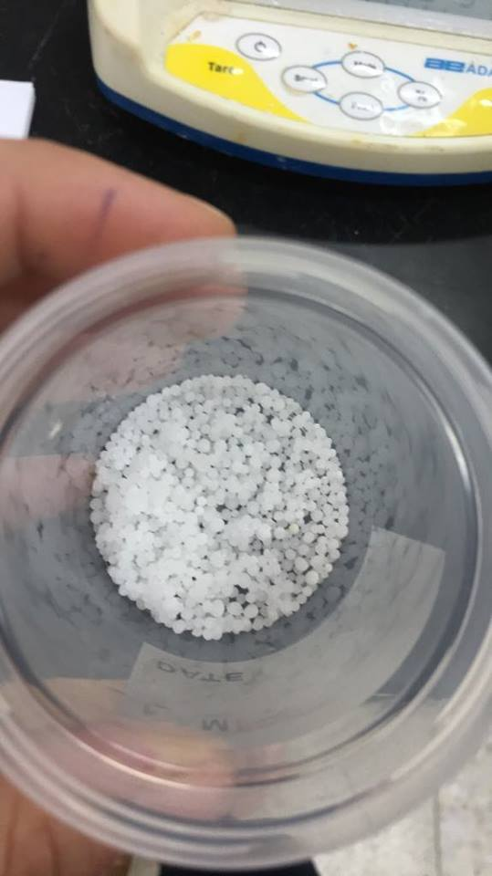
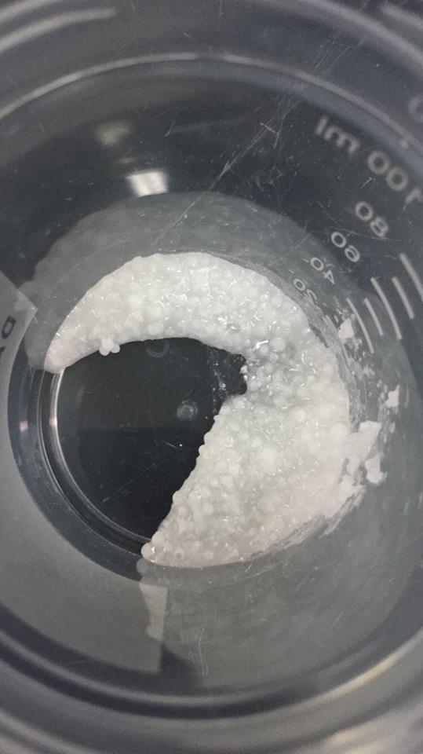
Fig9 : NaOH before reaction with air.
Fig:10 NaOH after reaction with air.

Slide 19
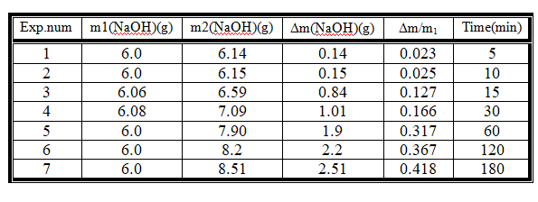
Result of air:
Table 2: readings of changed the weight of NaOH with time.

Slide 20
.
Fig11 : Relation between ∆m\m and time.

Slide 21
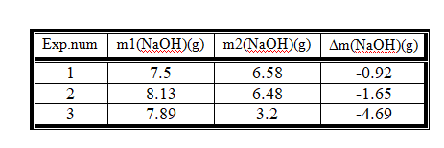
Drying of NaOH after reaction with air :
Table3 :changed the weight of NaOH after drying
NaOH+CO₂ NaHCO₃

Slide 22
Table 4: readings of changed the amount reacted of NaOH with time.
%reacted of NaOH | Amount of reacted NaOH | Time (min) | ∆m (NaOH)(g) | m2(NaOH) (g) | m1(NaOH) (g) | Exp. num
2.12 | 0.127 | 5 | 0.14 | 6.14 | 6.0 | 1
2.26 | 0.136 | 10 | 0.15 | 6.15 | 6.0 | 2
12.59 | 0.763 | 15 | 0.84 | 6.59 | 6.06 | 3
15.09 | 0.918 | 30 | 1.01 | 7.09 | 6.08 | 4
28.78 | 1.727 | 60 | 1.9 | 7.90 | 6.0 | 5
33.33 | 2 | 120 | 2.2 | 8.2 | 6.0 | 6
38.02 | 2.281 | 180 | 2.51 | 8.51 | 6.0 | 7

Slide 23
Fig12 : Relation between and amount of reacted NaOH with time..

Slide 24
Amount of CO2 in 1m³ air :
By assume this data
In our planet the percentage CO2 of air is 0.0409%
The total pressure is 1.013 atm
Assume the room temp is 22C
In volume = 1m³ = 1000L
by some calculations get
In1m³ of air there is 0.77g of CO2

Slide 25
Table 5: readings of changed the amount reacted of NaOH and the amount of reacted CO2.
Amount reacted of CO2 | Amount reacted of NaOH | Time(min) | Exp. num
0.1397 | 0.127 | 5 | 1
0.1496 | 0.136 | 10 | 2
0.8393 | 0.763 | 15 | 3
1.0098 | 0.918 | 30 | 4
1.8997 | 1.727 | 60 | 5
2.2 | 2 | 120 | 6
2.5091 | 2.281 | 180 | 7

Slide 26
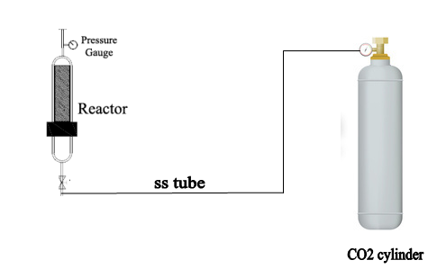
System II: Pure CO2 system

Slide 27
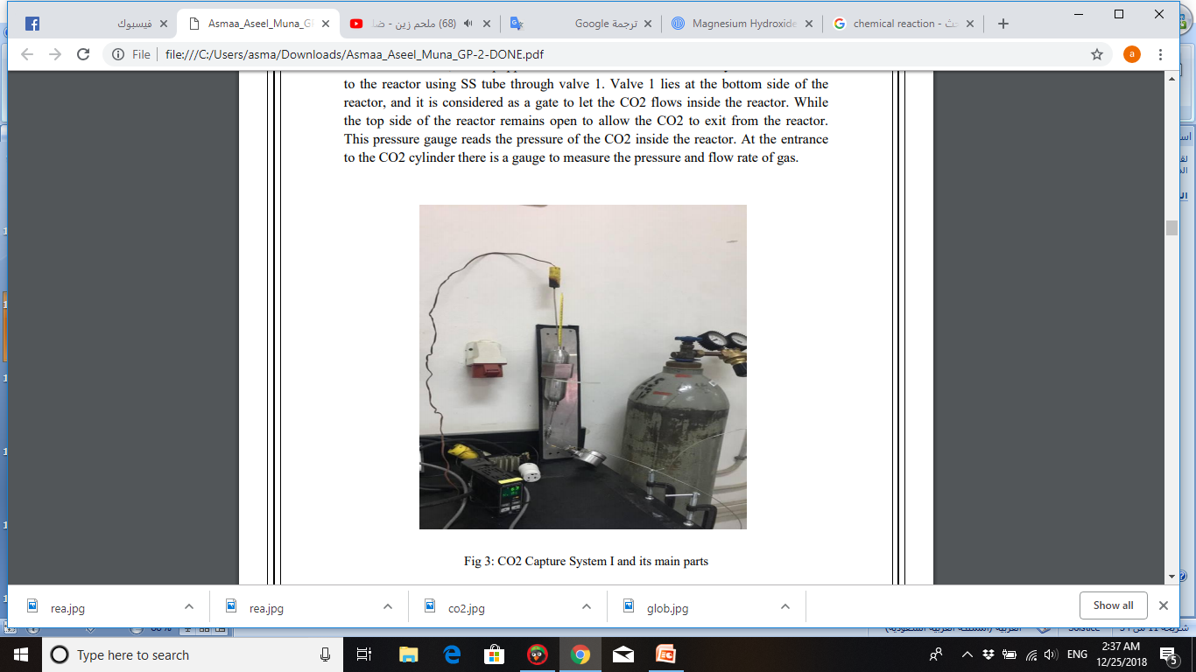
Fig 13 :System II

Slide 28
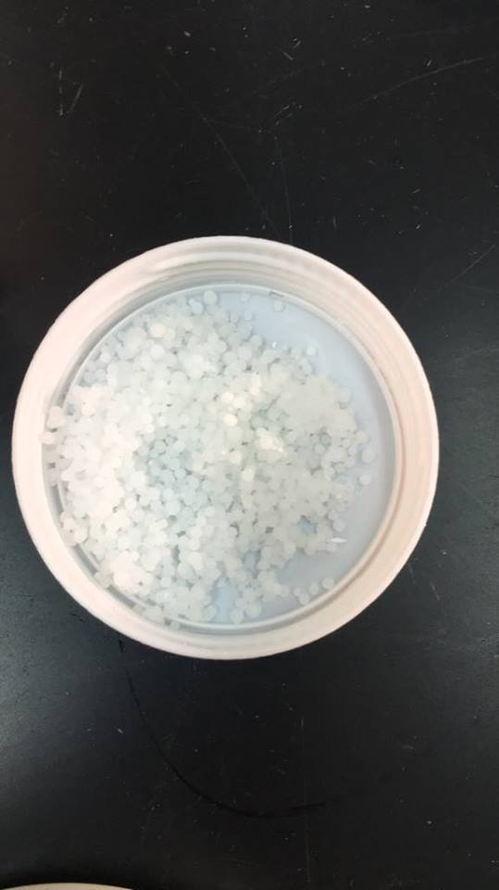
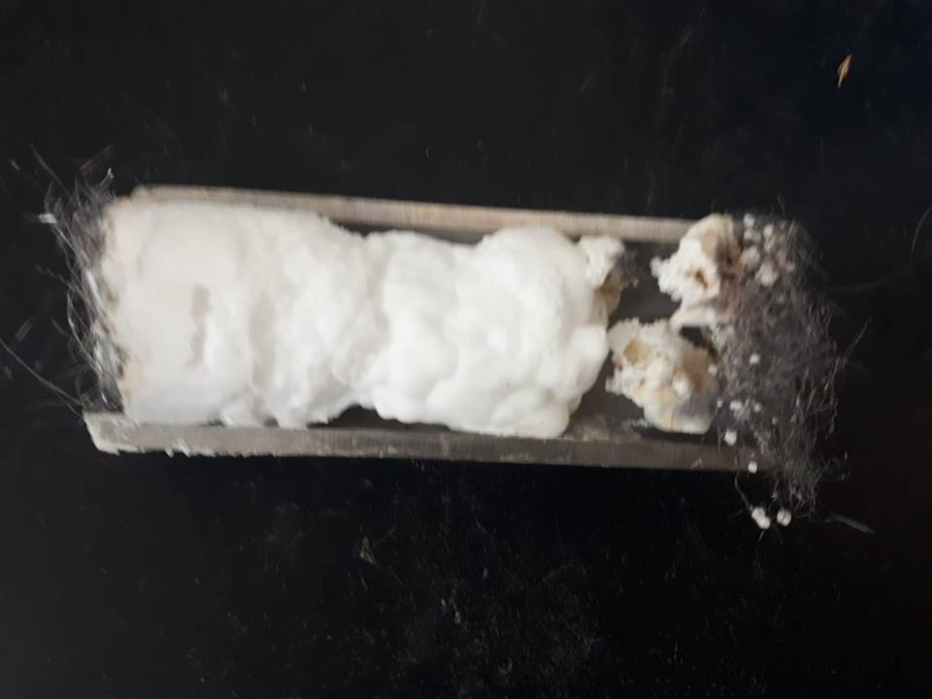
Fig14 : NaOH before reaction
Fig 15 : NaOH after reaction

Slide 29

One Hour:
Table6: The relation between and Flow Rate :
Time (min) |  | (gm) | m2 (NaOH) gm | m1 (NaOH) gm | Flow Rate (L/min) | EXP. NUM
60 | 0.24 | 7.97 | 40.91 | 32.94 | 5 | 1
60 | 0.25 | 8.74 | 43.22 | 34.48 | 10 | 2
60 | 0.34 | 11.8 | 46.26 | 34.46 | 15 | 3
60 | 0.44 | 13.28 | 43.65 | 30.37 | 20 | 4
60 | 0.35 | 12.7 | 49.61 | 36.91 | 25 | 5

Slide 30
Fig 16 : The relation between and Flow Rate :

Slide 31
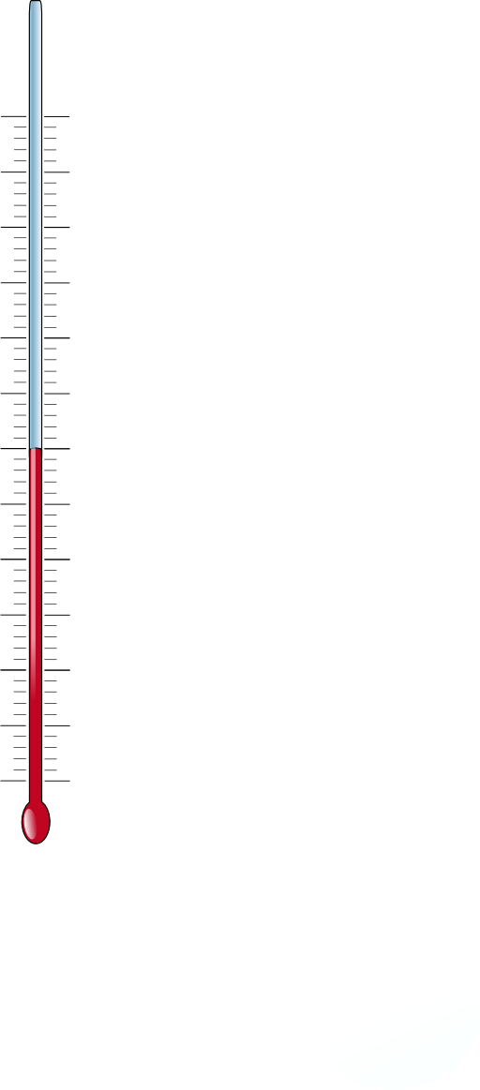
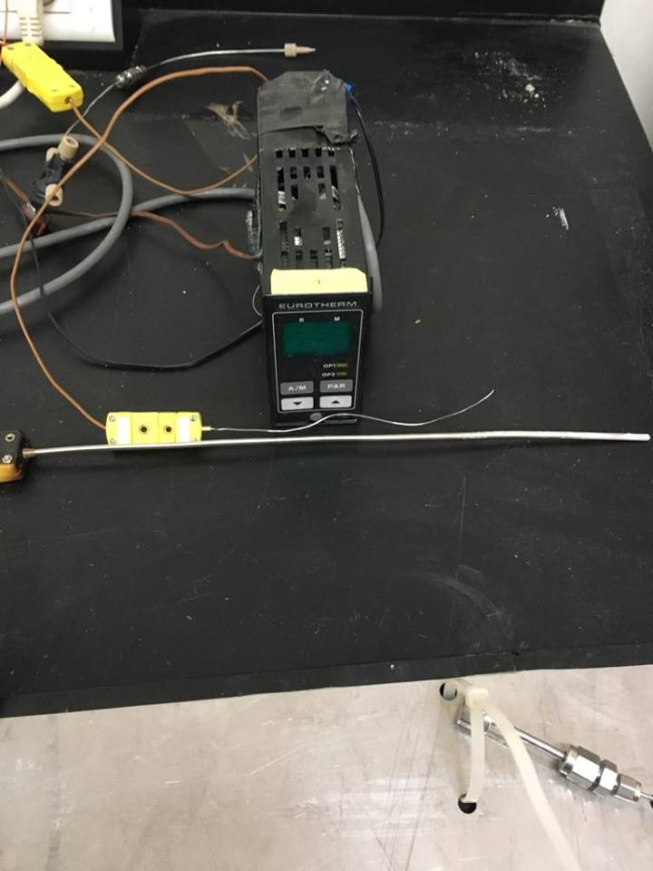
Temperature of the reaction:
Fig 17: Thermocouple.

Slide 32
Fig 18 : The relation between time and temperature at flow rate =5 L/min

Slide 33
At flow rate =10 L/min
At flow rate =15 L/min
At flow rate =20 L/min
At flow rate =25 L/min

Slide 34

Chemical Reaction:
NaOH+CO₂ NaHCO₃
The amount of reacted NaOH and it's percentage: Table7
%of reacted NaOH | Amount of reacted NaOH | (gm) | m2 (NaOH)gm | m1 (NaOH)gm | Flow rate (lit/min) | Exp. Num
21.99% | 7.24 | 7.97 | 40.91 | 32.94 | 5 | 1
23.04% | 7.94 | 8.74 | 43.22 | 34.48 | 10 | 2
29.4% | 10.72 | 11.8 | 46.26 | 34.46 | 15 | 3
39.7% | 12.07 | 13.28 | 43.65 | 30.37 | 20 | 4
31.12% | 11.54 | 12.70 | 49.61 | 36.91 | 25 | 5

Slide 35
Fig19 : The relation between flow rate and Amount of reacted NaOH.

Slide 36
One and half hour:
Table8: The relation between and Flow Rate :
Time (min) |  | (gm) | m2 (NaOH)gm | m1 (NaOH)gm | Flow rate (lit/min) | Exp. Num
90 | 0.21 | 7.90 | 44.75 | 36.85 | 5 | 1
90 | 0.25 | 9.28 | 46.20 | 36.92 | 10 | 2
90 | 0.28 | 10.34 | 47.18 | 36.84 | 15 | 3
90 | 0.33 | 12.17 | 48.96 | 36.79 | 20 | 4
90 | 0.32 | 11.73 | 48.64 | 36.91 | 25 | 5
90 | 0.31 | 11.53 | 48.43 | 36.90 | 30 | 6

Slide 37
Fig 20 : The relation between and Flow Rate

Slide 38
Temperature of the reaction:
Fig 21: Thermocouple.

Slide 39
Fig 22 : The relation between time and temperature at flow rate =5 L/min

Slide 40
At flow rate =10 L/min
At flow rate =15 L/min
At flow rate =20 L/min
At flow rate =25L/min

Slide 41
Chemical Reaction:
2NaOH+CO₂ Na₂CO₃+H₂O
Table 9: The amount of reacted NaOH and it's percentage
%of reacted NaOH | Amount of reacted NaOH | (gm) | m2 (NaOH)gm | m1 (NaOH)gm | Flow rate (lit/min) | Exp. Num
65.9% | 24.30 | 7.90 | 44.75 | 36.85 | 5 | 1
77.33% | 28.55 | 9.28 | 46.20 | 36.92 | 10 | 2
86.45% | 31.82 | 10.34 | 47.18 | 36.84 | 15 | 3
97.8% | 36.19 | 12.17 | 48.96 | 36.79 | 20 | 4
97.0% | 35.69 | 11.73 | 48.64 | 36.91 | 25 | 5
95.2% | 35.16 | 11.53 | 48.43 | 36.90 | 30 | 6

Slide 42
Fig 22: The relation between flow rate and Amount of reacted NaOH

Slide 43
Comparison between hour and half and hour :
Table 10: Comparison between hour , half and hour of the
percentage of reacted NaOH & CO2
1.5 H
1 H
1.5 H
1 H
%of reacted co2 | %of reacted co2 | Flow rate (lit/min) | %of reacted NaOH | %of reacted NaOH
21.99% | 32.95% | 5 | 21.99% | 65.90%
23.04% | 38.67% | 10 | 23.04% | 77.33%
29.40% | 43.23% | 15 | 29.40% | 86.45%
39.70% | 48.90% | 20 | 39.70% | 97.80%
31.12% | 48.50% | 25 | 31.12% | 97.00%

Slide 44
Fig23: Comparison between hour , half and hour of the percentage of reacted CO2

Slide 45

Conclusions and Recommendation
Co2 capture process
Co2 flow rate
Time

Slide 46

Problems
 A nitrogen (N2) cylinder was installed in the lab instead of CO2. This caused us a lot of delay because of wasted experiments.
 Problems in the balance: readings were sometimes very wrong.
 Knowing the flow rate of the air from the lineof laboratory and possibility to vary it.
 The lack of vise to assemble and disassemble the reactor in the laboratory.

Slide 47
To help improve the research we started, some points must be recommended:
● Making a tool suitable for cars exhaust that contains NaOH to capture CO2 gas into stable and environmentally friendly products.
● Searching for materials that are cheaper than sodium hydroxide and with the same efficiency.
● Studying the temperature and the pressure in the reaction of sodium hydroxide and carbon dioxide and compare them with the conditions of the car.
● Studying more about the resulting material from the reaction of sodium hydroxide and carbon dioxide and how will the recovered CO2 be used in other applications.

