Slide 1



Table of Content
01
02
Introduction
Project Execution
03
04
Project Features
Conclusion &
Future Work

Slide 2


01
Introduction

Slide 3
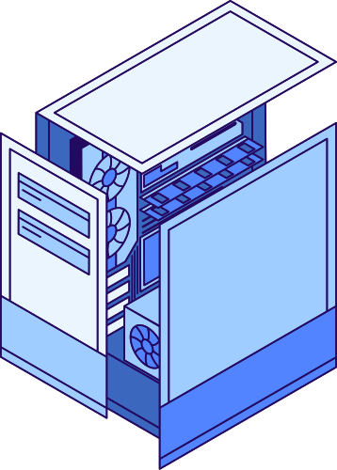
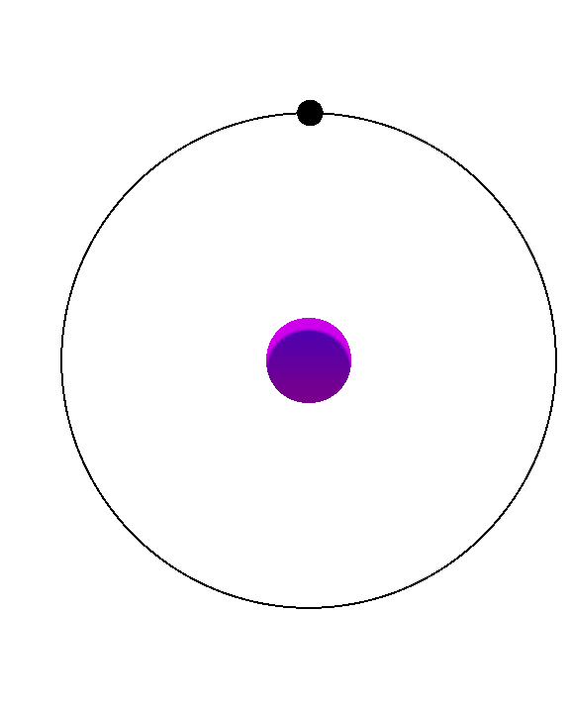
  Why do engineers need a system to track projects?
  How does this system help improve engineering project management?

Slide 4

Objectives
  Improving project management and follow-up and Provide quick access to files and tasks.
  Organizing tasks among team members
  Reduce errors , data loss and increase productivity
  Providing smart suggestions to divide the project into tasks using artificial intelligence

Slide 5
02
Project Execution

Slide 6



System
Architecture
Frontend
Backend
Database
Storage
AI Integration

Slide 7

Technologies Used
  Frontend
HTML , CSS , JavaScript , Bootstrap.
  Backend - Django Framework
Python , Django REST Framework.
  Database
PostgreSQL , Supabase.
  Storage
Cloudinary.
  AI Integration
Together.ai.

Slide 8
03
Project Features

Slide 9


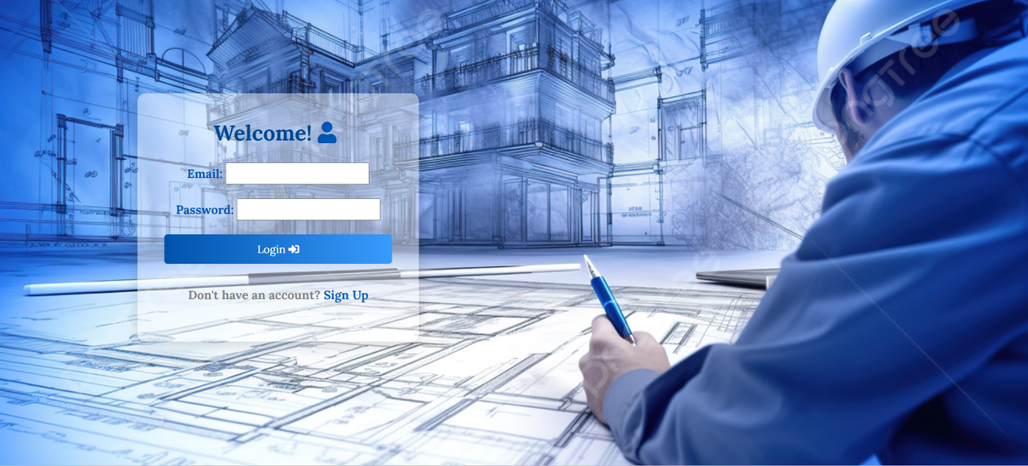
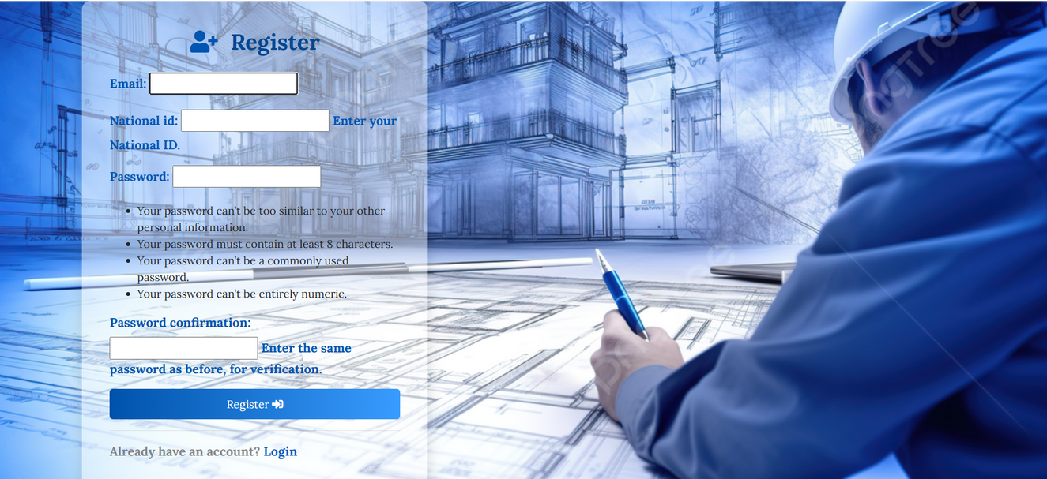
Login and register Page

Slide 10

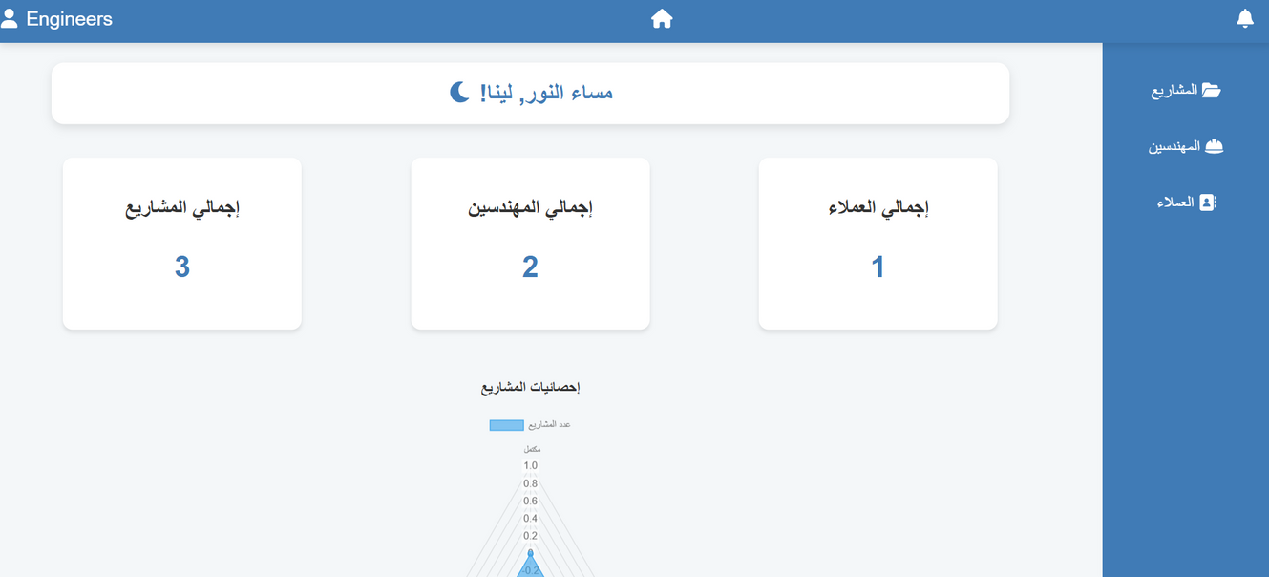
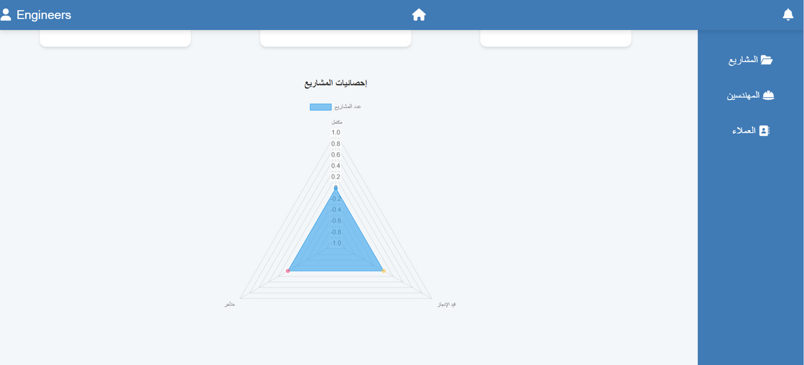

Admin Page

Slide 11


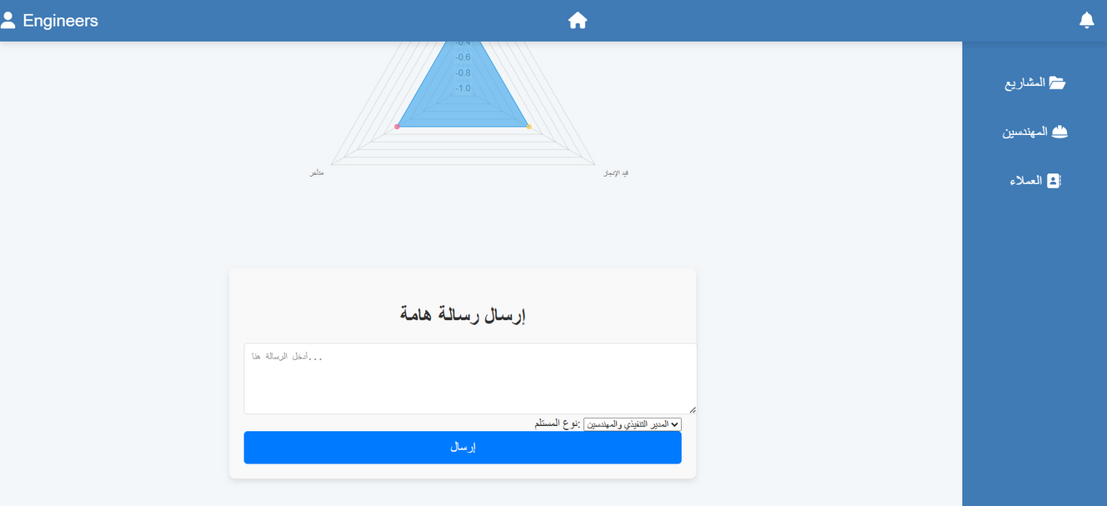

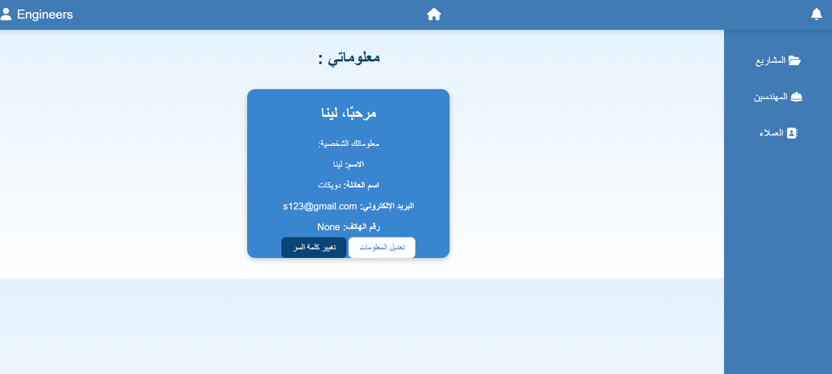
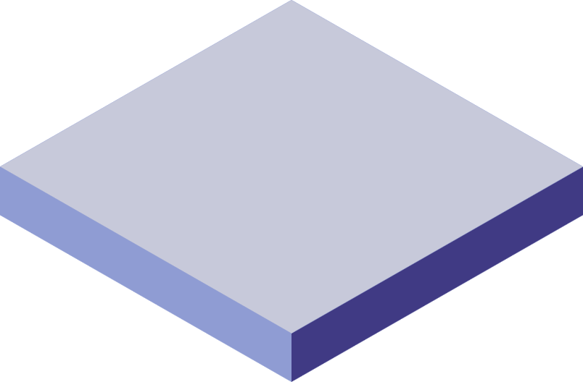
Admin Page

Slide 12
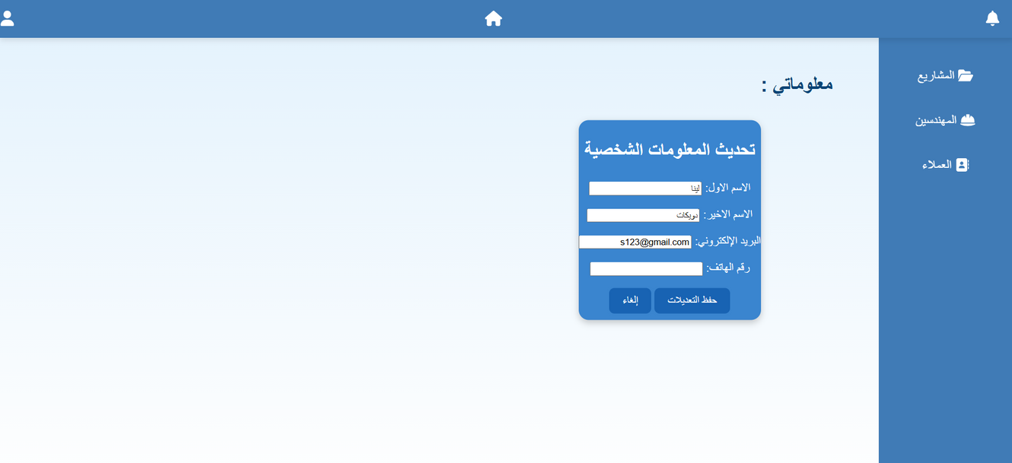
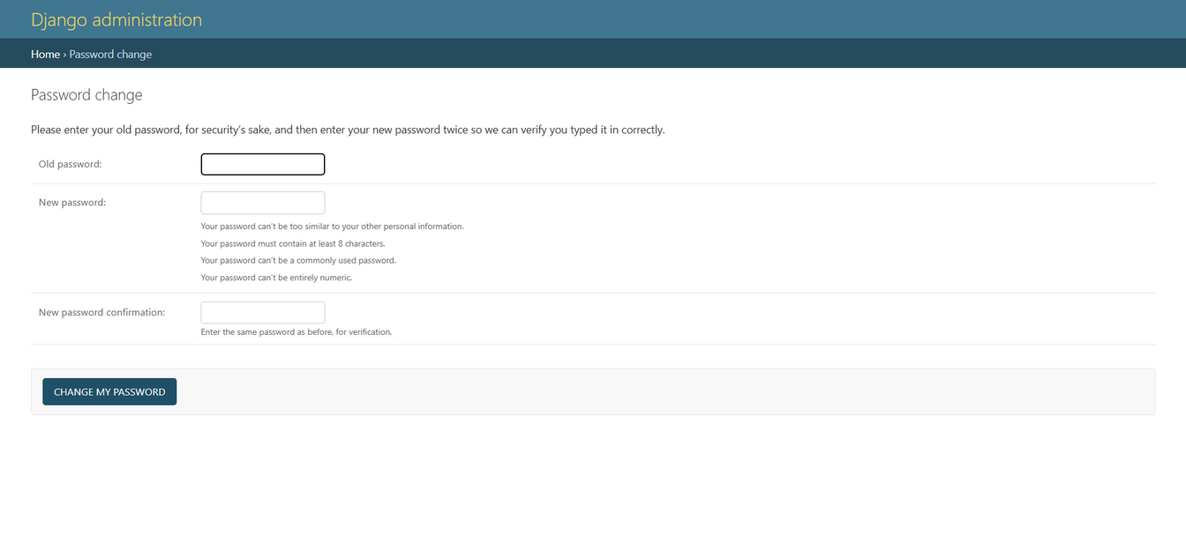
Admin Page

Slide 13
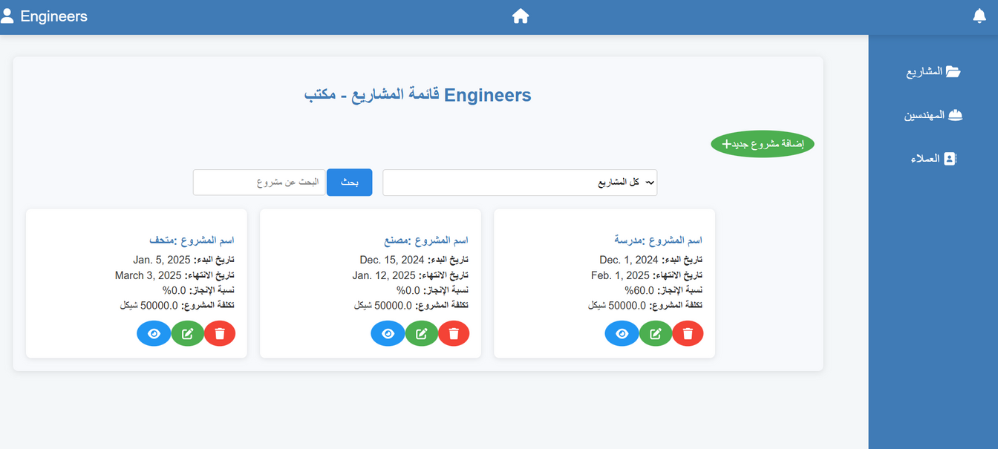
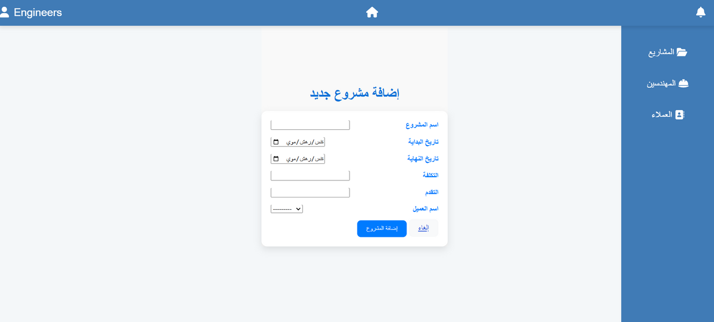
Admin Page

Slide 14
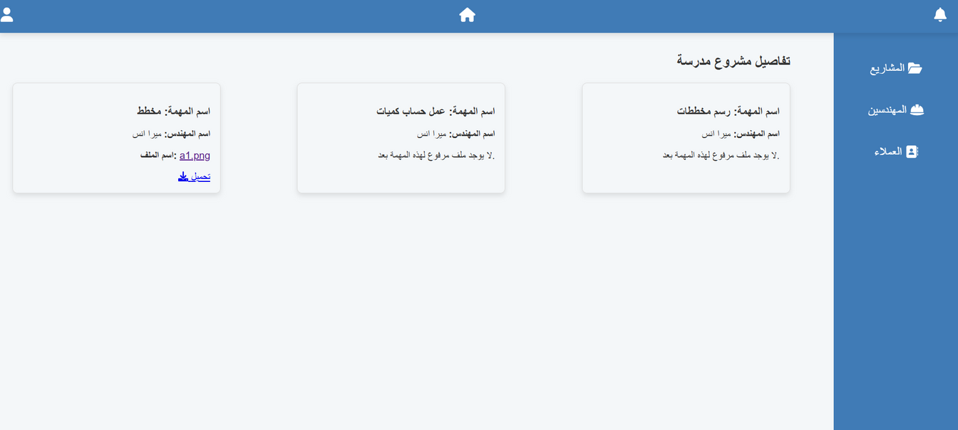

Admin Page

Slide 15
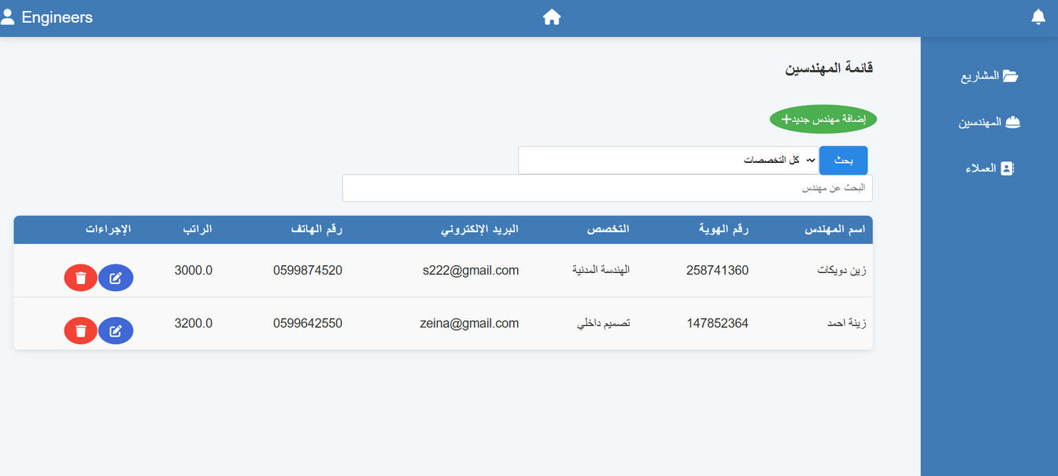
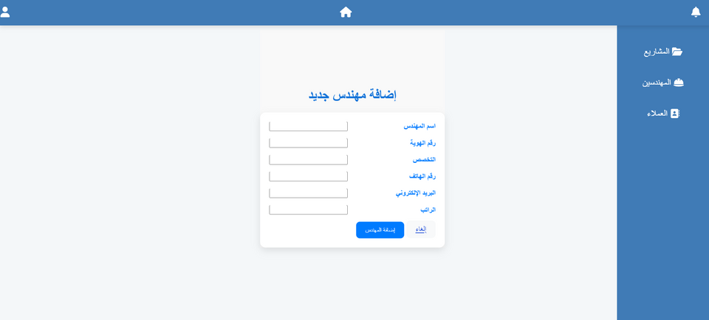
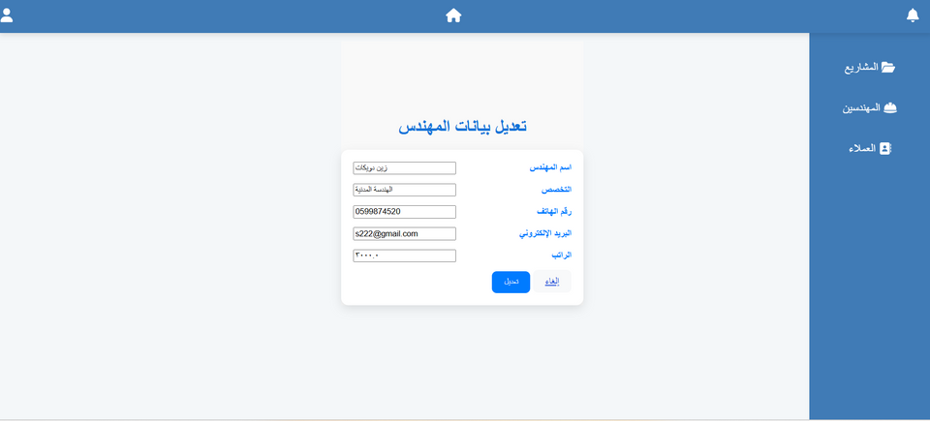
Admin Page

Slide 16
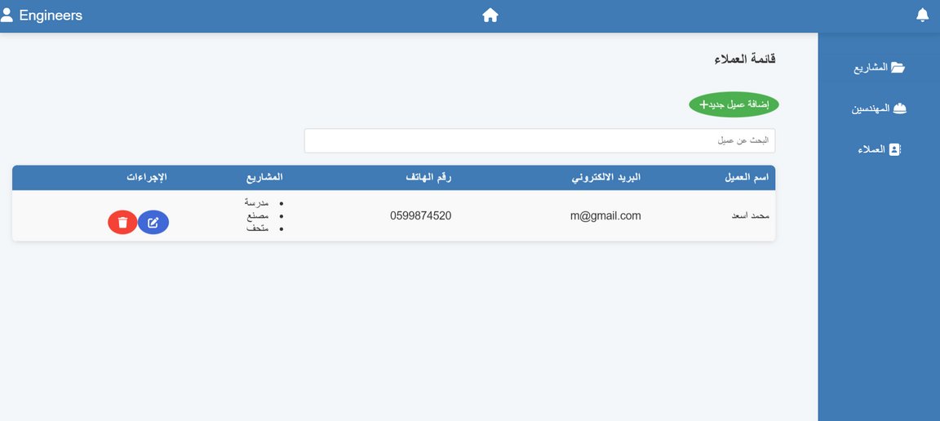
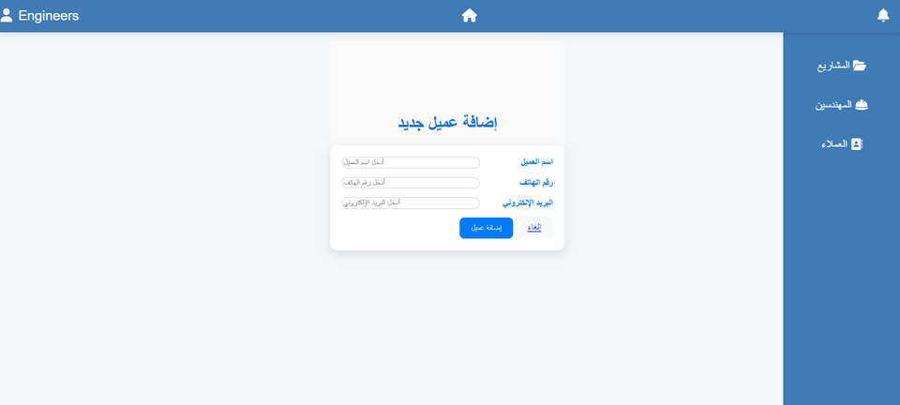
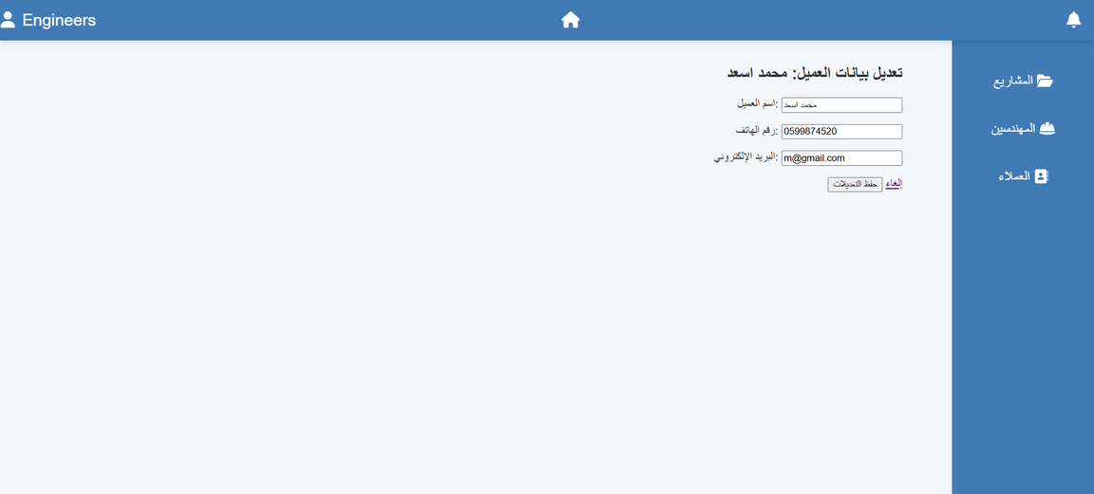
Admin Page

Slide 17
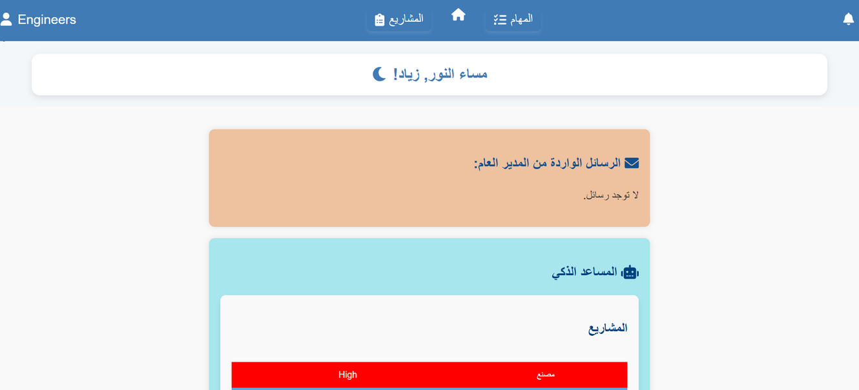
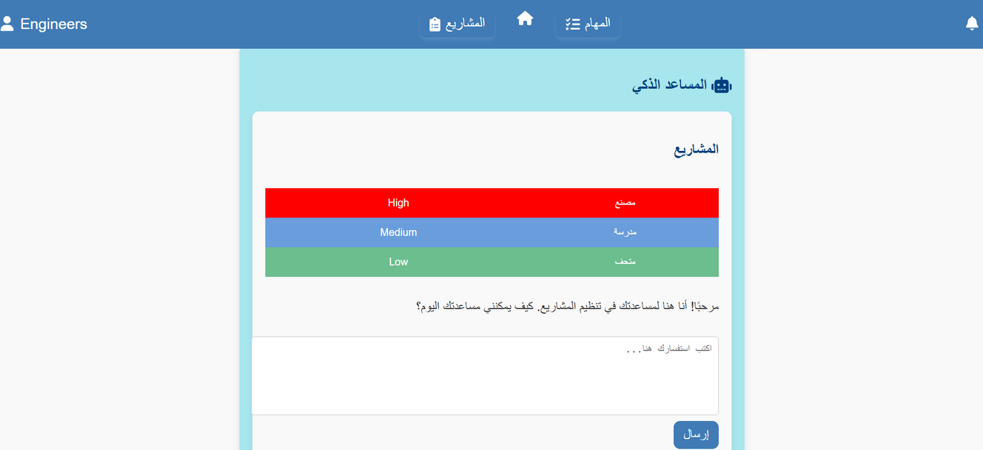
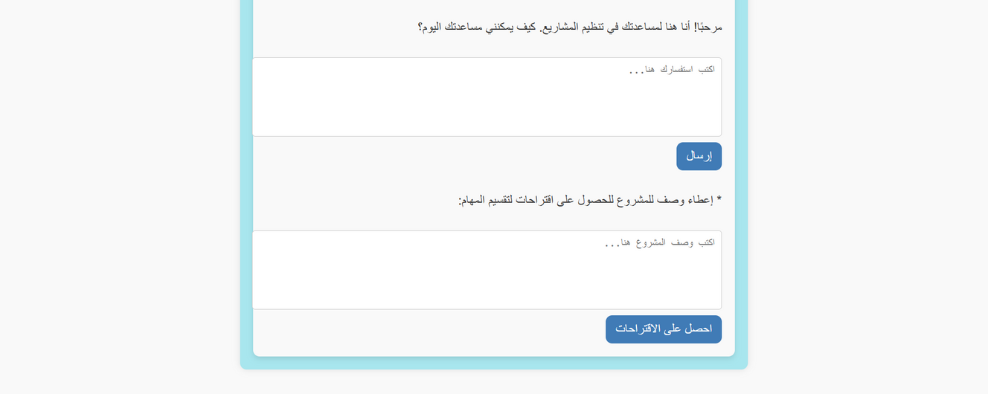

CEO Page

Slide 18
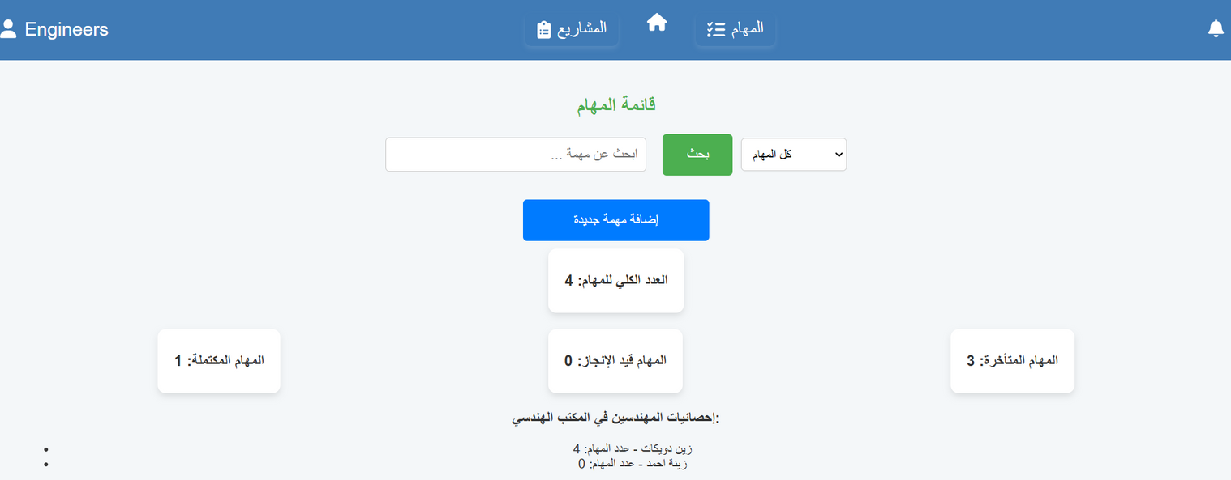
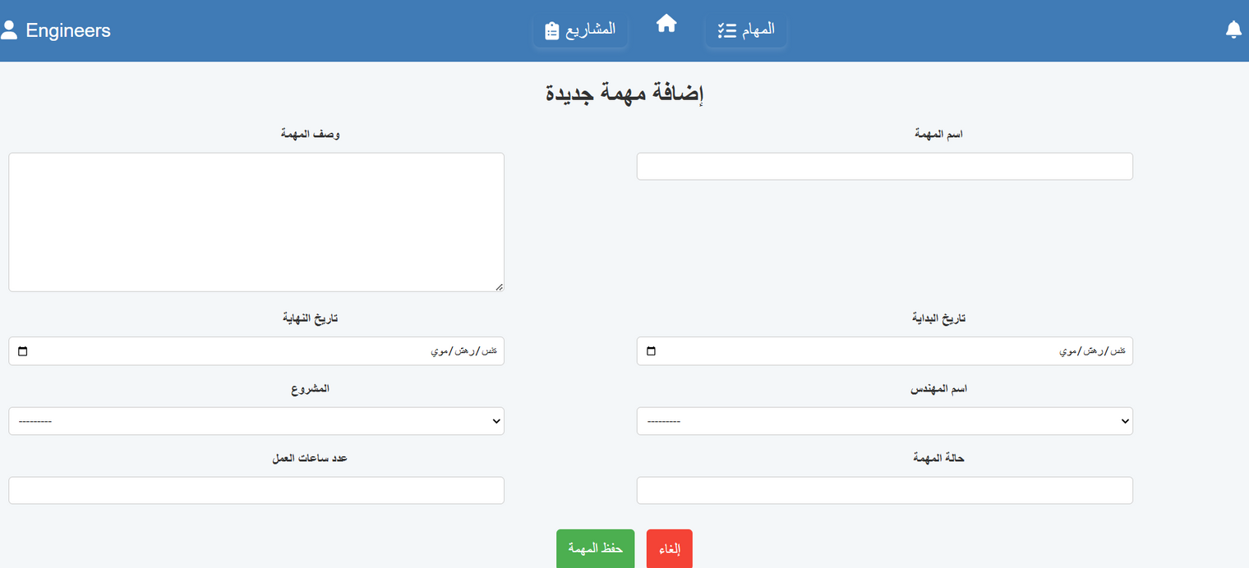
CEO Page

Slide 19
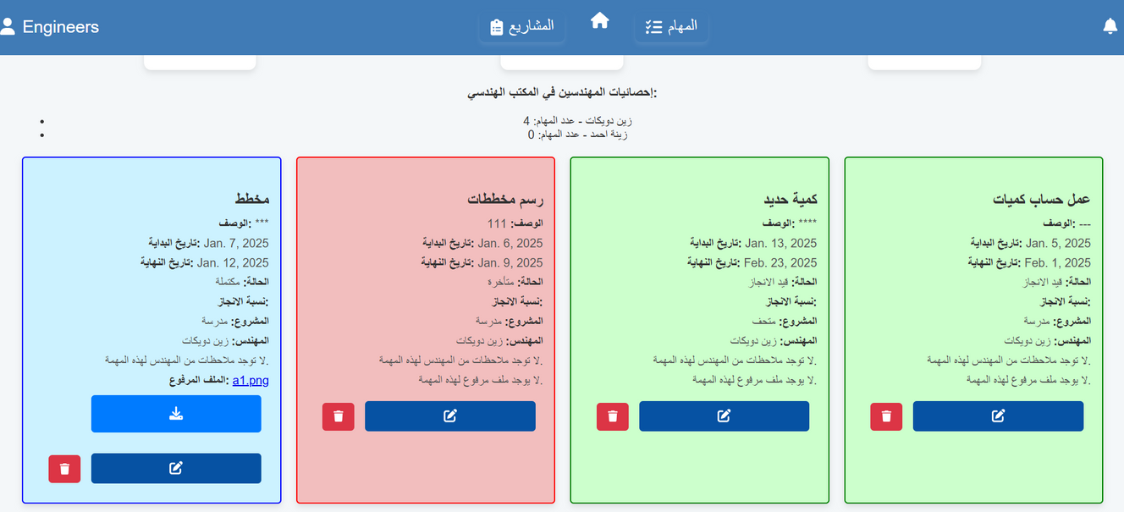
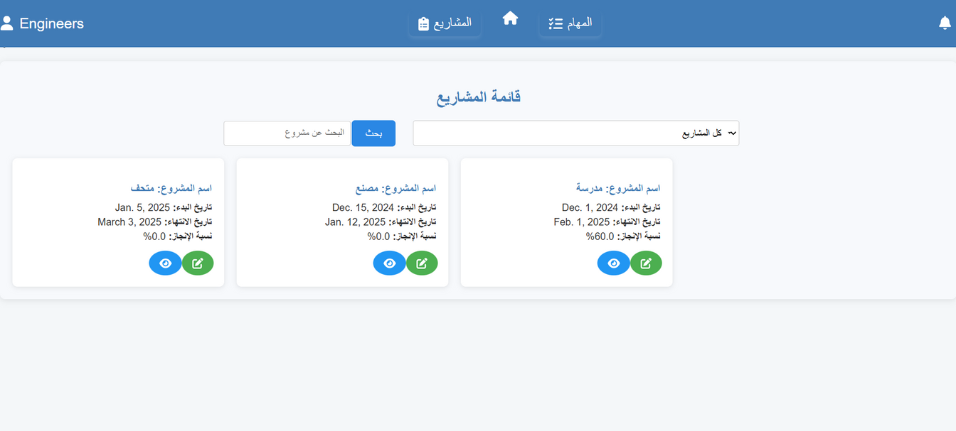
CEO Page

Slide 20

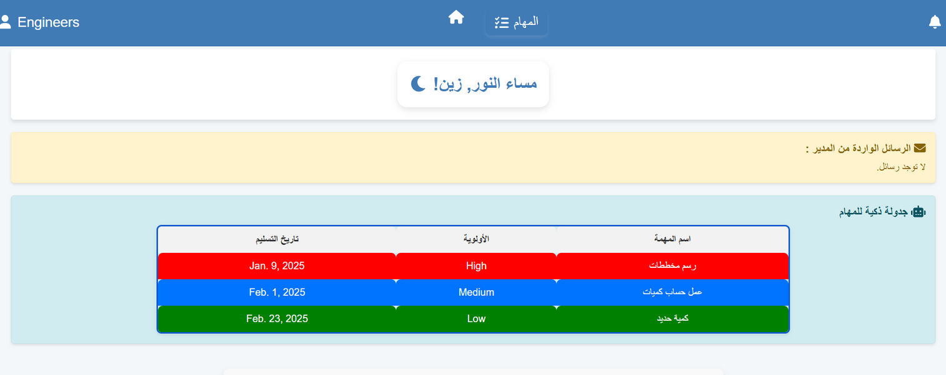
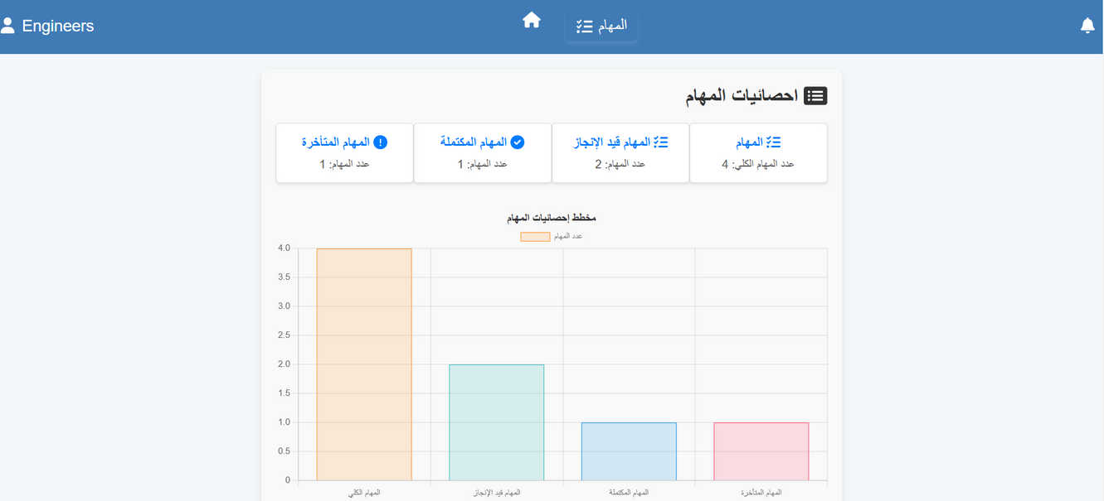
Engineer Page

Slide 21
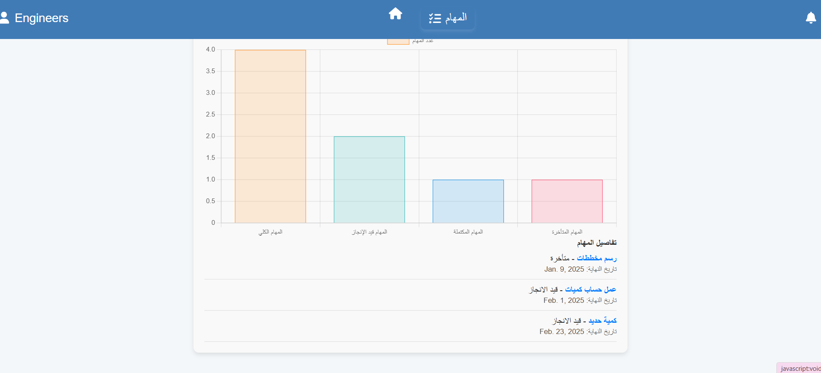
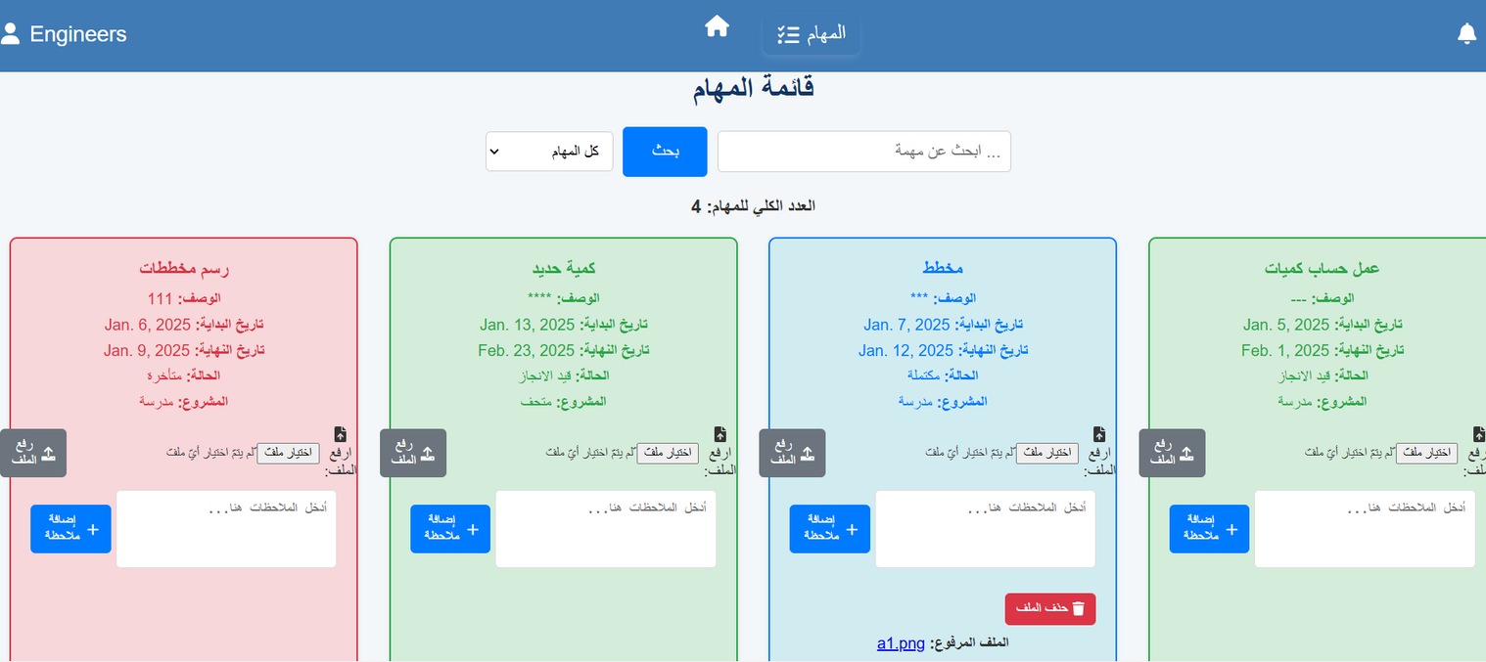
Engineer Page

Slide 22
04
Conclusion & Future Work

Slide 23
Conclusion & Future Work
  Conclusion:
The Engineering Project Tracking System provides an integrated solution for effective project management, which helps improve productivity and organize tasks using artificial intelligence. Integration with Django, PostgreSQL, and Gemini AI enables accurate reporting and intelligent recommendations, streamlining decision-making and improving workflow in engineering offices.
  Future Work:
1. Launching a mobile application that supports Android and iOS systems.
2. Integrating augmented reality (AR) technologies to display engineering drawings in interactive ways.
3. Adding an accounting system.
4. Add a chat system for communication.

Slide 24

Liceria Tech
THANK YOU!

