Slide 1

Dental clinics finder and booking services
Naqaa Omar Eid
Oraib Riad Basheer
Raghad Mohammad
Dr.Mai Abu-Sair

Slide 2

Problem

Slide 3
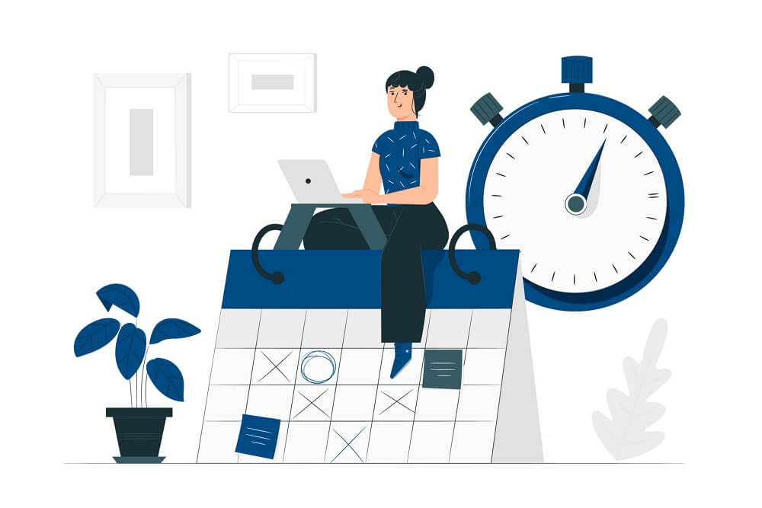



Objectives
01
Scheduling appointments
02
Find a doctor and clinic
03
Posting medical advice, ads and previous cases
04
Doctor can submit order to lab technician

Slide 4



Development and Design

Slide 5
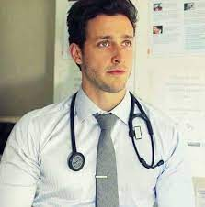
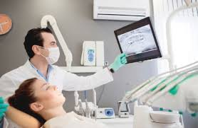
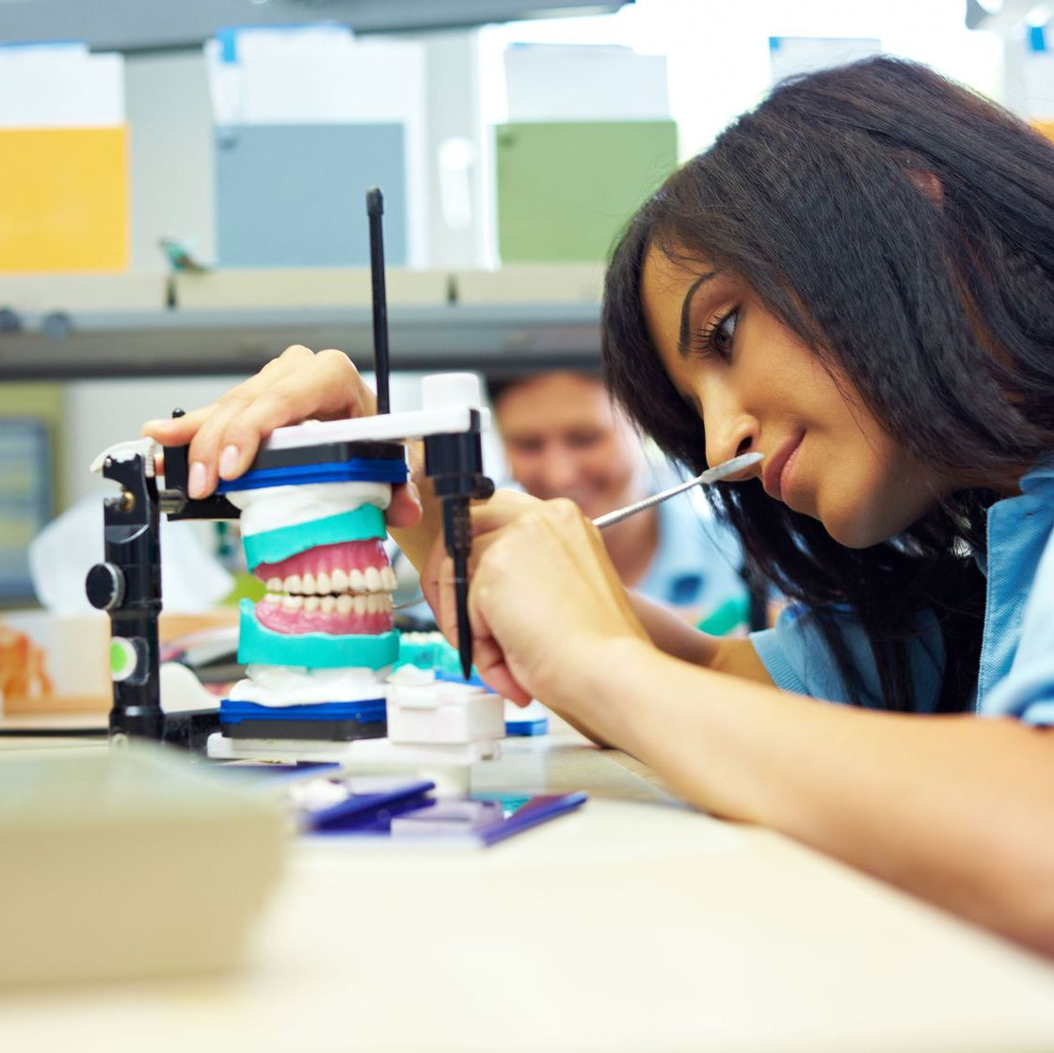

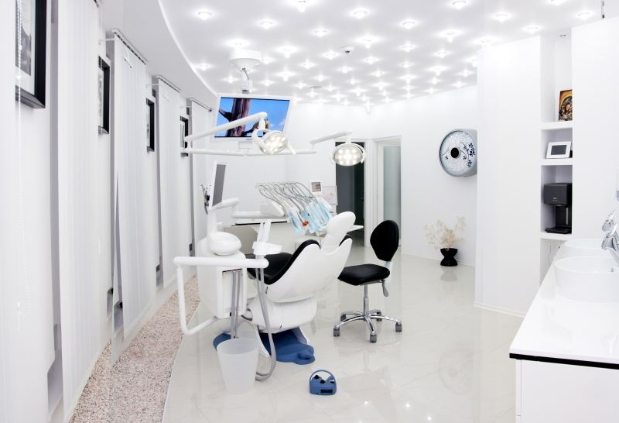
Target Audiences
Doctors
Patients
Dental clinic
secretary
laboratory technician

Slide 6
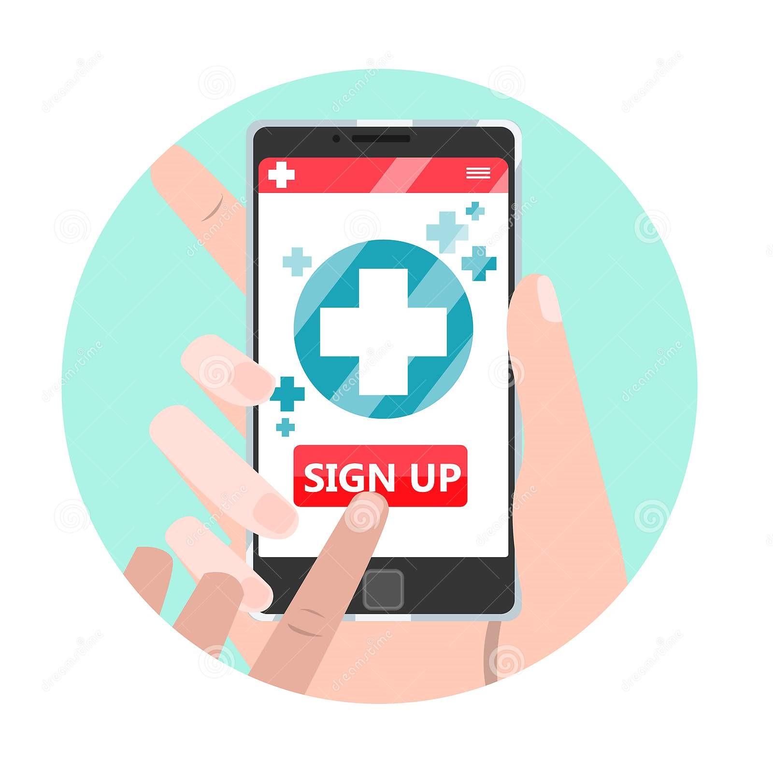
How to get an account on the site?
The Clinic and Laboratory Technician account is only obtained from the Admin

Slide 7

How to get an account on the site?
The Doctor and Secretary account is only obtained from the Clinic

Slide 8

How to get an account on the site?
The Patient can create his own account and enter the site

Slide 9

Profile personly
Each user on the site has his own personal page containing his information

Slide 10

Goals
The patient can book an appointment after seeing the doctors' schedule

Slide 11
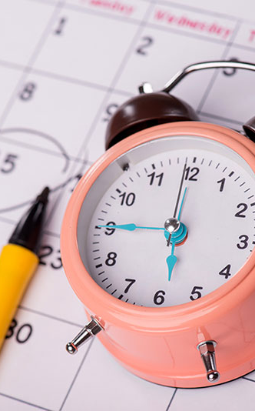


APPOINTMENT
The doctor and secretary can arrange appointments in the clinic

Slide 12

Profile
Patient health information
The site maintains patient health information that the doctor needs to know before dealing with any case

Slide 13
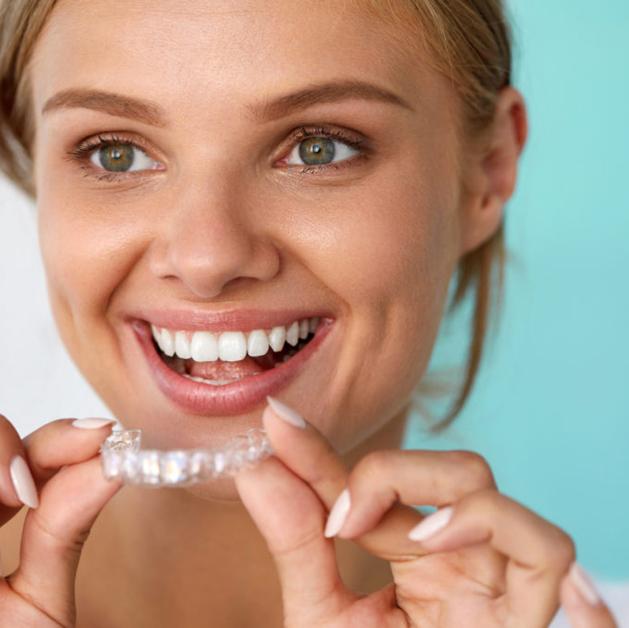

Goals
Are you nervous about going to the dentist?
In the previous cases, there is a solution

Slide 14
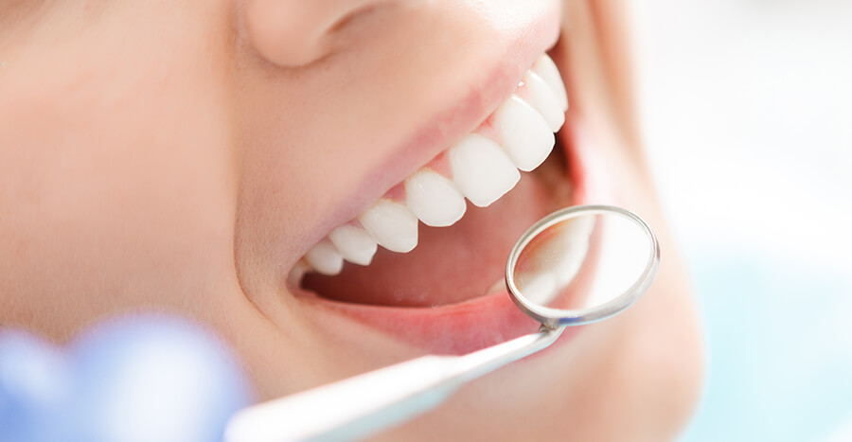
Previous Cases
The visitor can see the doctor's previous cases

Slide 15
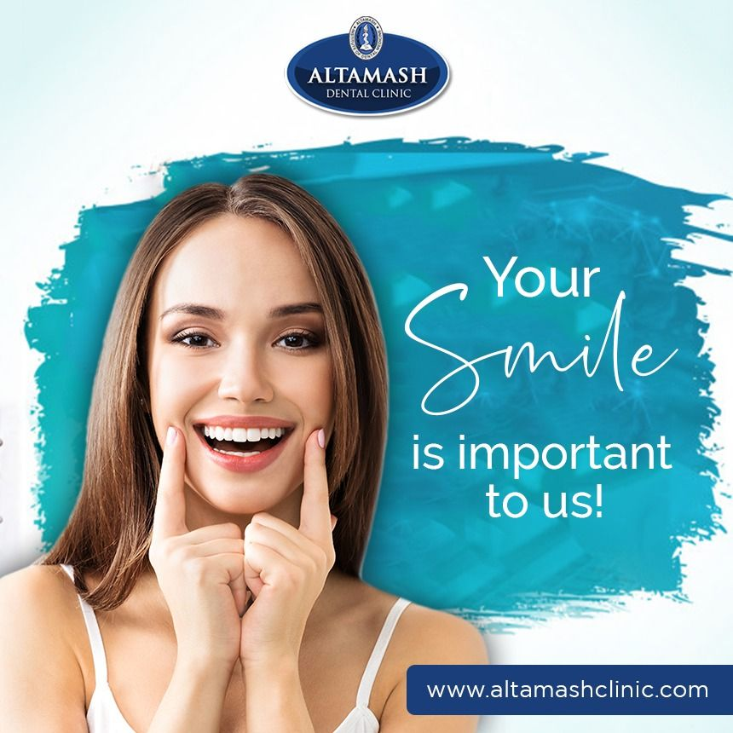
advertisements
The doctor can add a specified number of his advertisements every month

Slide 16

Search ads
We can search ads by ad title

Slide 17

Large image
Medical Advice
The doctor publishes medical advice for the benefit of users and to raise awareness

Slide 18
Dashboard
In the dashboard for each user, a statistic of their usage is displayed for each of the services

Slide 19
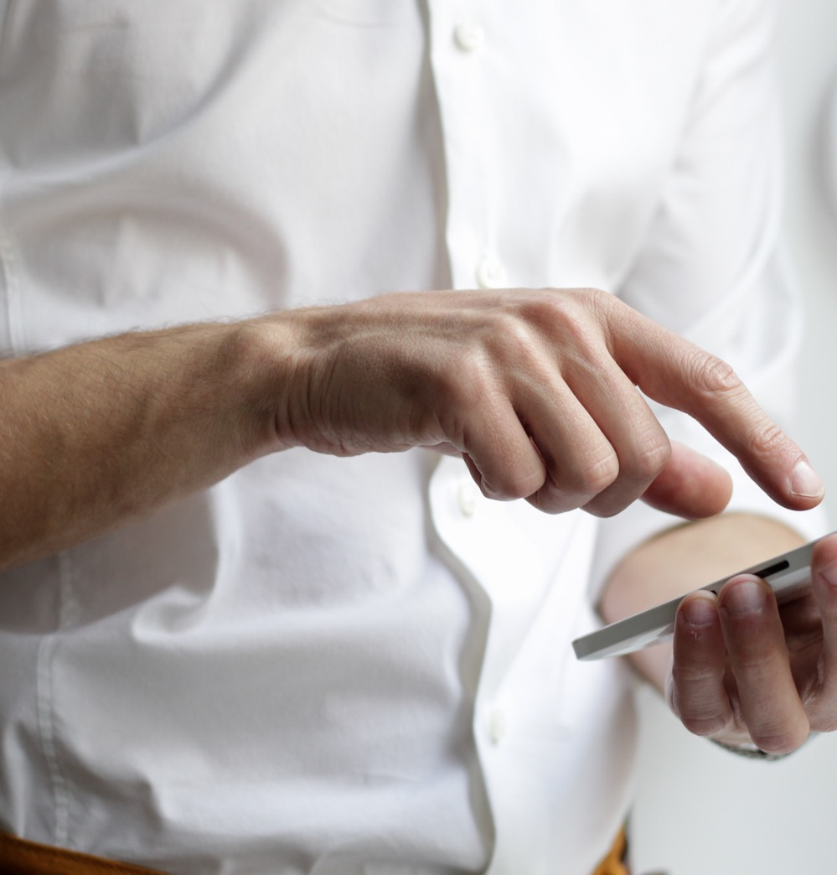
Goals
Search
The site visitor can search for clinics and doctors

Slide 20

Search
The site visitor can search for clinics through the clinic’s location or name

Slide 21

Search
The visitor can search through previous cases for the type of case so that the doctor with the most reservations appears first

Slide 22
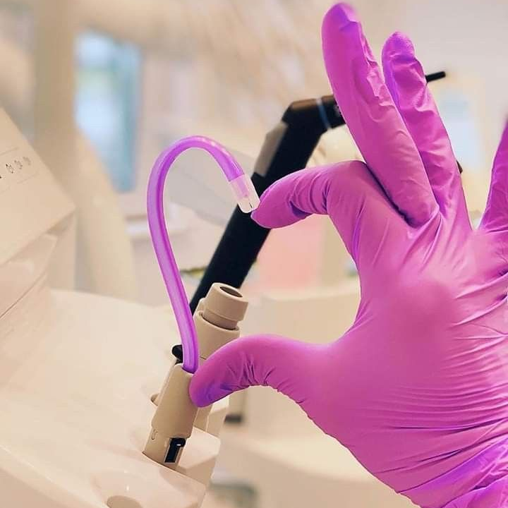
Orders
The doctor can book an order after viewing the list of laboratory technicians

Slide 23

Orders
The Technician can book an order for any doctor on the site

Slide 24

Appointment Algorithm
Patient appointment have certain limitations, so we created an AI algorithm to achieve these limitations

Slide 25

Appointment Algorithm
Appointment Algorithm
Finding the best suitable doctors for a specific patient's condition The AI algorithm shows the most booked doctors first
Patient appointment have certain limitations, so we created an AI algorithm to achieve these limitations

Slide 26

Future Work
01
Electronic payment
02
Use Google Maps
03
Expand the target group
04
Development mobile application dependent on website

Slide 27

The Website is controlled by the administrator Ipsum
The administrator controls all services provided by the site
And the number of additions in all services is seen by all users

Slide 29
