Slide 1
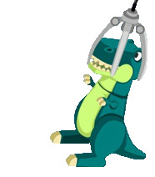
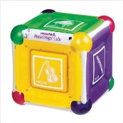

TOY CATCHER
By:
Asma’a Salman
Sondos Ishtawi
Supervised by:
Dr. Raed AL-Qadi
Notes:
Good morning every body , I hope that you all fine at this moment
Before presenting the project , I would like to introduce our self for those how don’t us
My name is asma salman and my partner
: sondos ishtawi
We would like to dedicate the project to our un.
:to our doctors
To our colleges
:and of course for my family
And also my dear family
:and now let us move to the project presentation that carry the title of toy catcher

Slide 2
Content
Overview
Mechanical part
Sensors
Controller part
Conclusion
Notes:
We have divided the talk into these sections
1
2
3
4
5
And of course the demo
The presentation will last about 15 minutes
We would be glad to take any questions at the end of our presentation
And it’s nice to see so many faces
ok. Let’s start with the first point which is the overview

Slide 3
Content
Overview
Mechanical part
Sensors
Controller part
Conclusion

Slide 4
Overview
Toys Catcher is a machine which challenges the user to capture items (stuffed toys, balls and more valuable prizes) that are placed in a wooden box.
The Player wears a special glove and moves his hand left – right, forward - backward and closes his fist in order to control wirelessly a moving shaft that ends with a gripper.

Slide 5
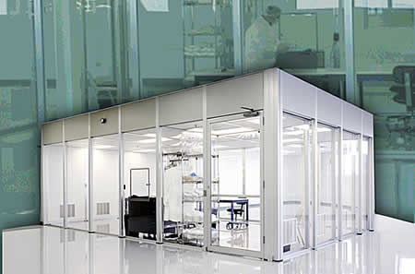
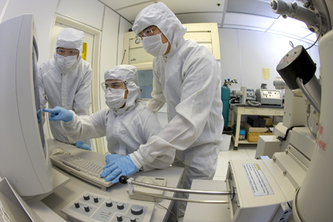
Overview
Our project can be used to control a group of components coordinated together to complete a specific tasks.
Various applications in real life:
  Clean Rooms
  Quarantine Environments (e.g. Chemical laboratories)
Notes:
and so they can manipulobjects and materials in these environments with the help of this project.

Slide 6
Content
Overview
Mechanical part
Sensors
Controller part
Conclusion

Slide 7
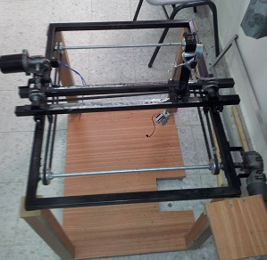
Mechanical part

Slide 8
Mechanical part
X-Y Table Box.
Timing Belts
Pulleys
Gripper
Motors

Slide 9
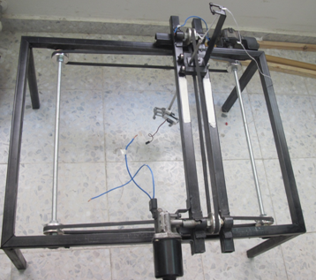
Mechanical part
X-Y Table:
Profile 2.5cm used to
build X-Y Table box with
60X77cm dimension.

Slide 10
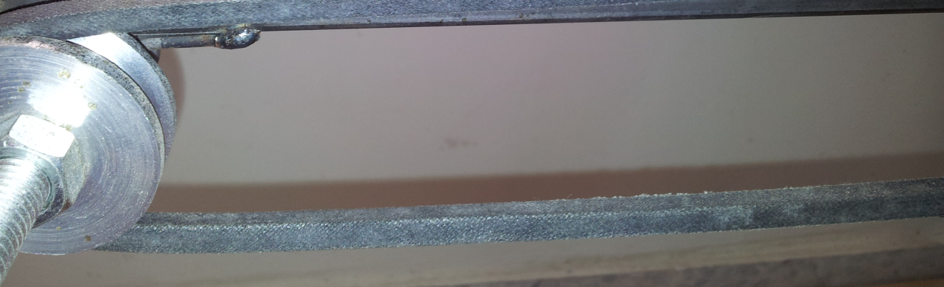
Mechanical part
Timing Belts:
Control and transfer the movement between pulleys (pulley moves → belt rotate).
  Two Belts → Y-Axis direction
  One Belt → X-Axis direction.

Slide 11
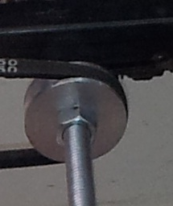
Mechanical part
Pulley:
Fixes the belts that connected to motors
(belt move → motor move).
Seven pulleys are used:
  Four Pulleys → Y-Axis direction
  Two Pulleys → X-Axis direction.
  One Pulley → Up and Down direction

Slide 12
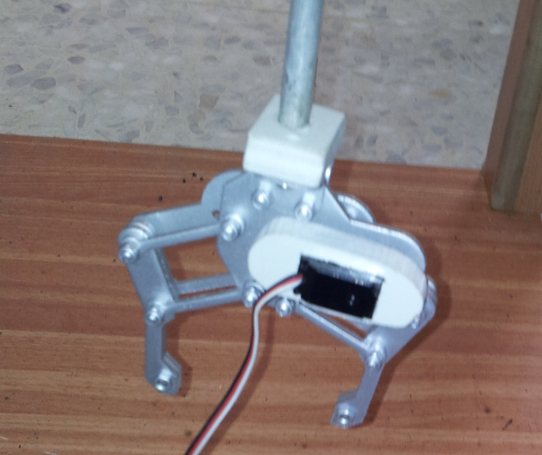
Mechanical part
Gripper:
end of arm tooling used to
catch stuffs.
Controlled by a
servo motor .

Slide 13
Mechanical part
Motors:
Three Types of Motors are used:
  DC Motors.
  Servo Motor.
  Stepper Motor.

Slide 14
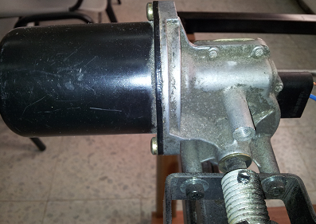
Mechanical part
Motors- DC Motors:

Slide 15
Mechanical part
Motors- DC Motors:
Responsible for the movement of gripper in
X-Y axis direction.
Direction of movement controlled wirelessly.
Car motors was our choice for our project.
Notes:
We face some difficulties in finding a DC motor with a high torque, after some searching and asking some experts people we find the required motors in the car spacing

Slide 16
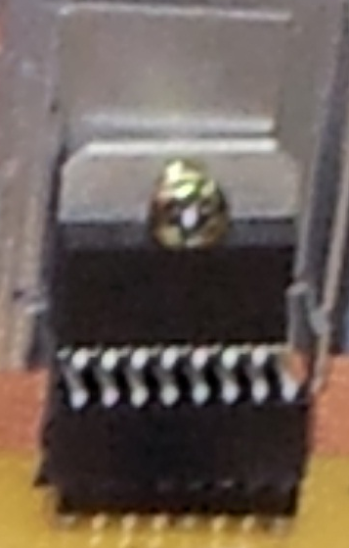
Mechanical part
Motors- DC Motors:
H-Bridge :
Reflect the direction of
DC Motor motion.
Controlled wirelessly by Accelerometer (located on the glove)
Notes:
We face some difficulties in finding a DC motor with a high torque, after some searching and asking some experts people we find the required motors in the car spacing

Slide 17
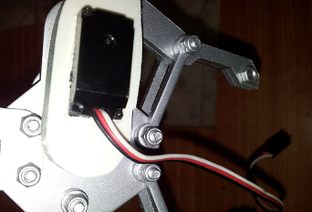
Mechanical part
Motors- Servo Motor:
Notes:
It's Operating Voltage: 4.8V~6.0V, Operating
speed: 0.10sec/60 degree, output torque:
1.4kg/cm (19.6oz/in),
Operating Range:
~170 degrees and its weight is 9g

Slide 18
Mechanical part
Motors- Servo Motor:
Control open and close motion of gripper
via PWM.
Flex sensor (located in the glove) control wirelessly movement of gripper.
Notes:
It's Operating Voltage: 4.8V~6.0V, Operating
speed: 0.10sec/60 degree, output torque:
1.4kg/cm (19.6oz/in),
Operating Range:
~170 degrees and its weight is 9g

Slide 19
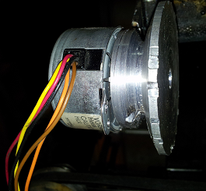
Mechanical part
Motors- Stepper Motor:
Notes:
an electromechanical device which converts electrical pulses into discrete mechanical movements
motor rotates when electrical command pulses are applied to it in the proper sequence.

Slide 20
Mechanical part
Motors- Stepper Motor:
Control up and down motion of shaft that ends with a gripper.
Flex sensor (located in the glove) control wirelessly movement of shaft.
Notes:
an electromechanical device which converts electrical pulses into discrete mechanical movements
motor rotates when electrical command pulses are applied to it in the proper sequence.

Slide 21
Content
Overview
Mechanical part
Sensors
Controller part
Conclusion

Slide 22
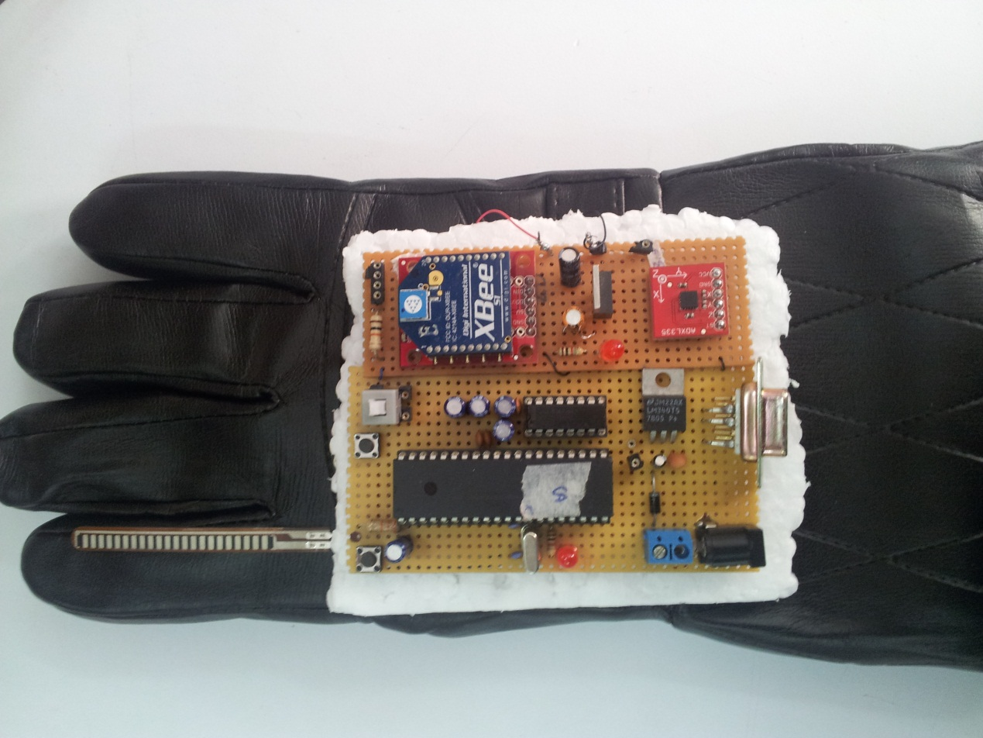
Sensors

Slide 23
Sensors
Player hand act as a main controller of all mechanical part components.
Two type of sensors are used:
  Flex Sensor.
  Accelerometer Sensor.

Slide 24
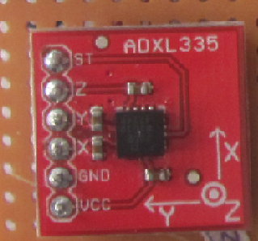
Sensors
Accelerometer:

Slide 25
Sensors
Accelerometer:
ADXL335 Accelerometer Sensor is
  Small and thin component.
  low power.
  Complete 3-axis
Control the DC motor movement in X-Y Axis direction.
Notes:
when accelerometer move left and right the robotic griper will be moved in the positive and negative-X direction, and when it move forward and backward
the robotic griper will be moved in positive
and negative-Y direction.

Slide 26
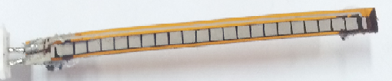
Sensors
Flex Sensor:
Notes:
the smaller the radius the higher the resistance value
We take care of these things while working in the flex sensor, since it’s a sensitive sensor the longer wire connection between microchip and sensor will dramatically increase noise in the readings
any irregular bending may produce irregular results.

Slide 27
Sensors
Flex Sensor:
Control motion of :
  Servo Motor ( open and close the Gripper )
  Stepper Motor ( up and down the shaft that ends with gripper)
Flex bent → resistance changed → Output value changed → motion of motors changed
Notes:
protocol for fast point-to-multipoint or peer-to-peer networking.
resistive carbon elements.

Slide 28
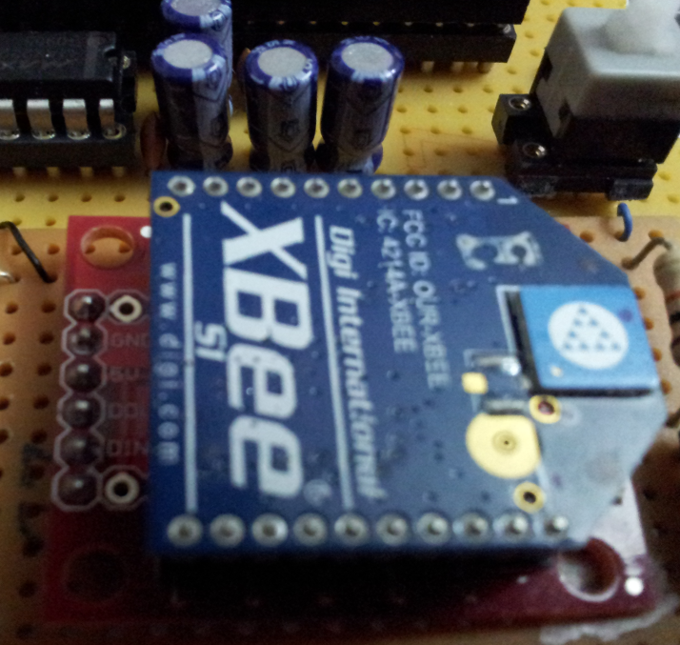
Sensors
Wireless XBee
Notes:
the smaller the radius the higher the resistance value
We take care of these things while working in the flex sensor, since it’s a sensitive sensor the longer wire connection between microchip and sensor will dramatically increase noise in the readings
any irregular bending may produce irregular results.

Slide 29
Sensors
Wireless XBee:
Send results of sensors (located on the glove ) to microcontroller that control the mechanical part.
  Transmission speed 25-250 kbps.
  Frequency 2.4 GHz ( 16 channel)
  Range 100 meter.
Notes:
protocol for fast point-to-multipoint or peer-to-peer networking.

Slide 30
Content
Overview
Mechanical part
Sensors
Controller part
Conclusion

Slide 31
Controller part
Sender Circuit
Receiver Circuit

Slide 32
Controller part
Sender Circuit:

Slide 33
Controller part
Sender Circuit:
  Microcontroller Chip( PIC18F4620)
  Accelerometer Sensor.
  Flex Sensor.
  Wireless XBee Component.
  Regulator ( 9 V → 5 V)

Slide 34
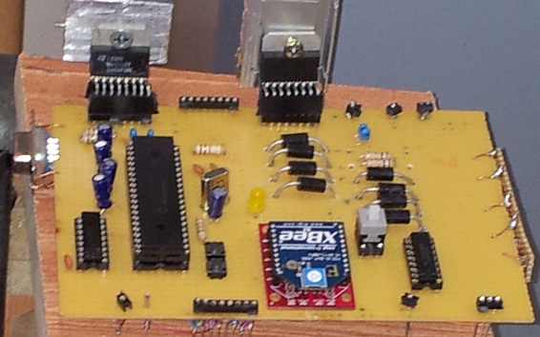
Controller part
Receiver Circuit:

Slide 35
Controller part
Receiver Circuit:
  Microcontroller Chip( PIC18F4620)
  H-Bridge
  ULN2003
  Wireless XBee Component.
  Regulator ( 9 V → 5 V)

Slide 36
Controller part
hand’s movement
User wear the Glove
Left-Right
Shaft move +ve , -ve
X-Axis
Movement
Finger Movement
Forward – Backward
Shaft move +ve , -ve
Y-Axis
Shaft move down
Shaft move down
Movement
Gripper Open
Gripper close
Shaft move up
Shaft move up

Slide 37
Content
Overview
Mechanical part
Sensors
Controller part
Conclusion

Slide 38
Conclusion
We build a system using microcontroller PIC18f4620, that can be divided into many parts:
Wireless part.
Sensor
Mechanical part
We apply that in a funny application,
TOYS CATCHER.

Slide 39
Thank you
Notes:
I’d be glad to answer any questions

