Slide 1

Vacuum cleaner!
Prepared by : Omama kittaneh
Donia Shwahne
Supervised by: Dr. Luai Melhis

Slide 2
Outline:
01.
Introduction
What is vacuum cleaner
02.
Hardware Components
03.

Slide 3
Outline:
Software Needed
04.
      Problems and Constraint
05.
Future Work
06.

Slide 4

Introduction:
01.

Slide 5
Introduction
With the development of the era and the expansion of buildings and the effort expended in cleaning these buildings, the need to develop tools that help save time and effort, especially for the labor force, has increased. Therefore, we decided to develop a vacuum cleaner that works in two ways:
1-Automatically by avoiding obstacles and sensors
2-Manual control via a web page and a camera that transmits the image

Slide 6
02.
What is vacuum cleaner:

Slide 7
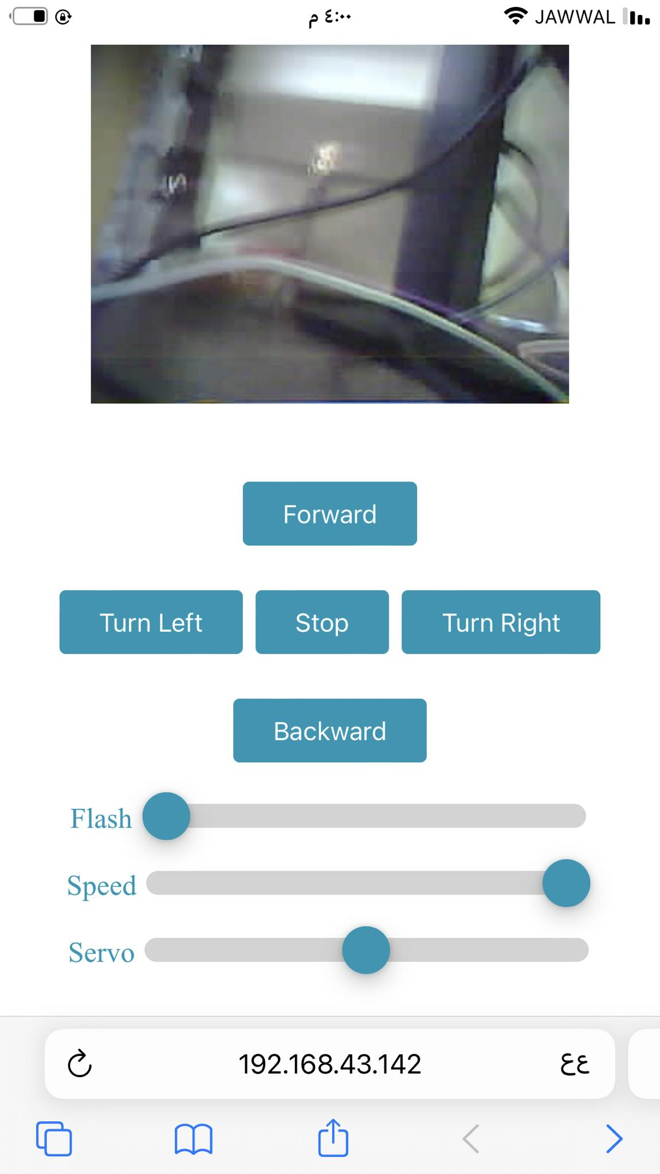
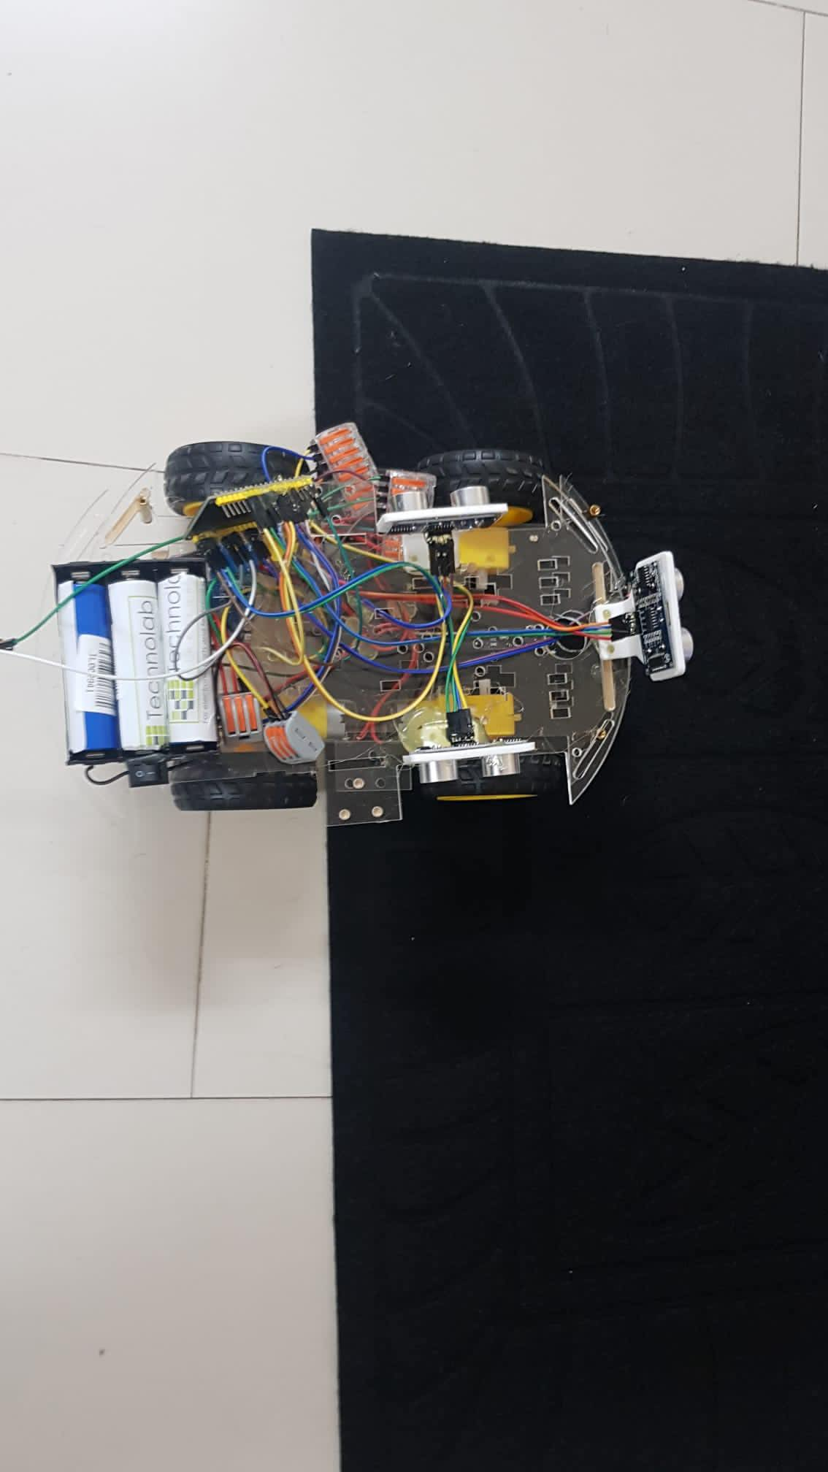

Slide 8
03.
Hardware
Components:

Slide 9

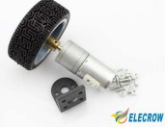
Ultrasonic sensor
DC Motor

Slide 10
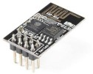
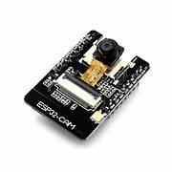
Wi-Fi ESP8266 Module:
ESP32cam

Slide 11
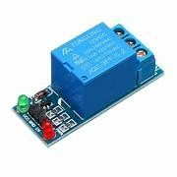
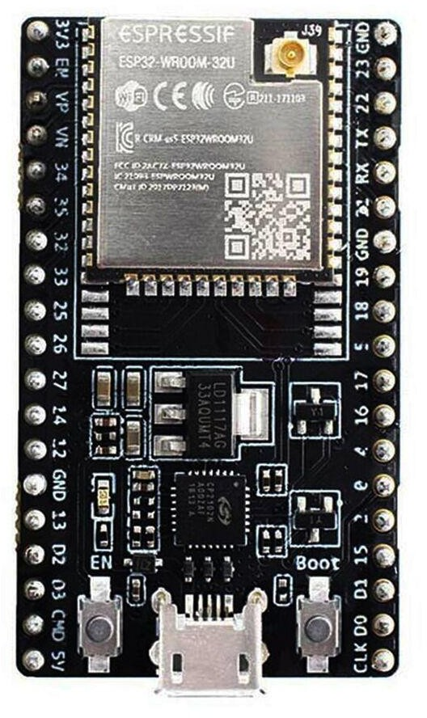
ESP32 wroom
Relay

Slide 12
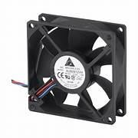
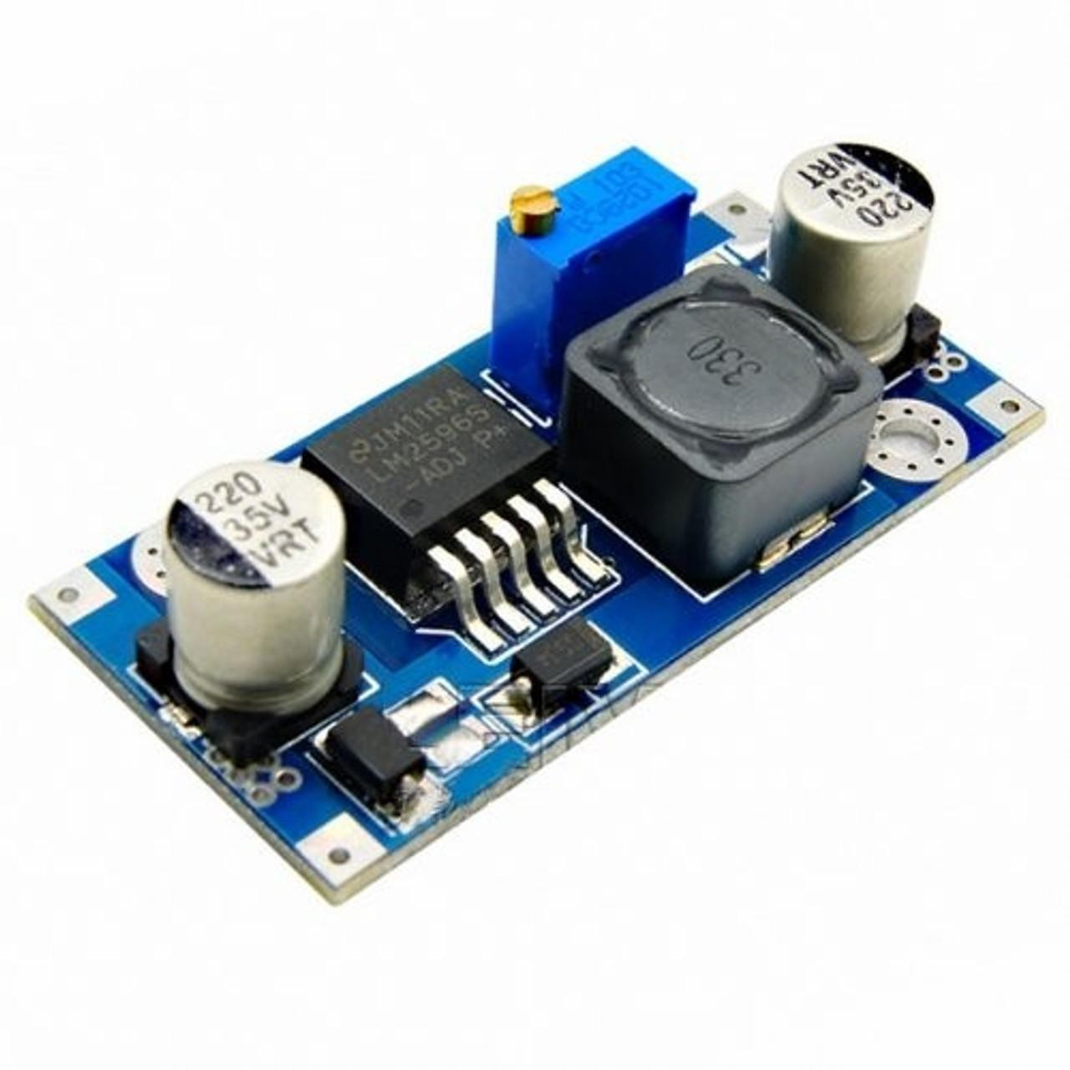
Suction fan12v 70mmx15mm 2pin
Back Converter

Slide 13
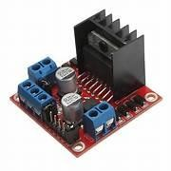
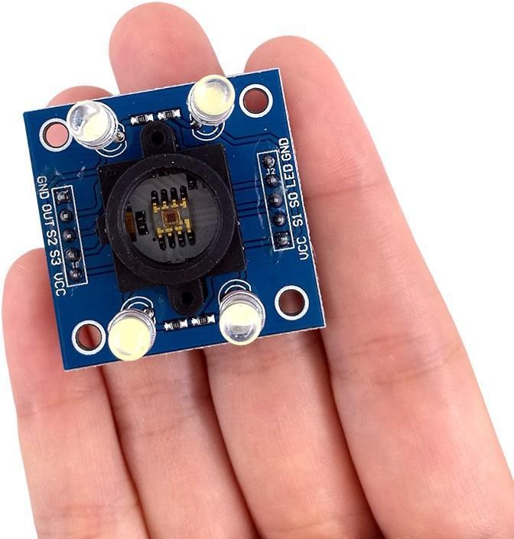
DriverL298n
IR Sensor

Slide 14
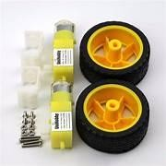
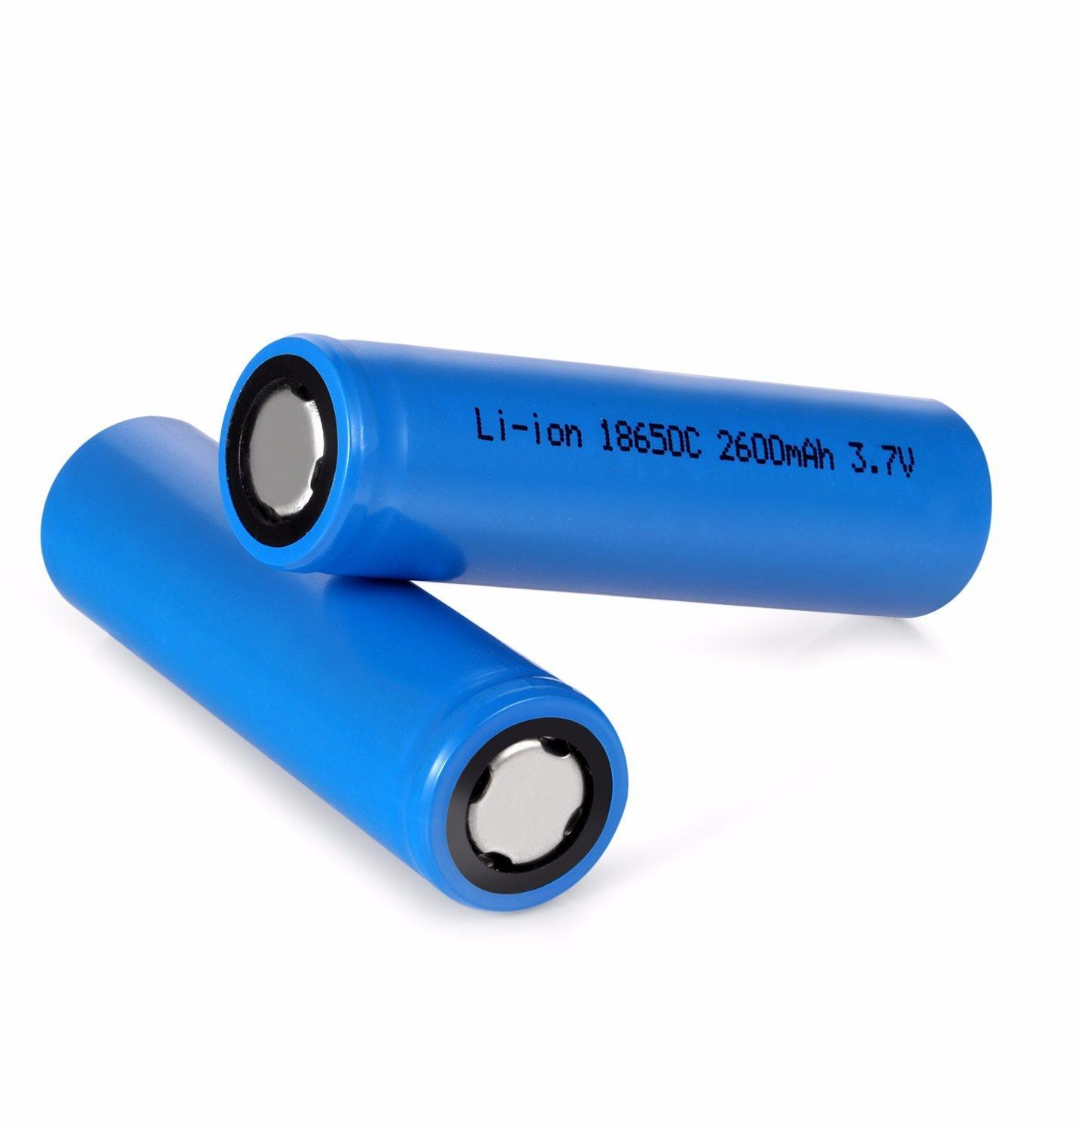
Wheels&Motors
Lithium Batteries

Slide 15
04.
Software Needed:

Slide 16
The following libraries were used:
1-HardwareSerial.h:
The HardwareSerial.h library is used to communicate with hardware serial ports on the microcontroller board.
2-NewPing.h:
The NewPing.h library used for ultrasonic distance sensing.
3-esp_wifi.h:
esp_wifi.h library enables you to establish and manage Wi-Fi connections on ESP32 boards.

Slide 17
4-esp_camera.h
the esp_camera.h library allows you to integrate camera functionality into your ESP32 projects.
5-WiFi.h :
the WiFi.h library allows you to establish and manage Wi-Fi connections on Arduino boards.
6-HardwareSerial.h:
HardwareSerial.h library facilitates serial communication between the Arduino board and external devices.

Slide 18
Other Software:
1-esp_http_server.h
2-esp_timer.h
3-esp_camera.h
4-img_converters.h
5-Arduino.h

Slide 19
05.
Problem and Constraints:

Slide 20
Problem and Constraints:
Time constrains.
Physical constrains.
Designing the vacuum cleaner to be user friendly.
Hardware availability.
Some Incomprehensible glitches .

Slide 21
06.
Future Work:

Slide 22
Future Work:
Self-Charging Capability.
Bag Emptying Feature

